Slide 2
General Information
This slide can be used to provide volunteers with specific information for your event. For example:
  Reporting Instructions (directions to venue, time to arrive, expected completion time, etc.)
  Sign-in sheets for volunteers
  Shirt pick-up instructions or dress code
  Volunteer assignments

Slide 3
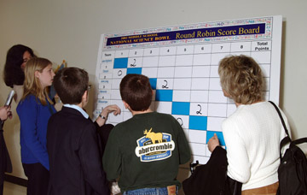
Round Robin Format
Teams draw random numbers to determine division and number
Play games against every teams in division
Points
  Win game = 2 points
  Tie game = 1 point
  Lose game = 0 points
Score Boards
  Read the points from left to right
Top XX teams from each division advance to single or double elimination

Slide 4
Elimination Formats
Double Elimination
  One Loss - Team Moves to Challenger Bracket
  Two Losses - Team is Eliminated
Single Elimination
  One Loss - Team is Eliminated

Slide 5
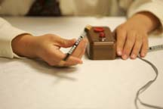

The Basics…
In Each Game...
  2 teams play head-to-head
  4 students on each team
  Coaches & substitutes sit together near the back of the room
  Two 8-minute halves
  2 minute break between halves
Volunteer Roles
  5 volunteers in each room
  Moderator
  Science Judge
  Rules Judge
  Timekeeper
  Scorekeeper
Score runners
Information Desk / Command Central

Slide 6
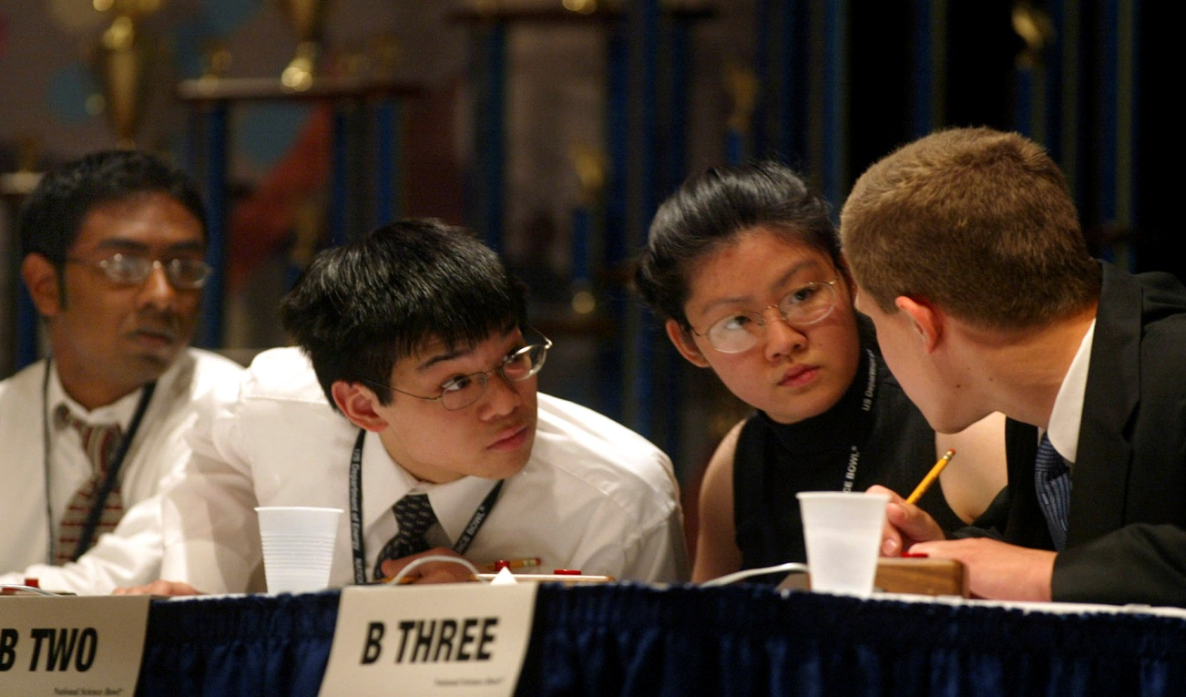
Competition Structure
Competition consists of toss-up and bonus questions.
  If the toss-up is correct, team gets bonus question.
Question types are either multiple choice or short answer.
  On multiple choice, answer provided must be EXACTLY as the Moderator has read.
Alternate can substitute at the half
  Only one substitution per team per match.
Matches have two eight-minute halves with a two-minute intermission.

Slide 7
Getting Started
Moderator follows the guidelines on the Official Scoresheet to begin each match.
  (i.e., introductions, buzzer check, etc.)
Announce who will be recognizing the students (Moderator or Science Judge).

Slide 8
The Questions
Toss-Up and Bonus
  Correct toss-up questions lead to bonus questions
Short Answer and Multiple Choice (W, X, Y, Z)
Six Question Categories:
  High School: Biology, Chemistry, Physics, Earth and Space Science, Mathematics, and Energy
  Middle School: Life Science, Physical Science, Earth and Space Science, Mathematics, General Science, and Energy
No True/False Answers
No “All/None Of the Above”

Slide 9
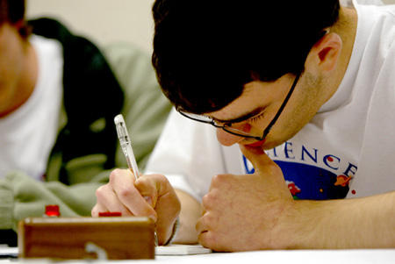
Multiple Choice & Short Answer
Multiple Choice
  Students may say letter answer (W, X, Y, or Z) or scientific answer
  If scientific answer – it must be exactly as is written on question & answer sheet
  If both letter & scientific answers provided, they must BOTH be exact
Short Answer
  Does not need to be exact
  Refer to the Conventions in the Official Rules
First word counts…
no “My answer is…”

Slide 10
Toss-up Questions
No consulting among team members.
Student must buzz in and be VERBALLY recognized before providing an answer.
  Teams have 5 seconds to buzz in.
  Student has 2 seconds to provide answer after being verbally recognized (no stalling)
  If correct, 4 points are awarded.
If interrupted and answered incorrectly, 4 points are awarded to opposing team and then the question is read in its entirety for the opposing team.
If question has begun when time expires at the half, the question will play through.
If blurt (not recognized), the opposing team is awarded 4 points and offered the question (Rule 4-5).

Slide 11
Bonus Questions
Teams have 20 seconds to begin their answer.
  Only the team captain can provide the answer.
  If correct, 10 points are awarded.
If Moderator responds to someone other than Captain and indicates correct or not, the next bonus question is read for the team.
After 15 seconds have expired, the timekeeper will say “5 seconds” to alert the team captain he or she needs to answer.

Slide 12
Distractions: Rule 3-9
The team that is not playing the toss-up or bonus question should remain quiet while the opposing team hears and answers the questions.
If the non-playing team engages in behavior that is visually or verbally distracting, the opposing team will be awarded the following:
  a) For toss-up questions: 4 points for the toss-up question, the option of having 20 additional seconds run off the clock, and the opportunity to answer the bonus question. The moderator will then proceed to the next toss-up.
  b) For bonus questions: 10 points for the bonus question and the option of having 40 additional seconds run off the clock. The moderator will then proceed to the next tossup.
During each round, each team will be allowed one “accidental” buzz during bonus questions for the opposing team. All subsequent buzzes during bonus questions will be called distractions.

Slide 13
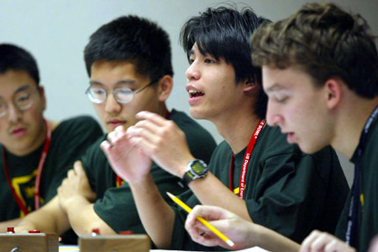
Interrupt
When a player buzzes in, interrupting the reading of the Toss-up question, is verbally recognized, and gives an answer.
Points
  Correct Answer:
    4 points is awarded
    Read the bonus question.
  Incorrect Answer:
    4 points awarded to other team
    Question is reread from beginning
    and other team has an opportunity
    to buzz in and answer

Slide 14
Blurt
When a player buzzes in, but says the answer before being verbally recognized
Moderator will not indicate if the answer given is correct or incorrect
4 points to opposing team
Question is offered to other team
  Re-read if interrupt
  5 seconds to buzz in if fully read

Slide 15
Penalty Points?
Rules Are Different For Pre and Post BUZZ
If Blurt/Consult Happens Before Buzz:
  No answer considered
  No penalty points awarded
After Buzz
  Consulting = blurt = 4 penalty points to opposing team

Slide 16
Summary of Scoring
Type of Question | Points Awarded
Correct Toss-up Incorrect Toss-up | +4 points & eligible for bonus +0 points
Correct Bonus or Distraction Incorrect Bonus | +10 points +0 points
Interrupted Toss-up: Correct Answer Incorrect Answer | +4 points & eligible for bonus +4 points to opposing team
After a team member buzzes in: Unrecognized Toss-up (Blurt) Unrecognized Interrupted Toss-up (also a Blurt) Consultation among players | +4 points to opposing team
Before a team member buzzes in: Answering a toss-up Consultation among players | +0 points but team will be disqualified from toss-up

Slide 17
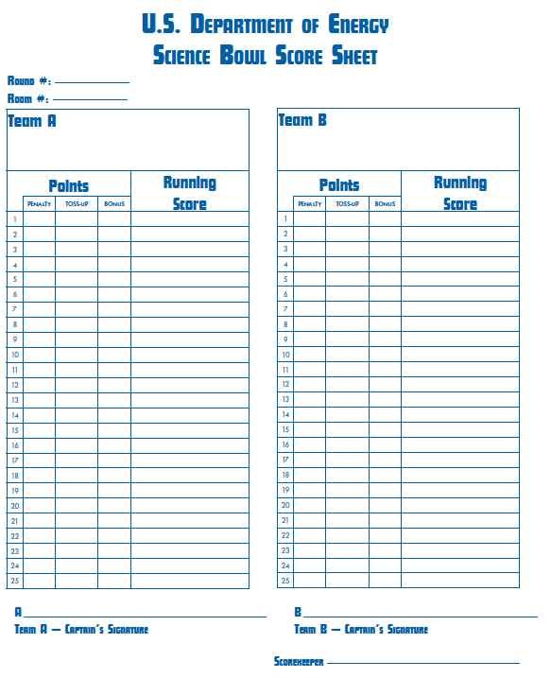
Summary of Scoring

Slide 18
Challenges
Must be made before Moderator begins reading the next question.
Only the active players may challenge, not substitutes, coaches, or audience members.
Only for scientific content, not judgment calls.
Each team can only have 2 unsuccessful challenges per round.
Clock is stopped and time may be added, if necessary.
On toss-up questions: if first team’s answer is incorrect, they must wait until the second team answers.
  If the challenge is upheld, the first team receives 4 points.

Slide 19
When Time Runs Out
The Process of the Question Continues
  Except if it is a toss-up question AND the time runs out before the subject area is read
Stop the Time After the Bonus Question is Completed

Slide 20
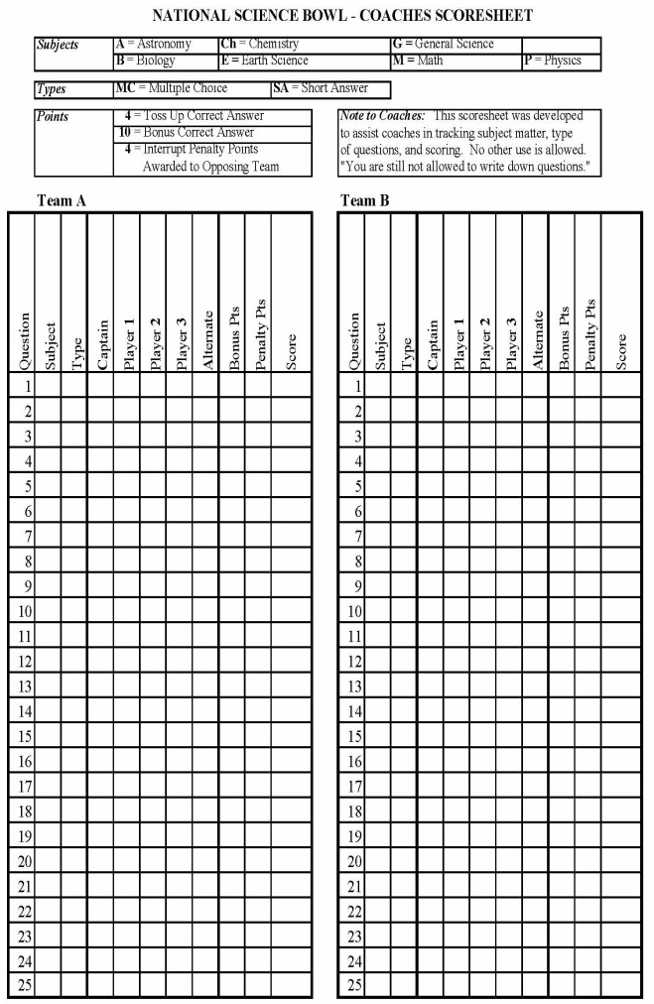
Audience/Coach Rules
No Writing Except on Coach Score Sheets
No Cell Phones, Cameras, Recorders.

Slide 21
Miscellaneous Items
Double interrupt
  If a toss-up is interrupted and a team incurs a penalty, 4 pts are awarded to the opposing team. The question is reread. If the second team interrupts and is incorrect, the first team is awarded 4 pts and the moderator goes to the next question. (Rule 6-3)
Moderator provides answer without letting teams answer…
  The moderator goes to the next toss-up.
  Same if Moderator indicates correct or incorrect before the second team may answer, throw the question out and go to the next question.

Slide 22
Miscellaneous Items (cont.)
First response given is the one that counts.
  If player starts with “my answer is” or repeats question, answer considered incorrect. Note: if short um, er is used – officials’ call regarding stalling.
Moderator inadvertently recognizes a player other than the one who buzzed…
  The player who buzzed in will be allowed to answer as if he/she was recognized.
Moderator responds to someone other than Captain on bonus…
  If right/wrong, the next bonus question will be read.
If a toss-up question is begun before time expires, the question will be finished.
  A question is considered begun if the subject area has been read.

Slide 23
Miscellaneous Items (cont.)
Audience cannot communicate in any way
  Offenders will be ejected from room.
Audience member shouts out answer…
  If the team association is identified, team will forfeit round.
Calculators are not permitted.
No electronic devices permitted.

Slide 24
Other Logistical Information
This slide may be used to provide additional details for your volunteers. For example:
  List of materials that will be set-up in each room.
  Information regarding large score sheets (i.e., electronic, taped or not to walls, etc.).
  Location for score sheets to be returned.
  Information on lunch, refreshments, etc.
  See this pdf from the NETL regional for ideas:
  http://swpasciencebowl.com/pdf/2013HSVolReportInstruct.pdf
                Updated 02-03-15

