Slide 1
The DOE Webinar will begin shortly . . .
Why is there no sound?
Once you logged into the webinar, you were provided two options to listen to this broadcast. The first option is through your computer speakers, the second option is via dialing the phone number provided to you upon login to the webinar. If you chose to listen through your computer speakers, you may need to turn your speaker volume on or up.
Will DOE provide access to the recorded webinar after the meeting?
Yes, all those who registered will receive a link to the slides and to the recorded webinar soon after the meeting. It will also be available on the DOE SBIR/STTR web site.
Where can I find the Topics being discussed today?
This link will take you to the Funding Opportunity Announcement (FOA) page that lists the FY 2024 Phase I Release 1 Topics: https://science.osti.gov/sbir/Funding-Opportunities
What if my question was not answered at today’s webinar?
Please contact the point of contact that follows each subtopic in the document listed above for further clarification.
If you have a question about the grant application process, please send us an email at: sbir-sttr@science.doe.gov.

Slide 2
DOE SBIR/STTR Phase I Release 1 Topics Webinar Topics associated with the FY 2024 Phase I Release 1 Funding Opportunity Announcement Topics 26-36
DOE SBIR/STTR Programs Office
July 26, 2022

Slide 3
TODAY’S AGENDA
Topics Introduction | DOE SBIR/STTR Programs Office
Topics 26 – 32 | Office of High Energy Physics
Topics 33 – 36 | Office of Nuclear Physics

Slide 4
FY 2024 Phase I Schedule
 | Release 1 | Release 2
Topics Issued | Monday, July 10, 2023 | Monday, November 6, 2023
Webinar(s) | Week of July 17, 2023 | Week of November 13, 2023
FOA Issued | Monday, August 7, 2023 | Monday, December 11, 2023
Webinar(s) | Friday, August 11, 2023 | Friday, December 15, 2023
Letters of Intent (LOI) Due | Monday, August 28, 2023 | Tuesday, January 2, 2024
Non-responsive LOI Feedback Provided | Monday, September 18, 2023 | Tuesday, January 23, 2024
Applications Due | Tuesday, October 10, 2023 | Tuesday, February 20, 2024
Award Notification | Tuesday, January 2, 2024 | Monday, May 13, 2024

Slide 5
Phase I Funding Opportunity Announcements Participating DOE Programs (FY 2024)
Office of Advanced Scientific Computing Research
Office of Basic Energy Sciences
Office of Biological and Environmental Research
Office of Fusion Energy Sciences
Office of High Energy Physics
Office of Nuclear Physics
Phase I
Release 1
Phase I
Release 2
Office of Cyber Security, Energy Security, and Emergency Response
Office of Defense Nuclear Nonproliferation
Office of Electricity
Office of Energy Efficiency and Renewable Energy
Office of Fossil Energy and Carbon Management
Office of Nuclear Energy

Slide 6
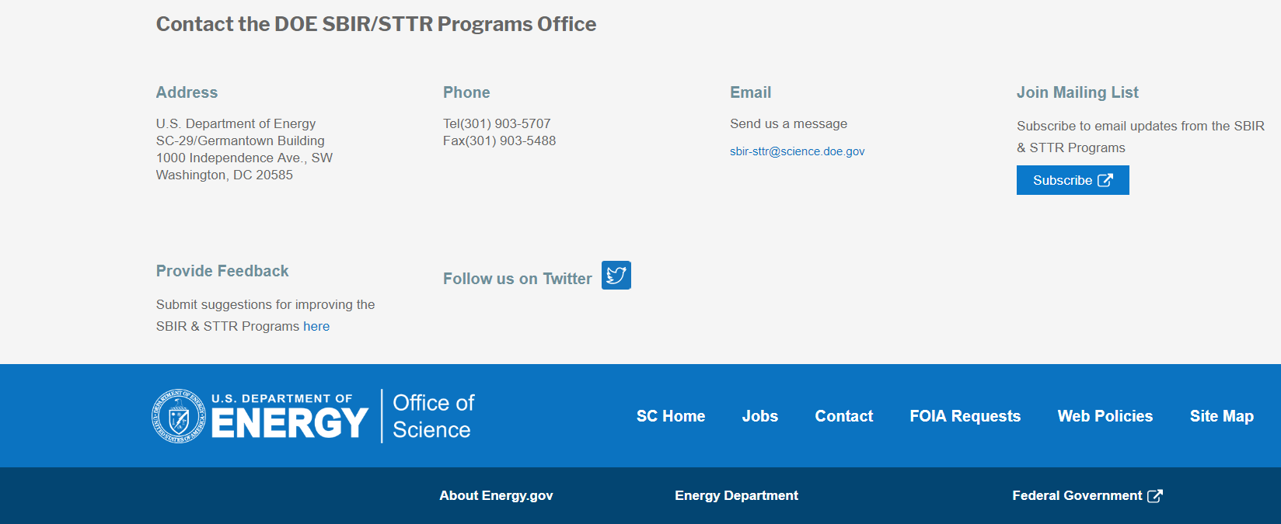
Funding Opportunity Announcement (FOA) Webinar
FY24 Phase I Release 1 FOA will be issued on August 7th
Join our Mailing List – this field is on every DOE SBIR/STTR web page
Following the issuance of the FOA, look for an email with a link to the FOA
Webinar with Q&A for this FOA on August 11th
Overview of the FY 2024 DOE SBIR/STTR Programs
Following the issuance of the FOA, look for an email announcing this webinar

Slide 7
Reminder - Phase 0 Application Assistance Program
Free
to you!
Phase 0 application assistance program is available for first-time DOE SBIR/STTR applicants
Participants receive an individual coach who is an expert in our application process.
Program opens when Topics are released (Open now!)
Visit http://www.dawnbreaker.com/doephase0/ to determine your eligibility and apply to Phase 0

Slide 8
Example Topic
Topic & Subtopic
You must specify the same topic and subtopic in your Letter of Intent and grant application
Topic Header
Lists the maximum award amounts for Phase I & Phase II and the types of application accepted (SBIR and/or STTR)
Program Manager
Each subtopic lists the responsible DOE program manager
“Other” Subtopic
References
Notes:
Here is an example topic from our current announcement. Note that every SBIR or STTR application must include the topic and subtopic to which you are applying. The general topic description describes the general field of technology that is of interest. The subtopics describe specific opportunities in which proposals are requested. Each topic at DOE will also have an “other” subtopic. Under this subtopic you can submit proposals that fall within the general topic description, but do not fit with any of the other subtopics. We have found that when we write the subtopics too narrow sometimes we miss good opportunities, and this “other” subtopic is a means collecting disruptive solutions.

Slide 9
Topic C57-26: ADVANCED CONCEPTS AND TECHNOLOGY FOR PARTICLE ACCELERATORS
Maximum Phase I Award Amount: $200,000 | Maximum Phase II Award Amount: $1,100,000
Accepting SBIR Phase I Applications: YES | Accepting STTR Phase I Applications: YES
Graphical User-Interfaces for Accelerator Modeling
Digital Twin for HEP Accelerator Beam Test Facilities
Non-Destructive Electron Beam Position Monitors
Other
Questions: Derun Li, Derun.Li@science.doe.gov

Slide 10
Topic C57-27: RADIO FREQUENCY ACCELERATOR TECHNOLOGY
Maximum Phase I Award Amount: $200,000 | Maximum Phase II Award Amount: $1,100,000
Accepting SBIR Phase I Applications: YES | Accepting STTR Phase I Applications: YES
Low-Cost Radio Frequency Power Sources for Accelerator Application
New Superconducting RF Cavity Design
Auxiliary Components and Instrumentation for SRF Cavities
Other
Questions: Subtopic a – Eric Colby, Eric.Colby@science.doe.gov
Subtopic b, c & d – Ken Marken, ken.marken@science.doe.gov

Slide 11
Topic C57-28: LASER TECHNOLOGY R&D FOR ACCELERATORS
Maximum Phase I Award Amount: $200,000 | Maximum Phase II Award Amount: $1,100,000
Accepting SBIR Phase I Applications: YES | Accepting STTR Phase I Applications: YES
a. High Energy and Broadband Components for Fiber Lasers and Arrays
b. High Damage Threshold Large Area Spatial Light Modulators
c. Other
Questions: Eric Colby, eric.colby@science.doe.gov

Slide 12
Topic C57-29: HIGH FIELD SUPERCONDUCTING MAGNET TECHNOLOGY
Maximum Phase I Award Amount: $200,000 | Maximum Phase II Award Amount: $1,100,000
Accepting SBIR Phase I Applications: YES | Accepting STTR Phase I Applications: YES
High-Field HTS Wire and Cable Technologies for Magnets
Superconducting Magnet Technology
Cryogenic Power Electronics for Distributed Powering and Quench Protection of HTS and Hybrid Magnets
Other
Questions: Ken Marken, ken.marken@science.doe.gov

Slide 13
Topic C57-30: HIGH ENERGY PHYSICS ELECTRONICS
Maximum Phase I Award Amount: $200,000 | Maximum Phase II Award Amount: $1,100,000
Accepting SBIR Phase I Applications: YES | Accepting STTR Phase I Applications: YES
a. Radiation-Hard Sensors and Engineered Substrates for Detectors at High Energy Colliders
b. High-Density Interconnects and Integration
c. Electronics and Sensors for Ultra-Low-Temperature Experiments (4 K and Below)
d. Other
Questions: Helmut Marsiske, helmut.marsiske@science.doe.gov

Slide 14
Topic C57-31: HIGH ENERGY PHYSICS DETECTORS AND INSTRUMENTATION
Maximum Phase I Award Amount: $200,000 | Maximum Phase II Award Amount: $1,100,000
Accepting SBIR Phase I Applications: YES | Accepting STTR Phase I Applications: YES
a. Low-Cost, High-Performance (V)UV/Visible/Near-IR Photon Detection
b. Scintillating Detector Materials and Wavelength Shifters
c. Low Radioactivity Integration Solutions for Cryogenic Detectors
d. Other
Questions: Helmut Marsiske, helmut.marsiske@science.doe.gov

Slide 15
Topic C57-32: ARTIFICIAL INTELLIGENCE/MACHINE LEARNING FOR HIGH ENERGY PHYSICS
Maximum Phase I Award Amount: $200,000 | Maximum Phase II Award Amount: $1,100,000
Accepting SBIR Phase I Applications: YES | Accepting STTR Phase I Applications: YES
a. HEP AI/ML Training Tools
b. HEP AI/ML Visualization Tools – Description
c. Other
Questions: Eric Church, Eric.Church@science.doe.gov

Slide 16
Topic C57-33: NUCLEAR PHYSICS SOFTWARE AND DATA MANAGEMENT
Maximum Phase I Award Amount: $200,000 | Maximum Phase II Award Amount: $1,100,000
Accepting SBIR Phase I Applications: YES | Accepting STTR Phase I Applications: YES
a. Tools for Large Scale, Widely Distributed Nuclear Physics Data Processing
b. Application of Emerging Data Science Techniques to Nuclear Physics
c. Heterogeneous Concurrent Computing
d. Other
Questions: Michelle Shinn, Michelle.Shinn@science.doe.gov or Gulshan Rai, Gulshan.Rai@science.doe.gov

Slide 17
Topic C57-34: NUCLEAR PHYSICS ELECTRONICS DESIGN AND FABRICATION
Maximum Phase I Award Amount: $200,000 | Maximum Phase II Award Amount: $1,100,000
Accepting SBIR Phase I Applications: YES | Accepting STTR Phase I Applications: YES
a. Advances in Digital Processing Electronics
b. Front-End Application-Specific Integrated Circuits
c. Next Generation Pixel Sensors
d. Other
Questions: Michelle Shinn, Michelle.Shinn@science.doe.gov or
Manouchehr Farkhondeh, Manouchehr.Farkhondeh@science.doe.gov

Slide 18
Topic C57-35: NUCLEAR PHYSICS ACCELERATOR TECHNOLOGY
Maximum Phase I Award Amount: $200,000 | Maximum Phase II Award Amount: $1,100,000
Accepting SBIR Phase I Applications: YES | Accepting STTR Phase I Applications: YES
Materials and Components for Radio Frequency Devices
Design and Operation of Radio Frequency Beam Acceleration Systems
Particle Beam Sources and Techniques
Polarized Beam Sources and Polarimeters
Rare Isotope Beam Production Technology
Accelerator Control and Diagnostics
Other
Questions: Michelle Shinn, Michelle.Shinn@science.doe.gov

Slide 19
Topic C57-36: NUCLEAR PHYSICS INSTRUMENTATION, DETECTION SYSTEMS AND TECHNIQUES
Maximum Phase I Award Amount: $200,000 | Maximum Phase II Award Amount: $1,100,000
Accepting SBIR Phase I Applications: YES | Accepting STTR Phase I Applications: YES
a. Advances in Detector and Spectrometer Technology
b. Development of Novel Gas and Solid-State Detectors
c. Technology for Rare Decay and Rare Particle Detection
d. Other
Questions: Michelle Shinn, Michelle.Shinn@science.doe.gov or
Elizabeth Bartosz, Elizabeth.Bartosz@science.doe.gov

Slide 20
DOE SBIR/STTR Programs Office Contact Information
SBIR/STTR Web: https://science.osti.gov/sbir
Email: sbir-sttr@science.doe.gov
Phone Assistance Hotline: 301-903-5707
DOE Phase 0 Assistance Program: https://doephase0.dawnbreaker.com/
DOE Application Assistance: https://science.osti.gov/SBIRLearning

