Slide 1
The DOE Webinar is scheduled to begin at 2:00 p.m. ET
Why is there no sound?
  This webinar is broadcast via your computer. You may need to turn your volume on or up as the sound for this webinar comes through your computer speakers.
    We recommend using Google Chrome for this and other DOE SBIR webinars.
    Use the dial-in number if you are having trouble with your computer sound
Will DOE provide access to the recorded webinar after the meeting?
  Yes, we will post the slides and the recorded webinar on the DOE SBIR/STTR web site.
Where can I find the FOA being discussed today?
  – This link will take you to the FY 2024 Phase I Release 1 FOA: https://science.osti.gov/sbir/Funding-Opportunities
What if my question was not answered at today’s webinar?
  If you have a question about the grant application process, please send us an email at: sbir-sttr@science.doe.gov
  or call us at (301) 903-5707

Slide 2
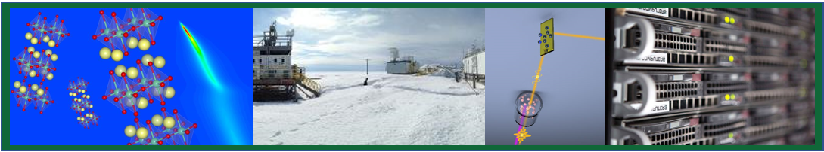

DOE’s
Small Business Innovation Research (SBIR) and Small Business Technology Transfer (STTR) Programs
Eileen Chant
Outreach Manager
DOE Office of SBIR/STTR Programs
eileen.chant@science.doe.gov, (301) 578-2386
August 11, 2023
Notes:
Thank you Zina and welcome to our FOA webinar, which provides you with an overview of our program

Slide 3

Federal SBIR/STTR Programs Overview

Slide 4





What are the Federal SBIR & STTR Programs?
A >$4 Billion early stage nondilutive R&D fund for US-based small businesses
Must be U.S. Citizen or permanent resident majority owned
A mechanism to fund best early-stage high-risk innovation ideas
Funds ideas that are too high risk for the private sector
Use U.S. Small Businesses to stimulates technological innovation
Federally Funded Laboratories
Extramural R&D ~$100B/year
> $4 B/yr
Businesses
Small Business R&D
Universities

Slide 5
FY 2022 SBIR/STTR Budgets by Agency
Agency | Budget (Millions)
Department of Defense (DoD) | $ 2,240
Department of Health and Human Services (HHS), incl. National Institute of Health (NIH) | $ 1,250
Department of Energy (DOE), incl. Advanced Research Projects Agency (ARPA -E) | $ 348
National Science Foundation (NSF) | $ 231
National Aeronautics and Space Administration (NASA) | $ 215
Department of Agriculture (USDA) | $ 38
Department of Homeland Security (DHS) | $ 20
Department of Commerce: National Oceanic and Atmospheric Administration (NOAA), National Institute of Standards and Technology (NIST) | $ 12
Department of Education (ED) | $ 12
Department of Transportation (DOT)* | $ 11
Environmental Protection Agency (EPA) | $ 5
SBIR & STTR (> $1B in extramural R&D)
SBIR only
(> $100M in extramural R&D)
SBIR: $3.85 Billion
STTR: $532 Million
Contracting agency
Granting agency
Both

Slide 6

Are Agencies’ Programs all the Same?
There are lots of differences!
Grants (DOE) vs Contracts
Focused topics (e.g. DOE), to no topics (e.g. NSF)
Who will be your customer? Not likely to be DOE, maybe DoD
Application processes, systems and deadlines are all different
Search SBIR.gov awards to understand what agencies are most likely to fund your technology. Focus on a limited set of agencies.
Get to know the agencies you are interested in

Slide 7
U. S. Department of Energy Mission & Program Offices
DOE’s Mission is to ensure America's security and prosperity by addressing its energy, environmental, and nuclear challenges through transformative science and technology solutions.
  Goal 1: Catalyze the timely, material, and efficient transformation of the nation's energy system and secure U.S. leadership in energy technologies.
  Goal 2: Maintain a vibrant U.S. effort in science and engineering as a cornerstone of our economic prosperity, with clear leadership in strategic areas.
  Goal 3: Enhance nuclear security through defense, nonproliferation, and environmental efforts.
Notes:
When people think about the Department of Energy they often think about renewable energy as our primary mission, but this is just mission area for the department. If you examine the goals in our mission statement you will see that we three areas in which we do research.
Goal 1: Transforming our energy systems includes making sure that our traditional energy sources (fossil fuels and nuclear) are operated as cleanly and safely as possible, that we use our energy as efficiently as possible, that we bring on renewable energy supplies, and that the electricity grid that delivers much of our energy is modernized as able to fully utilize these newer technologies.
Goal 2: The Department of Energy, through its Office of Science, also plays in important role in funding basic science and engineering that encompasses are wide range of disciplines, physics (elementary particle, nuclear physics, and fusion energy), chemistry, materials science, biology, environmental science (including climate change), and computation.
Goal 3: The Department of Energy, is also responsible through the National Nuclear Security Administration, for developing the US nuclear weapons and naval reactors for the Department of Defense. As part of this responsibility they are also responsible for preventing the proliferation of nuclear materials and weapons as well as cleaning up contamination that has resulted from earlier weapons development activities.

Slide 8
DOE SBIR/STTR Programs – The Specifics
Historically awards in excess of $300 Million per year
Grants not contracts – your idea & your execution
Focused topics are aligned with DOE Mission
Topics are more wide ranging than most expect!
Two Phase I solicitations per year
Letter of Intent is required
DOE unlikely to be your customer, so understand the marketplace.
We offer an expansive application assistance program “Phase 0”. It opens for an application cycle when the topics document are released https://doephase0.dawnbreaker.com/
DOE Mission
Clean Energy
Nuclear Security
Basic Energy and Engineering Sciences

Slide 9
SBIR vs STTR?
Small Business Innovation Research (SBIR) est. 1982 | Small Business Technology Transfer (STTR) est. 1992
Allows non-profit research institution partner Principal Investigator (PI) employee of small business | Foster technology transfer between small business concerns and research institutions Requires non-profit research institution (RI) partner PI can be employee of either small business or RI
There are different level of effort requirements to meet use our workbook to check compliance ! If you fulfill requirements of SBIR & STTR you can submit the same application to both programs Award always goes to the Small Business They are two pots of funding
SBIR and STTR were reauthorized on September 30, 2022
Notes:
When considering developing an application, note the important distinctions between SBIR and STTR

Slide 10
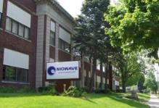
Small Business Eligibility for SBIR & STTR
For-profit U.S. business
500 employees or fewer, including affiliates
Ownership (applies to all agencies)
  Be a concern which is more than 50% directly owned and controlled by one or more individuals (who are citizens or permanent resident aliens of the United States), other small business concerns (each of which is more than 50% directly owned and controlled by individuals who are citizens or permanent resident aliens of the United States), or any combination of these
  Joint ventures where the entities meet the requirements above
Portfolio Companies (some agencies, not DOE)
  Be a concern which is more than 50% owned by multiple venture capital operating companies, hedge funds, private equity firms, or any combination of these. No single venture capital operating company, hedge fund, or private equity firm may own more than 50% of the concern. DOE does not allow portfolio company applicants.
Performance of R&D
  All R&D must be performed in the United States
Notes:
It is important to confirm that your small business is eligible

Slide 11
SBIR and STTR Awards
Critical, Early-Stage R/R&D funding
  The SBIR & STTR programs provide funding for innovative, early-stage research
  Awards process is competitive, i.e. high quality and aligned applications are funded
  SBIR & STTR awards provide credibility when seeking investors or partners
DOE SBIR/STTR awards are executed as grants
  No repayment
  No dilution of company equity
  No cost sharing is required for Phases I and II

Slide 12

Intellectual Property
Patent rights
  Small business concerns retain the principal worldwide patent rights to any invention developed with Government support
Government Use
  The Federal Government receives a royalty-free license for Federal Government use

Slide 13
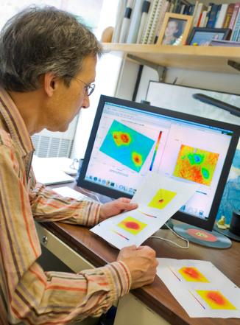
Data Protection
Protection Period
  Data generated from Phase I and II awards is protected from public disclosure for a minimum of 20 years from the start of your award. New policy change implemented in 2019.
Government Use
  The Government retains a royalty-free license for Government use of any technical data delivered under an SBIR award, whether patented or not

Slide 14
Participating DOE Program Offices – 2 Releases/year
Release 1 – July 10, 2023 <- Out Now!
Release 2 – November 6, 2023
Advanced Scientific Computing Research (ASCR)
Fusion Energy Sciences (FES)
Nuclear Nonproliferation (NNSA)
Cybersecurity, Energy Security & Emergency Response (CESER)
Basic Energy Sciences
(BES)
High Energy Physics
(HEP)
Energy Efficiency & Renewable Energy (EERE)
Electricity
(OE)
Biological & Environmental Research (BER)
Nuclear Physics
(NP)
Nuclear Energy
(NE)
Environmental Management (EM)
Fossil Energy & Carbon Management (FECM)

Slide 15
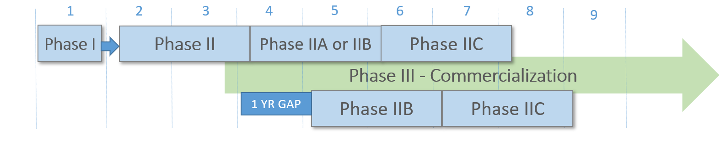
How does our funding work?
Phase I | Phase II | Phase IIA/IIB | Phase IIC
Focused, mission-aligned topics Proof of feasibility Feedback provided on letters of intent $200,000/$250,000 6 - 12 months duration ~ 350-400 awards per year | Phase I awardees apply for Phase II the following year Focus on prototype, demonstration and commercialization $1,100,000/$1,600,000 2 years duration ~ 160 awards per year | For projects that require additional R&D funding for commercialization $1,100,000 2 years duration ~30 awards per year | Pilot program to leverage 1:1 matching funds for commercialization $1,100,000 2 years duration
Notes:
This graphic provides a snapshot of how our funding works and the associated timeline.

Slide 16
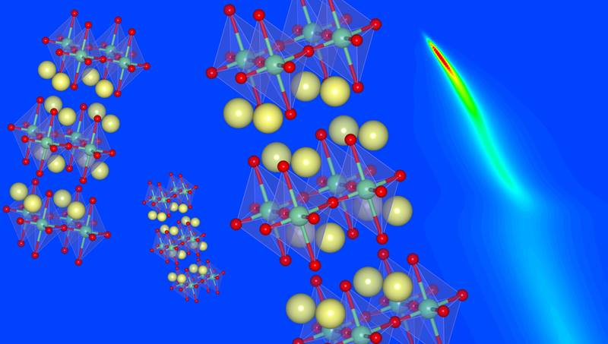
DOE SBIR & STTR Programs: Technology Areas
Release 1 Technology Areas
Topics Released: July 10, 2023

Slide 17
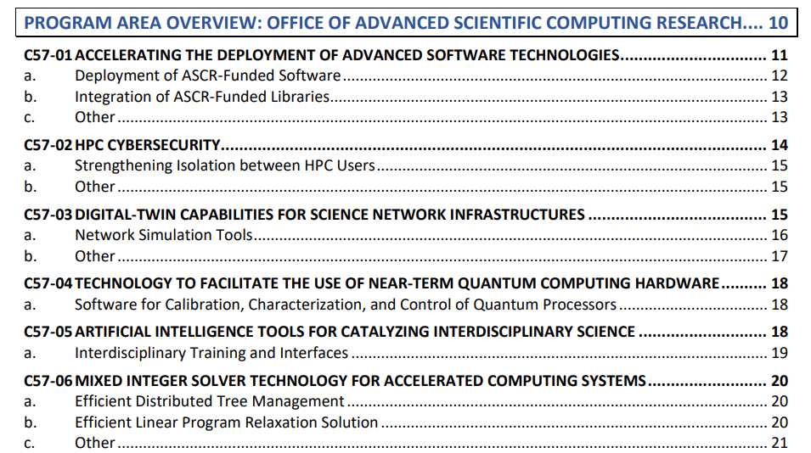
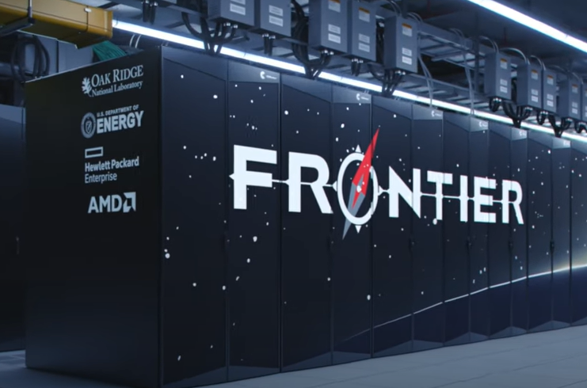
Advanced Scientific Computing Research
Website: Advanced Scientific Computing Research
World’s fastest supercomputer
at ORNL
Notes:
Computing technologies that speed up computing advance AI impact on interdisplinary science, HPC cybersecurity, taking ASCR funded programs and commercializing them , improving quantum computing.

Slide 18
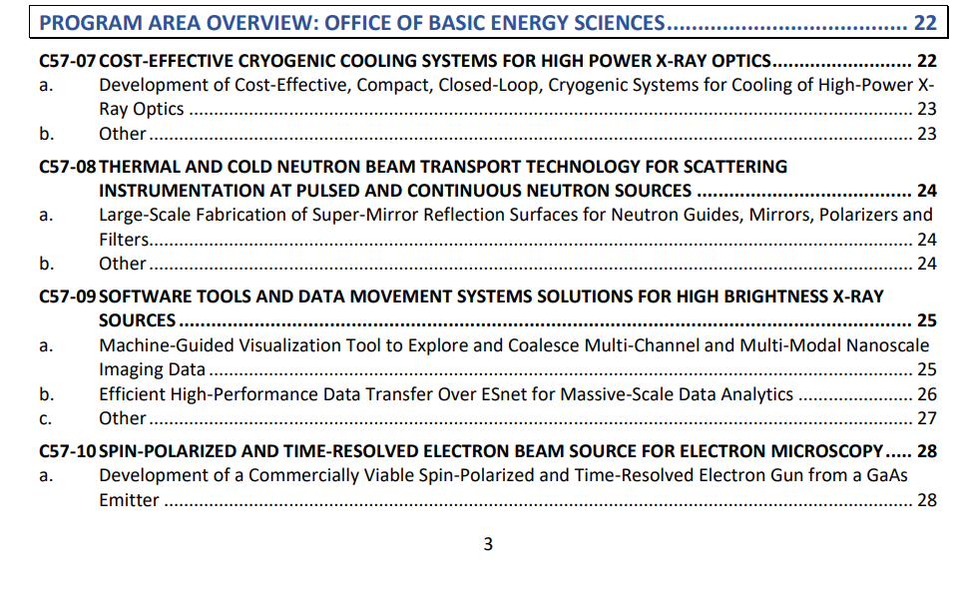

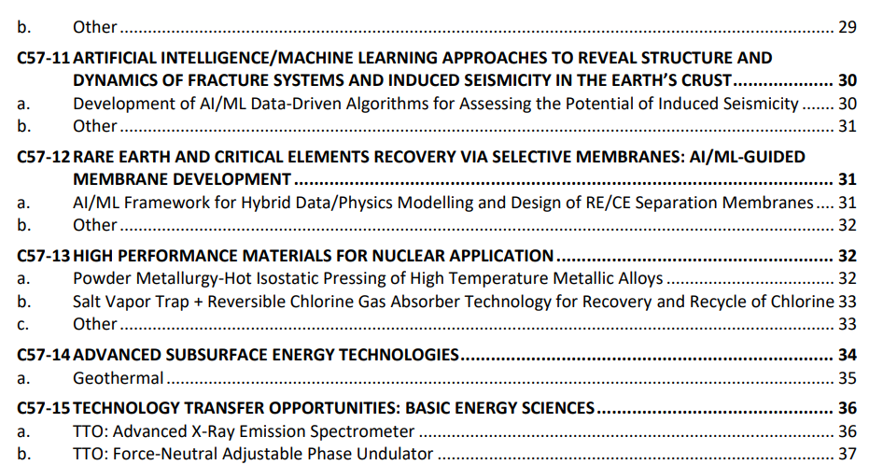
Basic Energy Sciences
Website: Basic Energy Sciences

Slide 19
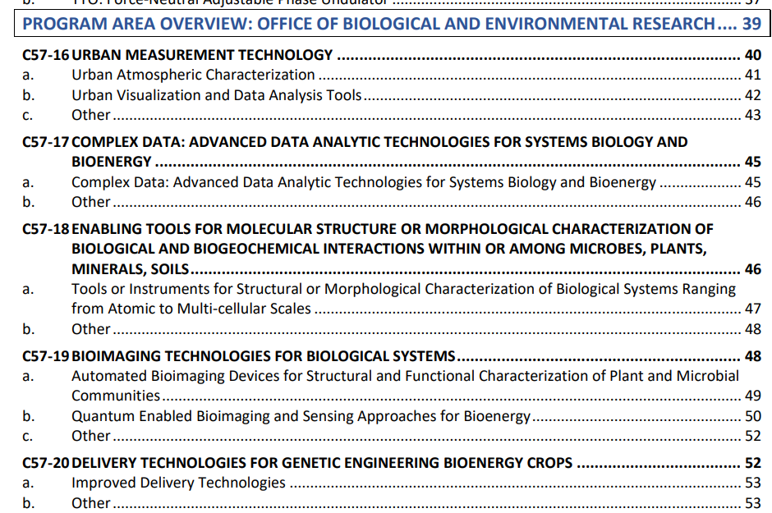
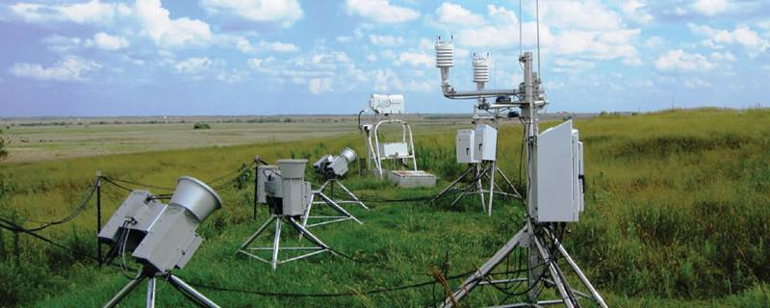
Biological and Environmental Research
Website: Biological and Environmental Research

Slide 20
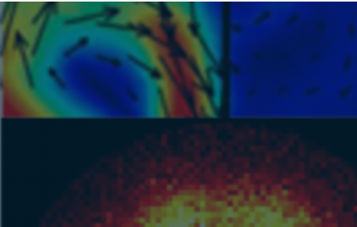
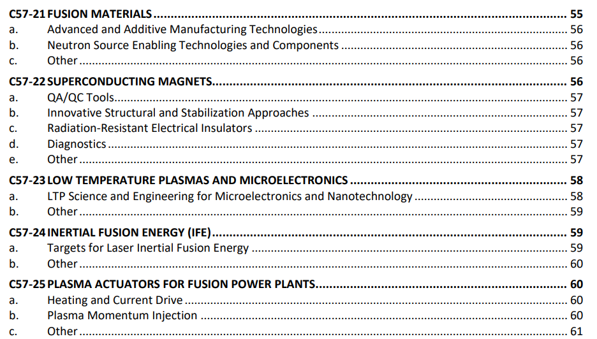
Fusion Energy Sciences
Website: Fusion Energy Sciences

Slide 21
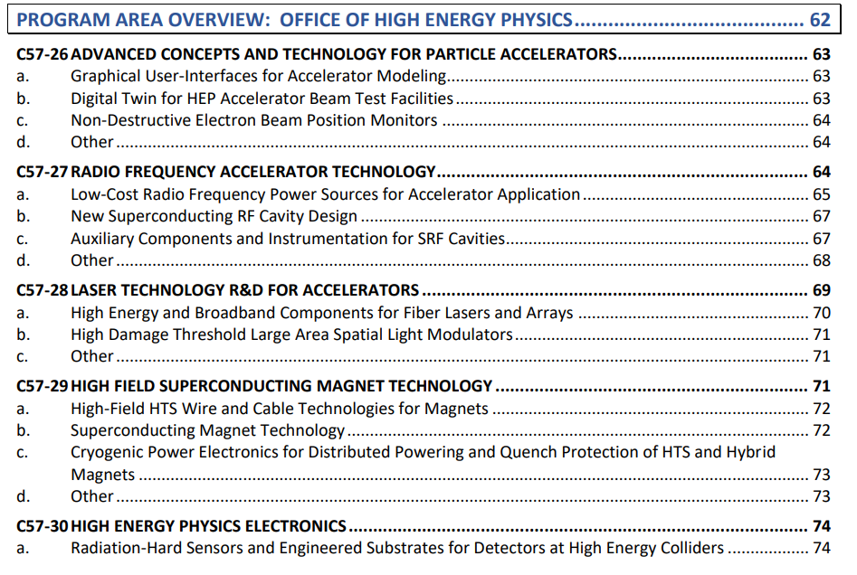
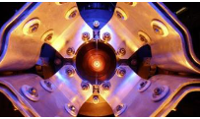
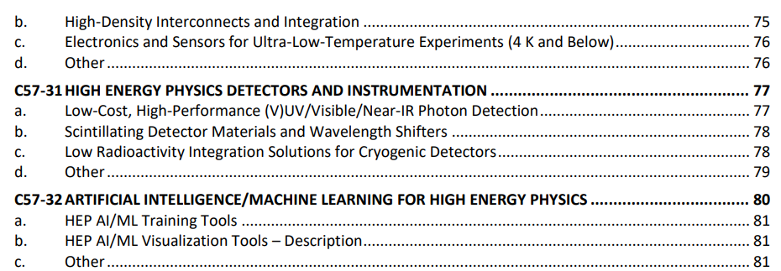
High Energy Physics
Website: High Energy Physics

Slide 22

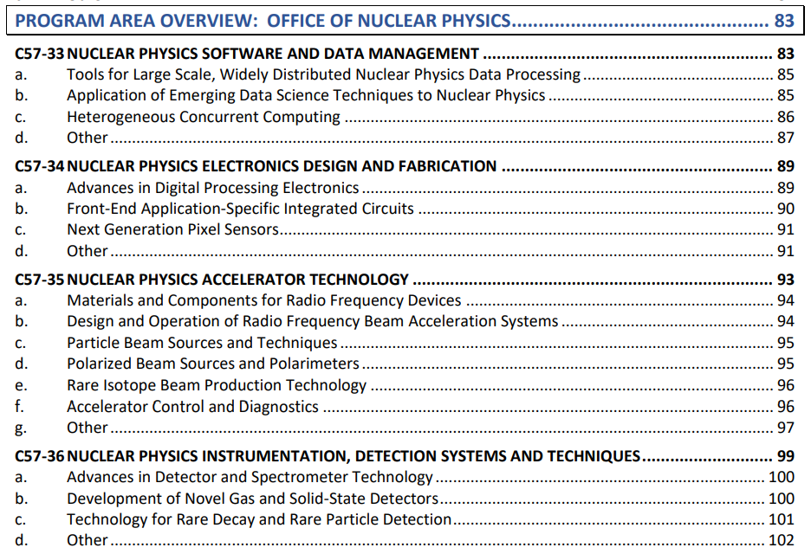
Nuclear Physics
Website: Nuclear Physics

Slide 23

DOE SBIR & STTR Programs: Technology Areas
Release 2 Technology Areas
Topics Released: November 6, 2023

Slide 24
FY2024 Phase I Release 2 Program Offices
Release 2
November 6 (topics) → February 21 (applications due)
Cyber Security, Energy Security, and Emergency Response
Defense Nuclear Nonproliferation
Electricity
Energy Efficiency and Renewable Energy
  Solar Energy
  Wind Energy
  Geothermal
  Hydrogen & Fuel Cells
Fossil Energy and Carbon Management
Nuclear Energy
Environment Management
Mark your calendar for November 6!
Advanced Manufacturing
Building Technologies
Water Power
Vehicles
Bioenergy
Industrial Efficiency & Decarbonization

Slide 25
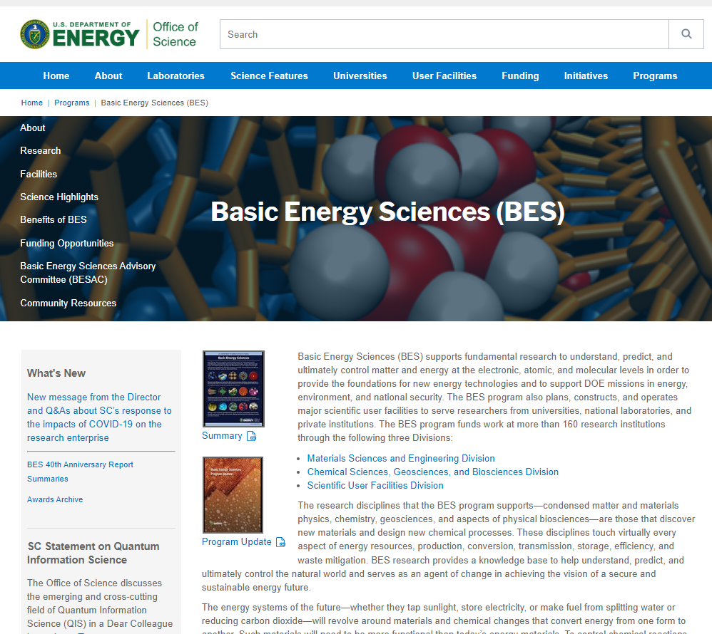
Information Available at DOE Program Office Websites
Mission
Funding Priorities and Announcements (non-SBIR)
Technical Reference Data and Reports
Workshop & Conference Proceedings
Contact Information
Notes:
Each program office has its own website, and in most cases provides a great deal of information of the R&D areas in which it funds research. These include more details about the mission and funding priorities, technical reports and conference proceedings, as well as contact information. Even though the SBIR/STTR programs fund only small companies, on the program office website you can also learn what else is being funded at universities, National Labs, and private companies—a great way to come up to speed on the state of the art in that field.

Slide 26

DOE SBIR & STTR Programs: Application & Award Process

Slide 27
Operation of the DOE SBIR and STTR Programs
Technical Expertise Leveraged Throughout DOE
Single Grants Office for Awardees
DOE Program Offices
  Develop Topics
  Identify Reviewers
  Select Awardees
  Manage Projects
DOE Chicago Office
  Negotiate Grants
  Issue New and Continuation Awards
  Grant Closeout
DOE Program Offices
  Develop Topics
  Identify Reviewers
  Select Awardees
  Manage Projects
DOE Program Office
  Develop Topics
  Identify Reviewers (Scientific Peer Review)
  Recommend Awardees
  Oversee Projects
Single Administrative Office for Applicants
DOE SBIR/STTR Programs Office
  Develop Funding Opportunity Announcements
  Administer Review and Selection Process
  Ensure Compliance with SBIR/STTR Legislation
  Conduct Outreach

Slide 28
Phase I Application & Award Timelines
months
-3
-2
-1
0
1
2
3
4
5
6
7
8
Issue Topics
Issue
FOA
LOI
Due
Applications Due
Award Notification
Start of Budget Period
TOPICS
FOA
REVIEW & SELECTION
NEGOTIATE
Budget Period: 6-12 months
Maximum Award Amount:
$200,000 or $250,000 (varies by topic)
9.5 months after start of Phase I award, your Phase II application is due

Slide 29
Schedule: FY 2024 Phase I, Releases 1 & 2
Phase I FOA Schedule | Release 1 | Release 2
Topics Issued | Monday, July 10, 2023 | Monday, November 6, 2023
Webinar(s) | Week of July 17, 2023 | Week of November 13, 2023
FOA Issued | Monday, August 7, 2023 | Monday, December 11, 2023
Webinar(s) | Friday, August 11, 2023 | Friday, December 15, 2023
Letters of Intent (LOI) Due | Monday, August 28, 2023 | Wednesday, January 3, 2024
Non-Responsive LOI Feedback Provided | Monday, September 18, 2023 | Tuesday, January 23, 2024
Applications Due | Tuesday, October 10, 2023 | Wednesday, February 21, 2024
Award Notification | Tuesday, January 02, 2023* | Monday, May 20, 2024*
Projected Grant Start Date | Monday, February 12, 2024 | Monday, July 1, 2024
*preliminary dates subject to change

Slide 30
Schedule: FY 2024 Phase II, Releases 1 & 2
Phase II FOA Schedule | Release 1 | Release 2
FOA Issued | Monday, October 16, 2023 | Monday, February 26, 2024
Letters of Intent Due (All Phase II Applications) | Tuesday, November 7, 2023 | Wednesday, March 27, 2024
Full Applications Due | Tuesday, December 5, 2023 | Tuesday, April 30, 2024
Award Notification | Tuesday, February 20, 2024* | Monday, July 29, 2024*
Grant Start Date | Monday, April 1, 2024 | Tuesday, September 10, 2024
*preliminary dates subject to change

Slide 31




Application Assistance
Phase 0 application assistance for first-time DOE applicants (open now for Phase I Release 1!)
Email us!
General questions: sbir-sttr@science.doe.gov
Get Connected!
Subscribe to our mailing list: https://science.osti.gov/sbir
Stay Connected!
Recorded Topic and FOA Webinars
Ask-Us Anything During the Application Process
Check your email next week!
Being on our mailing list is the most important way to stay up to date on our funding opportunities!

Slide 32
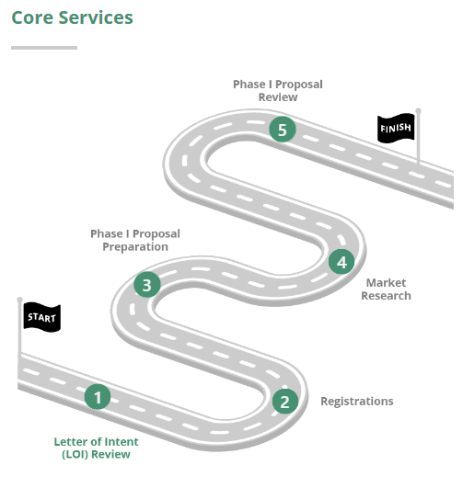
Phase 0 Application Assistance
Do you need help preparing your first DOE SBIR/STTR Phase I application?
All first –timers are eligible (first come-first serve)
Go/No-go discussion and decision:
  Responsive to topic
  Novel idea
  Ability to conduct the proposed R&D
Apply portal opens when Topics are released
“Ample” opportunity to enroll
Phase 0 program informational webinar hosted by provider.
Signup for Phase 0 mailing list
Optional Services (Pick 1 or 2):
Small business training/mentoring
Technology Advice & Consultation
Intellectual Rates & Financial Assistance
Travel Assistance

Slide 33
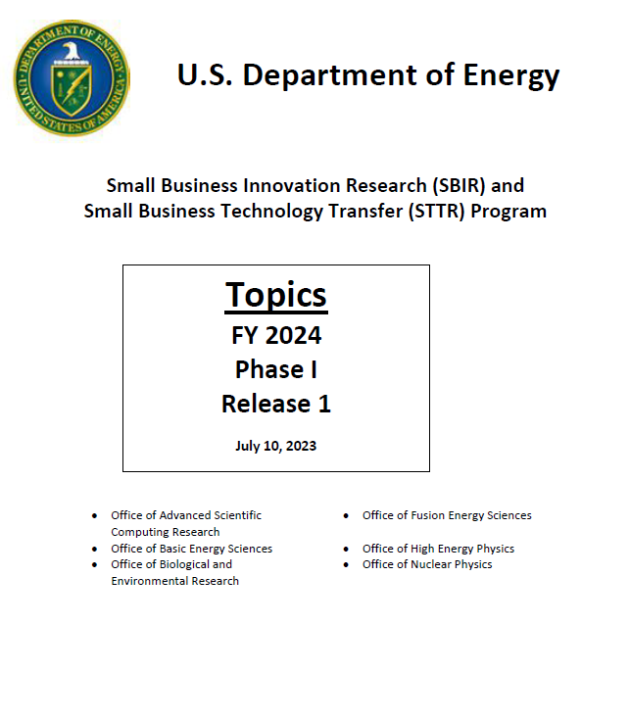
Topics
Topics Document
  DOE primarily uses focused topics
  Issued 4 weeks prior to the FOA
Communication with DOE program managers
  Open communication permitted about topic scope
Webinar
  DOE program managers discuss their topics
  Applicants submit questions in advance or during the webinar
  Webinars are recorded and available at our website
Notes:
New applicants are encouraged to examine current topic descriptions to explore whether they can propose novel solutions to the problems and opportunities presented. We currently have one Funding Opportunity Announcement open that contains topics from our Office of Science. We will have a second Funding Opportunity Announcement later this fall that will contain topics from our Applied Programs. These pdf documents are searchable so that you can type in keywords to identify potential matches between your capabilities and the topics.

Slide 34
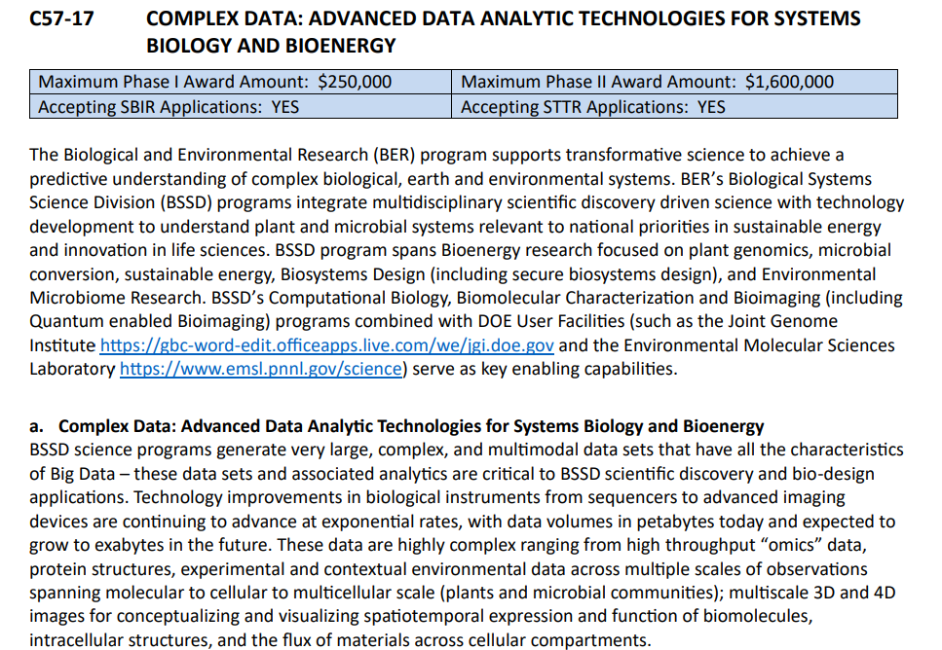
More about Topics
DOE Mission-Focused Specific Topics
R&D funding limits and type of applications accepted are specified
At Topic Webinar (recorded and available here), DOE Program Managers discuss the topic then Q&A
Letter of Intent and Application must specify same Topic and Subtopic

Slide 35
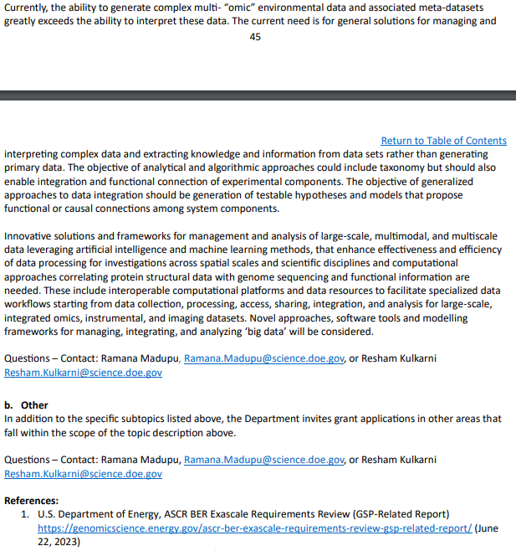
Subtopics
Open communication permitted about the topic scope with DOE Technical Topic Managers
Letter of Intent and Application must specify same Topic and Subtopic
Reading references is recommended
You are expected to be highly knowledgeable in your technology area, latest developments, what are the barriers, what are the competing technologies.

Slide 36
Technology Transfer Opportunities (TTOs)
An opportunity to transfer inventions made by a DOE National Lab or university to your small business for commercialization
Awardees receive
  an SBIR/STTR grant and
  an option to license the technology
Please review TTO information section at the beginning of the topics document if you plan to submit an application to a TTO.
Two TTO subtopics in this release

Slide 37
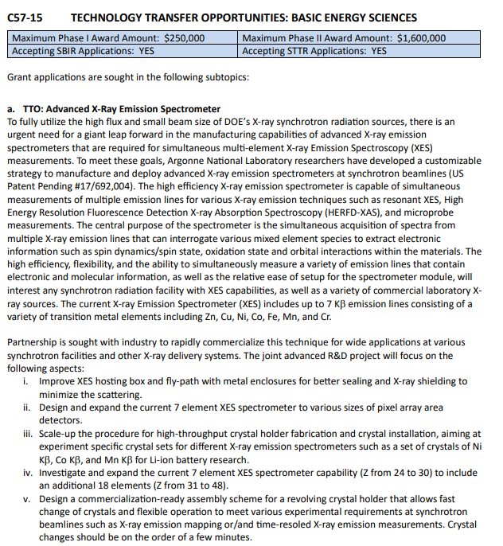
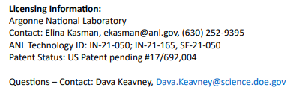
Technology Transfer Opportunity - Topics
Technology Transfer Opportunity
  The topic or subtopic will be clearly labeled
Research Organization
  The DOE National Lab or university responsible for the TTO is listed along with contact information and other references
  Please contact the Lab or university to obtain information about the TTO
DOE Program Manager contact info is provided
Notes:
There are two in this solicitation

Slide 38
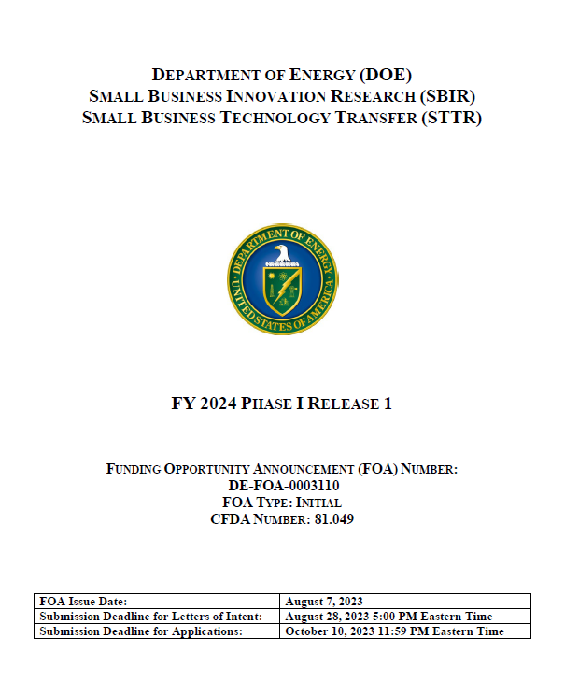
Funding Opportunity Announcement (FOA)
Available at the DOE SBIR website or Grants.gov and includes information on
  Anticipated number of awards and funding available
  Eligibility
  Application Requirements
  Review Criteria
  Award Administration
  Open for approximately 9 weeks
Notes:
Read the FOA to avoid mistakes

Slide 39
Letters of Intent (LOI)
Requirement
  You must submit an LOI by the due date to be eligible to submit an application
Primary purpose
  begin reviewer assignment to reduce award selection time
  due 3 weeks after FOA is issued
Secondary purpose
  provide email notification to applicants who appear to be non-responsive; you may submit an application if you receive this notification
  Applicants whose LOI appears responsive will NOT receive a notification
Limits
  Small businesses may submit only 10 letters of intent (and 10 applications) per solicitation
  Each letter of intent and application must be unique
Content of LOI
Title
Topic and Subtopic
Abstract (<500 words)
  Provide sufficient technical detail to enable reviewer assignment
  Non-proprietary
List of Collaborators
Small Business Information
  Name, address
  Business Official and contact information
  Principal Investigator
Notes:
Letter of Intent: Primary reason we included this is to assign reviewers. We need some basic information (title, topic/subtopic, Your abstract should be sufficiently detailed so we can start the process of identifying reviewers. If DOE program managers come a across an abstract that does not appear to fit with their topic/subtopic we will notify the applicant that it appears to be non-responsive (you will not get a specific letter stating why). You may submit a full application even if you receive such a letter from us. We would prefer you use the time before the letters of intent are due to discuss with DOE program managers whether your idea is a fit to their topic/subtopic.

Slide 40
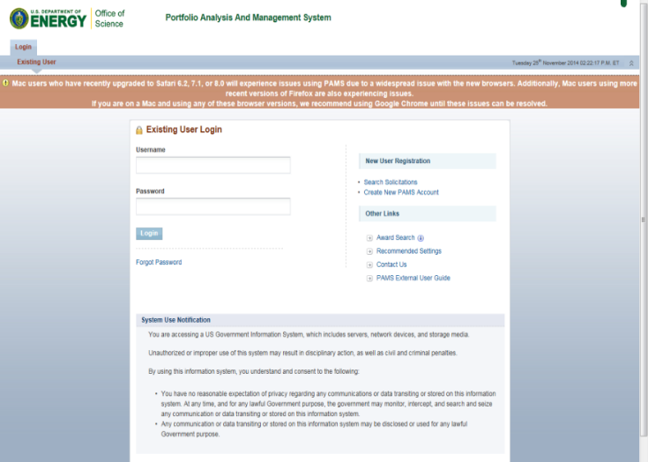
Letter of Intent (LOI) Submission is Required
Submit LOI online directly to the DOE Portfolio Analysis and Management System (PAMS) website: https://pamspublic.science.energy.gov/
  Due Monday, August 28 by 5 PM EDT
  Select “Create New PAMS Account” (if you do not have an account)
    No prior registrations (SAM, etc.) are required to submit a LOI
  Submit your abstract as a PDF file
  Utilize the LOI instructions available at the DOE website to ensure that you submit all the required information
  For additional details on the LOI submission process, see the FOA

Slide 41
Letter of Intent: Sample Abstract
ABC LLC will develop a new class of low cost battery separator materials for lithium ion batteries. It is anticipated that the cost of this separator will be 70% lower than separator materials available today and will be a critical factor in reaching the $150/kWh cost target specified in topic 4b for lithium ion batteries for electric vehicle applications.
These separators will utilize a new optically-activated method of producing pores in nano-structured polyolefin films. This optical pore formation method results in a 10x increase in the speed of creating porous films. During Phase I, ABC LLC will (1) develop the compositions and methodology for formulating the dense nano-structured polyolefin films and (2) carry out preliminary feasibility studies to characterize the appropriate optical intensities and wavelengths to achieve uniform, high speed, pore formation. It is anticipated that multiple iterations will be required to optimize the composition and nanostructure of the precursor films to achieve the desired porosity and process speeds. All processing work will be carried out at ABC LLC but polymer characterization will leverage capabilities of the Polymer Lab at State University to evaluate the structure, porosity, tortuosity, and thermal properties of the polymer films. In addition we will be collaborating with Lion Battery Inc. who will do preliminary battery testing of our separator materials to identify any manufacturing or performance issues of the separators.
Clearly explain why the proposed R&D is responsive to the subtopic
Provide sufficient technical detail about the R&D so that DOE program managers can select reviewers with appropriate technical expertise.
Do not include proprietary information in a letter of intent.

Slide 42
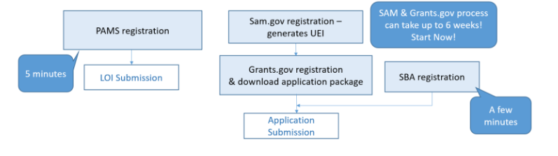
Application Process: Registrations
Applications must be submitted through Grants.gov
Registration at Grants.gov is a 3 step process
  Applicants must register with SAM at https://www.sam.gov/ and obtain a Unique Entity Identifier (UEI)*
    Complete a SAM registration. Can take 8 weeks!
    Must be updated annually
  Complete Grants.gov registration
    Start this process as early as possible!
    See the Grants.gov website for instructions
Small Business Administration (SBA) company registry
  Small businesses must register at the SBA company registry (http://www.sbir.gov/registration ) and submit a copy of their registration with their grants.gov application
https://www.grants.gov/web/grants/applicants/applicant-training.html
*DUNS was replaced by UEI in April 2022. No more DUNS & Bradstreet
Notes:
DUNS number was to be phased out in April 2022, was replaced by UEI. You may see your UEI populated in SAMS and going forward you can use it when requested.
No longer a 3rd party involved.
SAM update annually, allows you to do business with the fed govt. Don’t do it last minute it takes a few days!
Complete a SAM registration or update it. SAM needs to talk to Grants.gov so this needs to be done well before deadline
Call their help desk with any problems
SBA has oversight of SBIR/STTR. A copy of SBIR registration must be submitted with the application.

Slide 43

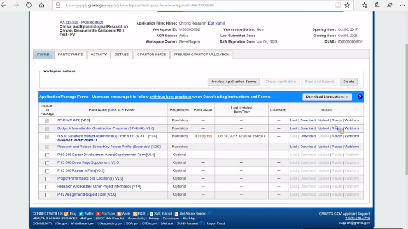
Completing a Grants.gov Application
Workspace
  Online application completion and submission
  Online tutorials are available
  https://www.grants.gov/applicants/workspace-overview.html
Notes:
Grants.gov has a workspace, this was an offline form in the past, but a workspace functionality has been implemented. Collaborative, complete online, work with different forms at the same time
All documents are held online
Tutorials are available
Other agencies use Grants.gov

Slide 44
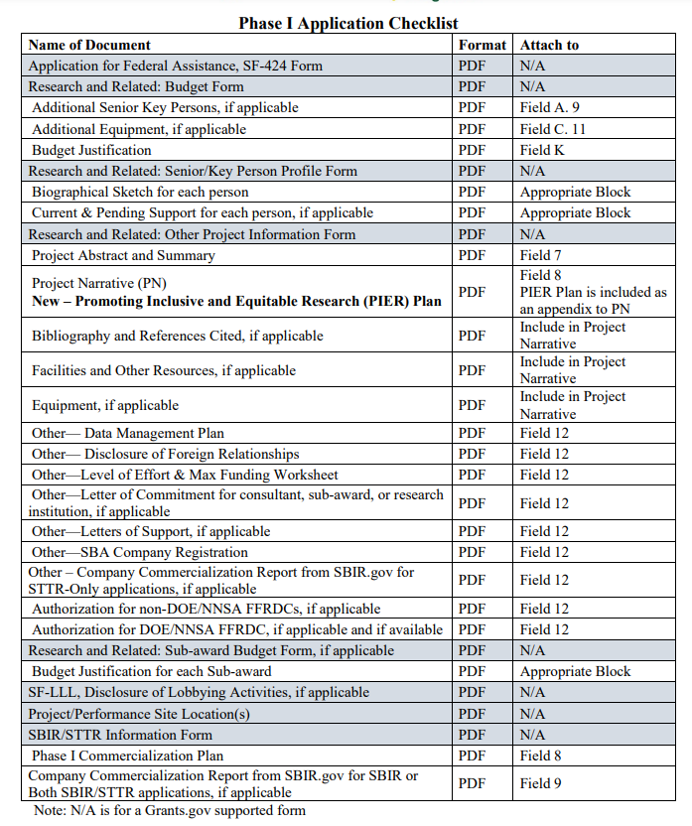
Elements of Your Application
Project Narrative
  Page and word limits
    Phase I: 15 pages, 7,500 words
    New Requirement - PIER Plan
Also new - Foreign Relationship Disclosure
Budget & Budget Justification
Key Personnel
  Provide a resume for each person listed on the budget form
Commercialization Plans
  Phase I commercialization plan (2000 words)
    an example can be found here at https://science.osti.gov/sbir/Applicant-Resources/Grant-Application
SBIR/STTR Information form
Data Management Plan
Notes:
There is a lot to do and get started early.
Make sure you have the time to dedicate to this effort
Include key personnel (anyone who is named on the budget form)
Note that you should be thinking about commercialization in Phase I, but Phase II application involves evaluation of your CP

Slide 45
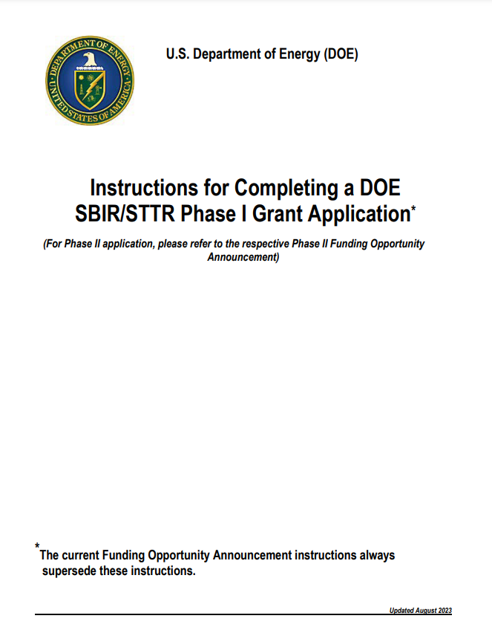
Completing an Application
Important documents to assist you with completing the application package
  Topics Document, Funding Opportunity Announcement, & Instructions are available at the DOE SBIR/STTR website
  Online tutorials: https://doetutorials.dawnbreaker.com/
  Coming later this month, a new application guide! Look for an email announcing the release.

Slide 46
Data Management Plan
Purpose – Disseminate, as widely as possible, data generated with public funding
Requirement – All SBIR and STTR applications must select one of the two Data Management Plan (DMP) options below:
  Option 1
    The Option 1 DMP is: “It is anticipated that all generated digital data will be protected as SBIR/STTR data and therefore will not be publicly shared during the applicable SBIR/STTR data protection period.” If any data generated under this award are published, an effort will be made to also release any related digital data that is not protected SBIR/STTR data.”
    Please note that if you do not include a DMP with your application, Option 1 for the DMP will be assumed for your application. However, If you plan to publicly disclose generated digital data, you must provide a DMP under Option 2.
  Option 2
    If you plan to publicly disclose technical data during the data protection period or, for data not expected to be asserted as protected SBIR/STTR rights data, please submit a DMP. Use the DMP requirements outlined in the FOA.

Slide 47

DOE SBIR & STTR Programs:
What’s New?

Slide 48
Foreign Relationships Disclosure Form
Per the SBIR/STTR Extension Act of 2022, you are now required to submit a Disclosure of Foreign Relationships using the form on: https://science.osti.gov/sbir/Applicant-Resources/Grant-Application
Your application may be declined if the form is not included
The disclosure is attached to Field 12 of the Research and Related Other Project Information Form
Even if your small business has no foreign relationships, you must complete the form and sign it to certify

Slide 49
NEW REQUIREMENT - Promoting Inclusive and Equitable Research (PIER) Plan
All applications must include a Promoting Inclusive and Equitable Research (PIER) Plan as an appendix to the research project narrative. The PIER Plan will be evaluated as part of the overall technical merit review.
The PIER plan should describe the strategies and activities of the applicant to promote equity and inclusion as an integrated element of the research and development project within the proposing small business concern.
Plans may include, but are not limited to:
Plans of your small business concern and collaborating institutions (if applicable) to recruit individuals from diverse backgrounds and groups historically underrepresented in the research community;
Plans to contribute to a research and development environment that fosters a safe, positive, and inclusive workplace, a sense of belonging among all personnel; and/or
Supporting training, mentoring, and partnering with underrepresented communities. Plans may leverage existing diversity, equity, accessibility, and inclusion efforts of the applicant small business concern, but should not be a statement of broad principles.

Slide 50
Promoting Inclusive and Equitable Research (PIER) Plan
Applicants are encouraged to focus on areas, including but not limited to:
The composition of the project team and partnering institutions
The research environment—cultivating respectful, professional and accessible environments
Equitable and inclusive implementation of the research project
Partnering with underrepresented institutions and/or underserved communities
PIER Plan Requirements:
Provided as an Appendix to the Project Narrative and 1-3 pages in length.
May leverage existing Diversity, Equity, Inclusivity and Accessibility (DEIA) plans, but the plan should be tailored to and integral to the proposed project.
Should include at least one specific, measurable, attainable, realistic and time-bound (SMART) milestone.
The progress relative to the milestone will be a reporting requirement.
The complexity and detail of PIER Plans are expected to increase with the size of the small business and the number of personnel supported.
Funds may be requested for execution of PIER Plan consistent with allowable cost guidelines for financial assistance.

Slide 51
Promoting Inclusive and Equitable Research (PIER) Plan
Phase I Note:
Since the Phase I award is of limited duration (6 – 12 months) and the award size is $200,000 to $250,000, it is expected that, one-page PIER Plans are suitable and will be most typical. The PIER Plan should be simple, focused, and relevant to the scope and duration of the award.
Visit our new web page providing PIER Plan resources
Genuine PIER plans are sought!

Slide 52
Proprietary Data
An application may include technical data and other data, including trade secrets and commercial or financial information that are privileged or confidential, which the applicant does not want disclosed to the public or used by the Government for any purpose other than application evaluation.
Certain documents may contain proprietary information.

Slide 53
Proprietary Data
To protect such data, the following guidelines must be followed:
The following legend must appear on the title page of the document:
This proposal contains information that shall not be disclosed outside the Federal Government and shall not be duplicated, used, or disclosed in whole or in part for any purpose other than evaluation of this proposal, unless authorized by law. The Government shall have the right to duplicate, use, or disclose the data to the extent provided in the resulting contract if award is made as a result of the submission of this proposal. The information subject to these restrictions are contained on all pages of the proposal except for pages [insert page numbers or other identification of pages that contain no restricted information.]
The following legend must appear on each page of the proposal that contains information the Applicant wishes to protect:
Use or disclosure of information contained on this sheet is subject to the restriction on the title page of this proposal.
There are no longer marking requirements (highlight, asterisks, brackets) of specific text containing protected information.
See Example

Slide 54
What makes you a good fit with DOE?
Application Review Criteria
Ability to Carry Out the Project
Impact
Technical Merit
PIER Plan
Must be technology development R&D!
Idea is novel
Solid work plan to prove feasibility
Responsiveness to the topic & subtopic
Your team is composed of the right expertise
Potential impact if R&D is successful
The first three review criteria are equally weighted and of greater weight than the fourth criterion

Slide 55

Top Application Errors
Updating SAM registration at the last minute – and unable to submit on Grants.gov
Fail to submit letter of intent by the deadline
Fail to check level of effort is compliant (see slide 6)
Fail to meet PI effort requirements (a minimum of 3 hours/week on average)
Incorrect/missing marking of proprietary data. Instructions in FOA
Missing letters of commitment, required for each consultant and subaward
Proposing a technology that is not new
Unresponsive to the subtopic/ Not clearly addressing technology need
Not including the required documents
Proposal reflects unfamiliarity with the current literature
Budget form and budget justification are in agreement (to the penny). Subawards too!
Not fully reading the FOA!!
Notes:
Please properly mark proprietary data. Review the info in the FOA.
Don’t forget subawards

Slide 56
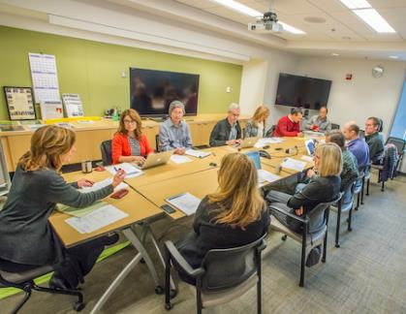
Review and Selection of Applications
DOE primarily uses external peer review to evaluate your applications
  Typically at least 3 technical reviewers
Selection
  DOE ranks the most meritorious applications—award selections are made based on available funding
You will be notified of the decision on your application within 90 days of the application deadline
  Reviewer comments will be made available to you through PAMS. Use this feedback constructively to improve future applications
Notes:
If you are not selected, it doesn’t mean it is not meritorious and that it is not worth pursuing. You will get comments on your application which can be used to adjust your approach for a subsequent application.

Slide 57
Phase I Application & Award Statistics for FY 2023
Phase I
  2110 applications
  374 awards
Notes:
Awards per topic: Generally 0 to many. It varies greatly by program. Some programs that are interested in many diverse areas will put out more topics than they plan to make awards. Others such as EERE have only two topics this year and I would expect each topic to have greater than 10 awards.

Slide 58
Phase II Application & Award Statistics for FY 2023
Phase IIA
  41 applications
  17 awards
Phase IIB
  66 applications
  16 awards
Phase II
  401 applications
  129 awards
Notes:
Awards per topic: Generally 0 to many. It varies greatly by program.

Slide 59
Phase I Principal Investigator Meeting
Phase I Principal Investigators are expected to attend a two-day DOE SBIR/STTR Principal Investigator Meeting held in the DC area
  Release 1: June
  Release 2: October
Objectives
  In-person meetings with DOE program managers and DOE Commercialization Assistance provider
  Presentations relating to Phase II and Commercialization
  Small business networking
You may include the cost for the trip (registration, travel) in your Phase I budget
Exceptions
  If the DOE program office that funds your topic has a separate principal investigator meeting, you will be notified that your participation in the Phase I PI meeting is optional
Notes:
The PI meeting is required. Put the trip to DC in your budget

Slide 60


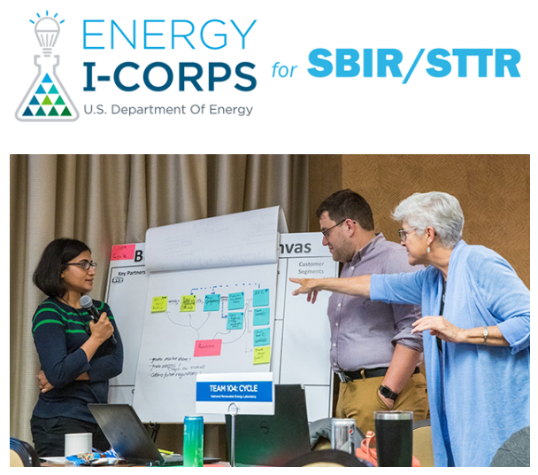
Commercialization Assistance
New for Applicants and Awardees! DOE SBIR/STTR Partnering Resources
  Looking for SMEs, collaborators,
  subcontractors?
  Understand related research being done at research institutes
  Email carol.rabke@science.doe.gov to discuss your partnering needs
Energy I-Corps
  40 are selected
  Designed to educate on entrepreneurial concepts
  2 months training at no cost to participants
  Customer discovery process
Technical and Business Assistance (TABA)
  $6,500 above maximum award amount in Phase I
    Select your own vendor
    Use DOE vendor
  $50,000 above maximum award for Phase II
  Current vendor: http://www.larta.org/doecap

Slide 61

Commercialization
DOE topics are drafted by program managers who are aware of the important technology roadblocks that are preventing progress in their mission areas.
Small business applicants are expected to address the commercialization challenges and ensure that there is a profitable, self-sustaining, business opportunity
  Phase I Applications must include Commercialization Plans
  Commercialization Plans can accommodate long commercialization timeframes
  Ability to address adjacent markets can also be included in your commercialization plan
DOE performs follow-up surveys to track commercialization outcomes of its SBIR/STTR awards.
Notes:
DOE PMs understand the state of the art of technology but may not understand how technology solution can result in a comm revenue stream. It is up to the SBs to determine if there is a viable path.

Slide 62
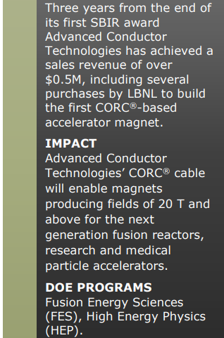
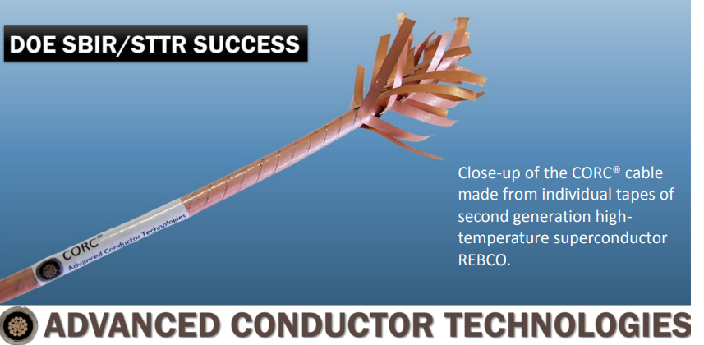
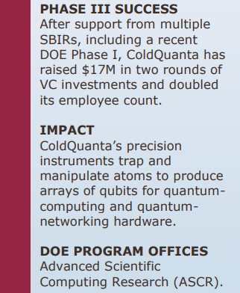

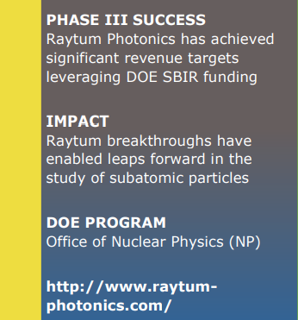
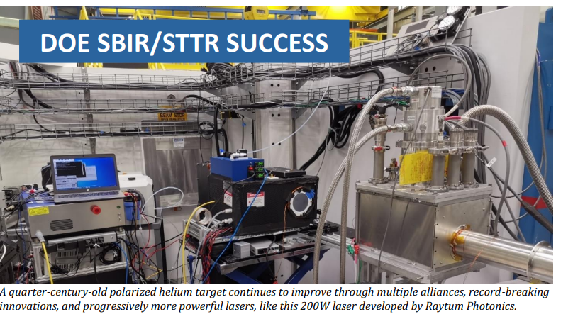
There are many Success Stories
https://science.osti.gov/sbir/SBIR-STTR-Phase-III-Success-Stories

Slide 63

DOE Office of Inspector General:
Fraud, Waste & Abuse

Slide 64
DOE Office of Inspector General
Combating Fraud
What types of fraud are found in the SBIR Program?
Application Process
  submitting a plagiarized proposal
  providing false information regarding the company, the Principal Investigator (PI), or work to be performed
  seeking funding for work that has already been completed
During Award
  using award funds for personal use or for any use other than the proposed activities
  submitting plagiarized reports or reports falsely claiming work has been completed
  claiming results for an award that were funded by a different source

Slide 65
DOE Office of Inspector General
Knowing the Rules
Which SBIR rules should you be particularly familiar with?
  Duplicate or overlapping proposals may not be submitted to multiple agencies without full disclosure to all agencies.
  The company must meet SBA’s requirements for a small business, including being majority American owned and have 500 employees or fewer.
  For SBIR: The PI’s primary employment must be with the company during the grant period. The PI may not be employed full time elsewhere.
  For SBIR: For Phase I, a minimum of two thirds of the research effort must be performed by the grantee company; for Phase II, a minimum of one-half of the research effort must be performed by the grantee company. Work performed by a university research lab is NOT work completed by the grantee company.
  University employees participating on an SBIR award should disclose their involvement to the university as well as their use of university facilities.
  R&D must be performed in the United States.

Slide 66
DOE Office of Inspector General
Consequences
What Happens If You Break the Rules?
  If you commit fraud or other wrongdoing in applying for or carrying out an SBIR award, we will investigate.
  We refer violations of civil or criminal law to the Department of Justice (DOJ). If DOJ prosecutes you for fraud or false statements, you may be sentenced to prison and required to pay full restitution. If DOJ pursues a civil action under the False Claims Act, you may have to pay treble damages and $11,000 for each false claim. In addition, DOE may terminate your awards and debar you from receiving grants or contracts from any federal agency.

Slide 67
Recent Prosecution
https://www.justice.gov/usao-mdfl/pr/scientists-sentenced-prison-defrauding-small-business-innovation-research-program

Slide 68
DOE Office of Inspector General
Reporting Fraud
The Department of Energy’s Office of Inspector General (OIG) promotes the effective, efficient, and economical operation of DOE’s programs and operations through audits, inspections, investigations, and other reviews.
Within DOE OIG, the Office of Investigations is responsible for investigating any fraudulent acts involving DOE, its contractors or subcontractors, or any crime affecting the programs, operations, Government funds, or employees of those entities.
If you want additional information or to report wrongdoing:
  Internet: ig.energy.gov
  E-mail: ighotline@hq.doe.gov
  Telephone: 202-586-4073
  Hotline: 800-541-1625
  Fax: 202-586-5697
  U.S. DEPARTMENT OF ENERGY
  OFFICE OF INSPECTOR GENERAL
  ATTN: OFFICE OF INSPECTIONS
  1000 INDEPENDENCE AVENUE, SW
  MAIL STOP 5D-031
  WASHINGTON, DC 20585

Slide 69


DOE SBIR/STTR Resources
Commercialization
Private Funding
Early-Stage Innovation
SBIR & STTR
Angels
Applicant Resources
Sequential Phase IIs
Phase 0 Application Assistance
Phase I Commercialization Program
Phase Shift I & Phase Shift II
TABA funds
Partnering Resources and Phase II Workshops
Diversity Supplement for Phase II Awardees

Slide 70
Other DOE Resources
Commercialization
Private Funding
Early-Stage Innovation
SBIR & STTR
Angels
Partnering with National Laboratories
Demonstration Facilities: Idaho, NREL, ORNL
National Labs – POCs and Core Capabilities
Office of Clean Energy Demonstrations
Technology Commercialization Fund (TCF)
Loan Programs Office
  Lab-Embedded Entrepreneurship Program (LEEP)
American-Made Challenges
National Energy Research Scientific Computing Center (NERSC)

Slide 71

Thank you!
Get organized!
Take advantage of Phase 0 and other resources if you are a first-timer!
Reach out to us:
eileen.chant@science.doe.gov
sbir-sttr@science.doe.gov
(301) 903-5707

