Slide 1
Agenda
Introduction, Manny Oliver
Patent, Data Rights and Responsibilities under SBIR/STTR Awards, Mike Dobbs
Proper Administration of DOE SBIR/STTR Grants, Mark Sojka
Preventing Fraud in the SBIR/STTR Programs, Nicolas Macedonia

Slide 2
Recent Program Changes: FY 2022-2023
U.S. Manufacturing Requirement
Technologies invented under SBIR/STTR awards must be substantially manufactured in the U.S.
Disclosure of Foreign Relationships
Must be updated during the award period
DOE Approval for Unnamed Key Personnel in your Application
Seek approval at least 30 days in advance of having unnamed key personnel start on the project

Slide 3
New Requirement coming in FY 2024
Cybersecurity Self-Assessment
Phase II applicants will be required to submit a cybersecurity self-assessment starting in FY 2024.
We recommend that thoroughly examine your current practices and utilize available resources to improve them
For more information: https://science.osti.gov/sbir/Foreign-Risk-Management
CISA has an excellent Cyber essentials guide aimed at small businesses: https://www.cisa.gov/resources-tools/resources/cyber-essentials
NIST has a useful publication that discusses the Fundamentals of Small Business Information Security: https://www.nist.gov/publications/fundamentals-small-business-information-security

Slide 4
Take Advantage of . . .
Supercomputer Resources https://science.osti.gov/sbir/Applicant-Resources/National-Labs-Profiles-and-Contacts/National-Energy-Research-Scientific-Computing-Center
Computing time available at no charge to DOE SBIR/STTR awardees
Partnering Resources: https://science.osti.gov/sbir/Partnering-Resources

Slide 5
Office of Science Intellectual Property Law (IPL)
Patent & Data Rights and Responsibilities under SBIR/STTR Awards
July 28, 2023
Michael J. Dobbs
Deputy Chief Counsel -- Intellectual Property Law (IPL)
U.S. Department of Energy
Mike.Dobbs@science.doe.gov Tel: (331) 465-1317
Providing responsive and impactful legal counsel to our customers and ensuring effective management and protection of DOE funded Intellectual Property.

Slide 6
Disclaimers – Consult your Attorney and Award Terms
Legal Representation: This presentation includes information about legal issues and legal developments for informational purposes only. These informational materials are not intended, and should not be taken, as legal advice on any set of facts or circumstances. You should contact an attorney for advice on specific legal problems.
Review your award terms, the SBA’s Policy Directive and the applicable laws and regulations with your legal counsel!
Personal Views and Opinions: The views and opinions expressed in this presentation are those of the author and do not necessarily reflect the official policy or position of any agency of the U.S. Government.

Slide 7
Key Takeaways
Properly mark your reports (SBIR/STTR markings only).
Timely report all Subject Inventions through iEdison (not just patents)
Watch statutory bars (publications, on-sale, and public use) and inform both your attorney and iEdison ASAP.
Watch U.S. Manufacturing requirements and consult DOE early with questions.

Slide 8
Data Rights v. Patent Rights
 | Data Rights | Invention Rights
Intellectual Property | Copyright | Patent Must provide enabling disclosure to USPTO and be issued a patent!
Subject Matter | “original works of authorship fixed in any tangible medium of expression” 17 USC 102 | “new and useful process, machine, manufacture, or composition of matter, or any new and useful improvement thereof” 35 USC 101
Disclosure to Government | Deliverables identified in the award. Typically, no deliverables after closeout. | All Subject Inventions and filed patents (Conceived or First Reduced to Practice) – Ongoing Obligation
Government Protection From Disclosure | Limited Rights, Restricted Computer Software, SBIR/STTR Data Rights | 35 USC 205 - Confidentiality
Export Control, Security Classification and other restrictions may also be applicable.
**Provided for discussion purposes only.

Slide 9
SBIR/STTR Data Rights GTC-0025
“Data” -- All recorded information, regardless of the form or method of recording. Not just experimental data. Typically, only certain data is reported to the agency (e.g. Final Report or other deliverables).
“Unlimited Rights” to Government.
Default rights to Government (all unmarked data).
No obligation to protect.
Automated Publication of Final Report.
Marked Privately Funded Data (Proprietary, Limited, and Restricted Computer Software)
Technical Proposal(FOA): Typically, may include in proposal; consult FOA.
Progress or Final Reports: Not authorized, unless otherwise directed by the Contracting Officer.
Marked SBIR/STTR Data (Statutory Data Protection)
Data generated in the performance of an SBIR/STTR Award
Properly marked as SBIR/STTR Data per award terms.
Government will protect marked SBIR/STTR data from release outside the Government and Government Support Contractors for a limited period.
20-years from award issuance fixed protection period (awards issued on or after May 2019).

Slide 10
SBIR/STTR Data Rights Markings - GTC-0025(c)
Identify as “20 YEAR SBIR/STTR DATA RIGHTS (2019)” in all submissions to Office of Scientific and Technical Information (OSTI).
Use the “20 YEAR SBIR/STTR DATA RIGHTS (2019)” legend.
On the first page or cover page of the document containing SBIR/STTR Data.
Subsequent pages shall also include the authorized legend or simply “SBIR/STTR Protected Data”.
Do NOT mark reports with “Proprietary”, “Limited Data”, “Restricted Computer Software” or the corresponding markings found in the FOA!
May identify only portions of a page as SBIR/STTR Data (e.g., by circling or underscoring with a note or other appropriate identifier).
Computer Software
Include legend in the
printed material or media containing the Computer Software; or
transmittal document or storage container.
May include both patent and data rights.

Slide 11
20 Year SBIR/STTR Data Rights (2019)
Funding Agreement No __________________________ (e.g. DE-SC000nnnn)
Award Date ________________ (Block 27 on the Assistance Agreement)
SBIR/STTR Protection Period: Twenty years from Award Date
SBIR/STTR Awardee __________________________
This report contains SBIR/STTR Data to which the Federal Government has received SBIR/STTR Technical Data Rights or SBIR/STTR Computer Software Rights during the SBIR/STTR Protection Period and Unlimited Rights afterwards, as defined in the Funding Agreement. Any reproductions of SBIR/STTR Data must include this legend.
*No other legends should be used on reports!

Slide 12
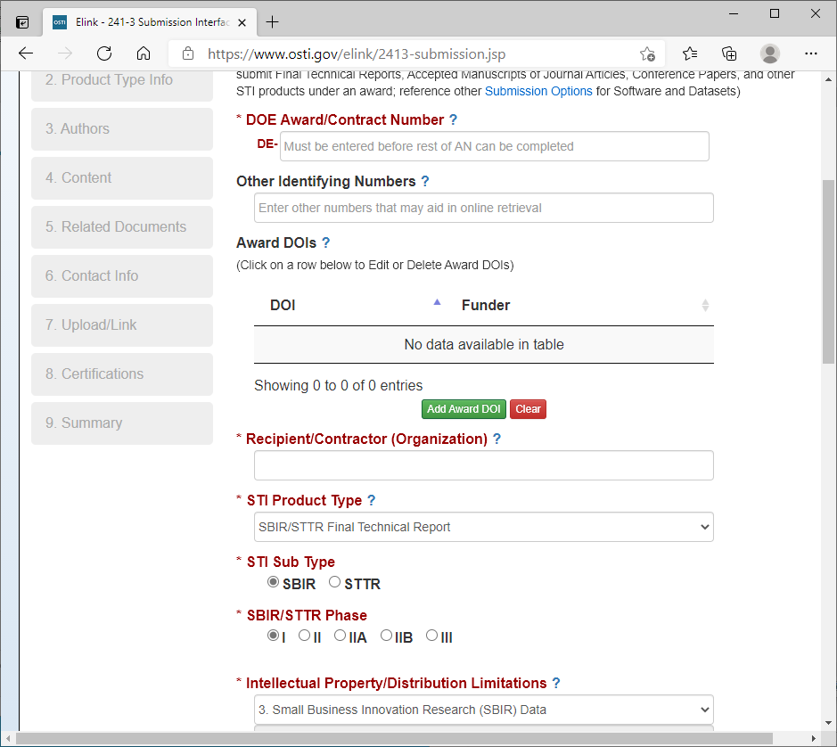
OSTI Submission -- www.osti.gov/elink/

Slide 13
Final Report Certification
I represent and warrant that the technical report being submitted does NOT contain any of the following:
Personally Identifiable Information (PII), limited rights data, classified information, information subject to export control classification, or other information not subject to public release.
Submissions must not contain any “Proprietary”, “Confidential” or “Business Sensitive” markings or similar restrictive markings not authorized by the applicable government agreement; I acknowledge that DOE has the right to cancel or ignore such markings.

Slide 14
Other Legends
“©” -- If including Copyrighted Notice, must include
This work was generated with financial support from the U.S. Government through Contract/Award No. __________________, and as such the U.S. Government retains a paid-up, nonexclusive, irrevocable, world-wide license to reproduce, prepare derivative works, distribute copies to the public, and display publicly, by or on behalf of the Government, this work in whole or in part, or otherwise use the work for Federal purposes.
Third party copyrighted material
Must remove from final report.
Data generated with private funding (Limited Rights Data, Restricted Rights Data), Export Control or Classified information should not be submitted through OSTI and should not be on the report.
Please contact Contracting Officer.
Do not email classified information.
Data markings when disclosing to others
Consult your attorney (e.g. NDA, confidential data markings, patent, copyright, trade secret, protection).

Slide 15
Data Markings -- Common Mistakes
Sharing data without protective markings
DOE data dissemination statutes and Freedom of Information Act.
Contact the Contracting Officer ASAP.
Invention Disclosures are protected under 35 USC 205 and should not be marked as SBIR/STTR or Proprietary (Limited Rights, Restricted Rights)
Incorrect markings (Use the markings in the FOA or your Terms)
“Confidential” or “Classified” are both security designations.
“This data is proprietary and cannot be shared”.
Confusing privately funded data with Government funded data
Privately Funded: (Proprietary): Restricted Rights and Limited Rights Data
Government Funded (Generated Data): SBIR/STTR & Unlimited Rights Data
Adding proprietary (Restricted Rights or Limited Rights Data) to Final Report
Privately funded data should not be included in final report unless approved by the Contracting Officer.
© Notice without Government license

Slide 16
Key Takeaways
Properly mark your reports (SBIR/STTR markings only).
Timely Report all subject inventions through iEdison (not just patents)
Watch Statutory bars (publications, on-sale, and public use) and inform both your attorney and iEdison ASAP.
Watch U.S. Manufacturing requirements and consult DOE early with questions.

Slide 17
Patent Rights GTC-0024
Small Business Firms and Nonprofit Organizations Terms (37 CFR 401.14 modified)
Statutory language (Bayh-Dole Act - 35 USC 202 et seq.).
Allows small businesses and non-profit entities to retain title to timely reported subject inventions
Subject to certain Government Rights (e.g. Government License, March-In, U.S. Manufacturing).
Government may take title
Unelected inventions/patents.
Late actions (e.g. reporting, title election, filing).
Unreported inventions.
Subcontracts: Must grant non-profit and small business entities rights to their inventions.
Non-profit and small business may grant invention right (e.g. patent assignments, licensing etc.), but not as a consideration for awarding a subcontract.
DOE Patent Counsel should be consult for sublicenses to entities other than small business and non-profit entities.

Slide 18
Invention Reporting (iEdison)
“Invention” means any invention or discovery which is or may be patentable or otherwise protectable under title 35 of the United States Code…
“Subject invention” means any invention of the Recipient conceived or first actually reduced to practice in the performance of work under this award (GTC 0024 (a)).
Must report the invention even if you do not intend to pursue patent protection!
Must implement written agreement with employees to report inventions (GTC 0024 (f)) .
Disclose in iEdison within two months after the inventor discloses it in writing (GTC 0024 (c)(1)).
Should leverage your existing invention management process.
Recommended to create an iEdison account now.
Must report subject inventions at any time, even after closeout.
DOE has annual reviews for potential unreported inventions.
Must disclose and elect 60 days before any Statutory Bars (GTC 0024 (c)(2)), from including any publication, on sale or public use of the invention.
Notify DOE of the acceptance of any publication, on sale or public use.
Invention Disclosures are protected under 35 U.S. Code § 205 – Confidentiality, NOT as SBIR/STTR Data

Slide 19
iEdison Contacts
www.nist.gov/iedison
For system issues with iEdison, please contact: iedison@nist.gov
DOE invention reporting support, please contact:
Maritza Rodriguez iEdison Lead Maritza.Rodriguez@science.doe.gov Phone : (630) 283-7117

Slide 20
Invention Reporting iEdison
Publication/1st Sale or other Patentability Bar Reporting (report Immediately at any time)
Invention
Report to
DOE via
iEdison
Confirmatory License
Submission (after filing)
Initial Patent Application Filing & Reporting
Patent
Issuance Reporting
Invention
Disclosure
Election Decision
Less than
2 mo.
Less than
2 years
Less than
1 year
~1-5 Years
*DOE may extend any due dates (including invention reporting)
with substantive justification.
** DOE may pursue patent protection on unreported, unelected, or
abandoned inventions.

Slide 21
Patent Filing
“Initial Patent Application” is defined to includes, both provisional and non-provisional patent applications, as well as PCT applications. See 37 CFR 401.2(n).
Must provide agency with a copy of each application and filing information (GTC 0024 and award checklist).
Must provide agency with a confirmatory license (GTC 0024 (f)(1))
iEdison confirmatory license is acceptable.
Must notify agency of any decision to discontinue prosecution of any patent application (GTC 0024 (f)(3)).
Must include a Government Interest Clause in Application (GTC 0024 (f)(4)).
“This invention was made with Government support under (identify the award) awarded by (identify DOE). The Government has certain rights in this invention.”
**USPTO does provide micro and small entity discounts **

Slide 22
Patent Prosecution Cost Allowability
Follow Award Terms and Consult Contracting Officer
Patent prosecution costs may be allowable (2 CFR §910.352) if authorized by award document.
Technical and Business Assistance (TABA) funds ($6,500 Phase I; $50,000 Phase II) may be authorized for patent prosecution costs related to obtaining U.S. patent protection for Subject Inventions of this award.
Includes attorney fees and USPTO fees.
Includes filings with the USPTO related to provisional, PCT, non-provisional, continuation, and continuation-in-part patent applications.
Excludes patent prosecution costs related to foreign patent protection (e.g. foreign attorney, foreign patent office or translation fees).
Unlikely to have a subject invention created and filed during the Phase I award.
Need to include patent costs in commercialization assistance budget.
Other Intellectual Property/Commercialization Costs may be allowable
Freedom to operate, market analysis, searching costs may be allowable.
Intellectual property licenses are typically not allowable as they are not a required cost in performance of the award. Check for Government Licenses.

Slide 23
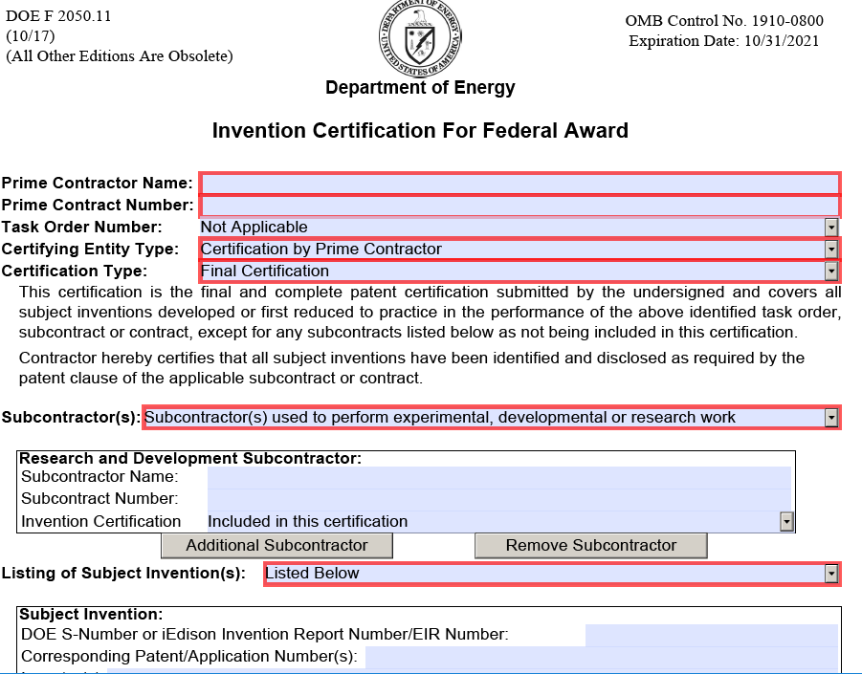
Closeout - Invention Certification
Invention Certification
Certify all inventions, patent applications, and patents are reported by DOE S-number or iEdison Invention Number.
If you do not have an S-number or iEdison number, was the invention reported?
Certified inventions should match list of inventions reported in iEdison.
Need certification from subawards.
Prime may certify or obtain separate certification from each subcontractor.

Slide 24
Patent Rights – Common Mistakes
Not registering an iEdison account now.
Not timely reporting ALL inventions, patent applications and patents.
Does NOT matter if you intend to pursue patent protection.
DOE can seek forfeiture for untimely inventions.
Not timely reporting all inventions, patent applications and patents to DOE Patent Counsel through iEdison.
USPTO, the DOE Program Manager, and your mailman are NOT DOE Patent Counsel.
Not including the Government Support Clause in all filed patents.
Not providing a confirmatory license with DOE Patent counsel through iEdison.
Not reporting software inventions.
Software may be patentable.
All inventions must be reported even if patent protection is not pursued.
Using DOE award funds to cover patent prosecution costs for an invention not related to a properly reported subject invention.
Must be developed under Phase I or Phase II.
Not contacting Maritza.Rodriguez@science.doe.gov or (630) 283-7117 with any questions.

Slide 25
Key Takeaways
Properly mark your reports (SBIR/STTR markings only).
Timely report all subject inventions through iEdison (not just patents).
Watch statutory bars (publications, on-sale, and public use) and inform both your attorney and iEdison ASAP.
Watch U.S. Manufacturing requirements and consult DOE early with questions.

Slide 26
Statutory Bars
“Statutory Bars” to patent protection include anything
patented, described in a printed publication, or in public use, on sale, or otherwise available to the public (35 USC 102(a)).
U.S. has one year “grace period” (35 USC 102(b)). Most other countries do not.
Invention disclosure must identify any publication, on sale or public use of the invention (GTC 0024 (c)(1)).
Recipient will promptly notify DOE of any statutory bars (GTC 0024 (c)(1&2)).
Will shorten election period.
Myths (Discuss with your Patent Counsel)
As long as you file within a year, you won’t lose patents rights after publishing.
Potential loss of both foreign and domestic patent rights.
Publish or perish!
False Dichotomy.
Patent, Publish and Profit!

Slide 27
Key Takeaways
Properly mark your reports (SBIR/STTR markings only).
Timely report all subject inventions through iEdison (not just patents).
Watch statutory bars (publications, on-sale, and public use) and inform both your attorney and iEdison ASAP.
Watch U.S. Manufacturing requirements and consult DOE early with questions.

Slide 28
U.S. Competitiveness
Consult FOA, Award Terms and DOE Guidance
U.S. Manufacturing | Department of Energy
Frequently Asked Questions (FAQs) | Department of Energy
Promotes the commercialization and public availability of inventions made in the United States by United States industry and labor.
Requires substantial U.S. Manufacture of Subject Inventions
For products embodying or produced through a subject invention (e.g. methods or manufacturing apparatus)
Additional requirement from U.S. Preference (35 U.S.C. 204)
DOE will accept and consider all applications for a clarifications, waiver or modification with business justification
DOE recognizes the need for flexibility and expects to modify the U.S. Competitiveness Provision in certain situations. DOE may grant waiver or modification requests. At this time, petitions for a waiver or modification of U.S. manufacturing requirements should be sent to GC-62@hq.doe.gov.

Slide 29
U.S. Competitiveness (SBIR/STTR Feb. 2022)
SBIR/STTR-GTC-0024 PATENT RIGHTS (m) U.S. Competitiveness
(1) The Recipient agrees that any products embodying any subject invention or produced through the use of any subject invention will be manufactured substantially in the United States unless the Recipient can show to the satisfaction of DOE that it is not commercially feasible. In the event DOE agrees to foreign manufacture, there will be a requirement that the Government's support of the technology be recognized in some appropriate manner, e.g., alternative binding commitments to provide an overall net benefit to the U.S. economy. The Recipient agrees that it will not license, assign or otherwise transfer any subject invention to any entity, at any tier, unless that entity agrees to these same requirements. (2) In the event that the Recipient or other such entity receiving rights in the Subject Invention undergoes a change in ownership amounting to a controlling interest, the Recipient or other such entity receiving rights shall ensure continual compliance with the requirements of this paragraph (m) and shall inform DOE, in writing, of the change in ownership within 6 months of the change. (3) The Recipient and any successor assignee will convey to DOE, upon written request from DOE, title to any subject invention, upon a breach of this paragraph (m). The Recipient will include this paragraph (m) in all subawards/contracts, regardless of tier, for experimental, developmental or research work.

Slide 30
Key Takeaways
Properly mark your reports (SBIR/STTR Markings only).
Timely report all subject inventions through iEdison (not just patents).
Watch statutory bars (publications, on-sale, and public use) and inform both your attorney and iEdison ASAP.
Watch U.S. Manufacturing requirements and consult DOE early with questions.

Slide 31
Work Well with Others
Follow award terms for all subcontracts, including patent and data rights (except DOE Laboratories)!
Consider working with a DOE Laboratory.
DOE Approved, Streamlined SPP or User agreements. Addresses intersection of work under two different DOE awards (Laboratory award with DOE and SBIR/STTR Recipient’s award).
Ongoing work and collaborations.
DOE User facility non-proprietary (DOE funded) or proprietary (privately funded).
Phase III – Use Phase I/II Data Rights terms and tell OSTI.
“The scope and extent of the SBIR/STTR Data Rights applicable to Federally-funded Phase III awards are identical to the SBIR/STTR Data Rights applicable to Phases I and II SBIR/STTR awards.” SBA Policy Directive pg. 102
Submit Phase III award to OSTI for older (4 year extendable) data protection.

Slide 32
Technology Transfer Mechanisms at DOE Facilities
Agreement | Use | Funding | Subject Inventions | Generated Data | U.S. Competitiveness | Cost | Highlights
Cooperative Research and Development Agreement (CRADA) | Collaborative research between DOE Labs and public and/or private entities for the mutual benefit of the parties | Private and/or Federal funds | Lab and Participant may elect their own inventions and Participant has right to negotiate exclusive license to Lab inventions | Protected for up to 5 years | Products embodying IP resulting from CRADA shall be manufactured substantially in the U.S. | Lab and Participant may share costs or Participant pays 100% funds-in | Collaborative research 5 year data protection Designed for multi-party collaborative research
Strategic Partnership Project (SPP) | Work for businesses and other non-federal entities using highly specialized or unique DOE facilities, services or technical expertise | Private funds | Sponsor may elect title to Subject Inventions¹ | Protected as Sponsor’s proprietary data w/limited exceptions^{1,2,3} | U.S. Preference: Sponsor agrees not to grant any party exclusive right to use or sell products embodying Subject Inventions in the U.S. unless products are manufactured substantially in the U.S. | Sponsor pays full cost recovery | Sponsor typically retains right to elect title to subject inventions Generated data treated as proprietary Option for limited Gov. R&D license³
 |  | Federal funds | Lab may elect title to Subject Inventions of the Lab | Unlimited Gov. rights or flow down of SBIR/STTR Data | U.S. Preference (see above) | Sponsor pays full cost recovery | Access to unique facilities and expertise using federal funds Streamlined SBIR/STTR Preapproved Model may be available
Agreements for Commercializing Technology (ACT) | Work for businesses and other non-federal entities using highly specialized or unique DOE facilities, services or technical expertise | Private funds | Initial title to the designated IP Lead. (ACT Participant or Lab Contractor) | Protected as proprietary data w/limited exceptions^{1,2,3} | U.S. Preference (see above) | Participant pays full cost recovery plus additional negotiated compensation to the Contractor | Flexibility for addressing indemnity & adv. payment Negotiable IP terms Optional performance guarantee Option for limited Gov. R&D license³
Proprietary User Agreement⁴ | User may access designated facilities to conduct its own proprietary research | Private funds | User may elect title to its Subject Inventions | User may protect as proprietary | n/a | User pays approved user rate | Generated data treated as proprietary Merit based access to unique facilities
Non-Proprietary User Agreement⁴ | Non-proprietary research at designated facilities | n/a | Lab and User may elect their own Subject Inventions | Unlimited Gov. Rights | U.S. Preference (see above) | Each party covers own cost | Merit based access to unique facilities Agree to publish results.
¹ Certain exceptions or restrictions may apply (e.g. foreign SPP Sponsors may be granted the right to elect title to inventions and receive proprietary data protection but only after the approval of DOE field patent counsel and concurrence from the cognizant DOE program office).² Proprietary data protection may not be available at all facilities. ³ If the limited Gov. R&D license is utilized, data protection will be limited to 5 years. ⁴ User Agreements are only available when the Sponsor/Participant/User is proposing to use a DOE Designated User Facility that offers such agreements. (see, http://technologytransfer.energy.gov/docs/designateduserfacilities.html)
Notes:
6/9/2020 – Streamlined SPP available at ANL, Ames, BNL, INL, NREL and possibly others

Slide 33
Schedule a Meeting
Please contact Laura to schedule a meeting if you have questions.
Laurie Miranda, Legal Assistant
Intellectual Property Law
U.S. Department of Energy
Office of Chief Counsel
Phone: 630-252-2046
Email: laura.miranda@science.doe.gov

Slide 34
Questions?
?

Slide 35
20 Year SBIR/STTR Data Rights (2019)
Fixed 20-year data protection from award date (Block 27 on the Assistance Agreement).
20 Years
Phase I Final Report Subject to Publication
Phase II Final Report
Phase I Award
Phase I Final Report
Phase II Award
Phase II Final Report Subject to Publication
20 Years

Slide 36
Post Award Requirements for DOE SBIR/STTR Phase I Awardees Mark Sojka DOE Office of Science Consolidated Service Center

Slide 37
Overview
Site Visit Findings
Importance of Knowing Your T&Cs
Award Attachments
Revisions to Award Needing Prior Approval
Current and Pending Support
Disclosure of Foreign Relationships
Closeouts

Slide 38
Site Visits
Recipient Site Visits Conducted by DOE October 2019 & June 2021 (Virtual)
Checked for Compliance with Award Terms and Conditions
Reviewed ASAP Draw Supporting Documents
Performed Accounting Systems Reviews
Ensure costs could be segregated
Property/Equipment Reviews
Answered Recipient Questions Concerning SBIR/STTR Program

Slide 39
Site Visits (cont.)
Findings:
Recipients Did Not Always Have Adequate Support for Their ASAP Draws
ASAP Draws in Advance (vs. Reimbursement)
Cumulative Job Cost Totals Rather Than Snapshot of Costs to Support Particular ASAP Draw
Missing SF-425s
Property Controls/Tracking of Subcontractor-acquired equipment did not list its location; follow-up confirmed location/status.

Slide 40
Site Visits (cont.)
Findings (cont.)
Insufficient Property Insurance Coverage
DOE wasn’t notified of company move
DOE was charged higher than MI&E per diem rates even though Company Policy Capped Limits

Slide 41
Importance of Knowing Your T&Cs
Per 2 CFR 200.338 Remedies for Noncompliance, if a non-Federal entity fails to comply with Federal statutes, regulations or the terms and conditions of a Federal award, the Federal awarding agency may impose additional conditions, as described in §200.207 Specific conditions.
Remove from Payment via ASAP/Require Submission of Invoices
Temporarily withhold cash payments pending correction of the deficiency
Denial of future SBIR/STTR Applications (due to Poor Past Performance)
Withholding of Continuation Funding (Phase II Only)
If the Federal awarding agency determines that noncompliance cannot be remedied by imposing additional conditions, the Federal awarding agency may take one or more of the following actions, as appropriate in the circumstances:
Disallow all or part of the grant costs not in compliance (Cost Recovery)
Wholly or partly suspend or terminate the Federal award.
Initiate suspension or debarment proceedings (of individuals and/or the Company)
Withhold further Federal awards for the project or program.
Take other remedies that may be legally available.

Slide 42
Importance of Knowing Your T&Cs (cont.)
Audits and Other Findings:
Recipient did not meet the minimum Research Institution Level of Effort (30%) for an STTR and therefore DOE sought over $18K in cost recovery. The recipient appealed the DOE Contracting Officer’s decision to the DOE Senior Procurement Executive, and was denied. The recipient paid DOE the money sought plus interest.
Two individuals were indicted, and found guilty of, committing conspiracy to commit wire fraud, wire fraud, aggravated identity theft and falsification of records. DOE recouped $149,720.
DOE recovered $16,500 as a result of a plea agreement from an SBIR awardee; the awardee plead guilty to wire fraud.
DOE OFS Audit and Review Team performing reviews of Awards
Possible undisclosed conflict of interest and payroll issues
ASAP draw reviews and Excessive Cash-on-Hand Balances

Slide 43
Award Attachments
Transmittal Letter
Final Budget Pages
Special Terms and Conditions
Federal Assistance Reporting Checklist
General Terms and Conditions
Know Your Rights Poster
Patent Responsibility Letter

Slide 44
Special Terms and Conditions
Incorporates Provisions Stated in 2 CFR Part 200 and as amended in 2 CFR Part 910 (DOE-Specific). http://www.eCFR.gov
Highlights:
FA-TC-0001C Award Project Period and Budget Periods
FA-TC-0003.2 Payment Procedures – REIMBURSEMENT Through the Automated Standard Application for Payments (ASAP)
FA-TC-0007.1 Rebudgeting and Recovery of Indirect Costs
FA-TC-0013 Reporting Requirements
FA-TC-0025A Insurance Coverage, FA-TC-0025D Equipment, FA-TC-0025G Property Trust Relationship (these 3 clauses pertain to awards containing equipment)

Slide 45
Reporting Requirements
Phase I
Closeout
Research Performance Progress Report (RPPR)
Final SF-425
Special Status Report
Patent Certification
SF-425
Property Certification (SF-428)
Compliance Audit
Final Technical Report
Life Cycle Certification
Life Cycle Certification
Disclosure of Foreign Relationships
Current and Pending Support
Note: Reporting Requirements are subject to change via award modification.

Slide 46
General Terms and Conditions
GTCs highlight those requirements which are especially pertinent to research grants in general.
GTCs DO NOT represent an exhaustive listing of all requirements applicable to the Assistance Agreement.
Highlights:
Revisions requiring Contracting Officer (CO) Approval
Current and Pending Support
Reporting of Disclosure of Foreign Relationships
Property
SBIR/STTR Participation Requirements (Awardee and PI)
Patent Rights
Rights in Data

Slide 47
Award Revisions –
PI/Key Personnel Changes
Request submitted via Portfolio Analysis and Management System (PAMS)
Selection of the new PI from registered PAMS users
– Specify how to handle the current PI (remove from award or leave on award but change role to Other)
– Attach resume or CV of the new PI.
The Small Business Authorized Representative must submit the request.

Slide 48
Award Revisions – Other Types
Change/add Subcontractor
Novation Agreement
Change of Name Agreement
Work outside of U.S.
No Fund/Cost Extensions (NFX)
Note: Per the PAMS clause in the GTCs, NFX and PI change requests need to be submitted via PAMS.
Contact your DOE Assistance Agreement Administrator if you anticipate any of these revisions.

Slide 49
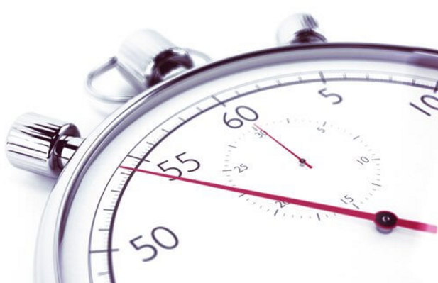
No Fund Extensions
Approvals for an NFX will not be granted for an award that contains a zero dollar balance.
Recipients are not authorized to grant themselves an extension.
Proposed end date cannot go/extend beyond start date of the upcoming Phase II start.
Submit request via PAMS at least one month prior to the expiration date. See SBIR/STTR-GTC-0043
The request must be submitted by the Recipient Business Officer
Info Required in Request:
Project status
Reason for extension
Extension date
Remaining Grant $ Balance

Slide 50
Current and Pending Support
SBIR/STTR-GTC-0074-CH Current and Pending Support
In accordance with the Federal Assistance Reporting Checklist, throughout the life of the award, the Recipient must submit current and pending support disclosure statements and a CV or Biosketch for any new PI and/or previously unnamed senior/key personnel, including graduate students and postdoctoral associates, at the recipient and subrecipient level, proposed to be added to the project funded under this Award at least thirty (30) days prior to the individual joining the project. In addition, if there are any changes to current and pending support disclosure statements previously submitted to DOE, the Recipient must submit updated current and pending disclosure statements within thirty (30) days of the change.
The Recipient must ensure all PIs and senior/key personnel, including graduate students and postdoctoral associates, at the recipient and subrecipient level, are aware of the requirement to submit updated current and pending support disclosure statements to DOE. Current and pending support is intended to allow the identification of potential duplication, overcommitment, potential conflicts of interest or commitment, and all other sources of support.
All foreign government-sponsored talent recruitment programs must be identified in current and pending support.

Slide 51
Disclosure of Foreign Relationships
SBIR/STTR-GTC-0041 Reporting of the Disclosure of Foreign Relationships
Disclosure statement originally submitted must be updated for any changes as follows:
Any change to a disclosure required under the Disclosure of Foreign Relationships,
Any material misstatement that DOE could determine to pose a risk to national security, and
A change in ownership, change to entity structure, or other substantial change in the circumstances of the small business concern that DOE could determine to pose a risk to national security
The Disclosure of Foreign Relationships is located at: https://science.osti.gov/sbir/Applicant-Resources/Grant-Application.
Must be submitted to CO via FedConnect and to the SBA w/i 30 days of a change and 30 days prior to the end of Phase I performance period along with the Life Cycle Certification

Slide 52
Disclosure of Foreign Relationships (cont.)
Penalties for Failing to Disclose Foreign Relationships
Recipient will be required to repay all amounts received under the award (15 U.S.C. § 638(g), (o)) if there is a material misstatement that DOE determines poses a risk to national security, or there is a change in ownership, change to entity structure, or other substantial change in the circumstances of the small business concern that DOE determines poses a risk to national security.
Further, the Recipient may be subject to the remedies established by 2 CFR 200.339 Remedies for noncompliance which may include termination under 2 CFR 200.400 Termination as set forth in SBIR/STTR-GTC-0042 and SBIR/STTR-GTC-0022, respectively, for failure to comply with the statutory requirements described in this award term.

Slide 53
Closeouts
After the expiration or termination of the award, the recipient must submit all financial, performance and other reports required as a condition of the award. These reports are listed in the Federal Assistance Reporting Checklist and may include, but are not limited to, the following:
Final Technical Report (due 14 calendar days after expiration)
Final Financial Status Report (due 120 calendar days after exp.)
Patent Certification (due 120 calendar days after expiration)
Property Certification (due 120 calendar days after expiration)
Life Cycle Certification (at least 30 calendar days prior to exp.)
NDAA of 2019 Annual Technical or Business Assistance Report (Submitted Annually in the Final Technical Report)
Disclosure of Foreign Relationships (at least 30 calendar days prior to exp.)
ALWAYS follow the instructions in your Reporting Checklist

Slide 54
Contacts
Post award administration and budget-related questions may be directed to the DOE Assistance Agreement Administrator listed on page 2 of your Assistance Agreement.
Post award technical and progress-related questions may be directed to the DOE Program Manager listed on page 2 of your Assistance Agreement.
Patent and Intellectual Property-related questions may be directed to Cynthia Ridge at (630) 252-2175 or Cynthia.Ridge@science.doe.gov
PAMS system requirements or any other technological issues should be directed to the DOE PAMS Support Center at 855-818-1846 or sc.pams-helpdesk@science.doe.gov

Slide 55
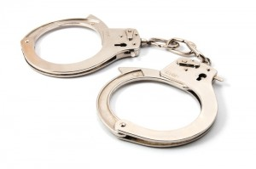
DOE Office of Inspector General SBIR/STTR Fraud Awareness
DOE OIG Office of Investigations
SBIR/STTR Fraud Awareness
Commonalities and Consequences
July 28, 2023

Slide 56
DOE Office of Inspector General Fraud Defined
What is Fraud?
Although it can take many forms, Fraud, at its core, is deception through the misrepresentation or omission of material facts for the purpose of illegitimate gain.
To be clear, Fraud within the Small Business Innovation Research (SBIR) and Small Business Technology Transfer (STTR) programs is a premeditated act with the intent to deceive.
The Office of Inspector General (OIG) does not prosecute innocent mistakes.
The purpose of this presentation is to educate the applicant and highlight commonalities with SBIR/STTR Fraud, and show what the OIG looks for in support of investigations.

Slide 57
DOE Office of Inspector General Combating Fraud
What types of fraud are found in the SBIR/STTR Program?
During the Application Process:
Submitting a plagiarized proposal.
Sham websites or e-mails.
Geographical improbabilities. i.e.: Apartments, PO Boxes, residential addresses or facilities shared with other companies. Is the company physically capable of providing the required product?
Providing false information regarding the company, the Principal Investigator or work to be performed. Can the company actually support what they say they can?

Slide 58
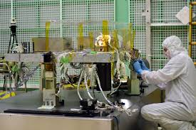
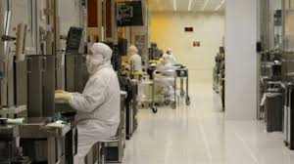
Real World Examples: Proposal Submission
Applicant maintains a 4,500 square foot state of the art technical facility including three clean rooms, ten laser benches, and a variety of laboratories.

Slide 59
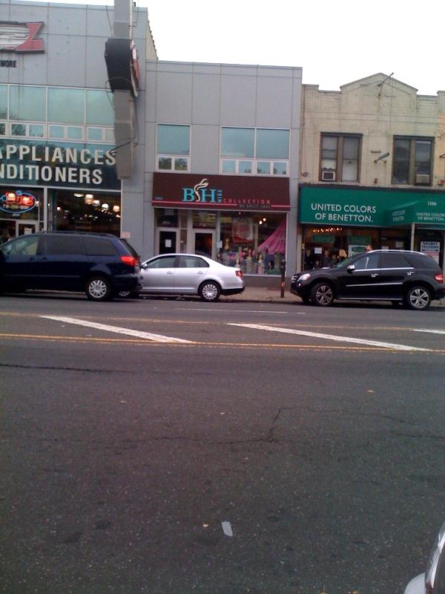
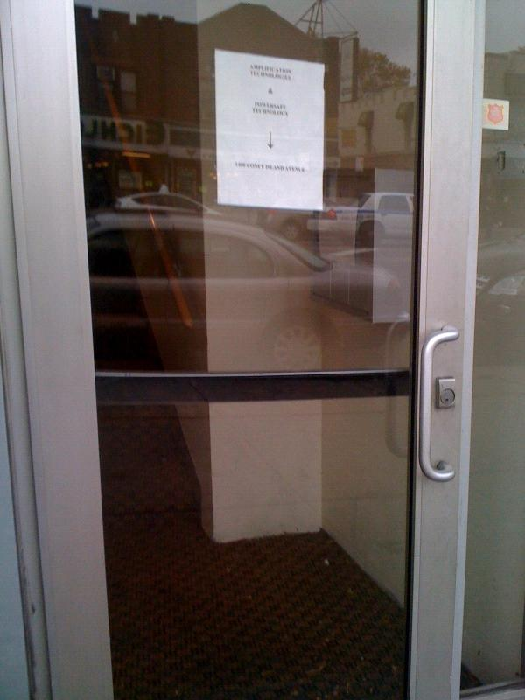
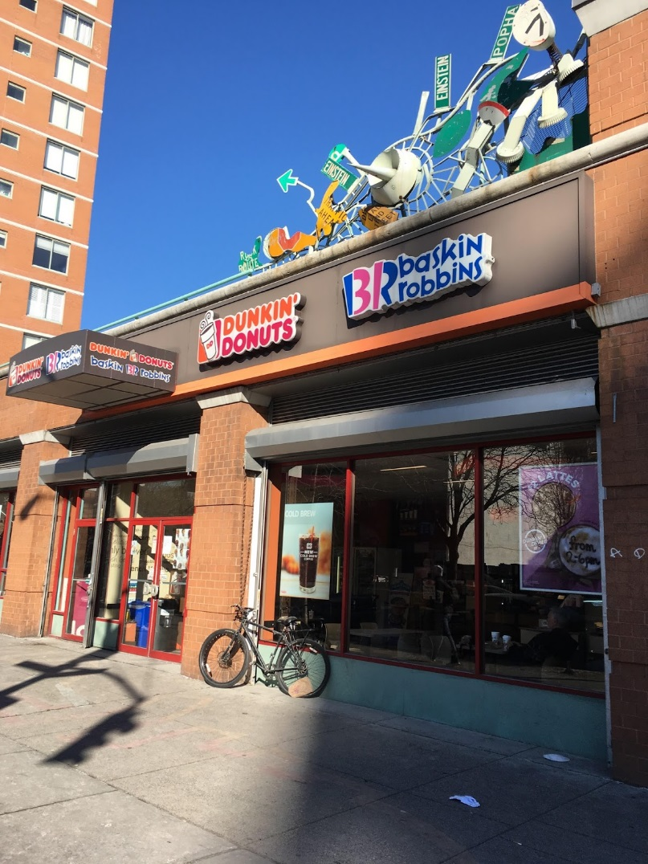
Real World Examples: Actual Facility

Slide 60
DOE Office of Inspector General Combating Fraud
What types of fraud are found in the SBIR/STTR Program?
During the Application Process (cont.):
Seeking funding for work that has already been completed.
Seeking federal funding on more than one SBIR/STTR grant for essentially equivalent work.
i.e.: “Duplicative funding”
Unauthorized use of facilities, i.e.: Unauthorized use of university laboratories, lack of an actual company facility or a U.S. presence is front for overseas operations.
Fraud in inducement of awards, i.e.: Fake investments, falsified letters of support, the company organizational chart reflects individuals who are not employees, or ineligible Principal Investigator.

Slide 61
DOE Office of Inspector General Combating Fraud
What types of fraud are found in the SBIR/STTR Program?
During the Award:
Using award funds for personal use or for any use other than the proposed activities. i.e.: Using SBIR/STTR funds to support ongoing business operations instead of the proposed research.
Submitting plagiarized reports or reports falsely claiming work has been completed.
Claiming results for an award that were funded by a different source.
Exploiting a perceived lack of communication and transparency between agencies by submitting duplicate or overlapping proposals to various agencies.

Slide 62
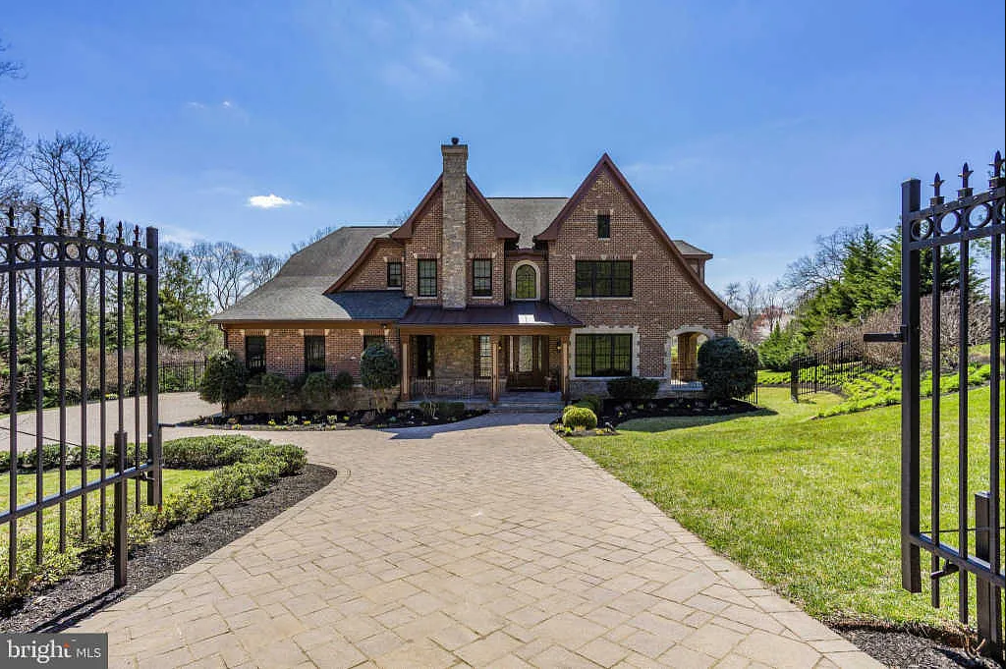
Real World Examples: Personal Use/Asset Forfeiture

Slide 63
DOE Office of Inspector General Knowing the Rules
Which SBIR rules should you be particularly familiar with?
Duplicate or overlapping proposals may not be submitted to multiple agencies without full disclosure to all agencies.
Company must meet the Small Business Association’s requirements for a small businesses, including being majority American owned and have 500 employees or less.
The Principal Investigator’s primary employment must be with the company during the grant period. The Principal Investigator may not be employed full time elsewhere. (**Note about STTR awards**)

Slide 64
DOE Office of Inspector General Knowing the Rules
Which SBIR rules should you be particularly familiar with (cont.)?
For Phase I, a minimum of two thirds of the research effort must be performed by the grantee company; for Phase II, a minimum of one-half of the research effort must be performed by the grantee company. Work performed by a university research lab is NOT work completed by the grantee company.
University employees participating on an SBIR/STTR award should disclose their involvement to the university as well as their use of university facilities.
Research and Development must be performed in the United States.

Slide 65
Real World Examples: Foreign Work Effort

Slide 66
Real World Examples: Foreign Work Effort

Slide 67
DOE Office of Inspector General Consequences
What Happens If You Break the Rules?
If you commit fraud or other wrongdoing in applying for or carrying out an SBIR award, the OIG will investigate.
Violations of civil or criminal law are referred to the Department of Justice. If the Department of Justice prosecutes you for fraud and/or other criminal conduct, you may be sentenced to prison and required to pay full restitution. If the Department of Justice pursues a civil action under the False Claims Act, you may have to pay treble damages and a fine between $12,537-$25,076 for each false claim. In addition, the Department of Energy may terminate your awards and debar you from receiving grants or contracts from any federal agency.

Slide 68
DOE Office of Inspector General Consequences
What Happens If You Break the Rules (cont.)?
Criminal Prosecution.
Civil Liability.
Administrative Remedies.
Criminal forfeiture = Full amount of grant/contract; personal assets can be seized to satisfy forfeiture or fine.

Slide 69
DOE Office of Inspector General Consequences
Criminal Prosecution.
Lying to obtain an SBIR/STTR grant or lying about the work performed violates several criminal laws:
False Statements (Punishable up to 5 years in prison, forfeiture and $250,000 fine).
Theft of Federal Property (Punishable up to 10 years in prison, forfeiture and $250,000 fine).
Wire Fraud (Punishable up to 20 years in prison, forfeiture and $250,000 fine).
False Claims (Punishable by $250,000 fine for individuals and $500,000 fine for corporations).
Criminal forfeiture = Full amount of grant/contract; personal assets can be seized to satisfy forfeiture or fine

Slide 70
DOE Office of Inspector General Consequences
Civil Liability.
May be imposed in addition to criminal prosecution.
Includes treble damages (3x actual damages) and a fine of between $12,537-$25,076 for each false claim (Fines are adjusted for inflation).
False claims liability includes payments received when the Government relied upon false information in the SBIR/STTR grant proposal, in a certification of current cost or pricing data, in a request for payment or in progress reports.
Although the statute requires knowledge that the claim was false, the term “knowledge” includes “deliberate ignorance” or “reckless disregard for the truth.”
Whistleblowers can receive up to 30% of award for reporting fraud via qui tam provision of False Claims Act.

Slide 71
DOE Office of Inspector General Consequences
Administrative Remedies.
Government can terminate grants/contracts tainted by fraud.
Government can debar the small business owner and/or employees. Debarment is typically for three years but can be for a longer period.
Prohibition from receiving any federal grants/contracts or working as a subcontractor on federal grants/contracts.
Program Fraud Civil Remedies Act subjects anyone who knowingly makes or submits a false claim or statement to a civil penalty of not more than $12,537 for each false claim or statement as well as twice the amount of any payments made by the Department.

Slide 72
DOE Office of Inspector General Consequences
Administrative Remedies (cont.).
The Government retains the right to examine the status of an SBIR grant at any time.
Status checks include:
Site visits.
Requests for records including financial documents and timesheets.
Good record keeping will help eliminate suspicion and ensure successful status checks.
Administrative remedies are in addition to criminal and civil liability.

Slide 73
DOE Office of Inspector General Case Example 1
Tampa, Florida
U.S. District Judge Virginia Hernandez Covington has sentenced Mahmoud Aldissi (a/k/a Matt) and Anastassia Bogomolova (a/k/a Anastasia) for conspiracy to commit wire fraud, wire fraud, aggravated identity theft, and falsification of records. Aldissi was sentenced to 15 years in federal prison and Bogomolova was sentenced to a term of 13 years. As part of their sentences, the court entered a money judgment in the amount of $10.6 million, representing the proceeds of the crime, and ordered them to pay $10.6 million in restitution. Aldissi and Bogomolova were found guilty on March 20, 2015.
According to testimony and evidence presented during the month-long trial, through their two companies, Fractal Systems, Inc., and Smart Polymers Research Corp., Aldissi and Bogomolova fraudulently obtained approximately $10.5 million of small business research awards from the federal government. In order to be awarded contracts, they submitted proposals using the stolen identities of real people to create false endorsements of and for their proposed contracts. In the proposals, they also lied about their facilities, costs, the principal investigator on some of the contracts, and certifications in the proposals.

Slide 74
DOE Office of Inspector General Case Example 2
Newark, Delaware
On December 27, 2018, the U.S. Department of Justice (DOJ) entered into a $2.75 million settlement agreement with EM Photonics (EMP) and its Chief Executive Officer Eric Kelmelis. Of that amount, $1.18 million will be paid in restitution to DOE, Navy, Air Force and NASA; DOE will be reimbursed approximately $124,000.
The investigation determined EMP received millions of dollars in Government contracts through the SBIR and STTR programs. The evidence demonstrated that EMP and Kelmelis engaged in two different billing schemes under SBIR/STTR, including: (1) that EMP/Kelmelis directed EMP employees to falsely complete timesheets for direct labor that the employees did not perform and to submit false invoices and public vouchers to the funding agencies for direct labor that was not performed on these awards; and (2) that EMP/Kelmelis received SBIR/STTR funding for essentially equivalent work already performed and funded by another Government agency and falsely certified such work was, in fact, non-duplicative.

Slide 75
DOE Office of Inspector General Case Example 3
Lexington, Kentucky
A Lexington woman, Jyoti Agrawal, 51, was sentenced to 42 months in federal prison on Friday, by Chief U.S. District Judge Danny C. Reeves, for conspiracy to commit wire fraud, wire fraud, and money laundering.
According to evidence at her trial, Agrawal was a co-owner of the company ScienceTomorrow, with Subhadarshi Nayak. In December 2013, Agrawal agreed with Nayak to electronically submit a proposal containing a fabricated letter of support from a key subcontractor, in order to increase their chances of receiving a Phase II SBIR grant from the U.S. Department of Energy (DOE), in the amount of $999,266, to research and develop a scanning electron microscope detector. Agrawal knew the fake letter inflated the budget an out-of-state university had provisionally authorized in support of the project.
In 2014, the DOE awarded the Phase II grant to ScienceTomorrow, in part relying on this misrepresentation. Agrawal ultimately received more than a million dollars for the electron detector project from the DOE, and $500,000 from Kentucky’s state matching funds program, which depends on the lawful receipt of a federal grant award.
The evidence further showed that Agrawal had controlled the money and that Nayak left the project early on. Ultimately, the out-of-state university did not work on the project, as proposed, and received no payments. Bank records established Agrawal had personally accumulated over $440,000 of DOE grant funds during the two-year performance period. Agrawal also spent an additional $146,000 of the DOE Phase II funds on an Executive MBA degree in Chicago, during this time, partially supporting her money laundering conviction. Subsequently, Agrawal submitted false certifications to the DOE, stating all funds had been expended in accordance with the DOE’s terms and conditions; however, the evidence at trial revealed she had unlawfully retained over $300,000 of the DOE funds she certified she had spent on the project.

Slide 76
DOE Office of Inspector General Protect Yourself and Your Business
OIG and Law Enforcement note with interest a rise in small business concerns being utilized as “pass-throughs” for illicit monies entering the U.S. financial system.
This is particularly notable with “angel investors” who are seeking to invest in small, unestablished entities with little or no promise of return.
Small business concerns should be encouraged to conduct due diligence and “know your investor” practices to ensure they are not taking money from bad actors.
“See something, say something” – Contact your program office and/or OIG if you have concerns or questions.

Slide 77
DOE Office of Inspector General Concerns About Foreign Influence
There is an increasing trend in the U.S. Government to view foreign collaborations with greater scrutiny; e.g. “foreign talent programs” or other foreign state-affiliated partnerships, particularly from countries perceived to be “of risk.”
Currently, on STTR partnerships with National Laboratories, you may encounter restrictions under DOE Directives prohibiting such affiliations for its employees and contractors.
Accepting money from multiple sources for essentially equivalent research is always a violation, regardless of where it comes from – disclosure is key; the more you share the better the relationship with your program manager.

Slide 78
DOE Office of Inspector General Export Controls
SBIR/STTR research is, by definition, “innovative,” and as such may not be specifically covered under U.S. export control regimes.
If you are intending to develop technology that has military applications or is potentially “dual-use,” seek the guidance of export control experts or start a dialogue with your program manager(s).
Better to be safe than sorry – Partnering with foreign-based fab foundries may complicate your commercialization efforts.

Slide 79
DOE Office of Inspector General Reporting Fraud
The OIG promotes the effective, efficient and economical operation of the Department of Energy’s programs and operations through audits, inspections, investigations and other reviews.
Within the OIG, the Office of Investigations is responsible for investigating any fraudulent acts involving the Department, its contractors or subcontractors, or any crime affecting the programs, operations, Government funds, or employees of those entities.
If you want additional information or to report wrongdoing:
Internet: ig.energy.gov E-mail: ighotline@hq.doe.gov Telephone: 202-586-4073 Hotline: 800-541-1625 Fax: 202-586-4902

