Slide 1

MANTRA: AN INTEGRAL REACTOR PHYSICS EXPERIMENT TO INFER ACTINIDE CAPTURE CROSS-SECTIONS FROM THORIUM TO CALIFORNIUM WITH ACCELERATOR MASS SPECTROMETRY
Applications of Nuclear Science and Technology Information
Exchange Meeting
August 22‐23, 2011, Washington DC
G. Youinou², R. Vondrasek¹, *M. Salvatores^{2,4}, B. Scott¹, E. Rehm¹,
M. Paul¹, R. Pardo¹, *G. Palmiotti², C. Nair¹, T. Maddock², J.K. Nimmagadda³ ,
M. Meyer², C. McGrath², S. Kondrashev¹, F. Kondev¹, G. Imel³, C. Glass²
¹ Argonne National Laboratory
² Idaho National Laboratory
³ Idaho State University
⁴ CEA-Cadarache
*Originators of the project

Slide 2
Principle of the experiment:
1 – Irradiate very pure actinide material (a few mg) in well-characterized neutron spectra in the Advanced Test Reactor (ATR) at INL
→ ²³²Th, ²³⁵U, ²³⁶U, ²³⁸U, ²³⁷Np, ²³⁸Pu, ²³⁹Pu, ²⁴⁰Pu, ²⁴¹Pu, ²⁴²Pu, ²⁴¹Am, ²⁴³Am, ²⁴⁴Cm and ²⁴⁸Cm
2 – Measure the atom densities of the transmutation products with Accelerator Mass Spectrometry at the ATLAS facility at ANL
→ detection limit of AMS is orders of magnitude lower than that of standard MS (~10⁻¹²)
→ more transmutation products can be measured
→ more neutron cross-sections to be inferred from a single sample
3 – Measure the neutron fluence in the actinide samples
→ ¹⁴⁸Nd and ¹³⁷Cs in ²³⁵U monitors
4 – Infer the effective neutron capture cross-sections from results of step 2 and 3

Slide 3
The relation between measured and inferred quantities is given by the solution to the Bateman equations which, in a 100% pure sample of mass number A, can be expressed as:
Very good approximation in most cases we are interested in. The correction factors will be taken into account in the actual analyses.
Example of A+1, A+2 and A+3 build-up from successive neutron captures on A
inferred quantities →
= effective neutron capture cross-section
measured quantities → relative atom densities N_{A+1}, N_{A+2},N_{A+3} … and neutron fluence τ
3

Slide 4
Relation between measured and inferred quantities
Example of a very pure sample containing essentially (i.e. at least 99%) an isotope of mass number A, but also a few tenths of a percent of other isotopes present as impurities (let’s say A+1, A+2 and A+3).
Contribution from A
Contribution from A+1
Left-over of the initial A+2
N.B.: i.e. we don’t need absolute N

Slide 5
Relation between measured and inferred quantities
If << the expressions are simpler and the inference is less dependant on the precision of the measurement of the atom densities. Relatively easy with thermal or epithermal neutron spectra ( ~ few 10 to few 100 barns). More difficult with fast neutron spectra ( ~ 1 barn)
→ High neutron fluence
→ High purity samples

Slide 6
Best sample candidates for ATLAS = Heaviest long-lived isotope in each element (U, Np, Pu, Am, Cm) because A+1, A+2… contamination can be kept at a much lower level. U-235 is added to this list because its chain is only loosely coupled with that of U-238. Pu-244 is not of interest for reactor physics or fuel cycle but has been included because it generates Cm-245 after 2 short beta decays.
For these samples the high sensitivity of ATLAS is an important asset because of a low background
When high background, precision matters more than sensitivity

Slide 7
Determination of the neutron fluence by the Nd-148 and Cs-137 method in U-235 monitors
measured
calculated
~0.5%
~0.5%
~1%-1.5%

Slide 8
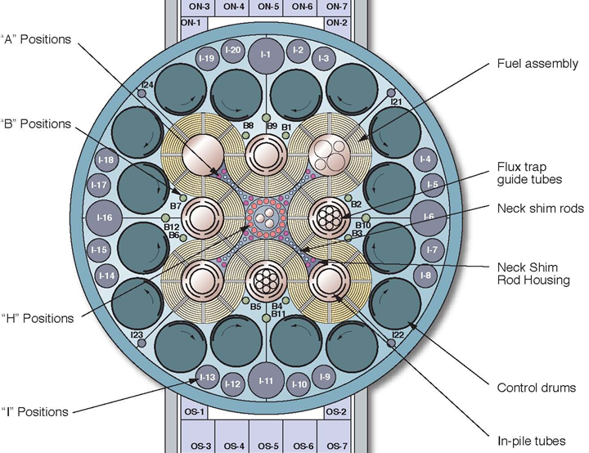
A Brief Description of ATR

Slide 9
Samples irradiation in ATR
Three Positions: B9, 10 and 11
Three Neutron filters: → 1 mm Cadmium → 5 mm Boron (70% ¹⁰B) → 10 mm Boron (70% ¹⁰B)
Irradiation in ATR: Jan.-Dec. 2012
Time of irradiation: → 50 days for Cd-filtered → 100 days for B-filtered

Slide 10
Samples irradiation in ATR
Example of a boron filtered setup
Actinide sample

Slide 11
Samples irradiation in ATR – Neutron filters
The Cd neutron filter can be manufactured at the INL.
Ceradyne, Inc identified as proposed vendor for B4C filters (70% ¹⁰B)
→ The 2 sets of boron filters are now at INL

Slide 12
Effect of neutron filters on the neutron spectrum in the samples

Slide 13
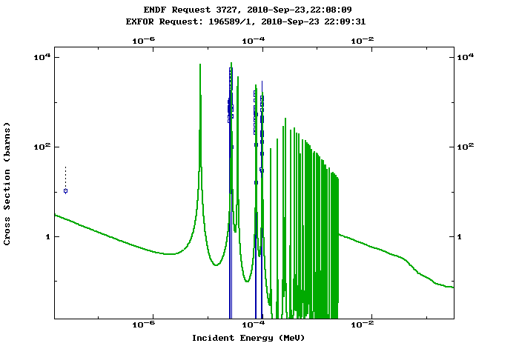
MANTRA does not access directly to
but instead
= effective neutron capture XS
1 mm Cd filter
depends strongly on
with Cd filter
with 5mm B
5 mm boron filter
10 mm boron filter
with 10mm B

Slide 14
experiment provides
calculation provides
Because of the strong dependence of with regard to
it is important that =
to ensure that the differences between and can be attributed to differences between and
Flux monitors will be used to characterize experimentally
Monitors: S-32, Sc-45, Ti-46, Fe-54, Fe-58, Co-59, Ni-58, Cu-63

Slide 15
MANTRA Neutron Spectra vs. Advanced Reactor Neutron Spectra
Low-moderation PWR
Deep Burn VHTR
Gas-cooled fast reactor
(C. Glass, G. Palmiotti, M. Pope, personal communication)

Slide 16
Example of U-238, Pu-242 and Cm-248 samples (100% pure)
 | U8 | Pu9 | Pu0 | Pu1 | Pu2 | Am3 | Cm2
50 days Cadmium | 0.991 | 8E-03 | 2E-05 | 2E-06 | 2E-09 | 2E-11 | 1E-11
100 days Boron | 0.999 | 2E-04 | 7E-08 | 2E-11 | - | - | -
 | Pu2 | Am3 | Cm4 | Cm5 | Cm6 | Cm7
50 days Cadmium | 0.964 | 3E-02 | 9E-04 | 6E-06 | 5E-09 | 4E-12
100 days Boron | 0.999 | 3E-04 | 1E-07 | 2E-11 | - | -
 | Cm8 | Bk9 | Cf9 | Cf0 | Cf1 | Cf2
50 days Cadmium | 0.992 | 7E-03 | 4E-04 | 1E-04 | 8E-06 | 7E-08
100 days Boron | 0.999 | 1E-04 | 3E-05 | 2E-07 | 1E-10 | -

Slide 17
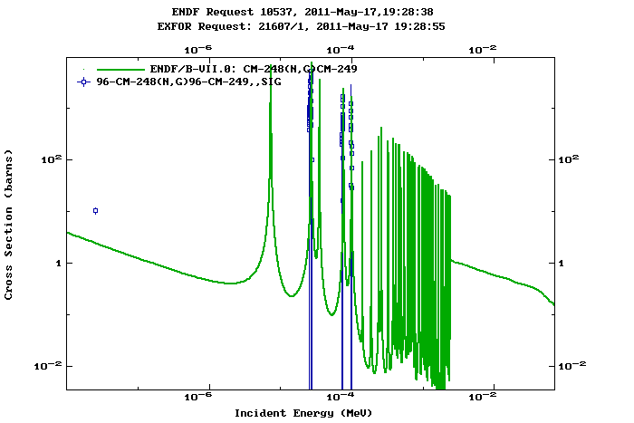
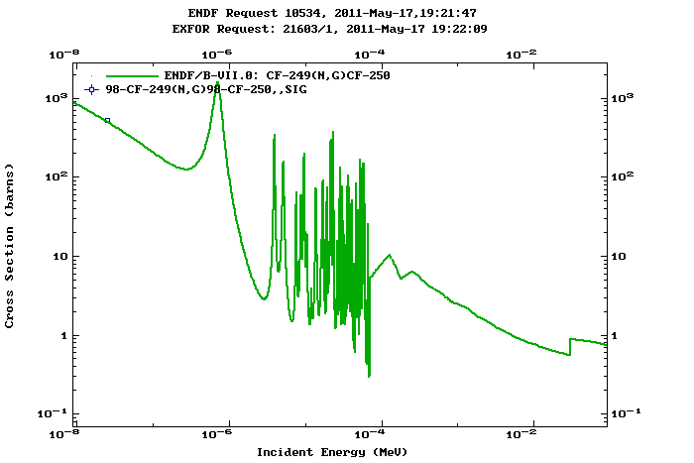
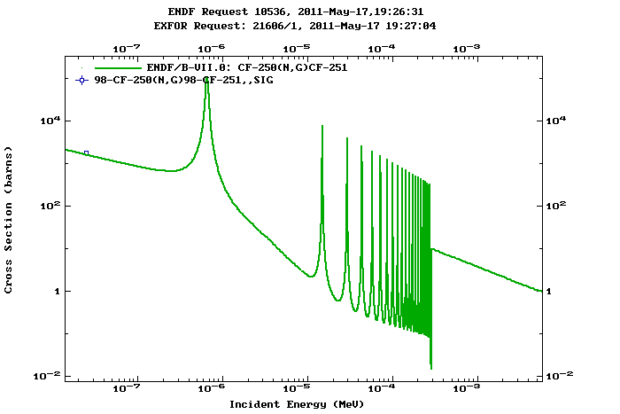
Experimental data are very scarce above Cm
→ MANTRA will provide valuable experimental data above Cm for advanced fuel cycles
17

Slide 18
From the atom densities to the neutron cross sections – Analyses Based on the C/E
C/E = 1 → nothing to be done – the nuclear data allow to reproduce the measured results
C/E ≠ 1 → global statistical adjustment of the effective cross sections to bring the C/E as close as possible to 1
The method makes use of:
    “a priori” nuclear data covariance information,
    integral experiments analysis to define C/E values
    integral experiment uncertainties
    sensitivity coefficients obtained via perturbation theory:
The use of the chain rule allows to go down one level from to the actual nuclear parameters characterizing
18

Slide 19
Planning & Budget
Planning shifted 18 months due to priorities at the Analytical Lab at INL as well as its unexpected shutdown earlier this year
Sample preparation completed by October 2011
Irradiation in ATR scheduled for Jan.-Dec. 2012
PIE (ANL & INL) completed by Dec. 2013
Final Report in March 2014
Summary of INL expenditures by FY
 | FY 2010 | FY 2011 | FY 2012
a) Funds allocated | $368,000 | $346,000 | $346,000
b) Costs accrued | $344,377 | $171,702 | $0
c) Uncosted commitments | $ 20,308 | $6,092 | $0
d) Uncommitted funds (d=a-b-c) | $ 3,315 | $168,206 | $346,000

Slide 20
Publications
G. Youinou, M. Salvatores, M. Paul, R. Pardo, G. Palmiotti, C. McGrath, F. Kondev, G. Imel, “MANTRA: An Integral Reactor Physics Experiment to Infer Actinide Capture Cross-Sections From Thorium To Californium With Accelerator Mass Spectrometry”, Eleventh International Conference on Nuclear Data for Science and Technology, Jeju Island, Korea, 2010, published in the Journal of the Korean Physical Society, Vol. 59, No. 2, August 2011, pp. 1940-1944
G. Youinou, G. Palmiotti, M. Salvatores, G. Imel, R. Pardo, F. Kondev, M. Paul. “Principle and Uncertainty Quantification of an Experiment Designed to Infer Actinide Neutron Capture Cross-Sections”, INL/EXT-10-17622 (2010), available at www.inl.gov/technicalpublications/Documents/4460753.pdf

