Slide 1

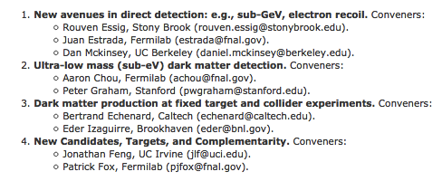
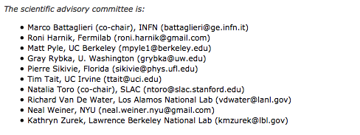
US Cosmic Visions: New Ideas in Dark Matter
Summary of the March 2017 workshop focused on small-scale projects in the US Dark Matter search program
Natalia Toro

Slide 2
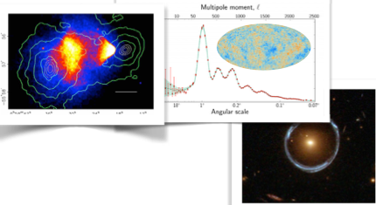
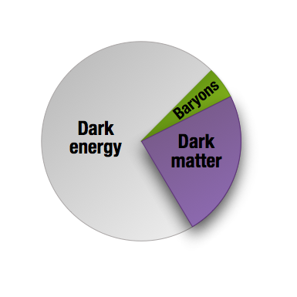
A Universe of Dark Matter
Overwhelming evidence
for ubiquitous Dark
Matter
Its physics governs our Universe
Its constituents are fundamentally different from familiar matter.
Nature and origin of Dark Matter are
among the foremost open questions
in fundamental science today.

Slide 3
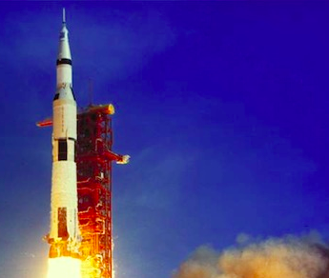

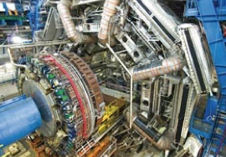
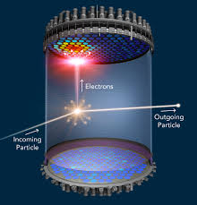
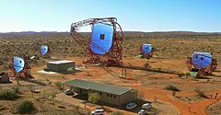
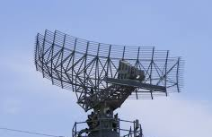
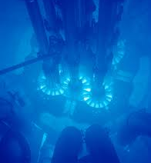
High Stakes of Dark Matter Science
Conservation of
Momentum
?
Conservation
of Energy
e.g. particle tied to origin of weak scale (WIMP)
Uncovering the nature of Dark Matter can lead to fundamental advances,
at the level of the greatest historical discoveries of physics
New Symmetry of Nature?
Natural first place to look
Mature, ongoing, important program
Electromagnetic
New forces and types of matter
?
Nuclear
Recent theory highlights well-motivated
frameworks with sharp, predictive targets from
cosmology, fundamental physics, and anomalies in data
New, cross-cutting experimental ideas bring them within
reach (at low cost) ➝ Logical next step for Dark Matter science
Dark Matter charged under new force – or
carrier of new force

Slide 4
“New Ideas in Dark Matter” Workshop
Investigating low-cost & high-impact opportunities in Dark Matter (DM) science
  The G2 experiments (ADMX, LZ, and SuperCDMS) are flagships of the US Dark Matter program and obvious priority
  Workshop focused on complementary science that can be done by small projects <$10M (some much less)
  100+ talks in 4 working groups, presenting new ideas, proposals, and science and R&D results

Slide 5
“New Ideas in Dark Matter” Workshop
Working groups
  New Avenues in Direct Detection
  Ultra-low mass (sub-eV) DM Detection
  DM Production at Fixed-Target and Collider Experiments
  New Candidates, Targets, and Complementarity
Timeline:
  Organizing group (conveners & SAC) formed in February
  Workshop March 23-25
  First draft of whitepaper circulated to community May 17
  Second draft to be circulated soon, aiming for whitepaper on arXiv by mid- to late-June

Slide 6
High-Level Conclusions
Small-scale searches for Dark Matter are guided by a few key priorities – testing general principles and sharp targets
Projects are ready to reach high-priority targets now, and there is a path forward, requiring further R&D, to do so comprehensively
This new field is especially cross-cutting in the technologies, techniques, and facilities that enable it – fostering these connections is essential to the field’s success
Small projects portfolio is a key part of the future of DM science!

Slide 7
Outline
Strong motivation to explore DM parameter space beyond G2 sensitivity
Innovative, low-cost ideas for small experiments with significant discovery opportunity
Need a program of complementary experiments to comprehensively explore priority science targets

Slide 8
Priority Targets in Dark Matter Science
Priority targets
WIMPs – extensively studied but important parameter space still to be explored
New paradigm of hidden sector DM – modest generalization of WIMPs with large expansion of experimental possibilities
QCD axion – just beginning to be explored
Another new paradigm, ultralight DM, generalizes axion

Slide 9
Hidden sector DM
Priority targets – Hidden-Sector DM
Natural generalization of WIMPs!
TeV
Classical WIMP
m_{W}
Hidden-sector DM
neutral under Standard Model forces, interacting through new force(s)
Interactions and production mechanisms similar to WIMPs
New experimental challenges & opportunities
Sharp, accessible parameter-space targets from theory and data
GeV
MeV
1/(Range of force) ~ Mediator Mass
keV
Interaction
strength
keV
MeV
GeV
TeV
PeV
DM Mass

Slide 10
Hidden sector DM
Priority targets – Hidden-Sector DM
Accessible to new experimental techniques!
SCDMS
LZ
LHC
TeV
Classical WIMP
m_{W}
New regime for
direct detection:
– Low-threshold
– Collective modes
GeV
Data anomalies
(⁸Be, muon g-2,
proton radius, small-scale structure)
point to new, weak force at 1-100 MeV scale
MeV
1/(Range of force) ~ Mediator Mass
New opportunities for small nuclear &
accelerator-based experiments looking
for new force and/or producing DM
Small-scale structure explores DM
self-interactions
keV
Interaction
strength
keV
MeV
GeV
TeV
PeV
DM Mass

Slide 11
Thermal Sub-GeV DM
Priority targets – Hidden-Sector DM
DM
SM
Classical WIMP
Abundance set by weak scale & coupling
m_{W}
DM
SM
Direct (m_{MED}>m_{DM})
Abundance set by mediator mass, couplings to DM and SM –
highly
predictive!
Sharp target
Predicted scattering rate (also depends on DM spin & mass structure)
Minimum production rate
GeV
1/(Range of force) ~ Mediator Mass
Secluded
(m_{MED}>m_{DM})
MeV
Important milestones for discovery or null result
Interaction
strength
MeV
GeV
TeV
DM Mass

Slide 12
Predictive Targets for Thermalized DM
Priority targets – Hidden-Sector DM
A series of sharp targets for DM thermally coupled to SM
Direct thermal freeze-out ➝ expected coupling vs. mass
Minimum annihilation rate for asymmetric fermion DM
  (from CMB bounds – coupling target assumes direct annihilation)
Minimum scattering rate for “SIMP/ELDER” (new force maintains kinetic but not chemical equilibrium until freezeout)
Interaction strength
Dark matter mass (MeV)

Slide 13
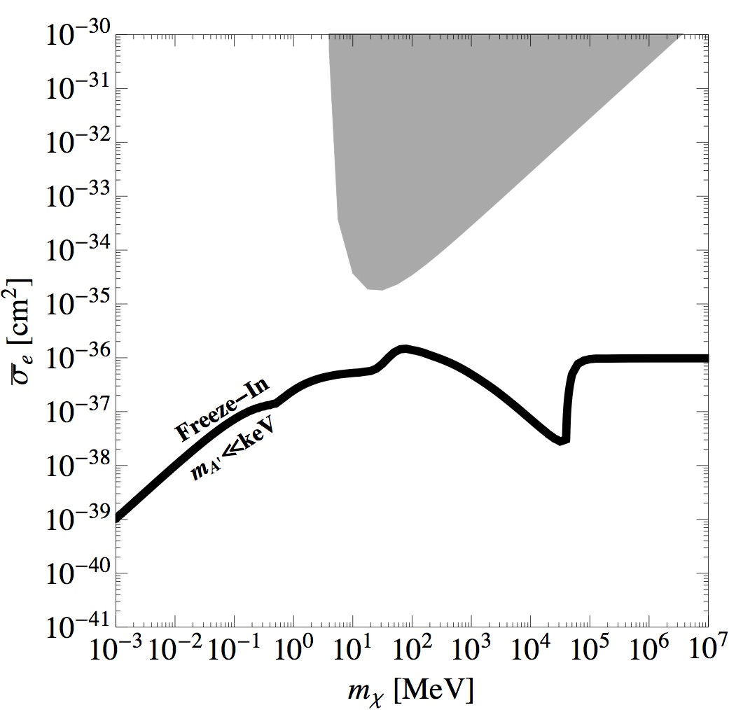
Motivation and Targets at Weaker Couplings
Priority targets – Hidden-Sector DM
Secluded Thermal/Asymmetric DM
Hidden-Sector freeze-in
Very weakly coupled DM never thermalizes, can ``freeze in’’
α_{D} ϵ²~10^{–10} x thermal
    If m_{MED} <<< m_{DM}, another sharp target for direct detection
m_{W}
Secluded
Annihilation into scalar mediators set by DM
couplings & mass – no sharp prediction for SM
GeV
DM
MED
1/(Range of force) ~ Mediator Mass
DM
MED
accessible in direct detection due to kinematic enhancement at low momentum transfer
MeV
Interaction
strength
MeV
GeV
TeV
DM Mass
Theoretically motivated loop-level couplings are accessible
For keV-scale DM, very weak coupling favored by cosmology

Slide 14
Hints of Hidden Sector Forces?
Priority targets – Hidden-Sector DM
New forces can also alter the physics of familiar matter and of dark matter, separately–anomalies in data may be first hints of such effects
Multiple anomalies can be explained by ~10–100 MeV boson with appropriate couplings to muons, quarks, and electrons of O(10^{–3}):
  ~3σ: muon g-2
  5.6σ: proton radius from muonic hydrogen vs. e-p scattering
  2-3σ: KTeV Br(π⁰➝e⁺e–)
  These are sharp targets in SM coupling vs. mass
Discrepancies between small-scale cosmological structure data & simulation
  baryonic effects?
  compatible with DM self-interaction through 10–20 MeV boson
ATOMKI ⁸Be decay anomaly
  6.8σ bump consistent with 17 MeV particle
  Couplings roughly consistent with other anomalies
  Sharp target in coupling and mass

Slide 15
Ultralight Dark Matter: Motivation
Priority targets – Ultralight DM
QCD Axions: A particularly motivated target
  Peccei-Quinn solution to strong CP
  problem implies light axion
  (10^{–12} to 10^{–2} eV) with predicted
  mass-coupling relation
  Expect significant abundance from
  inflation or high-temperature
  phase transition
Observational bound on DM
mass is >10⁻²² eV, entire mass
range is theoretically natural
Gluon coupling (GeV^{–1})
Mass (eV)
Photon coupling (GeV^{–1})
Mass (eV)

Slide 16
Ultralight (sub-keV) DM: Properties
Priority targets – Ultralight DM
Occupation number >1 – Must be boson, behaves as coherent field
  Field coupling to SM doesn’t destabilize DM
Can look for field coupling to matter or absorption of DM particles in detector

Slide 17
Detection Prospects
Priority targets – Ultralight DM
Search for classical background field with ω~m_{DM}/ℏ
Electromagnetic – DM drives a circuit
QCD – oscillating nucleon EDM
Fermion Spin precession in background field
Scalar Couplings – 5th force, time-varying mass/charge
Absorption especially useful for meV-to-keV, where high frequency complicates classical field detection

Slide 18
Experimental Directions
(in arbitrary order)
New Avenues in Direct Detection
Ultra-low mass (sub-eV) DM Detection
DM Production at Fixed-Target and Collider Experiments
New Candidates, Targets, and Complementarity

Slide 19
New Avenues in Direct Detection
Active, healthy community with several clear ideas to go beyond funded G2 experiments
Small-scale projects can explore orders of magnitude beyond G2!
  Spin-dependent WIMP-proton interactions
  Searching for O(GeV) mass and lighter DM through both nuclear and electron interactions
    Higher flux and cross-sections ➝ interesting science even from gram-scale detectors
    Same experiments also sensitive
    to absorption of meV-keV
    ultralight DM

Slide 20
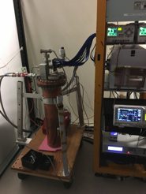
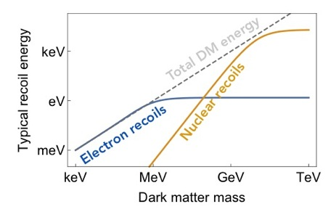
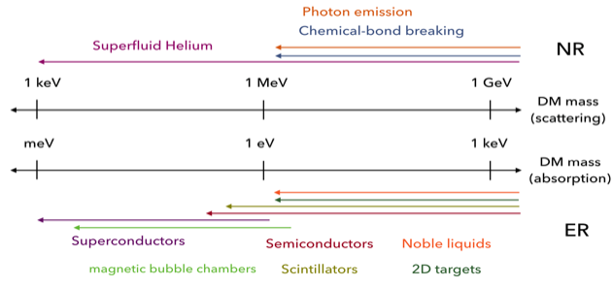
Low-Mass Direct Detection
Tongyan Lin
Fundamental challenge:
low-energy signal
Calls for
  Detecting DM scattering off electrons or low-mass nuclei
  Exploiting low-threshold processes and new readout technologies
Lighter nuclei
Several projects ready now
R&D needed to explore weaker coupling & lower masses

Slide 21
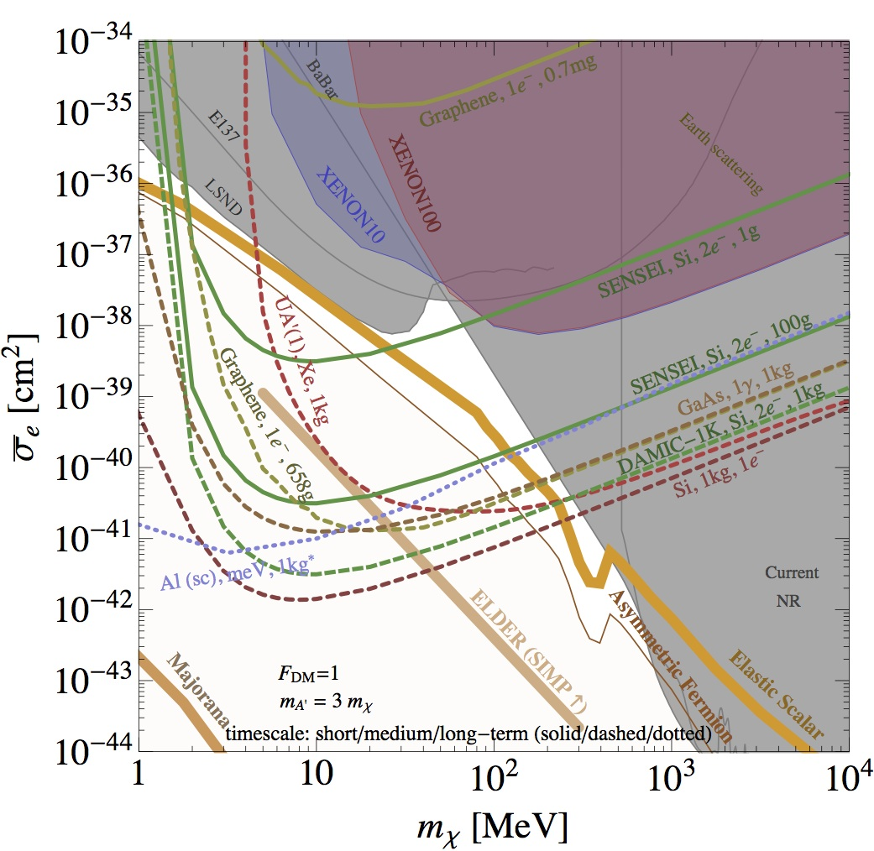
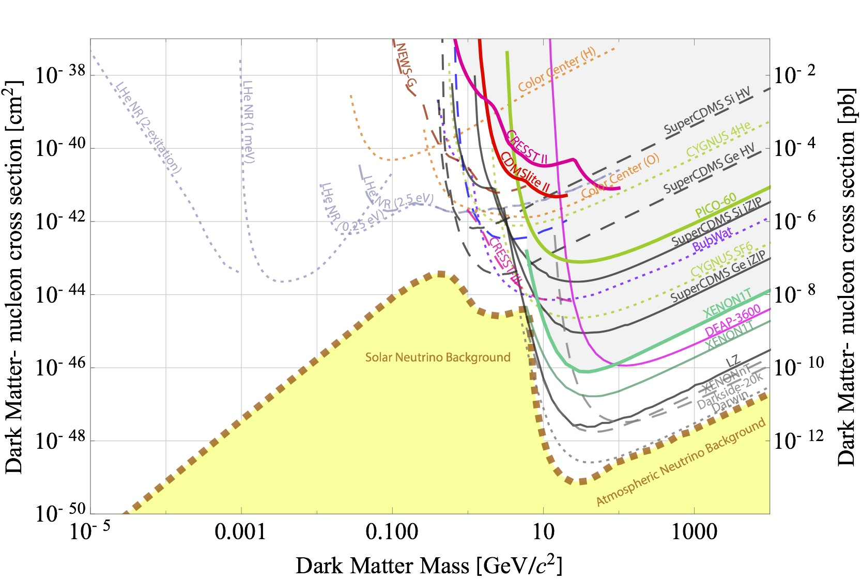
Experimental Prospects
Electron recoil (ER)
Explore hidden-sector targets:
ER Projects ready now explore elastic scalar thermal relic, asymmetric, SIMP/ELDER, freeze-in (see slide 35)
R&D needed to push to weaker couplings & MeV-mass NR
Long-term R&D to reach keV masses
Opportunities to explore WIMP-p SD scattering also ready now
Nuclear recoil (NR)
Spin independent

Slide 22
Ultra-Low Mass (sub-eV) DM Detection
Exploring DM masses from 10^{–22} to 1 eV
  Sharp goal: explore full mass range for
  QCD axion dark matter
Experiments look for collective effects of coherent DM field oscillating at ω~m_{DM}/ℏ
  Exploits high-precision sensor technology developed for other fields – technology development for DM search will impact
  these fields as well

Slide 23
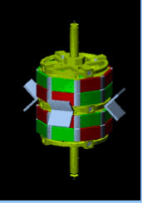
Experimental Prospects
Many projects currently building/operating pathfinder experiments or in advanced stages of hardware prototyping
R&D funds useful now; project funding on several-year
timescale will enable construction of <$10M full-sized
detectors with significant reach into uncovered dark
matter parameter space

Slide 24
Experimental Prospects
QCD Axion

Slide 25
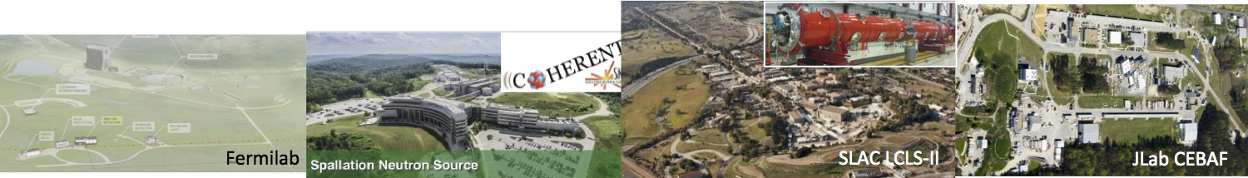
DM Production at Fixed-Target and Collider Experiments
Exploring hidden sector DM below O(GeV) mass
  Sharp goal: reach thermal DM sensitivity
  in generic models
Accelerators’ ability to produce and detect new particles enables multi-faceted search for hidden sector DM and mediator
New proposals make efficient use of US accelerator facilities (many outside HEP), existing detector technology, proven techniques

Slide 26
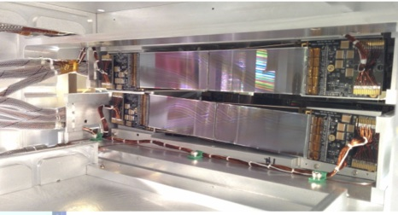
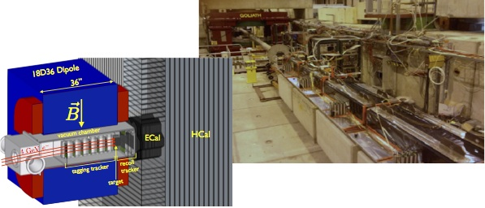
DM Production at Accelerators:
Three Proven Techniques
DM production
  Missing mass
  Missing energy/momentum
Visibly decaying mediator production
  Missing mass
  Resonance
  Displaced vertex
DM production
and scattering
  p or e beam dump
Already set powerful constraints on light dark matter, with clear path forward to reach key science targets

Slide 27
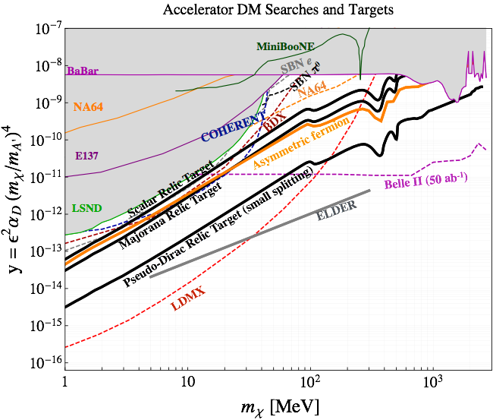
Experimental Prospects
  Dark Matter searches – reaching thermal targets!
  Mediator searches
(all projections = US or foreign small experiments, except for Belle II)
Proton- and electron-beam experiments with thermal & asymmetric target sensitivity – ready to move forward now

Slide 28
New Candidates, Targets, and Complementarity
4th WG looked broadly at DM candidates motivated by anomalies in data or new theoretical ideas, and how to test them
~30 M☉ black hole DM (motivated by LIGO events)
  Motivates microlensing search with DECam and/or LSST
Muon g-2, ⁸Be, and new light force carriers
Small-scale structure and DM self-interaction
  All suggestive of 1–100 MeV dark force

Slide 29
Testing Visible-Sector New-Force Anomalies
Several particle interpretations of ATOMKI 17 MeV bump
  protophobic vector
  pseudo-scalar
  axial-vector
  Appears incompatible with nuclear physics effects
Several ideas to confirm or refute this anomaly
  Nuclear-decay experiments with superior mass resolution and statistics
  Isotope shift spectroscopy
  1-2 year timescale, cost a fraction of the small projects threshold

Slide 30
New-Force Anomalies: Dark Sector
Outstanding problems in structure formation at small length scales: core-cusp problem, missing satellites problem, and too-big-to-fail problem
Dark matter with significant self-interactions has been argued to retain successes of CDM on large scales, while economically solving small-scale puzzles
Opportunities
  Leverage DES and LSST to measure halo mass function on smaller scales
  Theory and simulation key to interpreting these data

Slide 31
Importance of Theory
Progress in theory has been a driving force behind many of these recent developments
  New ideas for small-scale experiments
  Innovative connections to other subfields
  Cosmological and astrophysical simulation
Investment in theory is essential to continued progress

Slide 32
Comprehensive Exploration of Ultralight and Hidden-Sector DM
The Case for a Program of Complementary Experiments

Slide 33
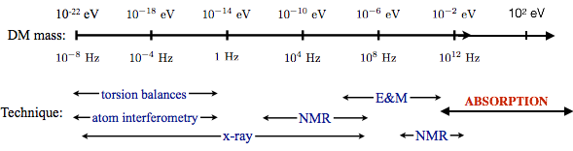
Ultralight Dark Matter
More than one experiment needed to cover full mass range – each technique has natural frequency range
QCD Axion DM

Slide 34
Hidden Sectors
Complementary experiments with overlapping mass sensitivity explore different targets and provide different information
  Relativistic and non-relativistic probes of DM have fundamentally different strengths
  Experiments searching for new interactions within dark and visible sectors are equally important probes

Slide 35
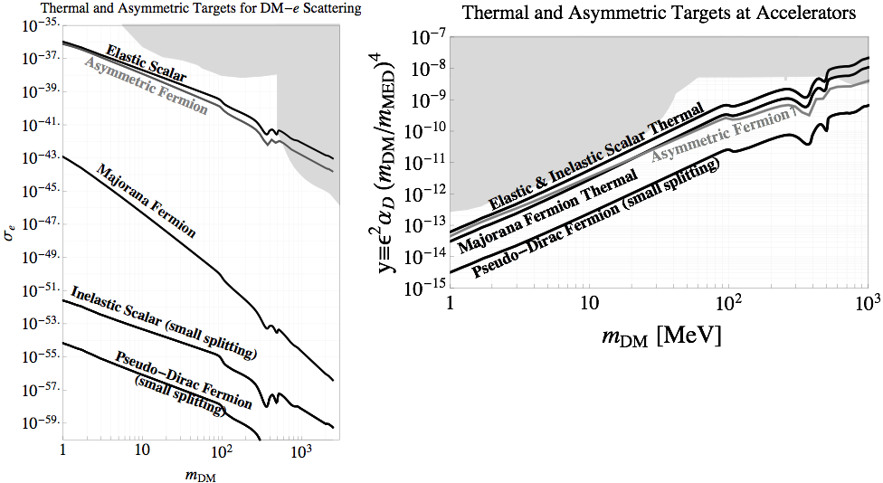
Hidden Sectors: The Need for a Relativistic Probe
High-value targets accessible at accelerators (v~c) but invisible to direct detection (v~10^{–3} c)
18 orders of magnitude –
Some below neutrino floor
1.5 orders of magnitude –
fully accessible
Accelerators are robust to details of DM mass structure

Slide 36
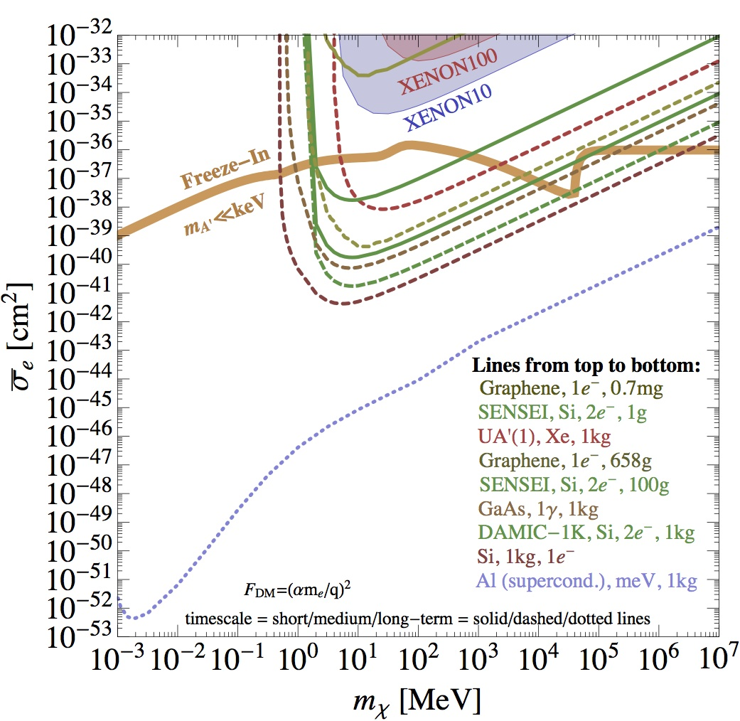
Hidden Sectors: The Need for a
Non-Relativistic Probe
High-value targets accessible to direct detection (v~10^{–3} c) but invisible to accelerators (v~c)
If m_{mediator} << m_{DM}, kinematic enhancement by up to 12 orders of magnitude gives direct detection access to very small DM-matter couplings – exemplified by freeze-in scenario

Slide 37
Different Techniques
Provide Crucial Lessons
Discovery in direct detection implies that a given particle constitutes all or part of the DM, but cannot disentangle the particle’s couplings from its abundance
Accelerator-based experiments provide clear probe(s) of particle properties & interactions, but not stability on cosmological timescales
The new force at the heart of hidden sector DM may be most readily explored, not through DM-SM interactions, but through the new physics it induces within the DM or visible sector – anomalies in both sectors can be tested with small experiments!

Slide 38
Summary of Opportunities
Ultra-low mass (sub-eV) DM:
Key priority: QCD Axion
Pathfinder/R&D now
Projects in several years
New candidates, targets, complementarity:
Small investments ready now in several areas – e.g. black hole, small-scale structure, and nuclear anomaly searches
DM Production at Accelerators:
Key priority: Hidden sector thermal & asymmetric targets (<GeV)
Ready now
New Avenues in Direct detection:
Diverse goals
Projects ready now –
hidden-sector(>MeV) & WIMP SD
R&D efforts – keV-mass threshold & other capabilities
38

Slide 39
Conclusion
Strong motivation to broadly explore priority targets of WIMP, hidden-sector and ultralight DM parameter space
Innovative, low-cost ideas for small experiments (some mature, others requiring significant R&D) with significant discovery opportunity
Need a program of complementary experiments to comprehensively explore priority science targets
Doing so will leave legacy of profound discovery or robust, lasting knowledge about DM
Small projects portfolio is a key part of the future of DM science!

