Slide 1
DOE HEP General Accelerator R&D
HEPAP Meeting
June 5, 2017
L.K. Len
Research and Technology Division
Office of High Energy Physics
Office of Science, U.S. Department of Energy

Slide 2
The HEP GARD Program
GARD supports accelerator science and technology R&D aimed at enabling HEP discovery science. It does so by developing new accelerator concepts, materials, designs and by pushing the performance limits, while acquiring and broadening the knowledge base of accelerator science.
GARD funds medium and long term accelerator R&D primarily aimed at supporting the High Energy Physics mission. However, the long-term generic R&D may also benefit other applications—one can regard it as [small case] “accelerator stewardship”.
  Medium term accelerator R&D refers to work performed in the support of possible new facilities or of upgrades to existing ones. This applies to facilities that possess a reasonable conceptual idea for implementation.
  Long-term accelerator R&D refers to the development of ideas and underlying technologies that could support facilities for which we do not currently have an integrated implementing concept

Slide 3
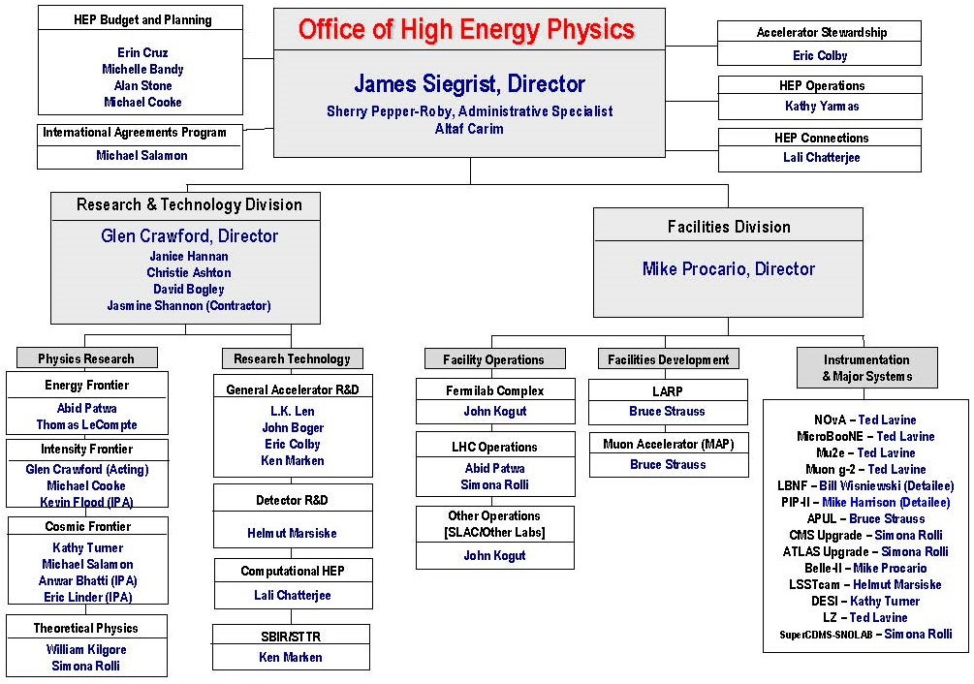
GARD w.r.t. HEP Org Chart
Other
Applications
Directed
R&D
Projects
Commercialization Tech Transfer

Slide 4
GARD Thrusts
Supports 5 Research Thrusts:
Advanced Accelerator Concepts
Accelerator and Beam Physics
  Expanded to include beam instrumentation and controls
Particle Sources and Targets
RF Acceleration Technology (NC and SC RF)
  Includes RF sources, NCRF and SRF R&D
Superconducting Magnets and Materials
Support research efforts at:
7 DOE national labs
30 university grants

Slide 5
FY 2016 GARD Research – % By Thrusts

Slide 6

P5 Report Strategy for GARD
In 2014—The P5 report recommended moving forward with a focused Advanced Technology R&D strategy:
  Play a leadership role in superconducting magnet technology focused on the dual goals of increasing performance and decreasing costs
  Pursue accelerator R&D with a focus on outcomes and capabilities that will dramatically improve cost effectiveness for mid-term and far-term accelerators

Slide 7

Accelerator R&D Subpanel
In 2015—Following P5, the Accelerator R&D Subpanel (charged to identify the most promising accelerator research areas to support the advancement of HEP) rolled out its report with 25 recommendations
  provides prioritization advice to GARD on accelerator R&D towards the Next Steps [Medium-term] and Further Future [Long-term] accelerators
 | Intensity Frontier Accelerators | Hadron Colliders | e⁺e⁻ Colliders
Current Efforts | PIP | LHC
 | PIP-II | HL-LHC | ILC
Next Steps | Multi-MW proton beam | Very high-energy pp collider | 1 TeV class energy upgrade of ILC*
Further Future Goals | Neutrino factory* | Higher-energy upgrade | Multi-TeV collider*
*dependent on how physics unfolds

Slide 8
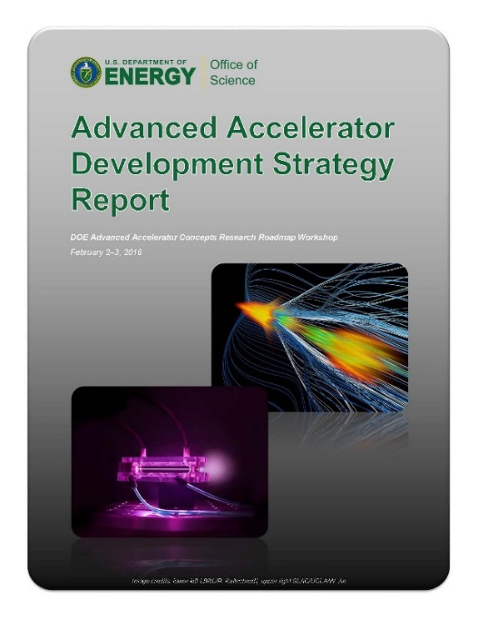
ARDS Recommendations – AAC
Advanced Acceleration Concepts
  Support development of the most promising concepts toward far-term accelerators as envisioned by P5
    [7] Vigorously pursue PWFA of positrons at FACET …
    preserve the momentum of PWFA research
    using other facilities.
    [8] Support LWFA experiments on BELLA at the
    current level.
    [9] Reduce funding for direct laser acceleration
    research activities.
    [10] Convene the university and laboratory
    proponents of advanced acceleration
    concepts to develop R&D roadmaps
    [C1b] Develop, construct, and operate a
    next-generation facility for PWFA
    research and development.
  • Implemented • Implementing • In progress • Deferring

Slide 9
ARDS Recommendations – ABP
Accelerator and Beam Physics
  Maintain accelerator science core competence and support high intensity proton beam physics R&D
    [2] Construct the IOTA ring, and conduct experimental studies of high-current beam dynamics in integrable non-linear focusing systems.
    [3] Support a collaborative framework among laboratories and universities that assures sufficient support in beam simulations and in beam instrumentation to address beam and particle stability including strong space charge forces.
    [14] Continue ABP R&D aimed at developing the accelerators defined in the Next Steps and the Further Future Goals.
    [15] Ensure a healthy, broad program in accelerator research, allocate a fraction of the budget of the ABP thrust to pursue fundamental accelerator research outside of the specific goals.
  • Implemented • Implementing • In progress • Deferring

Slide 10
ARDS Recommendations – PST
Particle Sources and Targets
  Develop plan to support high-power target for Intensity Frontier
    [1] Fund generic high-power component R&D at a level necessary to carry out needed thermal shock studies and ionizing radiation damage studies on candidate materials that are not covered by project-directed research.
  • Implemented • Implementing • In progress • Deferring

Slide 11
ARDS Recommendations – RF
RF Acceleration Technology
  Support high-efficient RF source development and high-gradient research
    [4] Invest in SRF R&D in order to inform the selection of the acceleration technology for the multi-MW proton beam at Fermilab.
    [6] Increase SRF R&D funding to significantly reduce the cost of a 1TeV-ILC. 80 MV/m accel gradients with new materials over 10 years.
    [11] Continue research on high-efficiency power sources and high-gradient NCRF structures.
    [12] Make NLCTA available for RF structure tests using its RF power and beam sources.
    [13] Focus NCRF R&D on developing a multistage prototype based on high-gradient NCRF structures and high-eff RF sources to demonstrate the technology for a multi-TeV e+e- collider.
  • Implemented • Implementing • In progress • Deferring

Slide 12
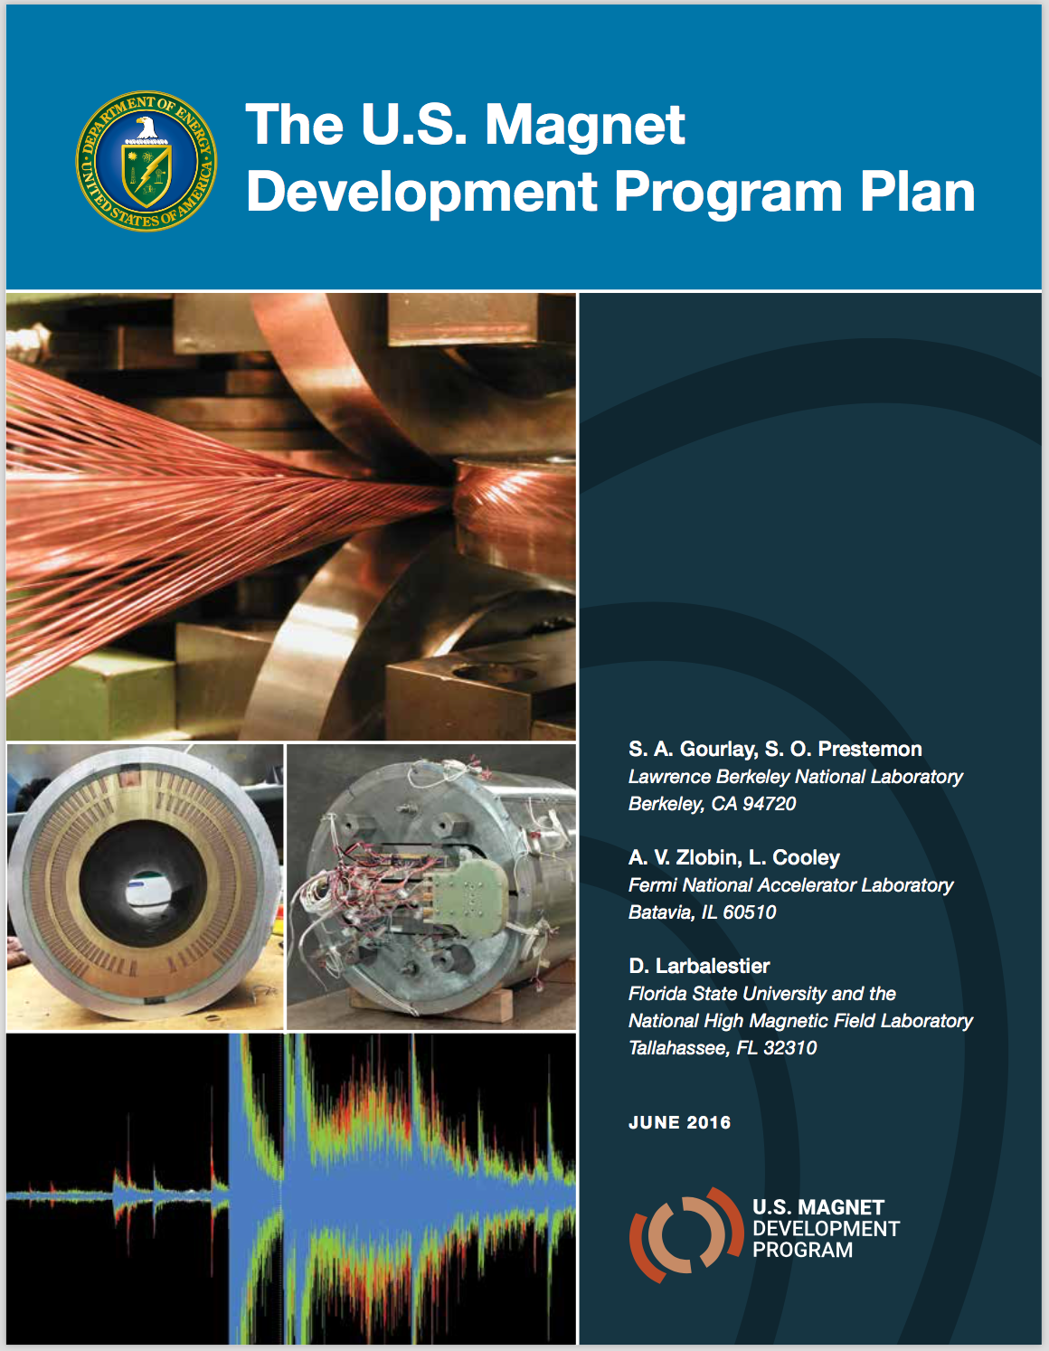
ARDS Recommendations – SCM
Superconducting Magnet and Materials
  Support a balanced portfolio magnet and materials
  efforts; LTS and HTS conductors
    [5a] Support accelerator design and simulation activities
    that guide and are informed by the SC magnet R&D
    program for a VHEPP collider.
    [5b] Form a U.S. HFM R&D collaboration that is
    coordinated with global design studies for a VHEPP
    collider. The over-arching goal is a large
    improvement in cost-performance.
    [5c] Aggressively pursue the development of Nb3Sn
    magnets suitable for use in a VHEPP collider.
    [5d] Establish and execute a HTS material and
    magnet development plan with appropriate
    milestones to demonstrate the feasibility of
    cost-effective accelerator magnets using HTS.
  • Implemented • Implementing • In progress • Deferring

Slide 13
ARDS Recommendations – SCM
Superconducting Magnet and Materials
  Support a balanced portfolio magnet and materials efforts; LTS and HTS conductors
    [5e] Engage industry and manufacturing engineering disciplines to explore techniques to both decrease the touch labor and increase the overall reliability of next-generation SC accelerator magnets.
    [5f] Significantly increase funding for SCM R&D in order to support aggressive development of new conductor and magnet technologies.
    [C1a] Ramp up SCM R&D, targeted primarily for a VHEPP collider, to permits a multi-faceted program to explore breakthroughs in parallel in magnet configurations, prototype fabrication, low-cost manufacturing and industrial scale-up of conductors. Increase HTS support to demonstrate the viability of accelerator-quality HTS magnets for a VHEPP collider.
  • Implemented • Implementing • In progress • Deferring

Slide 14
ARDS Recommendations – General
The GARD Program
  Current GARD budget is insufficient to satisfy the expectation of P5. Modest rise in base funding would open numerous critical R&D opportunities.
    [B1] Increase base GARD funding modestly in order to open numerous critical R&D opportunities that do not fit in the current base, as well as to invigorate fundamental accelerator science research, and to step up development of the national accelerator workforce.
  • Implemented • Implementing • In progress • Deferring

Slide 15
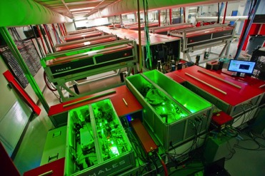
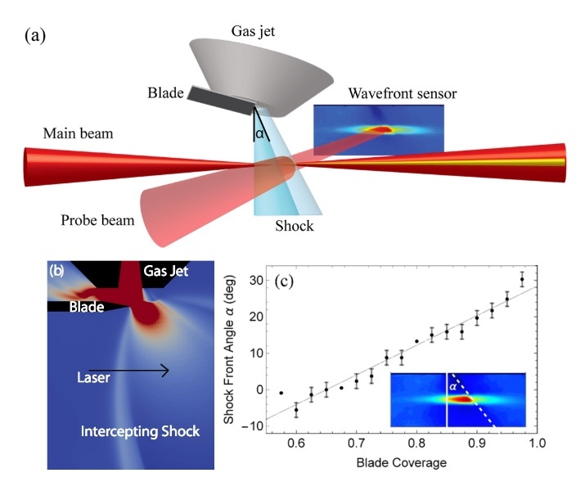
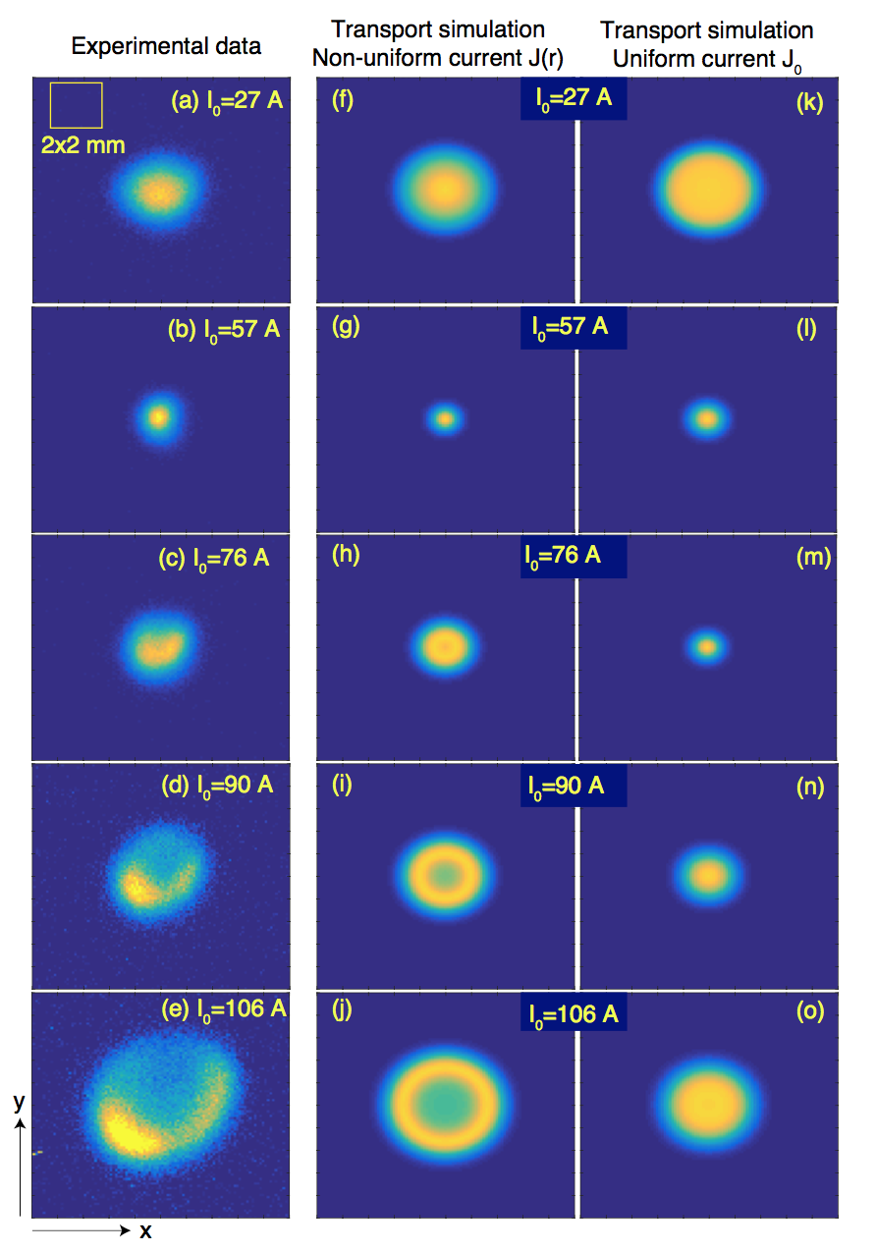
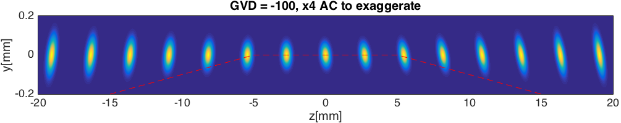
GARD Highlights
Advanced Accelerator Concepts – LWFA
BELLA Center at LBNL
  Most powerful 1Hz laser
  Highest accelerated beam (4.25 GeV)
  LPA staging at low energy
  Tunable injection in a jet with a sharp shock
  Active plasma lens
  Pulse front tilt and
  electron beam steering
1 Hz, PW BELLA laser

Slide 16
GARD Highlights
Advanced Accelerator Concepts – PWFA
FACET at SLAC
  9 GeV e-beam acceleration
  Positron beam gain 4 GeV/1.3m
  Hollow plasma
  channel for e+
  >1 GeV e+ acceleration in quasi-linear regime

Slide 17
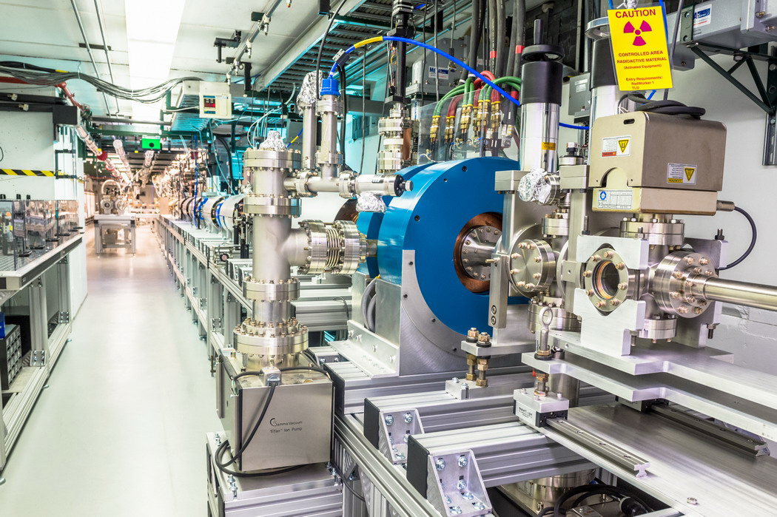
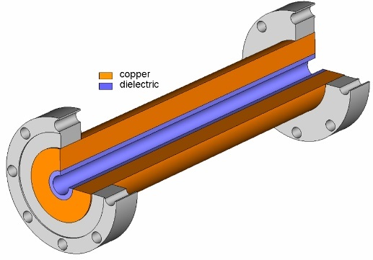
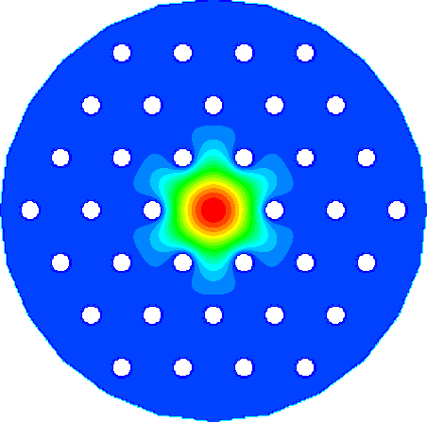
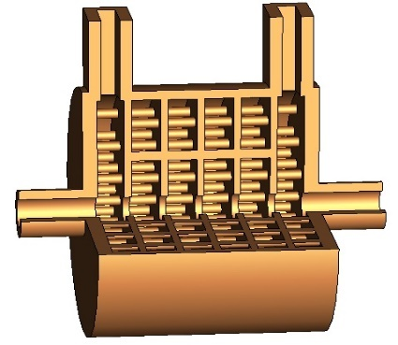
GARD Highlights
Advanced Accelerator Concepts – Argonne Wakefield Accelerator
Dielectric loaded structures
Photonic band gap structures
Collinear wakefield acceleration

Slide 18
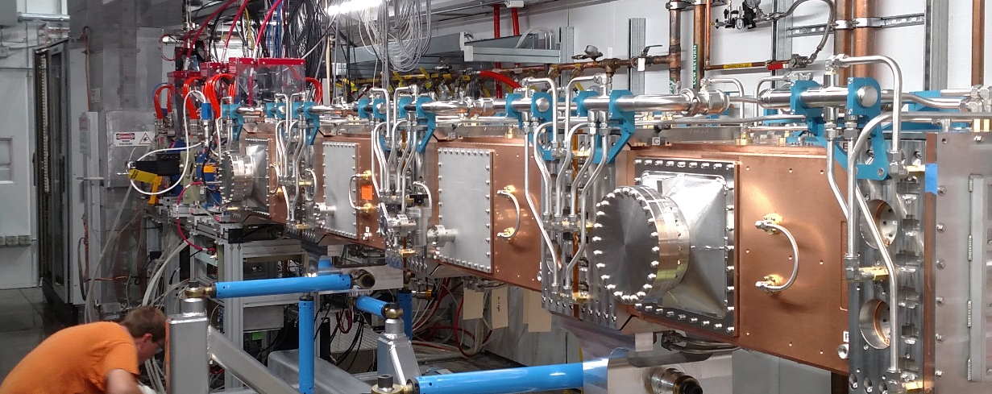
GARD Highlights
Accelerator and Beam Physics
  RFQ accelerator—
  fabricated by LBNL,
  installed at FNAL (~100%
  transmission; 1-10mA;
  2.11 MeV ± 0.5%)
  Beam phase space
  manipulation @AWA
Train
Triangle
Rectangle
Trapezoid
Train
Triangle
Rectangle
Trapezoid

Slide 19









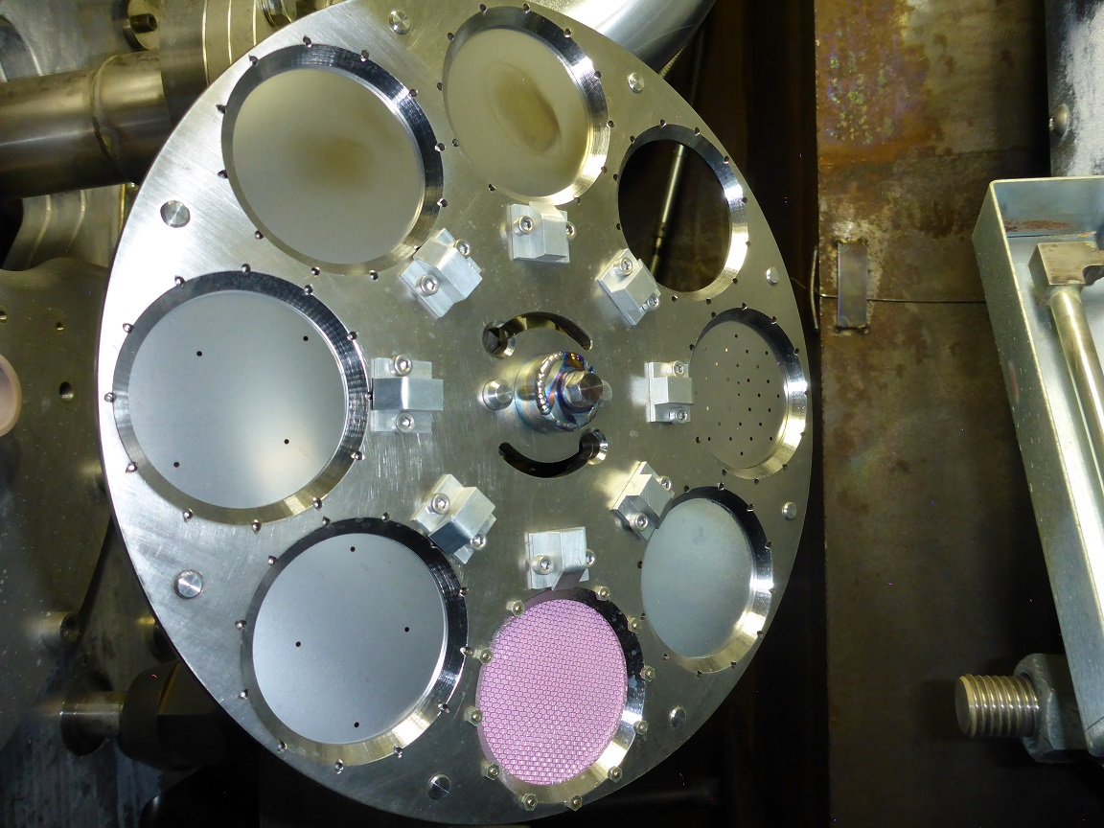
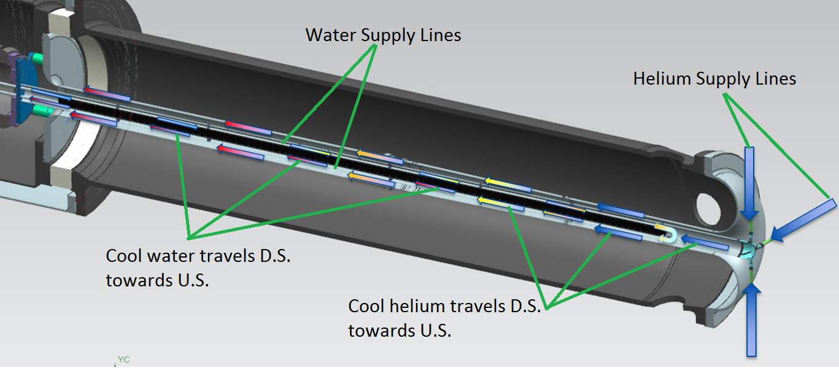
GARD Highlights
Particle Sources and Targets
  RaDIATE Collaboration (Radiation Damage In Accelerator Target Environments)
  LBNF graphite target/Ti cooling tube
  Ti OTR foils
Ti-2: 5.22x10²⁰
0.42DPA(MARS)
Ti-1: 1.42x10²⁰
0.17DPA

Slide 20
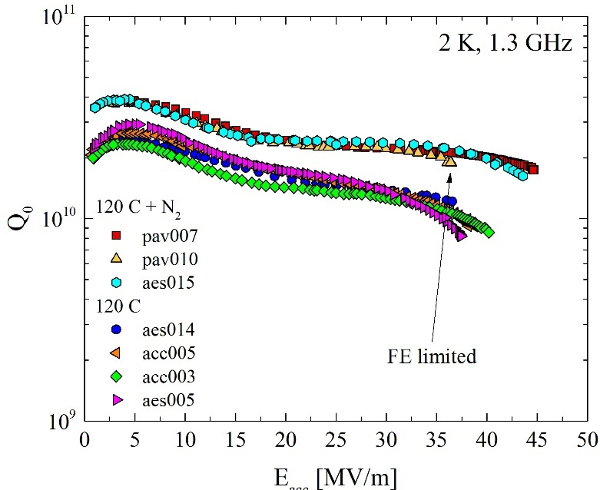
GARD Highlights
RF Acceleration Technology—SRF
  State-of-the-art equipment @FNAL
  Nitrogen doping and better understanding
  of magnetic flux losses→SRF cavities with
    High Q₀
    High accelerating gradient
  Enable LCLS-II cryomodule to achieve
  world record Q₀

Slide 21
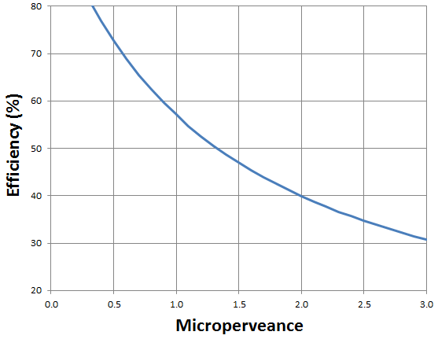
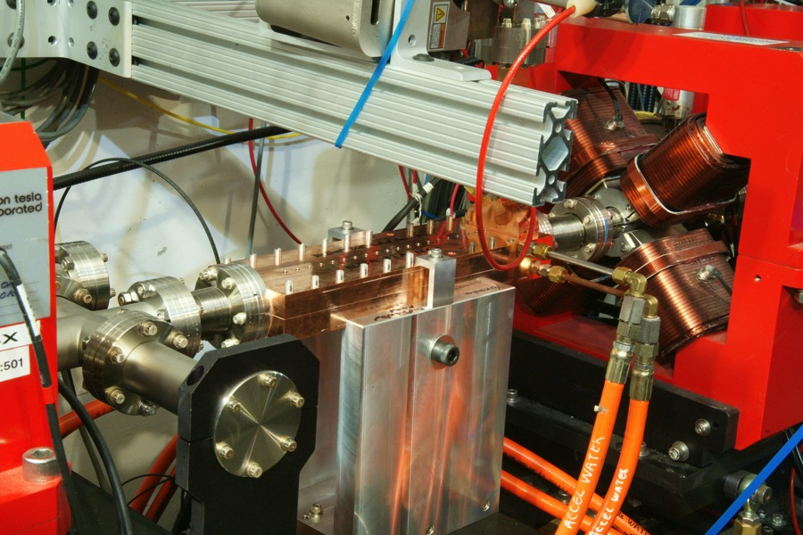
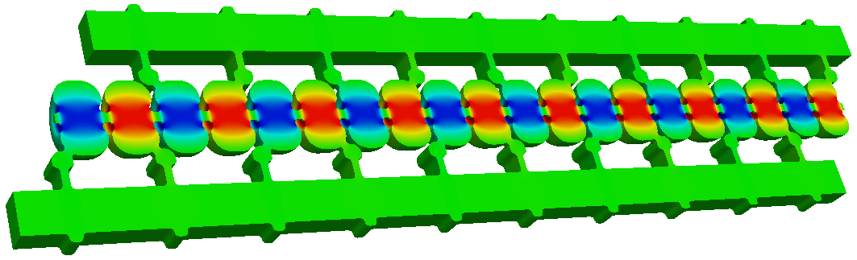
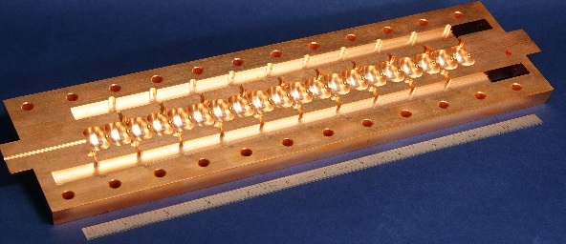
GARD Highlights
RF Acceleration Technology—NCRF
  Better understanding RF breakdown
  → dramatic increase in accel gradient
  High efficiency RF sources
  Massively parallel computing tools
  enable virtual RF design
Unconstrained BAC 5045
Future work
Retrofit BAC 5045
Existing 5045
Hard CuAg#3
Cu@45K
Empirical Relation
for Klystrons (+/-5pp)
Soft Cu
Hard Cu
Hard
CuAg#1
(I/V^{3/2})
Accelerating Gradient [MV/m]
26 cm Structure on XTA beamline
RF optimization and full structure modeling
Machined in two halves
RF parameter calculation verified by measurement

Slide 22
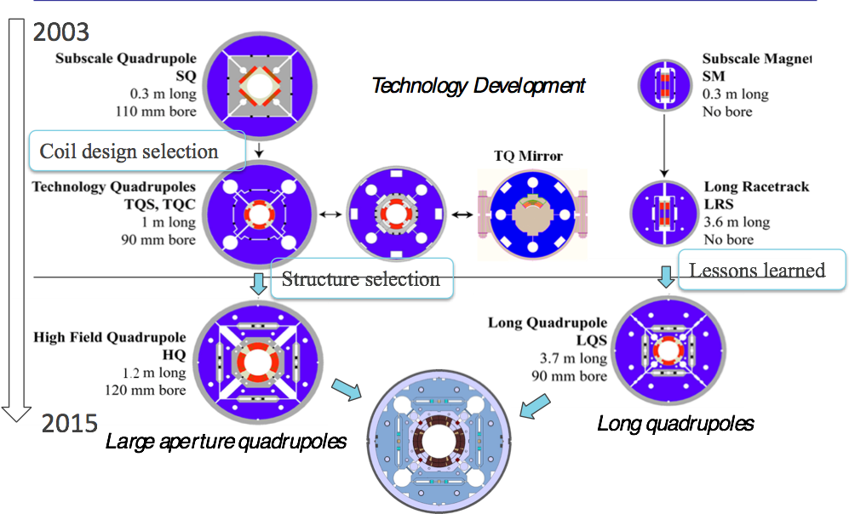
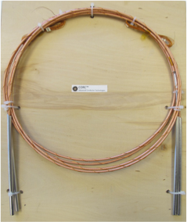
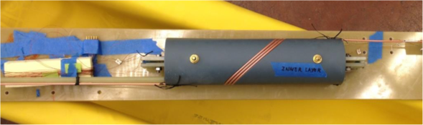

GARD Highlights
Superconducting Magnets and Materials
  GARD SC magnet and conductor
  development at BNL, FNAL, and LBNL
  → LHC upgrades.
  Explore new design—Canted Cosine Theta
  (CCT) at LBNL
  Develop HTS technology—
    Round Bi2212 wire
    REBCO tape and CORC cables

Slide 23
Summary
The GARD Program
  supports a broad spectrum of R&D in Accelerator Science and Technology
  supports many research efforts that are world-leading and continues to push their frontiers
  is implementing the ARDS recommendations within its budget and programmatic constraints
  is developing research roadmaps for each of its research thrusts

