Slide 1
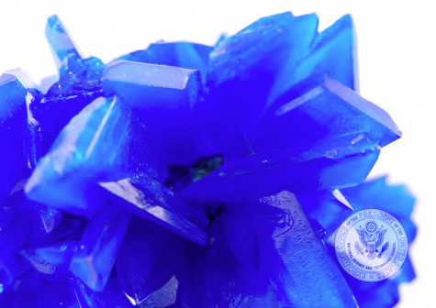
Materials by Design and Condensed Matter Connections to High Energy Physics
Mike Norman
Director, Materials Science Division
PI, Center for Emergent Superconductivity
Argonne National Laboratory
December 8, 2014

Slide 2
Outline
Low Temperature Superconducting Detectors (TES, etc.)
Superconducting RF Cavities, Magnets & Undulators
Wide Band Gap γ-ray Detectors
Monopoles, Anapoles, Skyrmions, Majoranas & Higgs
AdS/CFT and Tensor Networks
with special thanks to Val Novosad (TES), Thomas Proslier & Mike Pellin (SRF),
Mercouri Kanatzidis (wide band gap), Wai Kwok & Ulrich Welp (SC wires & magnets)

Slide 3
Low Temperature Detectors (Joel Ullom, NIST, Aug. 2012 BES Workshop)

Slide 4
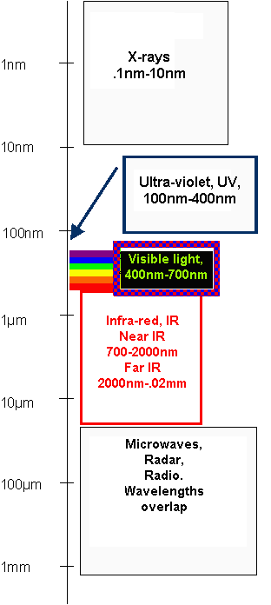
Bolometric detector - thermal detector
EM Radiation Temperature Change Electrical signal
Spectral range is defined by the absorber
an opportunity for broad-band imaging
General Idea
CMB INFRARED X-RAY
Heat sink to bath
COMPONENTS: Absorber, Thermometer, Thermal link

Slide 5
It takes time & expertise to make a deployable device
TES components optimization
Electronic properties
Thermal properties
Materials
Geometry
Membrane
Membrane
perforation
Thickness
Mo/Au
Mo: Fe
Ti
Edge effects
(Proximity)
(Implantation)
(metal)
control
Optically active devices
Characterization & design optimization
Computer modeling
Absorber
Spider
Antennas
-
web structure
(polarization
-
sensitive)
Transmission line
Planar filters
Array testing
-

Slide 6
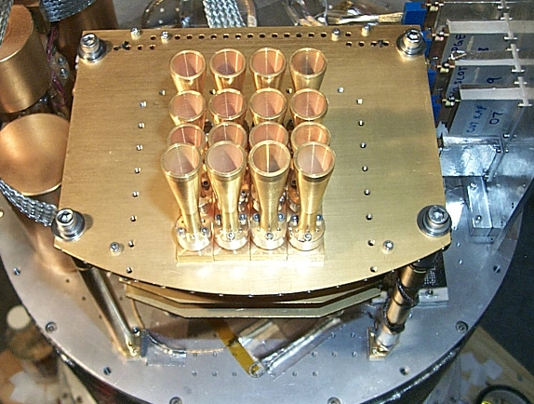
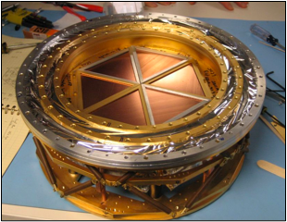
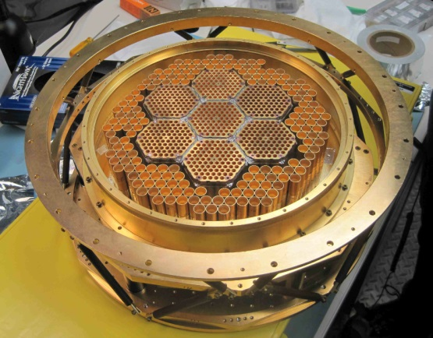
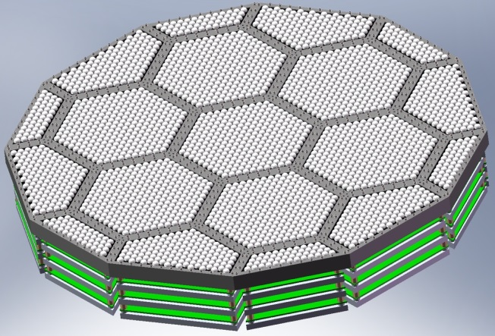
Evolution of CMB TES detectors
2001: ACBAR
16 detectors
50x improvement
2007: SPT
960 detectors
Add polarization
2012: SPTpol
1536 detectors
10x improvement
2016: SPT-3G
15,324 detectors
Requires new approach for higher focal plane density

Slide 7
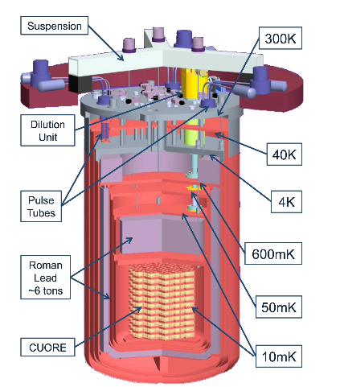
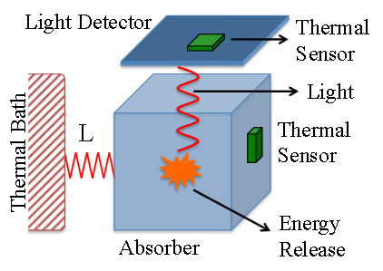
Neutrinoless double beta decay with CUORE
(The Cryogenic Underground Observatory for Rare Events)
CUORE is funded by the US (DOE and NSF) and EU (INFN)
988 x 750 gram crystals of natural TeO₂ with thermistors
Future R&D: Better background suppression and particle identification
“Thermal” + “light” detectors to distinguish between 0νββ events and α particles
SC detectors as a candidate technology: ultimate energy resolution, scalable, multiplexing with SQUIDs, thermal and/or optical sensitivity
Materials with T_{c} 10-15 mK are needed
D. R. Artusa et al., http://arxiv.org/abs/1407.1094

Slide 8
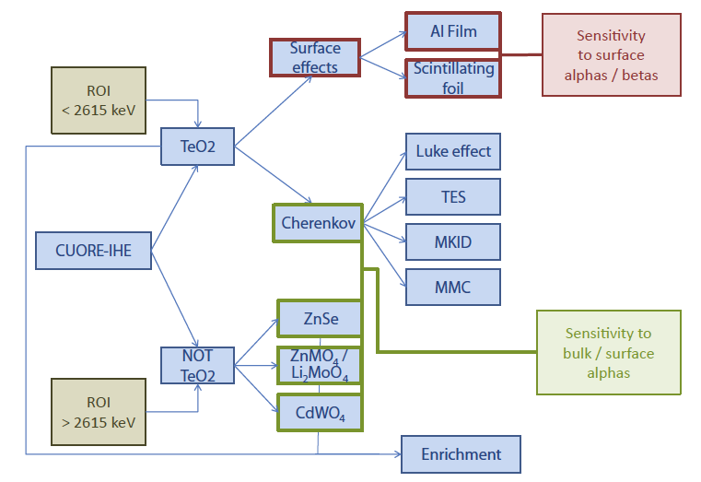
Scheme of R & D detector activities for CUORE-IHE
(Y. G. Kolomensky et al)

Slide 9
Energy discrimination with TES for X-ray scattering
Joel Ullom, NIST,
Aug. 2012 BES Workshop
Elastic (RXS)
Will allow for a 100 fold improvement in signal to noise ratio
Inelastic (RIXS)

Slide 10
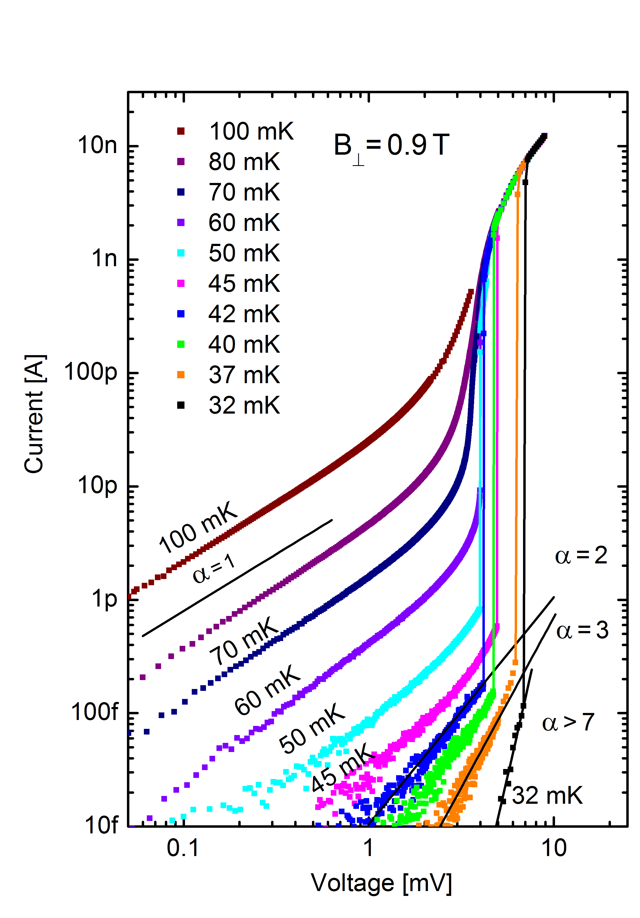
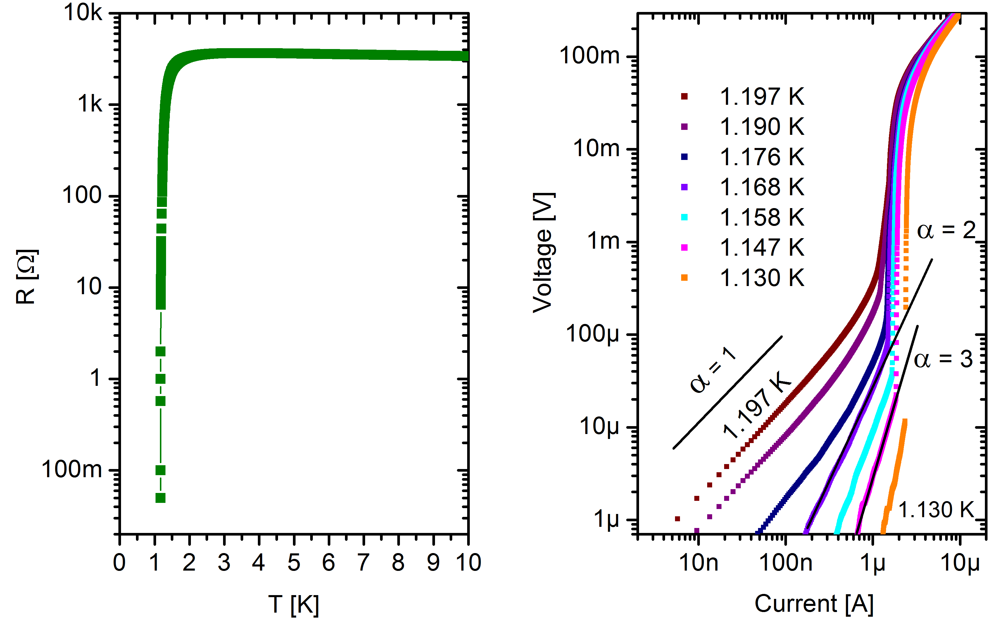
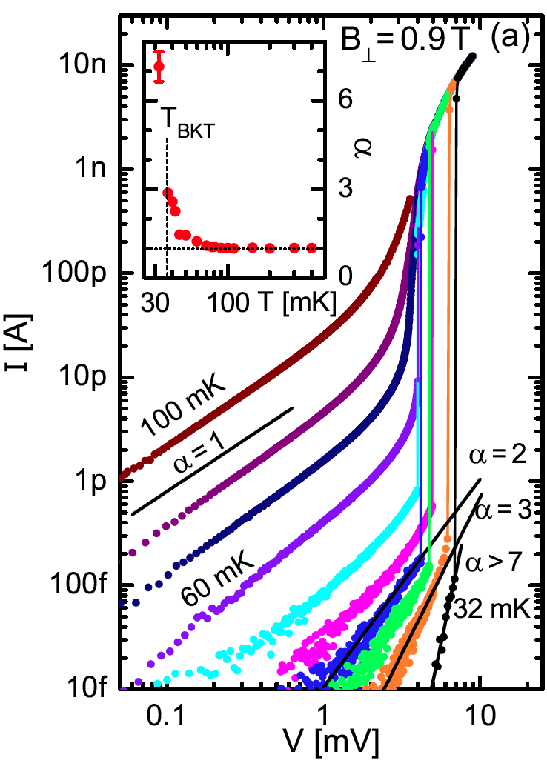
Improved resolution from superconductor-insulator transition?
transition to superinsulating state (TiN)
transition to superconducting state (TiN)
Baturina et al, EPL (2012)

Slide 11
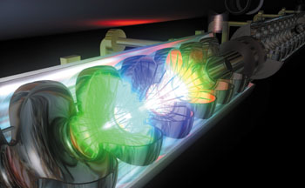
Superconducting Radio-Frequency (SRF) Cavities
SRF Cavity Needs:
Higher Gradients, Currents
Lower operational costs
  Operating Temperature
  Dissipation
Lower Capital Costs – Nb, fabrication, etc.
RF electromagnetic field inside the cavity:
screening currents -> dissipation
-> performance
Performance limitations: fundamental understanding of dissipation mechanisms
Atomic Layer Deposition: synthesizing new materials and application to RF cavities

Slide 12
Niobium surfaces are complex and poorly controlled at the nanometer scale
Inclusions,
Hydride precipitates
Surface oxide
Nb₂O₅ 5-10 nm
Residue from chemical processing
45 nm
RF depth
Interface: sub oxides NbO, NbO₂
often not crystalline
(niobium-oxygen “slush”)
Interstitials dissolved in niobium (mainly O, some C, N, H)
e⁻ flow only in the top 45 nm
Clean niobium
Grain boundaries
Probe the surface superconductivity (by tunneling, etc.)

Slide 13
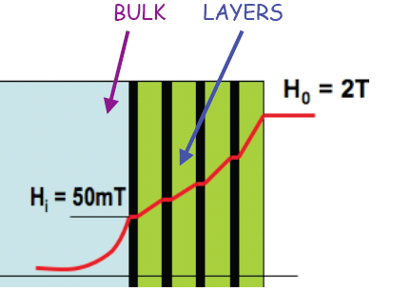
A basis to build new cavity layered structures that might allow for transformationally higher field gradients
Al
Nb
Nb
NbTiN
NbTiN
NbTiN
AlN
AlN
AlN
AlN
Gurvevich, Appl. Phys. Lett. (2006)
Layered structures raise the critical magnetic field at which vortex losses form.
ALD allows fabrication with atomic scale precision without regard to the aspect ratio.
We need to develop ALD synthetic chemistries for superconducting material growth.

Slide 15
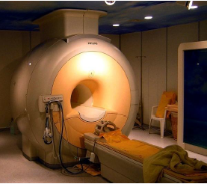
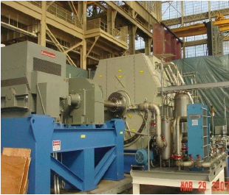
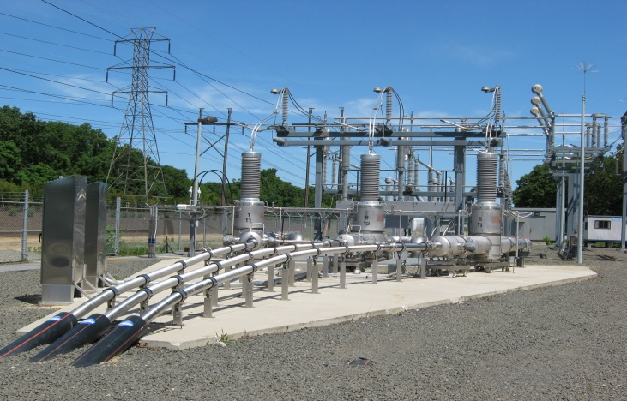
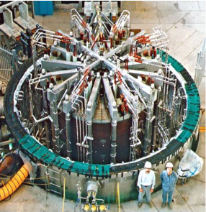
Superconductors at Work
Medical
MRI
Motors, Generators
& Wind turbines
Transportation
MagLev
Magnetic
Energy Storage
Power Cables, Electric Grid
Fusion Energy
Superconducting RF cavities
Long Island

Slide 16
Envisioned specifications for technical applications
Typical operational parameters in various superconductor applications
V. Selvamanickam, HTS4 Fusion Workshop, May 26-27, 2011, Karlsruhe, Germany
TARGET ‘Sweet spot’ for rotating machines and high field magnets
10 MA/cm² at T ~ 30K in several H = 2 – 30 Teslas
Notes:
Target specs for improving current state-of-the-art HTS YBCO commercial coated conductors

Slide 17
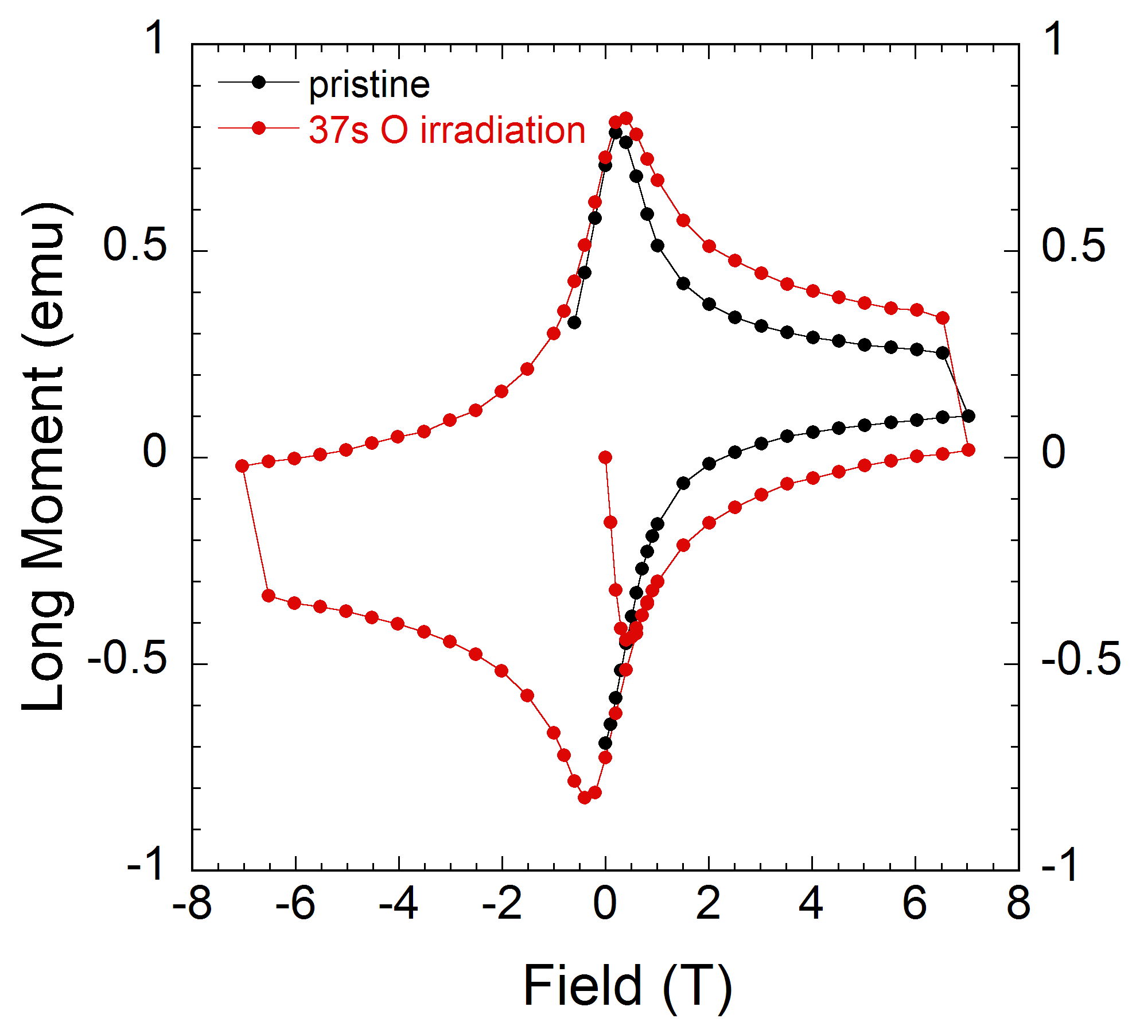
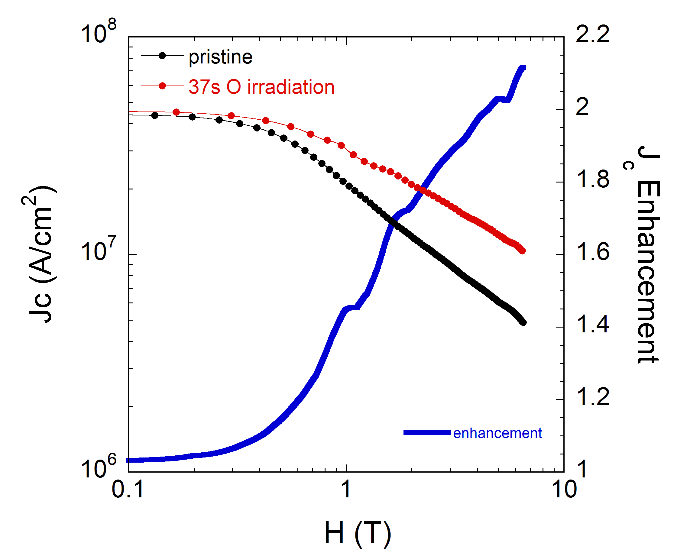

Doubling J_{c} in a Few Seconds with Oxygen Irradiation
2500 fold increase in defect creation: 1x10¹³ O²⁺/cm²
T = 5 K
ɑ = 0.57
ɑ = 0.77
M. Leroux (ANL)
A. Kayani (WMU)
• No reduction in T_{c}
• Doubling of J_{c} after 37 sec with a 17 nA beam current
• Largest enhancement in high fields: rotating machinery, transformers, magnets
Viable reel-to-reel manufacturing process

Slide 18
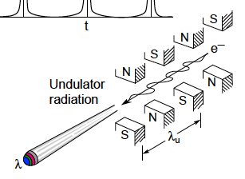
Undulators
Undulators: sources of partially coherent, tunable X-rays
commonly used in linear accelerators and storage rings
Based on deflection of relativistic electrons in a periodic magnetic structure
Magnetic deflection parameter K
B₀
Emitted wavelength
After: D. T. Attwood, http://ast.coe.berkeley.edu/sxreuv/
Range of tunability, brilliance of X-ray beam increase with K
Highest possible on-axis magnetic field B₀

Slide 19
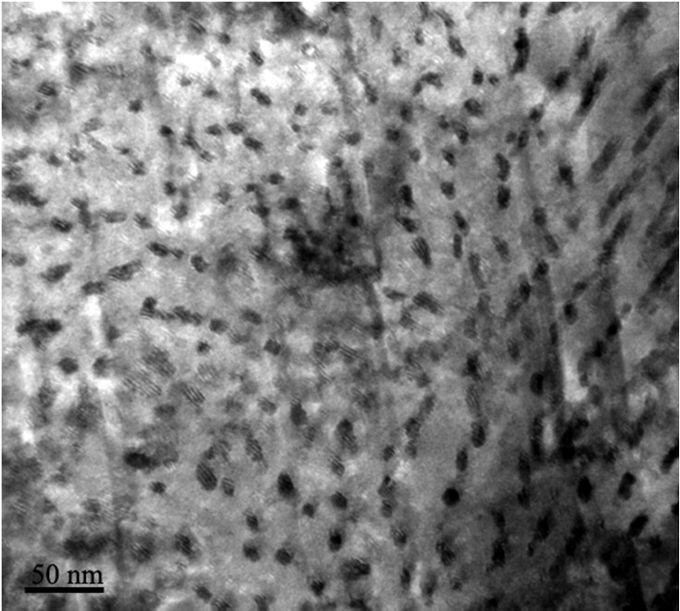
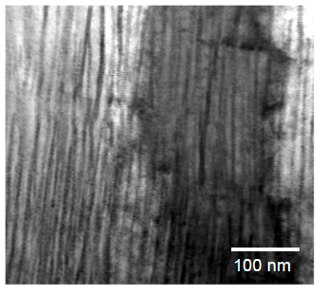
Addition of 15% zirconium to MOCVD grown YBCO:
Dense array of self-assembled BaZrO₃ nano-rods
c
effective pinning of
extended vortex
sections
Plane-view
Cross-section
V. Selvamanickam (Univ. Houston)
~ 17 nm spacing, ~ 5 nm diameter
Research samples reach the requirements for undulators

Slide 20
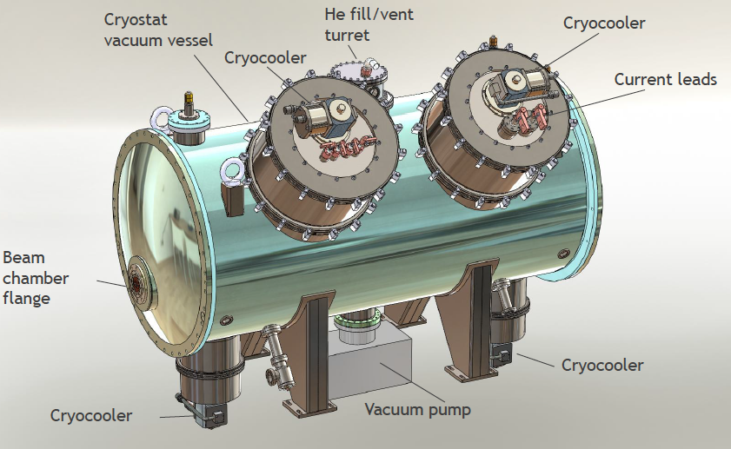
Possible operation of HTSC at temperatures above 4.2 K
Complex, expensive cryogenics for current NbTi-undulators
Y. Ivanyushenkov (ANL)
~ 10 K: higher cooling power, simpler and cheaper operation

Slide 21
Metal chalcogenide - metal halide hybrid: high density wide band gap materials for γ-ray detection
CB
E_{g}
VB
M_{x}Q_{y}
Chalcogenides
M_{x}Q_{y}X_{z}
Chalco-halides
MX_{n}
Halides
Bandgap too low
Optimum range
1.6 < E_{g} < 2.5 eV
Bandgap too high
For example:
BiBr₃ (E_{g} ~ 2.2 eV) + Bi₂S₃ (E_{g} ~ 1.1 eV) → 2BiSBr (E_{g} ~ 1.95 eV)
BiSBr has a high density of 6.7 g/cm³ and a band gap of 1.95 eV
Kanatzidis & Chung (ANL)

Slide 22
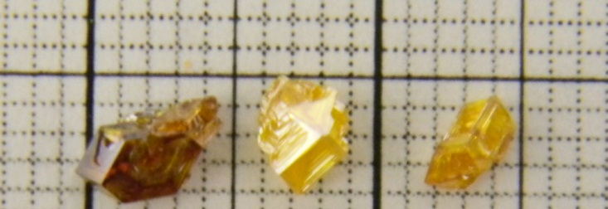
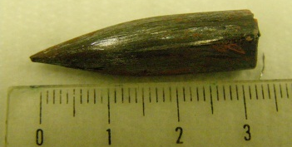
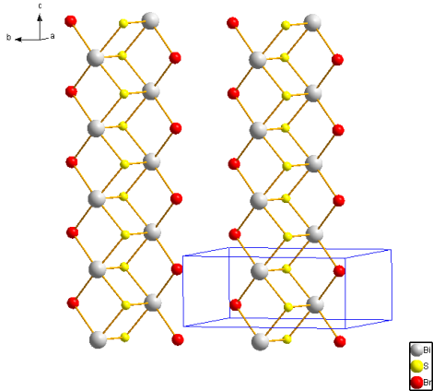
Accomplishments – crystal growth and characterization
  Initiated synthesis and growth experiments in the SbSeX and Hg₃Q₂X₂ (Q = S, Se, Te; X = Cl, Br, I) family of promising materials.
  Hg₃Te₂Br₂ phase possess the highest density in the Hg₃Q₂X₂ family of 7.78 g/cm³ and an optical band gap of 2.5 eV.
  Single crystal growth of SbSeI: - 8 mm x 10 mm in dimensions.
  Single crystal growth for Hg₃Te₂Br₂ - up to 3 x 3 x 2 mm³ in dimensions.
Hg₃Te₂Br₂
Single crystals of Hg₃Te₂Br₂ grown by vapor transport (grid is 1 mm)
Photoconductivity response
SbSeI
SbSeI
Kanatzidis & Chung (ANL)

Slide 23
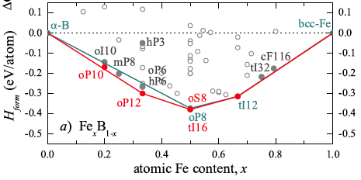
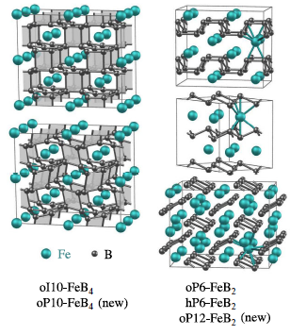
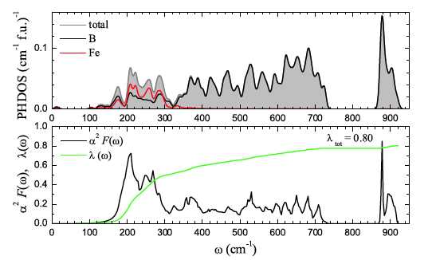
Evolutionary search for
new superconductors
(FeB series)
Predicted Superconductivity in oP10-FeB₄ (15-20K)
Kolmorgorov et al, PRL (2010)

Slide 24
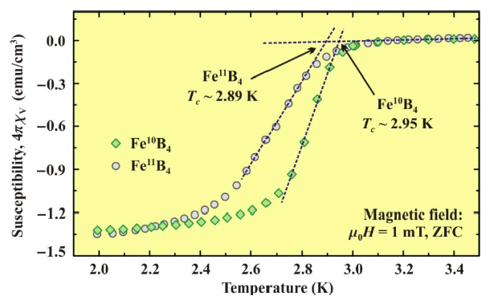
Synthesized and found to have a T_{c} of 3K
(only known “hit” from a materials genome approach)
Gou et al, PRL (2013)

Slide 25
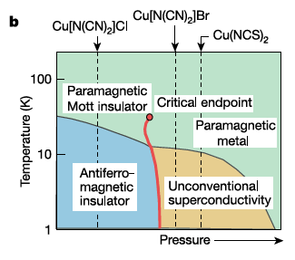
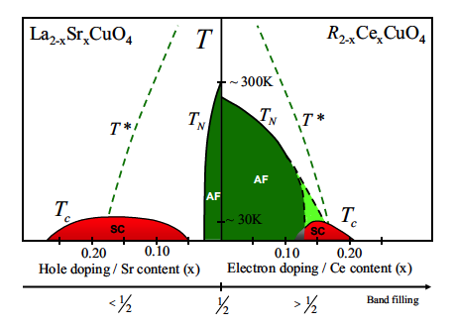
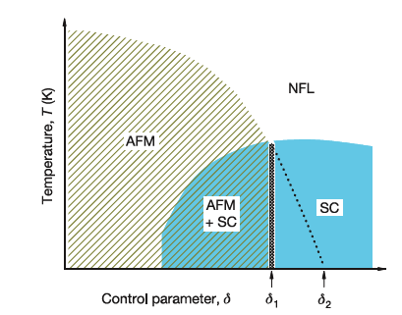
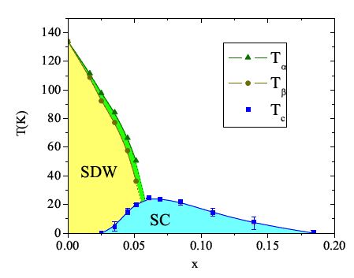
Similarity of SC Phase Diagrams
organics
cuprates
heavy fermions
pnictides

Slide 26
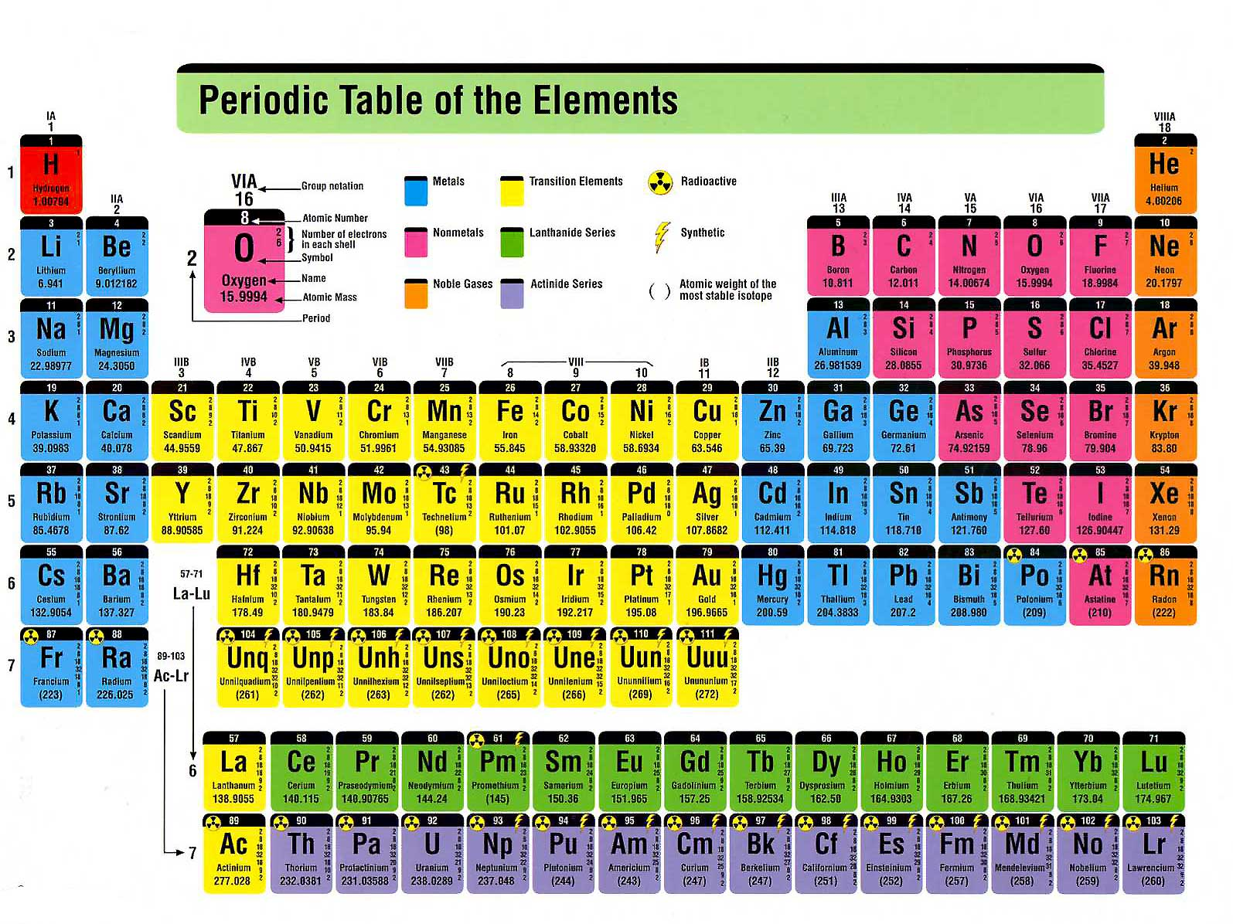
A possible search strategy for new superconductors
Yellow – the “metal”, Red – the “ligand”, Blue, Green – the “spacer”

Slide 27
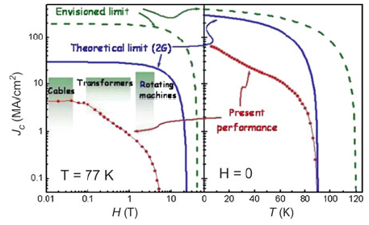
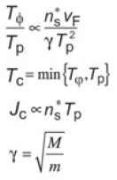
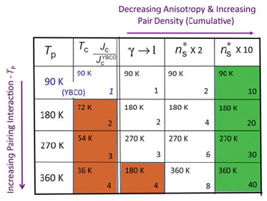
But an increased T_{c} leads
to a reduced phase stiffness
Beasley, MRS Bulletin (2011)

Slide 28
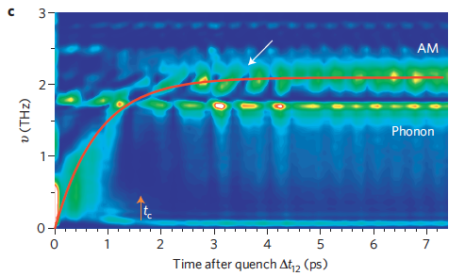
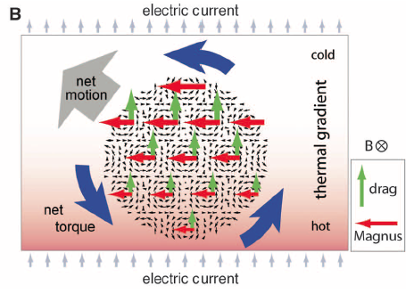
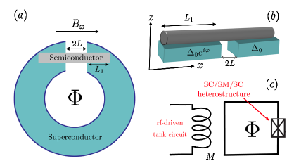
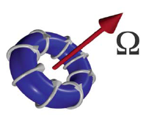
Monopoles, Anapoles, Skyrmions, Majoranas and Higgs
Welcome to the New World of Condensed Matter Physics

Slide 29
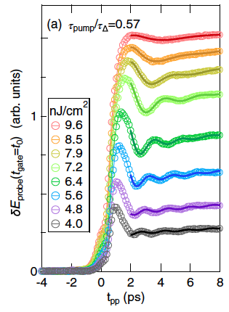
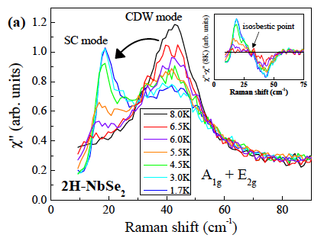
Higgs modes in superconductors and charge density waves
Transfer of weight from SC to CDW Higgs modes
with decreasing T in NbSe₂ (Raman scattering)
Measson et al, PRB (2014)
SC Higgs oscillations seen in THz
pump-probe studies of NbTiN
Matsunaga et al, PRL (2013)

Slide 30
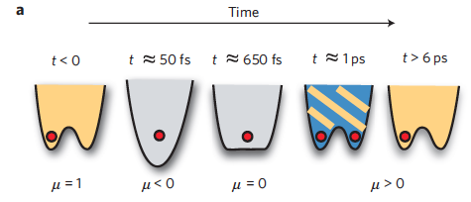
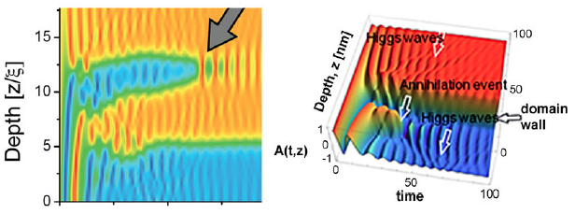
CDW order parameter domain creation and annihilation in TbTe₃
as revealed by pump-probe studies (Kibble-Zurek mechanism)
pump-probe delay (ps)
Yusupov et al., Nat. Phys. (2010)

Slide 31

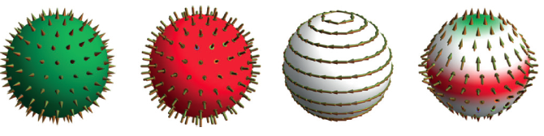
Multipole expansion of magnetic free energy in a solid where
m is the magnetic dipole moment; a the magnetic monopole;
t the toroidal (anapole) moment; q the magnetic quadrupole
+ monopole - monopole z anapole z² quadrupole
Dubrovik & Tugushev, Phys Rep (2000)
Di Matteo, J Phys D (2012)
Spaldin et al, PRB (2013)

Slide 32
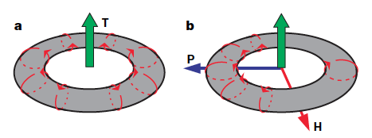
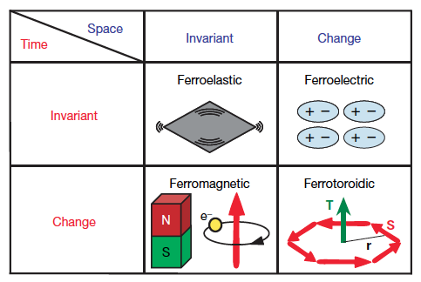

Toroidal moments have been observed in LiCoPO₄
(used as a cathode in Li-ion batteries!)
by optical second harmonic generation
Van Aken et al., Nature (2007)

Slide 33

Magnetic Monopoles in Spin Ice
Leonard: Are you really going to be on NPR?
Sheldon: Yes, they’re interviewing me by phone from my office regarding the recent so-called discovery of magnetic monopoles in spin-ices. It’s pledge week and they’re trying to goose the ratings with a little controversy.

Slide 34

Magnetic Monopole Defects in Artificial Spin Ice
imaged with Lorentz TEM
Phatak et al, PRB (2011)

Slide 35





Emergent E₈ Symmetry in an Ising Spin Chain (CoNb₂O₆)
Zamolodchikov, IJMPA (1989)
Coldea et al, Science (2010)

Slide 36



Skyrmions in Co doped FeSi (top) and Sc doped Ba ferrite (bottom)
imaged by Lorentz TEM
Yu et al, Nature (2010)
Yu et al, PNAS (2012)

Slide 37

A junction between a topological insulator (or a wire with
strong spin-orbit coupling) and a superconductor
might localize a Majorana mode at their junction
Kitaev, Phys Usp (2001)
Fu & Kane, PRL (2008)
Lutchyn et al, PRL (2010)
Oreg et al, PRL (2010)

Slide 38




Majorana Fermions in an InSb nanowire on NbTiN ?
zero mode
↓
Mourik et al, Science (2012)

Slide 39


Topological Quantum Computing by Braiding Majorana Fermions
Kitaev, Phys Usp (2001)
Nayak et al, RMP (2008)
Alicea, RPP (2012)
Beenakker, ARCMP (2013)

Slide 40


Holographic Approach – AdS/CFT
Map a strong coupling QFT on the boundary of an AdS₄ space-time to a weak coupling gravity dual in the interior with μ and T determined by a “black brane” at the center
← RG Flow (UV to IR)
AdS₂ → CFT₁
Hartnoll, Science (2008); Sachdev, ARCMP (2012)

Slide 41

Applications to Condensed Matter Physics (?)
(well, there have always been those resistant to change!)

Slide 42

Scalar fields near the “black brane” can condense (holographic
superconductivity) leading to a change from AdS₂ x R² → AdS₄
This change in geometry causes the “light cone” for spinors to open
up (plot 2) giving rise to quasiparticles, with a Majorana coupling of
the spinors to the scalar opening up a Bogoliubov gap (plots 3 and 4)
Energy vs momentum
Faulkner et al, JHEP (2010)

Slide 43
Can AdS/CFT help with condensed matter gauge theories?
(slave bosons for Kondo lattice, RVB for cuprates, etc.)
AdS/CFT large N limit is different from a typical condensed matter physics large N limit
Condensed matter gauge fields are typically constraint fields
In particular, they do not have a “kinetic” energy
(that is, one is at “infinite” coupling)
3. Can we find an AdS dual to such theories?
Nayak, Phys Rev Lett (2000)
Lee, Nagaosa, Wen, Rev Mod Phys (2006)

Slide 44


iPEPS simulations of t-J model for doped cuprates
(lower variational free energy than fixed node QMC)
U – uniform antiferromagnet (AF) + d-wave superconductor (dSC)
W5 – modulated AF + dSC + charge density wave (CDW)
W5AP – modulated AF + antiphase dSC + CDW
Corboz et al, PRL (2014)

Slide 45


Tensor Networks for Lattice Gauge Theories
H – Hilbert space
H_{P} – physical Hilbert space
D – low energy sector
(area law for entanglement)
Tagliacozzo et al, PRX (2014); Rico et al, PRL (2014);
Buyens et al, PRL (2014); Banuls et al, JHEP & PoS (2013)

