Slide 1
High Energy Physics Program International Status
Jim Siegrist
Associate Director
Office of High Energy Physics
Office of Science, U.S. Department of Energy
8-Dec-2014

Slide 2
International Agreements

Slide 3
Some Context
In 2012, under Secretary Chu, major changes were made in how DOE operates with respect to international Lab-to-Lab interactions, including:
Memoranda Of Understanding (MOU)
Cooperative Research and Development Agreements (CRADA)
Work for Others (WFO)
Agreements for Commercializing Technology (ACT)
A November 17, 2014 delegation order by Secretary Moniz provides further guidance:
Previously, the labs negotiated MOUs with foreign labs in an independent manner, with limited coordination and no HQ clearances required.
Now, lab-to-lab MOUs cannot be used for R&D collaborations and scientific exchanges, and such activities need to be cleared through the DOE Site Office and DOE HQ before being signed.
Implications for HEP:
Any actual R&D collaboration (outside info sharing and workshops) need legally binding agency-to-agency agreements negotiated at the DOE level.
Better coordination between the labs, DOE, and State Department and greater USG visibility for HEP international activities

Slide 4
Hierarchy of International Agreements
Nation-to-Nation Science & Technology Agreements:
Highest level S&T agreement acts as umbrella for legally-binding, lower-level accords. Exchange of personnel, intellectual property and other aspects of cooperation are broadly covered.
Implementing Arrangements:
Under the aegis of an S&T agreement, implementing arrangements between USG agencies and international counterparts focus on particular S&T areas of cooperation (e.g., “high energy physics and nuclear physics”) and provide additional detail on the execution of cooperative activities.
Project Annexes/Protocols:
Annexes to implementing arrangements cover cooperation on specific projects or classes of activities (e.g., “high intensity proton accelerators”).
Example: Project Annex I to the Indian DAE and U.S. DOE Implementing Arrangement for Cooperation in the Area of Accelerator and Particle Detector R&D for Discovery Science for High Intensity Proton Accelerators

Slide 5
International Agreement Process at DOE
Informal discussions with international counterparts are used to draft an agreement.
The draft is reviewed by SC International advisors and DOE General Counsel.
The DOE draft under goes the U.S. State Department interagency review (C-175 Review).
State Department approval gives DOE “authorization to negotiate” the agreement language with the other Party.
The Parties exchange drafts until convergence, after which the agreement is signed.
This process usually takes several months to complete.

Slide 6
Existing U.S.-CERN LHC Agreement
The existing agreement dates from 1997 and expires in 2017. The agreement was signed jointly between DOE and NSF and CERN. The agreement facilitated US participation in the experiments at the LHC without being a full member.
A new agreement between DOE, NSF and CERN is currently being negotiated and will hopefully be signed in the near future.
The P5 report is a major step in this process, as it reaffirms the importance of US involvement in LHC.

Slide 7
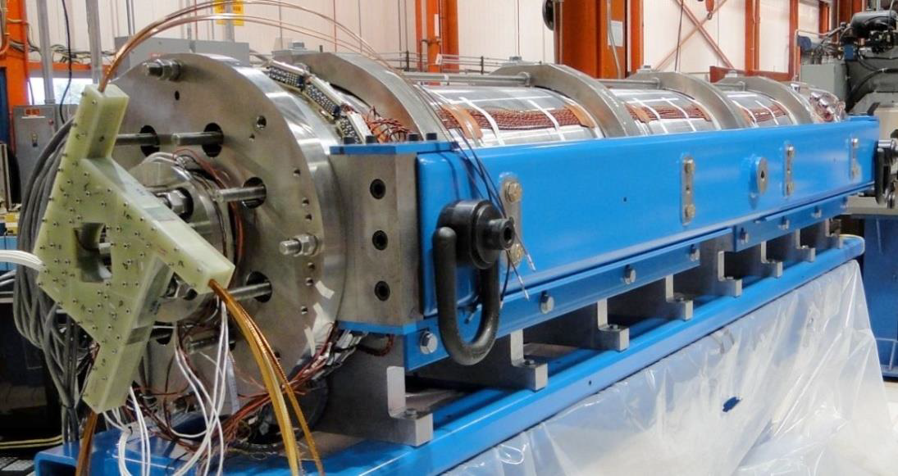
U.S.-CERN LHC Agreement Renewal
U.S. leadership in superconducting magnet technology generally, and now Nb₃Sn in particular, is widely recognized and acknowledged
U.S. LHC Accelerator Research Program (LARP) aims to leverage this expertise to serve needs of HEP community
Consists of four U.S. laboratories: BNL, Fermilab, LBNL, and SLAC (+ industrial firms)
LARP has been charged to begin prototyping accelerator components for the HL-LHC upgrades in order to reduce risk for the eventual project
U.S. Department of State has given C-175 approval to negotiate with CERN on the U.S.-CERN LHC Agreement
Bilateral Cooperation Agreement now being discussed with CERN
Concurrently, DOE has also initiated the drafting of Annexes (≡ Protocols) for the agreement
Accelerator Protocol for contribution towards LARP
Experiment Protocol for contribution towards the HL-LHC detector upgrades
A protocol outlining contribution towards an international neutrino program

Slide 8
Internationalization of Long-baseline Neutrino Program
Significant progress has been made on internationalization of LBNE:
International Meeting for Large Neutrino Infrastructures, Paris, June 22-23, 2014
FNAL Interagency Meeting on a Global Neutrino Program, July 14, 2014
World Neutrino Summit at Fermilab, July 21−22, 2014
Interim International Executive Board (iIEB) Board Meeting at Fermilab, September 23-24, 2014
iIEB SURF site visit, October 8-9
Fermilab has developed a first draft of a governance document
Draft expected to be ready in mid-December for review by iIEB
Open community meetings for potential PIs to discuss the Letter of Intent are planned at CERN and Fermilab on December 5 and 12, respectively
The LOI will be submitted to the Fermilab Program Advisory Committee after these meetings
Fermilab talk on Tuesday will discuss status and future plans for internationalization efforts in more detail…

Slide 9
International Agreements with India
An Implementing Agreement exists between DOE and the Indian Department of Atomic Energy (DAE) for Cooperation in the Area of Accelerator and Particle Detector R&D for Discovery Science
Progress is being made with India on several DOE-DAE Project Annexes:
The Annex I agreement, which enables cooperation in the area of accelerator R&D, has been signed by DAE Secretary Sinha and is en route to DOE for signature by DOE Secretary Moniz
Primary focus is on R&D and construction of high-intensity SRF linear proton accelerators (HISPA)
Significant progress has been made towards finalizing the Annex II agreement on cooperation in scientific activities that are enabled by HISPA

Slide 10
International Agreements with Italy
The State Department has just granted DOE the authority to negotiate with the Italian Ministry of Education, Universities and Research on an Implementing Arrangement for Cooperation in High Energy, Astroparticle and Nuclear Physics Research and Related Fields and Technologies.

Slide 11
International Agreements with UK
No over-arching U.S.-UK S&T agreement exists to which lower-level agreements can be attached
We need this, or equivalent, for LBNF and are actively exploring options
U.S. involvement on MICE has not required an S&T level agreement so far
In this specific case, a RAL user agreement may be appropriate formalizing this research collaboration
There are no ongoing U.S.-UK agency level meetings, but we talk regularly to UK agency representatives at various international meetings

Slide 12
International Agreements with Japan
An Implementing Arrangement between DOE and MEXT (Ministry of Education, Culture, Sports, Science and Technology) was signed in April 2013.
The U.S.-Japan S&T was renewed on April 24, 2014.
A Project Annex between DOE and MEXT for cooperation in the next generation of accelerators, detectors and related science and technologies is under review.
Regular meetings with Japanese (‘U.S.-Japan’ meetings) over 36 years attended by Lab representatives and the HEPAP chair.
Much discussion about ILC at these meetings.
Framework for future U.S. involvement with Japan on ILC exists from a U.S. perspective: when the Japanese are ready to proceed, the elements are in place to do so.

Slide 13
International Agreements with China
DOE has agreements with the Chinese Academy of Sciences and the Ministry of Science and Technology of the PRC.
We have had regular U.S.-China HEP meetings for 35 years, attended by lab representatives and HEPAP chair.
We will move toward HEP project annexes if we have joint projects large enough to justify the effort. (LBNF? JUNO? Etc.)
Daya Bay was done without formal protocols, just lab-to-lab MOU (LBNL-IHEP-BNL) as it predates the Chu orders.

Slide 14
Other Countries in Progress
Canada: SNOLab for SuperCDMS-SNOLAB
Brazil for the neutrino program
FALC (Funding Agencies for Large Colliders) meets regularly as a funding agency complement to ICFA in considering the global accelerator based program

