Slide 1


Workshop on Predictive Simulation of Internal Combustion Engine (PreSICE)
Wayne Eckerle Co-Chair
Cummins
BESAC March 18, 2011
Jointly sponsored by:

Slide 2
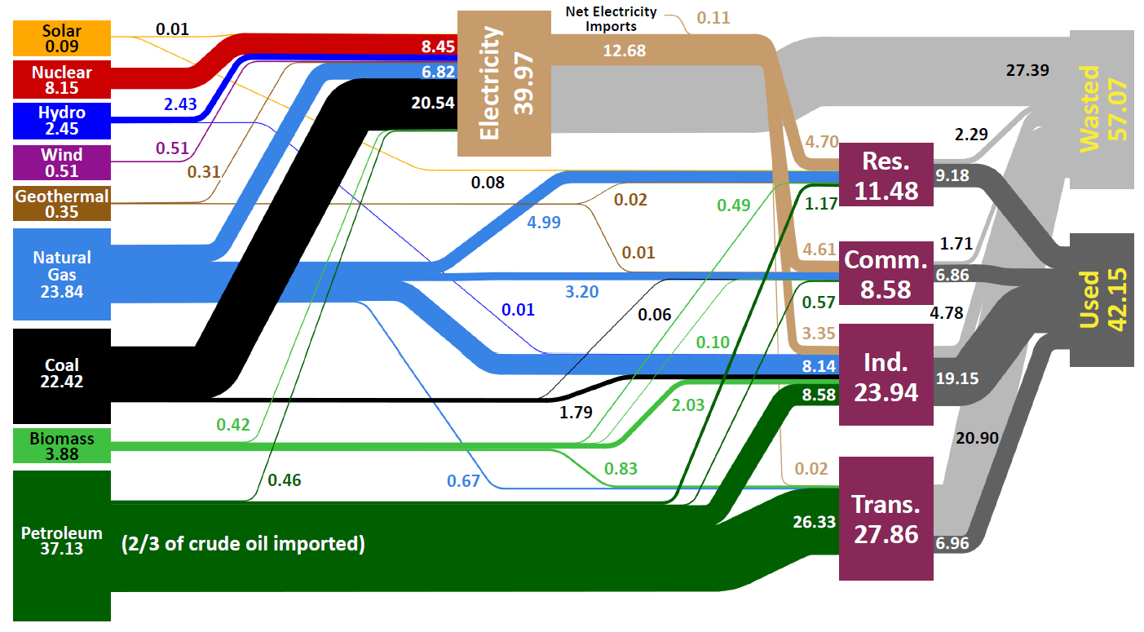
Energy Security Tied to Transportation
2/3 Oil for
Transportation
2/3 Oil Imported
Source: Lawrence Livermore National Laboratory and the Department of Energy, Energy Information Administration, 2009 (based on data from DOE/EIA-0384(2008), June 2009).

Slide 3


Reducing Fuel Use Through Enhancing Engine Efficiency
Internal combustion engines thermodynamic limit 60%
Average current gasoline engine efficiency: 30%
Improvements to >45% thermal efficiency achievable
Fuel economy improvements >50%
  Potential for 50% reduction of fuel use from cars
March 9, 2011
“Conventional gas-powered cars starting to match hybrids in fuel efficiency”
“The new Chevrolet Cruze Eco can reach eye-popping fuel economy levels of more than 50 miles per gallon on the highway, which even in this era of hybrid-electric cars stands among the best.
“But here's the real trick: The Cruze Eco is neither a hybrid nor electric. It runs on that "old" technology, the conventional gasoline engine. “
Potential to save 4 M barrels per day ($400 M per day)

Slide 4
Product Development Must Be Accelerated
To Meet Energy Goals
With predictive modeling:
Conversion to CO₂
Neutral Infrastructure
Product
Development
Cycles
Full Market
Transition
R&D
Business as usual:
2000
2010
2020
2030
2040
2050
R&D time frame unrealistically short in ‘business as usual’

Slide 5
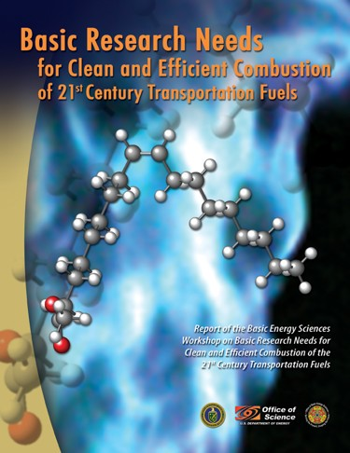

Advanced Combustion Research-Development-Deployment Critical to Achieving CO₂ and Fuel Reduction Goals
Realizing thermodynamic limits with clean operation
Maintain clean fleet operation with evolving fuel streams
Optimize IC engines for PHEV use
Grand Challenge: Predictive
Simulation of Combustion
Engine Performance in an
Evolving Fuel Environment
Predictive modeling is the key to rapid combustion optimization in a non-linear parameter space

Slide 6
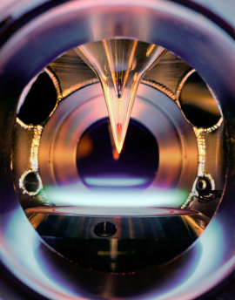
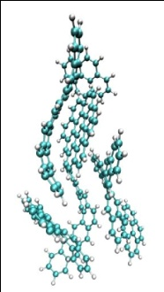
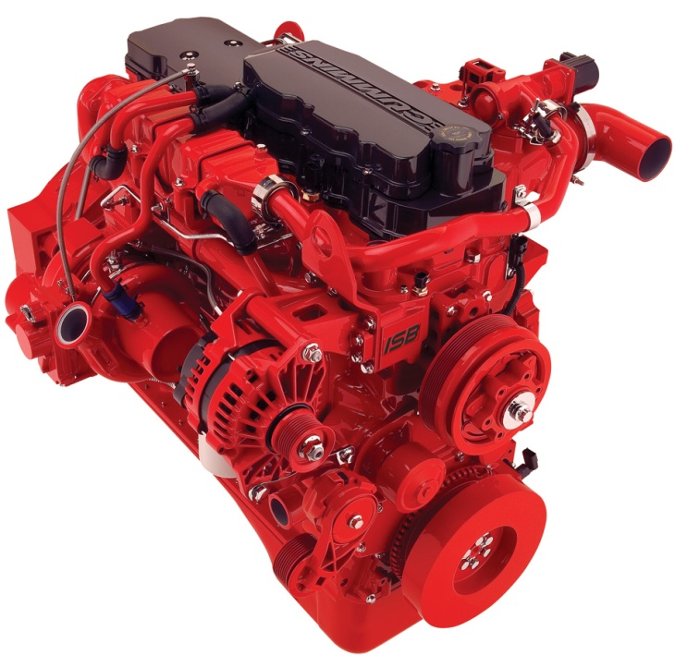
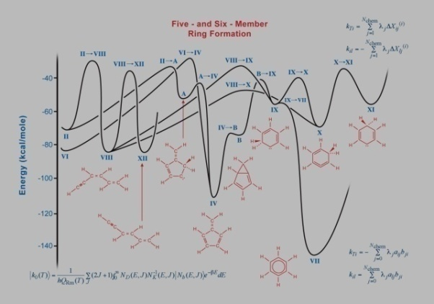

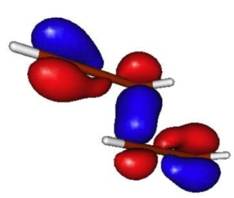
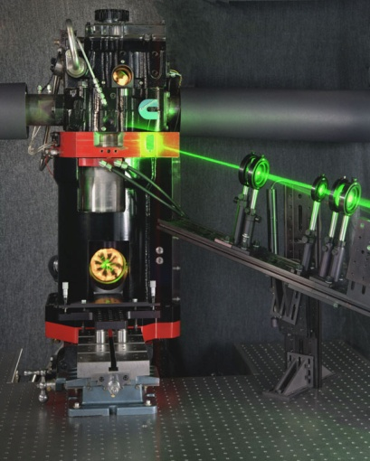
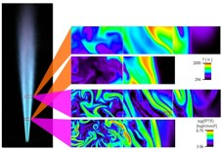
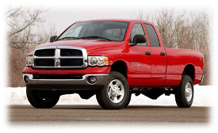
Science-Based Engine Design
An early example
Basic Science
Applied R&D
Manufacturing/
Commercialization
BES
BES → EERE
Cummins and Dodge
Sustained support in 2 areas
Applications of chemistry and diagnostics to engines
Cummins used simulation tools and improved understanding of diesel fuel sprays to design a new diesel engine with reduced development time and cost and improved fuel efficiency.
Development of predictive chemistry in model flames
Predictive chemical models under realistic conditions
Computational kinetics and experiments
Advance laser diagnostics applied to model flames
ISB 6.7 liter Cummins diesel engine first marketed in the 2007 Dodge Ram pickup truck; more than 200,000 sold
Laser diagnostics of diesel fuel sprays in engine cylinders
Laser-based chemical imaging

Slide 7
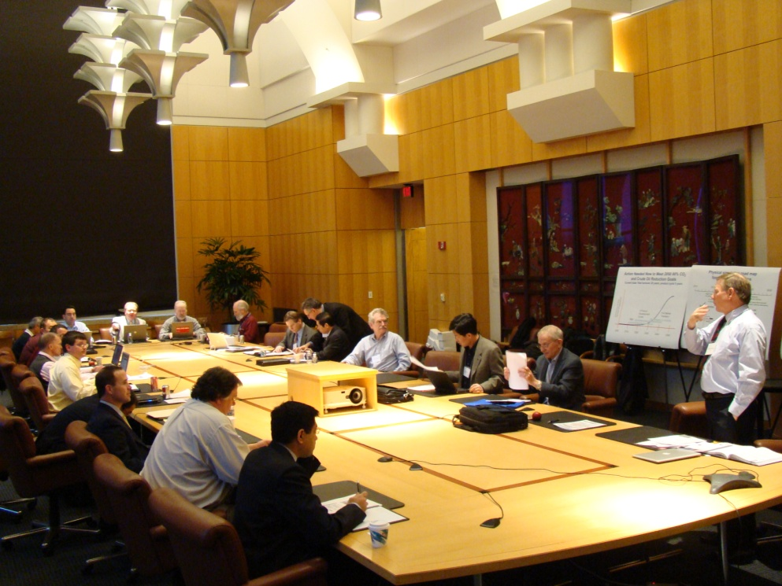
PreSICE Workshop Culmination of
Year-Long DOE-Community Engagement
Workshop for national laboratories
Sandia National Laboratories, Livermore CA
January 20, 2010
Combustion Research Facility Advisory Board
Sandia National Laboratories, Livermore CA
January 22, 2010
Workshop for industry and academia
University of Michigan, Ann Arbor, MI
February 11, 2010
Workshop on near term priorities
O’Hare Airport Hilton, Chicago, IL
March 23, 2010
Argonne National Laboratory
Lawrence Berkeley National Laboratory
Lawrence Livermore National Laboratory
Los Alamos National Laboratory
Oak Ridge National Laboratory
Pacific Northwest National Laboratory
Sandia National Laboratories
U.S. Department of Energy
U.S. Department of Treasury
University of Michigan
University of Sydney
University of Wisconsin-Madison
UC Berkeley
University of Illinois
Purdue University
Massachusetts Institute of Technology
Sawyer Associates/UC Berkeley
Chevron
BP
Caterpillar
Cummins Inc.
General Electric
Chrysler Group LLC
Ford Motor Company
General Motors
ConocoPhillips
IBM
Cray Inc
Intel

Slide 8
Identified Industry Barriers For Advanced Engines
Highest priorities – PreSICE workshop focus
Effect of stochastic nature of in-cylinder flow on engine combustion, performance and emissions
Spray modeling and experimentation in dense spray and nozzle internal flow regions, including physics like cavitation and flash boiling
Surface chemistry and physics for high-efficiency, low-temperature catalysis and filtration
Fundamental understanding of near-wall processes (e.g., flow, heat transfer, diffusion, chemistry, wall films)
High-pressure, dilute combustion including turbulence-chemistry interaction and extremes of equivalence ratio, dilution, and turbulence
All can be mitigated or overcome through science-based modeling

Slide 9
PreSICE Workshop Charge: Answer 4 Questions
Why is investment in pre-competitive R&D for predictive engine simulation needed?
Why is now the opportune time to develop predictive simulation tools for advanced engine design?
What are the critical needs in basic and applied R&D in chemistry, physics, and engineering required for the successful realization of predictive combustion simulation for engines?
What is the potential impact on the U.S. automotive and engine industries if new simulation tools are developed?

Slide 10

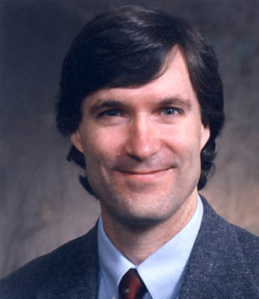




PreSICE Workshop
March 3, 2011
Sheraton National, Arlington, VA
Chairs:
  Wayne Eckerle, Cummins
  Chris Rutland, University of Wisconsin
Breakout Chairs:
  Sprays
    Caroline Genzale, Georgia Tech
    Joe Oefelein, Sandia
  Stochastic In-Cylinder Processes
    Dan Haworth, Penn State
    Volker Sick, University of Michigan

Slide 11
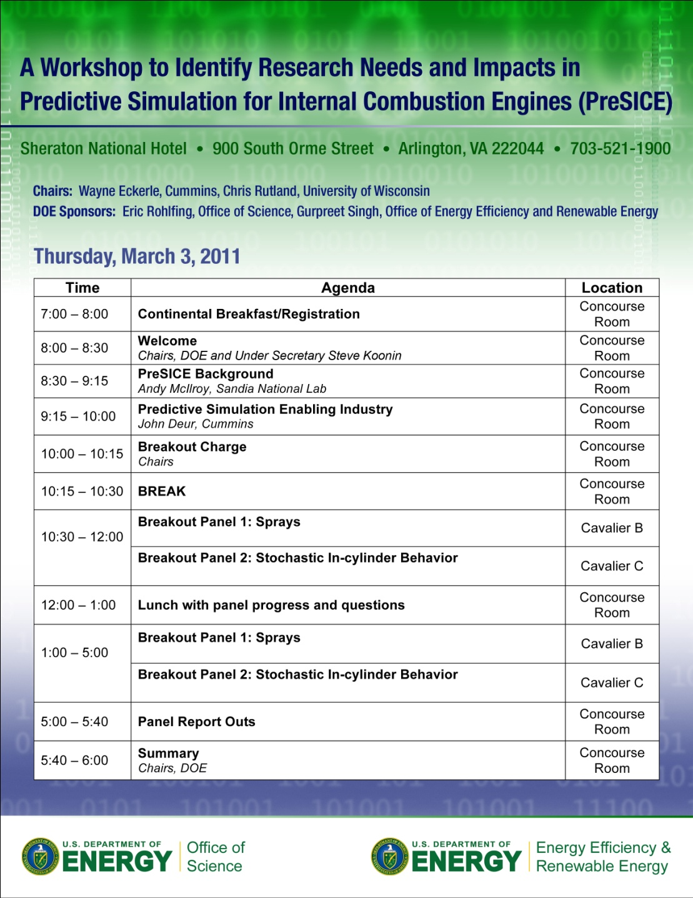
PreSICE Workshop Agenda & Attendees
Invitation only – 63 participants.
Significant industrial participation (Cummins, GM, Ford, Chrysler, Caterpillar, GE, Navistar..)

Slide 12
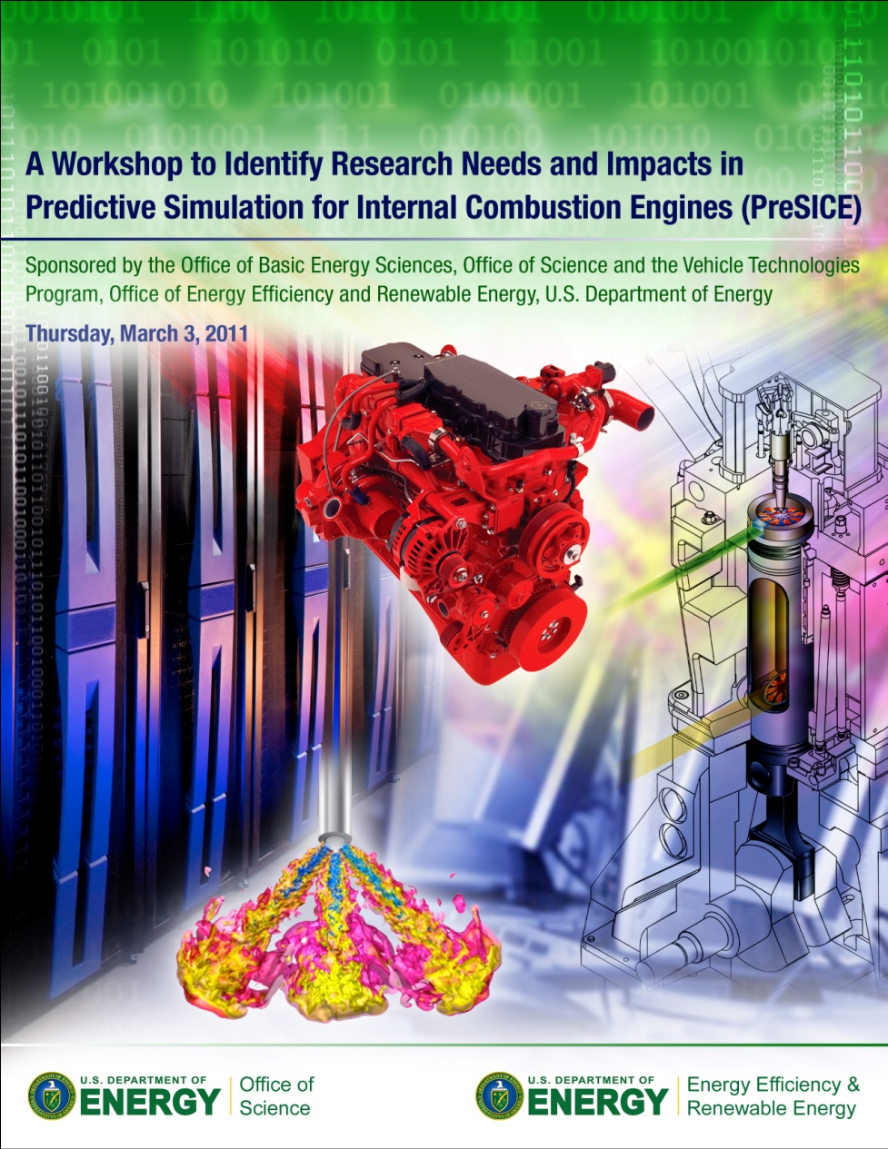
PreSICE Workshop Report
Executive Summary (1 page)
Introduction (3 pages)
Research and Development Foci:
Sprays
  Research needs (4 pages)
  Expected software tools (1 page)
  Impact on future vehicles (1 page)
Stochastic In-cylinder Processes
  Research needs (4 pages)
  Expected software tools (1 page)
  Impact on future vehicles (1 page)
Conclusion (1 page)
Report complete by March 31!

Slide 13
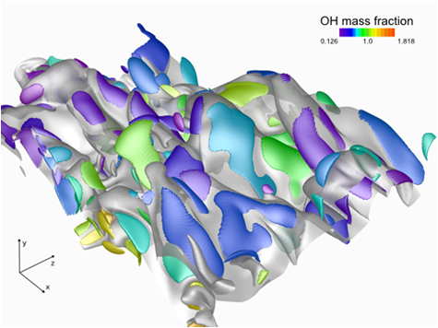
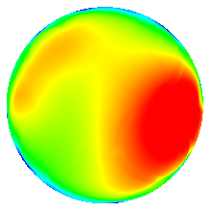
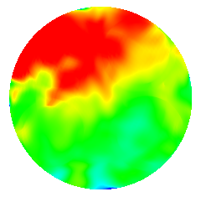
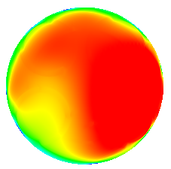
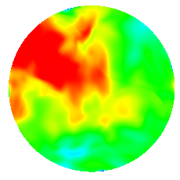
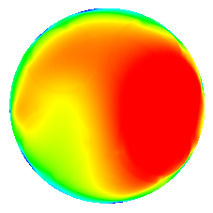
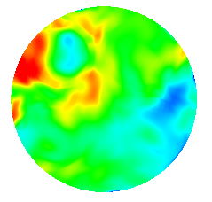
Hierarchy of software tools is needed
DNS
Direct Numerical Simulation (DNS) – Extremely high fidelity simulation tools that enable scientific discovery
High-Fidelity Large Eddy Simulation (LES) – Fine resolution and stringent error control will provide insight for modeling and the bench-mark for computations encompassing the full complexity of stochastic engine flows and sprays
Engineering LES – The design tool for minimizing cyclic variability. Less demanding computationally to allow simulations of many cycles or design optimization, but modeling of small scale processes needs refinement
Reynolds-Averaged Navier Stokes (RANS) approaches – The current workhorse of industry will continue to play a dominant role in multi-parameter optimization. Improved sub-model accuracy will lead to more optimum designs
RANS
LES
Cycle 3
Cycle 4
Cycle 5
Temperature at Start of Injection

Slide 14
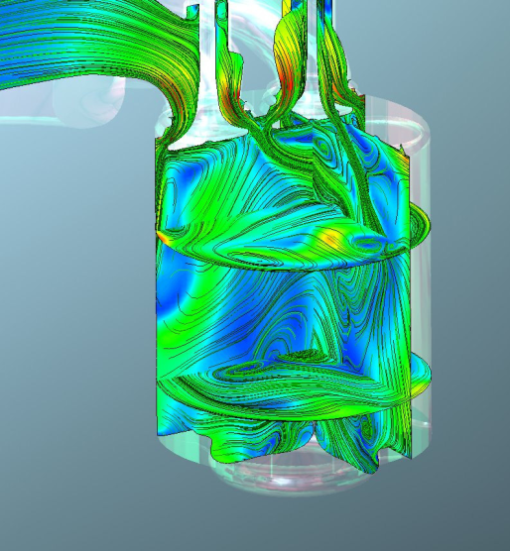
What are the critical needs?
Stochastic Processes Priority Research Directions
Development and validation of models to enable simulation of stochastic processes
  Sub-grid scale models for unresolved processes
  Reduced chemical kinetic mechanisms
  New theoretical frameworks / efficient numerical approaches
Complex in-cylinder flow during intake stroke in diesel engine
Notes:
Need captions

Slide 15
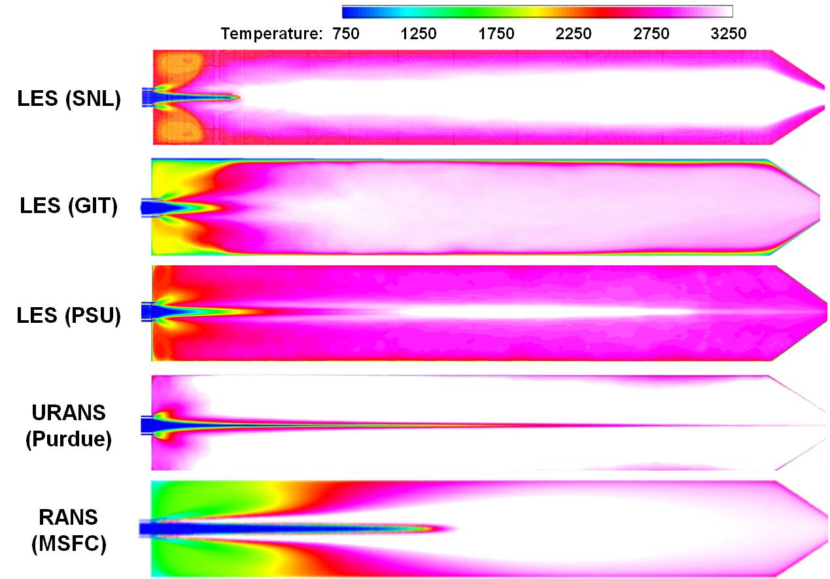
What are the critical needs?
Stochastic Processes Priority Research Directions (cont.)
Improved accuracy and minimization of uncertainty
  Ability to tune model complexity to necessary accuracy level
  Impact of uncertainty in initial conditions, boundary conditions, parameters
  Propagation of uncertainties and errors reduction

Slide 16
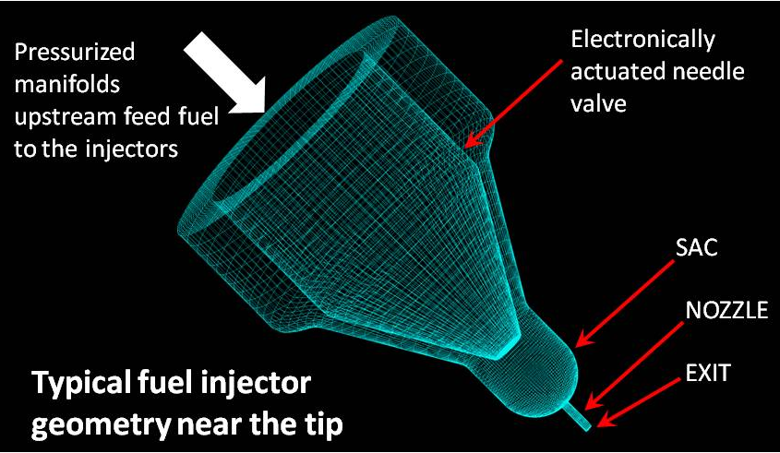
What are the critical needs?
Spray Dynamics Priority Research Directions
Detailed treatment of fuel-delivery systems (fuel rail and internal injector flows)
  Geometric complexities of flow passages upstream of injector
  High pressure internal flow dynamics and transients
  Turbulence and cavitation within injector sac and nozzle(s)

Slide 17
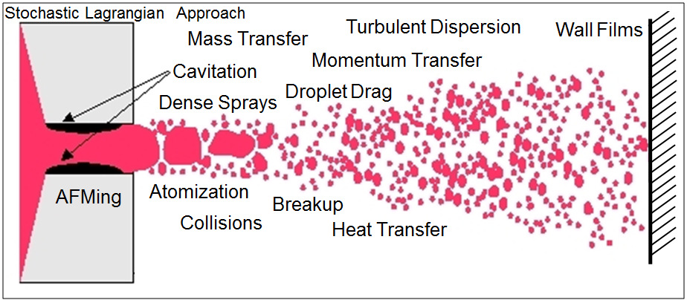
What are the critical needs?
Spray Dynamics Priority Research Directions (cont.)
Optimization of fuel-preparation strategies (in-cylinder injection, mixing and combustion)
  Injection timing and strategy (single/multiple-pulse, etc.)
  Primary-breakup, atomization, dense spray dynamics
  Secondary-breakup, particle deformation, coalescence
  Dilute drop dynamics, vaporization, combustion
  High-pressure thermodynamically supercritical flow

Slide 18
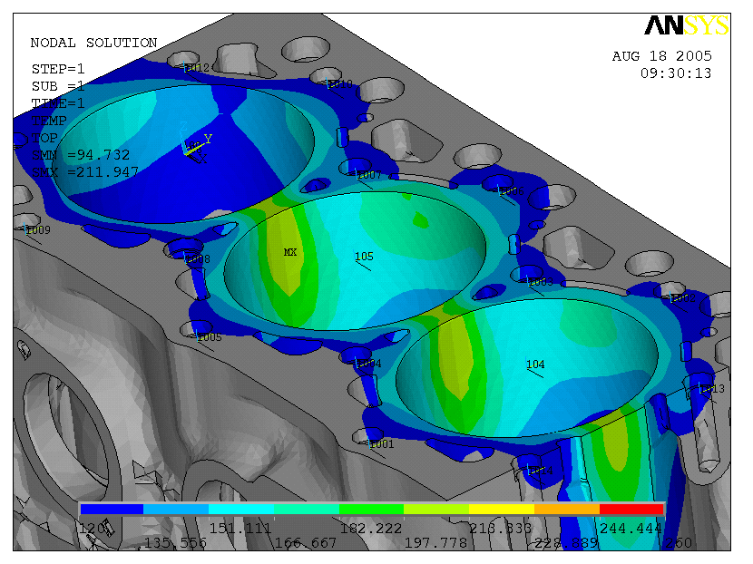
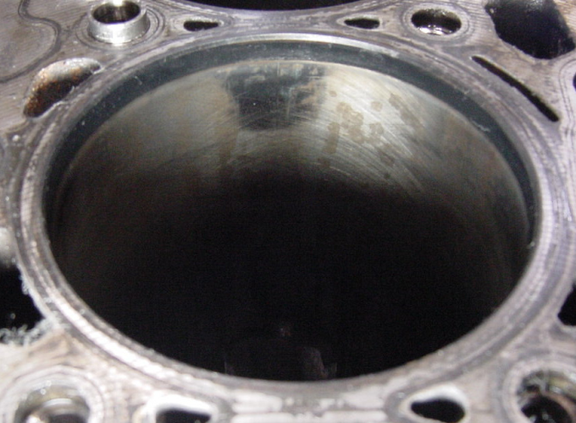
What are the critical needs?
Spray Dynamics Priority Research Directions (cont.)
In-cylinder fluid-wall interactions, heat transfer
  Fuel impingement on cylinders degrades performance, emissions and durability
  Surface temperature variations create similar problems
  Improved modeling of near-wall effects is required for advanced systems
Excessive
Wear
Calculated heat load from wall impingement and observed wear

Slide 19
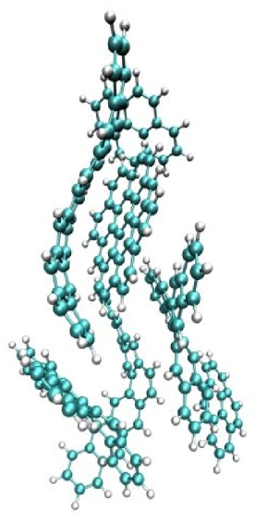
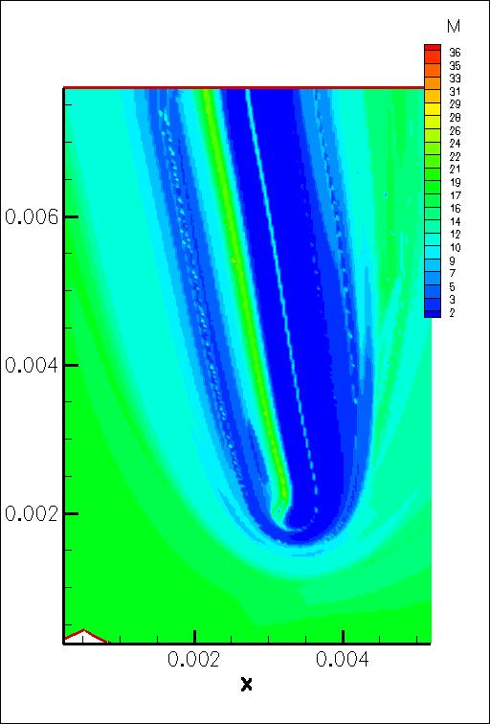
Cross Cutting Research Needs
Chemistry of complex systems
  Methods to obtain chemical force fields, rate representations, and automatic mechanism generation
  Efficient, on-the-fly kinetic mechanism reduction as a function of local conditions will be needed to enable cost-effective simulation of combustion
Uncertainty quantification
  Error (perturbation) propagation tools
  Sophisticated sensitivity analysis
Computational Singular Perturbation (CSP) theory analysis of edge flame chemistry

Slide 20
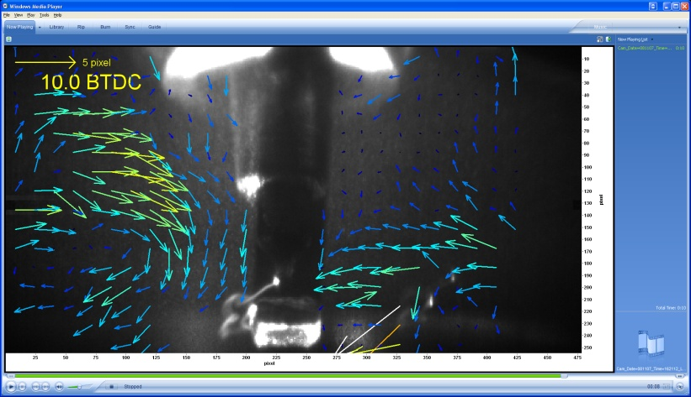
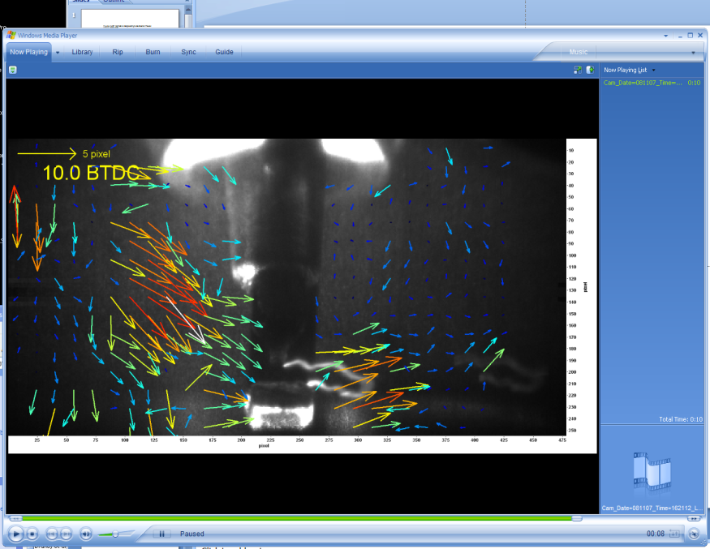
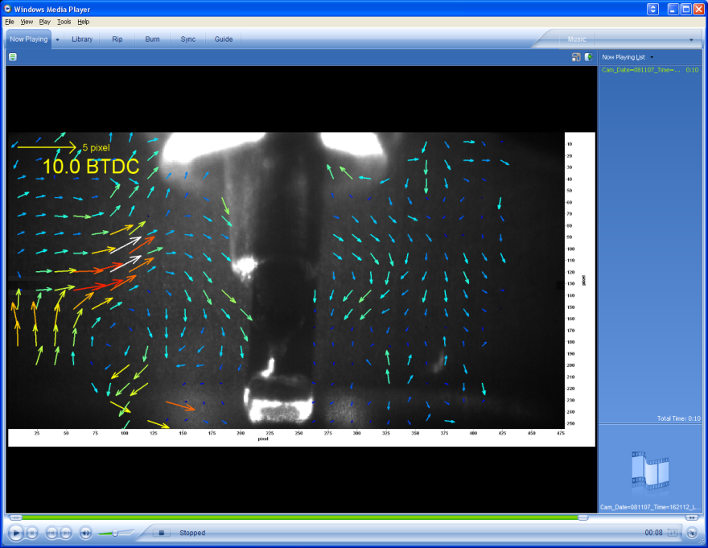
Cross Cutting Research Needs (cont.)
Development of tailored discovery and validation experiments
  Spatially and temporally-resolved, multi-parameter diagnostics
  High pressure chemistry of complex mixtures
  High pressure spray facilities with advanced diagnostics
  Standard optical engine for advanced combustion strategies
Cycle 4
Cycle 5
Cycle 33
High frame rate, in-cylinder velocity field measurements

Slide 21
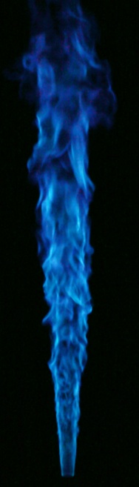
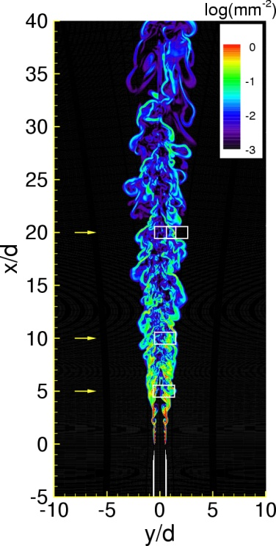
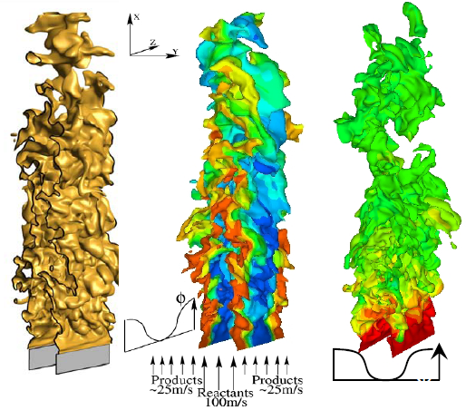
Research supporting a hierarchy of software tools is needed
Model development, validation and reduction:
  Benchmark experiments for validation data
  Companion high-fidelity LES for detailed model development and reduction (detailed physics)
  Engineering LES/RANS for engine cycle optimization and analysis (fast solution times)
  DNS for analysis of small-scale turbulence-chemistry interactions
Tool infrastructure development:
  Advanced grid generation and grid quality assessment
  Core solver development (science-based LES and engineering-based LES/RANS)
  Advanced model reduction and uncertainty quantification
  Post-processing, visualization, data management for both science and engineering
Notes:
21

Slide 22
What is the impact if new simulation tools are developed?
Design, testing, and calibration portions of the product development cycle can all be shortened
  Calibration savings alone could reduce the product development cycle time and cost by 25-50% (industry dependent)
Expand design space to broad range of design concepts
Reach the theoretical 60% limit on thermodynamic efficiency
  Potential for saving 4 M barrel of petroleum per day
A program based on PreSICE will enhance the competitiveness of and develop the future workforce for US industry, improve US energy security, and promote global environmental security.

Slide 23
Thank you!
Questions?

