Slide 1
FY 2012 budget Presentation for DOE’s Office of Science
March 17, 2011
Dr. W. F. Brinkman
Director, Office of Science
U.S. Department of Energy
www.science.doe.gov

Slide 2

Office of Science
Science to Meet the Nation’s Challenges Today and into the 21st Century
The Frontiers of Science
  Supporting research that led to over 100 Nobel Prizes during the past 6 decades—22 in the past decade alone
  Providing 45% of Federal support of basic research in the physical sciences and key components of the Nation’s basic research in biology and computing
  Supporting over 27,000 Ph.D.s, graduate students, undergraduates, engineers, and support staff at more than 300 institutions
21st Century Tools of Science
  Providing the world’s largest collection of scientific user facilities to over 26,000 users each year

Slide 3
Science, Innovation, and DOE’s Office of Science
  Science is the basis of technology and underpins all of the work of DOE.
  Science of the 20th century brought us the high standard of living we now enjoy. Today, we are laying the foundations for the new technologies of the coming decades.
  Progress in science and technology depends on continuing advances in, and replenishment from, basic research, which is the federal government’s—and SC’s—special role.
  A highly trained work force is required to invent the future—scientists and engineers trained in the most modern science and technologies and with access to the best tools.

Slide 4

Our Generation’s Sputnik Moment
  “This is our generation's Sputnik moment. Two years ago, I said that we needed to reach a level of research and development we haven't seen since the height of the Space Race.
  …[this] budget to Congress helps us meet that goal. We'll invest in biomedical research, information technology, and especially clean energy technology—an investment that will strengthen our security, protect our planet, and create countless new jobs for our people.”
Remarks of President Barack Obama
State of the Union Address to the Joint Session of Congress
Tuesday, January 25, 2011

Slide 5
Office of Science Research Underpins the President’s Goals
  The Office of Science commands an arsenal of basic science capabilities—major scientific user facilities, national laboratories, and researchers—that we are using to break down the barriers to new energy technologies.
  We have focused these capabilities on critical national needs, e.g., through the Bioenergy Research Centers, the Energy Frontier Research Centers, and the new Energy Innovation Hub—the Joint Center for Artificial Photosynthesis.

Slide 6
New in FY 2012: Science for Innovation and Clean Energy
  Applications of 21st century science to long-standing barriers in energy technologies: employing nanotechnology, biotechnology, and modeling and simulation
  Examples:
    Materials by design using nanoscale structures and syntheses for: carbon capture; radiation-resistant and self-healing materials for the nuclear reactor industry; highly efficient photovoltaics; and white-light emitting LEDs.
    Biosystems by design combining the development of new molecular toolkits with testbeds for the design and construction of improved biological components or new biohybrid systems and processes for improved biofuels and bioproducts.
    Modeling and simulation to facilitate materials and chemistry by design and to address technology challenges such as the optimization of internal combustion engines using advanced transportation fuels (biofuels).

Slide 7
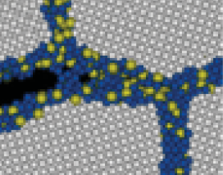
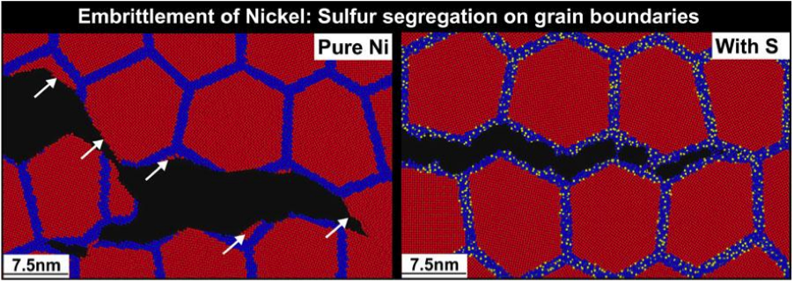


Stress Corrosion Cracking
Molecular Dynamics Simulation Reveals Mechanisms of Nickel Fracture
Fracture simulations for nanocrystalline nickel without and with amorphous sulfide grain- boundary phases, showing ductile, transgranular tearing and brittle, intergranular cleavage.
The performance and lifetime of materials used in nuclear technology and in advanced power generation are severely limited by corrosive environments and extreme conditions.
Premature failure of materials can result from undetected stress corrosion cracking.
Annually, corrosion costs about 3% of the U.S. gross domestic product.
48-million-atom simulation on Argonne Leadership Computing Facility showed a link between sulfur impurities segregated at grain boundaries of nickel and embrittlement. An order-of-magnitude reduction in grain-boundary shear strength, combined with tensile-strength reduction, allows the crack tip to always find an easy propagation path in this configuration. This mechanism explains an experimentally observed crossover from microscopic fracture to macroscopic cracks due to sulfur impurities.
Notes:
A multidisciplinary team of physicists, chemists, materials scientists, and computer scientists made innovations in simulation methods and parallel computing technologies to perform the largest-ever (48 million atoms), chemically reactive molecular dynamics simulation on 65,536 IBM Blue Gene/P processors at the Argonne Leadership Computing Facility. The team answered a fundamental question encompassing chemistry, mechanics, and materials science: How a minute amount of impurities segregated to grain boundaries of a material essentially alters its fracture behavior. The researchers simulated the introduction of small amounts of sulfur into the boundaries between nickel grains to investigate a material property known as “embrittlement.” Seeing how different configurations of nickel function at these exceptionally small scales helps them understand the basic chemistry that will expedite the development of next-generation nuclear reactors. The study was published in Physical Review Letters (April 2010).
Figure Caption: Closeups of fracture simulations for nanocrystalline nickel without and with amorphous sulfide grain- boundary phases, where red, blue, and yellow colors represent nickel atoms inside grains (>0.5 nanometers from grain boundaries), nickel atoms within 0.5 nm from grain boundaries, and sulfur atoms, respectively. The figure shows a transition from ductile, transgranular tearing to brittle, intergranular cleavage. White arrows point to transgranular fracture surfaces.

Slide 8
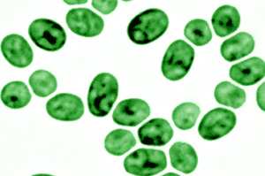
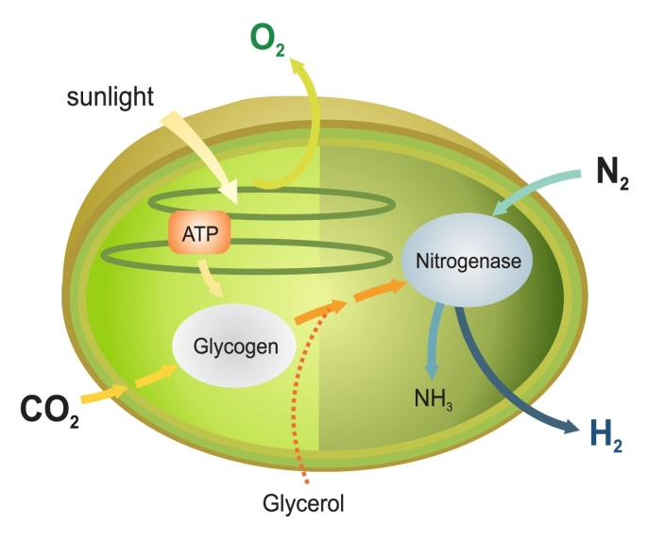
Systems Biology for Bioenergy Production
Systems biology techniques were used to dissect how the common microbe Cyanothece balances photosynthesis with carbon, nitrogen, and hydrogen metabolism.
Although oxygen is toxic to the enzymes involved in ammonia and hydrogen production, Cyanothece is unique in generating both in the presence of air and while producing O₂ as a byproduct of photosynthesis.
These results suggest metabolic engineering this microbe for enhanced production of hydrogen, biodiesel, or other biofuels using only water and sunlight and without the need for added fertilizers.
Bandyopadhyay, A., J. Stockel, H. Min, L. Sherman, & H. Pakrasi. 2010. “High Rates of Photobiological Hydrogen Production Under Aerobic Conditions “ Nature Communications DOI:10.1038/ncomms1139
Notes:
High rates of photobiological H₂ production by a cyanobacterium under aerobic conditions
Anindita Bandyopadhyay1, Jana Stöckel1, Hongtao Min2, Louis A. Sherman2 & Himadri B. Pakrasi1
Among the emerging renewable and green energy sources, biohydrogen stands out as an appealing choice. Hydrogen can be produced by certain groups of microorganisms that possess functional nitrogenase and/or bidirectional hydrogenases. In particular, the potential of photobiological hydrogen production by oxygenic photosynthetic microbes has attracted significant interest. However, nitrogenase and hydrogenase are generally oxygen sensitive, and require protective mechanisms to function in an aerobic extracellular environment. Here, we describe Cyanothece sp. ATCC 51142, a unicellular, diazotrophic cyanobacterium with the capacity to generate high levels of hydrogen under aerobic conditions. Wild-type Cyanothece 51142 can produce hydrogen at rates as high as 465 μmol per mg of chlorophyll per hour in the presence of glycerol. Hydrogen production in this strain is mediated by an efficient nitrogenase system, which can be manipulated to convert solar energy into hydrogen at rates that are several fold higher, compared with any previously described wild-type hydrogen-producing photosynthetic microbe.
In the present report, we describe Cyanothece sp. ATCC 51142, a cyanobacterial strain with the ability to produce remarkably high amounts of H2 under aerobic conditions. Cyanothece strains thrive in marine environments limited in dissolved inorganic bioavailable nitrogenous compounds, and have been recognized for their role in maintaining the marine nitrogen cycle. Cyanothece 51142 can derive the majority of its nutritional requirements from sunlight, atmospheric carbon dioxide and nitrogen gases. During the day, it performs photosynthesis and fixes carbon, which is stored as large reserves of glycogen. At the onset of the dark period, high rates of respiration rapidly create a suboxic intracellular environment. This, in turn, facilitates oxygen-sensitive and energy-intensive processes such as N2 fixation and H2 production to occur at night at the expense of the accumulated glycogen. The orchestrated diurnal cycling patterns of the central metabolic processes in this organism have recently been described using a global transcriptomic approach. These unique attributes of Cyanothece 51142, which make it an ideal organism for H2 production, are possibly the remnants of the metabolic and regulatory processes that aided in the acclimatization of ancient cyanobacteria during their transition from an anaerobic to an aerobic environment. Retention of ancient metabolic traits that originated in the Archaean oceans has been reported in other cyanobacterial strains.

Slide 9
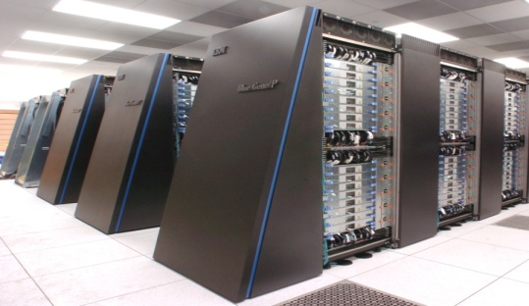



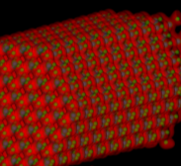
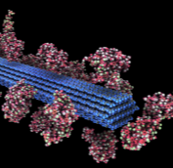
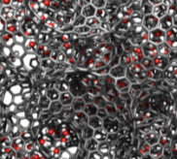


Modeling and Simulation at the Petascale
The Cray XT5 ("Jaguar") at ORNL and the IBM Blue Gene/P ("Intrepid") at ANL will provide ~2.3 billion processor hours in FY12 to address science and engineering problems that defy traditional methods of theory and experiment and that require the most advanced computational power.
Peer reviewed projects are chosen to advance science, speed innovation, and strengthen industrial competitiveness.
Demand for these machines has grown each year, requiring upgrades of both.
Among the topics in FY2011:
Advancing materials for lithium air batteries, solar cells, and superconductors
Exploring carbon sequestration
Improving combustion in fuel-efficient, near-zero-emissions systems
Understanding how turbulence affects the efficiency of aircraft and other transportation systems
Designing next-generation nuclear reactors and fuels and extending the life of aging reactors
Developing fusion energy systems
Understanding the roles of ocean, atmosphere, land, and ice in climate change
Argonne Leadership Computing Facility
Oak Ridge Leadership Computing Facility
In FY 2012, the Argonne LCF will be upgraded with a
10 petaflop IBM Blue Gene/Q. The Oak Ridge LCF will continue site preparations for a system expected in FY 2013 that will be 5-10 times more capable than the Cray XT-5.
Nuclear Reactor Simulation
Fusion Plasmas
Nanoscale Science
Biofuels
Energy Storage Materials
Turbulence

Slide 10
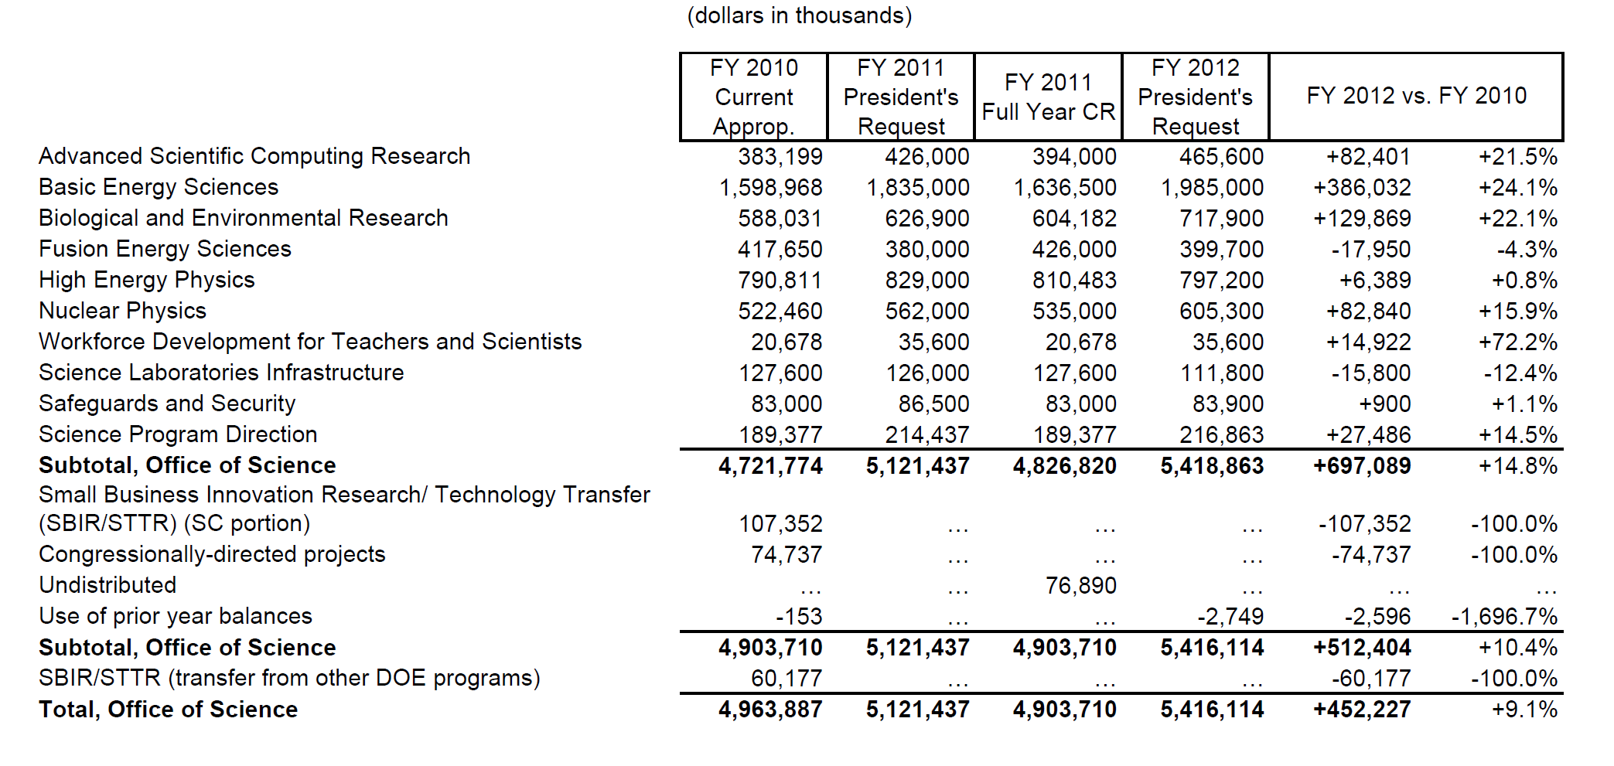
Office of Science FY 2012 Budget Request to Congress
Continuing Resolution (CR) column reflects the current CR (P.L. 111-322), annualized to a full year. Funding amounts reflect the FY 2010 appropriation level prior to the SBIR/STTR transfer. Funding on the undistributed line reflects FY 2010 Congressionally directed project funding prior to the SBIR/STTR transfer.

Slide 11
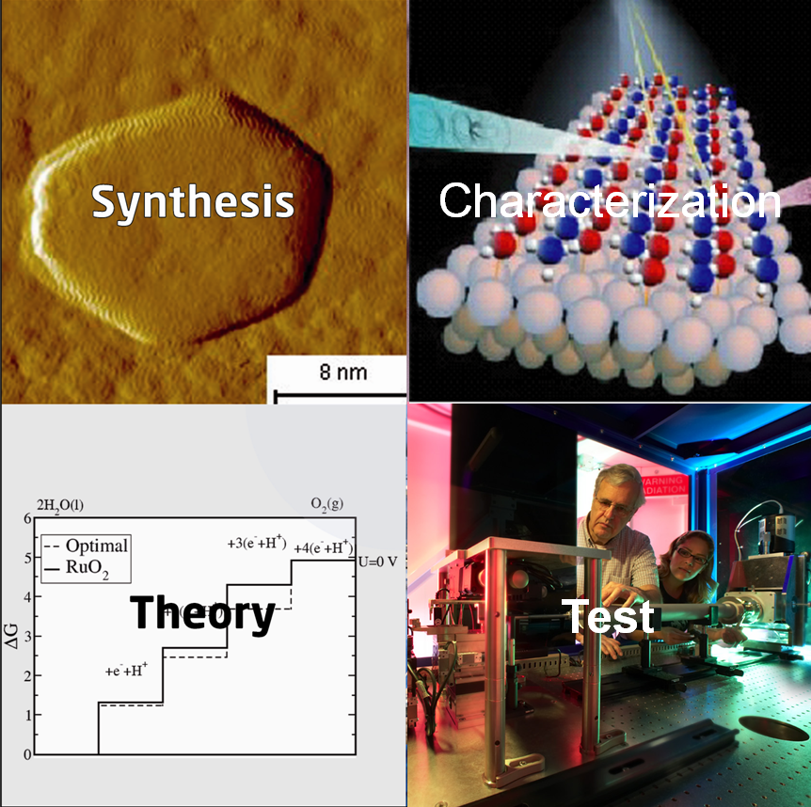
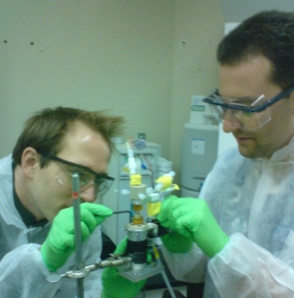
Science for Clean Energy: Materials by Design
Research to establish materials design rules to launch an era of predictive modeling, changing the paradigm of materials discovery from serendipity to rational design.
Discovery of new materials has been the engine driving science frontiers and fueling technology innovations. The U.S. has the world’s most powerful suite of tools for materials synthesis, characterization, and computation.
Research Focus:
  Synthesis: Rational molecular-scale design guided by simulation.
  Characterization and Testing: Verify & validate computational designs and software, including in situ measurements using x-ray, neutron, microscopy, and nanoscience facilities.
  Theory/Simulation: New methods and algorithms for complex, multi-scale systems. Development of software and toolkits through a networked, broad community. Emphasis areas include: catalysis, light-weight materials, and materials for energy applications including radiation-resistant materials, carbon capture, batteries, liquid fuels, and photocatalysis.
Test
11

Slide 12
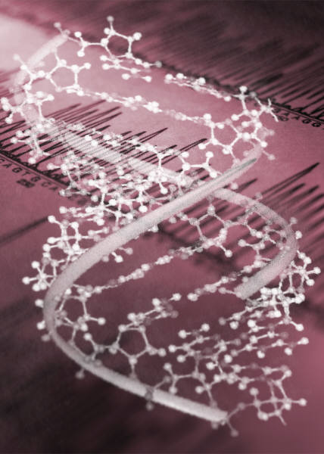
Science for Clean Energy: Biosystems by Design
Research to establish biological design rules to enable the predictive design of innovative natural and hybrid systems for clean energy production.
Discovery and synthetic redesign of plant and microbial systems pushes science frontiers and paves the way for sustainable production of advanced biofuels and bioproducts. Leverages strong U.S. resources and leadership in fundamental biological research and industrial biotechnology.
Research focus:
Synthesis: New methods for high-throughput data acquisition to catalogue components of biological systems. Develop genetic toolkits to measure rates and magnitudes of processes, and identify regulatory control points in metabolic pathways and cellular networks. Apply fundamental biological design rules for predictive integration of components and processes, including potentially new cellular functions.
Characterization & Testing: Verify & validate computer-aided design toolkits for improved genetic manipulation of plants and microbes and design of hybrid biosystems , building on knowledge of the natural world. Develop new testbeds to prototype and validate performance and function.
12

Slide 13



JCAP Collaborating Energy Frontier Research Centers
Harry Atwater | Light-Material Interactions in Energy Conversion | California Institute of Technolog, Pasadena,CA
Friedric B. Prinz | Center on Nanostructuring for Efficient Energy Conversion | Stanford University, Stanford, CA
Berend Smit | Center for Gas Separations Relevant to Clean Energy Technologies | UC Berkeley, Berkeley, CA
John Bowers | Center on Materials for Energy Efficiency Applications | UC Santa Barbara, Santa Barbara, CA
James Spivey | Computational Catalysis and Atomic-Level Synthesis of Materials: Building Effective Catalysts from First Principles | Louisiana State University, Baton Rouge, LA
Thomas Russell | Polymer-Based Materials for Harvesting Solar Energy | University of Massachusetts, Amherst, MA
Peter Green | Solar Energy Conversion in Complex Materials | University of Michigan, Ann Arbor, MI
Victor Klimov | The Center for Advanced Solar Photophysics | Los Alamos National Labs
Hector Abruna | Nanostructured Interfaces for Energy Generation, Conversion, and Storage | Cornell University, Ithaca, NY
Kenneth Reifsnider | Science Based Nano-Structure Design and Synthesis of Heterogeneous Functional Materials for Energy Systems | University of South Carolina, Columbia, SC
Devens Gust | EFRC Center for Bio-Inspired Solar Fuel Production | Arizona State University, Tempe, AZ
Neal R. Armstrong | Center for Interface Science: Hybrid Solar Electric Materials | University of Arizona, Tucson, AZ
Vidvuds, Ozolins | Molecularly Assembled Material Architectures for Solar Energy Production, Storage, and Carbon Capture | UC Los Angeles, Los Angeles, CA
Daniel Dapkus | Emerging Materials for Solar Energy Conversion and Solid State Lighting | University of Southern California, Los Angeles, CA
Alex Zunger | Center for Inverse Design | National Renewable Energy Laboratory, Golden, CO
Michael Thackeray | Center for Electrical Energy Storage: Tailored Interfaces | Argonne Nat'l Labs, Argonne, IL
Michael Wasielewski | Argonne-Northwestern Solar Energy Research Center | Northwestern University, Evanston, IL
Thomas Meyer | Solar Fuels and Next Generation Photovoltaics | University of North Carolina, Chapel Hill, NC
David Wesolowski | Fluid Interface Reactions, Structures and Transport Center | Oak Ridge National Labs, Oak Ridge, TN
Morris Bullock | Center for Molecular Electrocatalysis | Pacific Northwest National Laboratory, Richland, WA
13

Slide 14
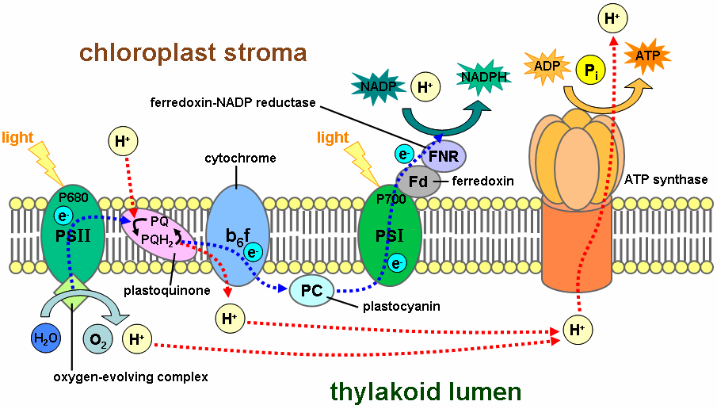
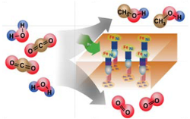
Fuels from Sunlight Energy Innovation Hub:
Joint Center for Artificial Photosynthesis (JCAP)
The design of highly efficient, non‐biological, molecular‐level “machines” that generate fuels directly from sunlight, water, and carbon dioxide is the challenge.
Basic research has provided an understanding of the complex photochemistry of the natural photosynthetic system and the use of inorganic photo‐catalytic methods to split water or reduce carbon dioxide – key steps in photosynthesis.
JCAP Mission: To demonstrate a scalable, manufacturable solar-fuels generator using Earth-abundant elements, that, with no wires, robustly produces fuel from the sun 10 times more efficiently than (current) crops.
JCAP R&D focuses on:
      Accelerating the rate of catalyst discovery for solar fuel reactions
      Discovering earth-abundant, robust, inorganic light absorbers with optimal band gap
      Providing system integration and scale-up
Begun in FY 2010, JCAP serves as an integrative focal point for the solar fuels R&D community – formal collaborations have been established with 20 Energy Frontier Research Centers.
14
Natural photosynthesis
Artificial photosynthesis

Slide 15
Batteries and Energy Storage Energy Innovation Hub
Transform the Grid and Electrify Transportation
Improved energy storage is critical for the widespread use of intermittent renewable energy, electric vehicles, and efficient and reliable smart electric grid technologies.
The Hub, proposed for FY 2012, will develop electrochemical energy storage systems that safely approach theoretical energy and power densities with very high cycle life.
These are systemic challenges requiring new materials, systems, and knowledge.
The Hub will address key fundamental questions in energy storage including:
  Can we approach theoretical energy density?
  Can we safely increase the rate of energy utilization?
  Can we create a reversible system with minimal energy loss?
The Hub will link fundamental science, technology, and end-users, and it will collaborate with relevant Energy Frontier Research Centers, ARPA-E and EERE
15

Slide 16
R&D Coordination
  The FY 2012 budget request includes funding for integrated R&D activities across the Office of Science and the DOE technology programs.
  The Office of Science will address topics for which an understanding of fundamental phenomena is required to achieve game-changing discoveries for mid-to-long-term technological innovation.
  The DOE technology programs will address topics in applied research, development, and deployment to gain and apply knowledge to achieve identified near-to-mid-term clean energy goals.
16

Slide 17

Secretary
Steven Chu
Deputy Secretary
Daniel B. Poneman
Advanced Research Projects Agency – Energy
Arun Majumdar
Under Secretary for Nuclear Security/Administrator for National Nuclear Security Administration
Thomas P. D’Agostino
Under Secretary
for Science
Steven E. Koonin
Under Secretary
Cathy Zoi (A)
Defense Nuclear Nonproliferation
Office of Science
William Brinkman
Patricia Dehmer
Energy Efficiency & Renewable Energy
Cathy Zoi
Defense Programs
Basic Energy Sciences
Harriet Kung
High Energy Physics
Mike Procario (A)
Naval Reactors
Fossil Energy
Victor Der (A)
Counter-terrorism
Advanced Scientific Computing Research
Dan Hitchcock (A)
Nuclear Physics
Tim Hallman
Nuclear Energy
Pete Lyons (A)
Defense Nuclear Security
Biological & Environmental Research
Sharlene Weatherwax (A)
Fusion Energy Sciences
Ed Synakowski
Electricity Delivery
& Energy Reliability
Pat Hoffman
Emergency Operations
SBIR/STTR
Manny Oliver
Workforce Develop. for Teachers & Scientists
Bill Valdez
Notes:
17

Slide 18
Continuum of Research, Development, and Deployment
Applied
Research
Technology
Maturation
& Deployment
Discovery
Research
Use-Inspired
Basic Research
Office of Science
Applied Programs
ARPA-E*
Goal: new knowledge / understanding
Focus: phenomena
Metric: knowledge generation
Goal: practical targets
Focus: performance
Metric: milestone achievement
Basic research to address fundamental limitations of current theories and descriptions of matter in the energy range important to everyday life – typically energies up to those required to break chemical bonds.
Basic research for fundamental new understanding on materials or systems that may revolutionize or transform today’s energy technologies
Basic research for fundamental new understanding, usually with the goal of addressing scientific showstoppers on real-world applications in the energy technologies
Proof of new, higher-risk concepts
Prototyping of new technology concepts
Explore feasibility of scale-up of demonstrated technology concepts in a “quick-hit” fashion.
Research with the goal of meeting technical milestones, with emphasis on the development, performance, cost reduction, and durability of materials and components or on efficient processes
Scale-up research
Small-scale and at-scale demonstration
Cost reduction
Manufacturing R&D
Deployment support, leading to market adoption
High cost-sharing with industry partners
* ARPA-E: targets technology gaps, high-risk concepts, aggressive delivery times

Slide 19
R&D Continuum for Energy Storage (Batteries/Vehicles)
Discovery
Research
Use-Inspired
Basic Research
Applied
Research
Technology
Maturation
& Deployment
Office of Science
ARPA-E
Applied Programs
BES
Understand and predict interfacial charge transfer and multi-body effects
Predict and control dynamics of phase transitions
Control of chemistry and its dynamics at electrified interfaces
Physicochemical consequences of nano-dimensions
Fundamentals of solvation dynamics and ionic transport
Retrosynthetic approaches to high performance new materials
Design of new materials capable of multi-electron storage per redox center
Understand design criteria for electrolytes that enable higher voltages
Tailor nanoscale electrode architectures for optimal transport
Novel chemistries for scavenging impurities and self-healing
Generation of knowledge and computational and experimental tools to predict properties, performance evolution, and lifetime of materials
ARPA-E
Quick scale-up feasibility tests of demonstrated new-generation battery technology concepts
Rapid development of new technology concepts—demonstration within 1-2 years
EERE: Significant focus on batteries and capacitors for vehicle applications
Development of full battery systems and advanced materials for those systems
Systems analysis which includes thermal analysis and simulation, various simulations to determine battery requirements, life modeling, and recycling studies
Research, development, and engineering of higher energy advanced materials and cell chemistries that simultaneously address the life, performance, abuse tolerance, and cost issues.
Research on inherent thermal and overcharge abuse tolerance of different Li-ion cell materials, components, and cell chemistries.
Batteries/ Vehicle Energy Storage
Battery and Energy Storage Hub*
ARPA-E (Individual Awards)
Demonstration
Individual Awards
Individual Awards
Individual Awards
Individual Awards
Individual Awards
Small Groups: EFRCs
Small Group Awards
BES User Facilities: New tools & techniques
* Proposed
Development & Test Facilities

Slide 20
R&D Continuum for Energy Storage (Grid)
Discovery
Research
Use-Inspired
Basic Research
Applied
Research
Technology
Maturation
& Deployment
Office of Science
ARPA-E
Applied Programs
BES
Understand and predict interfacial charge transfer and multi-body effects
Predict and control dynamics of phase transitions
Control of chemistry and its dynamics at electrified interfaces
Physicochemical consequences of nano-dimensions
Fundamentals of solvation dynamics and ionic transport
Retrosynthetic approaches to high performance new materials
Design of new materials capable of multi-electron storage per redox center
Understand design criteria for electrolytes that enable higher voltages
Tailor nanoscale electrode architectures for optimal transport
Novel chemistries for scavenging impurities and self-healing
Generation of knowledge and computational and experimental tools to predict properties, performance evolution, and lifetime of materials
ARPA-E
Focus on storage technology for short-duration variability in renewable generation.
Proof of concept storage-component projects; advanced system prototypes that address known shortcomings of existing systems
OE: Focus on decreasing cost and size while increasing performance of storage systems
Advanced research in new or scaled batteries systems, flywheels, electrochemical capacitors, superconducting magnet energy storage, power electronics, and control systems, working closely with industry partners.
Collaborative projects with utilities and state energy organizations on pioneering storage installations at the several megawatt size
Analytical studies on technical and economic performance of grid storage technologies
Demonstration of storage technologies on intermittency issues.
Grid Energy Storage
Battery and Energy Storage Hub*
ARPA-E (Individual Awards)
Demonstration
Individual Awards
Individual Awards
Individual Awards
Individual Awards
Individual Awards
Small Groups: EFRCs
Large-Scale Demonstration
BES User Facilities: New tools & techniques
* Proposed

Slide 21
R&D Continuum for Biofuels
Discovery
Research
Use-Inspired
Basic Research
Applied
Research
Technology
Maturation
& Deployment
Office of Science
ARPA-E
Applied Programs
BER:
Systems biology towards understanding the principles underlying the structural and functional design of living systems
Predictive capability to model and engineer optimized plants, microorganisms and enzymes
BES:
Rational catalyst design and chemical transformation control
Structure-activity relationships of inorganic, organic, and hybrid catalytic materials in solution or solids
BER:
Genetic properties, molecular and regulatory mechanisms and resulting functional potential of microbes & plants for novel approaches to new biofuels
Mining for natural environments for new biological catalysts.
Characterization of microbial soil communities
BES:
Biochemical and biophysical principles determining assembly and architecture of biopolymers and protein complexes
Mechanisms of biological energy transduction, bioinspired solar energy conversion
Synthesis of robust, functional catalysts that mimic biological processes
Solar conversion into oils and biofuels in plant and algal systems
ARPA-E
Non-photosynthetic electrofuels – using microbial use of electric currents (from solar PV) to convert CO₂ & H₂O to fuels; engineering of H₂-using microbes to convert CO₂ liquid fuels and other hydrocarbons
Production of isobutanol from seaweed
EERE:
Validate and demonstrate biorefinery technologies at pilot through commercial scale; integrated biorefineries employing combinations of feedstocks and conversion technologies, main focus is biofuels, but side products (chemicals, heat, power) allowed
Sustainable feedstock production; cellulosic bioenergy crop selection and inventory – updating the “Billion Ton Study,” replicated field trials
New technologies for sustainable commercialization of algal biofuel
Process improvement of industrial enzymes and microbial biofuel fermentation; performers take strains to a commercial scale and have a business strategy to market the organism/process.
Development and testing of biofuels and fuel mixes for performance, emissions, engine longevity, also combined with different vehicle technologies
ARPA-E (Individual Awards)
Demonstration
Individual Awards
Individual Awards
Individual Awards
Individual Awards
Individual Awards
Individual Awards
Small Group Awards
DOE Bioenergy Research Centers
Small Group Awards
Joint Genome Institute
Development & Test Facilities

Slide 22
Funding Overview
Office of Science
Applied Programs
ARPA-E
Funding Source
Funding
Small Groups [e.g., EFRCs]
Large, Multi-disciplinary Groups [e.g., Hubs]
Facilities
Large-Scale Demonstrations
Funding Modality
Individual
Awards
Funding
Universities
National Labs
Small Businesses
Large Corporations/
Utilities
Performer

Slide 23

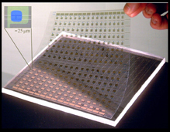


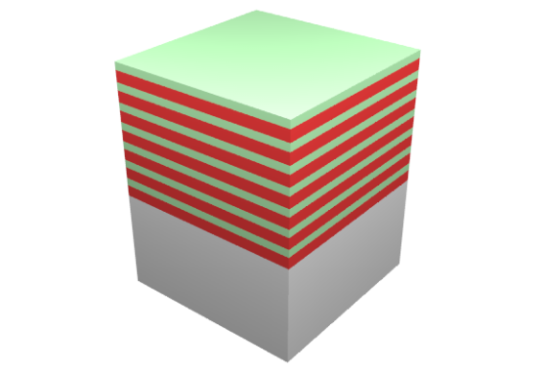





Low Cost Solar Cells:
From Fundamental Research to Commercialization
Basic Science
Applied R&D
Manufacturing/
Commercialization
EERE Solar America Initiative: Established new materials strategies & manufacturing methods for low-cost, high performance photovoltaic modules
John Rogers, Ralph Nuzzo (co-founders)
Micro-Contact Printed Solar Cells
Industrial collaborations
GaAs epi-stacks for
solar microcells
Basic research focused on materials-centric aspects of a micro-transfer printing process for single crystalline silicon and other semiconductors, dielectrics and metals.
release; transfer print
AlAs release
layers
GaAs wafer
etch in HF
regrow
23
Notes:
John Rogers and Raplh Nuzzo University of Illinois
BES-supported materials research at UIUC has resulted in an extensive intellectual property (IP) portfolio related to printable, flexible electronics.
The basic research knowledge base includes key materials-centric aspects of a micro-transfer printing process for single crystalline silicon and other semiconductors, dielectrics and metals.
BES-supported materials research at UIUC has resulted in an extensive intellectual property (IP) portfolio related to printable, flexible electronics.
The basic research knowledge base includes key materials-centric aspects of a micro-transfer printing process for single crystalline silicon and other semiconductors, dielectrics and metals.
Key Technology Outcomes/Benefits:
Efficiencies of ~12% at thicknesses of 15 microns (> 10x thinner than conventional monocrystalline silicon photovoltaic devices)
Integration with flexible substrates (e.g., plastic)
Integration with optical over-layers for directing/focusing light
Controllable transparency
The goal of the EERE program was to establish new materials strategies & manufacturing methods for low-cost, high performance photovoltaic modules
Semprius has 25 full-time employees; 2 researchers received PhD’s at UIUC under DOE BES support
Large joint development programs: Siemens (solar), Cambridge Display Technology, Sumitomo, X-FAB
First purchase order for 1 kW concentrator PV system from Tucson Electric Power
Attracted over $10 M in venture capital funding from: Applied Materials, Arch, GVC, In-Q-Tel and Intersouth Partners,

Slide 24
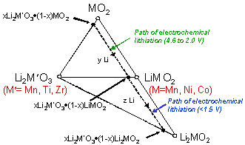


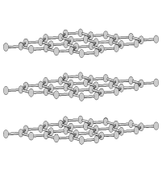


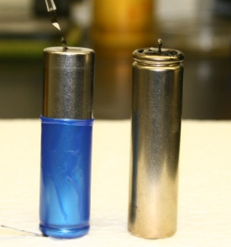

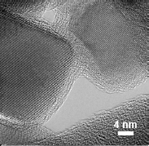


High-Energy Lithium Batteries:
From Fundamental Research to Cars on the Road
Basic Science
Applied R&D
Manufacturing/
Commercialization
Li_{x}C₆
(Anode)
xLi₂MnO₃•(1-x)LiMO₂
(Cathode)
e⁻
Li⁺
Discovered new composite structures for stable, high-capacity cathodes
Created high energy Li-ion cells…
Nanoparticle TiO₂ anode/C coating
EFRC research
…with double cathode capacity, enhanced stability
Tailored electrode-electrolyte interface using nanotechnology
Licenses to materials and cell manufacturers and automobile companies
24
Notes:
Basic Science
The story of this new battery technology begins in the late 1990s, when the DOE's Office of Basic Energy Sciences funded an intensive study of lithium-ion batteries. Basic challenge was that existing materials were not sufficient to create a battery with enough power for a high-range vehicle.
Basic research looked at atomic structure of materials. Team wanted to improve the cathode – began by using APS synchrotron to monitor and understand reactions in lithium batteries in real time
Using new synthesis methods, created lithium- and manganese-rich materials that proved remarkably more stable than previous battery materials.
On the anode side, nanotechnologists produced carbon-coated TiO2 anode particles, each of which is electronically connected to a neighboring particle providing excellent electronic contact between the particles
4. Patents for new materials granted in 20xx.
Applied R&D
Argonne materials used to create high-energy lithium-ion cells. The researchers increased the upper charging voltage limit to 4.6 volts—higher than the usual operating voltage—and saw a tremendous jump in the battery's energy capacity.
The manganese-rich cathodes were more stable, so batteries were safer, less likely to overheat. Additionally, manganese is less expensive, reducing battery cost.
New cells represented a radical leap forward – more powerful, cheaper, safer and longer-lasting. Rare for a breakthrough to provide all those benefits at once.
Promising new results -- High-energy composite electrode uses advanced nano-processing to increase the battery capacity substantially; Technology won R&D 100 award
Manufacturing/commercialization
ANL collaborated closely with battery manufacturers, carmakers to transfer technology.
LG Chem licensed the technology from Argonne and used the materials to create the battery supplied for the 2011 Volt. GM has also licensed the technology for their own tests. Other battery manufacturers have licensed as well.
Batteries are a large, heavy component of electric and hybrid cars, and so it's best to manufacture them near the factory where the cars are assembled. That creates real opportunity to renew battery industry in U.S. To promote new car battery industry, $1.5 billion in federal stimulus grants went to several companies last year—including A123 Systems, Johnson Controls and an LG-Chem subsidiary—to build battery plants in the U.S. using Argonne technology.
This battery technology represents a step towards energy independence for the U.S. provides positive impact on the environment – cuts to the heart of green energy.
Current technology remains available for licensing to other private companies
Future results
Lithium-ion technology improvements will bring down cost of producing plug-in hybrid cars – puts savings in the hands of taxpayers who funded research
Foreign Policy magazine recently noted, "The future of the electric-car industry belongs not to the scientists and engineers who perfect the batteries we have now, but the ones who figure out what comes next, in the 2020s, the 2030s, and beyond... The holy grail is a battery powerful and safe enough to challenge the energy density of gasoline and the freedom of the internal combustion engine.”
Argonne science continues to work on 20-year horizon to address these challenges, studying new chemistries and focusing on the electrode-electrolyte interface that allow for higher energy capacity. Argonne’s EFRC, the Center for Electrical Energy Storage, is focused on addressing fundamental gaps in understanding atomic and molecular-level processes batteries and developing novel technologies to challenge current limits of electrochemical energy storage and create new breakthroughs for next-generation batteries.
While the ideal Li-ion battery is key to today’s electric vehicle technologies, the storage device with gasoline-level capacity has not yet been invented. Argonne now pursuing research into Lithium-air batteries. Li-air batteries use a catalytic air cathode that converts oxygen to lithium peroxide, an electrolyte and a Li anode. Hold promise of energy density 5 to 10 time higher than lithium-ion batteries. Will require solution to critical scientific challenges. ANL Director’s Grand Challenge LDRD focused on chemistries and interfaces in Li-air systems.
1. K. Amine, I. Belharouak, Z. H. Chen, T. Tran, H. Yumoto, N. Ota, S.T. Myung, and Y.K. Sun, Nanostructured Anode Material for High-Power Battery System in Electric Vehicles. Advanced Materials, 22(28): p. 3052-3057 (2010).
2. S. M. Oh, S. W. Oh, C. S. Yoon, B. Scrosati, K. Amine, and Y.K. Sun, High-Performance Carbon-LiMnPO4 Nanocomposite Cathode for Lithium Batteries. Advanced Functional Materials, 20(19): p. 3260-3265 (2010).
Michael M. Thackeray, Sun-Ho Kang, Christopher S. Johnson, John T. Vaughey, Roy Benedek and S. A. Hackney, “Li2MnO3-stabilized LiMO2 (M = Mn, Ni, Co) electrodes for lithium-ion Batteries,” Journal of Materials Chemistry, (2007) 17, 3112
3. Michael M. Thackeray, Christopher S. Johnson, John T. Vaughey, N. Li and Stephen A. Hackney, “Advances in manganese-oxide ‘composite’ electrodes for lithium-ion Batteries,” Journal of Materials Chemistry, (2005) 15, 2257
4. Jeom-Soo Kim, Christopher S. Johnson, John T. Vaughey, and Michael M. Thackeray, “Electrochemical and structural properties of xLi2M¢O3â(1-x)LiMn0.5Ni0.5O2 electrodes for lithium batteries (M¢ ) Ti, Mn, Zr; 0 e x E 0.3),” Chem. Mater., Vol. 16, No. 10, 2004

Slide 25
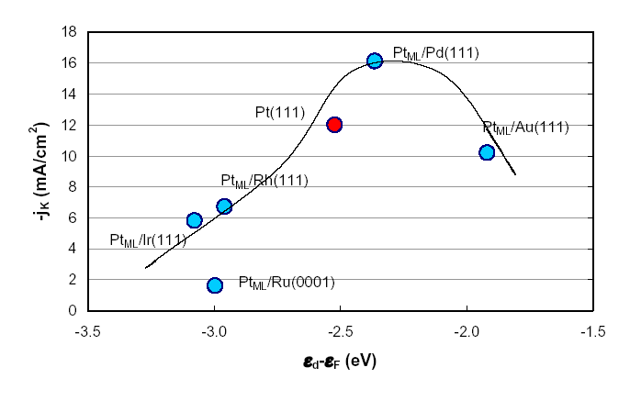
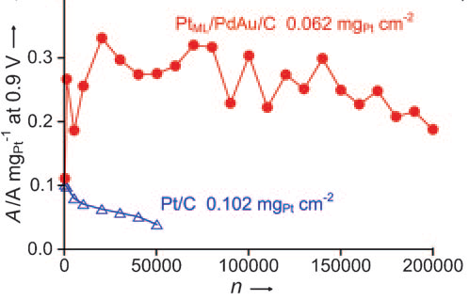
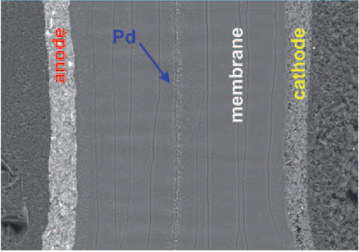
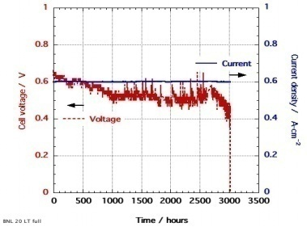
Platinum Monolayer Electro-Catalysts:
Stationary and Automotive Fuel Cells
Basic Science
Applied R&D
Manufacturing/
Commercialization
BES
BES → EERE
BNL-Toyota CRADA
Two research advances
Core-Shell Nanocatalysts
Scale-up synthesis: Pt-ML/Pd₉Au₁/C
Excellent fuel Cell durability 200,000 cycles
Pt Monolayer catalysis – high activity with ultralow Pt mass
Active Pt ML shell – Metal/alloy core
Core tunes activity & durability of shell
Core-shell catalyst
Model and HAADF image of a Pt Monolayer on Pd nanoparticle
Standard catalyst
Pt
Membrane Electrode Assembly >200K cycles
Very small Pt diffusion & small Pd diffusion
Pd
Pt stabilized against corrosion in voltage cycling by Au clusters
Pt-mass weighted activity enhanced 20x
3000 hr Fuel Cell Durability
Performance
Angewandte Chemie 49, 8602 (2010)
Fuel Cell Catalyst readied for automotive application
25
Science 315, 220 (2007)
Notes:
Barriers to widespread commercialization of fuel cells have been substantially reduced by research at Brookhaven National Laboratory (BNL) that has demonstrated key improvements in cost and reliability of critical electrocatalyst materials. BES initiated a basic research project at BNL in 1992, centered on fundamental studies of electrochemical interface structure and properties. These studies led to the realization that the electrochemical activity of metals could be tuned by putting a single atomic layer of one metal over another. This in turn led to the synthesis of tailored core-shell nanoparticles, with one or two layers of atoms of one active metal decorating a core particle comprised of a second metal. These core-shell nano-catalysts were further developed under funding by the fuel cell program in EERE in the period 2003-2009. The coordinated BES and EERE research has resulted in electrocatalysts for fuel cells that demonstrate a 4-20 fold reduction in the amount of expensive platinum necessary for good performance and show important improvements in long-term stability. Based on these promising results and starting in 2005, BNL entered into cooperative research agreements funded by industrial partners (GM, Toyota, UTC Fuel Cells, Battelle) and this work has demonstrated good performance in fuel cell tests and practical methods toward scaling up the synthetic method. The industrial partners believe that these core-shell nano-catalysts are currently the most promising electrocatalyst path for commercialization of low temperature fuel cells for automotive and stationary applications. A strong basic understanding and breakthrough synthesis methods developed under BES funding, along with key characterization at two BES user facilities at BNL, the National Synchrotron Light Source and the Center for Functional Nanomaterials, were critical to the development of these novel nano-catalysts for fuel cells.

Slide 26
Program Details

Slide 27
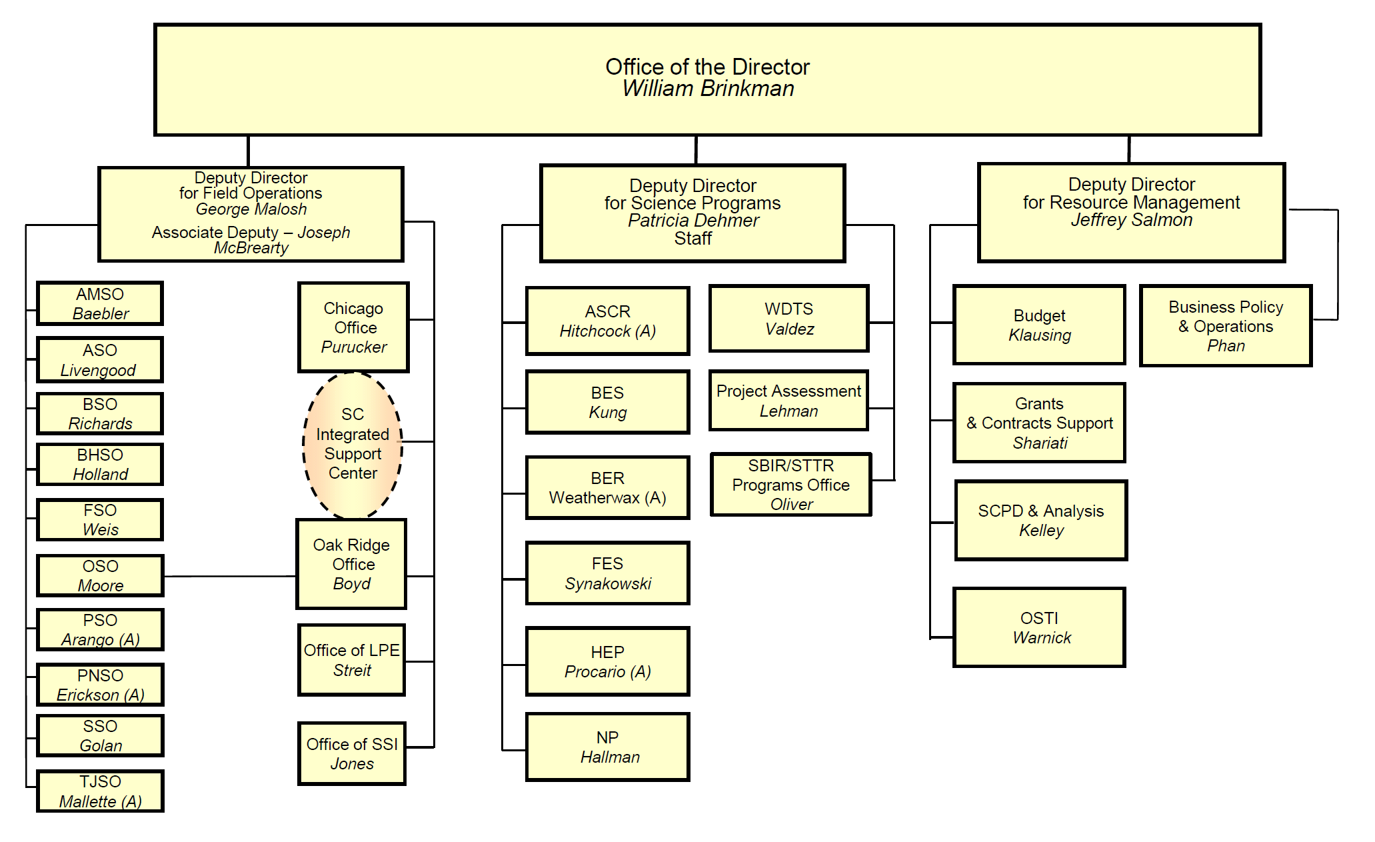
Notes:
27

Slide 28
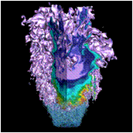
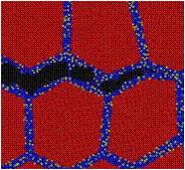
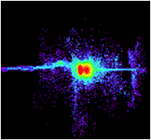
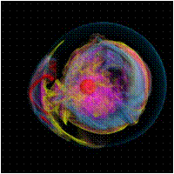
Advanced Scientific Computing Research
Delivering world leading computational and networking capabilities to extend the frontiers of science and technology
The Scientific Challenges:
Deliver next-generation scientific applications using today’s petascale computers.
Discover, develop and deploy tomorrow’s exascale computing and networking capabilities.
Develop, in partnership with U.S. industry, next generation computing hardware and tools for science.
Discover new applied mathematics and computer science for the ultra-low power, multicore-computing future.
Provide technological innovations for U.S. leadership in Information Technology to advance competitiveness.
FY 2012 Highlights:
Research in uncertainty quantification for drawing predictive results from simulation
Co-design centers to deliver next generation scientific applications by coupling application development with formulation of computer hardware architectures and system software.
Investments in U.S. industry to address critical challenges in hardware and technologies on the path to exascale
Installation of a 10 petaflop low-power IBM Blue Gene/Q at the Argonne Leadership Computing Facility and a hybrid, multi-core prototype computer at the Oak Ridge Leadership Computing Facility.

Slide 29
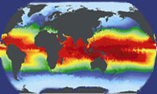
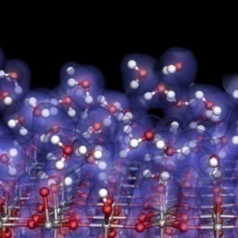
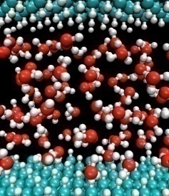
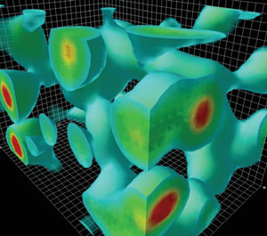
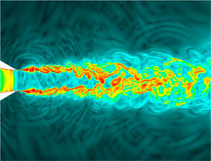
Investments for Exascale Computing
Opportunities to Accelerate the Frontiers of Science through HPC
Why Exascale?
SCIENCE: Computation and simulation advance knowledge in science, energy, and national security; numerous S&T communities and Federal Advisory groups have demon-strated the need for computing power 1,000 times greater than we have today.
U.S. LEADERSHIP: The U.S. has been a leader in high performance computing for decades. U.S. researchers benefit from open access to advanced computing facilities, software, and programming tools.
BROAD IMPACT: Achieving the power efficiency, reliability, and programmability goals for exascale will have dramatic impacts on computing at all scales–from PCs to mid-range computing and beyond.
DOE Activities will:
Leverage new chip technologies from the private sector to bring exascale capabilities within reach in terms of cost, feasibility, and energy utilization by the end of the decade;
Support research efforts in applied mathematics and computer science to develop libraries, tools, and software for these new technologies;
Create close partnerships with computational and computer scientists, applied mathematicians, and vendors to develop exascale platforms and codes cooperatively.

Slide 30
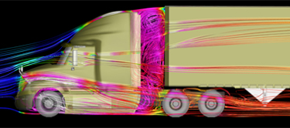








High Performance Computing: SmartTruck/DOE Partnership
Aerodynamic forces account for ~53% of long haul truck fuel use.
Class 8 semi trucks (300,000 sold annually) have average fuel efficiency of 6.7 MPG
Used ORNL’s Jaguar Cray XT-5 2.3 petaflop computer for complex fluid dynamics analysis – cutting in half the time needed to go from concept to production design
Outcome: SmartTruck UnderTray add-on accessories predict reduction of drag of 12% and yield EPA-certified 6.9% increase in fuel efficiency.
If the 1.3 million Class 8 trucks in the U.S. had these components, we would save 1.5 billion gallons of diesel fuel annually (~$4.4B in costs and 16.4M tons of CO₂)
Awarded as one of the “Top 20 products of 2010” from Heavy Duty Trucking magazine
Con-way Freight Inc. is the first corporation to install the SmartTruck UnderTray system.
Notes:
ORNL’s Jaguar helps BMI win award, nation save fuel (DOE press release)
OAK RIDGE, Tenn., Feb. 8, 2011 – A BMI Corp. SmartTruck technology that could save 1.5 billion gallons of diesel fuel and $5 billion in fuel costs per year has hit the road in record time in part because of simulations performed on the nation’s most powerful supercomputer at the Department of Energy’s Oak Ridge National Laboratory.
While South Carolina-based BMI Corp. has just won an industry award from Heavy Duty Trucking magazine, the real winners could be trucking companies and the environment. With installation of BMI’s SmartTruck UnderTray System to improve the aerodynamics of 18-wheeler (Class 8) long-haul trucks, the typical big rig can achieve fuel savings of between 7 and 12 percent, easily meeting the new California Air Resources Board mandate that calls for a minimum mileage improvement of 5 percent.
Those results, which earned BMI one of the publication’s top 20 products of the year awards, were made possible because of simulation work performed on ORNL’s Jaguar supercomputer.
“We were able to run simulations based on the most complex tractor and trailer models instead of simplified models, and we were able to run them faster,” said Mike Henderson, chief executive officer and founder of BMI, an engineering services firm based in Greenville, S.C.
The work on Jaguar shortened the computing turnaround time for BMI’s complex models from days to a few hours and eliminated the need for costly and time-consuming physical prototypes. In all, running simulations on Jaguar allowed BMI to go from concept to a design that could be turned over to a manufacturer in 18 months instead of the 3½ years they had anticipated, according to Henderson, who noted, however, that more work remains.
“Our first goal was to design add-on parts for existing trucks and trailers to make them more aerodynamic,” Henderson said. “By reducing drag we boost fuel efficiency and cut the amount of carbon that’s being dumped into the environment.”
In time, BMI plans to design trucks that are far more aerodynamic from the ground up.
“We hope to soon turn our attention to creating a brand new highly aerodynamic vehicle with optimum fuel efficiency,” Henderson said.
Until then, Henderson noted that if all of the nation’s 1.3 million Class 8 trucks were configured with just the minimum UnderTray package, the average fuel economy of 6 miles per gallon could increase to about 6.5 mpg or more, which is significant given the fact 18-wheelers collectively travel some 130 billion miles per year. And from an emissions standpoint, equipped with the aerodynamics package, those trucks would reduce their carbon dioxide emissions by 32.7 billion pounds (16.4 million tons).
BMI’s work with ORNL was made possible through the laboratory’s Industrial High-Performance Computing Partnerships Program, supported by the DOE Office of Science. Through this effort, BMI was able to access Jaguar, which boasts nearly 225,000 processing cores with a theoretical peak computational capability of 2.3 petaflops (2.3 quadrillion floating operations per second).
The UnderTray’s aerodynamic components are manufactured in Georgia by Cellofoam while various metal brackets, bolts and other hardware that attach the parts to the trailer are made by a number of companies in South Carolina. Several fleets, including Con-way Truckload and Frito-Lay, are already using the parts. The kit can be installed in the field by fleet owners and operators.
The award is to be presented today at the American Trucking Association’s 2011 Technology & Maintenance Council’s annual truck show in Tampa, Fla. UT-Battelle manages ORNL for DOE’s Office of Science.

Slide 31
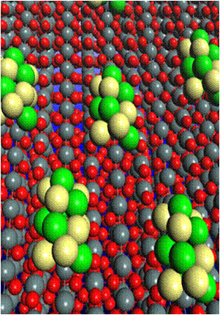
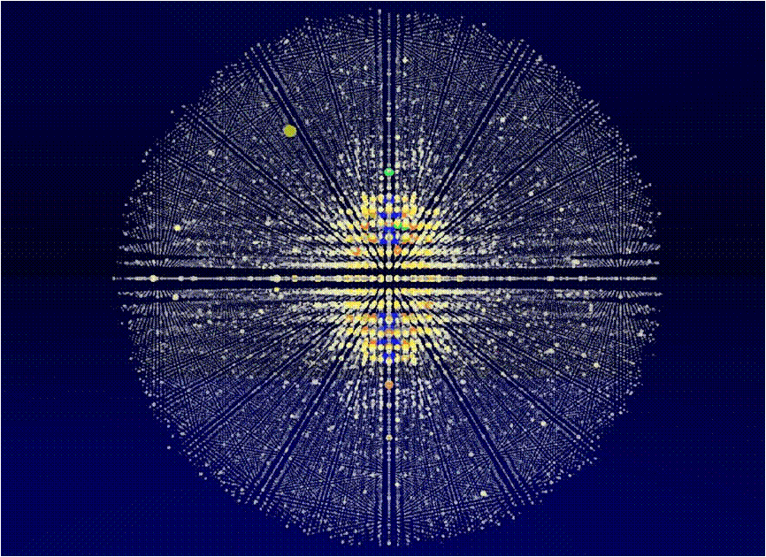
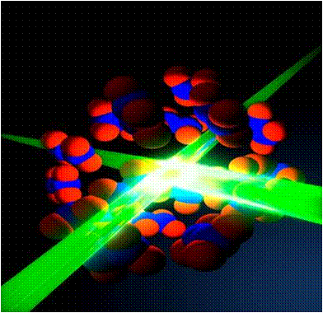
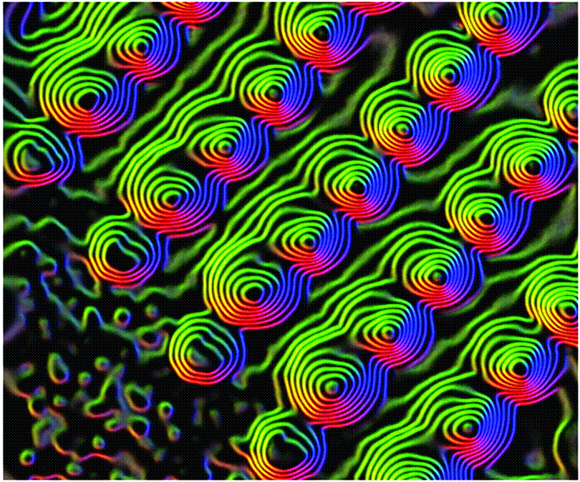
Basic Energy Sciences
Understanding, predicting, and ultimately controlling matter and energy flow at the electronic, atomic, and molecular levels
The Scientific Challenges:
Synthesize, atom by atom, new forms of matter with tailored properties, including nano-scale objects with capabilities rivaling those of living things
Direct and control matter and energy flow in materials and chemical assemblies over multiple length and time scales
Explore materials functionalities and their connections to atomic, molecular, and electronic structures
Explore basic research to achieve transformational discoveries for energy technologies
FY 2012 Highlights:
  Science for clean energy
      Batteries and Energy Storage Hub
      Interface sciences for high efficiency PV & next- generation nuclear systems; molecular design for carbon capture and sequestration; enabling materials sciences for transmission and energy efficiency; predictive simulation for combustion
Computational Materials and Chemistry by Design and Nanoelectronics research with inter-agency coordination.
Enhancements at user facilities:
  LCLS expansion (LCLS-II); NSLS-II EXperimental Tools (NEXT); APS Upgrade (APS-U); TEAM II (aberration-corrected microscope); upgraded beamlines and instruments at the major facilities

Slide 32
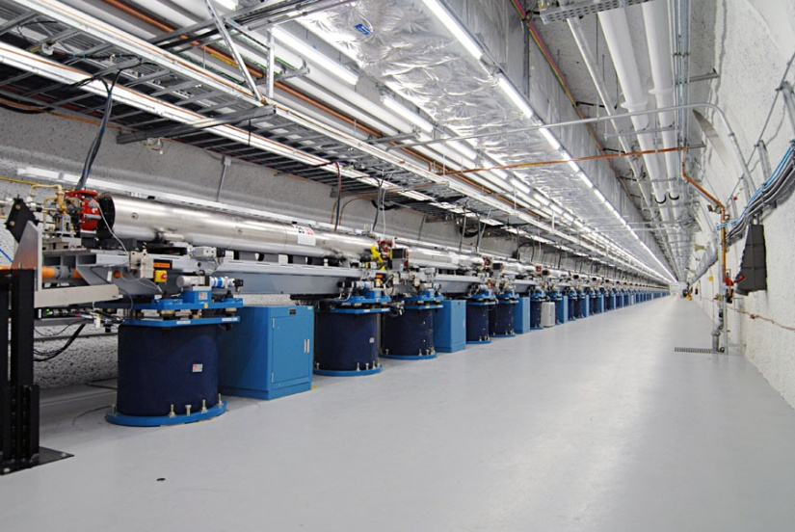
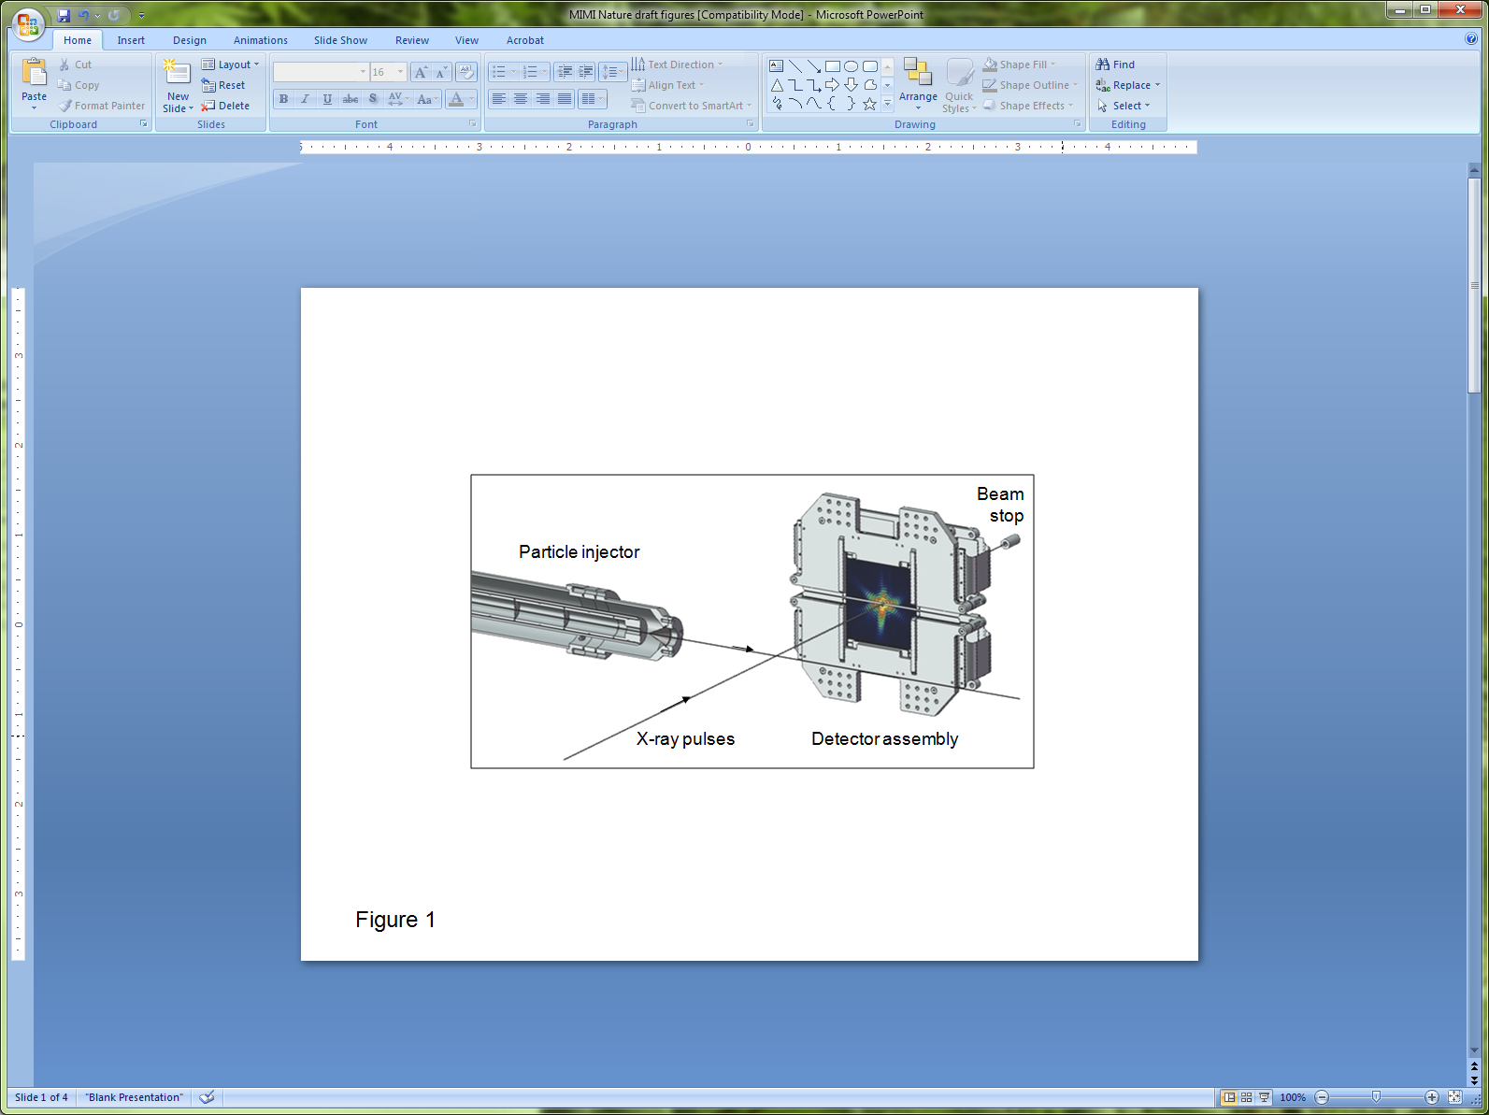
Nature Publishes First Bioimaging Results from the LCLS
The World’s First Hard X-ray Laser
Within 6 months of completion, LCLS is being used to study a wide array of science topics, including:
Hollow atoms
Magnetic materials
Structure of biomolecules in nano-crystals
Single shot images of viruses and whole cells
LCLS instruments provide new approach to x-ray bioimaging:
Liquid or aerosol injection
Very low noise, high-frame-rate CCD detectors
Integrated computing infrastructure to manage gigabytes of data per day

Slide 33
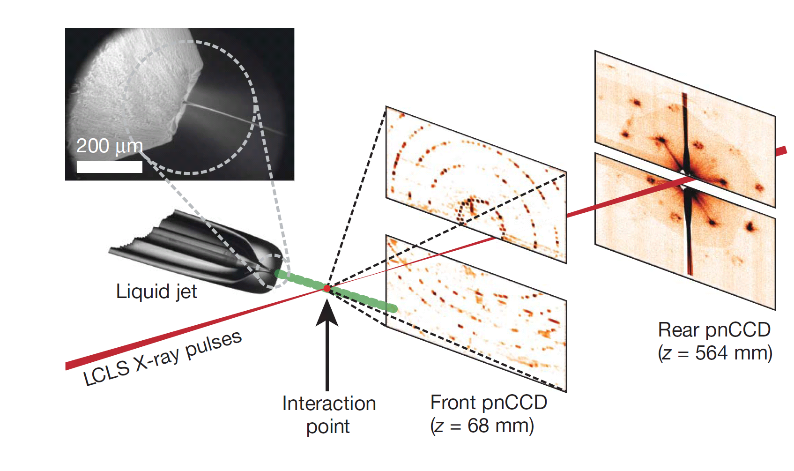
Femtosecond X-ray Protein Nanocrystallography
Nanocrystals flow in their buffer solution in a gas-focused, 4-μm-diameter jet at a velocity of 10m/sec perpendicular to the pulsed X-ray FEL beam that is focused on the jet.
Chapman, H. N., et al. Nature, Feb 3rd, 2011.
Notes:
Our experimental set-up (Fig. 1 and Methods) records single-crystal diffraction data from a stream of crystals carried in a 4-μm-diameter, continuous liquid water jet that flows across the focused LCLS X-ray beam in vacuum at 10 μl/min. In contrast to cryo-electron microscopy or standard crystallography on microcrystals, which require cryogenic cooling, these data were collected on fully hydrated, 3D nanocrystals. The crystal located in the interaction region when an X-ray pulse arrives gives rise to a diffraction pattern that is detected on a set of two low-noise, X-ray p–n junction charge-coupled device (pnCCD) modules and read out before the arrival of the next pulse at the FEL repetition rate of 30Hz, or 1,800 patterns per minute. The photon energy of the X-ray pulses was 1.8 keV (6.9-A˚ wavelength), with more than 10¹² photons per pulse at the sample and pulse durations of 10, 70, and 200 fs. An X-ray fluence of 900 J/cm² was achieved by focusing the FEL beam to a full-width at half-maximum of 7 mm, corresponding to a sample dose of up to 700MGy per pulse (calculated using the programRADDOSE14) and a peak power density in excess of 10¹⁶W/cm² at 70-fs duration. In contrast, the typical tolerable dose in conventional X-ray experiments is only about 30MGy. A single LCLS X-ray pulse destroys any solid material placed in this focus, but the stream replenishes the vaporized sample before the next pulse. The front detector module, located close to the interaction region, recorded high-angle diffraction to a resolution of 8.5A˚ , whereas the rear module intersected diffraction at resolutions in the range of 4,000 to 100A˚ . We observed diffraction from crystals smaller than ten unit cells on a side, as determined by examining the data recorded on the rear pnCCDs (Fig. 2). A crystal with a side length of N unit cells gives rise to diffraction features that are finer by a factor of 1/N than the Bragg spacing (that is, with N² fringes between neighbouring Bragg peaks), providing a simple way to determine the projected size of the nanocrystal. Images of crystal shapes obtained using an iterative phase retrieval method are shown in Fig. 2. The 3D Fourier transform of the crystal shape is repeated on every reciprocal lattice point. However, the diffraction condition for lattice points is usually not exactly satisfied, so each recorded Bragg spot represents a particular ‘slice’ of the Ewald sphere through the shape transform, giving a variety of Bragg spot profiles in a pattern; these are apparent in Fig. 2. The sum of counts in each Bragg spot underestimates the underlying structure factor square modulus, representing a partial reflection.

Slide 34
Femtosecond X-ray Protein Nanocrystallography
Photosystem I plays key role in photosynthesis.
Difficult to crystallize and use standard x-ray crystallography to obtain structure.
Single shot images from LCLS of nanocrystals used to build up full 3-D diffraction pattern.
Low resolution (~9 Å) shows structural details (e.g., helix density).
Single shot diffraction pattern
Combined 3D diffraction pattern
Reconstructed 3-D Structure
Chapman, H. N., et al. Nature, Feb 3rd, 2011.
Notes:
Femtosecond X-ray protein nanocrystallography
X-ray crystallography provides the vast majority of macromolecular structures, but the success of the method relies on growing crystals of sufficient size. In conventional measurements, the necessary increase in X-ray dose to record data from crystals that are too small leads to extensive damage before a diffraction signal can be recorded. It is particularly challenging to obtain large, well-diffracting crystals of membrane proteins, for which fewer than 300 unique structures have been determined despite their importance in all living cells. Here we present a method for structure determination where single-crystal X-ray diffraction ‘snapshots’ are collected from a fully hydrated stream of nanocrystals using femtosecond pulses from a hard-Xray free-electron laser, the Linac Coherent Light Source. We prove this concept with nanocrystals of photosystem I, one of the largest membrane protein complexes. More than 3,000,000 diffraction patterns were collected in this study, and a three-dimensional data set was assembled from individual photosystem I nanocrystals ( 200nm to 2 mm in size). We mitigate the problem of radiation damage in crystallography by using pulses briefer than the timescale of most damage processes. This offers a new approach to structure determination of macromolecules that do not yield crystals of sufficient size for studies using conventional radiation sources or are particularly sensitive to radiation damage.
Radiation damage has always limited resolution in biological imaging using electrons or X-rays. With the recent invention of the femtosecond X-ray laser, an opportunity has arisen to break the nexus between radiation dose and spatial resolution. It has been proposed that femtosecond X-ray pulses can be used to outrun even the fastest damage processes by using single pulses so brief that they terminate before the manifestation of damage to the sample. Experiments at the FLASHfree-electron laser (FEL), Germany, confirmed the feasibility of ‘diffraction before destruction’ at resolution lengths down to 60A˚ on test samples fixed on silicon nitride membranes. It was predicted that the irradiance (or power density) of focused pulses from a hard-X-ray FEL such as the Linac Coherent Light Source (LCLS), USA, would be sufficient to produce diffraction patterns at near-atomic resolution. We demonstrate here that this notion of diffraction before destruction operates at subnanometre resolution, using the membrane protein photosystemI as amodel system, and establish an approach to structure determination based on X-ray diffraction data from a stream of nanocrystals. Membrane proteins have a central role in the functioning of cells and viruses, yet our knowledge of the structure and dynamics responsible for their functioning remains limited. Photosystem I is a large membrane protein complex (1-MDamolecular mass, 36 proteins, 381 cofactors) that acts as a biosolar energy converter in the process of oxygenic photosynthesis. Its crystals display the symmetry of space group P63, with unit-cell parameters a5b5281A˚ and c5165A˚ , and consist of 78% solvent by volume. We show that diffraction data can be recorded from these fragile protein nanocrystals before destruction occurs. Furthermore, we demonstrate that structure factors can be extracted from the ‘partial’ reflections of tens of thousands of singlecrystal diffraction snapshots, showing that interpretable high-quality, three-dimensional (3D) structure factor data can be obtained from a suspension of submicrometre crystals.

Slide 35
High-Energy Lithium Batteries:
From Fundamental Research to Cars on the Road
Basic Science
Applied R&D
Manufacturing/
Commercialization
Li_{x}C₆
(Anode)
xLi₂MnO₃•(1-x)LiMO₂
(Cathode)
e⁻
Li⁺
Discovered new composite structures for stable, high-capacity cathodes
Created high energy Li-ion cells…
Nanoparticle TiO₂ anode/C coating
EFRC research
…with double cathode capacity, enhanced stability
Tailored electrode-electrolyte interface using nanotechnology
Licenses to materials and cell manufacturers and automobile companies
35
Notes:
Basic Science
The story of this new battery technology begins in the late 1990s, when the DOE's Office of Basic Energy Sciences funded an intensive study of lithium-ion batteries. Basic challenge was that existing materials were not sufficient to create a battery with enough power for a high-range vehicle.
Basic research looked at atomic structure of materials. Team wanted to improve the cathode – began by using APS synchrotron to monitor and understand reactions in lithium batteries in real time
Using new synthesis methods, created lithium- and manganese-rich materials that proved remarkably more stable than previous battery materials.
On the anode side, nanotechnologists produced carbon-coated TiO2 anode particles, each of which is electronically connected to a neighboring particle providing excellent electronic contact between the particles
4. Patents for new materials granted in 20xx.
Applied R&D
Argonne materials used to create high-energy lithium-ion cells. The researchers increased the upper charging voltage limit to 4.6 volts—higher than the usual operating voltage—and saw a tremendous jump in the battery's energy capacity.
The manganese-rich cathodes were more stable, so batteries were safer, less likely to overheat. Additionally, manganese is less expensive, reducing battery cost.
New cells represented a radical leap forward – more powerful, cheaper, safer and longer-lasting. Rare for a breakthrough to provide all those benefits at once.
Promising new results -- High-energy composite electrode uses advanced nano-processing to increase the battery capacity substantially; Technology won R&D 100 award
Manufacturing/commercialization
ANL collaborated closely with battery manufacturers, carmakers to transfer technology.
LG Chem licensed the technology from Argonne and used the materials to create the battery supplied for the 2011 Volt. GM has also licensed the technology for their own tests. Other battery manufacturers have licensed as well.
Batteries are a large, heavy component of electric and hybrid cars, and so it's best to manufacture them near the factory where the cars are assembled. That creates real opportunity to renew battery industry in U.S. To promote new car battery industry, $1.5 billion in federal stimulus grants went to several companies last year—including A123 Systems, Johnson Controls and an LG-Chem subsidiary—to build battery plants in the U.S. using Argonne technology.
This battery technology represents a step towards energy independence for the U.S. provides positive impact on the environment – cuts to the heart of green energy.
Current technology remains available for licensing to other private companies
Future results
Lithium-ion technology improvements will bring down cost of producing plug-in hybrid cars – puts savings in the hands of taxpayers who funded research
Foreign Policy magazine recently noted, "The future of the electric-car industry belongs not to the scientists and engineers who perfect the batteries we have now, but the ones who figure out what comes next, in the 2020s, the 2030s, and beyond... The holy grail is a battery powerful and safe enough to challenge the energy density of gasoline and the freedom of the internal combustion engine.”
Argonne science continues to work on 20-year horizon to address these challenges, studying new chemistries and focusing on the electrode-electrolyte interface that allow for higher energy capacity. Argonne’s EFRC, the Center for Electrical Energy Storage, is focused on addressing fundamental gaps in understanding atomic and molecular-level processes batteries and developing novel technologies to challenge current limits of electrochemical energy storage and create new breakthroughs for next-generation batteries.
While the ideal Li-ion battery is key to today’s electric vehicle technologies, the storage device with gasoline-level capacity has not yet been invented. Argonne now pursuing research into Lithium-air batteries. Li-air batteries use a catalytic air cathode that converts oxygen to lithium peroxide, an electrolyte and a Li anode. Hold promise of energy density 5 to 10 time higher than lithium-ion batteries. Will require solution to critical scientific challenges. ANL Director’s Grand Challenge LDRD focused on chemistries and interfaces in Li-air systems.
1. K. Amine, I. Belharouak, Z. H. Chen, T. Tran, H. Yumoto, N. Ota, S.T. Myung, and Y.K. Sun, Nanostructured Anode Material for High-Power Battery System in Electric Vehicles. Advanced Materials, 22(28): p. 3052-3057 (2010).
2. S. M. Oh, S. W. Oh, C. S. Yoon, B. Scrosati, K. Amine, and Y.K. Sun, High-Performance Carbon-LiMnPO4 Nanocomposite Cathode for Lithium Batteries. Advanced Functional Materials, 20(19): p. 3260-3265 (2010).
Michael M. Thackeray, Sun-Ho Kang, Christopher S. Johnson, John T. Vaughey, Roy Benedek and S. A. Hackney, “Li2MnO3-stabilized LiMO2 (M = Mn, Ni, Co) electrodes for lithium-ion Batteries,” Journal of Materials Chemistry, (2007) 17, 3112
3. Michael M. Thackeray, Christopher S. Johnson, John T. Vaughey, N. Li and Stephen A. Hackney, “Advances in manganese-oxide ‘composite’ electrodes for lithium-ion Batteries,” Journal of Materials Chemistry, (2005) 15, 2257
4. Jeom-Soo Kim, Christopher S. Johnson, John T. Vaughey, and Michael M. Thackeray, “Electrochemical and structural properties of xLi2M¢O3â(1-x)LiMn0.5Ni0.5O2 electrodes for lithium batteries (M¢ ) Ti, Mn, Zr; 0 e x E 0.3),” Chem. Mater., Vol. 16, No. 10, 2004

Slide 36
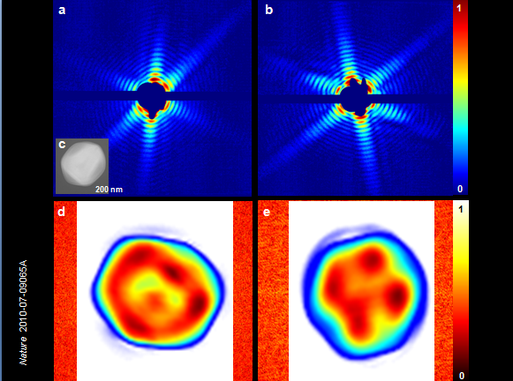
Single Mimi Virus Particles Intercepted and Imaged
Mimi virus is the largest known virus. Its size is comparable to the size of the smallest living cells – 45μm.
Cannot be crystallized or imaged by conventional techniques.
Reconstructions of single shot images from LCLS (32 nm resolution) reveal inhomogeneous interior structure of virion.
Future enhancements will improve resolution and enable visualization of contents of living cells.
Single shot scattering patterns (above) and reconstructed images (below)
Seibert, M. M., et al. Nature, Feb 3rd, 2011
Notes:
X-ray lasers offer new capabilities in understanding the structure of biological systems, complex materials and matter under extreme conditions. Very short and extremely bright, coherent X-ray pulses can be used to outrun key damage processes and obtain a single diffraction pattern from a large macromolecule, a virus or a cell before the sample explodes and turns into plasma1. The continuous diffraction pattern of non-crystalline objects permits oversampling and direct phase retrieval. Here we show that high-quality diffraction data can be obtained with a single X-ray pulse from a noncrystalline biological sample, a single mimi virus particle, which was injected into the pulsed beam of a hard-X-ray free-electron laser, the Linac Coherent Light Source. Calculations indicate that the energy deposited into the virus by the pulse heated the particle to over 100,000K after the pulse had left the sample. The reconstructed exit wavefront (image) yielded 32-nm full-period resolution in a single exposure and showed no measurable damage. The reconstruction indicates inhomogeneous arrangement of dense material inside the virion. We expect that significantly higher resolutions will be achieved in such experiments with shorter and brighter photon pulses focused to a smaller area. The resolution in such experiments can be further extended for samples available in multiple identical copies.
Diffraction studies of crystalline samples have led to spectacular breakthroughs in physics, chemistry and biology over the past hundred years. Many important targets are difficult or impossible to crystallize, and this creates systematic blank areas in the structural sciences. X-ray lasers offer the possibility of stepping beyond X-ray crystallography, to extend structural studies to single, non-crystalline particles or molecules.
In this Letter, we present results on biological imaging with an X-ray free-electron laser, and bring together all the elements required for structural studies of single, non-crystalline objects. Mimi virus (Acanthamoeba polyphaga mimivirus) is the largest known virus. Its size is comparable to the size of the smallest living cells (in fact, the namemimivirus stands for ‘microbe-mimicking virus’). The viral capsid (0.45 mmin diameter) has a pseudo-icosahedral appearance and is covered by an outer layer of dense fibrils. The total diameter of the particle, including fibrils, is about 0.75 mm. Mimivirus is too big for a full three-dimensional reconstruction by cryo-electronmicroscopy7 and its fibrils prevent crystallization. The genome has 1.2 million base pairs (comparable to a small bacterium) and contains several genes previously thought to be present only in cellular organisms, including components of the protein translation apparatus. Mimi virus can be infected by a smaller virus, named a ‘virophage’, which seems to be the first example of a virus behaving as a parasite of another virus8. Studies of mimi virus are causing a paradigm shift in virology and have led to renewed debates about the origin and the definition of viral and cellular life.

Slide 37
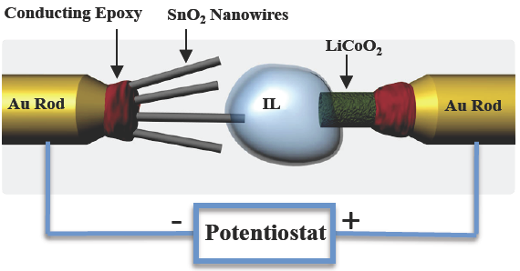
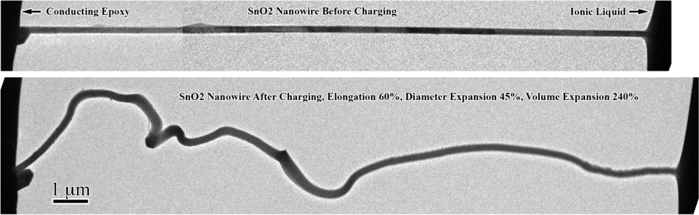
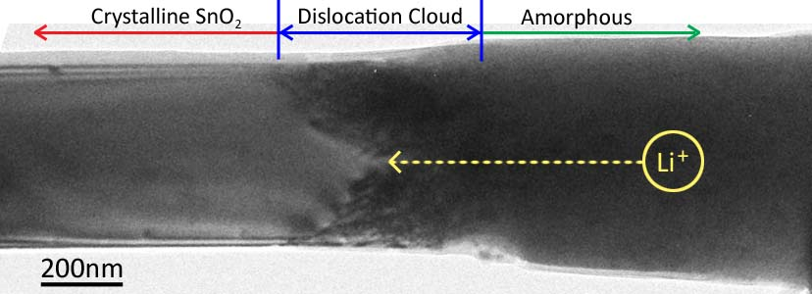






Advancing Energy Technologies through Energy Frontier Research Centers
World’s smallest battery placed inside an electron microscope yields images of electrochemistry at atomic scales
New insight into electrochemical processes at the nanoscale:
    Nanowires can sustain large stresses (>10 GPa) caused by Li⁺ transport without breaking—good candidate for battery
    Elongation and twisting of nanowires during charging may lead to a short circuit and failure of the battery, a key factor to consider during design
    Research at SNL supported by the Center for Science of Precision Multifunctional Nanostructures for Electrical Energy Storage (an EFRC led by University of Maryland) and in collaboration with PNNL and university contributors
Jian Yu Huang, et al., Science 330, 1515 (2010)
Notes:
Top panel, a nanobattery consists of a single SnO2 nanowire anode, an ionic liquid electrolyte, a lithium cobalt oxide cathode, ionic liquid is a molten salt which survives the high vacuum of TEM, enabling the function of the nanobattery
Middle panel, a SnO2 nanowire before (upper) and after (lower) charging, showing significant morphology changes (spiraling, elongation, swelling, volume expansion) caused by charging the nanowire
Bottom panel, a high density of dislocations (a kind of flaw in materials) appear in the reaction front, proving that nanowires can sustain large stress (>10 GPa) without breaking, good battery materials
In Situ Observation of the Electrochemical Lithiation of a Single SnO₂ Nanowire Electrode
Science 10 December 2010: Vol. 330 no. 6010 pp. 1515-1520
Jian Yu Huang et al.
Abstract: We report the creation of a nanoscale electrochemical device inside a transmission electron microscope—consisting of a single tin dioxide (SnO₂) nanowire anode, an ionic liquid electrolyte, and a bulk lithium cobalt dioxide (LiCoO₂) cathode—and the in situ observation of the lithiation of the SnO₂ nanowire during electrochemical charging. Upon charging, a reaction front propagated progressively along the nanowire, causing the nanowire to swell, elongate, and spiral. The reaction front is a “Medusa zone” containing a high density of mobile dislocations, which are continuously nucleated and absorbed at the moving front. This dislocation cloud indicates large in-plane misfit stresses and is a structural precursor to electrochemically driven solid-state amorphization. Because lithiation-induced volume expansion, plasticity, and pulverization of electrode materials are the major mechanical effects that plague the performance and lifetime of high-capacity anodes in lithium-ion batteries, our observations provide important mechanistic insight for the design of advanced batteries.
First para, full article: Lithiation and delithiation of the electrode materials in lithium-ion batteries (LIBs) induce large strains in the host material, leading to plasticity and fracture. Lithiation is also often accompanied by phase transformations, such as electrochemically driven solid-state amorphization (ESA). These electrochemical reaction–induced microstructural events limit the energy capacity and cycle lifetime of LIBs. It was recently reported that lithium-ion anode materials composed of nanowires can offer improved performance and lifetime relative to those of micrometer-scale or larger materials. The improvements are often attributed to the nanowire’s unique geometry and enhanced accommodation of the transformation strains that occur during cycling. However, the detailed mechanisms of strain-induced plasticity and strain accommodation in nanowires during electrochemical charging are largely unknown.

Slide 38
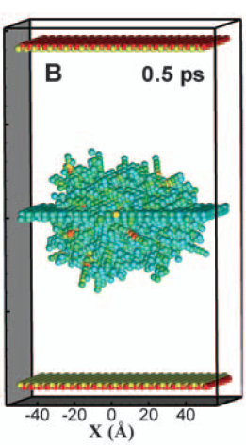




EFRC Research Predicts Radiation Damage Resistant Materials
Simulations reveal why nanostructured materials with a large number of grain boundaries exhibit increased tolerance to radiation damage
New interstitial emission and vacancy recombination mechanism critical to self-healing of radiation damaged material
    At very short times, interstitial atoms are concentrated on the grain boundary, but at longer times they re-emit and annihilate trapped vacancies many atomic distances away
    Grain boundaries loaded with interstitials reduce the barrier for vacancy diffusion and promote defect recombination
    Designed nanostructured grain boundaries could slow down the accumulation of radiation damage
Research supported by the Center for Materials at Irradiation and Mechanical Extremes (an EFRC led by Los Alamos National Laboratory)
Radiation damage
Interstitials quickly move to grain boundary
Vacancies trapped in bulk material
interstitial emission
Interstitials
emit from grain boundary
Interstitials
and vacancies recombine
Diffusion of remaining vacancies very slow
Xian-Ming Bai et al. Science, 327, 1631 (2010)
Notes:
Center for Materials at Irradiation and Mechanical Extremes
EFRC Director: Michael Nastasi
Lead Institution: Los Alamos National Laboratory
Mission Statement: To understand, at the atomic scale, the behavior of materials subject to
extreme radiation doses and mechanical stress in order to synthesize new materials that can
tolerate such conditions.
Our EFRC addresses two of the five BESAC grand challenges: How do we design and
perfect atom and energy-efficient syntheses of revolutionary new forms of matter with
tailored properties?; and How do we characterize and control matter away-especially very
far away-from equilibrium? In responding to these grand challenges our center will focus on
Materials at Irradiation and Mechanical Extremes (MIME). This Center recognizes that the
challenge to developing materials with radically extended performance limits at irradiation
and mechanical extremes will require designing and perfecting atom- and energy- efficient
synthesis of revolutionary new materials that maintain their desired properties while being
driven very far from equilibrium. We have developed a set of common issues that will drive
our science focus and serve as the unifying foundation of this center. These scientific issues
include: 1) Absorption and recombination of point and line defects at interface; 2)
Morphological and chemical stability of interfaces; 3) Interface-driven mechanical response.
By addressing these issues we will develop a fundamental understanding of how atomic
structure and energetics of interfaces contribute to defect and damage evolution in materials,
and use this information to design nanostructured materials with tailored response at
irradiation and mechanical extremes.
In the pursuit of the grand challenge and science issues outlined above, we have developed
specific hypotheses for each science issue. These defining hypotheses are listed below.
Scientific issue #1: Absorption and recombination of point and line defects at interfaces
Hypotheses:
1) The atomic structure of the interface controls the absorption, emission, storage and
annihilation of defects at the interface.
2) Misfit dislocation intersections with other misfit dislocations and with disconnections are
the most favorable sites for point defect absorption and delocalization.
3) The lower the elastic strain energy penalty associated with defect absorption, the more
likely it is that point defect delocalization by interface reconstruction can take place.
4) The ability of an interface to absorb dislocations is determined by its shear strength and the
areal density of preferred sites for nucleation of interface glide dislocations.
Scientific issue #2: Morphological and chemical stability of interfaces
Hypotheses:
5) Interface structures with high sink strengths or enhanced abilities to act as defect sources
will be morphologically stable at extremes of temperature, irradiation and mechanical
deformation.
6) Interface energy controls interface stability; high-energy interfaces are less likely to be
morphologically stable.
7) The saturation limit for defect absorption at interfaces for a given type of defect (e.g.,
helium atom, solute segregant, vacancy, interstitial, dislocation) is determined by the
interface structure. Above the defect solubility limit, interfaces exhibit chemical instabilities
such as defect clustering, gas bubbles, precipitates, disordering or amorphization.

Slide 39
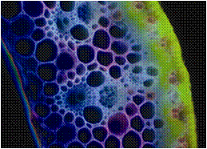
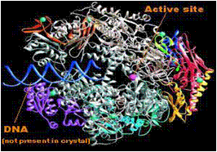
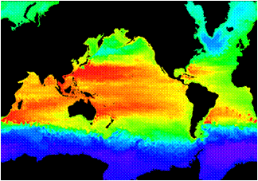

Biological and Environmental Research
Understanding complex biological, climatic, and environmental systems across vast spatial and temporal scales
The Scientific Challenges:
Understand how genomic information is translated with confidence to redesign microbes, plants or ecosystems for improved carbon storage, contaminant remediation, and sustainable biofuel production
Understand the roles of Earth’s biogeochemical systems (atmosphere, land, oceans, sea ice, subsurface) in determining climate so we can predict climate decades or centuries into the future, information needed to plan for future energy and resource needs.
FY 2012 Highlights:
Clean energy biodesign on plant and microbial systems through development of new molecular toolkits for systems and synthetic biology research.
Research and new capabilities to develop a comprehensive Arctic environmental system model needed to predict the impacts of rapid climate change.
Continue support for the three DOE Bioenergy Research Centers, and operations of the Joint Genome Institute, the Environmental Molecular Sciences Laboratory, and the Atmospheric Radiation Measurement Climate Research Facility.

Slide 40






Advancing Energy Technologies through Bioenergy Research Centers
In the first three years of operations, the BRCs together had 66 inventions in various stages of the patent process, from disclosure to formal patent application, and over 400 peer-reviewed publications.
Developed modified switchgrass that enable a 30% improvement in the yield of ethanol
Used synthetic biology toolkit to construct the first microbes to produce an advanced biofuel (biodiesel) directly from biomass.
Characterized impacts of
biomass crop agriculture on marginal lands, studying shifts
in microbial community and
potential for changes in
greenhouse gas emissions.
Notes:
The lignin part of plant cell walls makes plants difficult to breakdown and convert to biofuels. BESC researchers identified a key gene involved in lignin biosynthesis in switchgrass, a major perennial feedstock for lignocellulosic ethanol production. Their results provide a potential target for modification in the development of switchgrass as a bioenergy crop. Photo shows transgenic switchgrass in lab culture.
Reference: Escamilla-Treviño et al 2010. Switchgrass (Panicum virgatum) possesses a divergent family of cinnamoyl CoA reductases with distinct biochemical properties. New Phytologist 185: 143-155.
JBEI researchers (in collaboration with LS9) engineered several key changes into E. coli to take up hemicellulose, break it down and convert into biodiesel.
overproduce fatty acids that could then be metabolically converted into structurally tailored fatty esters (biodiesel), alcohols and waxes
produce hemicellulases.
Photo shows microbes producing oil droplets
Reference : Microbial production of fatty-acid-derived fuels and chemicals from plant biomass; Steen et al, Nature, Vol 463|28 January 2010
GLBRC uses high-capacity sequencing technology to characterize microbial rhizosphere communities of biofuel crops grown on agricultural vs. marginal lands. Found that soil environment and land management were key factors influencing community structure. Although more limited in plant diversity, greater bacterial diversity was observed in the biofuel crop samples than in the forest samples. Photo shows agricultural row cropland tested.
Reference: Jesus, E. C., et al., 2010, “Bacterial Communities in the Rhizosphere of Biofuel Crops Grown on Marginal Lands as Evaluated by 16S rRNA Gene Pyrosequences,” Bioenergy Research, 3: 20–27.

Slide 41



Tackling Major Climate Uncertainties:
The Atmospheric Radiation Measurement Climate Research Facility (ACRF)
The ACRF provides the world’s most comprehensive 24/7 observational capabilities for obtaining atmospheric data for climate change research.
ARM data have transformed our understanding of aerosol-cloud interactions and built the most advanced parameter-izations of atmospheric radiative transfer.
The ARM Facility operates highly instrumented ground stations worldwide to study cloud formation and aerosol processes and their influence on radiative transfer.
In FY 2012, ARM will deploy its new suite of measurement capabilities to regions of high scientific interest, e.g., the Azores (marine clouds) and Alaska (Arctic clouds and aerosols over land, sea, and ice).
Scanning Cloud
Radar with Data Plot
The challenge of studying radiative transfer on land-ice-atmosphere-water in the Arctic
Notes:
The Atmospheric Radiation Measurement (ARM) Program was created in 1989 to develop several highly instrumented ground stations to study cloud formation processes and their influence on radiative transfer. This scientific infrastructure now includes two mobile facilities, an aerial facility, and data archive available for use by scientists worldwide through the ARM Climate Research Facility—a scientific user facility.
ARM is a multi-laboratory, interagency program, and is a key contributor to national and international research efforts related to global climate change. This user facility has enormous potential to advance scientific knowledge in a wide range of interdisciplinary Earth sciences. A primary objective of the facility is improved scientific understanding of the fundamental physics related to interactions between clouds and radiative feedback processes in the atmosphere. ARM focuses on obtaining continuous field measurements and providing data products that promote the advancement of climate models.
Brief History
During the early years of the program, efforts focused on establishment of field research sites, development and procurement of instruments, and development of techniques for both atmospheric retrievals and model evaluation.
To obtain the most useful climate data, three main sites were chosen that represented a broad range of weather conditions. The Southern Great Plains site in Oklahoma provides a wide variability of climate cloud type and surface flux properties, and large seasonal variation in temperature and specific humidity. The North Slope of Alaska site is providing data about cloud and radiative processes at high latitudes, which have been identified as one of the most sensitive regions to climate change. The Tropical Western Pacific locale experiences widespread convective clouds due to the consistently warmest sea surface temperatures on the planet (referred to as the Pacific "warm pool"). Changes in sea surface temperature and convection patterns in this region play a large role in the interannual variability observed in the global climate system.
In addition, the ARM Mobile Facilities contain most of the same instruments as the permanent sites and can support short-term (up to one year) experiments in different climate regions. Airborne measurements from the ARM Aerial Facility have been an integral measurement capability of ARM since 1993 and have used a variety of aerial platforms and instruments during intensive field campaigns or long-term, regularly-scheduled flights.

Slide 42




Fusion Energy Sciences
Understanding matter at very high temperatures and densities and building the scientific foundations for a fusion energy source
The Scientific Challenges:
Control a burning plasma state to form the basis for fusion energy
Develop materials that can withstand the harsh heat and neutron irradiation in fusion facilities
Manipulate and control intense transient flows of energy and particles
Control the interaction of matter under extreme conditions for enabling practical inertial fusion energy
FY 2012 Highlights:
ITER construction is supported
DIII-D, Alcator C-Mod, and NSTX operate and investigate predictive science for ITER
HEDLP investments continue in basic research on fast ignition, laser-plasma interaction, magnetized high energy density plasmas, and warm dense matter
International activities are increased
SciDAC expands to include fusion materials
The Fusion Simulation Program pauses to assess now-completed planning activities

Slide 43


Progress on the ITER Project
ITER’s goal: first demonstration of high-gain fusion energy production—fusion power 10 times greater than that used to heat the plasma.
  The U.S. is a member to the ITER partnership, formed by seven governments representing
  more than half the world’s population. It is a 10-year construction activity in France.
This past year, the U.S. led initiatives to put in place a world-leading management team for the construction phase of ITER and to establish the cost and schedule baselines.
Site construction is underway in Cadarache, France
The ITER Device

Slide 44



Stabilization of High-Temperature Plasmas
U.S. researchers at the DIII-D tokamak invented a new method for mitigating potentially damaging transient heat fluxes (Edge Localized Modes) by precision manipulation of the magnetic field.
This can have an enormous positive impact for ITER if the results can be verified.
Researchers at the Max Planck Institute (Garching, Germany) recently made major modifications to the ASDEX-U tokamak and reproduced these results.
DIII-D
Time (ms)
ITER: ELM coil design

Slide 45




Nuclear Physics
Discovering, exploring, and understanding all forms of nuclear matter
The Scientific Challenges:
Understand:
  The existence and properties of nuclear matter under extreme conditions, including that which existed at the beginning of the universe
  The exotic and excited bound states of quarks and gluons, including new tests of the Standard Model
  The ultimate limits of existence of bound systems of protons and neutrons
  Nuclear processes that power stars and supernovae, and synthesize the elements
  The nature and fundamental properties of neutrinos and neutrons and their role in the matter-antimatter asymmetry of the universe
FY 2012 Highlights:
12 GeV CEBAF Upgrade to study exotic and excited bound systems of quarks and gluons and for illuminating the force that binds them into protons and neutrons.
Design of the Facility for Rare Isotope Beams to study the limits of nuclear existence.
Operation of three nuclear science user facilities (RHIC, CEBAF, ATLAS); closure of the Holifield Radioactive Ion Beam Facility at ORNL.
Research, development, and production of stable and radioactive isotopes for science, medicine, industry, and national security.

Slide 46

Discovery of Element 117
A new super heavy element (SHE) with atomic number 117 was discovered by a Russian-U.S. team with the bombardment of a Berkelium target by 48-Ca. The existence and properties of SHEs address fundamental questions in physics and chemistry:
How big can a nucleus be?
Is there a “island of stability” of yet undiscovered long-lived heavy nuclei?
Does relativity cause the periodic table to break down for the heaviest elements?
Experiment conducted at the Dubna Cyclotron (Russia) with an intense 48-Ca beam
Berkelium target material produced and processed by the Isotopes Program at ORNL
Detector and electronics provided by U.S. collaborators were used with the Dubna Gas-Filled Recoil Separator
Rare short-lived 248-Bk was produced at HFIR and processed in Isotope Program hot cell facilities at ORNL to purify the 22 mg of target material used for the discovery of element 117.
Notes:
[ber-kee-lee-uhm] For decades, the new element sweepstakes has been a three-way race. Beginning in 1940, the Berkeley lab dominated the field, claiming or sharing credit for all elements except for one from 93 through 106. In 1981, the GSI Helmholtz Centre for Heavy Ion Research in Darmstadt, Germany, pulled ahead, planting flags on elements 107 through 112, the recently named copernicum. Even with stretches of beam time available at Dubna, going after 117 required “experimentally, an enormous tour de force,” says nuclear physicist Konrad Gelbke, director of the National Superconducting Cyclotron Laboratory (NSCL) at Michigan State University in East Lansing. To get to 117 protons from calcium’s 20, Dubna physicists needed the 97 protons in the devilishly hard- to-synthesize element berkelium. Nuclear chemists at the world’s most intense neutron source, the High Flux Isotope Reactor at Oak Ridge National Laboratory in Tennessee, spent 250 days scraping together 22.2 milligrams of the stuff and another 90 days purifying it to one part in 10 million. Then the clock began to tick: Berkelium’s half-life is 320 days. The hot material’s next stop was Russia’s Research Institute of Atomic Reactors in Dimitrovgrad, where scientists deposited it on a thin film of titanium. Then it went on to Dubna, where physicists pummeled the target with 7 trillion calcium-48 ions per second, day and night for 5 months. A gas-filled separation chamber diverted atoms blasted off the target into an array of detectors. From thousands of potentially interesting events, the physicists pinned down just six atoms of element 117. To do so, they looked at the chains of other elements produced as the radioactive atoms decayed toward stability. An isotope of 117 with 177 neutrons, for example, spits out alpha particles to metamorphose first into daughter nucleus 115 and later into dubnium (105) before fissioning. The elements in this chain—115, 113, 111, and so on—had all been made before. But the new versions had more neutrons than earlier ones did and were strikingly longer-lived—6000 times as long, in the case of one isotope of element 111. Those results fit with theorists’ current picture of heavy-element nuclei, says Witold Nazarewicz, a theoretical physicist at Oak Ridge and the University of Tennessee, Knoxville. The theory predicts that certain so-called magic numbers of protons and neutrons confer extra stability to a nucleus. A magic number at 184 neutrons, for example, ought to anchor an “island of stability,” a still-to-be discovered group of long-lived super-heavy isotopes that hold together for days, years, or even millennia. (In contrast, super-heavy elements made so far have half-lives of fractions of a second.) Physicists at all three facilities agree that the way to reach the island of stability is by producing heavier isotopes of known elements. That will require superb beams of radioactive elements unlike any now achievable, says Sigurd Hofmann, the head of heavy element research at Darmstadt. Such beams may become available at labs like NSCL’s planned Facility for Rare Isotope Beams, currently in the conceptual design phase, but they are still decades away, Hofmann says. The Darmstadt group plans to confirm 116 this summer by training a calcium beam on a radioactive curium target, says Hofmann; the technique could lay the groundwork for creating 120 from curium with a chromium beam. The Berkeley team, which was devastated in 2002 when it had to withdraw its claim on element 118 after critical data turned out to have been fabricated (Science, 19 July 2002, p. 313), is back in the game, recently confirming Dubna’s element 114 with a calcium beam and plutonium target. And a newcomer—the super-heavy element lab at the Institute of Physical and Chemical Research (RIKEN) in Japan—has been instrumental in confirming some of Darmstadt’s finds. Confirmation is key to the discovery process: Under international rules, a lab may not name a new element until a competitor repeats the finding. That could take years for element 117, says Dubna team member Dawn Shaughnessy, a nuclear chemist at Lawrence Livermore National Lab in Livermore, California.

Slide 47

New Antimatter Detected at RHIC’s STAR Detector
Discovery of the heaviest known antinucleus and first antinucleus with an anti-strange quark, from gold nuclei collisions at RHIC.
Opens further exploration of fundamental symmetries and understanding the dominance of matter over antimatter in the universe
Has implications for our understanding of the structure of collapsed stars
Discovery extends 3-D chart of the nuclides and suggests even heavier antinuclei exist.
The STAR collaboration observed the first antimatter hypernucleus: antihypertriton. This nucleus contains an antiproton, an antineutron, and an antilambda hyperon, which is made up of an up quark, a down quark, and a strange quark. The discovery extends our knowledge of the nuclear terrain, represented by a three-dimensional graph with axes Z, the number of protons in a nucleus; N, the number of neutrons; and S, the degree of strangeness. Each axis has positive and negative sections, representing particles and antiparticles. This latest result extends the nuclear terrain below the N–Z plane for the first time.
Results highlighted at the American Physical Society Meeting, Feb 13-16, 2010; Over 500 related news articles published worldwide.
Notes:
A hypertriton is an a type of hypernucleus formed of a proton, a neutron, and any hyperon. The name comes from hyperon, which refers to baryons containing strange quarks but no charm quarks or bottom quarks, and triton, which refers to the nucleus of tritium. Because low-mass hyperons are longer-lived and easier to create than high-mass hyperons, the most common hypertritons are those containing Lambda baryons. Its antiparticle, the antihypertriton, is formed of an antiproton, an antineutron, and any antihyperon. The first one was discovered in March 2010 by STAR detector of the Relativistic Heavy Ion Collider (RHIC).
New nuclear terrain
All terrestrial nuclei are made of protons and neutrons, which contain only up and down quarks. The standard Periodic Table of Elements is arranged according to the number of protons, which determines each element’s chemical properties. A more complex, three-dimensional chart conveys information on the number of neutrons, which may change in different isotopes of the same element, and a quantum number known as “strangeness,” which depends on the presence of strange quarks.
For all ordinary matter, with no strange quarks, the strangeness value is zero and the chart is flat.
Nuclei containing one or more strange quarks are called hypernuclei. Hypernuclei appear above the plane of the chart.
Nuclei containing one or more antistrange quarks are called antihypernuclei. Antihypernuclei appear below the plane of the chart.
The new discovery of strange antimatter with an antistrange quark marks the first entry below the plane.
Antiatoms made up of antiprotons and antineutrons are still a rarity. Because we live in a world dominated by regular matter, antiprotons and antineutrons typically annihilate before they can form into antinuclei. To date, only a handful of groups have successfully coaxed antiparticles into atomic configurations.
To make the antiatoms requires two conditions. First, you need enormously high energies to generate the antimatter. Second, you need enough of the stuff around that it has a chance to meet other antimatter particles and form atoms before it annihilates.
RHIC is perfect for this kind of work. The collider smashes gold nuclei together at 200 gigaelectronvolts, an energy that approaches the earliest moments following the Big Bang. When they hit, nuclei quickly dissolve into a soup of quarks and antiquarks, the fundamental particles that make up protons and neutrons.
To form the new antihydrogen isotope, first an antistrange quark binds with an antiup and antidown quark to make an antilambda — an antineutron-like particle. The antilambda, which is fractionally heavier than a neutron, must then combine with a conventional antineutron and an antiproton. The chances of this happening are very slim: out of 100 million collisions, RHIC generated just 70 of the new antihydrogen isotopes.
Neutron stars, the remnants of once-massive stars, are thought to contain large numbers of strange quarks, and antinuclei containing strange quarks could play a part in their evolution. Moreover, studying the properties of antinuclei such as these might help physicists to better understand why the Universe is full of matter rather than antimatter.

Slide 48





Isotope Development and Production Program
Making hundreds of isotopes available to the community for science, medicine, industry and national security.
  Decision-making guided by strategic planning with federal agencies, community, and peer review mechanisms
  Coordinating with other federal agencies on addressing shortages of critical isotopes such as He-3 and Mo.
  Broadening the suite of isotope production facilities to include university facilities and other laboratory facilities.
50 mCi of purified Ac-225 from new isotope R&D program–important for medical trials
Production of Ni-63 for trace explosives detection systems
Cf-252 production for well logging and research

Slide 49
Production Sites of the Isotope Program
Brookhaven – BLIP:
Ge-68 – Calibration sources for PET equipment; Antibody labeling
Sr-82 – Rb-82 gen used in cardiac imaging
Cu-67 – Antibody label for targeted cancer therapy
Richland:
Sr-90 – Y-90 gen for cancer therapy
Idaho – ATR:
Co-60 – Sterilization of surgical equipment and blood
NIH - Cyclotrons:
Collaborative supplier for research isotopes (e.g. Br-76)
Washington Univ:
Collaborative supplier for research isotopes
(e.g. Cu-64)
20%
Science Research
20%
Industry
Oak Ridge – HFIR:
Se-75 - Industrial NDA; Protein studies
Cf-252 - Industrial source
W-188 - Cancer therapy
Stable Isotopes Inventory:
Top 10 stable isotopes sold over the last 5 years:
Ca-48, Ga-69, Rb-87, Cl-37, Pt-195, Nd-146, Sm-149, Ru-99, Zr-96
Inventory:
Ac-225 - Cancer therapy
60%
Medical: Clinical
Diagnostic, & Research
UC Davis/McClellan:
Collaborative supplier for research isotopes (e.g. At-211)
Columbia – MURR:
Collaborative supplier for research isotopes
(e.g. As-72)
Los Alamos – LANSCE/IPF:
Ge-68 – Calibration sources for PET equipment; Antibody labeling
Sr-82 – Rb-82 gen used in cardiac imaging
As-73 – Biomedical tracer
Savannah River – Tritium Facility:
(NNSA)
He-3 – Neutron detection
– Fuel source for fusion reactors
– Lung testing

Slide 50
Decision to close HRIBF
We are facing a tight budget for the next years
The nuclear community has two major projects to support and unlikely prospects for getting large increases
Budgets decisions sometimes need to be made quickly and external consultation is not possible

Slide 51
Nuclear Physics Budget
SC INTERNAL : FY 2006 - FY 2020
Recovery Act
$ in thousands

Slide 52




High Energy Physics
Understanding how the universe works at its most fundamental level
The Scientific Challenges:
  Determine the origins of mass in terms of the fundamental particles and their properties
  Exploit the unique properties of neutrinos to discover new ways to explain the diversity of particles
  Discover new principles of nature, such as new symmetries, new physical laws, or unseen extra dimensions of space-time
  Explore the “dark” sector that is 95% of the Universe (Dark Matter and Dark Energy)
  Invent better and cheaper accelerator and detector technologies to extend the frontiers of science and benefit society
FY 2012 Highlights:
Support for U.S. researchers at the LHC
Research, design, and construction for NOvA, LBNE, and Mu2e experiments as part of a program of high energy physics at the intensity frontier
Research in accelerator technologies including superconducting radio frequency and plasma wakefield acceleration.
U.S. participation in international collaborations pursuing dark matter, dark energy and neutrino physics; the Reactor Neutrino Experiment in China and the Dark Energy Survey in Chile begin operations in FY 2012

Slide 53




Fermi Gamma-Ray Space Telescope (FGST)
Many Unexpected Findings about the Gamma-ray Sky
March 2010: Results show that less than 1/3 of gamma-ray emission arises from black-hole-powered jets in active galaxies. Particle acceleration occurring in normal star-forming galaxies or gamma-ray production from dark matter particle interactions may be the cause.
October 2009: 1 year map of the gamma-ray sky, showing the rate at which the LAT detects gamma-rays above 300 MeV. Brighter colors represent higher rates. Blue denotes the extragalactic gamma-ray background.
The 2011 Bruno Rossi Prize in Astrophysics is being awarded to Bill Atwood (SLAC) and Peter Michelson (Stanford) and the FGST/LAT team for enabling, through the development of the LAT, new insights into variety of high energy cosmic phenomena.
August 2010: The Fermi LAT detected gamma-rays from a nova for the first time overturning the long-held assumption that novae explosions lack the power to emit such high-energy radiation.
DOE partnered with NASA on the fabrication of the Large Area Telescope (LAT), with contributions from France, Japan, Italy and Sweden. The LAT is the primary instrument on NASA’s FGST, launched in June 2008. SLAC managed the fabrication and now hosts the LAT Instrument Science Operations center.

Slide 54


The Energy Frontier: Tevatron (FNAL) and the LHC
The Tevatron at FNAL has been running extremely well.
  Experiments now significantly limit the allowed values of the Standard Model (SM) Higgs Boson. These limits will continue to improve, ruling out a larger range of SM Higgs masses.
The LHC is also running extremely well.
  LHC is expected to discover or rule out the Higgs Boson across the entire SM mass range by the end of 2012.
An extended Tevatron run was considered
  Though shutdown was planned after FY 2011, the High Energy Physics Advisory Panel (HEPAP) was asked to advise the Office of Science on extension of running. In light of potential impacts on the rest of the HEP program, particularly the Intensity Frontier activities, HEPAP recommended that the Tevatron run be extended for three years only if additional funds could be secured.
  The FY 2012 President’s Request does not include running the Tevatron beyond 2011.
Tevatron
LHC

Slide 55
The Intensity Frontier: Neutrinos and Rare Processes
The Intensity Frontier uses intense particle beams to uncover properties of neutrinos and observe rare processes that point to new paradigms of physics.
The U.S. is poised to make significant advances at the Intensity Frontier.
The FY 2012 budget request builds on unique capabilities at Fermilab and supports associated research in Intensity Frontier physics.
Neutrino Physics
Mixing: Experimental evidence that neutrinos can switch (“mix”) from one type to another proved that these elementary particles have non-zero mass, which violates the predictions of the Standard Model of particle physics.
More detailed measurements of mixing in neutrinos and other elementary particles could reveal differences between matter and antimatter and discover new physics.
Rare Processes
The Mu2e experiment will search for the conversion of a muon to an electron in the field of a nucleus.
This is expected to be a very rare event, and an intense source of muons and a large detector will be required.
This experiment searches for fundamentally new symmetries in the laws of nature.
Notes:
“Steve Weinberg, one of the three Nobel-Prize-winning creators of the Standard Model of the elementary particles, has stated that the discovery of neutrino mass is the most important discovery in elementary particle physics in the last quarter century. He has in mind the fact that neutrino mass is the first phenomenon to be seen in laboratory experiments that cannot be understood within the original Standard Model, and that calls for new physics at a very high energy scale beyond the scope of the Standard Model.” (“THE NEUTRINOS” Boris Kayser & Stephen Parke FNAL, 2009)

Slide 56

The Neutrino Physics Program
Neutrinos from the Main Injector (NuMI) is the most intense neutrino beamline in the world.
Experiments using this beamline use a detector near the neutrino source at Fermilab and also a far detector, hundreds of kilometers away.
Experiments seek to quantify neutrino mixing; measure the neutrino masses; and detect the effects of matter on neutrinos as they pass through the earth.
Summary of key experiments:
MINOS – This experiment has produced the most precise measurement of one of the neutrino mass differences. Operations continue to collect data for initial measurements of neutrino and antineutrino behavior.
NuMI Off-Axis Electron Neutrino Experiment (NOvA) – Results from MINOS and other experiments worldwide helped determine the design specifications for this experiment. NOvA will provide precision measurements of neutrino mixing and will determine the relative masses of neutrinos. Funds are requested to continue construction in FY 2012. Operations are planned to being in 2013.
Long Baseline Neutrino Experiment (LBNE) – Like NOvA, the specific design will be determined by the results of currently active experiments. LBNE should be sensitive to differences between neutrinos and antineutrinos to test our assumptions about the symmetries between matter and antimatter and will deliver more precise measurements of neutrino mixing.
The trajectory of the NuMI beam and far detectors
The NuMI horn, part of the neutrino sources

Slide 57

Long Baseline Neutrino Experiment (LBNE)
A high priority experiment at the intensity frontier
LBNE will explore the interactions and transformations of neutrinos from the world’s highest intensity neutrino beam at FNAL.
Precision measurements from LBNE could explain why there is more matter than antimatter in the Universe and bring us closer to a Grand Unified Theory of the fundamental forces of nature.
Tau neutrino
ν
τ
Electron neutrino
ν
ν
e
Muon neutrino
μ
Notes:
This slide was copied from Oddone presentation to DOE (6 Dec 2010)

Slide 58
Deep Underground Science and Engineering Laboratory (DUSEL)
The FY2012 Request includes $15 M ($10 M in HEP and $5M in NP) to maintain the viability of DUSEL, including dewatering and maintaining security, while DOE assesses options for an underground research program.
DOE has plans for Long Baseline Neutrino, Dark Matter, and Double Beta Decay experiments.
A DOE assessment will identify options to carry out the planned research program in a cost effective way, including an alternatives analysis for the location of individual experiments.
The DOE assessment will seek input from the DOE, NSF, and the DUSEL stakeholder communities as well as the Sanford Laboratory in Lead, South Dakota.

Slide 59



Accelerator Technologies Developed for
Basic Research Have Far-Reaching Benefits
Higher field magnets using new superconductors enable new applications
  High frequency NMR by Oxford Instruments using materials developed by HEP
  Compact cyclotrons for making medical isotopes
  ITER will use new superconducting cables first developed by HEP
Higher gradient superconducting RF cavities for new accelerators
  HEP R&D led to new US companies producing high performance superconducting RF cavities.
Entirely new methods of accelerating
particles using plasmas could make
Accelerators 10-100x smaller.

Slide 60


HEP & NP Superconducting Radio Frequency (SRF) Development
The U.S. is now the leader in SRF technology
Superconducting electron gun, developed at BNL by DOE in cooperation with DOD and industry.
World's most advanced
superconducting accelerator
cavity developed at ANL.
A large variety of RF cavities are used in particle accelerators. Historically they have been made of copper and operated near room temperature with water cooling. In the past two decades, though, there has been a growing number of accelerator facilities for which SRF cavities were desirable or necessary.
Several U.S. laboratories have world-leading capabilities in SRF technology: ANL, BNL, FNAL, TJNAF.
U.S. industries are commercializing SRF: Advanced Energy Systems (Medford, NY) and Niowave, (Lansing, MI)
Other potential applications include high-power lasers, naval defense, disposal of long-lived nuclear waste, “clean” accelerator-driven-systems nuclear energy

Slide 61




Workforce Development for Teachers and Scientists
Encouraging and supporting the next generation of scientific talent
Program Goals:
Increase the pipeline of talent pursuing research important to the Office of Science
Leverage the resources of the DOE national laboratories for education and training
Increase participation of under-represented students and faculty in STEM programs
Improve methods of evaluation of effectiveness of programs and impact on STEM workforce
FY 2012 Highlights:
Office of Science Graduate Fellowships—
3-year fellowships to pursue advanced degrees in areas of research important to the Office of Science
150 Fellowships in FY10 (1st year of the program); 450 in steady state
National Science Bowl (NSB)—
Regional and national middle school and high school competitions to encourage education and careers in science, with 22,000 students from 1,500 schools
Research Experiences at DOE Labs—
Science Undergraduate Laboratory Internship
Community College Institutes
Academies Creating Teacher Scientists for middle school and high school educators

Slide 62


Supporting and Encouraging Next Generation Scientists
The National Science Bowl
Middle School and High School Students
Begun in 1991, DOE’s National Science Bowl® is a nationwide academic competition that tests students' knowledge in all areas of science. High school and middle school students are quizzed in a fast paced question-and-answer format similar to Jeopardy.
22,000 students from 1,500 schools; 6000 volunteers
Office of Science Graduate Fellowship
Graduate Students
  Begun in 2009 with ARRA funding, the SCGF program provides 3-year fellowship awards totaling $50,500 annually.
  The awards provide support towards tuition, a stipend for living expenses, and support for expenses such as travel to conferences and to DOE user facilities.
First Lady Michelle Obama and Secretary of Energy Steven Chu congratulate Albuquerque Academy, Albuquerque, NM, First Place winner in the 2010 NSB Middle School competition .
DOE SCGF Cohort 2010 at the SCGF Annual Meeting at Argonne National Laboratory.

Slide 63





Science Laboratory Infrastructure
Supporting infrastructure and fostering safe and environmentally responsible operations at the Office of Science laboratories
Program Goals:
  Support scientific and technological innovation at the Office of Science laboratories by providing state-of-the-art research space in modern, safe, and sustainable laboratory facilities.
  Correct longstanding infrastructure deficiencies while ensuring laboratory infrastructure provides a safe and quality work environment.
  Support stewardship responsibilities for the Oak Ridge Reservation and the Federal facilities in the city of Oak Ridge, and provide payments in lieu of taxes to local communities around the Argonne, Brookhaven, and Oak Ridge National Laboratories.
FY 2012 Highlights:
Continuation of funding for five ongoing line item construction projects at ANL, BNL, LBNL, SLAC and TJNAF
Supports one new construction start at SLAC for the Science & User Support Building which will bring together many of the laboratory’s visitors, users, and administrative services
Modernization of Laboratory Facilities at ORNL project is scheduled to complete construction in 1QFY12
Building 74 Renovation at LBNL is scheduled for completion in 1QFY12
ANL
ORNL
LBNL
BNL
SLAC
TJNAF

Slide 64
Safeguards and Security
Supporting appropriate levels of protection against unauthorized access, theft, or destruction of DOE assets and hostile acts
Program Goals:
Provide physical and cyber security controls at Office of Science national laboratory facilities to mitigate risks to facilities and laboratory employees to an acceptable level while enabling the mission.
Assure site security programs result in the secure workplace required to facilitate scientific advances.
Align accountability for performance through National Standards, rigorous peer review, and Federal oversight through mature contractor assurance systems.
Protect special, source, and other nuclear materials, radioactive material, and classified and unclassified controlled information at Office of Science laboratories.
FY 2012 Highlights:
The baseline level of protection to provide mission tailored security
Full recovery for S&S services to non-DOE customers to reduce pressure on overhead burdens and S&S budgets
Oversight through mature contractor assurance systems to minimize duplicative audits and assessments.
Investments in infrastructure and automation technology to reduce reliance on personnel for routine security functions and long-term costs

Slide 65
Program Direction
Supporting a skilled workforce to oversee the Office of Science investments in world-leading scientific research
Program Goals:
  Ensure the recruitment and retention of a highly skilled workforce to provide the planning, execution, oversight, and management of the Office of Science’s research programs and world-leading facilities
  Provide an effective modernized business infrastructure to support the scientific mission
  Provide public access to DOE-supported research results
  Support professional development opportunities for the Office of Science workforce
FY 2012 Highlights:
Supports salaries and benefits of over 1,000 FTEs across the Office of Science complex.
Supports the development of an improved internal grants management system through best-in-class software development.
Supports development of an integrated, transparent information technology system between HQ and Field operations looking to cloud computing and other cost efficiency gains.

Slide 66
America COMPETES Reauthorization Act of 2010
Section 103:
Establishes a working group under the National Science and Technology Council to coordinate Federal science agency research and policies related to the dissemination and long-term stewardship of the results of unclassified research, including digital data and peer reviewed scholarly publications, supported wholly, or in part, by funding from the Federal science agencies.

Slide 67
New BESAC Charge
To submit a report describing current policies and practices for disseminating research results in the fields relevant to the Basic Energy Sciences Physics Program.
The report should:
Describe current policies and practices for disseminating research results, including written findings and digital data, in the fields relevant to the Basic Energy Sciences Program.
Identify which dissemination models, if any, successfully maximize the potential benefit of research results in a way that is sustainable within the research community.
Identify any opportunities where public access policies or practices could enhance the discovery potential of Office of Science research results.
The report should be finalized by July 1st, 2011.

