Slide 1
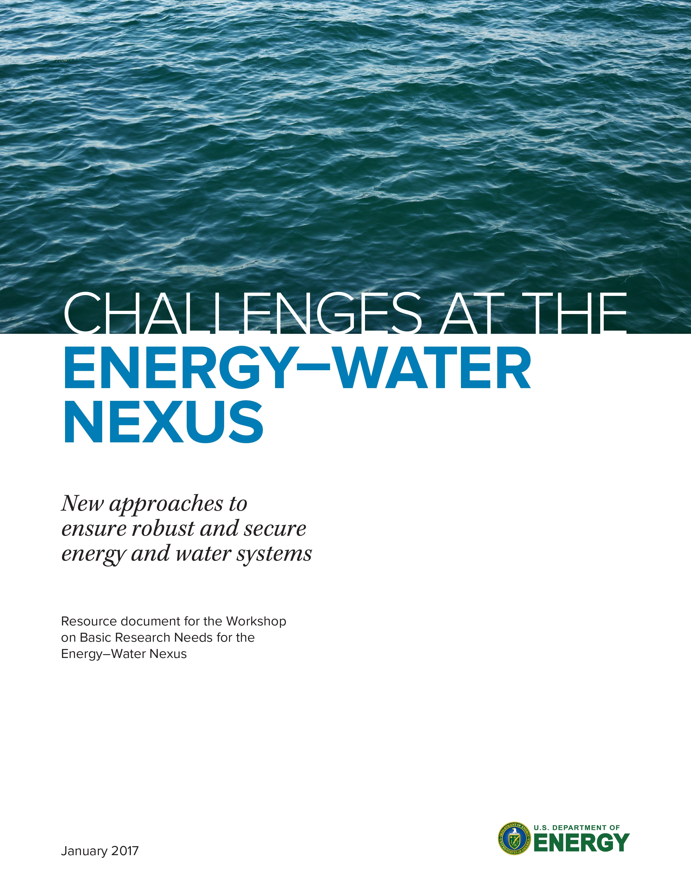
Basic research needs for the energy-water nexus (EWN) workshop
January 4-6, 2017
drhgfdjhngngfmhgmghmghjmghfmf
Matthew Tirrell
Susan hubbard
David Sholl
Argonne National Laboratory
University of Chicago
Lawrence Berkeley National Laboratory
Georgia Tech
BESAC
February 23, 2017

Slide 2
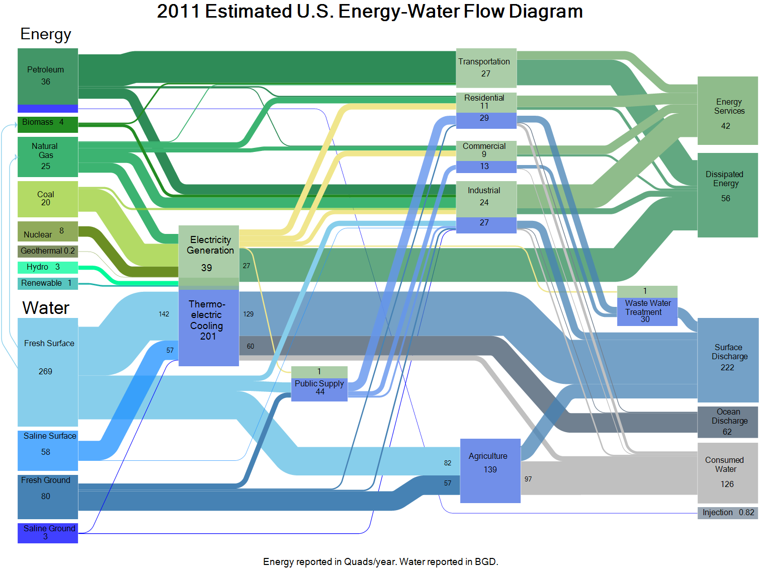
Interrelation of energy and water
DOE LLNL Sankey Diagram
Energy in Quads; Water in 10⁹ gal/day

Slide 3
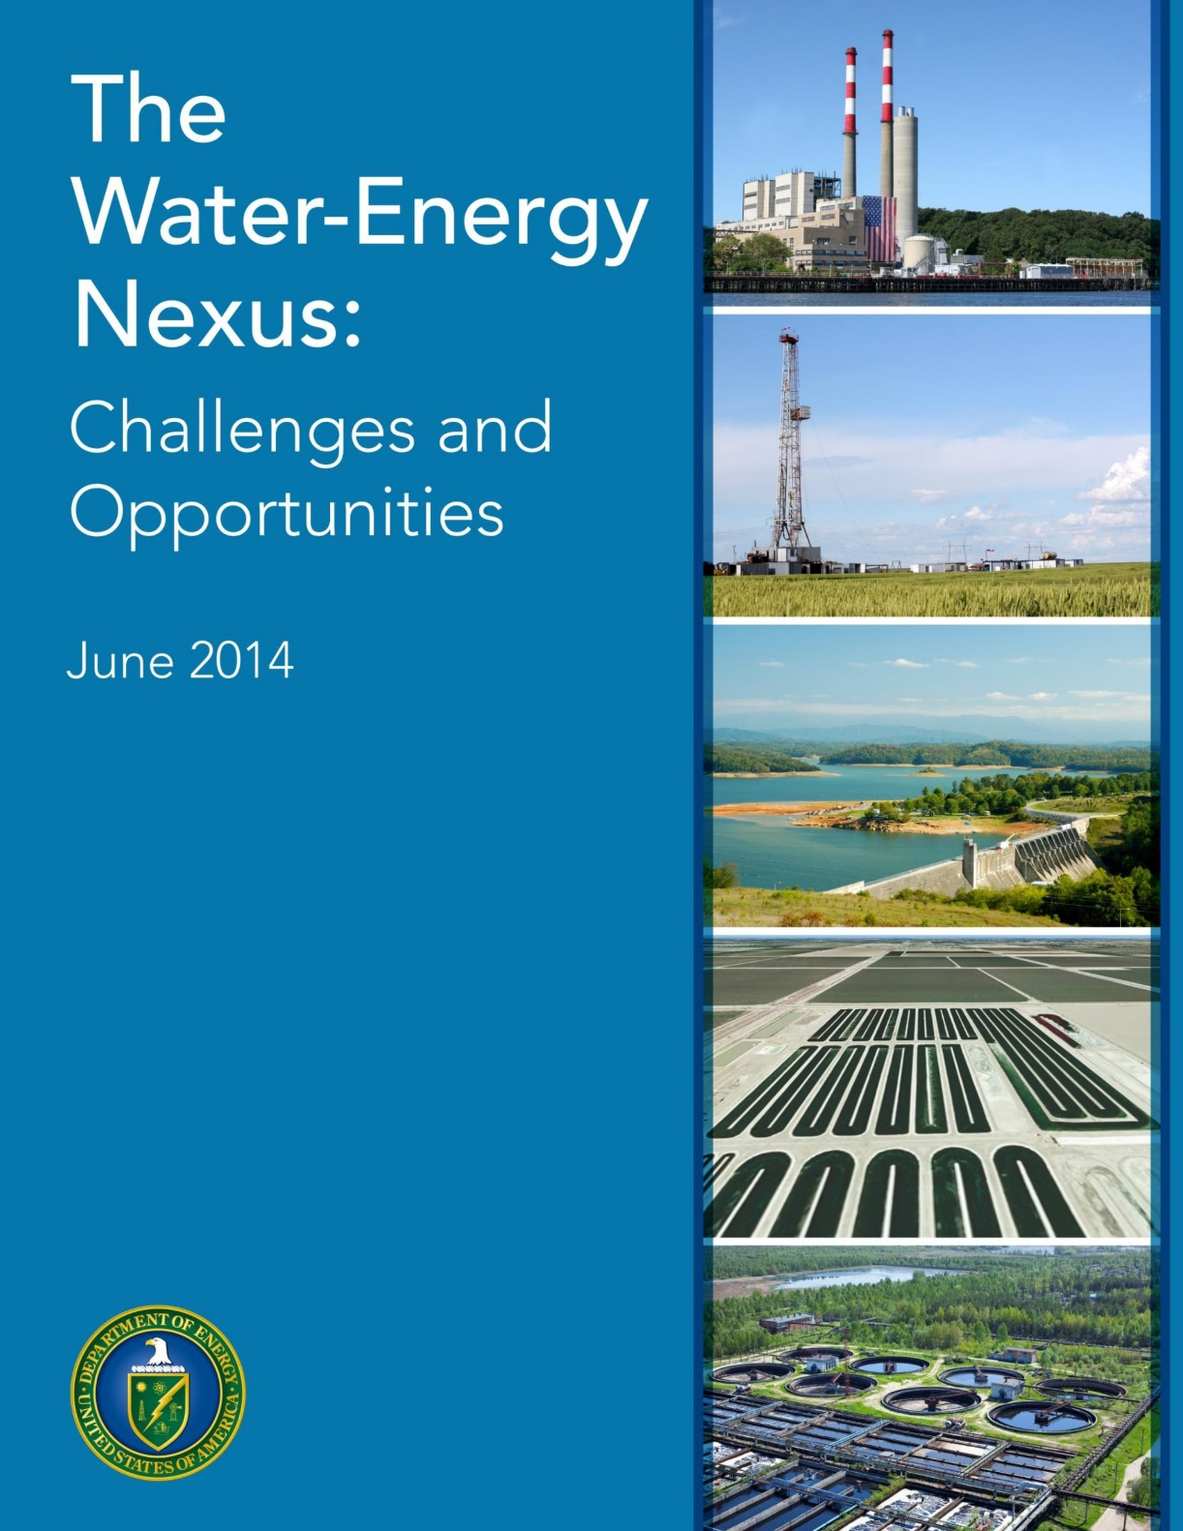
Doe and the EWN
Emerging global water crisis necessitates improvements in water use efficiency and development of new supplies of fit-for-use water
DOE emphasis has been on data, modeling, and analysis (DMA) and technology research, development, demonstration, and deployment (RDD&D)
Pressing need to complement these efforts with a broad suite of basic science programs to extract new insights and discoveries

Slide 4
Water is a diverse, multidisciplinary topic that can leverage the full power of the BES portfolio
Scientific progress in the EWN, perhaps more so than any other arena, will require integration and cooperation among chemists, physicists, biologists, geoscientists, materials scientists, and state-of-the-art experimental and computational facilities
Office of Basic Energy Sciences
Scientific User Facilities Division
Chemical Sciences, Geosciences, and Biosciences Division
Materials Sciences and Engineering Division

Slide 5
workshop charge
The goal of the workshop and the subsequent report is to provide an assessment of the basic science bottlenecks and gaps in our fundamental understanding of issues related to the energy-water nexus. The workshop will identify scientific challenges and the resulting priority basic research directions for:
  Enhancing the efficiency of water use in energy-intensive processes
  Minimizing water use for energy production
  Increasing the availability of fresh water through new developments and improvements in energy-intensive water purification and distribution processes
73 panelists and 56 observers

Slide 6
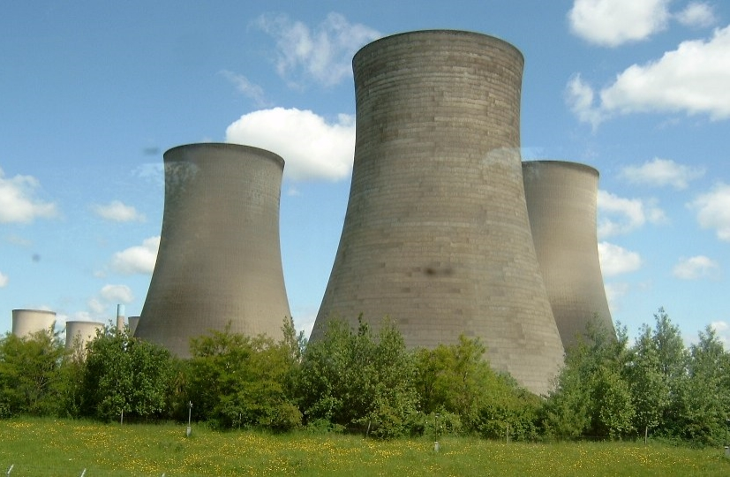
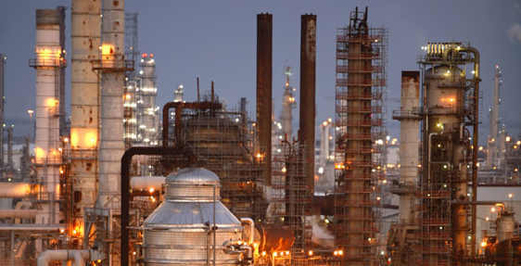

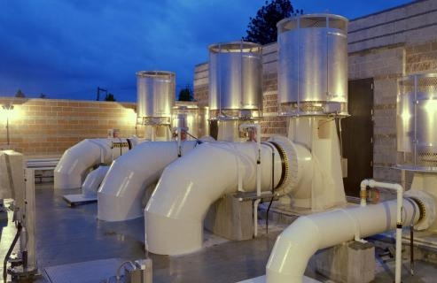
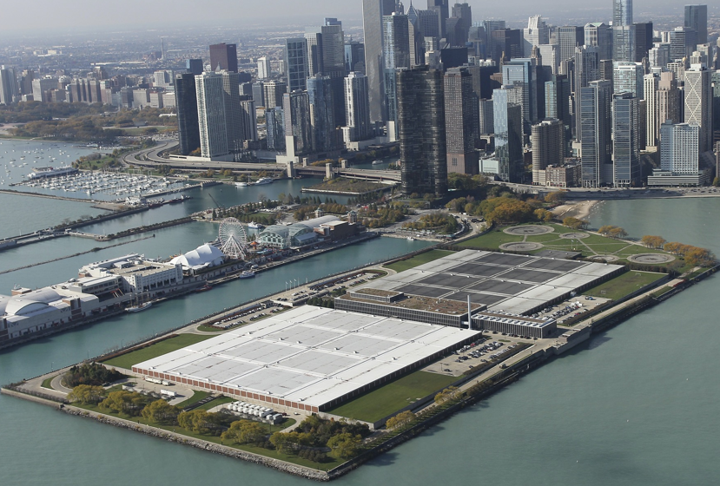
Organization of the workshop
Panel 1: Basic science challenges to improve water use in industrial applications and electricity generation
  Eric Peterson (INL) and Michael Tsapatsis (Univ. of Minnesota)
Panel 2: Basic science challenges to reduce water use in energy production
  Dan Giammar (Wash U) and Ben Gilbert (LBNL)
Panel 3: Basic science challenges to increase availability of fit-for-purpose water
  Kate Maher (Stanford) and Bill Tumas (NREL)
Panel 4: Cross-cutting basic science in the energy-water nexus
  Lynn Loo (Princeton) and Martin Schoonen (BNL)

Slide 7
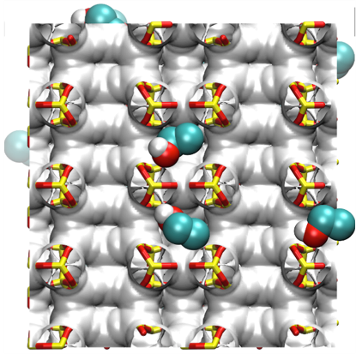
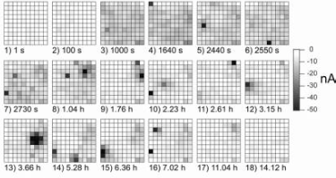
panel 1: Basic science challenges to improve water use in industrial applications and electricity generation
Key application targets
  Residuals management (Zero Liquid Discharge)
  Reduce fresh water use
  Increase water reuse
Models for thermodynamics, transport, and separation processes in complex aqueous mixtures
High-resolution sensor networks (remote, sensitive, selective)
Zeolite selective sorption
[Nat. Commun. 6 (2015) 5912]
Multi-electrode imaging of chloride breakthrough

Slide 8
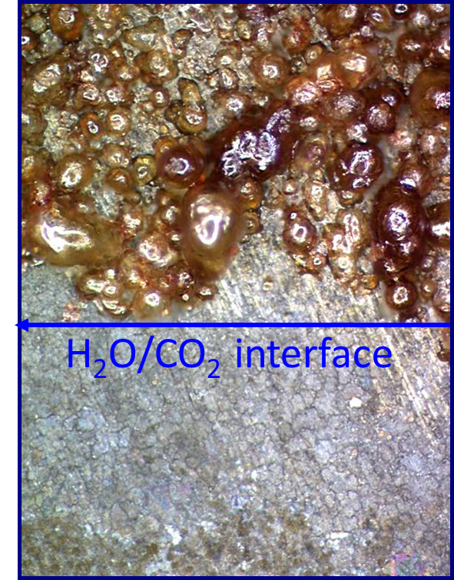
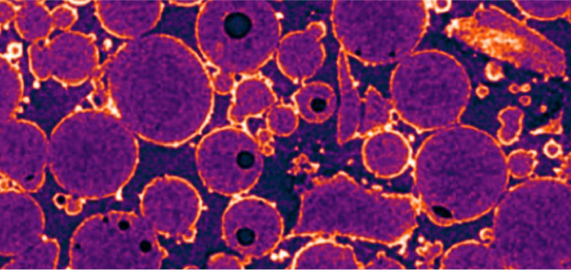
panel 2: Basic science challenges to reduce water use in energy production
Key application targets
  Hydrocarbon extraction
  Geothermal energy extraction
  Geological carbon sequestration
  Brine disposal
Nucleation, growth, and ion incorporation
Interfacial reactivity and characterization of non-crystalline solids
Complex fluid rheology and reactivity
Steel corrosion in water/CO₂ system
[McGrail et al. (2009)]
X-ray tomography of barite nucleation
[Godinho et al. (2016)]
Nanoparticle-stabilized foams
[courtesy M. Prodanovic]

Slide 9
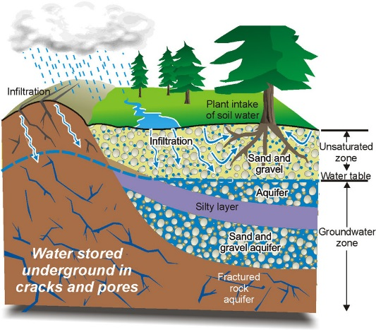
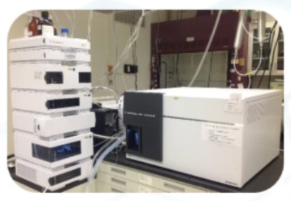
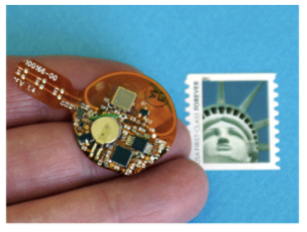
panel 3: Basic science challenges to increase availability of fit-for-purpose water
Key application targets
  Aquifer “reactors” for in-situ water treatment
  Multiphase subsurface fluid dynamics
  Subsurface water storage
  Water reuse/recycling
Pairing of water sources and uses
Fluid flow through porous natural media
Low-cost, reliable sensing technologies
Development of HPLC on chip
[courtesy C. Stafford]
http://www.cgenarchive.org/bowen-island-underground.html

Slide 10
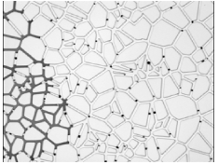
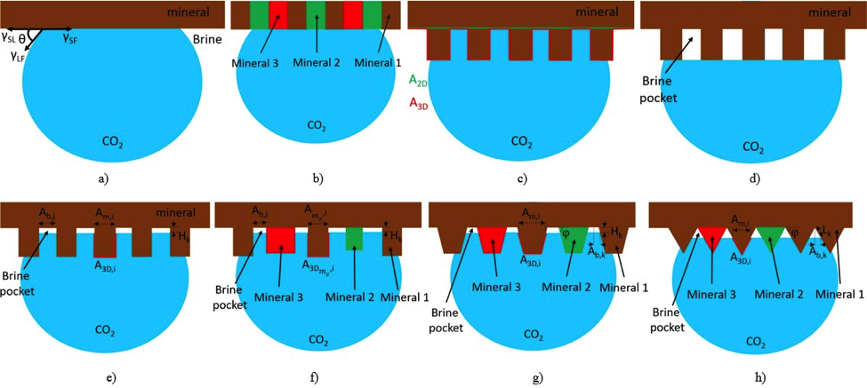
panel 4: Cross-cutting basic science in the energy-water nexus
New materials and material properties
Processes
(heat transport, flow in porous media, dissolution/precipitation, clathrates, fouling)
Microfluidic models
[courtesy X. Yin]
Advanced oil sorbents
[J. Mater. Chem. A 5 (2017) 2929]
Enabling analytical, characterization, and data management strategies
Wetting of mineral surfaces by immiscible fluids
[ACS Fuels and Energy (2017) In Review]
SAXS characterization of water infiltration
[PRL 112 (2014) 216101]

Slide 11
High-priority, shared topical areas emerged—often independently—from
the panels

Slide 12
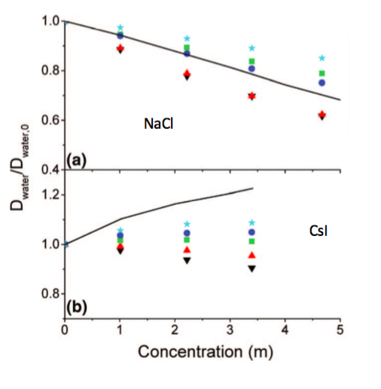
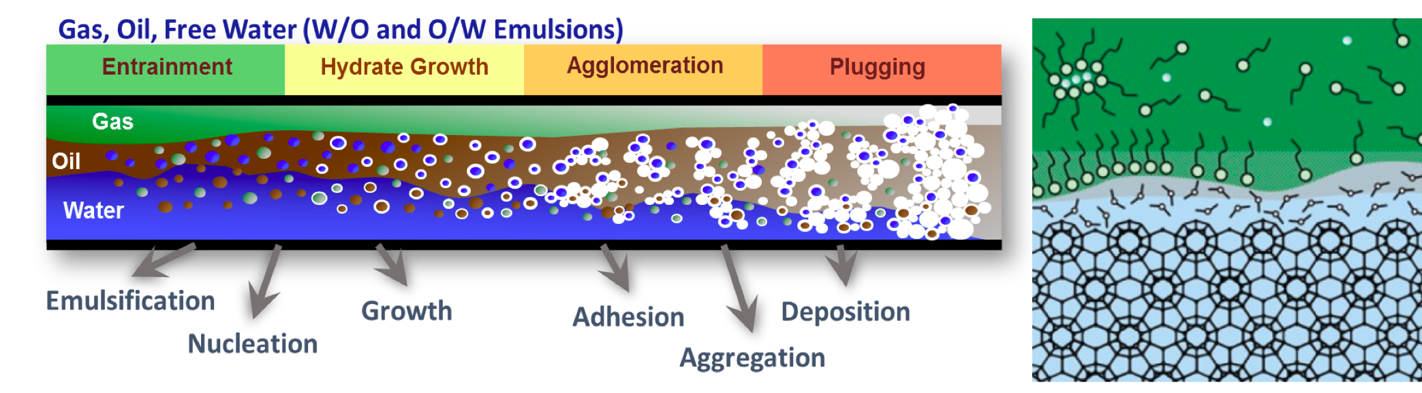
theme 1: fundamentals of complex fluids
Need to develop understanding of fluids (brines, blends, emulsions, low water content fluids) where macroscopic properties—including structure and reactivity under confinement—cannot currently be predicted from first principles
Gas hydrate plugging in an oil pipeline
[Chem. Soc. Rev. 45 (2016) 1678; Clathrate Hydrates of Natural Gases, 2007]
Comparison of measured and calculated water diffusion coefficients in electrolyte solutions
[courtesy J. Skinner]

Slide 13
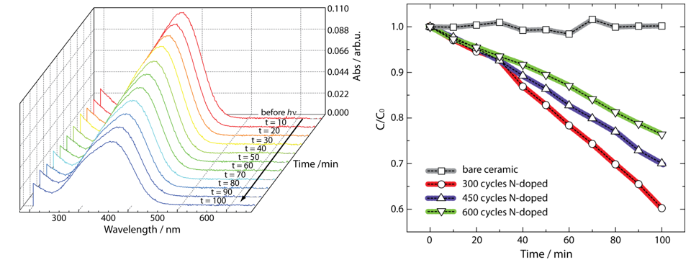
theme 2: interfaces and transport in complex environments
Interfaces—and confinement by interfaces—play a central role in the diverse transport and reactive processes associated with the energy-water nexus, from water treatment membranes and catalysts to subsurface resource recovery
Interface fouling
[Ang. Chemie (2017) DOI:10.1002/anie.201601509]
Confinement effects can enhance transport
[Nature Nano. 11 (2016) 639]
Photocatalytic degradation of organics with novel coatings
[Adv. Sust. Sys. (2017) DOI:10.1002/adsu.201600041]

Slide 14
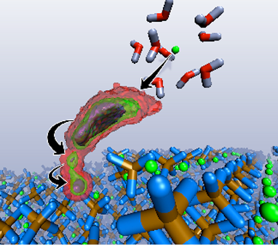
theme 3: materials and fluids by design
Rational design of new materials to exploit specific material-fluid interactions will enable step-change improvements in tunability and selectivity of purification, transformation, and transport processes
Molecular design of selective membranes
[Nature Rev. Mater. 1 (2016) 16018]
Metadynamics of cation attachment and detachment
[J. Phys. Chem. C 111 (2007) 16387]

Slide 15
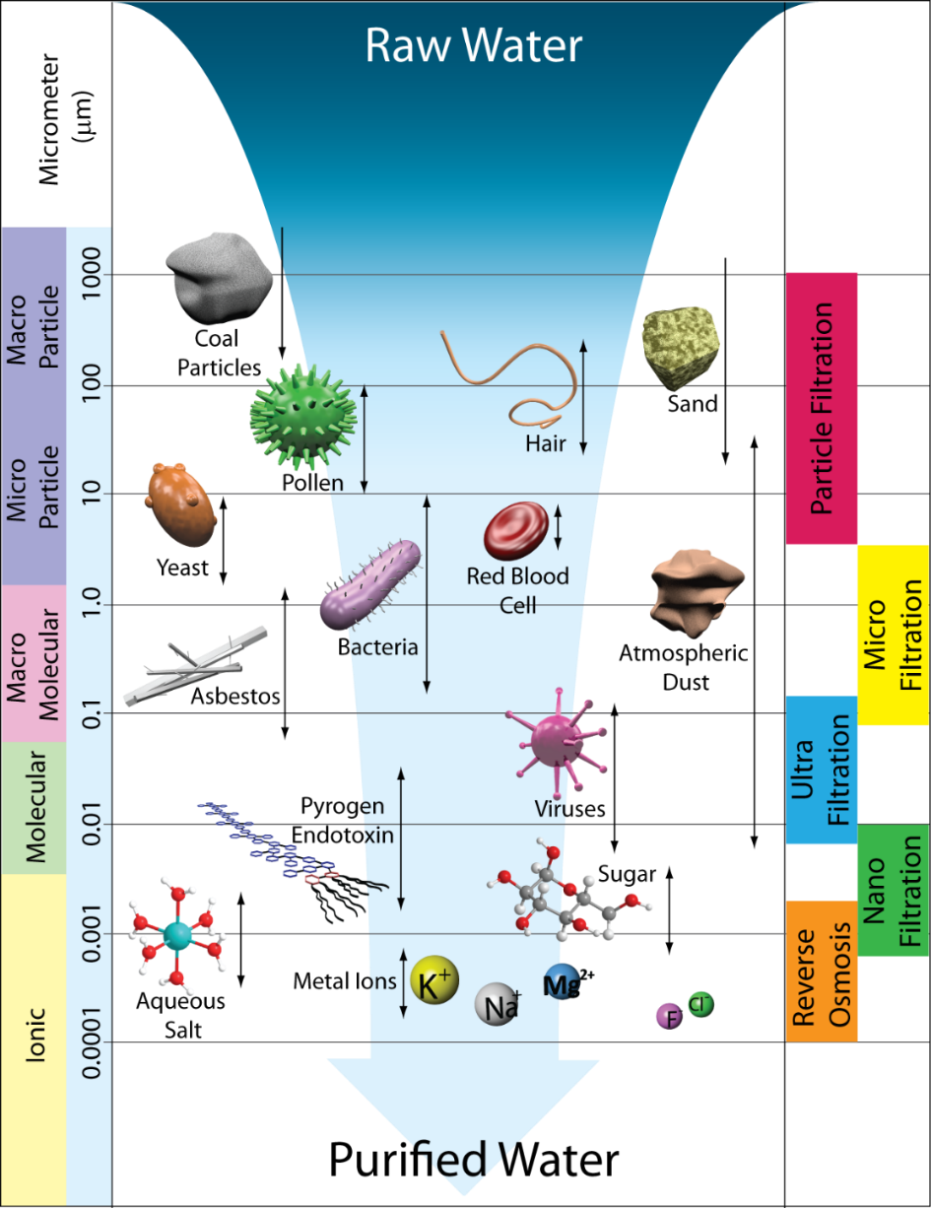
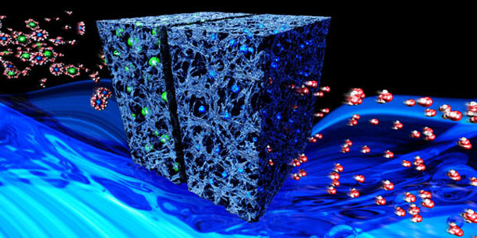
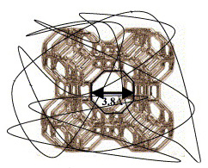
theme 4: Science to advance separations for water purification and Treatment
Energy-efficient treatment of water to be fit-for-use will necessitate advances in membranes, sorbents, and field-dependent separations
Flow-through capacitive deionization
[Energy Environ. Sci. 5 (2012) 9511]
Polymer-modified zeolites
[J. Membr. Sci. 275 (2006) 17]
Membrane size regimes
[Environ. Sci.: Water Res. Technol. 2 (2016) 17]

Slide 16
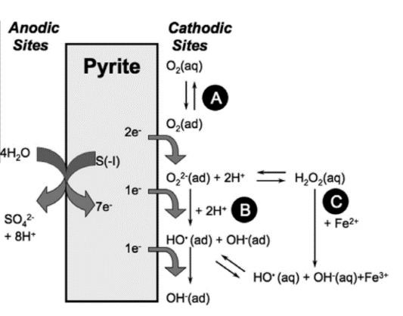
theme 5: Revolutionary approaches to manipulate water in natural environments
Subsurface systems offer tremendous capacity for water treatment and storage but can only be effectively utilized with deeper understanding of multiphase flow and reactive transport, including non-linear physical, chemical, and biological subsurface processes
Mineral-induced reactive oxygen species formation
[Geochim. Cosmochim. Acta 74 (2010) 4971]
Aquifer recharge mechanisms under current and future climate conditions
[J. Hydrology 534 (2016) 124]

Slide 17
Basic science will lay the groundwork for ensuring robust and secure energy-water systems in both natural and manufactured environments

