Slide 1
DOE Office of Advanced Scientific Computing Research
Presented to the
Basic Energy Sciences Advisory Committee
by
Steve Binkley
DOE Office of Advanced Scientific Computing Research
Steve.Binkley@science.doe.gov
February 11, 2016

Slide 2
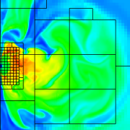
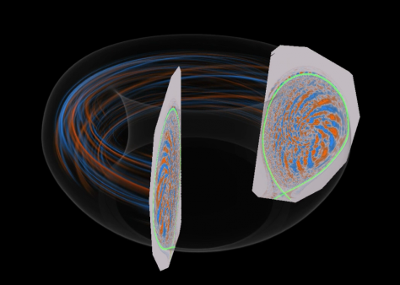
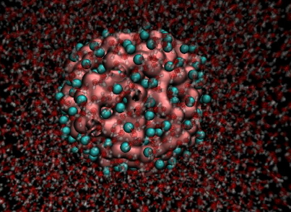
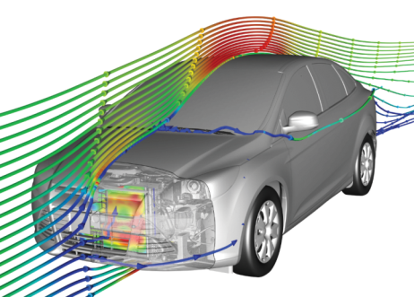
Advanced Scientific Computing Research
Computational and networking capabilities to extend the frontiers of science and technology
Exascale Computing Initiative (ECI) and Exascale Computing Project (ECP). The ECP is initiated as a joint ASCR/NNSA partnership using DOE’s formal project management processes. A new budget line is created for the ECP.
Facilities operate optimally and with >90% availability; deployment of 10-40 petaflop upgrade at NERSC and site preparations for NERSC-9; upgrade of high traffic links on Esnet; and continued preparations for 180-200 petaflop upgrades at ALCF and OLCF.
SciDAC partnerships will be recompeted in FY 2017 with new activities to include accelerating the development of clean energy technologies.
Applied Mathematics research addresses challenges of increasing complexity and Computer Science research addresses exploration of “beyond Moore’s law” architectures and supports data management, analysis, and visualization techniques.
The Computational Sciences Graduate Fellowship is funded at $10,000K.

Slide 3
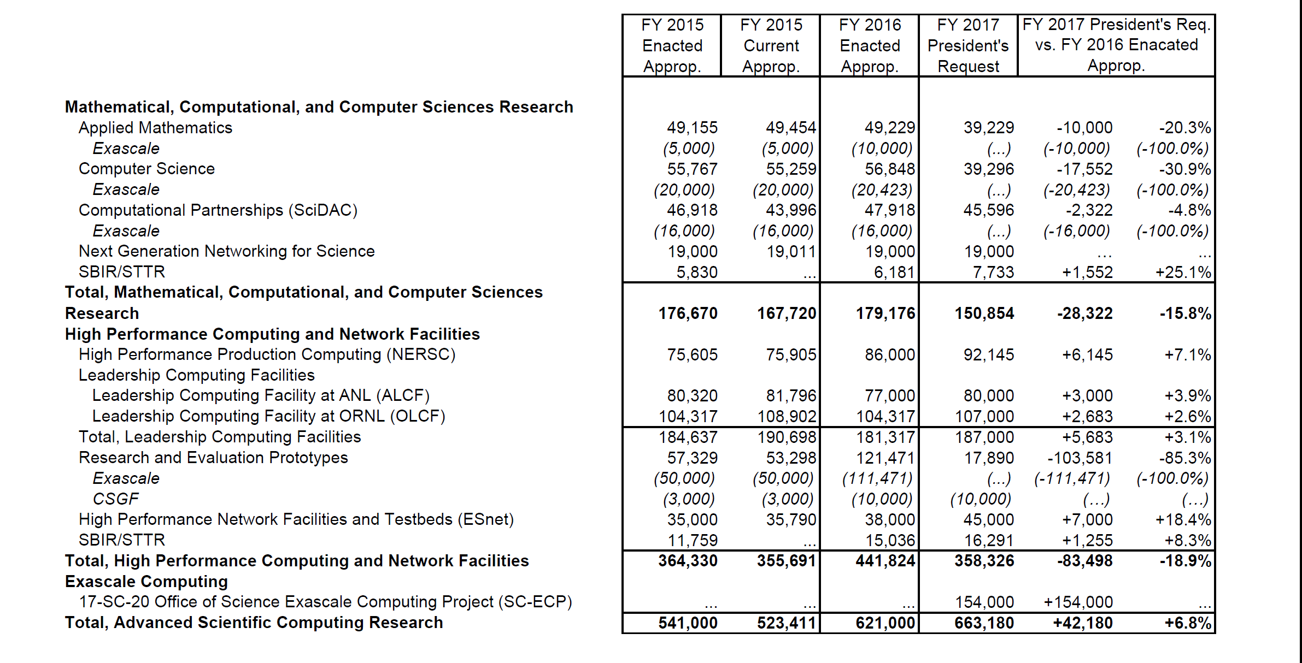
ASCR FY 2017 Budget Request to Congress
(Dollars in thousands)

Slide 4
ASCR Computing Upgrades At a Glance
System attributes | NERSC Now | OLCF Now | ALCF Now | NERSC Upgrade | OLCF Upgrade | ALCF Upgrades
Name Planned Installation | Edison | TITAN | MIRA | Cori 2016 | Summit 2017-2018 | Theta 2016 | Aurora 2018-2019
System peak (PF) | 2.6 | 27 | 10 | > 30 | 200 | >8.5 | 180
Peak Power (MW) | 2 | 9 | 4.8 | < 3.7 | 13.3 | 1.7 | 13
Total system memory | 357 TB | 710TB | 768TB | ~1 PB DDR4 + High Bandwidth Memory (HBM)+1.5PB persistent memory | > 2.4 PB DDR4 + HBM + 3.7 PB persistent memory | 676 TB DDR4 + High Bandwidth Memory (HBM) | > 7 PB High Bandwidth On-Package Memory Local Memory and Persistent Memory
Node performance (TF) | 0.460 | 1.452 | 0.204 | > 3 | > 40 | > 3 | > 17 times Mira
Node processors | Intel Ivy Bridge | AMD Opteron Nvidia Kepler | 64-bit PowerPC A2 | Intel Knights Landing many core CPUs Intel Haswell CPU in data partition | Multiple IBM Power9 CPUs & multiple Nvidia Voltas GPUS | Intel Knights Landing Xeon Phi many core CPUs | Knights Hill Xeon Phi many core CPUs
System size (nodes) | 5,600 nodes | 18,688 nodes | 49,152 | 9,300 nodes 1,900 nodes in data partition | ~4,600 nodes | >3,200 nodes | >50,000 nodes
System Interconnect | Aries | Gemini | 5D Torus | Aries | Dual Rail EDR-IB | Aries | 2nd Generation Intel Omni-Path Architecture
File System | 7.6 PB 168 GB/s, Lustre® | 32 PB 1 TB/s, Lustre® | 26 PB 300 GB/s GPFS™ | 28 PB 744 GB/s Lustre® | 120 PB 1 TB/s GPFS™ | 10PB, 210 GB/s Lustre initial | 150 PB 1 TB/s Lustre®

Slide 5
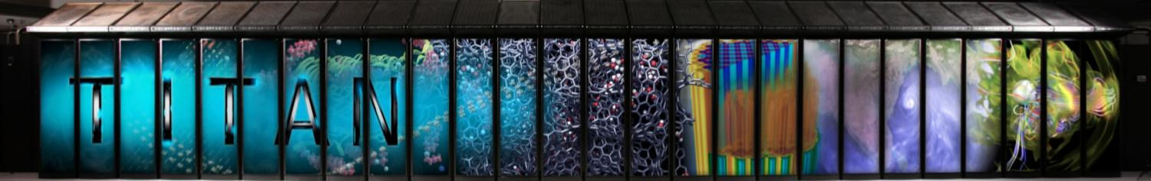
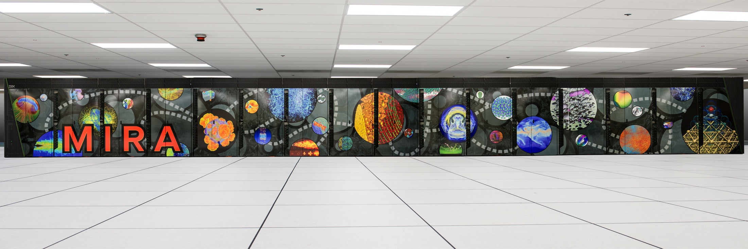
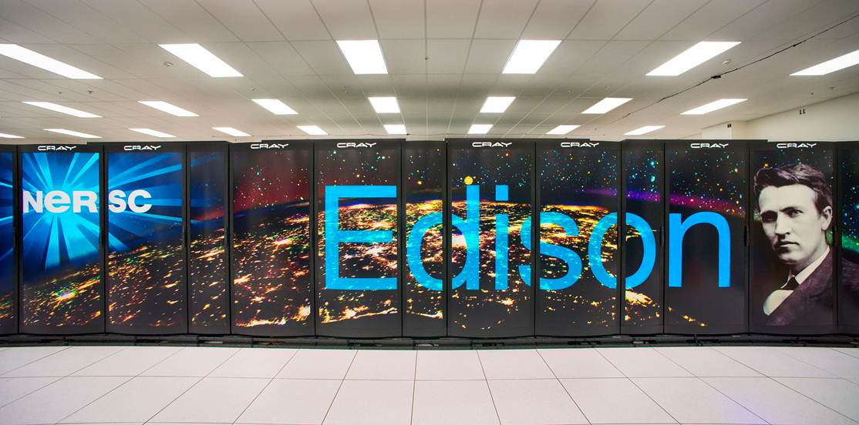
Leadership and Production Computing Facilities
Titan:
Peak performance of 27.1 PF
18,688 Hybrid Compute Nodes
8.9 MW peak power
Mira:
Peak performance of 10 PF
49,152 Compute Nodes
4.8 MW peak power
Edison XC30:
Peak performance 2.4 PF
124,608 processing cores
2.1 MW peak power

Slide 6

ESnet5 Winter 2014/15
AMST
SEAT
100
10
PNNL
BOST
MIT/ PSFC
STAR
NEWY
100
10
INL
AOFA
100
10
10
10
EQCH
10
BNL
LOND
BOIS
FNAL
100
10
100
CLEV
100
100
JGI
SACR
10
LBNL
100
10
10
AMES
10
ANL
10
LOND
10
100
100
100
PPPL
100
SUNN
10
Salt Lake
10
100
PU Physics
CERN
NERSC
10
100
SNLL
100
100
CHIC
JLAB
10
LLNL
ORNL
EQASH
WASH
10
SLAC
100
DENV
KANS
EQSJ
LSVN
100
100
10
LANL
100
10
LOSA
100
NASH
SDSC
10
10
ALBQ
100
SNLA
CHAT
100
GA
10
ATLA
ELPA
SUNN
ESnet PoP/hub locations
100
HOUS
100
ESnet managed 100G routers
100
Routed IP 100 Gb/s
Routed IP 40 Gb/s
Routed IP 4 X 10 Gb/s
3rd party 10Gb/s
Express / metro / regional 100 Gb/s
Express / metro 10G
Express multi path 10G
Lab supplied links
Other links
Tail circuits
10
ESnet managed 10G router
Geographical representation is
approximate
10
100
Site managed routers
LOSA
ESnet optical node locations (only some are shown)
commercial peering points
R&E network peering locations – US and international
LBNL
Major Office of Science (SC) sites
Geography is
only representational
LLNL
Major non-SC DOE sites
100G testbed
SF Bay Area
Chicago
New York
SUNN
STAR
AOFA

Slide 7
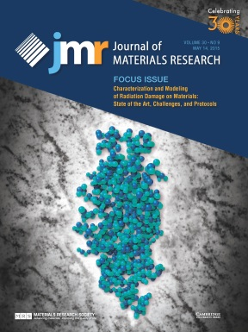
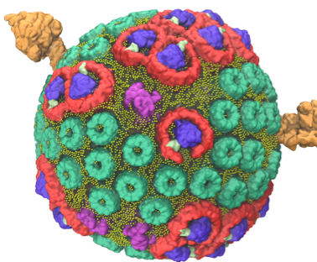
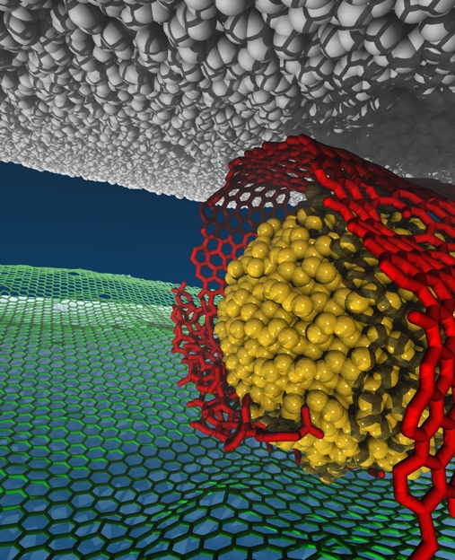
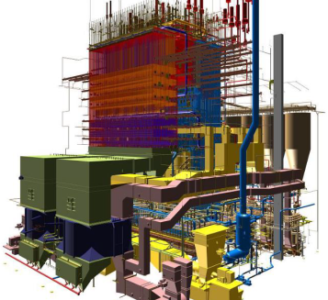

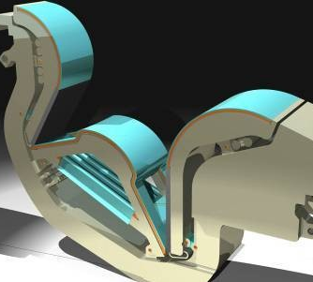
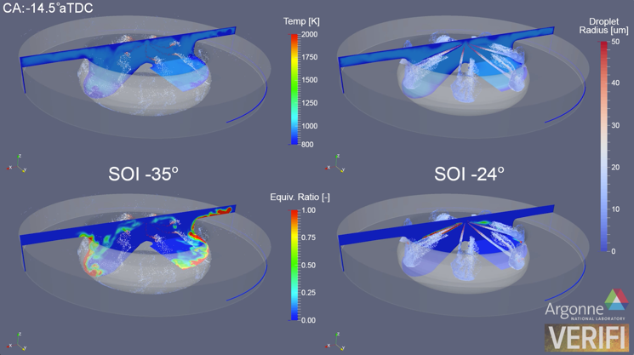

HPC Advancing Clean Energy
Materials for Nuclear Energy
Simulations at NERSC reveal structural defects from irradiation in nuclear power plants that can’t be seen in experiments.
(R. Devanathan, PNNL)
Photosynthesis
A team from the University of Illinois at Urbana-Champaign (UI-UC) used the OLCF to achieve a milestone in the field of biomolecular simulation, modeling a complete photosynthetic organelle of the bacteria Rhodobacter sphaeroides in atomic detail. The project is the first of its kind. (C. Shulten, UI-UC)
Clean Coal Combustion
Researchers at the University of Utah and its Carbon Capture Multi-Disciplinary Simulation Center (CCMSC) are using the OLCF to enable petascale simulations to guide the design of next-generation oxy-coal boilers for clean electric energy. (M. Berzins, Utah)
Reducing Friction
A team of researchers used the ALCF to observe a mechanism for eliminating friction at the macroscale with potential to achieve superlubricity for a wide range of mechanical applications.
(S. Sankaranarayanan, ANL)
Cellulosic Ethanol
To understand barriers to biofuel production, researchers used the OLCF to develop detailed knowledge of lignin behavior that can guide genetic engineering of enzymes that produce bioethanol more efficiently.
(J. Smith, ORNL)
Materials for Fusion Energy
Researchers used the OLCF to obtain fundamental understanding of the plasma heat-load impinging on the Tokomak divertor and its dependence on the plasma current in present-day tokamak devices and in ITER. (C.S. Chang, PPPL)
Superconductivity
ALCF research is providing advanced calculations to identify the electronic mechanisms for high-temperature superconductivity in cuprates.
(L. Wagner, UI-UC)
Better Engines
The ALCF is partnering with industry to develop simulation capabilities that can improve the fuel economy of vehicles.
(S. Som, ANL)

Slide 8




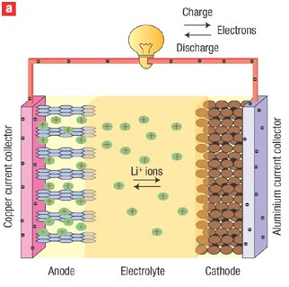
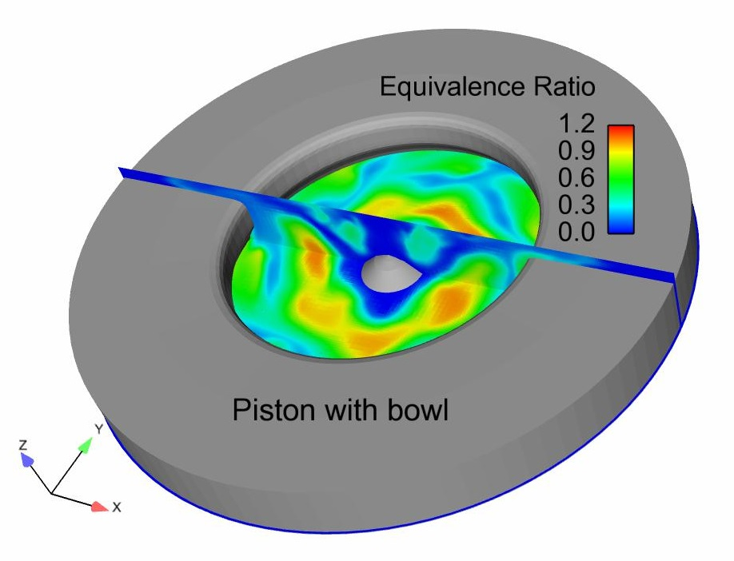




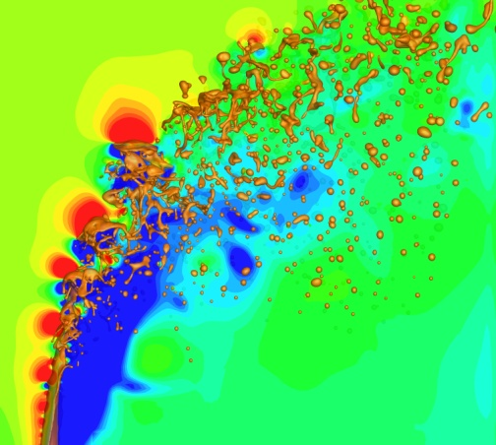


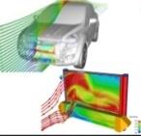
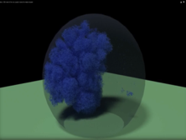

HPC Accelerating Energy Technology Development
General Motors
Increasing Fuel Efficiency of Cars
Caterpillar
Heavy Equipment Efficiency
Ramgen Power Systems
Compressor Design Innovation
Caterpillar used ALCF resources to develop more powerful combustion engine simulation capabilities to allow shorter development times and reduce need for multi-cylinder test programs. CAT also used the OLCF for evaluating large-scale HPC and GPU capability of critical welding simulation software and further developing & testing weld optimization algorithm.
GM used the OLCF to accelerate, by at least a year, research to develop
new thermoelectric materials that
increase the fuel efficiency of cars.
Typical car engines lose about 60
percent of fuel energy to waste
heat. Access to DOE computers
allowed GM to develop unique
materials that convert some waste
heat into electricity that can power
various subsystems, removing a major burden from the car’s main
generator and lowering fuel consumption. GM also used the OLCF to optimize
injector hole pattern design for desired in-cylinder fuel-air mixture distributions
with a 4 - 40x improvement in workflow throughput via 100s of ensembles.
Ramgen Power Systems, a small firm in
Bellevue, WA used the OLCF to accelerate
the design of shock wave turbo compressors
for carbon capture and sequestration and
for energy production. Very high resolution
computer models enabled the company to
go from computer testing to cutting a titanium prototype in two months.
Bosch
Li-ion Batteries
Convergent Science
Engine Design
Bosch used OLCF resources to discover and optimize new classes of solid inorganic Li-ion electrolytes with high ionic and low electronic conductivity, and good electrochemical stability.
Convergent Science is an Independent Software Vendor specializing in Computational Fluid Dynamics tools. They used the ALCF to improve scaling of combustion simulations to allow unprecedented number of simultaneous jobs, providing a valuable design tool
for engine manufacturers jobs,
Pratt & Whitney
Accelerating Energy Efficient Jet Engine Design
Fiat Chrysler Automobiles
Improving Pickup Aerodynamics
Airlines are constantly seeking better fuel efficiency and lower emissions, but
redesigning jet engines has traditionally involved many time-consuming, repetitive experiments. Pratt & Whitney has dramatically decreased problem-
to-solution turnaround times by adding
computer based virtual testing to the
design process. Using the ALCF, Pratt
& Whitney improved the fuel efficiency
in its Pure Power engines by 12–15%
with potential savings to airlines of
nearly $1M per aircraft per year. The
new design is also 75 percent quieter.
providing a valuable design tool for engine manufacturers.
FCA has begun working with the OLCF to better understand the aerodynamics of a pickup truck. They will be doing large scale design of experiment studies to understand the influence of about 40 different geometric parameters on the aerodynamic behavior, specifically the drag coefficient, of pickup truck designs.
United Technologies
Jet Efficiency & Catalysis
The Boeing Company
Aircraft Efficiency and Safety
UTRC used the OLCF to conduct first-of-a-kind high-fidelity LES computations of flow in turbomachinery components for more fuel efficient, next-generation jet engines. They also used the OLCFs to Demonstrate biomass as a viable, sustainable feedstock for fuel cell hydrogen production; showed that nickel is a feasible catalytic alternative to platinum
Increasingly, aircraft manufacturers use
predictive computational tools to take the
place of expensive wind tunnel tests. Boeing
used the OLCF to discover multiple solutions
for steady RANS equations with separated
flow to explain why numerical models
sometimes fail to capture maximum Iift.
SmartTruck Systems
Reducing Truck Fuel Consumption
SmartTruck Systems of South Carolina used the OLCF to reduce by 50% the time to develop add-on parts that substantially improve the fuel efficiency - up to 12% - exceeding the EPA SmartWay requirements for long-haul Trucks. Add-on parts from SmartTruck can save each outfitted truck up to 3,700 gallons of fuel each year.
General Electric
Advancing Wind Energy
Ford Motor Company
Underhood Cooling
GE used ALCF resources to enable the design of quieter, more efficient wind turbines by accurate simulations of the complex behavior of air flows around wind turbine blades. GE also used the OLCF to conduct first time simulations of ice formation within million-molecule water droplets . This is expanding
Ford used OLCF resources to develop a new, efficient and automatic analytical cooling package optimization process leading to one- of-a-kind design optimization of cooling systems. Ford also used the OLCF to develop a high-performance computational strategy for modeling engine Cycle-to-Cycle Variation (CCV) - the first such simulation at scale.
Royal Dutch Shell
Catalysis
Shell used the ALCF to improve the production of synthetic gas products by simulating the catalytic properties of cluster-based materials.
understanding of freezing at the molecular level to enhance wind turbine resilience in cold climates.

Slide 9
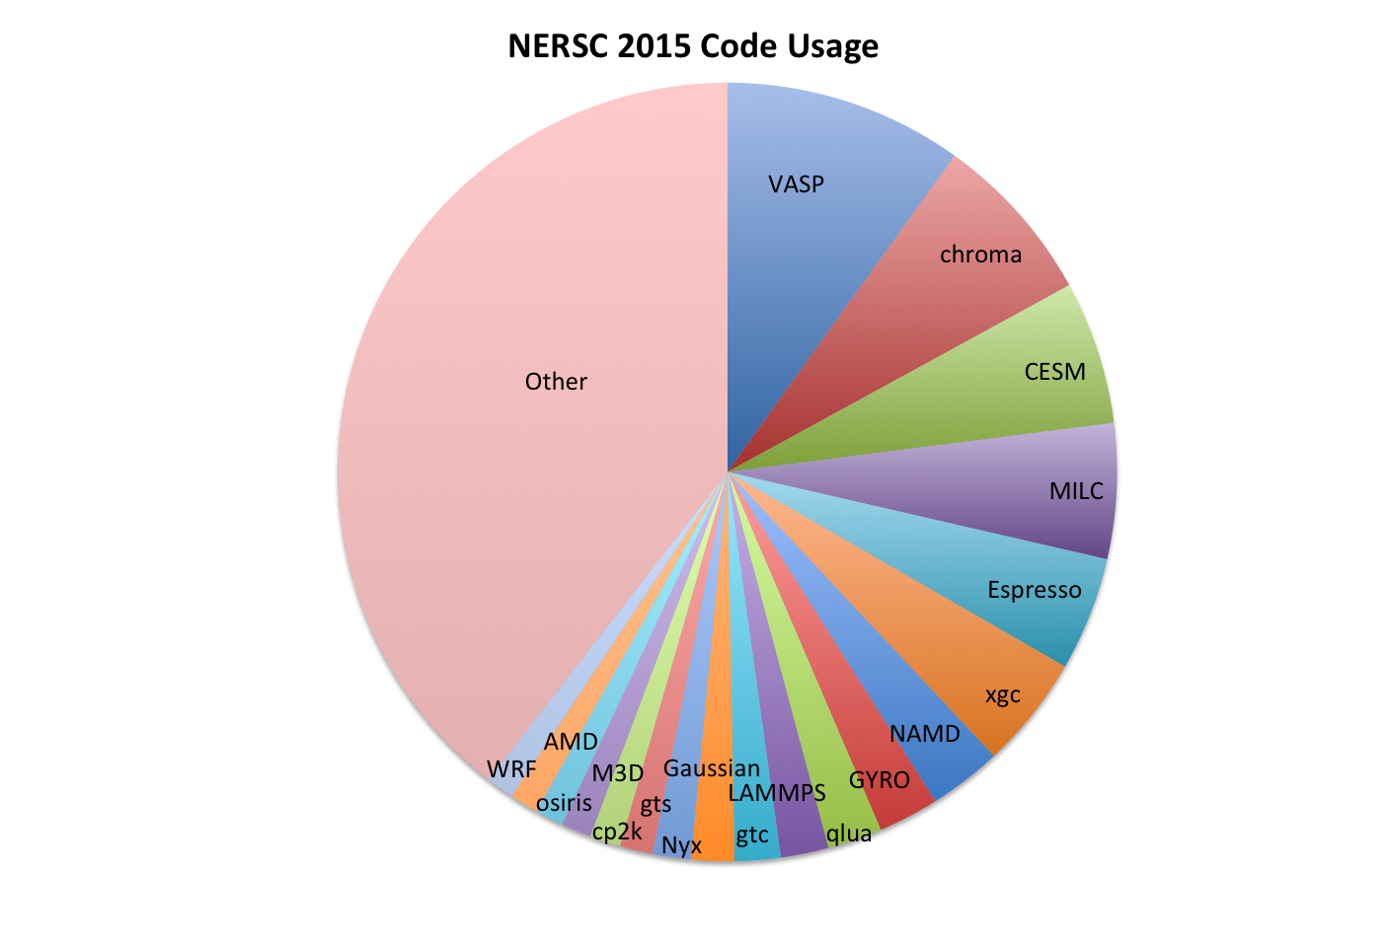
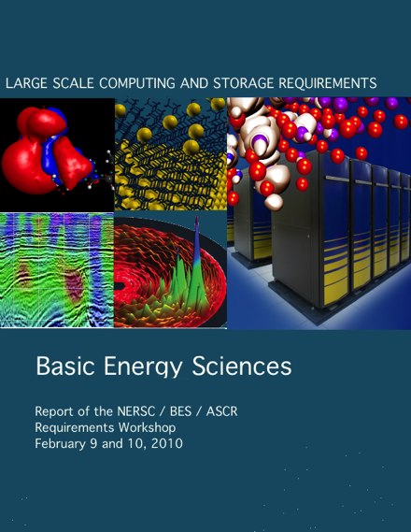

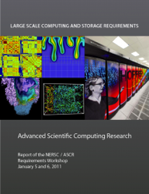

Computational Capacity is Based on Requirements
“Lead with the Science”
Formal Requirements
Gathering Process

Slide 10
Objectives of Current “Exascale” Requirements Review (RR)
Goal: Ensure the ability of ASCR facilities to support SC mission science in the exascale regime (2020-2025 timeframe).
  SC Program Office : Identify key computational science objectives that push exascale and describe the HPC ecosystem –HPC machine and related resources- needed to successfully accomplish your science goals
    Capture the whole picture:
      Identify continuum of computing needs for the program office from institution clusters to Leadership computing.
        Note: ASCR focus is on HPC and Leadership computing.
      Include modeling and simulation, scientific user facilities and large experiments needs, data needs, and near real time needs.
    Information gathered will inform the requirements for ecosystems for planned upgrades in 2020-2023 including the pre-exascale and exascale systems, network needs, data infrastructure, software tools and environments, and user services.
  ASCR: Communicate to DOE SC scientists the known/fixed characteristics of upcoming compute system in the 2020-2025 timeframe and ask the computational scientists for feedback on proposed architectures.
  Strengthen and inform interactions between HPC facility experts and scientists as well as ASCR and SC Program Offices

Slide 11
Implementation of Exascale Requirements Review (RR)
Series of workshops, one per SC Office (a hybrid between NERSC requirements reviews and Scientific Grand Challenges)
Location: Washington DC area
Program Committee: Representative community leaders from SC domain program office and ASCR facility staff
Attendance: ~50 attendees including DOE program managers, DOE SC community representatives, ASCR supported applied mathematicians and computer scientists and a small number of Postdocs and senior CSGF fellows
Proposed Schedule
June 10-12,2015 | HEP
November 3-5 2015 | BES
January 2015 | FES
April/March 2016 | BER
June 2016 | NP
September 2016 | ASCR
Agenda: Plenary session and themed breakout sessions determined by program committee
Pre-meeting homework: Templates will be developed and provided to chairs and attendees of breakout session for discussing and documenting case studies
Output: Summary workshop report written for each workshop.

Slide 12
Requirements Reviews Meet Multiple Needs
Facilities needs
  Develop mission need statements for proposed upgrades (stretch your imaginations!!)
  Identify emerging hardware and software needs of researchers, including experimentalists at SC or other scientific user facilities or experiments
Headquarters needs
  Articulate the case for future upgrades to SC and DOE management, OMB and Congress
    What are the potential impacts from the investments in upgrades
    How broad is the reach – industry, other user facilities, other agencies
  Identify emerging hardware and software needs for SC, including research
    What gaps can we fill
  Develop strategic roadmap for facilities division based on scientific need
    Who are our customers
    What niche are facilities filling
    What gaps should we fill

Slide 13

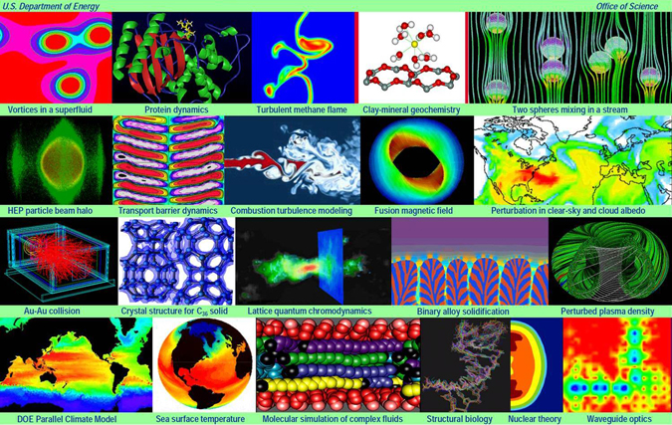
ASCR Partnerships Across the Office of Science
Partnerships facilitate transfer of ASCR research results into SC applications
SciDAC focuses on the high end of high performance computing and addresses two challenges:
  to broaden the HPC community to increase the impact of high performance computing on the Department’s missions, and
  to ensure that further progress at the forefront of HPC technology is rapidly assimilated into DOE applications.
In its 3rd five-year generation, 18 partnerships span Office of Science programs
SciDAC is leading U.S. industry into new ways to use computing to improve competitiveness.
13

Slide 14
Exascale

Slide 15
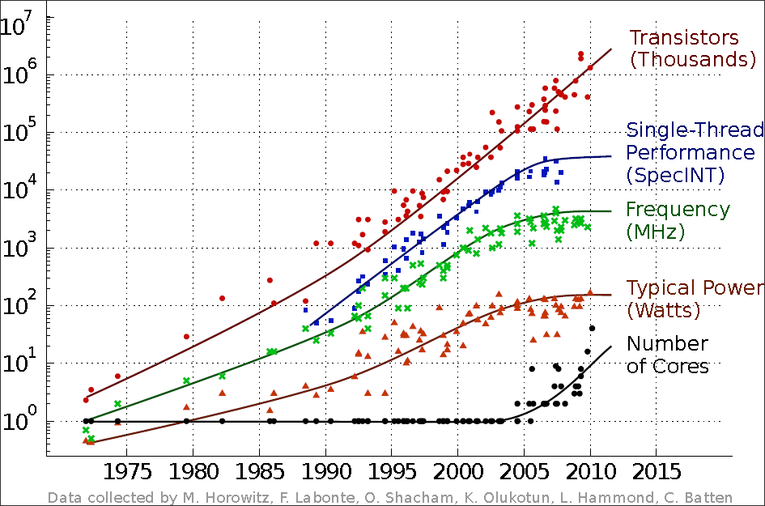
Progress in CMOS CPU Technology
Moore’s Law continues
  Transistor count still doubles every 24 months
Dennard scaling stalls
  Voltage
  Clock Speed
  Power
  Performance/clock
15

Slide 16
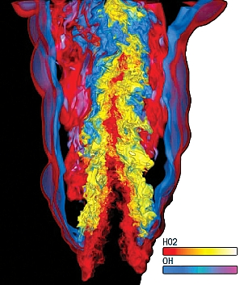
DOE’s Exascale Computing Initiative:
Next Generation of Scientific Innovation
Departmental Crosscut – In partnership with NNSA
“All-in” approach: hardware, software, applications, large data, underpinning applied math and computer science
Supports DOE’s missions in national security and science:
  Stockpile stewardship – support annual assessment cycle
  Discovery science – next-generation materials; chemical sciences
  Mission-focused basic science in energy – next-generation climate software
  Use current Leadership Computing approach for users
The next generation of advancements will require Extreme Scale Computing
  100-1,000X capabilities of today’s computers with a similar physical size and power footprint
  Significant challenges are power consumption, high parallelism, reliability
Extreme Scale Computing, cannot be achieved by a “business-as-usual,” evolutionary approach
  Initiate partnerships with U.S. computer vendors to perform the required engineering, research and development for system architectures for capable exascale computing
  Exascale systems will be based on marketable technology – Not a “one off” system
  Productive system – Usable by scientists and engineers

Slide 17
Components of the Exascale Program
Exascale Computing Initiative (ECI)
  The ECI was initiated in FY 2016 to support research, development, and computer-system procurements to deliver an exascale (10¹⁸ ops/sec) computing capability by the mid-2020s.
  It is a partnership between SC and NNSA, addressing science and national security missions.
  The Exascale Crosscut includes primary investments by SC/ASCR and NNSA/ASC and software application developments in both SC (BES and BER) and NNSA.
Exascale Computing Project (ECP)
  Beginning in FY 2017, the ASCR ECI funding is transitioned to the DOE project (the ECP), which is managed according to the principles of DOE Order 413.3b.
  The new ECP subprogram in ASCR (SC-ECP) includes only activities required for the delivery of the exascale computers. An ECP Project Office has been established ORNL.
  NNSA/ASC Advanced Technology Development and Mitigation (ATDM) supports activities for the delivery of exascale computers and the development of applications.
Relationship of the ECI and ECP to the National Strategic Computing Initiative
  On July 29, 2015, an executive order established the National Strategic Computing Initiative (NSCI) to ensure a coordinated Federal strategy in HPC research, development, and deployment.
  DOE, along with the DoD and NSF, co-lead the NSCI. Within DOE, SC and NNSA execute the ECI and the ECP, which are the DOE contributions to the NSCI.

Slide 18
Exascale Target System Characteristics
20 pJ per average operation
Billion-way concurrency (current systems are O(million))
Ecosystem to support new application development and collaborative work, enable transparent portability, accommodate legacy applications
High reliability and resilience through self-diagnostics and self-healing
Programming environments (high-level languages, tools, …) to increase scientific productivity

Slide 19
From Giga to Exa, via Tera & Peta*
Exa
Peta
1.5x from transistor
670x from parallelism
8x from transistor
128x from parallelism
Tera
32x from transistor
32x from parallelism
Giga
*S. Borkar, Intel
Performance from parallelism

Slide 20
Top Ten Technical Challenges for Exascale
(Advanced Scientific Computing Advisory Committee Findings)
Energy efficiency: Creating more energy efficient circuit, power, and cooling technologies.
Interconnect technology: Increasing the performance and energy efficiency of data movement.
Memory technology: Integrating advanced memory technologies to improve both capacity and bandwidth.
Scalable System Software: Developing scalable system software that is power and resilience aware.
Programming systems: Inventing new programming environments that express massive parallelism, data locality, and resilience
Data management: Creating data management software that can handle the volume, velocity and diversity of data that is anticipated.
Exascale algorithms: Reformulating science problems and refactoring their solution algorithms for exascale systems.
Algorithms for discovery, design, and decision: Facilitating mathematical optimization and uncertainty quantification for exascale discovery, design, and decision making.
Resilience and correctness: Ensuring correct scientific computation in face of faults, reproducibility, and algorithm verification challenges.
Scientific productivity: Increasing the productivity of computational scientists with new software engineering tools and environments.
http://science.energy.gov/~/media/ascr/ascac/pdf/reports/2013/report.pdf
➔
➔
➔
➔
➔
➔

Slide 21




Computational Materials and Chemical Sciences
BES-
ASCR
Link
High-accuracy software is needed to understand how the behavior of atoms and molecules (or quantum effects) impacts energy conversion and materials synthesis.
Open-source, experimentally validated software, based on advanced quantum mechanical methods, is needed for accelerated prediction of functional materials and molecular assemblies..
At NERSC, the most used code is VASP, a commercial Austrian atomic scale modeling code requiring purchase of license. Development of Espresso, a materials sciences code, is led by Italy.
Top codes used at NERSC for other fields were developed in the U.S. and are all free, open-source community codes.
In FY 2017, a new effort in computational chemical sciences is proposed ($14M).
2015 Top Application Codes at NERSC
Atomic Scale
Modeling
High Energy Physics
Climate
High Energy
Physics
Atomic Scale Modeling
Plasma Physics
Biophysics
Plasma Physics
21

Slide 22
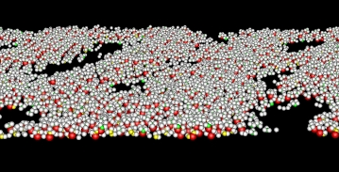
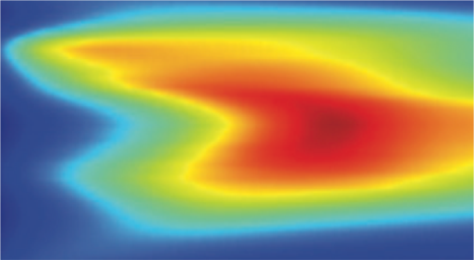
Computational Materials Sciences
BES-
ASCR
Link
  Deliverable: Robust, open-source community software and databases for predictive design of functional materials within the Materials Genome Initiative for Global Competitiveness
  Support began in FY 2015 for 3 teams for 4-year awards at $8M/yr; Additional FY 2016 funds will complement previous awards including an emphasis for future use with exascale computing
  Deliver research codes and data for design of functional materials to the materials sciences communities in academia, labs, and industry
  Use integrated teams combining expertise in materials theory, modeling, computation, synthesis, characterization, and processing/fabrication
  Use facilities and tools for synthesis, characterization, simulation, and computation, relying especially on the SC scientific user facilities and leadership class computing
  FY 2015 Awards:
Experimental & Calculated Images of Ordered Nanoparticle Chains
Structure and Dynamics in Self-Assembled Monolayers
Inelastic Neutron Response Predicted by Dynamical Mean Field Theory
Functional Materials Design for Energy Conversion
Argonne National Laboratory
Computational Synthesis of Layered Materials
University of Southern California
Computational Design of Correlated Materials
Brookhaven National Laboratory

Slide 23
Computational Materials Sciences – FY 2015 Award
BES-
ASCR
Link
  Begun in FY 2015, Computational Materials Sciences supports research by integrated, multidisciplinary teams to develop validated software and databases for predictive design of functional materials.
  Part of DOE’s contribution to the Materials Genome Initiative for Global Competitiveness (MGI)
  Software will be usable by a broad community in universities, government and the private sector
  Additional funds requested in FY 2016 will support gaps in functionality and next-generation software
  Midwest Integrated Center for Computational Materials, $3M/yr for 4 years
    PI, Giulia Galli, Argonne National Lab. University partners: Chicago, Michigan, Northwestern, Notre Dame, and California-Davis
    Nano-particle assemblies leading to artificial meta-materials with potential application to solar cells
    Validation at Advanced Photon Source. Leadership computing and data capabilities at Argonne
  Center for Computational Design of Functional Strongly Correlated Materials & Theoretical Spectroscopy, $3M/yr for 4 years
    PI, Gabriel Kotliar, Brookhaven National Lab. Partners: Rutgers Univ., Univ. Tennessee, Ames Laboratory
    New generation of software to accurately describe electronic correlations in oxides and complex materials where current theory fails. Application to thermoelectric materials. Validation at National Synchrotron Light Source. Codes to run at NERSC and Oak Ridge Leadership Computing Facility
  Computational Synthesis of Materials Project, $2M/year for 4 years
    PI, Priya Vashishta. U Southern California. Partners: California Institute of Technology, Lawrence Berkeley National Lab, Univ. Missouri, Rice Univ., SLAC National Accelerator Lab
    Studies of synthesis of 2-D layered structures. Application to electronics and catalysis. Confirmation includes ultrafast free electron laser experiments at LCLS. Data (Materials Project) and computing at NERSC and Argonne Leadership Computing Facility.

Slide 24
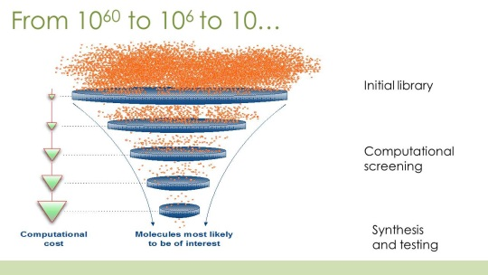
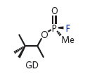
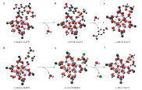
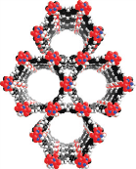
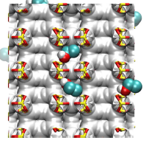
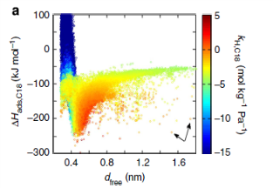

Computational Chemical Sciences
BES-
ASCR
Link
  Deliverable: Open-source modular chemistry codes and software packages that are automated, account for quantum/relativistic effects, and with sufficient accuracies for d- and f- electron systems
  A new activity -- $14M is requested to support 4-5 teams of researchers to capitalize on existing investments in quantum chemistry codes and upgrade them to be compatible with the current and future generations of high performance computers.
  Assemble teams of mathematical and computational chemists to develop open-source software with new algorithms to allow simulation of chemical processes of complex systems.
  Rewrite software and algorithms to fully realize the current and future gains in efficiency offered by massively parallel computing platforms.
  Deliver codes that treat electronic and spin effects in order to avoid case-by-case retooling of the model of electronic potential that is embedded in many current computational methods.
Solar Harvesting Molecules
Gas Purification of 33000 ZIFs
Initial Library
Computational Screening
High Accuracy Validation
Accuracy
Catalytic Frameworks
Best Compound
Performance vs Structure
High-Accuracy Design of Catalysis Artificial Photosynthesis Field-Driven Chemical Rearrangements

Slide 25
Broadening the Reach of
Exascale Science Applications
BES-
ASCR
Link
Call for input from all 17 DOE Laboratories released on May 31, 2015 to identify potential applications that could deliver new science capabilities on exascale systems. Input will be used by ASCR/ASC
  to identify additional key scientific areas for exascale discovery, and specific opportunities for new and existing scientific applications. They will also
  Provide broad input on the kinds of partnerships and investments required to address technical challenges of exascale applications.
  Short time frame – lab responses due June 15th --- 133 responses received
NIH-NSF-DOE Request for Information to identify scientific research topics that need High Performance Computing (HPC) capabilities that extend 100 times beyond today’s performance on scientific applications.
  Information will be used to assist agencies to construct a roadmap, build an exascale ecosystem required to support scientific research, and inform the research, engineering and development process. It is likely that a range of advanced capabilities will need to be developed to respond to the varied computing needs across science disciplines.
  Released September 15, 2015 and due November 13, 2015 --- 115 responses received

Slide 26
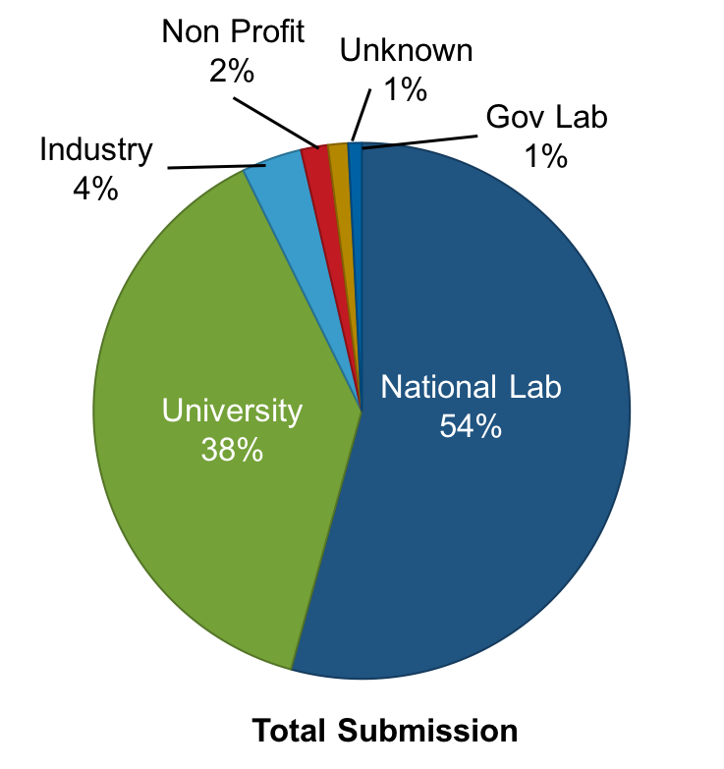
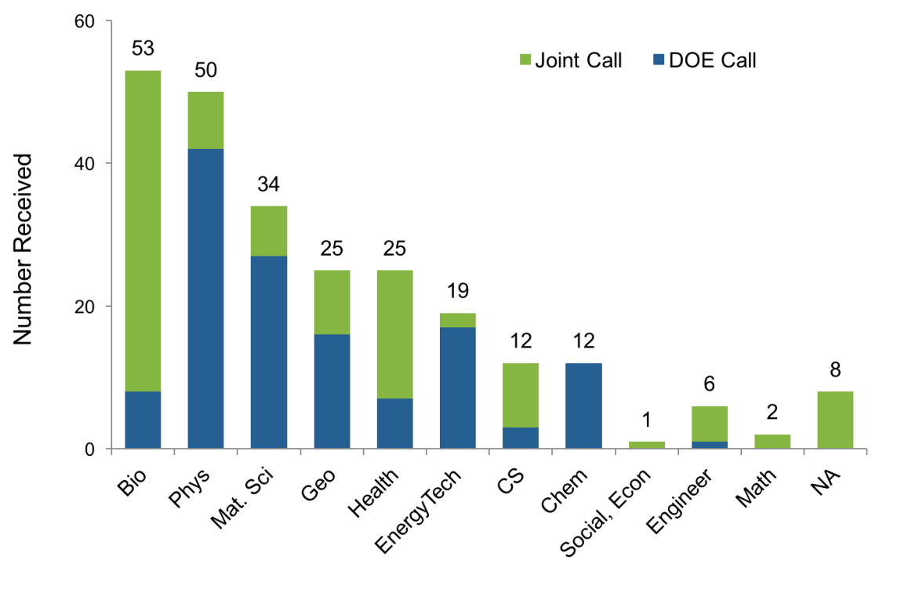
Summary of RFI responses
BES-
ASCR
Link
RFI response breakdown by science area
RFI response breakdown by PI affiliation

Slide 27

BES-
ASCR
Link
BESAC Briefing February 11, 2016

Slide 28
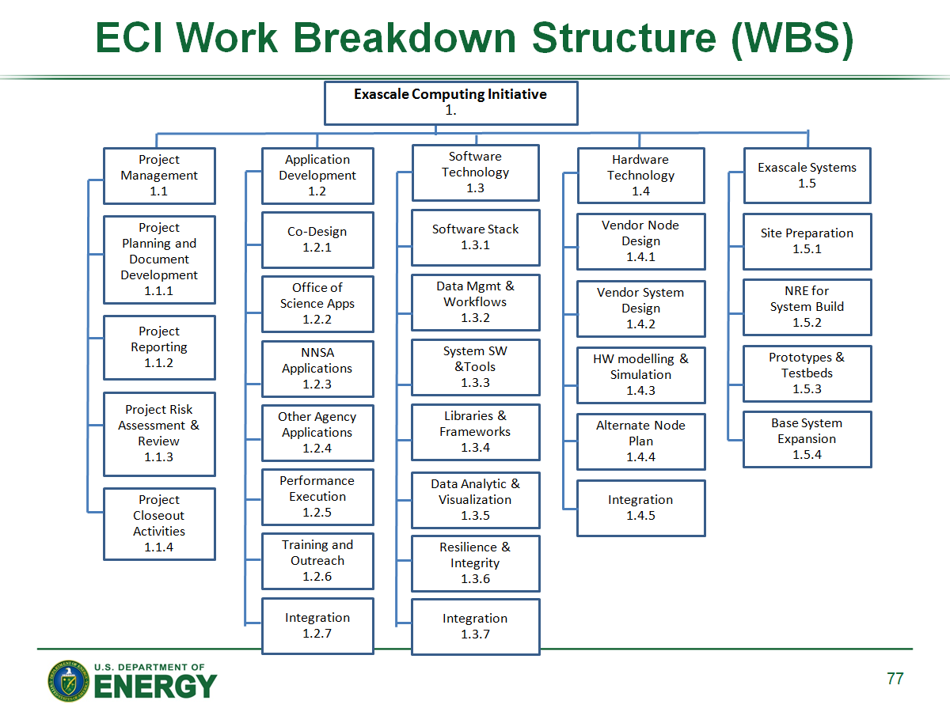
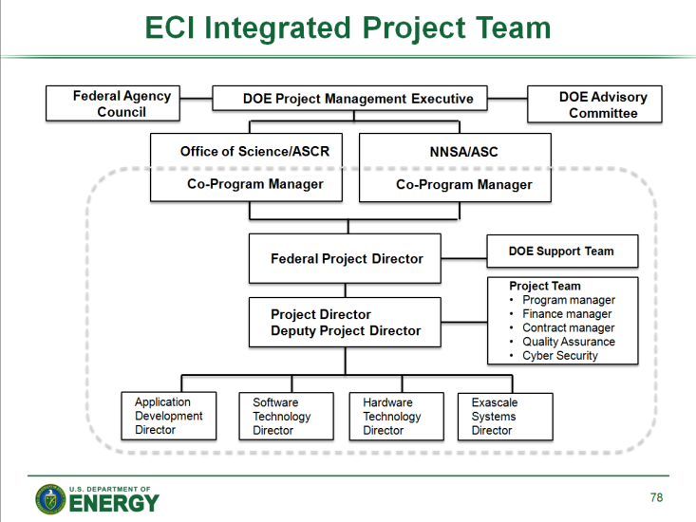
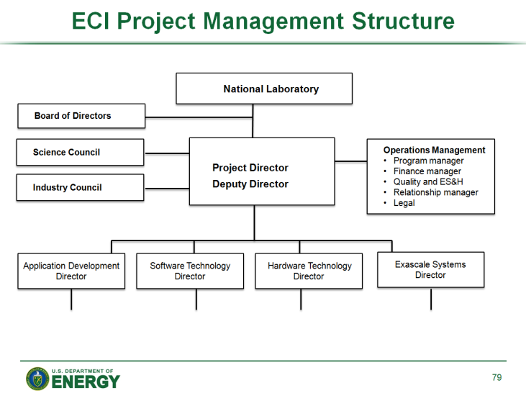
“Projectizing” the Exascale Initiative
The exascale initiative will follow established DOE review and decision protocols for its execution
A project office has been established at ORNL with representation from the major participating laboratories (ANL, LANL, LBNL, LLNL, ORNL, SNL)
An Integrated Project Team (IPT) has been established, analogous to execution of previous, large, Office of Science projects
The IPT is refining the work breakdown structure (WBS) and is preparing required project documentation (e.g., critical-decision packages, preliminary project execution plans, etc.)
A top-level WBS activity has been established to develop and implement exascale applications, based on a labs-wide request for information

Slide 29
ECP WBS
Exascale Computing Project
1.
Project Management
1.1
Application Development
1.2
Software Technology
1.3
Hardware Technology
1.4
Exascale Systems
1.5
Project Planning and Management
1.1.1
DOE Science and Energy Apps
1.2.1
Programming Models and Runtimes
1.3.1
Path forward
Vendor Node
and System
Design
1.4.1
Site Preparation
1.5.1
Reporting and Controls
1.1.2
DOE NNSA Applications
1.2.2
Tools
1.3.2
System Build
Phase NRE
1.5.2
Mathematical and Scientific Libraries
and Frameworks
1.3.3
Risk and Quality Assessment
1.1.3
Other Agency Applications
1.2.3
Design Space Evaluation
1.4.2
Prototypes and Testbeds
1.5.3
Business Services
1.1.4
Developer Training and Productivity
1.2.4
Data Management and Workflows
1.3.4
Alternative Technology Paths and Gap Analysis
1.4.3
Base System Expansion
1.5.4
Procurement
1.1.5
Co-Design and Integration
1.2.5
Data Analytics and Visualization
1.3.5
Co-Design
and Integration
1.5.5
Co-Design
and Integration
1.4.4
Information Services
1.1.6
System Software
1.3.6
Outreach
1.1.7
Resilience and Integrity
1.3.7
Integration
1.1.8
Co-Design and Integration
1.3.8

Slide 30
ECP Timeline
DOE Milestones
CD-0
CD-1/3a
CD-2/3b
CD-4
Application Development
Software Technology
Hardware Technology
System Build NRE
Site Prep
Exascale
Systems
System expansion
Testbeds & Prototypes
FY
2016
2017
2018
2019
2020
2021
2022
2023
2024
2025
2026

Slide 31
Data

Slide 32

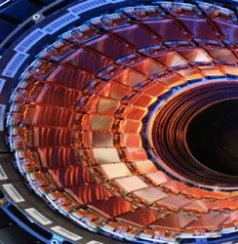
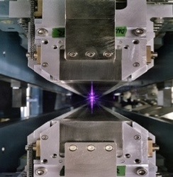
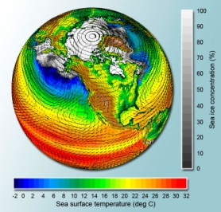
Extreme-Scale Science Data Explosion
BES-
ASCR
Link
Genomics
Data Volume increases to 10 PB in FY21
Driven by exponential technology advances
Data sources
  Scientific Instruments
  Scientific Computing Facilities
  Simulation Results
  Observational data
Big Data and Big Compute
  Analyzing Big Data requires processing (e.g., search, transform, analyze, …)
  Extreme scale computing will enable timely and more complex processing of increasingly large Big Data sets
High Energy Physics (Large Hadron Collider)
15 PB of data/year
Light Sources
Approximately
300 TB/day
Climate
Data expected to be hundreds of 100 EB
32

Slide 33
Leadership and Production Computing Facilities
Titan:
Peak performance of 27.1 PF
18,688 Hybrid Compute Nodes
8.9 MW peak power
Mira:
Peak performance of 10 PF
49,152 Compute Nodes
4.8 MW peak power
Edison XC30:
Peak performance 2.4 PF
124,608 processing cores
2.1 MW peak power

Slide 34

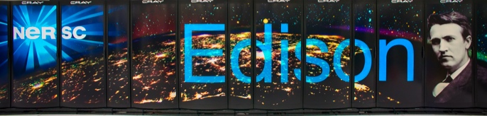

NERSC Systems Today
BES-
ASCR
Link
Hopper: 1.3PF, 212 TB RAM
3.6 PB
5 x SFA12KE
2.2 PB Local Scratch
70 GB/s
80 GB/s
Global
Scratch
5 PB
DDN9900 & NexSAN
/project
Cray XE6, 150K Cores
16 x QDR IB
50 GB/s
Edison: 2.39PF, 333 TB RAM
6.4 PB Local Scratch
140 GB/s
/home
250 TB
NetApp 5460
5 GB/s
HPSS
50 PB stored, 240 PB capacity, 20 years of community data
16 x FDR IB
12 GB/s
Cray XC30, ~125K Cores
Production Clusters
Mendel, Carver, PDSF, JGI,KBASE,HEP, Planck
14 x QDR IB
Ethernet &
IB Fabric
Science Friendly Security
Production Monitoring
Power Efficiency
WAN
2 x 10 Gb
1 x 100 Gb
Vis & Analytics Data Transfer Nodes
Adv. Arch. Testbeds Science Gateways
Software Defined
Networking

Slide 35
Data drivers from DOE Scientific User Facilities†
 | 2013 Current data rate* | 2015 Projected need | 2018 Projected need
HEP Cosmic Frontier example – Large Synoptic Survey Telescope | ~0.2 GB/s | ~0.5 GB/s | ~1-10 GB/s
HEP Energy Frontier Example – Atlas LHC | 1 GB/s* | 2 GB/s* | 4 GB/s*
HEP Intensity Frontier Example – Belle II | 1 GB/s | 2 GB/s | 20 GB/s
BER Climate | 100 GB/s | 1000 GB/s | 1000 GB /s
BER EMSL – one instrument example - TEM | 100 – 1000 images (2Kx2K)/ per day | 1000 Images/s = 2GB/s | 1,000,000 Images/s = 2 TB/s
BER JGI example - Illumina HiSeq | 18 MB/s | 72 MB/s | 600 MB/s
BES Advanced Photon Source example – 2-BM Beamline | 1 GB/s/beamline |  | 10 GB/s
BES Nano Science example – X-Ray Spectroscopy |  | 100 MB x 100 excited atoms x 100 snapshots = 1 TB per point (P,T)
BES Neutron Facilities | ~0.05GB/s | ~0.10 GB/s | ~0.30GB/s
* Data Rate after 99% reduction in hardware data acquisition system
† http://science.energy.gov/~/media/ascr/pdf/program-documents/docs/ASKD_Report_V1_0.pdf

Slide 36
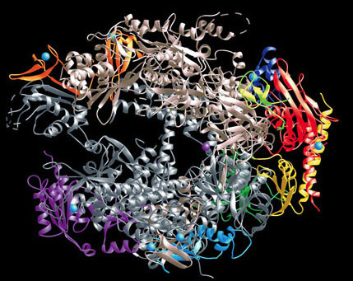
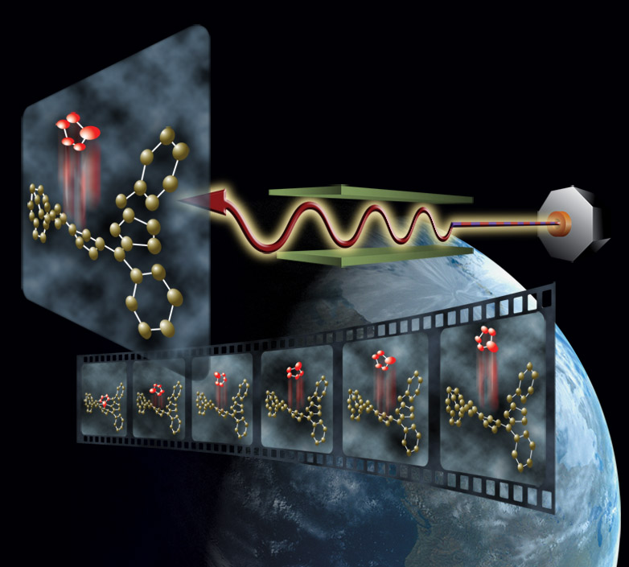
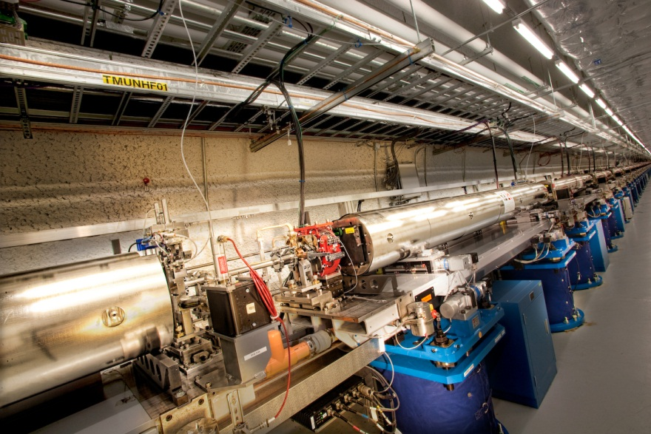
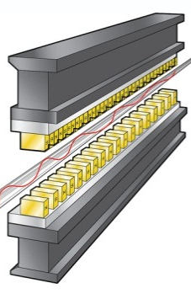
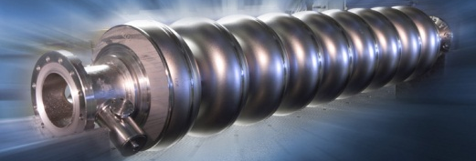
LCLS & LCLS-II:
The Ultimate High Speed, Atomic Resolution Cameras
LCLS-II Performance
  High Peak Power: ~5 milli-joule pulses at 120 Hz from 1-20 keV
  High Rep Rate: ~0.1milli-joule pulses at up to 1 MHz from 0.2-5 keV
  Ultrafast Pulses: ~500 as-100 fs
  Key Enhancements: New 4 GeV superconducting linac & 2 variable gap undulators
Move beyond
Static Images to Molecular Movies
LCLS
36

Slide 37
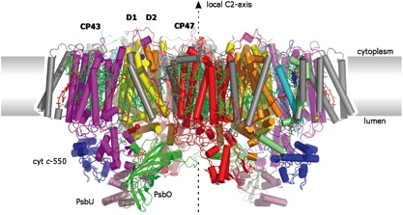


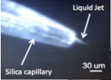
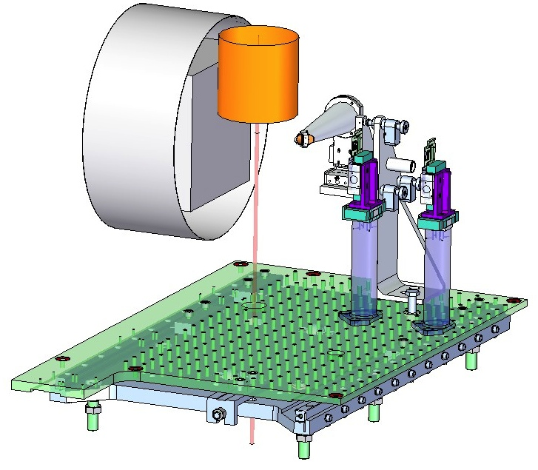


Linac Coherent Light Source (LCLS) Partnership
Taking Snapshots of the Catalytic Reaction in Photosystem II
BES-
ASCR
Link
X-ray Free-electron laser, 10¹⁷-fold greater peak brightness than ALS 5.0.2
50 fs X-ray pulses above the Mn absorption edge
Diffract before destroy approach
Simultaneously detect X-ray emission
X-ray diffraction
(structure)
Liquid-jet
Injection of
μm-size crystals
Optical
pump
Injector
Diffraction
Detector
150 TB transferred in four days
LCLS Beam
135K core-hours data analysis w/ PyANA
Analyzer
Crystals
XES Detector
(water-plastoquinone oxidoreductase)
X-ray Beam
Apertures
Kern et al (2012) PNAS 109: 9721, Sierra et al (2012) Acta Cryst D68: 1584, Mori et al (2012) PNAS 109: 19103

Slide 38


Photosystem II Data Transfer (SLAC → NERSC)
Total Traffic

Slide 39
ASCR-BES Partnership to Address Data Issues
ASCR/BES Data Pilot Projects
BES-
ASCR
Link
BES and ASCR have Jointly selected 3 projects to participate in a pilot program in late FY 2013
Advanced Structural Characterization using Experimental Scattering Data from Multiple Facilities (ORNL)
  Design, prototype, and evaluate a suite of tools for integration, analysis, and modeling of scattering data collected in materials experiments at BES user facilities.
Data Movement, Processing, and Sharing of Synchrotron Data (LBNL)
  Dramatic improvement in time-to-discovery for three ALS beamlines.
Image Reconstruction of Ptychographic Diffraction Patterns in Light Source Facilities (ANL)
  Develop real-time data pre-processing, reconstruction, and visualization codes for ptychography (a coherent diffractive imaging technique).
39

Slide 40

Growing BES and ASCR Collaborations
BES-
ASCR
Link
Center for Applied Mathematics for Energy Research Applications (CAMERA)
  Building the applied mathematics that transforms experimental data into understanding
Today:
Facilities data is time- consuming
Tomorrow:
More data. More quickly.
High resolution.
Critical need: algorithms and analysis for understanding
LBNL approach:
Focused teams of mathematicians/ domain scientists
New math to:
Guide and optimize experiments
http://camera.lbl.gov
40

Slide 41








Computing, experiments, networking and expertise in a “Superfacility” for Science
BES-
ASCR
Link
GISAX
Slot-die printing of
Organic photovoltaics
HipGISAXS & RMC

Slide 42
Next-Generation
Computing

Slide 43
Post-Moore’s Law Computing: What comes after exascale?
CMOS lithographic feature sizes are approaching fundamental limits
  Currently at 22 nm (both Intel and Nvidia)
  11 nm is projected for ~2015 2016 (both Intel and Nvidia)
    However, gate lengths may be smaller than 6 nm – corresponding gate dielectric thickness may reach a monolayer or less
  The industry roadmap reaches beyond 11 nm (7 nm and 5 nm) but may be unattainable
    Non-silicon extensions of CMOS, e.g., using III-V materials or nanotubes/nanowires or non-CMOS technoligies, including molecular electronics, spin-based computing, single-electron devices, and graphene have been proposed
    At scales of ~10 nm, quantum tunneling may become significant
  Capital costs for tooling are increasing dramatically as feature sizes shrink
Options:
  Computing using superconducting technologies
  Quantum computing/quantum information science
  Neuromorphic computing
  Probabilistic computing
  ???
Considerable R&D
required

Slide 44

https://www.whitehouse.gov/blog/2015/10/15/nanotechnology-inspired-grand-challenge-future-computing

Slide 45
Neuromorphic Computing
Community Engagement
BES-
ASCR
Link
2015 DOE Report: Neuro-Inspired Computational Elements (NICE)*
  Information Processing and Computation Systems beyond von Neumann/Turing Architecture and Moore’s Law Limits
  A specific focus for this year’s Workshop was the value proposition for neuro-inspired/neuromorphic computing: what these systems offer, or may offer, that exceeds the current and forecasted capabilities of conventional computing approaches.
    Key Finding ‒ Neuromorphic systems could provide value in two, coupled tracks:
      Analysis, sense making, prediction and control
      Platform for understanding neural systems and testing hypotheses generated by neuroscience.
    Key Recommendation ‒ Coordinated effort across multiple disciplines and application areas is needed to:
      Establish appropriate metrics
      Develop performance parameters
      Support development of neuro-inspired/neuromorphic systems
BES/ASCR “Study Group” – October 29-30, 2015
*http://science.energy.gov/~/media/ascr/pdf/programdocuments/docs/NICE2015_Workshop_Report.pdf

Slide 46
ASCR at a Glance
Office of Advanced Scientific Computing Research
Associate Director – Steve Binkley
Phone: 301-903-7486
E-mail: Steve.Binkley@science.doe.gov
Research
Division Director – William Harrod
Phone: 301-903-5800
E-mail: William.Harrod@science.doe.gov
Facilities
Division Director – Barbara Helland
Phone: 301-903-9958
E-mail: Barbara.Helland@science.doe.gov
Relevant Websites
ASCR: science.energy.gov/ascr/
ASCR Workshops and Conferences:
science.energy.gov/ascr/news-and-resources/workshops-and-conferences/
SciDAC: www.scidac.gov
INCITE: science.energy.gov/ascr/facilities/incite/

Slide 47
Questions?

Slide 48
NSCI

Slide 49


Slide 50

National Strategic Computing Initiative
Executive Order 13702 Signed July 29, 2015
National
  “Whole of government” approach
  Public/private partnership with industry
  and academia
Strategic
  Leverage beyond individual programs
  (a key “platform” technology)
  Long time horizon (decade or more)
Computing
  HPC = most advanced, capable computing technology available in a given era
  Multiple styles of computing and all necessary infrastructure
  Scope includes everything necessary for a fully integrated capability
    Theory and practice, software and hardware
Initiative
  Above baseline effort
  Link and lift efforts
Enhance U.S. strategic advantage in HPC for
security, competitiveness, and discovery
NLCRO Briefing November 9, 2015
50

Slide 51
National Strategic Computing Initiative – NSCI
OSTP/NSTC Fast Track task force, established November 2013
  Led by Pat Falcone, Associate Director for National Security
  Charged to define USG approach to HPC for next decade, in time to inform FY 2016 budget
Membership comprises all federal agencies with equity in HPC
  EOP (OSTP, OMB)
  DOE (SC, NNSA, Energy, Labs)
  IC (IARPA, CIA, NSA)
  DoD (HPCMod)
  DOC (NIST, NOAA)
  NASA
  NIH
  NSF
Executive Order 13702 issued July 29, 2015
NSCI Executive Council first meeting August 26, 2015
NSCI “kick-off” workshop, October 20-21, 2015

Slide 52
National Strategic Computing Initiative (NSCI)
Executive Order 13702, July 29, 2015
It is the policy of the United States to sustain and enhance its scientific, technological, and economic leadership position in HPC research, development, and deployment through a coordinated Federal strategy guided by four principles:
1) The United States must deploy and apply new HPC technologies broadly for economic competitiveness and scientific discovery.
2) The United States must foster public-private collaboration, relying on the respective strengths of government, industry, and academia to maximize the benefits of HPC.
3) The United States must adopt a "whole-of government" approach that draws upon the strengths of and seek cooperation among all Federal departments and agencies with significant expertise or equities in HPC in concert with industry.
4) The United States must develop a comprehensive technical and scientific approach to efficiently transition HPC research on hardware, system software, development tools, and applications into development and, ultimately, operations.
This order establishes the NSCI to implement this whole-of-government strategy, in collaboration with industry and academia, for HPC research, development, and deployment.

Slide 53
NSCI Objectives
Executive departments, agencies, and offices participating in the NSCI shall pursue five strategic objectives:
1) Accelerating delivery of a capable exascale computing system that integrates hardware and software capability to deliver approximately 100 times the performance of current 10 petaflop systems across a range of applications representing government needs.
2) Increasing coherence between the technology base used for modeling and simulation and that used for data analytic computing.
3) Establishing over the next 15 years, a viable path forward for future HPC systems in the Post-Moore's-Law Era to advance beyond traditional lithographic scaling of devices.
4) Increasing the capacity and capability of an enduring national HPC ecosystem, employing a holistic approach that addresses relevant factors such as networking technology, workflow, downward scaling, foundational algorithms and software, and workforce development.
5) Developing an enduring public-private collaboration to ensure that the benefits of the research and development advances are, to the greatest extent, shared between the U.S. commercial, government, and academic sectors.

Slide 54
NSCI Agency Responsibilities
“whole-of government” approach
The order identifies lead agencies, foundational research and development agencies, and deployment agencies:
Lead agencies (DOE, DoD, NSF) are charged with developing and delivering the next generation of integrated HPC capability and will engage in mutually supportive research and development in hardware, software, and workforce to support the objectives of the NSCI.
Foundational research and development agencies (IARPA, NIST) are charged with fundamental scientific discovery work and associated advances in engineering necessary to support the NSCI objectives.
Deployment agencies (NASA, FBI, NIH, DHS, NOAA) will develop mission-based HPC requirements to influence the early stages of design of new HPC systems and will seek viewpoints from the private sector and academia on target HPC requirements.

Slide 55
NSCI Governance: Executive Council
Executive Council. (a) To ensure accountability for and coordination of research, development, and deployment activities within the NSCI, there is established an NSCI Executive Council to be co-chaired by the Director of the Office of Science and Technology Policy (OSTP) and the Director of the Office of Management and Budget (OMB). The Director of OSTP shall designate members of the Executive Council from within the executive branch. The Executive Council will include representatives from agencies with roles and responsibilities as identified in this order.
(b) The Executive Council shall coordinate and collaborate with the National Science and Technology Council established by Executive Order 12881 of November 23, 1993, and its subordinate entities as appropriate to ensure that HPC efforts across the Federal Government are aligned with the NSCI. The Executive Council shall also consult with representatives from other agencies as it determines necessary. The Executive Council may create additional task forces as needed to ensure accountability and coordination.
(c) The Executive Council shall meet regularly to assess the status of efforts to implement this order. The Executive Council shall meet no less often than twice yearly in the first year after issuance of this order. The Executive Council may revise the meeting frequency as needed thereafter. In the event the Executive Council is unable to reach consensus, the Co-Chairs will be responsible for documenting issues and potential resolutions through a process led by OSTP and OMB.
(d) The Executive Council will encourage agencies to collaborate with the private sector as appropriate. The Executive Council may seek advice from the President's Council of Advisors on Science and Technology through the Assistant to the President for Science and Technology and may interact with other private sector groups consistent with the Federal Advisory Committee Act.
First meeting occurred August 26, 2015

Slide 56
NSCI Implementation
(a) The Executive Council shall, within 90 days of the date of this order,* establish an implementation plan to support and align efforts across agencies in support of the NSCI objectives. Annually thereafter for 5 years, the Executive Council shall update the implementation plan as required and document the progress made in implementing the plan, engaging with the private sector, and taking actions to implement this order. After 5 years, updates to the implementation plan may be requested at the discretion of the Co-Chairs.
(b) The Co-Chairs shall prepare a report each year until 5 years from the date of this order on the status of the NSCI for the President. After 5 years, reports may be prepared at the discretion of the Co-Chairs.
*delivered October 26, 2015

Slide 57

CORAL Node/Rack Layout – ORNL Summit Computer
CORAL rack layout
18 nodes
779 TF
11 TB RAM
55 KW
CORAL/Summit System
~200 racks

Slide 58

CORAL Node/Rack Layout – ORNL Summit Computer
2017
CORAL rack
18 nodes
779 TF
11 TB RAM
55 KW
~6 ft²
1976
Cray 1
150 MF
8 MB RAM
110 KW
~150 ft²

Slide 59
Trends Across the HPC Landscape
Increasing importance of computing and simulation within SC and DOE programs (across our missions: science, national security, and quest for cleaner energy)
  Continued full subscription of computational resources
  Increasing importance of effective partnerships (domain + applied math + CS)
  Difficulties persist in acquiring and retaining highly skilled workforce
Nexus of big data and powerful compute is an emerging frontier
The drive toward exascale – Scientifically important and challenging questions await exascale
  Dennard scaling is driving further increases in concurrency → billion-way concurrency is coming
  Post-CORAL computer architectures may be significantly different → significant re-coding
  Data movement is increasingly costly → becoming the rate limiter
  Power consumption remains an issue ($1M/megawatt-year)
  A petaflop in a 19-inch rack
The post-Moore’s Law epoch is drawing nearer – we need to start preparing

Slide 60
Exascale Computing Initiative (ECI)
Key Performance Goals
Parameter
Performance | Sustained 1 – 10 ExaOPS
Power | 20 MW
Cabinets | 200 - 300
System Memory | 128 PB – 256 PB
Reliability | Consistent with current platforms
Productivity | Better than or consistent with current platforms
Scalable benchmarks | Target speedup over “current” systems …
Throughput benchmarks | Target speedup over “current” systems …
ExaOPS = 10¹⁸ Operations / sec
60

Slide 61



International Competitors Have Ambitious Plans
China (goal: 2020)
European Union (goal: 2020)
Japan (goal: 2020)
Other countries:
Russia
South Korea
India
Singapore
Australia
EU: J-Y. Berthou, IESP Workshop, Kobe, Japan, April 2012
China: Y. Lu, IESP Workshop, Kobe, Japan, April 2012
Japan: M. Kondo, IESP Workshop, Kobe, Japan, April 2012

