Slide 1
Materials Sciences and Engineering Division
Strategic Planning Process
BESAC
July 8, 2015
Linda L. Horton
Division Director
Office of Science - Basic Energy Sciences
U.S. Department of Energy

Slide 2
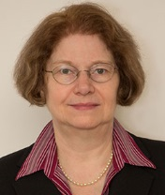

















Administrative Staff
Marsophia Agnant, Cheryl
Howard, MaryBeth Luther,
Teresa Crockett
Materials Sciences and Engineering Division
Linda Horton, Division Director
Materials Discovery, Design, and Synthesis Team
Condensed Matter
and Materials
Physics Team
Scattering and Instrumentation Sciences Team
Team Lead - Arvind Kini
Team Lead - Jim Horwitz
Team Lead - Helen Kerch
Materials
Chemistry
Experimental Condensed Matter Physics
X-ray Scattering
Lane Wilson
Michael Sennett
Craig Henderson
Michael Pechan
Biomolecular Materials
Theoretical Condensed Matter
Physics
Neutron Scattering
Thiyaga P. Thiyagarajan
Mike Markowitz
Matthias Graf Jim Davenport
Synthesis and Processing Science
Physical Behavior of Materials
Electron and Scanning Probe Microscopies
Bonnie Gersten
Refik Kortan
Jane Zhu
Batteries and Energy Storage Hub & Integrated Energy Research
Mechanical Behavior & Radiation Effects
Experimental Program to Stimulate Competitive Research (EPSCoR)
Craig
Henderson
John
Vetrano
John Vetrano
Tim Fitzsimmons

Slide 3
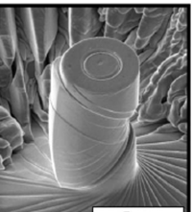
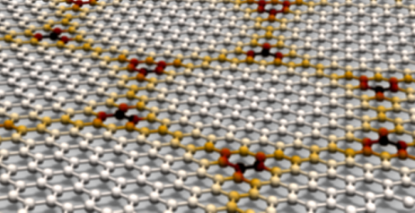
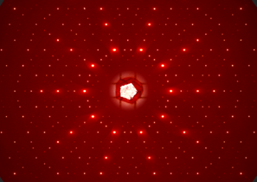
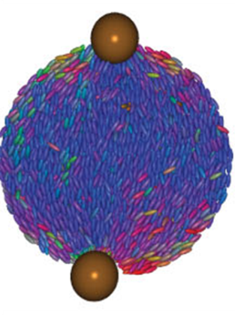
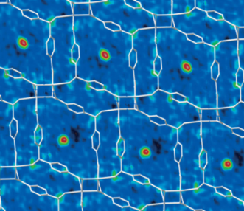
Materials Sciences and Engineering Research
Broad Portfolio of Grand Challenge and Use-Inspired Fundamental Research
Division-wide themes
strongly correlated electron systems
theory, modeling & simulation
nano- and meso-scale science
advanced instrumentation
materials synthesis
Condensed Matter and Materials Physics:
  Control and understanding of materials behavior and discovery of new phenomena (correlation effects, exotic states of matter), physical behavior, and radiation effects
Scattering and Instrumentation Sciences:
  Investigation of photon, neutron, and electron interactions with matter to characterize material structures, dynamics, and functionality
Materials Discovery Design and Synthesis:
  Understanding design and synthesis to discover new materials via physical, chemical, and bio-molecular routes
Notes:
From the Top:
Science Underpinning Lifetime Extension Evaluation Stress measurements for ion irradiation doses up to 190 displacements per atom show that strengthening measured at low doses continues to increase at the high doses expected under end-of-life conditions for nuclear reactors. Sharon et al, SNL, Mat Res Letters 2014 DOI: 10.1080/21663831.2013.859179
First Observation of Theoretical Predicted novel electronic structure – the Hofstadter Butterfly
Predicted in 1977, this novel energy structure emerges when electrons are confined in two dimensions and subjected to both a periodic potential energy and a strong magnetic field. Electronic conductivity and capacitance measurements of atomically thin graphene on an atomically flat BN substrate at low temperatures and high magnetic fields show the predicted self-similar patterns. (Kim, Columbia, and Ashorri, Jarillo-Herrero at MIT).
Visualization of 3D Sculpted Cobalt Nanospirals Advanced microscopy and simulations reveal interactions between nanoscale building blocks control the properties of mesoscopic systems; the magnetic domain structure was shown to be controlled by the shape anisotropy energy (Petford-Long, ANL)
Discovery of New Class of Magnetic Materials: The first binary magnetic quasicrystals could enable understanding of structure, dynamics, and magnetism in aperiodic materials (Goldman, Ames Lab)
Cell-like Decoration of “Gooey” Surface; Precise, predictable positioning of nanoparticles on a liquid crystal droplet. Image shows simulation of particle adsorption; region of disorder within droplets coincides exactly with the particle positions at the poles. For the first time, the ability of liquid crystals to control the organization of particles at the surfaces of micrometer-sized droplets has been demonstrated. This is similar to how specific features on membrane surfaces control the orientation of fatty molecules (lipids) or proteins within a cell. U Chicago J.Whitmer, X. Wang, D. Miller, F. Mondiot, N.L. Abbott, and J.J. de Pablo, “Nematic-Field-Driven Positioning of Particles in Liquid Crystal Droplets,” Physical Review Letters, 111, 227801, 2013); DOI: http://dx.doi.org/10.1103/PhysRevLett.111.227801
Mechanism of CO₂ adsorption from direct structural evidence: A combination of multiple experimental probes and theoretical calculations have revealed the mechanism of CO₂ adsorption in MOFs. The adsorbed CO₂ stays in a “pocket” between two phenyl rings, interacting with the aromatic π-electron density, a key design principle for further optimizing CO₂ adsorption. (Parise, Stony Brook U; Chabal, UT-Dallas; Li, Rutgers)
Division-wide themes: strongly correlated electron systems; materials synthesis; nano- and meso-scale science; theory, modeling, & simulation; advanced instrumentation

Slide 4
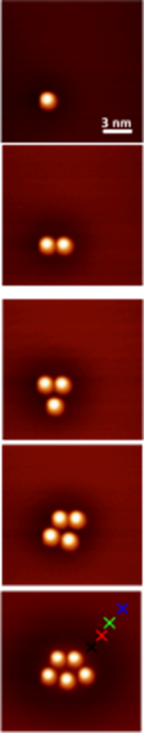
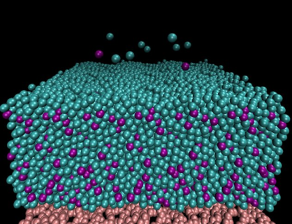
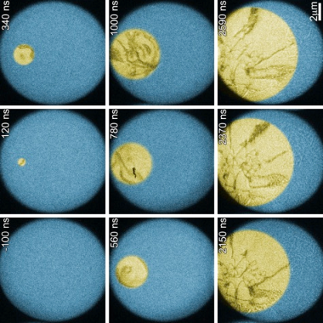
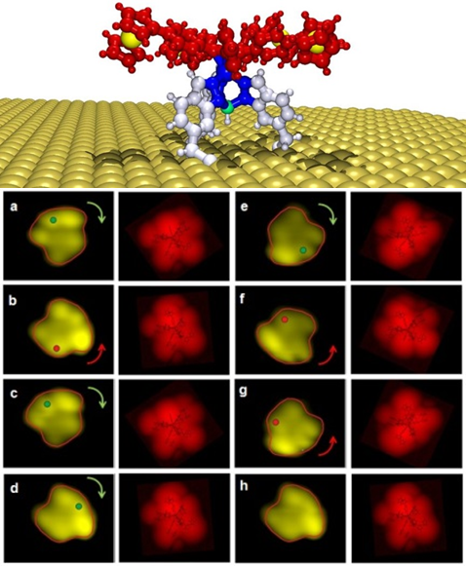
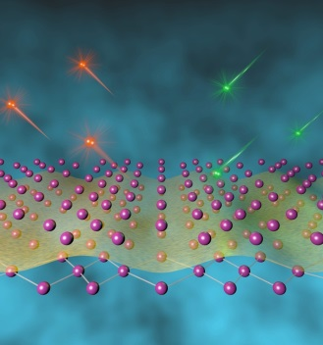
Materials Sciences and Engineering
Research Addresses Grand Challenge Science
Atomic Collapse in Graphene
Control the quantum behavior of electrons in materials
Synthesize, atom by atom, new forms of matter with tailored properties
Computational Route to Better Glass
Control emergent properties that arise from the complex correlations of atomic and electronic constituents
Laser Crystallization of Phase Change Material
Synthesize man-made nanoscale objects with capabilities rivaling those of living things
Characterize and control matter
very far away from equilibrium
Controlled Rotation of Molecular Machines
New mechanism for emergent charge orders

Slide 5
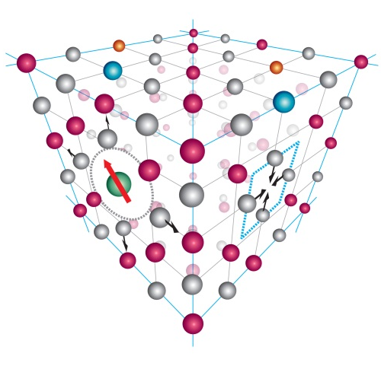
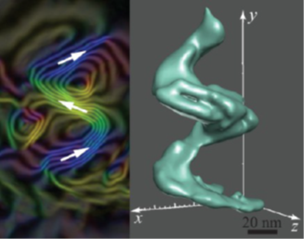
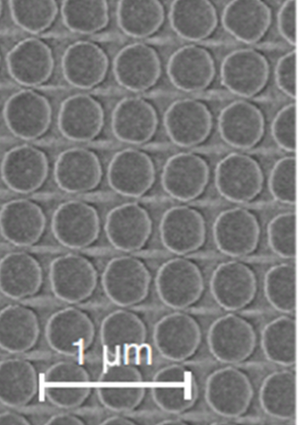
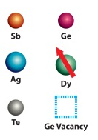

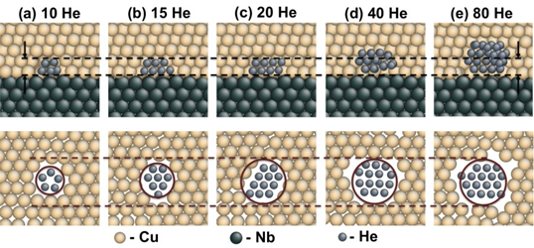
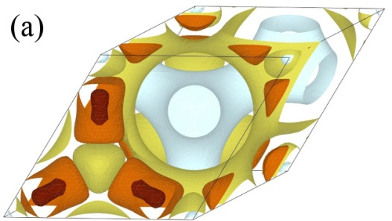
Materials Sciences and Engineering
Research Addresses Use-Inspired science
Solar Energy
Energy Storage
Thermoelectric Materials
Visualization of 3D Sculpted Nanospirals
Radiation Effects
Magnet Materials
Rare Earth Atoms
Make the Best Thermoelectrics Better
New Approach to Highly Efficient Solid State Lighting
Carbon Capture
Solid State Lighting
Designer MOF-like porous materials for selective CO₂ removal
Watching Ions Hop in Next Generation Battery Materials
Understanding How Semiconductors Absorb Light
Reducing the Deleterious Impact of Helium

Slide 6
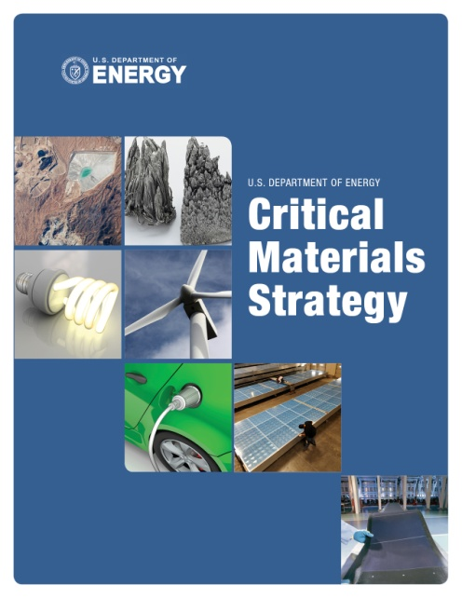

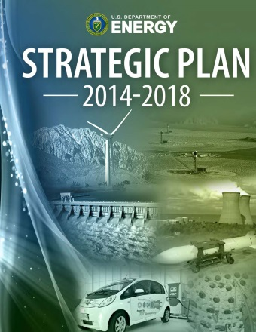
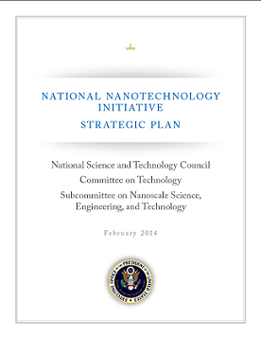
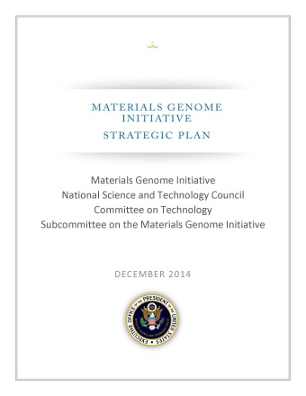
Extensive Strategic Planning Provides Research Direction
DOE strategic planning
  2014 Strategic Plan
  Quadrennial Technology Review (under revision in 2015) and Quadrennial Energy Review
  2011 Critical Materials Strategy
BES strategic planning
  Basic Research Needs and Grand Challenges workshops and reports
  Other BES and BESAC workshops
  Annual planning at the program and division level
    Materials Council Workshops
Joint planning with other agencies
  Office of Science and Technology Policy
  2014 Materials Genome Initiative Strategic Plan
  2014 National Nanotechnology Initiative Strategic Plan

Slide 7
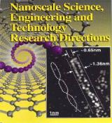
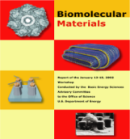
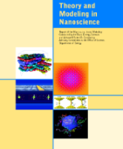
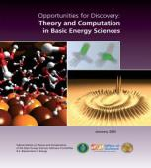
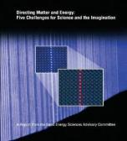
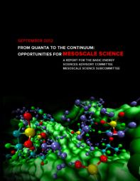
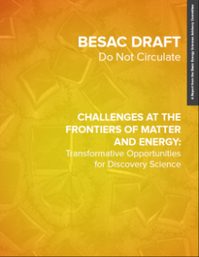
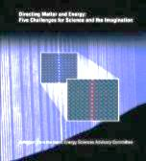
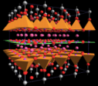

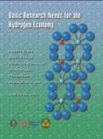





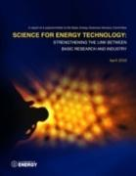
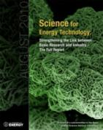
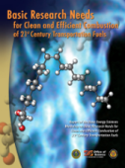
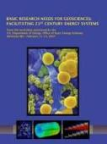

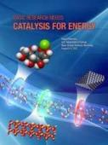
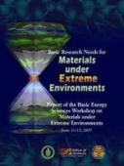
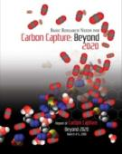
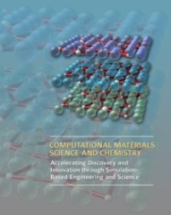

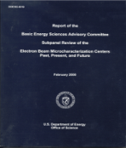
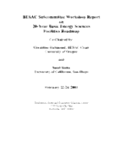
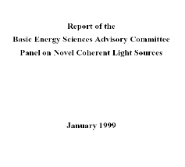
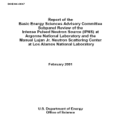
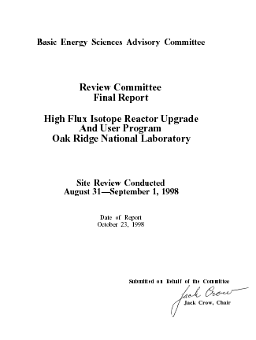

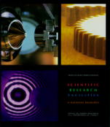
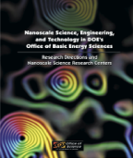
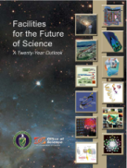
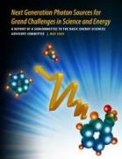

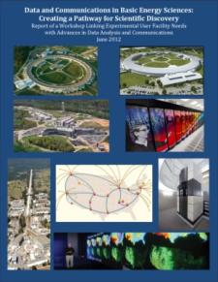

BES Strategic Planning Activities
Include Materials Sciences Emphasis
Science for Discovery
Complex
Systems
Science for National Needs
MSE PM on organizing team
National Scientific User Facilities, the 21st century tools of science
http://science.energy.gov/bes/news-and-resources/reports/
Notes:
7

Slide 8
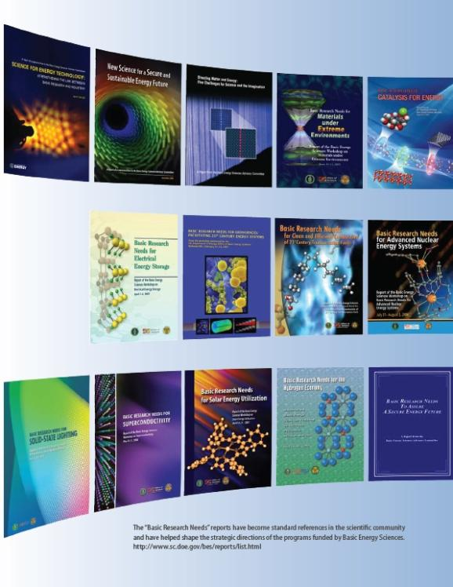
Recurring Themes from the Basic Research Needs Workshops
>>1,500 participants from academia, industry, and federal labs
Disruptive, Transformational Advances Require “Control”
Control of materials properties and functionalities through electronic and atomic design
New materials discovery, design, development, and fabrication, especially materials that perform well under extreme conditions
“Control” of photon, electron, spin, phonon, and ion transport in materials
Science at the nanoscale, especially low-dimensional systems
Designed catalysts
Designed interfaces and membranes
Structure-function relationships
Bio-materials and bio-interfaces, especially at the nanoscale
New tools for spatial characterization, temporal characterization, and for theory/modeling/computation
http://science.energy.gov/bes/news-and-resources/reports/

Slide 9







National Academy Assessments
BES-MSE provides support for the Condensed Matter and Materials Research Committee (http://sites.nationalacademies.org/BPA/BPA_048457)
Additional support is provided for specific studies and assessments
Current ongoing assessments:
  Responsible Science: Ensuring the Integrity of the Research Process
Recent National Academy studies have influenced our program directions

Slide 10
National Academy Reports and Related MSE Programs
Report Title | Year | MSE Program
Harvesting The Fruits of Inquiry How Materials Discoveries Improve Our Lives | 2014 | Entire Division
High Magnetic Field Science and Its Application in the United States | 2013 | Condensed Matter Physics, Scattering Programs
Optics and Photonics: Essential Technologies for Our Nation* | 2013 | Condensed Matter Physics, Microscopy and X-Ray, Physical Behavior
Research at the Intersection of Physical and Life Sciences | 2010 | Biomolecular Materials
Frontiers in Crystalline Matter: From Discovery to Technology | 2009 | Synthesis and Processing Science + much of division
Inspired by Biology: From Molecules to Materials to Machines | 2008 | Biomolecular Materials
CMMP 2010: An Assessment of and Outlook for Condensed Matter and Materials Physics | 2007 | Entire Division
Condensed-Matter and Materials Physics: The Science of the World Around Us: An Interim Report | 2006 | Entire Division
Midsize Facilities: Infrastructure for Materials Research | 2005 | Entire Division
Opportunities in High Magnetic Field Science | 2005 | Condensed Matter Physics
Materials and Society: From Research to Manufacturing – Report from a Workshop | 2003 | Entire Division
Letter report on the Spallation Neutron Source | 2000 | Neutron Scattering
Condensed Matter and Materials Physics: From Basic Research to Tomorrow’s Technology | 1999 | Entire Division
Materials in a New Era: Proceedings of the 1999 Solid State Sciences Committee Forum | 1999 | Entire Division
The Physics of Materials: How Science Improves Our Lives | 1997 | Entire Division
Biomolecular Self-Assembling Materials: Scientific and Technological Frontiers | 1996 | Biomolecular Materials

Slide 11






National Academy, BES and BESAC Reports
Focus: Strategic Directions for Synthesis Science
Control of Synthesis -- a “grand challenge” for materials science
BESAC 2007: “How do we design and perfect atom and energy efficient synthesis of revolutionary new forms of matter with tailored properties?”
BESAC 2015: “Mastering hierarchical architecture and beyond equilibrium matter”

Slide 12



Materials Sciences and Engineering Research
Capabilities in Material Synthesis Enable New Science at DOE Laboratories
Tricking Iron into Acting like a Rare-earth Element
  Researchers are able to induce magnetic properties in iron so that it behaves like rare-earth elements by slipping it between two nitrogen atoms in a lithium matrix. This research points the way toward new, less expensive magnetic materials.
  (Canfield et al. Ames Laboratory)
Putting the “Insulator” into Topological Insulators
  Pb_{1-x}Sn_{x}Te crystals doped with increasing amounts of In exhibit the properties of a topological crystalline insulator, with unusual electronic conduction at the surface but no conduction within the bulk. Such materials offer promise for applications in spintronics. (Tranquada et al. Brookhaven National Laboratory)
Mining New Materials at High Pressure
  High pressure zone growth offers a unique and powerful new materials discovery tool as it stabilizes phases not found under ambient conditions. By opening a new window on perovskites, this research challenges existing models of structural stability, exposes a rare re-entrant phase transition, and reveals two novel antiferromagnetic structures. (Mitchell et al. Argonne National Laboratory)
Synthesis & Scattering Reveal the Rich Physics of Superconductors
  Local probes of Cu dopants in FeAs planes of BaFe₂As₂ shows that local lattice distortions and spin fluctuations prevent superconductivity. The results provide new information about the interplay between local composition, magnetism and superconductivity. (Sefat et al. Oak Ridge National Laboratory)
12

Slide 13






Materials Sciences and Engineering Research
Capabilities in Material Synthesis Enable New Science at our Nation’s Universities
Emergence in Manganite Yields Observation of Universal Behavior
  Visualization of numerous topological vortices in hexagonal RMnO₃ enable statistical analysis, the results of which are closely relevant for understanding unconventional superconductivity, superfluidity, and the formation of our cosmos.
  (Cheong et al. Rutgers)
Improved Thermoelectrics via Nanodomains
  A combination of non-traditional characterization techniques were used to probe the local ordering of Li/Sn atoms in Li₁-xSn₂+xAs₂ that resulted in low thermal conductivity. This research demonstrated that local inhomogeneities caused by mixing two cations of differing chemical nature may be used to develop novel thermoelectric materials. (Kovnir et al. UC Davis)
Crystal Modification Directed by Bricklayer Proteins
  Mollusk nacre protein phases were shown to direct the 3-D patterning of nanocrystalline assembly onto an existing calcite crystal thus demonstrating the potential for using proteins to generate single-crystal nanoparticle coatings or too modify crystal architectures. (Evans et al. NYU)
“Mesons” and “quarks” in the 1D ferromagnetic Ising chain
  Time-domain THz spectroscopy and large crystals grown via a floating zone furnace allows measurements of a remarkably rich low frequency susceptibility spectrum of CoNb₂O₆ may be the most ideal realization of a 1D ferromagnetic Ising spin chain, a model system for modern physics . (Armitage et al.
  Johns Hopkins U )
13

Slide 14
Division Strategic Planning
Materials Council and Council workshops
National Academy studies
Interactions with DOE technology offices
  Technology teams, proposal reviews, etc.
Since 2011, annual assessments of strategic directions by the program managers
  Identification of topical areas for expansion and reduction
  Discussion of “hot” topics in the field
  Based on literature, BES/BESAC and other community reports, assessment of incoming proposals, discussions at PI meetings, lab management reviews, and attendance at conferences and workshops
BES strategic planning sessions and international benchmarking

Slide 15



Example: Theoretical Condensed Matter Physics
Program Evolution
Chubukov: Iron-pnictide phase diagram.
Prior Program Core Research Activities
  Quantum Physics
  Transport
  Energy Related
  Facilities Related
Current Program Core Research Activities
Quantum Materials
  High-T_{c} superconductivity, exotic & topological
  states, magnetism, quantum Hall
Materials Discovery
  Materials Genome, new algorithms, designer materials
Non-Equilibrium, Ultra-Fast Physics
  Time dependent, e⁻ transport, pump-probe, thermal conductivity
Energy Related Physics
  Thermoelectrics, phonon transport, solid-state photovoltaics
Balents: QCP in 3D pyrochlore iridates.
Knezevic: Non-equilibrium phonon distribution in GaAs laser.

Slide 16
The Materials Council Contributes to MSE Strategic Planning
Established in 1969 – name has evolved but focus remains the same
Identifies emerging research needs and opportunities through focused workshops/panel studies that result in peer-reviewed publications in archival journals
Recent workshops
  “Dissipative Self-Assembly as a Foundation for Biomimetic Systems” (Markowitz/Kini)
  Co-chairs: Anna Balazs and Jeff Brinker; August 14-15, 2014
  Static and Dynamic Interfacial Effects in Magnetism” (Pechan/Horwitz)
  Co-chairs: Frances Hellman, LBNL; Axel Hoffman, ANL; and Yaroslav Tserkovnyak (UCLA); Planned for April 13 - 15
Frances Hellman | UC-Berkeley
Joanna Aizenberg | Harvard
David Awschalom | U Chicago
Anna Balazs | U Pittsburgh
Collin Broholm | Johns Hopkins
Paul Canfield | Ames
Bob Cava | Princeton
Yet Ming Chiang | MIT
Diana Farkas | Virginia Tech
Cherie Kagan | U Pennsylvania
Jennifer Lewis | Harvard
Peter Littlewood | ANL
Margaret Murnane | U Colorado
ZX Shen | SLAC
Sunil Sinha | UC-SD
Published workshop papers:
  "Imaging physical phenomena with local probes: From electrons to photons," Dawn A. Bonnell, D. N. Basov, Matthias Bode, Ulrike Diebold, Sergei V. Kalinin, Vidya Madhavan, Lukas Novotny, Miquel Salmeron, Udo D. Schwarz, Paul S. Weiss, Rev. Mod. Phys. 84 (2012) 1343.
Information on all Council workshops are on the MSE website

Slide 17





Impact: The Materials Council Contributes to the Division’s Strategic Planning and Provides a Valuable Service to Community
Council sponsored workshops have produced highly cited archival reports and defined strategic directions of the MSE programs
  Towards an Integrated Materials Characterization Toolbox, I. M. Robertson, et al. J. Mater. Res., 26, 2011, 1341 (Times Cited: 26)
  Long-range Interactions in Nanoscale Science, R. H. French, et al. Rev. Mod. Phys., 82, 2010, 1887 (Times Cited: 123)
  Electrostatic Modifications of Novel Materials, C. H. Ahn, et al. Rev. Mod. Phys., 78, 2006, 1185 (Times Cited: 220)
  Macromolecules at Surfaces: Research Challenges and Opportunities from Tribology to Biology, S. Granick, et al. J. Poly. Sci. Part B: Polymer Phys., 41, 2003, 2755 (Times Cited: 129)
  Nanoscale Thermal Transport, D. G. Cahill, et al. J. Appl. Phys., 93, 2003, 793 (Times cited: 1270)
  Relaxation in Glassforming Liquids and Amorphous Solids, C. A. Angell, et al. J. Appl. Phys., 88, 2000, 3113 (Times Cited: 1121)
  Tailored Porous Materials, T. J. Barton, et al. Chem. Mater., 11, 1999, 2633 (Times Cited: 494)
  Molecular Monolayers and Films, J. D. Swalen, et al. Langmuir, 3, 1987, 932. (Times Cited: 896)
As of 6-17-2015

Slide 18


Impact of Strategic Planning
Birth of a New Programmatic Area – Biomolecular Materials
New program in MSE was formed in 2002
  Based on strategic directions identified in multiple workshops and reports
  1988 Materials Council workshop on “Enzymatic Synthesis of Materials”
  1996 National Academy Report on Biomolecular Self-Assembling Materials
  2002 BESAC workshop and report on “Biomolecular Materials
Program focused on fundamental research on the discovery, design and synthesis of functional materials, structures and materials aspects of energy conversion processes, based on principles and concepts of biology.
  Programmatic evolution driven by subsequent BESAC, BES and National Academy Reports

Slide 19



Materials Science and Engineering Research
Learning from Biology to Improve Materials
Design principles for functional biomaterials
  Enhanced control of self-assembly of polymers based on understanding the role of water – and its concentration during synthesis via neutron scattering (Olsen, MIT)
Biomimetic motors by integrating MOFs with peptides
  A hybrid MOF-peptide system has been created that functions as an autonomous motor powered by the release of peptides from within the pores of MOF, thus mimicking chemotaxis (motion induced by chemical gradients) seen in biological motors and swimming bacteria. (Matsui, CUNY)
Complex Inorganic Structures Built From Cells
  Rapid ‘fossilization’ of delicate mammalian cells enabling them to withstand dehydration and extreme temperatures (up to 500oC). This simple procedure combined with cell structural and behavioral malleability provides opportunities to develop robust biocomposites with programmed structures and functions via chemical and genetic engineering (Brinker, SNL)
19

Slide 20



Strategic Planning for Materials Genome Initiative:
Initial Definition of the Scientific Opportunities and Challenges
Multi-agency Workshop 2009
DOE BES-ASCR Workshop 2010
DOE BES-ASCR Workshop 2009
        Inventing a New America through Discovery and Innovation in Science, Engineering, and Medicine: A Vision for Research and Development in Simulation-Based Engineering and Science in the Next Decade
        Chairs: Peter Cummings, Vanderbilt University and Sharon Glotzer, University of Michigan
        Computational Materials Science and Chemistry: Accelerating Discovery and Innovation through Simulation-based Engineering and Science
        Chairs: Jim Roberto, ORNL, George Crabtree, ANL, Sharon Glotzer, U of Michigan, Bill McCurdy, LBNL/UC, Davis
        Scientific Grand Challenges Discovery in Basic Energy Sciences: The Role of Computing at the Extreme Scale
        Chairs: Giulia Galli, UC, Davis, Thom Dunning, U. of Illinois
20

Slide 21
Impact of Strategic Planning
Predictive Theory and Modeling & SciDAC 2012
Related to the Materials Genome Initiative, driven by BES Computational Materials Science and Chemistry workshop and report
Predictive Theory and Modeling, FY2012
  19 Awards, $13 million/year (10 Materials + Chemistry)
  5-year awards: Materials Project (LBNL), MOFs( U Minn), Oxide Catalysts (SLAC), Quantum Monte Carlo (ORNL), Light Weight Alloys (U Michigan); Center for Accelerating Materials Modeling (ORNL)
  3 & 5 Year awards; for 5 year awards – mid-term review in 2015; 3-year awards ended in 2015 (2 renewals, 4 no cost extensions)
Scientific Discovery through Advanced Computing (SciDAC): development of new algorithms and computational approaches which could dramatically accelerate the discovery of new materials
  7 Awards, $6 million/year [BES (3.5 MSE awards) + ASCR]
  5 year awards, not renewable

Slide 22

Materials Genome Initiative (MGI) – An Update
MGI was announced by the President in 2011
The Vision:
MGI will enable discovery, development, manufacturing, and deployment of advanced materials at least twice as fast as possible today, at a fraction of the cost.
Key Challenges:
  Leading a culture shift in materials research: Integrated team approach that links computation, data, and experiment and crosses boundaries from academia to federal laboratories to industry
  Integrating experiment, computation, and theory: advanced tools and techniques
  Making digital data accessible: Combining data from experiment and computation
  Creating a world-class materials workforce
Multiagency initiative coordinated by the MGI Subcommittee of the OSTP Committee on Technology
http://www.whitehouse.gov/mgi
  Cross-agency coordination, including workshops and PI meetings
Strategic Plan was released in December 2014

Slide 23

2013 “Grand Challenges” Workshops Informed the MGI Strategic Plan
Focused identifying grand challenges for MGI related to hard and soft materials
Academic, federal lab and industry participants
Cross-cutting grand challenges included:
  Building multiscale (time and space)
  theory/models including use of data "genomics"
  Intelligent extrapolation of materials data to new systems
  Developing accurate models of interfaces
  Evolution of materials characterization from 3D to 4D
  Developing new methodology for operando experimentation
  Real time theory/simulation/experiment interactions
  Harnessing the complexity of materials systems for new functionality

Slide 24



Materials Science and Engineering Research
Materials Genome Initiative
Materials Project Clears 12,000 Users
  New tool provides access to data base with properties of over 60,000 compounds, 70,000 electrochemical phase diagrams, 28,000 electronic band structures and 1,300 full elastic tensors on line. The data has been used to identify many new materials including thermoelectrics and photocatalysts. (Persson, LBNL)
New, Light Magnesium Alloys with Increased Strength
  Combination of theory and experiment reveals precipitate structure and provides new mechanism for light-weight alloy strengthening. (Allison, U Michigan)
Quantum Theory of Exotic Phases
  New community quantum Monte Carlo code, provides unprecedented accuracy for correlated materials and molecular crystals. (Kent, ORNL)
Filling the Frequency Gap in Solid State Lasers
  New approach to non-equilibrium calculations couples electrons with vibrational modes to explain solid state lasing in the teraherz to mid-infrared frequencies. (Knezevic, U Wisconsin)

Slide 25




Computational Materials Sciences
Accelerating Materials Discovery and Development
  Deliverable: Open-source community codes and software packages that incorporate multiple length and time scales for discovery and prediction of materials functionality
  Deliver research codes and data for design of functional materials to the materials sciences communities in academia, labs, and industry
  Use integrated teams combining expertise in materials theory, modeling, computation, synthesis, characterization, and processing/fabrication
  Use facilities and tools for materials synthesis, characterization, simulation, and computation, relying especially on the SC scientific user facilities
  Support will begin in FY 2015 for up to 4 teams for multi-year awards
Tailored Surfaces for Advanced Electronics
Novel Thermal Transport
Next Generation Magnets
Enhanced Light Absorption

Slide 26
























Impact: BES Strategic Planning and Program Development
1999
2000
2002
2004
2006
2008
2010
2012
2015
NNI
HFI
EFRCs
Early Career Awards
Batteries Hub
Solar Fuels Hub
Computational Materials Sciences
Ultrafast Materials Sciences
Predictive Materials Sciences and SciDAC FOA
Biomolcular Materials program formed
BESAC
BES
Materials Genome
Initiative Announced
26
http://science.energy.gov/bes/news-and-resources/reports/

Slide 27
Communication of Strategic Directions
BES webpages
  Links to reports
  Cited in the descriptions of the individual programs
Presentations at professional society meetings and other forums
  Use of video conferences to reach broader audiences
Annual Funding Opportunity Announcements
  Increasing use of the FOAs to communicate areas of enhanced and decreasing emphasis
  Extensively used for the Early Career program

Slide 28
Strategic Directions are Reflected in Funding Opportunity Announcements and Program Descriptions
Annual funding opportunity announcement (FOA) is updated to reflect programmatic emphasis and topical areas that will not be supported or that are being de-emphasized
Additional information on each subprogram (or core research area) is found on the BES web page
This information is presented at conferences during overviews of the MSE division
  Synthesis and Processing Science: The program has an increasing focus on understanding of kinetics and mechanisms of materials growth ....
  Experimental Condensed Matter Physics: Growth in research support is expected in the areas of spin physics, magnonics, and topological states of matter.
  Materials Chemistry: Research primarily aimed at the optimization of synthetic methods or properties of materials for applications, and research with a primary goal of device fabrication and testing will be discouraged.
  Mechanical Behavior: Proposals emphasizing mechanics of materials, rather than materials science, will not be considered responsive.

Slide 29
Future Steps
Continued support of workshops
Next decadal National Academy Study
Incorporation of ideas from the latest BESAC report
Enhanced communication of program directions
  Per the COV recommendation
  Improve website content
  Expanded outreach to the community (including video presentations)

Slide 30
Questions?

Slide 31


Batteries and Energy Storage Hub
Joint Center for Energy Storage Research (JCESR)
Overview:
Mission: Discovery Science to enable next generation batteries—beyond lithium ion—and energy storage for transportation and the grid
Launched in December 2012; Led by George Crabtree (ANL) with national laboratory, university and industrial partners: LBNL, SNL, SLAC, PNNL,UI-UC, NWU, UCh, UI-C, UMich, Dow, AMAT, JCI, CET.
Goals and Legacies:
5x Energy Density, 1/5 Cost, Within 5 years
Library of fundamental knowledge
Research prototype batteries for grid and transportation
New paradigm for battery development
FY 2015 - 2016 Milestones:
For the “electrolyte genome,” calculate data for >10,000 molecular systems.
Complete techno-economic modeling for electrolyte systems identified by the electrolyte genome, that have the potential to meet the “5-5-5” goals
Research Accomplishments:
Rational design of high-performance Li₂S cathodes;
Discovery that incorporation of percolating networks of nanoscale conductors improves charge transfer kinetics in liquid electrodes;
Techno-economic modeling of alternate designs for lithium-air batteries; Fabrication/testing of the first research prototype Mg-ion battery to establish baseline capability.
Bench-top prototype flow battery
31
Notes:
An isosurface of the charge density difference between pristine Mo₆S₈ and the inclusion of a single Mg²⁺ intercalant (and accompanying 2 electrons). Colors: Yellow (cyan) indicates an increase (decrease) in electron density, the Mg atom is shown in orange, S yellow, Mo purple.

Slide 32
Ultrafast Materials and Chemical Sciences
FY 2014 Funding Opportunity Announcement
Funding Opportunity for Scientific Discovery through Ultrafast Materials and Chemical Sciences
  Support for hypothesis-driven research by collaborative investigator teams that combine experimental and theoretical efforts
  Addresses the grand challenge to characterize and control chemical and materials processes at the level of the electrons
  Focus on application of the new ultrafast capabilities in areas critical to the BES mission, utilizing x-rays, VUV, and lower energy photons; not source development
  A total of 9 projects with ~$6M/year was funded starting in FY 2014.
Feb 14
Mar 14
Apr 14
May 14
Jun 14
Jul 14
Aug 14
Sep 14
2/21/2014
FOA issued
3/17/2014
71 Letters of Intent
Received
4/21/2014
58 Full
Proposals
Received
April - May
Merit
Review
June 2014
9 Proposals Recommended for Funding
August/ September 2014
Awards Start
  Adapted from BESAC July 2014
32

Slide 33

Energy Frontier Research Centers
2014 Competition had >200 applications resulting in 32 Awards:
    32 EFRCs in 33 States + Washington D.C.
    Led by 23 universities, 8 DOE National Laboratories and 1 not-for-profit
    ~525 senior investigators and
    ~900 students, postdoctoral fellows, and
    technical staff at ~100 institutions
EFRC Impact for 2009 Awards (46 EFRCs):
    Nearly 6,000 peer-reviewed papers including
    >215 publications in Science and Nature
    > 280 US and 180 foreign patent applications, ~100 patent/invention disclosures,
    and ~70 licenses
    ~70 companies benefited from EFRC research
    EFRC participants now work in: >300 university faculty and staff positions; >475 industrial positions; >200 national labs, government, and not-for-profit positions
http://science.energy.gov/bes/efrc/
Notes:
EFRC Members
Last updated April 30, 2013. Senior investigators in more than one EFRC have only been counted once. Students only refer to graduate students. If undergrads were included, the number would increase to ~2250.
Scientific Advisory Board
Last updated April 30, 2013. Countries includes USA; 266 unique advisors, 300 EFRC advisors (236 serve on 1 board, 26 serve on 2 boards, and 4 serve on 3 boards); 33 states + DC; Institution Type – Total unique board members (unique institutions): University – 143 (85); National Lab – 49 (13); Government – 6 (6); Non-Profit – 5 (5); Industry – 63 (41)
Publications
Last updated 8/19/2013. Each publication is only counted once, even if more than one EFRC is on the paper.
PECASE and DOE EC Awards
Last updated January 2014. If a PI who has a PECASE or EC award leaves the EFRC program, their award is removed from the total count of awards.
Patents
Last updated April 30, 2013. Once an invention/patent disclosure is used in a patent application, we no longer count it as a disclosure. Starting in April 2013, PCT or other foreign patent applications are reported separately, even if there is a related U.S. patent. The large increase in patent activity in the last six months is due in part to more complete reporting by the EFRCs and the counting of foreign patents separately.
Companies
Last updated April 2013
When to count a company:
- They have licensed EFRC IP
- There is a CRADA
- The company is using the ideas in their business
When not to count a company:
- The only interaction is with an advisory board member
- There have only been talks
Guiding Principal - If the company is asked, would they say the EFRC contribution is significant to their business or are they simply helping out the EFRC. If the former, count the company. Providing a few materials or measuring a couple properties is a grey area that is decided on a case by case basis.
EFRC Alumni
Last updated April 30, 2013. Interesting fact: 39 EFRC Alumni from 16 different EFRCs have been hired by Intel. That’s more than 3% of all EFRC Alumni from over 1/3 of the EFRCs.

Slide 34
EFRC FY2014 Recompetition
Oct 13
Dec 13
Feb 14
Apr 14
Jun 14
Aug 14
9/30/2013
FOA issued
11/13/2013
Nearly 300 letters of intent received
1/9/2014
More than 200 proposals received
Feb – April 2014
Merit Review
May 2014
Awards Selected
June 2014
32 Awards Announced
August/ September 2014
32 Awards Start
Solicitation requested both renewal and new EFRC applications including:
  Areas of energy-relevant research identified by recent BES and BESAC workshops
  Research to advance the rate of materials and chemical discovery
  Mesoscale science
Selection of awards will be based on rigorous peer review of applications of the proposed research
  Renewal awards will include assessment of the progress during the first 5-year award
32 EFRCs were selected for funding in FY 2014
Starting in FY2016 DOE plans to open the EFRC program to new applications every two years.
34

Slide 35
EPSCoR Implementation Grant Awards
FY 2014 Funding Opportunity Announcement
Experimental Program to Stimulate Competitive Research (DOE EPSCoR) Implementation Grant Awards
  Enhance capabilities of designated jurisdictions to conduct sustainable and nationally competitive energy-related research
  Jumpstart infrastructure development in the jurisdiction(s) through increased human and technical resources
  Support a group of scientists working on a common theme, with mutually supporting goals and objectives
  3 3-yr Awards: First year funding: $4,823k EPSCoR funds, $514k partnering programs
Feb 14
Mar 14
Apr 14
May 14
Jun 14
Jul 14
Aug 14
Sep 14
2/14/2014
FOA issued
3/25/2014
25 Letters of Intent
Received
4/15/2014
25 Full
Proposals
Received
April - May
Merit
Review
June 2014
3 Proposals Recommended for Funding; 3 Proposals held for Possible FY 2015 Funding; Based on appropriation, 2 declined in FY 2015.
August/
September 2014
Awards Start
  Adapted from BESAC July 2014
35

