Slide 1
Perspectives from the Office of Science
BESAC Meeting
7 July 2015
Dr. Patricia M. Dehmer
Acting Director, Office of Science

Slide 2
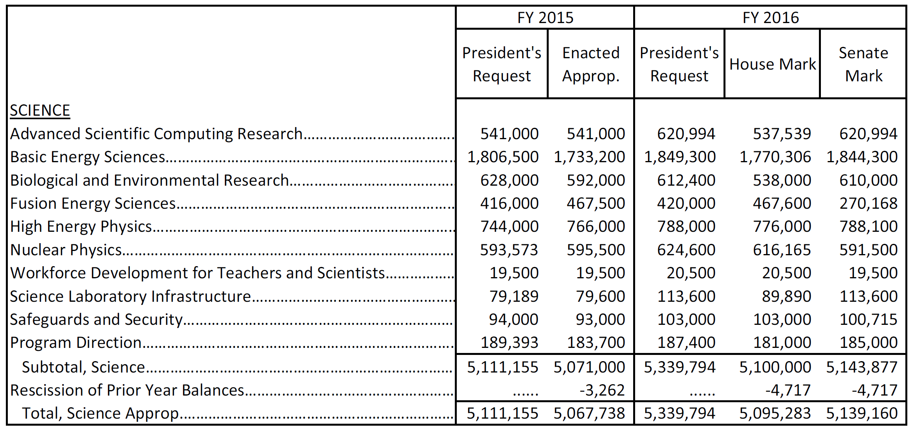
Office of Science FY 2016 Budget Request to Congress (Dollars in thousands)

Slide 3
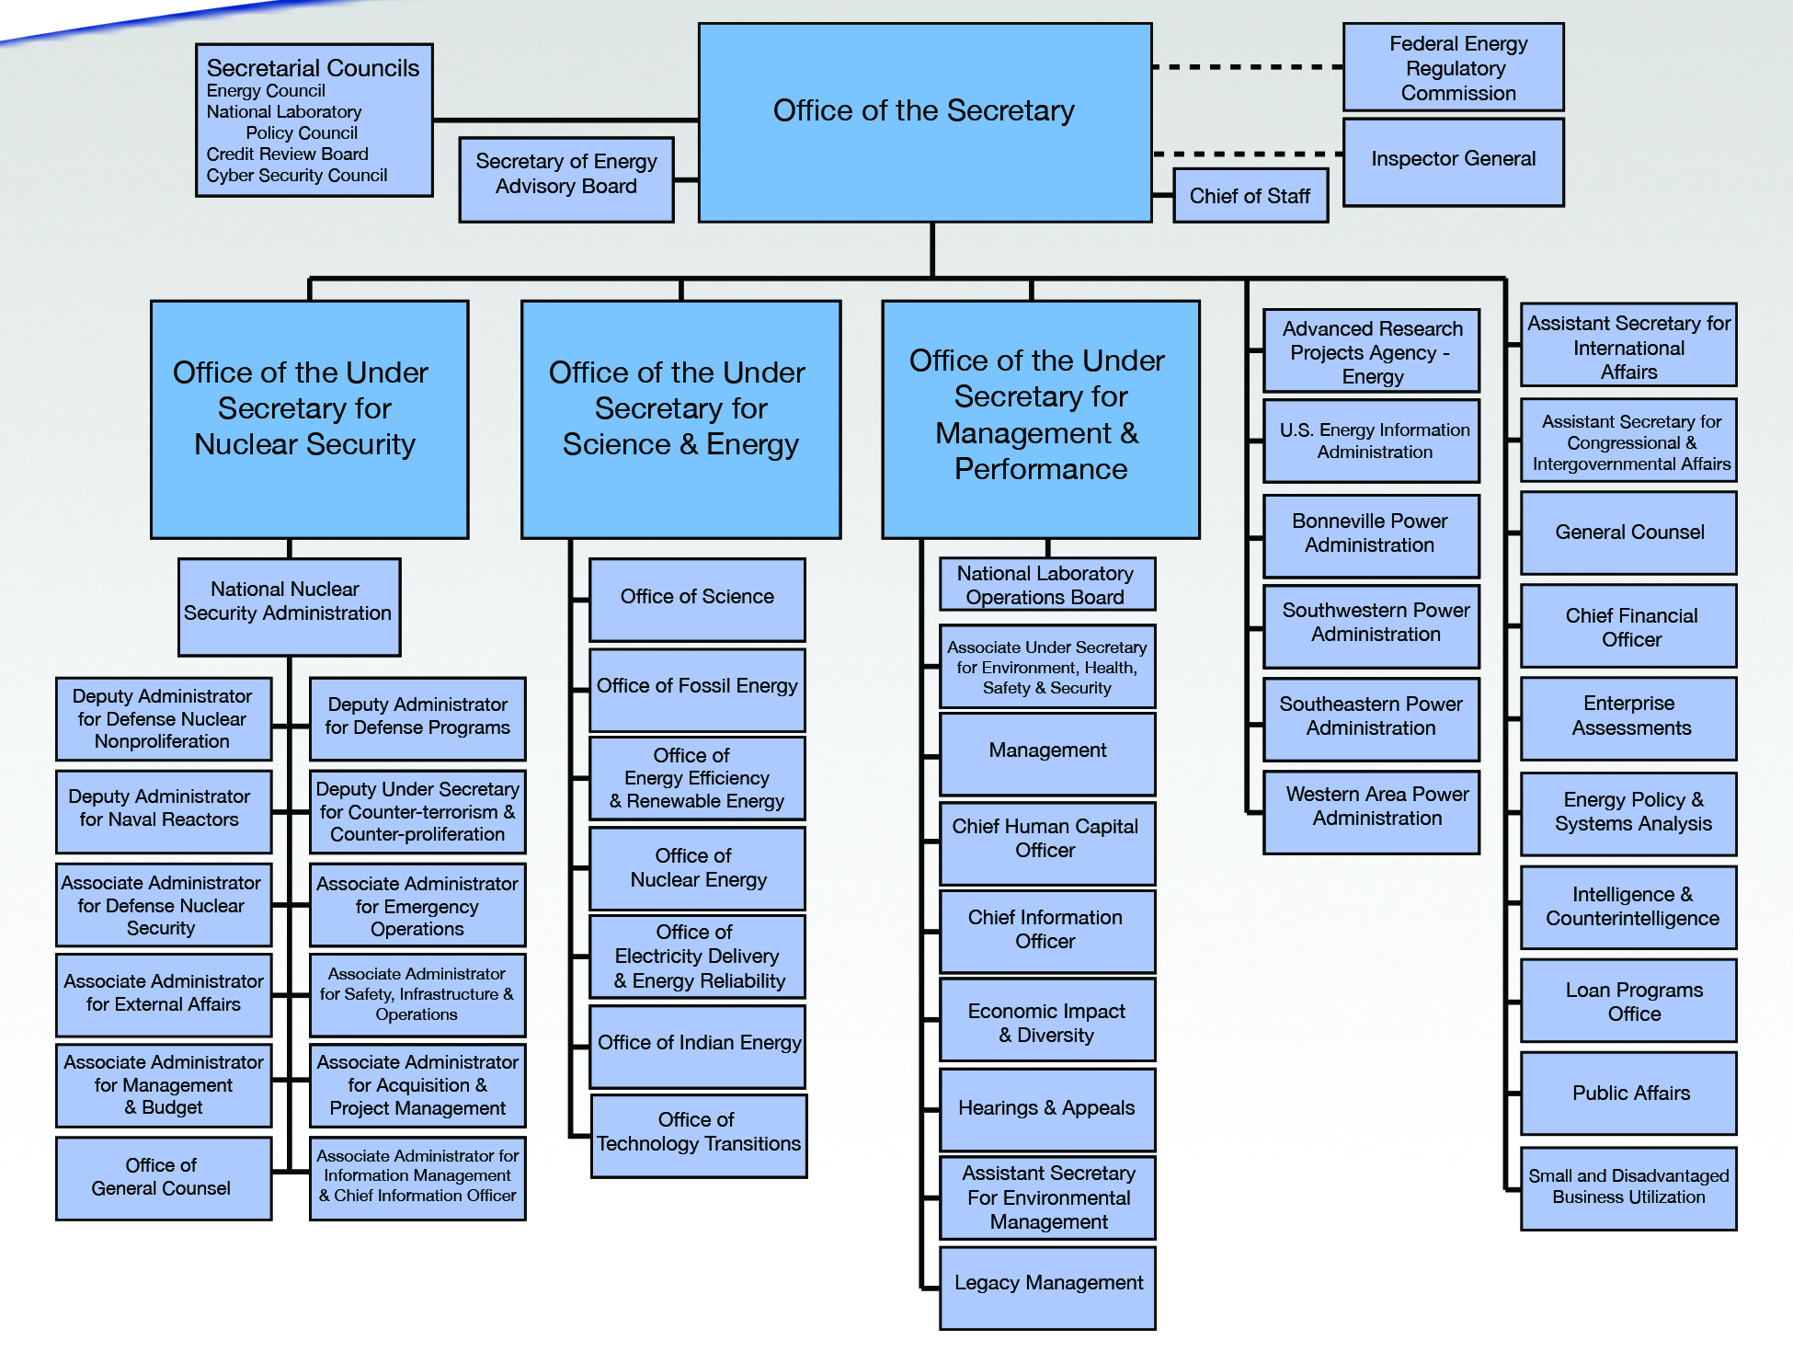
17 DOE Laboratories
AMES, ANL, BNL, FNAL, LBNL, ORNL, PNNL, PPPL, SLAC, TJNAF
NETL
NREL
INL
The remaining 4 DOE labs are:
NNSA—LANL, LLNL, SNL
EM—SRNL

Slide 4
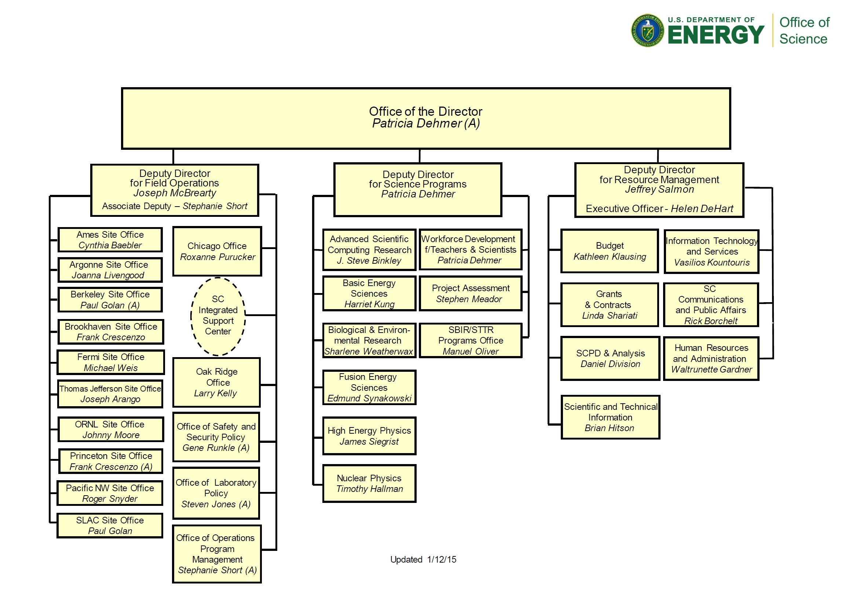
FY 2016 Congressional Request = $5,339,794K
$620,994K
$20,500K
$1,849,300K
$612,400K
$187,400K
$420,000K
$103,000K
$788,000K
$624,600K
16%
universities
$113,600K
FY 2015
Research | 42%
Facility Ops | 39%
Projects | 13%
Other | 6%
73%
industries
6%
FY 2014

Slide 5
Program Planning in SC
Executive branch priorities
Administration priorities
National Science and Technology Council (and WGs)
Office of Science and Technology Policy (and WGs)
Other Administration convened ad hoc WGs
Interagency coordination
Departmental priorities
DOE and program strategic plans
Quadrennial Technology Review/Quadrennial Energy Review
Congressional branch priorities
Legislative authorities and annual appropriations
Program priorities, via engagement of community experts and stakeholders
Federal Advisory Committees*
DOE sponsored scientific and technical workshops/reports
Non-DOE (NRC, JASONS, …) sponsored scientific and technical workshops/reports
* Virtually all major facilities and research programs in SC have roots in Federal Advisory Committee reports and recommendations.
Mission
Need
Scientific Opportunity

Slide 6
Major SC Program Funding (% of total) FY 1978-2015
NP
HEP
FES
BER
BES
ASCR

Slide 7
Charges/Reports: ASCAC, 2013-present Excludes COVs and special topics, e.g., workforce development
Determine potential synergies between the challenges of data-intensive science and exascale computing. (Charge given July 25, 2012; “Synergistic Challenges in Data-Intensive Science and Exascale Computing” delivered March 2013).
Determine the 10 principal research challenges and the technical approaches (hardware and software) required to develop a practical exascale computing system. (Charge given July 29, 2013; “The Top Ten Exascale Research Challenges” delivered February 10, 2014).
Review the Department's draft preliminary conceptual design for the Exascale Computing Initiative. Specifically, determine whether there are gaps in DOE’s plans or areas that need to be given priority or extra management attention. (Charge given November 19, 2014; preliminary report due March 30, 2015; final report due September 30, 2015).
Notes:
Research
Continue on the path to exascale computers by
initiating a research program in the area programming models and runtime systems that address the challenges of energy efficient, data intensive applications, which are characterized by asynchronous, fine grain parallelism;
funding HPC vendors to perform research efforts in critical technologies and system interconnects, with the goal of migrating these technologies into their future exascale products;
initiating system engineering efforts with high performance computer vendors that address system level challenges to ensure resulting exascale computer systems will achieve DOE goals.
expanding exascale system studies to model system performance, from hardware architecture to application workflow, with system software management. These studies are necessary to understand the properties determining ultimate operational and performance characteristics, within the projected range of exascale size and capability.
Initiate exploratory SciDAC partnership efforts to establish for future partnership programs for data intensive scientific problems.
Initiate a computer science research program to support development of scientific data management and analysis and visualization techniques, including knowledge representation.
Conduct innovative mathematics research to improve the fidelity and predictability of continuous and/or distributed complex systems that accurately capture the physics and/or subcomponent interactions across vastly different time and length scales.
Facility Operations
Operate NERSC and the LCFs at a level to achieve 90% availability.
Begin deployment of planned 20-30 petaflop upgrade at NERSC (NERSC-8); Relocate NERSC from the Oakland Scientific Facility into the new Computational Research and Theory building, located on the LBNL campus.
Begin preparations for the 75-200 petaflop upgrades at each Leadership Computing Facility, which are planned to be operational in the 2017-2018 timeframe.
Extend ESnet to further support SC facilities and large experiments in the U.S. and Europe.
Initiate a Postdoctoral Computational Scientists for Energy, Environment and National Security (CSEENS) program at ASCR facilities to ensure an adequate supply of computational science and engineering trained to meet the national workforce need.

Slide 8
Charges/Reports: BESAC, 2013-present Excludes COVs and special topics, e.g., workforce development
Provide advice on the future of photon sources and science, considering both new science opportunities and new photon source technologies in parallel.
Assessment of the grand science challenges that could best be explored with current and possible future SC light sources. The assessment should cover the disciplines supported by Basic Energy Sciences (BES) and other fields that benefit from intense light sources.
Evaluation of the effectiveness of the present SC light source portfolio to meet these grand science challenges.
Enumeration of future light source performance specifications that would maximize the impact on grand science challenges.
Prioritized recommendations on which future light source concepts and the technology behind them are best suited to achieve these performance specifications.
Identification of prioritized research and development initiatives to accelerate the realization of these future light source facilities in a cost effective manner.
(Charge given January 2, 2013; “Report of the BESAC Subcommittee on Future X-ray Light Sources” delivered July 25, 2013).
Revisit the BESAC 2007 “Challenges” Report (“Five Challenges for Science and the Imagination”) considering progress achieved, impact of the challenges on energy sciences, funding modalities, and new areas of basic research not described in the original report. (Charge given February 11, 2014; report requested in 2015.)
Notes:
Research
Continue on the path to exascale computers by
initiating a research program in the area programming models and runtime systems that address the challenges of energy efficient, data intensive applications, which are characterized by asynchronous, fine grain parallelism;
funding HPC vendors to perform research efforts in critical technologies and system interconnects, with the goal of migrating these technologies into their future exascale products;
initiating system engineering efforts with high performance computer vendors that address system level challenges to ensure resulting exascale computer systems will achieve DOE goals.
expanding exascale system studies to model system performance, from hardware architecture to application workflow, with system software management. These studies are necessary to understand the properties determining ultimate operational and performance characteristics, within the projected range of exascale size and capability.
Initiate exploratory SciDAC partnership efforts to establish for future partnership programs for data intensive scientific problems.
Initiate a computer science research program to support development of scientific data management and analysis and visualization techniques, including knowledge representation.
Conduct innovative mathematics research to improve the fidelity and predictability of continuous and/or distributed complex systems that accurately capture the physics and/or subcomponent interactions across vastly different time and length scales.
Facility Operations
Operate NERSC and the LCFs at a level to achieve 90% availability.
Begin deployment of planned 20-30 petaflop upgrade at NERSC (NERSC-8); Relocate NERSC from the Oakland Scientific Facility into the new Computational Research and Theory building, located on the LBNL campus.
Begin preparations for the 75-200 petaflop upgrades at each Leadership Computing Facility, which are planned to be operational in the 2017-2018 timeframe.
Extend ESnet to further support SC facilities and large experiments in the U.S. and Europe.
Initiate a Postdoctoral Computational Scientists for Energy, Environment and National Security (CSEENS) program at ASCR facilities to ensure an adequate supply of computational science and engineering trained to meet the national workforce need.

Slide 9
Charges/Reports: BERAC, 2013-present Excludes COVs and special topics, e.g., workforce development
Recommend initiatives for field-based research (the so-called Integrated Field Laboratory) that capture a multi-disciplinary approach and build on observations and modeling: (1) define the criteria for selecting sites for future BER field-based research and (2) prioritize the sites identified or described. As described by BERAC in 2013, the IFLs are highly instrumented laboratories that build on existing BER observational and modeling capabilities that serve to integrate and expand vertically (from the bedrock to the atmosphere) and geographically (across key geographic regions).
(Charge given September 23, 2014; draft report presented February 19, 2015; final report due fall 2015. This charge continues earlier BERAC charges that resulted in: “Grand Challenges for Biological and Environmental Research: A Long-Term Vision” December 2010; "BER Virtual Laboratory: Innovative Framework for Biological and Environmental Grand Challenges” February 2013)
Notes:
Research
Continue on the path to exascale computers by
initiating a research program in the area programming models and runtime systems that address the challenges of energy efficient, data intensive applications, which are characterized by asynchronous, fine grain parallelism;
funding HPC vendors to perform research efforts in critical technologies and system interconnects, with the goal of migrating these technologies into their future exascale products;
initiating system engineering efforts with high performance computer vendors that address system level challenges to ensure resulting exascale computer systems will achieve DOE goals.
expanding exascale system studies to model system performance, from hardware architecture to application workflow, with system software management. These studies are necessary to understand the properties determining ultimate operational and performance characteristics, within the projected range of exascale size and capability.
Initiate exploratory SciDAC partnership efforts to establish for future partnership programs for data intensive scientific problems.
Initiate a computer science research program to support development of scientific data management and analysis and visualization techniques, including knowledge representation.
Conduct innovative mathematics research to improve the fidelity and predictability of continuous and/or distributed complex systems that accurately capture the physics and/or subcomponent interactions across vastly different time and length scales.
Facility Operations
Operate NERSC and the LCFs at a level to achieve 90% availability.
Begin deployment of planned 20-30 petaflop upgrade at NERSC (NERSC-8); Relocate NERSC from the Oakland Scientific Facility into the new Computational Research and Theory building, located on the LBNL campus.
Begin preparations for the 75-200 petaflop upgrades at each Leadership Computing Facility, which are planned to be operational in the 2017-2018 timeframe.
Extend ESnet to further support SC facilities and large experiments in the U.S. and Europe.
Initiate a Postdoctoral Computational Scientists for Energy, Environment and National Security (CSEENS) program at ASCR facilities to ensure an adequate supply of computational science and engineering trained to meet the national workforce need.

Slide 10
Charges/Reports: FESAC, 2013-present Excludes COVs and special topics, e.g., workforce development
Assess priorities among and within the elements of the magnetic fusion energy science program. (Charge given April 13, 2012; “Report of the FESAC Subcommittee on the Priorities of the Magnetic Fusion Energy Science Program” delivered March 2013).
Develop a strategic plan for the Fusion Energy Sciences program assuming several different funding scenarios that will ensure long-term U.S. leadership in the foundations of burning plasma science (the science of prediction and control of burning plasmas); long-pulse burning plasma science (the science of fusion plasmas and materials approaching and beyond ITER); and discovery plasma science (the science of laboratory plasmas and the high energy density state). (Charge given April 8, 2014; “Report on Strategic Planning: Priorities Assessment and Budget Scenarios” delivered December 2014).
Assess connections between research supported by the Fusion Energy Sciences program and other scientific disciplines and technological applications. (Charge given February 4, 2015; report requested in 2015.)
Notes:
Research
Continue on the path to exascale computers by
initiating a research program in the area programming models and runtime systems that address the challenges of energy efficient, data intensive applications, which are characterized by asynchronous, fine grain parallelism;
funding HPC vendors to perform research efforts in critical technologies and system interconnects, with the goal of migrating these technologies into their future exascale products;
initiating system engineering efforts with high performance computer vendors that address system level challenges to ensure resulting exascale computer systems will achieve DOE goals.
expanding exascale system studies to model system performance, from hardware architecture to application workflow, with system software management. These studies are necessary to understand the properties determining ultimate operational and performance characteristics, within the projected range of exascale size and capability.
Initiate exploratory SciDAC partnership efforts to establish for future partnership programs for data intensive scientific problems.
Initiate a computer science research program to support development of scientific data management and analysis and visualization techniques, including knowledge representation.
Conduct innovative mathematics research to improve the fidelity and predictability of continuous and/or distributed complex systems that accurately capture the physics and/or subcomponent interactions across vastly different time and length scales.
Facility Operations
Operate NERSC and the LCFs at a level to achieve 90% availability.
Begin deployment of planned 20-30 petaflop upgrade at NERSC (NERSC-8); Relocate NERSC from the Oakland Scientific Facility into the new Computational Research and Theory building, located on the LBNL campus.
Begin preparations for the 75-200 petaflop upgrades at each Leadership Computing Facility, which are planned to be operational in the 2017-2018 timeframe.
Extend ESnet to further support SC facilities and large experiments in the U.S. and Europe.
Initiate a Postdoctoral Computational Scientists for Energy, Environment and National Security (CSEENS) program at ASCR facilities to ensure an adequate supply of computational science and engineering trained to meet the national workforce need.

Slide 11
Charges/Reports: HEPAP, 2013-present Excludes COVs and special topics, e.g., workforce development
HEPAP via the P5 panel (i.e, the Particle Physics Project Prioritization Panel) should develop an updated strategic plan for U.S. high energy physics that can be executed over a 10-year timescale in the context of a 20-year global vision for the field. Consider the recent discovery of the long-sought Higgs boson, the observation of missing among all three known neutrino types at unexpectedly large rates, and budgets that are more stringent than those considered by the previous P5 panel (2008). (Charge given September 2013; “Building for Discovery: Strategic Plan for U.S. Particle Physics in the Global Context” delivered May 22, 2014.)
Assess the accelerator R&D effort supported by the High Energy Physics program. (Charge given June 10, 2014; “Accelerating Discovery: A Strategic Plan for Accelerator R&D in the U.S.” delivered May 18, 2015.)
Notes:
Research
Continue on the path to exascale computers by
initiating a research program in the area programming models and runtime systems that address the challenges of energy efficient, data intensive applications, which are characterized by asynchronous, fine grain parallelism;
funding HPC vendors to perform research efforts in critical technologies and system interconnects, with the goal of migrating these technologies into their future exascale products;
initiating system engineering efforts with high performance computer vendors that address system level challenges to ensure resulting exascale computer systems will achieve DOE goals.
expanding exascale system studies to model system performance, from hardware architecture to application workflow, with system software management. These studies are necessary to understand the properties determining ultimate operational and performance characteristics, within the projected range of exascale size and capability.
Initiate exploratory SciDAC partnership efforts to establish for future partnership programs for data intensive scientific problems.
Initiate a computer science research program to support development of scientific data management and analysis and visualization techniques, including knowledge representation.
Conduct innovative mathematics research to improve the fidelity and predictability of continuous and/or distributed complex systems that accurately capture the physics and/or subcomponent interactions across vastly different time and length scales.
Facility Operations
Operate NERSC and the LCFs at a level to achieve 90% availability.
Begin deployment of planned 20-30 petaflop upgrade at NERSC (NERSC-8); Relocate NERSC from the Oakland Scientific Facility into the new Computational Research and Theory building, located on the LBNL campus.
Begin preparations for the 75-200 petaflop upgrades at each Leadership Computing Facility, which are planned to be operational in the 2017-2018 timeframe.
Extend ESnet to further support SC facilities and large experiments in the U.S. and Europe.
Initiate a Postdoctoral Computational Scientists for Energy, Environment and National Security (CSEENS) program at ASCR facilities to ensure an adequate supply of computational science and engineering trained to meet the national workforce need.

Slide 12
Charges/Reports: NSAC, 2013-present Excludes COVs and special topics, e.g., workforce development
Provide advice for an effective strategy for implementing a possible 2nd generation U.S. experiment on Neutrinoless Double Beta Decay (NLDBD) capable of reaching the sensitivity necessary to determine whether the neutrino is a Majorana or Dirac particle. (Charge given December 2013; “Report to NSAC on Neutrinoless Double Beta Decay” delivered April 24, 2014.)
Conduct a new study of the opportunities and priorities for U.S. nuclear physics research, and recommend a long-range plan that will provide a framework for coordinated advancement for the nation’s nuclear science research programs over the next decade. (Charge given April 23, 2014; report requested October 2015.)
Establish an NSAC Isotope (NSACI) subcommittee for an initial period of two years to conduct a new study of the opportunities and priorities for isotope research and production, an effort that should result in a long-range strategic plan for the DOE Isotope Program managed by the Nuclear Physics program. (Charge given April 23, 2014; report requested March 2015.)
Provide additional advice for an effective strategy for implementing a possible 2nd generation U.S. experiment on Neutrinoless Double Beta Decay (NLDBD) capable of reaching the sensitivity necessary to determine whether the neutrino is a Majorana or Dirac particle under the inverted-hierarchy mass scenario. (Charge given March 30, 2015; report requested November 2015.)
Notes:
Research
Continue on the path to exascale computers by
initiating a research program in the area programming models and runtime systems that address the challenges of energy efficient, data intensive applications, which are characterized by asynchronous, fine grain parallelism;
funding HPC vendors to perform research efforts in critical technologies and system interconnects, with the goal of migrating these technologies into their future exascale products;
initiating system engineering efforts with high performance computer vendors that address system level challenges to ensure resulting exascale computer systems will achieve DOE goals.
expanding exascale system studies to model system performance, from hardware architecture to application workflow, with system software management. These studies are necessary to understand the properties determining ultimate operational and performance characteristics, within the projected range of exascale size and capability.
Initiate exploratory SciDAC partnership efforts to establish for future partnership programs for data intensive scientific problems.
Initiate a computer science research program to support development of scientific data management and analysis and visualization techniques, including knowledge representation.
Conduct innovative mathematics research to improve the fidelity and predictability of continuous and/or distributed complex systems that accurately capture the physics and/or subcomponent interactions across vastly different time and length scales.
Facility Operations
Operate NERSC and the LCFs at a level to achieve 90% availability.
Begin deployment of planned 20-30 petaflop upgrade at NERSC (NERSC-8); Relocate NERSC from the Oakland Scientific Facility into the new Computational Research and Theory building, located on the LBNL campus.
Begin preparations for the 75-200 petaflop upgrades at each Leadership Computing Facility, which are planned to be operational in the 2017-2018 timeframe.
Extend ESnet to further support SC facilities and large experiments in the U.S. and Europe.
Initiate a Postdoctoral Computational Scientists for Energy, Environment and National Security (CSEENS) program at ASCR facilities to ensure an adequate supply of computational science and engineering trained to meet the national workforce need.

