Slide 1
NSLS-II Update
J. P. Hill
NSLS-II Director,
BESAC February 26th , 2015

Slide 2
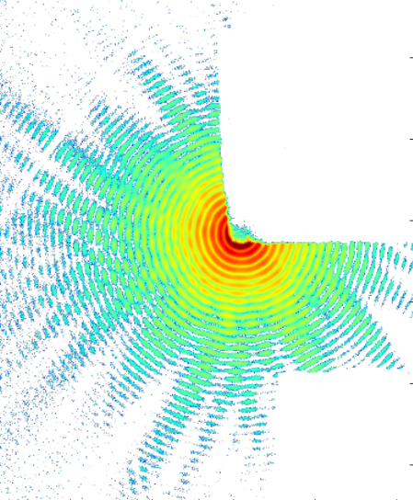
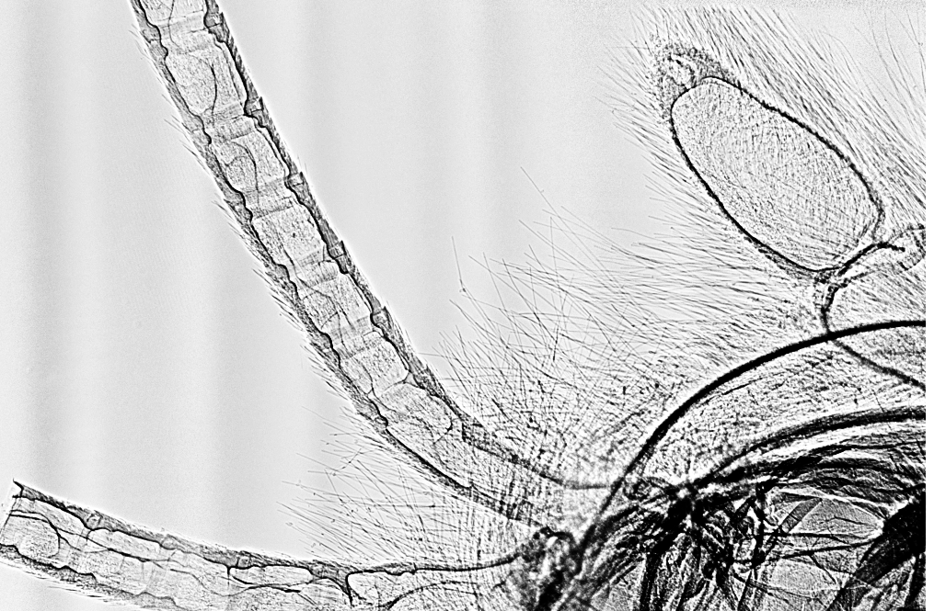
Outline
NSLS-II - Vision
NSLS-II project Update
  CD-4
  Machine ramp-up
  Beamline commissioning
First science at NSLS-II
Next 5 years
Summary

Slide 3
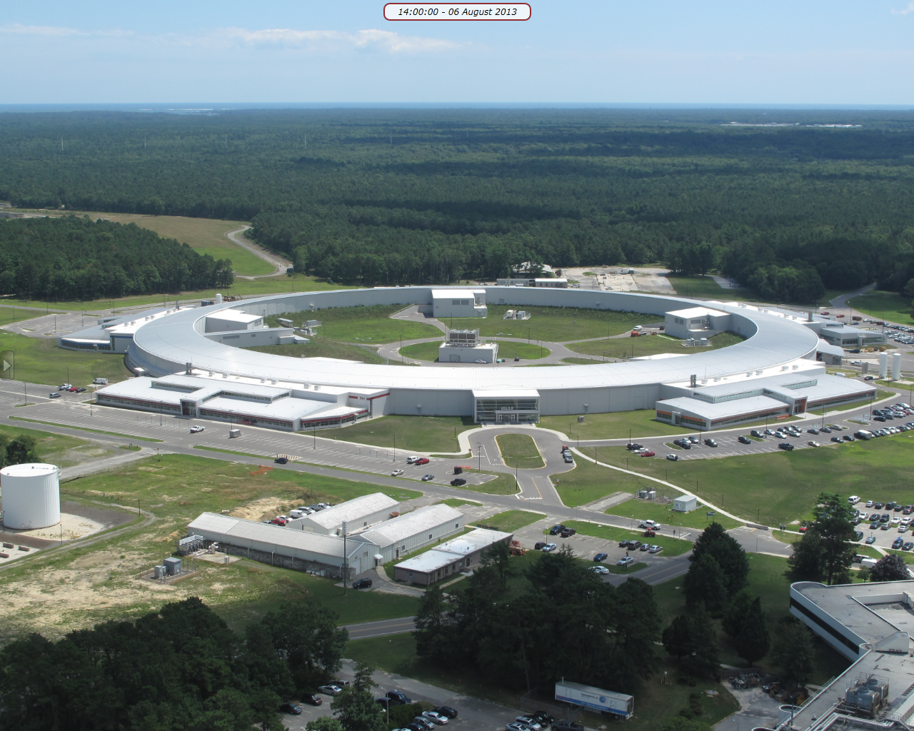
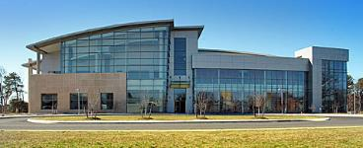
NSLS-II Vision
  Vision:
  NSLS-II will be the brightest synchrotron in the world. This will enable world-leading programs in imaging and dynamics with unprecedented resolution, providing impact in condensed matter physics, materials physics, chemistry and biology.
  Key strengths of NSLS-II :
  IMAGING – multiple imaging modes including lensless with unprecedented spatial resolution (nanoscale)
  DYNAMICS – inelastic scattering in the energy domain and coherent scattering in the time domain (meV and μs).
  SYNERGY – colocation with the nanocenter (CFN) and integrated suites of instruments will provide complex data sets across multiple techniques
NSLS-II
CFN

Slide 4
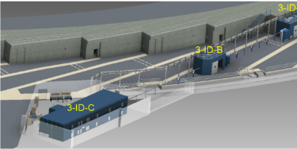
NSLS-II Design Features
Best-in-class brightness & flux from far infrared to hard x-rays
Design Parameters
  3 GeV, 500 mA, top-off injection
  Circumference 791.5 m
  30 cell, Double Bend Achromat
      15 high-β straights (9.3 m)
      15 low-β straights (6.6 m)
Novel design features:
  Damping wigglers
  Soft bend magnets
  Three pole wigglers
Ultra-low emittance for high brightness and small source size
  ε_{x}, ε_{y} = 0.6, 0.008 nm-rad
  Diffraction limited in vertical at 12 keV
  Small beam size: σ_{y} = 2.6 μm, σ_{x} = 28 μm, σ’_{y} = 3.2 μrad, σ’_{x} = 19 μrad
  Large gap IR dipoles
  Long beamlines
  Ultra-high stability

Slide 5
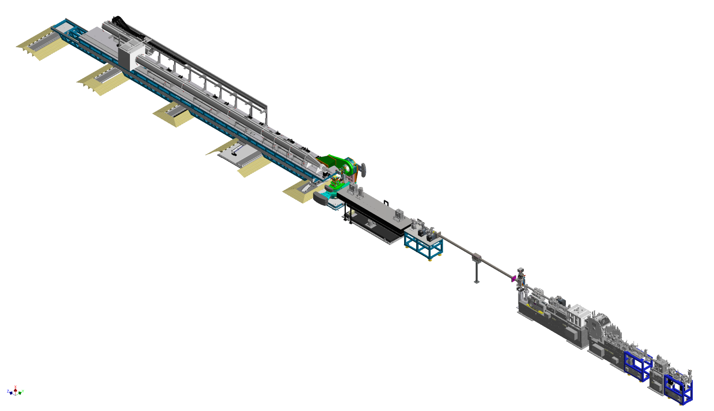
  Complexity and Dynamics
  From simple materials with self-organized phases to intrinsically heterogeneous systems, complexity and its dynamics is one of the key scientific questions of today
Coherent Hard X-ray (CHX) beamline
  NSLS-II will enable world-leading leading coherence, nanoimaging, and inelastic scattering capabilities that will be ideally suited for fundamental understanding and ultimately control of intrinsic and emergent
  heterogeneities and associated naturally-
  occurring, unclocked, and irreversible processes

Slide 6
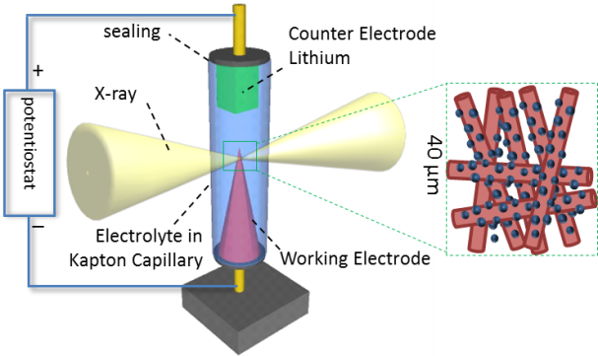
  In-operando Functional Systems
  There is demand for advanced characterization tools to allow in-operando studies of real functional materials under working conditions that are
  relevant to natural or industrial processes
FXI: Operando TXM
  NSLS-II high brightness and high flux in a broad range of the spectrum will enable correlated in-operando capabilities in scattering and diffraction, spectroscopy, and imaging for a variety of functional systems critical to future advances in energy, environment, and human health

Slide 7
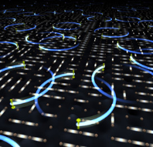
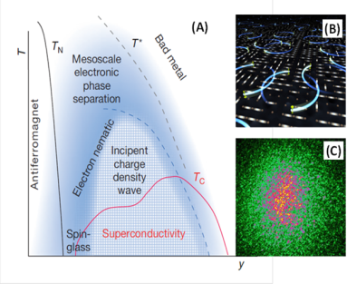
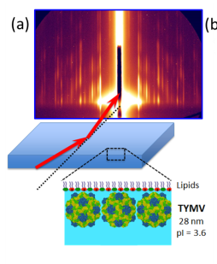
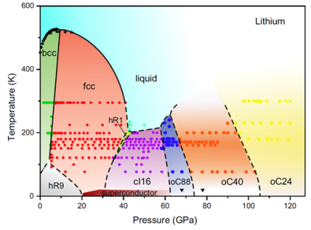
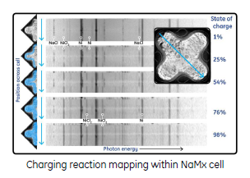
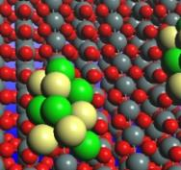
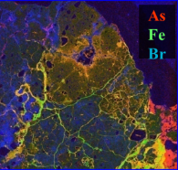
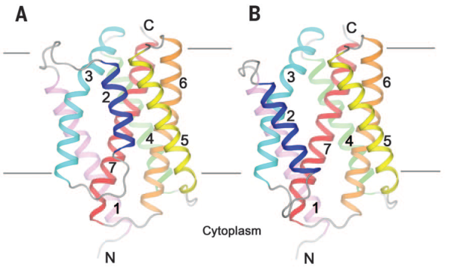
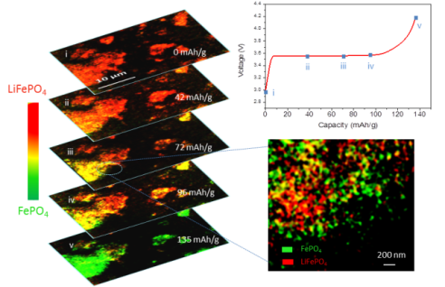
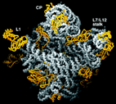
NSLS-II Impact
  Emergent Behavior from Complexity
  Mastering Materials Discovery & Processing
  Catalysis and Energy Science
  Environment and Climate Science
  Structures and Functions of Life

Slide 8
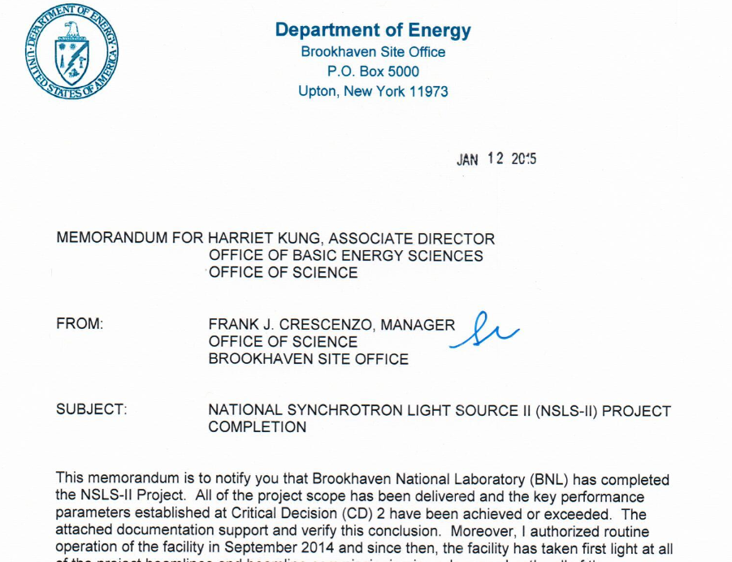
NSLS-II Project Update
We are done!
Independent scope review
Dec 12-14th 2014
KPPs all exceeded, on time and under budget.
Dedication Ceremony
Feb 6th 2015
OPA CD-4 review
Feb 10-11th 2015
Unanimous recommendation:
“Proceed to CD-4”

Slide 9
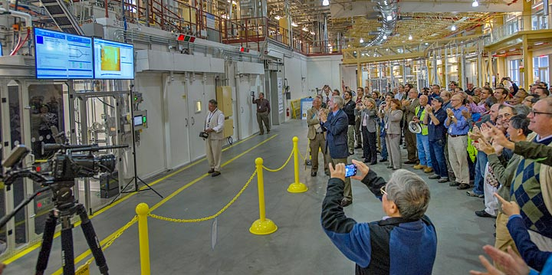
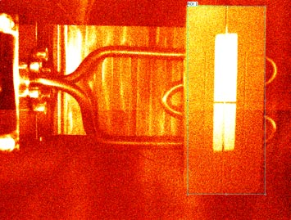
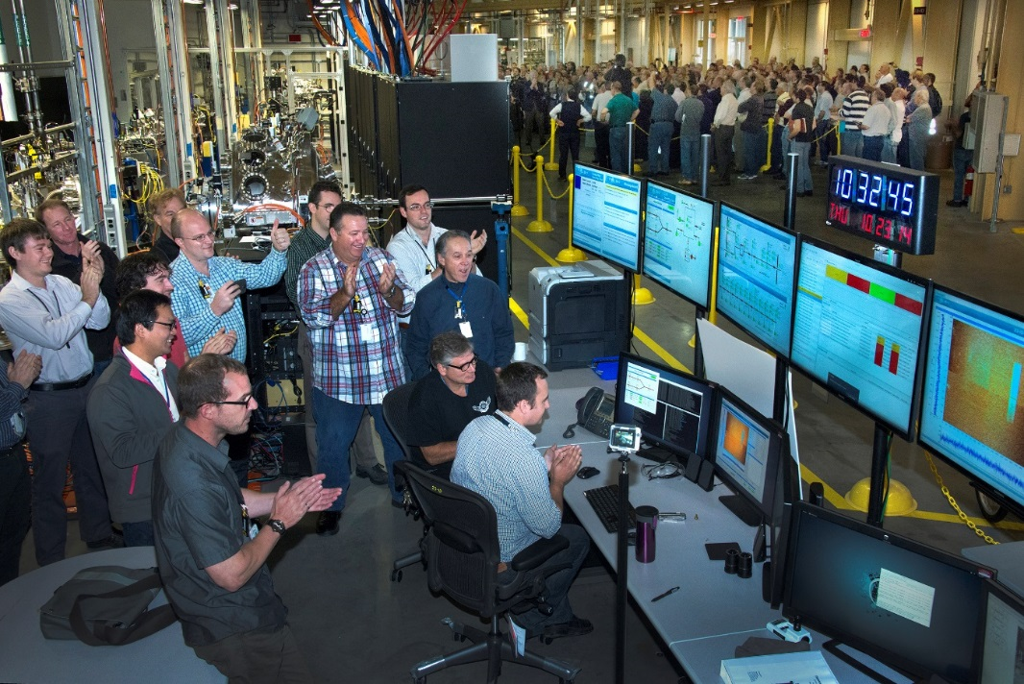
NSLS-II First Light!
“First light” was observed in the FOE at 23-ID on the morning
of Thursday,
October 23, 2014

Slide 10
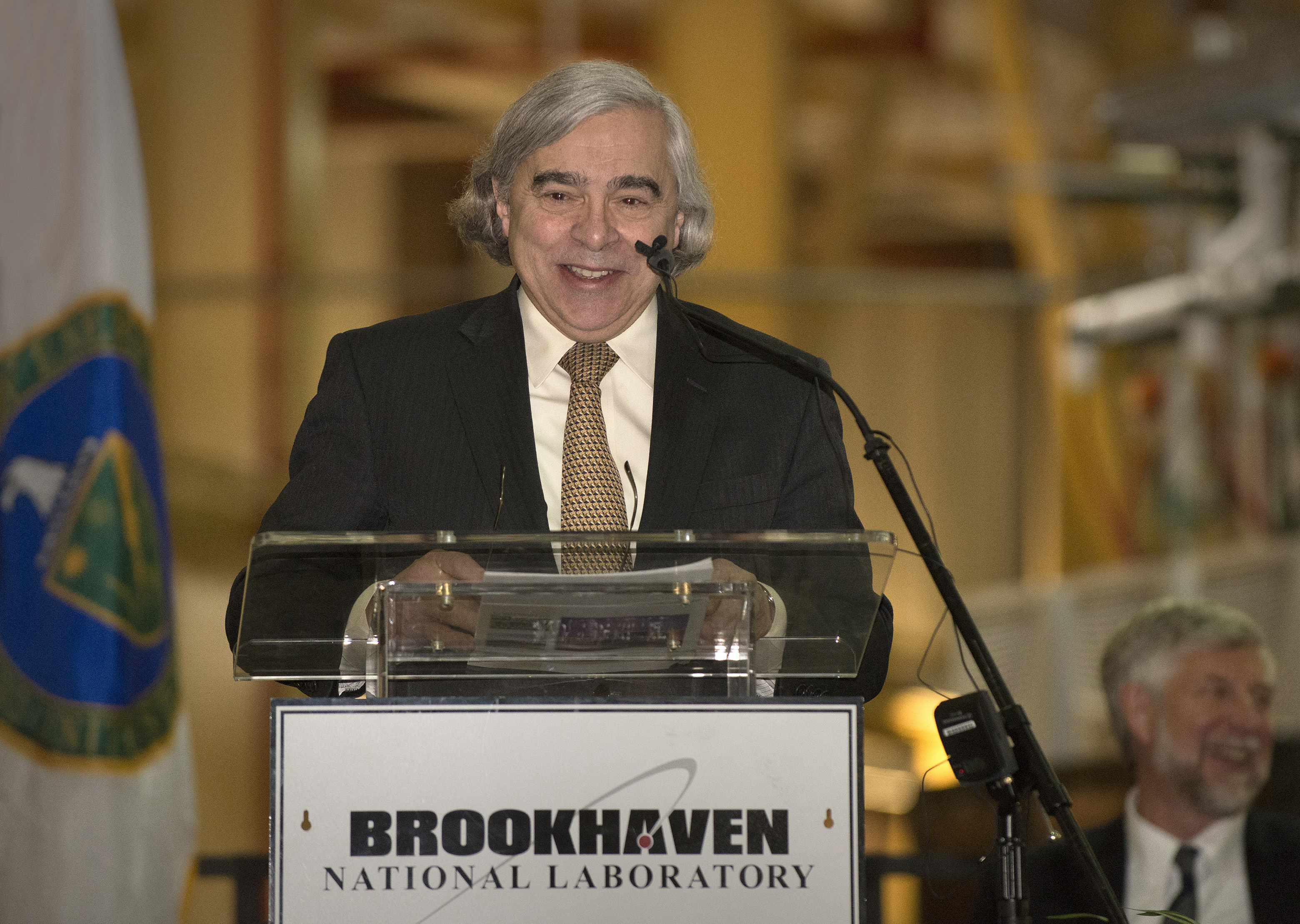
NSLS-II Dedication February 6th 2015

Slide 11
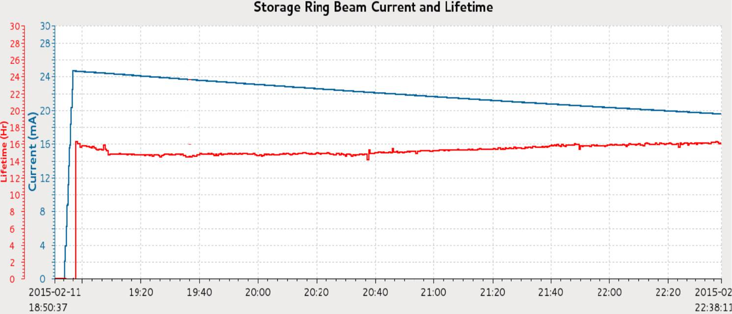
NSLS-II Accelerator Commissioning
NSLS-II Accelerator Systems have provided >1300 hours of SR operations to date.
All project BL IDs commissioned and front-ends are conditioned for 50 mA operations
Lifetime > 15 hrs at 25 mA
11

Slide 12
Horizontal Beam Emittance with 3 DW
3 DWs closed
Horizontal Design Emittance Achieved
ε_{x}^{dw} = 1 nm∙rad, requires good control of lattice and beam optics
Excellent Stability
Currently
X: <10% σ_{x}, Y: ~20% σ_{y}

Slide 13
Early Storage Ring Operations
 | FY15 | FY16 | FY17
Current (mA) | 50-300 | 300-400 | 400-500
Reliability (%) | 85 | 90 | 95
Schedule (hrs)
User Operations | 2087 | 3357 | 3517
Installation/Commissioning | 3260 | 1986 | 2240
Studies | 783 | 786 | 1042
Maintenance | 2630 | 2631 | 1961
Top off operation is being implemented for user operations starting FY16

Slide 14
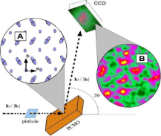
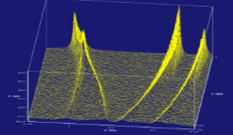
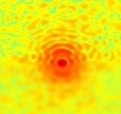
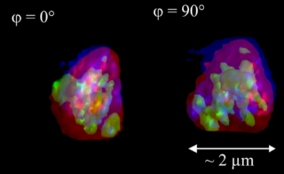
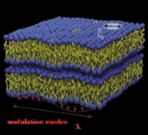
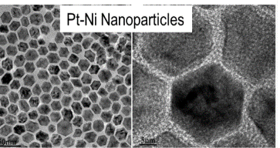
NSLS-II 7 Project Beamlines
Coherent Soft X-ray Scattering (CSX-1)
Fast Switching Polarization (CSX-2)
X-ray Powder Diffraction (XPD-1)
Resonant magnetic scattering, spectroscopy, XMCD
High energy
Powder diffraction, scattering
World-leading coherent flux
XPCS, CDI
Time-resolved in-situ in-operando extreme conditions Understanding complex nanostructured materials
Imaging & dynamics in strongly correlated and
magnetic materials
Coherent Hard X-ray Scattering (CHX)
Sub-um Resolution X-ray Spectroscopy (SRX)
Non-equilibrium and heterogeneous dynamics in soft matter, at buried interfaces, biomaterials, glasses,
driven systems
World-leading spectroscopy in sub-100 nm spot
3D chemical imaging and speciation at the nanoscale
100x greater time resolution in XPCS studies
of dynamics
Inelastic X-ray Scattering (IXS)
Hard X-ray Nanoprobe (HXN)
THz dynamics in liquid, glassy, and crystalline materials with nanoscale inhomogeneities
Nanoscale imaging with fluorescence and diffraction
100m long beamline

Slide 15
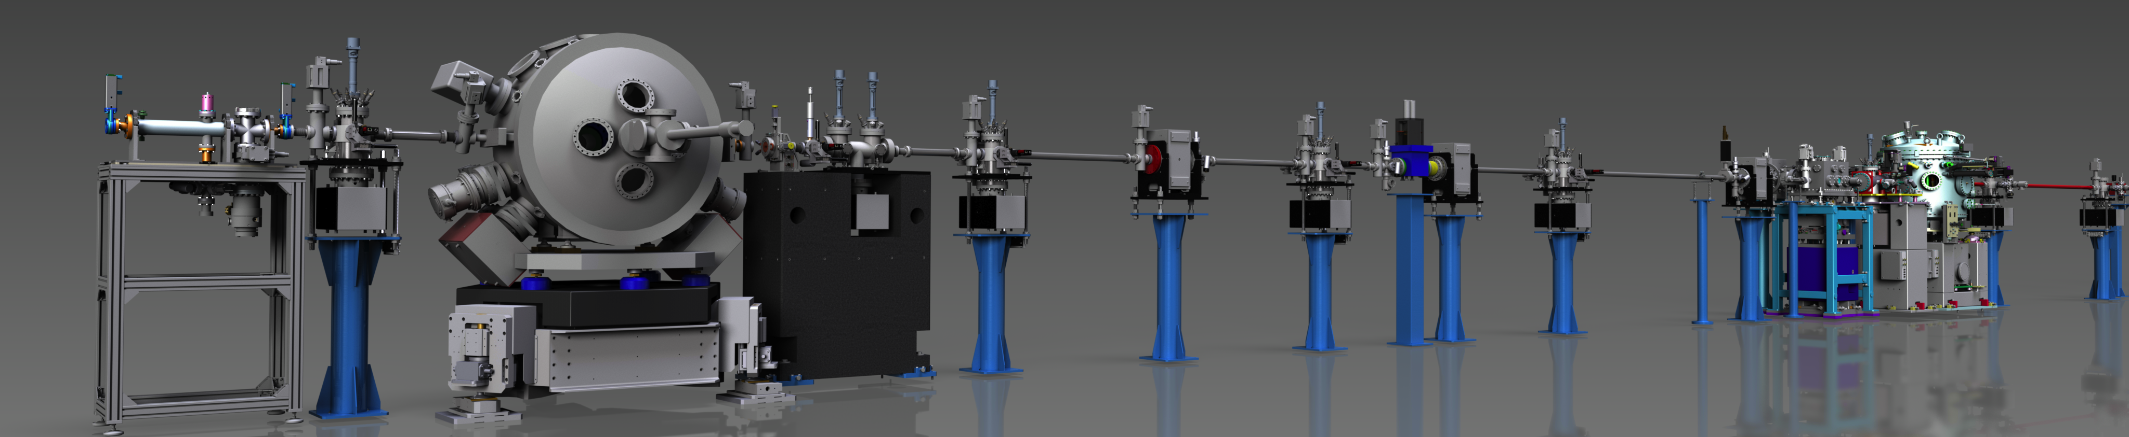
NSLS-II Beamline Commissioning Going Well
Monochromatic X-ray beams obtained at all NSLS-II project beamlines.
All project beamline radiation safety systems and FOE optics are commissioned for 25 mA operations. High current vacuum conditioning underway.
Technical commissioning progressing well. XPD-1 starts science commissioning with early users this week.

Slide 16
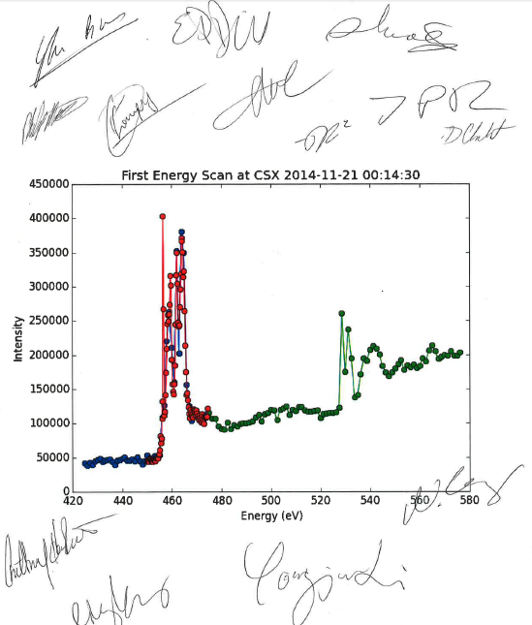
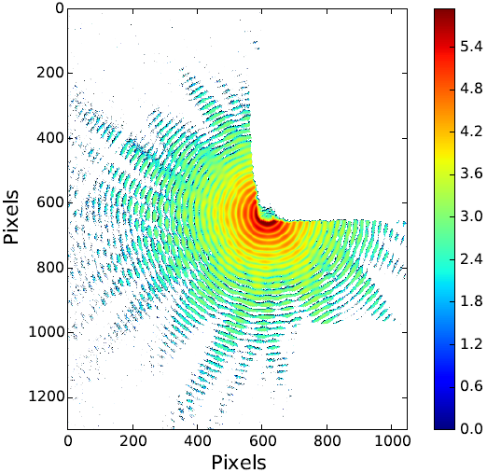
First Spectroscopy & Coherent Diffraction at CSX
Nov 21, 2014
Dec 3, 2014
Excellent coherence and beam stability

Slide 17
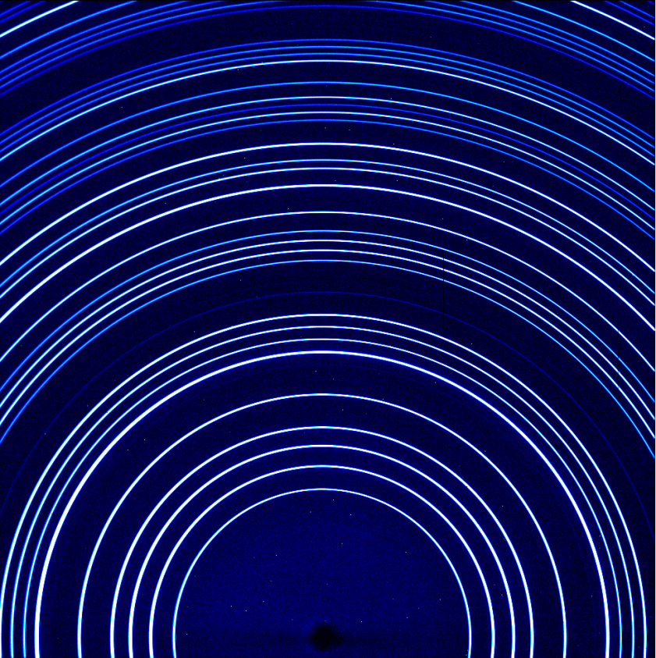
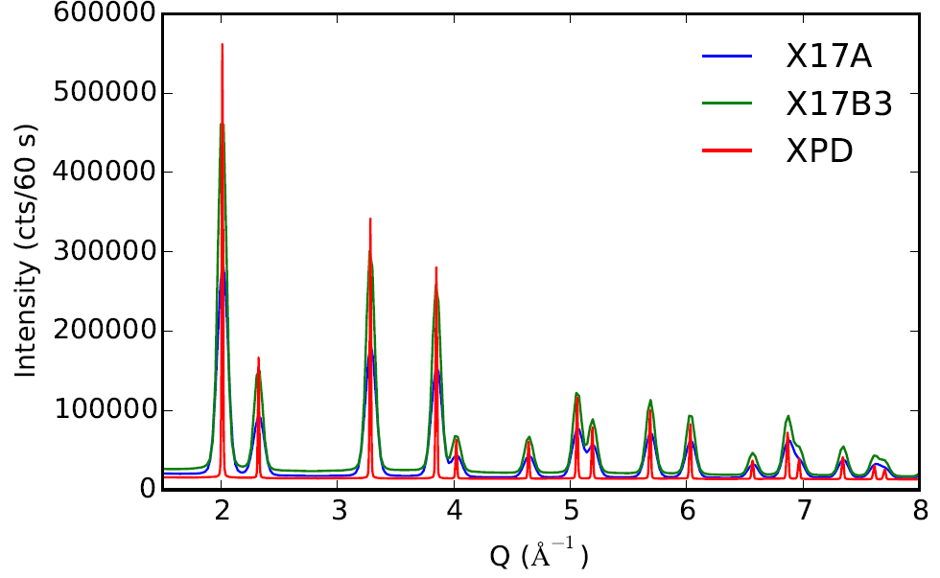
Benchmarking Measurements at XPD
Several benchmarking measurements have been conducted at XPD on reference samples at 0.5 mA
Ru_{0.8}Ir_{0.2}Se₂
Comparisons with
NSLS
CeO₂
Manuscript submitted to APL Materials on Dec (2014)
Title: "Enhanced Thermoelectric Power and Electronic Correlations in RuSe2“.
In press Feb. (2015)

Slide 18
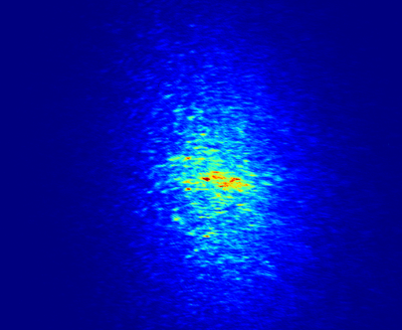
Coherence and stability
Benchmarking measurements and tests conducted at HXN, CSX-1
First X-ray Imaging at NSLS-II
Hard X-ray Nanoprobe Beamline, 3-ID,
Dec. 16th, 2014
First Speckle Pattern
Pr_{0.5}Ca_{0.5}MnO₃ orbital order at ~80K
Dec. 20th, 2014
Image: 5 sec at 0.5 mA
Speckle Image: 120 sec at 5 mA
HXN
CSX-1

Slide 19
Project Beamline Commissioning & Ramp-up
Run 2014-3
Run 2015-1
Run 2015-2
 | accelerator studies
 | shutdown
 | BL construction
 | BL technical commissioning
 | BL science commissioning
 | BL user operations
User science program will begin once a scientific capability is commissioned, alternating with additional commissioning
This “Phased Commissioning” approach will permit technical commissioning of all science capabilities and will achieve early, high impact scientific productivity
CSX-1, XPD-1, SRX beamlines will start
conducting 1st science commissioning experiments in Feb-Apr cycle

Slide 20
NSLS-II User Program
Accepting proposals. Tremendous interest from the community
Expectation management:
  Early days for beamline’s
  user-friendliness and limited time for users with commissioning still underway.
Plus 18 proposals for beamtime supported by us at ALS, SSRL.
Notes:
Bit wordy

Slide 21
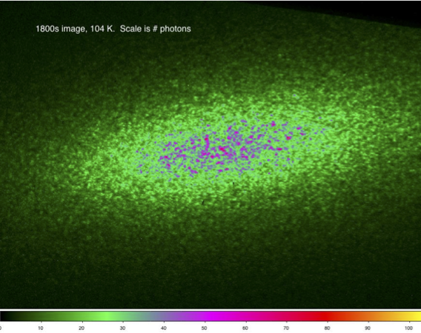
Dynamics of Mesoscopic Electronic Phases
S.D. Kevan, J.C.T. Lee, X. Shi, Sujoy Roy, ALS, LBNL, Berkeley CA USA
Proposed Experiment:
Measuring Mesoscopic time scales in complex oxides with XPCS.
Scientific Significance/Impact:
Studying processes in complex oxides at the mesoscale is an emerging new field looking to understand collective domain dynamics.
Domain dynamics are important as they define the behavior of many real-world devices, for example HDD.
First Experiment Plan at CSX-1:
Nickelates will be studied using XPCS analysis to gain insight into the timescales of domain motion of charge stripes.
Coherent scattering from a charge stripe

Slide 22
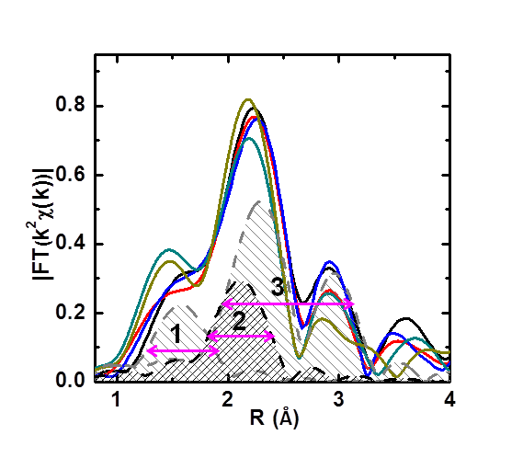
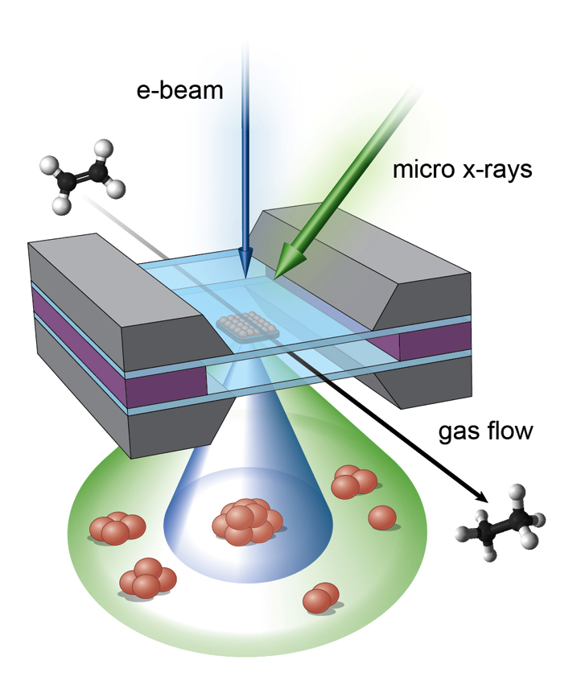
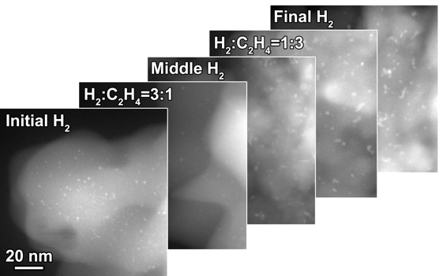
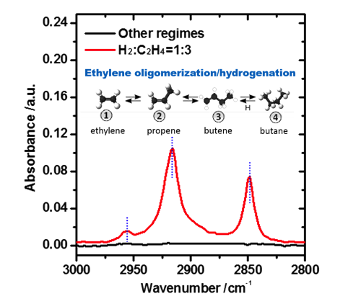

Correlative experiments with photons & electrons
E. Stach (CFN) A. Frenkel (Yeshiva U.)
X-ray Absorption Spectroscopy
Global average structure and electronic structure
Transmission Electron Microscopy
Physical and electronic structure of individual catalysts
Use of microfabricated reactor to confine
liquids and gases (CFN developed)
Allows:
  In-situ electrochemistry at the nanoscale
  In-operando studies of nanoparticle catalysts
Infrared Spectroscopy
Direct determination of surface adsorbates
Cells are compatible with XAS, XRD at NSLS-II,
TEM at CFN, Infrared & Raman spectroscopy

Slide 23
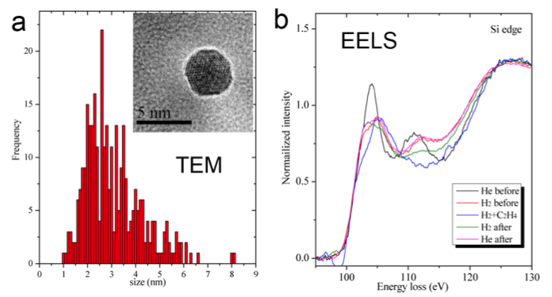
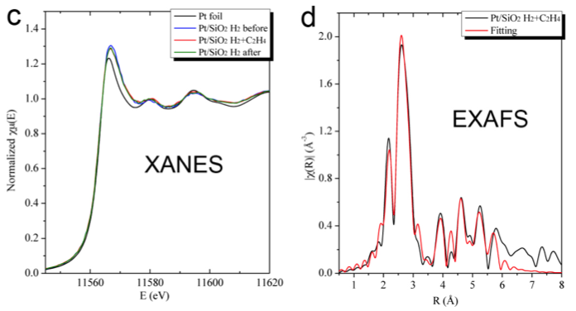
Operando studies of catalytic mechanisms
A. Frenkel (Yeshiva U), E. Stach (CFN, BNL), R. Nuzzo (U Illinois), J. Chen (Columbia U, BNL),
R. Crooks (U Texas), J. Rehr (U Washington)
Proposed Experiment:
Heterogeneity in catalytic mechanisms studied with spatially resolved XANES.
Scientific Significance/Impact:
Overcome the ‘materials,’ ‘pressure’ and `complexity’ gaps by studying real catalysts in real working environments utilizing spatially-resolved techniques
First Experiment Plan at SRX:
Study of catalytic materials in the micro-cell using XRF imaging and XANES spectroscopy.
Prototype data exist from EXAFS at the NSLS: 1mm scale
Extensive data exist from CFN (FEI Titan): 1-10nm scale.
Sub-µm spatial resolution will probe the 1-10 μm scale.
TEM and X-ray study of
catalytic Pt/SiO₂ nanoparticles

Slide 24
Next Five Years
Establish NSLS-II as a world-class synchrotron with exceedingly bright, stable beams and a robust, diverse user program
Strategic focus on becoming a center for imaging and dynamics with seminal impact in energy storage, catalysis, materials problems and life sciences
Establish next generation data management and analysis. This is being developed now, drawing on experience of HEP and NP at BNL and that at other labs (e.g. CAMERA). BNL has a vision for 3 tiers of data analysis, housed in “C3D”
Complete beamline construction activities underway on the next 21 beamlines
Begin next phase of beamline construction

Slide 25
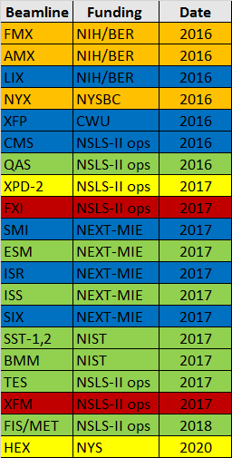
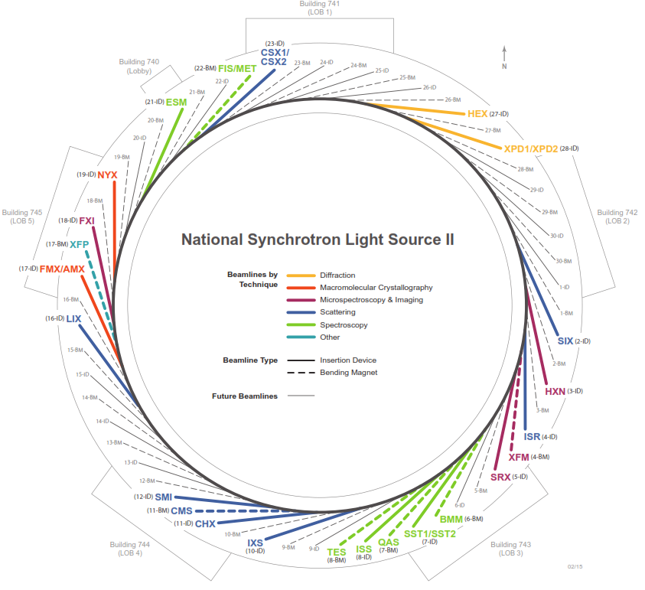
Additional Beamline Construction Underway
To realize this vision, there is an aggressive beamline construction program underway to deliver 21 more beamlines in addition to the 7 project beamlines.
Scattering
Diffraction
MX
Imaging
Spectroscopy

Slide 26
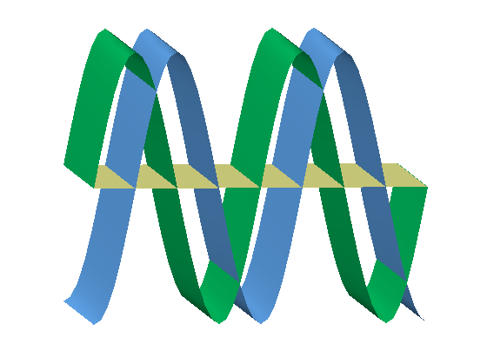
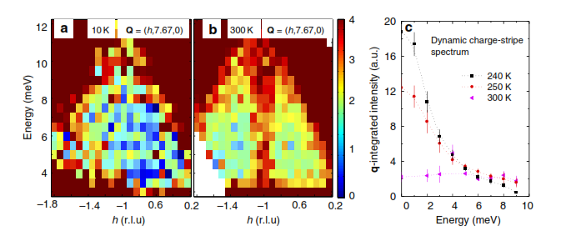
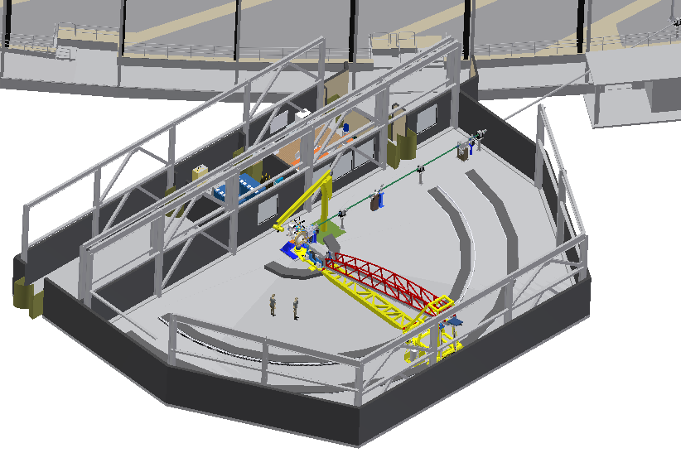
Electronic Correlations in the Cuprates
1) Is there a “pair density wave state”?
SDW + PDW
CSX beamline.
Search for “1Q” satellite using O K-edge resonant scattering and high coherent flux.
Fradkin, Kivelson, Tranquada (2014)
2) What are the dynamics of the charge correlations?
La_{1.67}Sr_{0.33}NiO₄
SIX beamline
Understanding charge dynamics is central to understanding the physics of the high-Tc cuprates
ΔE=15 meV
World-leading resolution
Anissimova et al. (2013)

Slide 27

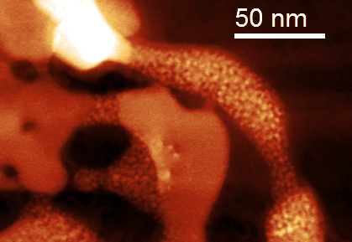
In-situ X-ray Imaging on SEI at 5 nm
Grand Challenge of Nanoscale X-ray Imaging:
Determine the reduction (lithiation) mechanism, its origin and propagation path
HXN beamline
Under in-situ or in-operando conditions
~5 nm resolution
Map out heterogeneous SEI structure/ chemistry
- fluorescence (composition)
- transmission/scattering (morphology)
- diffraction (crystalline phases)
- spectroscopy (oxidation state of metal species)
Visualize Li intercalation
- by measuring lattice distortion using diffraction
Li intercalation in NiO, TEM image
27

Slide 28
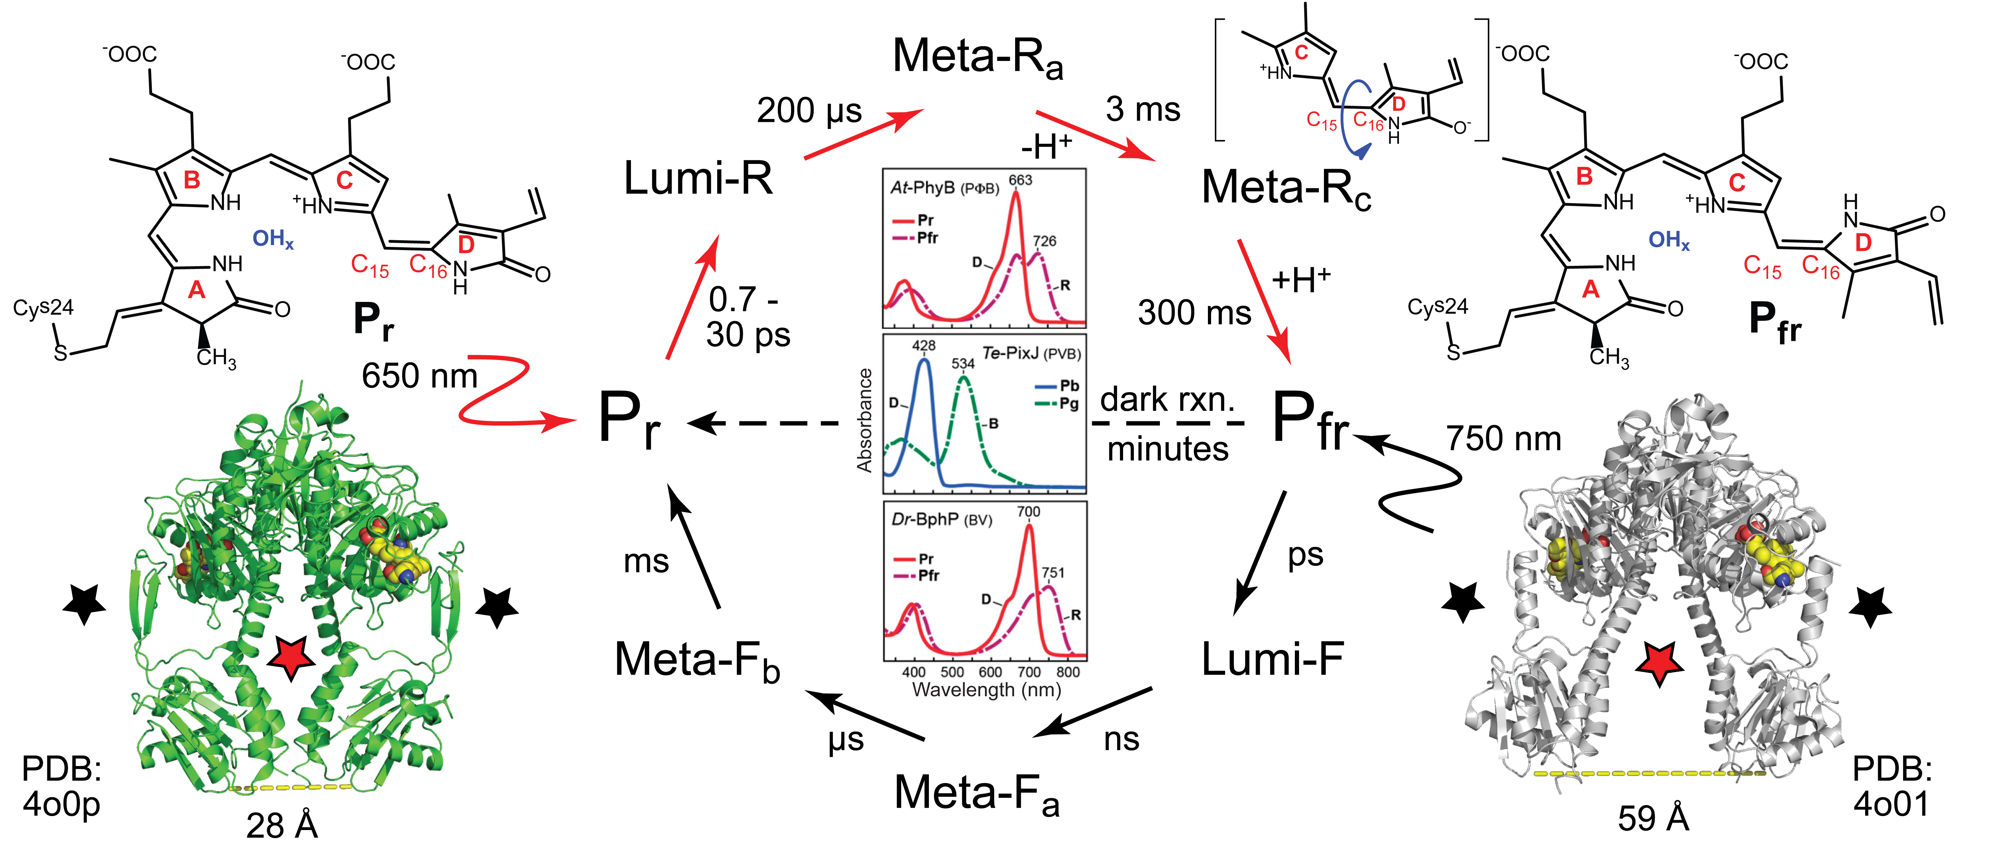
Proteins are mobile not static
Protein function often requires dynamical rearrangement of the protein domains, but measuring the dynamics of functional states requires micro-second diffraction capacity.
FMX beamline
NSLS-II will be the only synchrotron source capable of delivering sufficient flux (density) to make micro-second serial diffraction experiments possible from nano-crystals..
Light perception is essential for the survival and adaptation of nearly all cellular organisms. Phytochromes (Phy) evolved to sense light and initiate signaling via a large conformational change

Slide 29

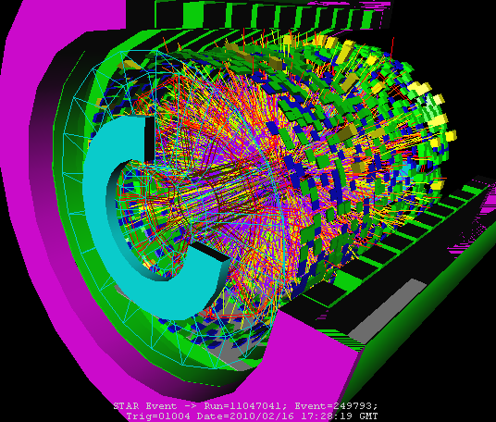



Center for Data Driven Discovery (C3D)
BNL initiative to create a new center for data storage and analysis
$15 M of seed money from NYS
Center will house analysis scientists, compute power and storage
Share and leverage infrastructure and expertise with HEP and NP (RHIC – Atlas Computing Facility) for large data sets and remote access
NSLS-II and CFN users will be able to spend time there to learn analysis software and begin their data analysis, working with analysis scientists
Heterogeneous data sets. Combining data from multiple experiments (including photons and electrons) to obtain a complete picture

Slide 30
Conclusion
We have a fabulous machine up and running - and its performing beautifully
Commissioning of project beamlines is proceeding well, early data looks extraordinary.
First users have arrived. First paper accepted!
Beamline construction continues apace.
Transition to operations has begun. Our challenge is to see it through and construct a thriving, robust user science program at the most advanced synchrotron in the world.
Its going to be an exciting decade ahead!

Slide 31
Back Up Slides

Slide 32

Reduction of Beam Emittance by Adding Radiation Sources
DW : 6 DW100
NSLS-II Project ID: 6 DW, 2 IVU20, IVU21,
IVU22, EPU49
ABBIX : 2 IVU21, IVU23
NEXT : EPU57, 2 IVU23, EPU57/105
NxtGen : 5 x 3PW
Partners : X25, U24, EPU60
SCW : 4.2 tesla peak, 1m length (HEX)
Full built-out : 10 IVU20 (add’l)

