Slide 1
Comments from the Office of Science
BESAC
27 February 2014
Patricia M. Dehmer Acting Director, Office of Science
U.S. Department of Energy

Slide 2
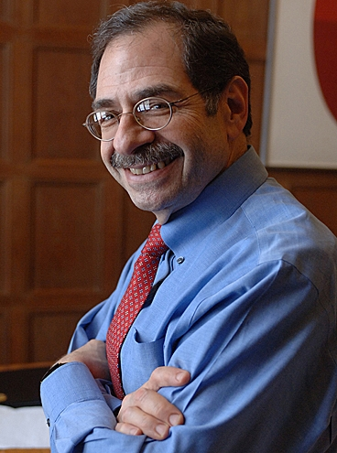
Professor Marc Kastner – Nominee for SC-1
Professor Marc Kastner is the dean of MIT’s School of Science and the Donner Professor of Physics. He has been on the MIT faculty since 1973 and has led MIT’s Department of Physics and its Center for Materials Science and Engineering. MIT’s School of Science, which Kastner has led since 2007, includes the departments of Biology; Brain and Cognitive Sciences; Chemistry; Earth, Atmospheric and Planetary Sciences; Mathematics; and Physics. The school is home to approximately 300 faculty, 1,200 graduate students, and 1,000 undergraduate majors. Kastner’s early research focused on the electronic and optical properties of amorphous semiconductors. In 1990, his research group fabricated the first semiconductor single-electron transistor; his group continues to use these devices as tools to study the quantum mechanical behavior of electrons confined to nanometer dimensions. Kastner is a member of the NAS and American Academy of Arts and Sciences, and a fellow of the AAAS and the APS. He received a B.S. in chemistry, an M.S. in physics, and a Ph.D. in physics from the University of Chicago.
Professor Marc Kastner
2

Slide 3
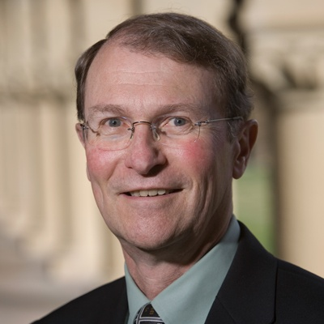
Professor Lynn Orr – Nominee for S-4
Professor Franklin "Lynn" Orr has served as director of the Precourt Institute for Energy at Stanford University since 2009.
The $100 million Precourt Institute, founded by primary donors Jay Precourt and the husband-and-wife team of Thomas Steyer and Kat Taylor, draws talent from across the campus and around the world to develop sustainable energy solutions and search for ways to reduce atmospheric levels of carbon. The Precourt Institute and the TomKat Center for Sustainable Energy foster Stanford-wide, interdisciplinary research combining science and technology research with research on energy economics, policy, finance and the behavior of energy consumers. Prior to leading the Precourt Institute, Orr served as the founding director of the Global Climate and Energy Project at Stanford from 2002 to 2008.
Since 1985, Orr has been an associate professor and professor in Stanford's Department of Energy Resources Engineering (formerly the Department of Petroleum Engineering). He was dean of the School of Earth Sciences at Stanford from 1994 to 2002 and chairman of the Department of Petroleum Engineering from 1991 to 1994. Orr held several other research positions from 1970 to 1985 in New Mexico, Texas and Washington, D.C. He received his BS degree from Stanford University and PhD from the University of Minnesota.
Professor Lynn Orr
3

Slide 4
Outline
Reflections on prioritization of science and scientific facilities
Reflections on the impact of the BESAC Report on “Future X-Ray Light Sources”
Full funding of financial assistance awards <$1M
Administration consolidation of STEM activities across federal agencies
4

Slide 5
SC’s Scientific User Facilities

Slide 6
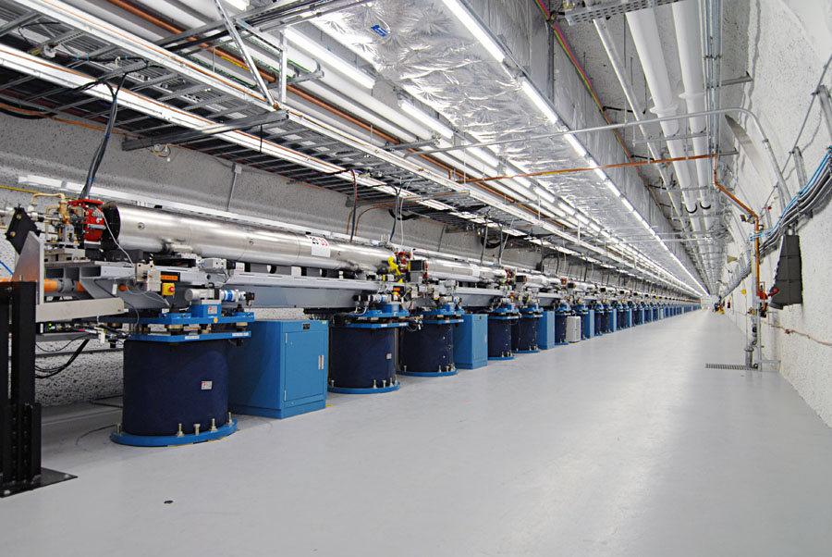
Office of Science
Support for Researchers
Supports about 22,000 Ph.D. scientists, graduate students, undergraduates, engineers, and support staff at more than 300 institutions.
Provides 47% of Federal support of basic research in the physical sciences and key components of the Nation’s basic research in biology and computing.
Supports research that led to over 100 Nobel Prizes during the past 6 decades—more than 20 in the past 10 years.
Support for Scientific User Facillities
Provides the world’s largest collection of scientific user facilities to nearly 28,000 users each year.

Slide 7
Distribution of Users at the ~30 SC Facilities 2013 Nearly ¾ of users do their work at ASCR or BES facilities
Alcator
Basic Energy Sciences
Advanced Scientific
Research Computing
High Energy Physics
Nuclear Physics
Biological & Environmental
Research
Fusion Energy Sciences
ARM
DIII-D
JGI
SSRL
EMSL
FES
ALS
ATLAS
Bio & Enviro
Facilities
TJNAF
RHIC
Nuclear physics
facilities
B-Factory
APS
Light Sources
Tevatron
High energy physics facilities
ALCF
OLCF
NSLS
Computing
Facilities
Neutron Sources
Nano
Centers
LCLS
HFIR
Lujan
Does not include LHC; HEP supports about 1,700 scientists, technicians, and engineers at the LHC.
SNS
NERSC
NSRCs

Slide 8
Distribution of Users at the SC Facilities 2007
Mouse House
Alcator
Basic Energy Sciences
Advanced Scientific
Research Computing
High Energy Physics
Nuclear Physics
Biological & Environmental
Research
Fusion Energy Sciences
DIII-D
NSTX
FACE
SSRL
PGF
ARM
EMSL
FES
ALS
Bio & Enviro
Facilities
ATLAS
HRIBF
TJNAF
Nuclear physics
facilities
Light Sources
APS
RHIC
High energy physics facilities
B-Factory
Computing
Facilities
Tevatron
NSLS
ALCF
IPNS
OLCF
CRF
HFIR
Lujan
NERSC
SNS

Slide 9
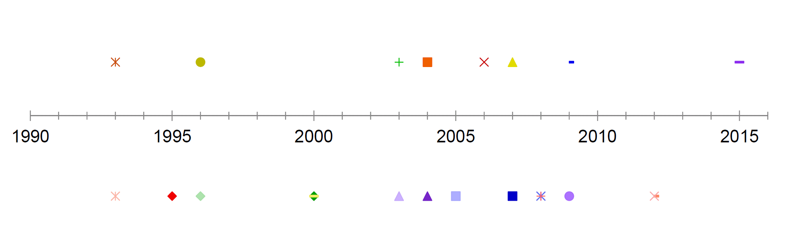
A Summary of Terminated and New Major Facilities 1990-2015
Basic Energy Sciences
Advanced Scientific
Research Computing
High Energy Physics
Nuclear Physics
Biological & Environmental
Research
Fusion Energy Sciences
Nat. Sph. Tok. Exp. (PPPL)
Contributions LHC (CERN)
5 Nanoscale Science Research Centers (ANL, BNL, LBNL, ORNL, SNL & LANL)
Joint Genome Inst. (LNBL)
Env. Mol. Sci. Lab (PNNL)
Spallation Neutron Source (ORNL)
Continuous Electron Beam Acc. Fac. (TJNAF)
Leadership Computing Facility (ORNL)
National Synchrotron Light Source-II (BNL)
Advanced Photon Source (ANL)
Stanford Synchrotron Rad. Lightsource (SLAC)
Leadership Computing Facility (ANL)
NUMI Off-Axis Neutrino Appearance (FNAL)
Advanced Light Source (LBNL)
B Factory (SLAC)
Relativistic Heavy Ion Collider (BNL)
NUMI-MINOS (FNAL)
Linac Coherent Light Source (SLAC)
Daya Bay (China)
New facilities
Terminated facilities (Does not include facilities that were proposed but never started, e.g. BTeV, ILC, )
Alternate Gradient Synchrotron (BNL)
Bevalac (LBNL)
LAMPF (LANL)
Bates Lab (MIT)
B Factory (SLAC)
High Flux Beam Reactor (BNL)
Intense Pulsed Neutron Source (ANL)
Tokamak Fusion Test Reactor (PPPL)
National Compact Stellerator Exp (PPPL)
88-inch Cyclotron (LBNL)
Tevatron Collider (FNAL)
Superconducting Supercollider (Texas)
Radiochemical Eng&Dev.Cntr (ORNL)
Mouse House (ORNL)
Holifield Radioactive Ion Beam Facility (ORNL)
Advanced Neutron Source (ORNL)
Alcator C-Mod (MIT)
Free Air CO₂ Exp (ORNL)

Slide 10
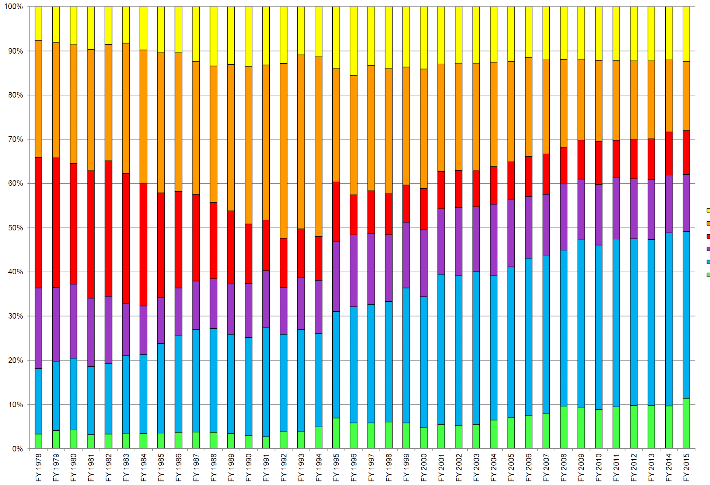
Major SC Program Funding (% of total) FY 1978-2014
NP
HEP
FES
BER
BES
ASCR

Slide 11
Some User Demographics for the Light Sources

Slide 12
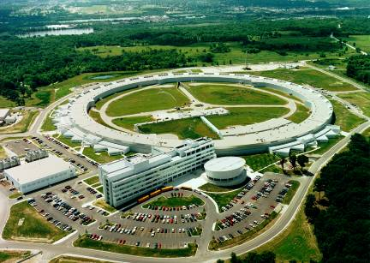
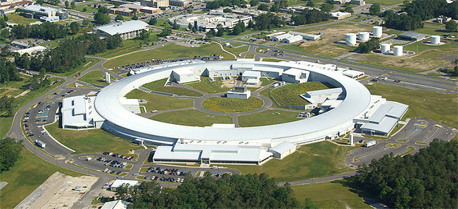
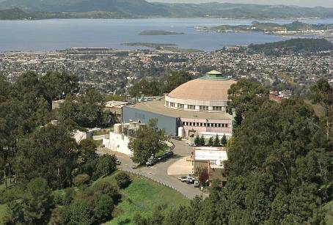
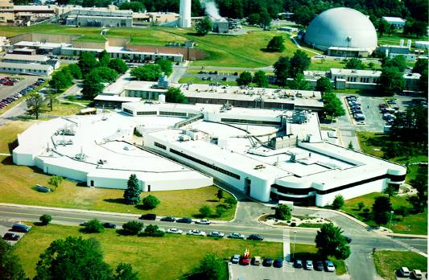
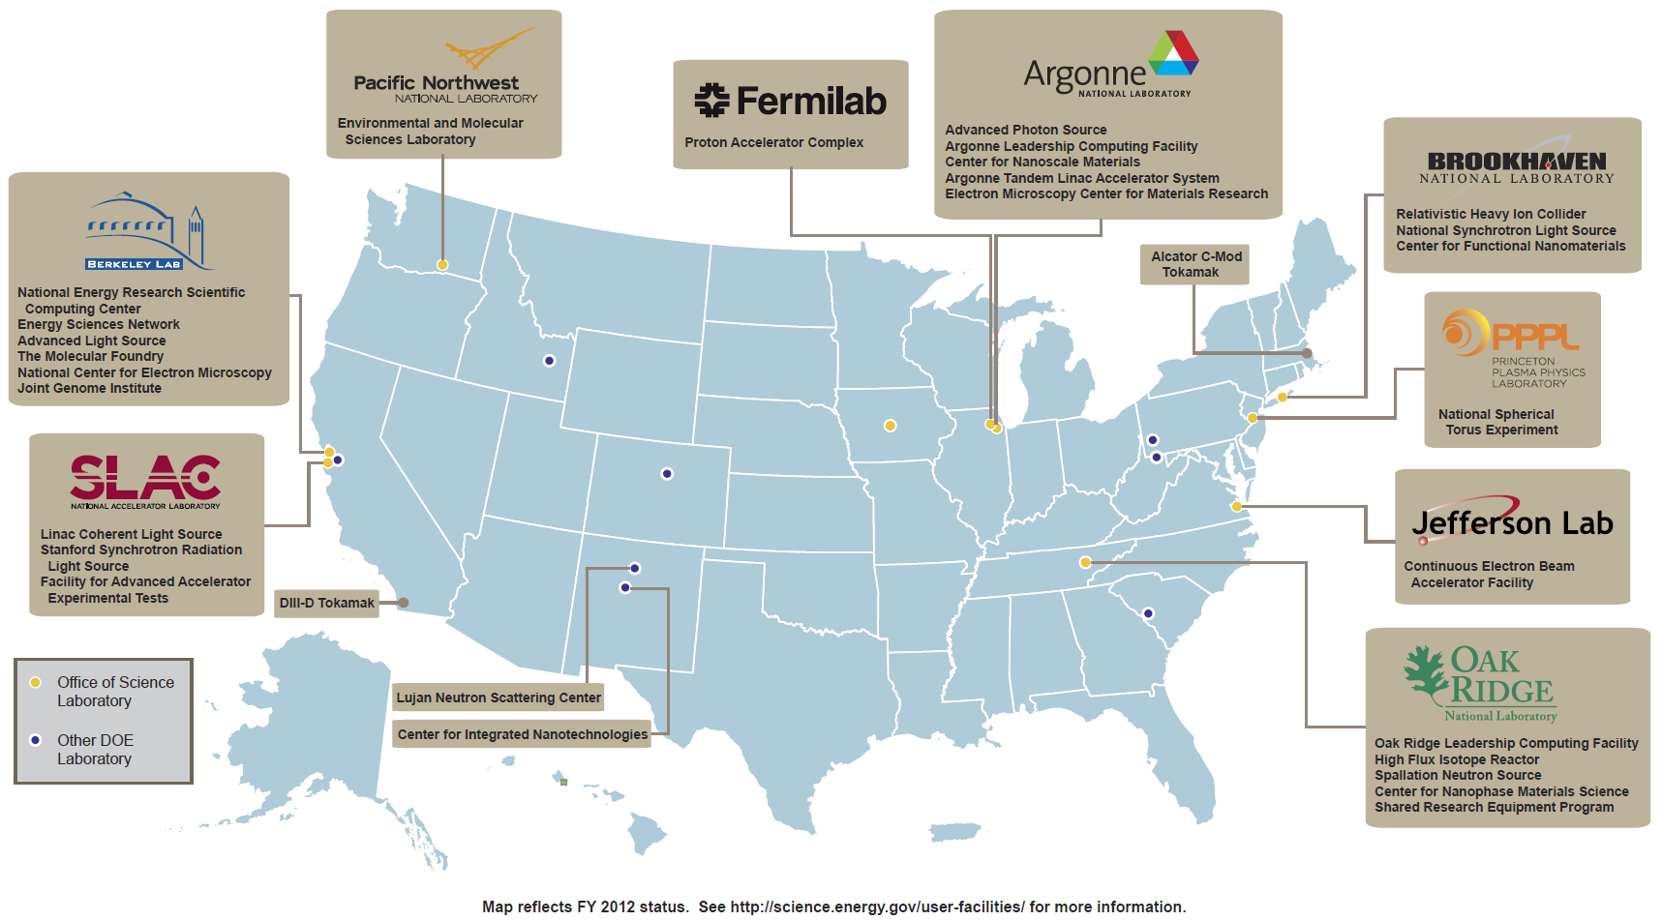
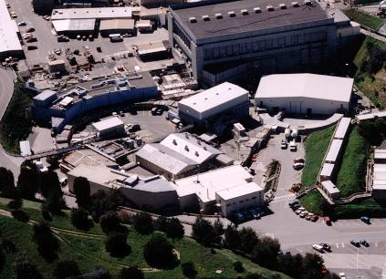
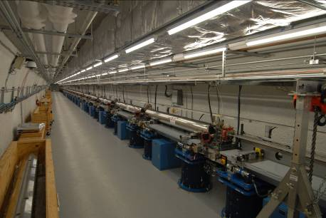
APS 1996
NSLS-II 2014
ALS 1993
NSLS 1982
SSRL 1974&2004
LCLS 2009

Slide 13
Users by Facility at the Light Sources
SSRL 1974 & 2004
NSLS 1982
LCLS 2009
ALS 1993
APS 1996

Slide 14
Users by Discipline at the Light Sources
Number of Users
14

Slide 15
Users by Employer at the Light Sources

Slide 16
Other Demographics of Users at Light Sources for FY 2013
33% | First-Time Users
28% | Female
 | Citizenship
50% | United States
29% | Foreign, Non-Sensitive Countries
21% | Foreign, Sensitive Countries
 | Nature of Research
97% | Nonproprietary research only
1% | Nonproprietary & proprietary research
2% | Proprietary research only
16

Slide 17
Technical Quality of 171 Operating Beamlines at the 4 BES Light Sources circa 2005
10
30
21
45
65
1.0 = optimal performance
0.8 = minor upgrade required
0.6 = moderate upgrade required
0.4 = major upgrade required
0.2 = marginally useful
Beamlines were rated according to a quality factor by light source senior staff; the assignments were vetted by a “normalization” team of senior technical staff from each of the light sources. The data show that only 18 percent of the beamlines were operating at optimal performance. An equal number required major upgrades or were marginally useful. The majority of beamlines, 64 percent, required minor or moderate upgrades. Across the four facilities, 46 beamlines (27 percent) were rated as "Best in Class" as bench-marked against similar capabilities worldwide.
17

Slide 18
Facilities for the Future of Science: A 20-year Outlook
(November 2003)

Slide 19
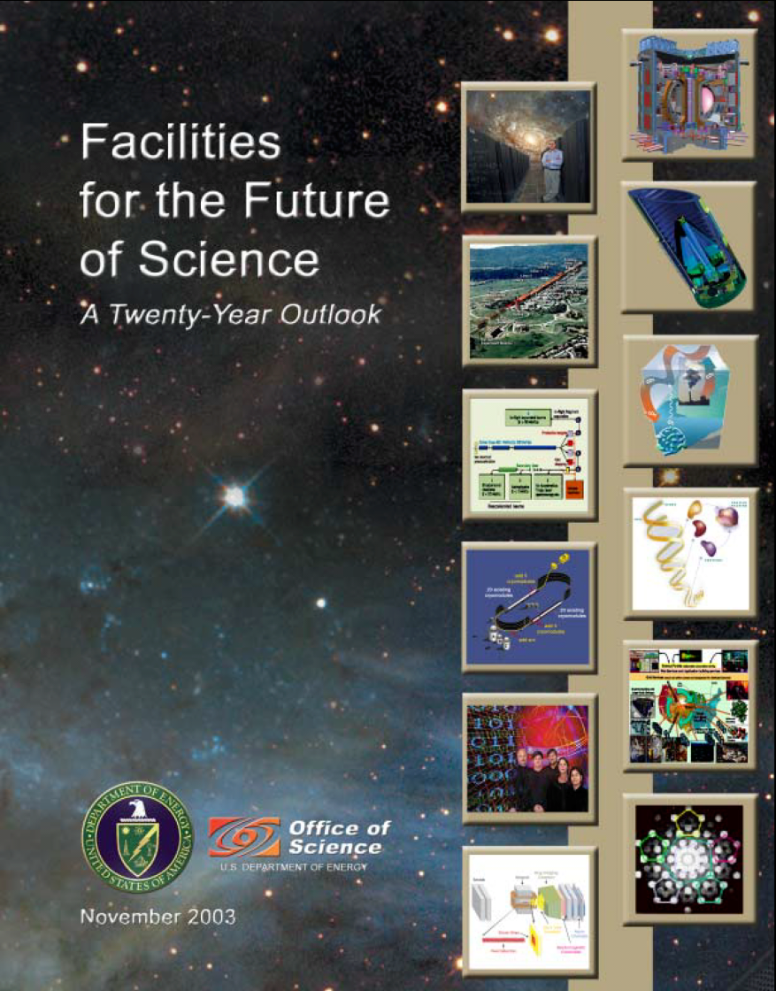
Facilities for the Future of Science (2003)
Paraphrasing FFS, “Today, the Department of Energy is building the Spallation Neutron Source, the last large-scale SC user facility under construction. And that raises the question that Facilities for the Future of Science: A Twenty-Year Outlook addresses: What facilities are needed next for scientific discovery?”
Funding envelopes were constructed from the “Biggert Bill” authorization levels for SC for FY 2004 through FY 2008 (replaced later by H.R. 6 and S. 14) and then a four percent increase in authorization level each following year until 2023.
H.R. 34, the "Energy and Science Research Investment Act of 2003,” aka the Biggert Bill, authorized an increase in funding for SC of ~60% from FY 2004 through FY 2007. The bill called for an increase of ~8% for FY 2004 followed by increases of 11%, 15%, and 15% in the following three years. The FY 2007 authorization level would have been $5.31 B.

Slide 20
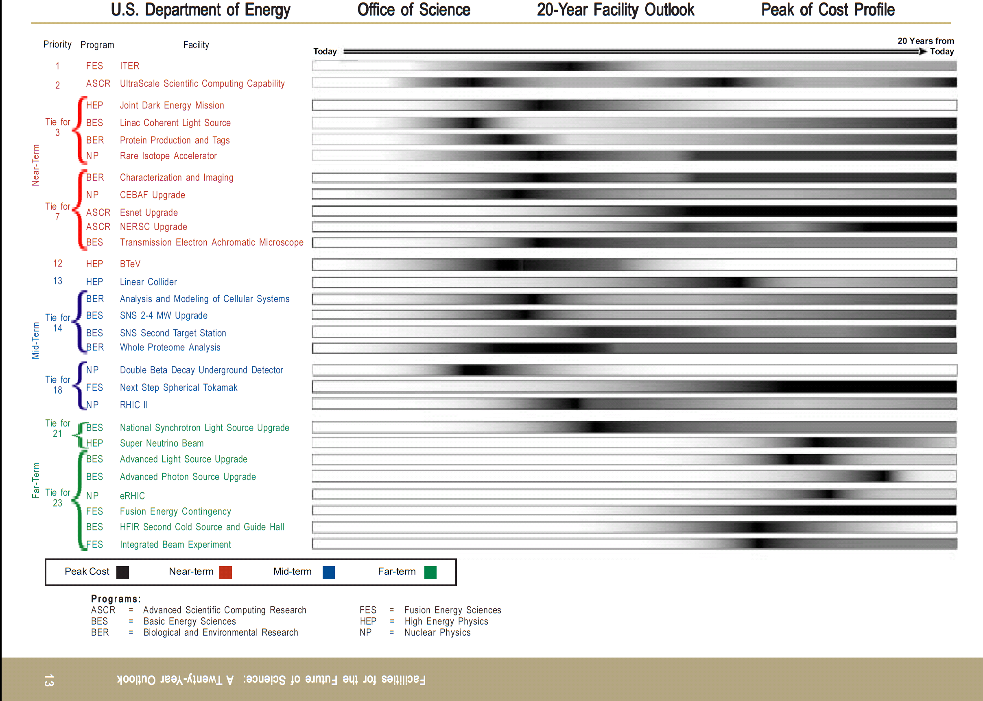
February 2014
We are here.
20
Published November 2003

Slide 21
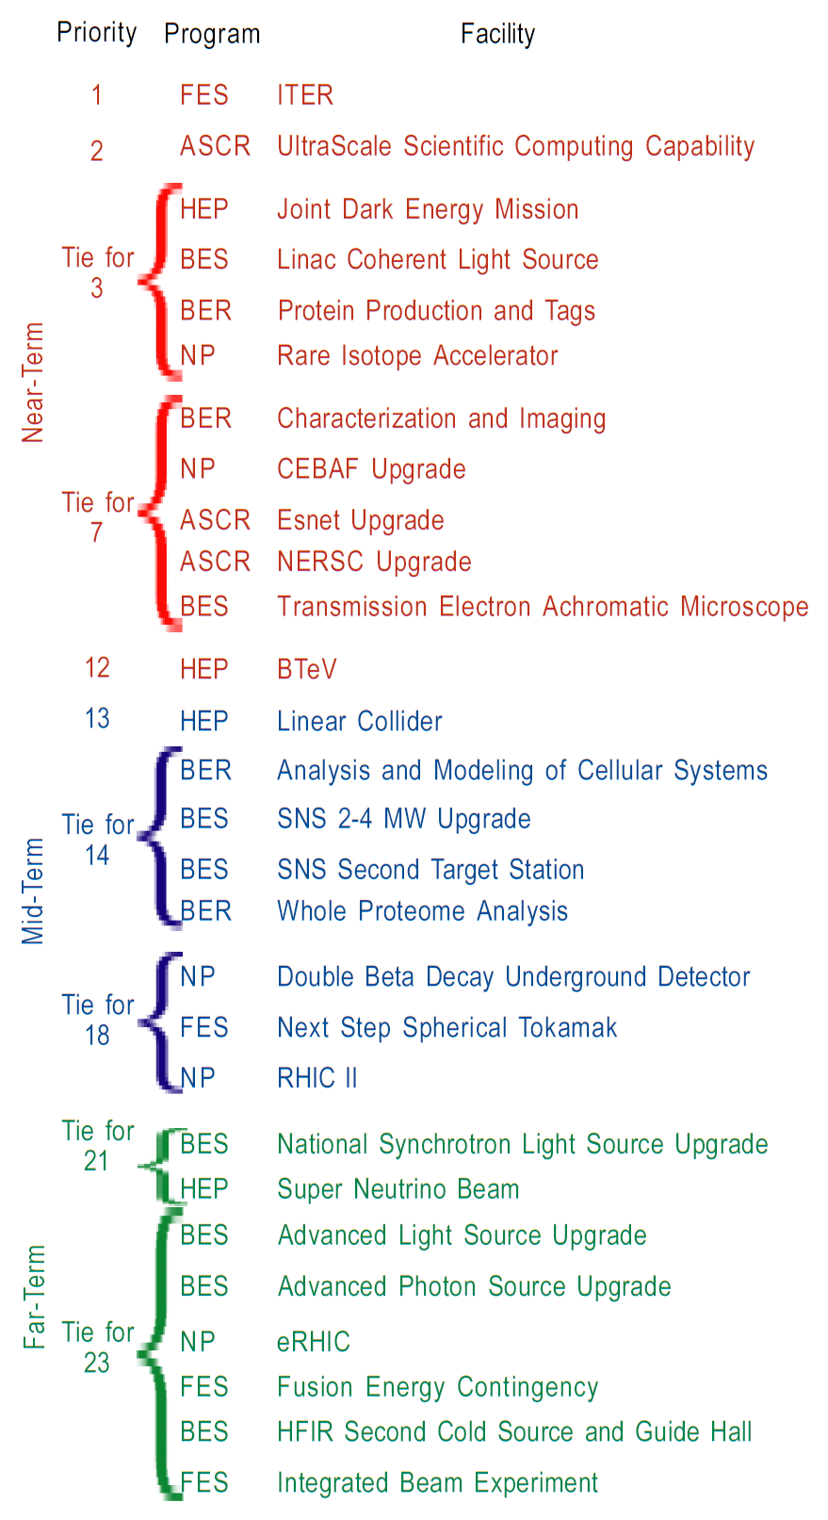
…..…………………………………Yes; ITER is underway
……Yes; ANL and ORNL LCFs complete and are already upgraded
………………No; terminated
…….…...……Yes; complete, in upgrade
………………No; replaced with BRCs, which are not user facilities
………………Yes; replaced with less expensive FRIB, in construction
………………No; replaced with BRCs, which are not user facilities
………………Yes; upgrade in progress
………………Yes; complete
………………Yes; complete
...Yes; complete
………………No; terminated
………………No; terminated
……No; replaced with BRCs, which are not user facilities
………………No; power upgrade will be included in 2nd Target Station
………………No; past CD-0 but cost precludes near-term start
………………No; replaced with BRCs, which are not user facilities
..…Partially; Majorana demonstrator operating, but not yet full exp.
………………No, NSTX upgrade was pursued following NCSX termination due to cost overruns
…….………………………… Yes, luminosity upgrade complete at a fraction of the cost & within operating budget
…Yes, NSLS-II will commission in FY 2014
…………Partially; NOνA is near complete, but not yet LBNE
…………No
…………Partially; APS-U has R&D funding
…….…………………………No
………………No
……No
21
…………No

Slide 22
“Prioritization of Scientific Facilities to Ensure Optimal Benefit from Federal Investments”
(October 2013)

Slide 23
FY2012-2013 SC Priority Goal
From OMB to DOE/SC
Prioritization of scientific facilities to ensure optimal benefit from Federal investments. By September 30, 2013, formulate a 10-year prioritization of scientific facilities across the Office of Science based on (1) the ability of the facility to contribute to world-leading science, (2) the readiness of the facility for construction, and (3) an estimated construction and operations cost of the facility.
23

Slide 24
Steps in Addressing the Priority Goal
Funding levels allowed the SC Associate Directors some flexibility but did not permit the growth seen in the Biggert Bill. It is recognized that even COL growth may be optimistic.
The ADs prepared draft lists of facilities needed for scientific leadership in their programs to 2024. In general, upgrades or new facilities were >$100M.
Lists were submitted to the respective Federal Advisory Committees, which could add facilities at their discretion. They were asked to rate each facility on:
The ability of the facility to contribute to world-leading science in one of these categories: Absolutely Central; Important ; Lower priority; or Don’t know enough yet
The readiness of the facility for construction in one of these categories: Ready to initiate construction; Scientific/engineering challenges to resolve before initiating construction; or Mission and technical requirements not yet fully defined
Facilities were grouped in bins, but they were not numerically ranked.
This activity provides input to decisions on scientific priorities, i.e., it provides the financial impacts resulting from facility needs for the disciplines supported by SC.

Slide 25
Impacts of a Recent FACA (BESAC) Study

Slide 26
BESAC Report on “Future X-Ray Light Sources” and the DOE Actions
Snippets from:
Patricia Dehmer Acting Director, Office of Science
Harriet Kung
Director, Office of Basic Energy Sciences
Jim Murphy
Director, BES Scientific User Facility Division

Slide 27
Charge to BESAC on X-ray Light Sources
On January 2, 2013, Bill Brinkman, then the Director of the Office of Science, issued a charge to the Basic Energy Sciences Advisory Committee (BESAC).
The charge requested:
An assessment of the grand science challenges that could best be explored with current and possible future SC light sources.
An evaluation of the effectiveness of the present SC light source portfolio to meet these grand science challenges.
An enumeration of future light source performance specifications that would maximize the impact on grand science challenges.
Prioritized recommendations on which future light source concepts and the technology behind them are best suited to achieve these performance specifications.
Identification of prioritized research and development initiatives to accelerate the realization of these future light source facilities in a cost effective manner.
John Hemminger, the Chair of BESAC, served as Chair of a 22 member Subcommittee, which used previous BESAC and BES reports and new input from the x-ray sciences communities to formulate findings and recommendations.
The final report was accepted by BESAC on July 25, 2013.

Slide 28
BESAC – Findings
At the present time, the U.S. enjoys a significant leadership role in the x-ray light source community. This is a direct result of the successes of the major facilities managed by BES for the U.S. This leadership position is due to the science successes of the storage ring facilities and the particularly stunning success of the first hard x-ray free electron laser, the Linac Coherent Light Source (LCLS). However, it is abundantly clear that international activity in the construction of new diffraction limited* storage rings and new free electron laser facilities will seriously challenge U.S. leadership in the decades to come.
The U.S. will no longer hold a leadership role in such facilities unless new unique facilities are developed as recommended by the BESAC facilities prioritization report.
* To upgrade an existing storage ring to one that is diffraction limited will require the replacement of the entire lattice to greatly reduce the electron source size and angular divergence in order to maximize the x-ray beam brightness.

Slide 29
BESAC – Recommendations
For free electron lasers: In spite of the present intensely competitive environment, an exciting window of opportunity exists for the U.S. to provide a revolutionary advance in x-ray science by developing and constructing an unprecedented x-ray light source. This new light source should provide high repetition rate, ultra-bright, transform limited, femtosecond x-ray pulses over a broad photon energy range with full spatial and temporal coherence. Stability and precision timing will be critical characteristics of the new light source.
The best approach for a light source would be a linac-based, seeded, free electron laser.
The linac should feed multiple, independently tunable undulators each of which could service multiple endstations.
The new light source must have pulse characteristics and high repetition rate to carry out a broad range of “pump probe” experiments, in addition to a sufficiently broad photon energy range (~0.2 keV to ~5.0 keV).
For storage rings: At best the present plans for upgrades of U.S. storage rings will leave the U.S. behind the international community in this area of x-ray science. BES should ensure that U.S. storage ring x-ray sources reclaim their world leadership position. This will require a careful evaluation of present upgrade plans to determine paths forward that will guarantee that U.S. facilities remain at the cutting edge of x-ray storage ring science.

Slide 30
SC/BES Response to BESAC Recommendations
Project | Project prior to BESAC report | Project after BESAC report
Linac Coherent Light Source II (LCLS-II) SLAC | Incorporate an additional 1 km of the existing 3 km linac; add a new electron injector and 2 new undulators. Major construction required for a new tunnel and experimental hall. Status: Completed CD-0 and CD-1. CD-2 on hold pending BESAC recommendations. TPC = approx. $400M + instruments. | SC directed SLAC to consider incorporating the BESAC recommendations into the LCLS-II project. SLAC proposed a modified LCLS-II: use 1 km of the existing 3 km linac tunnel to add a new 4 GeV superconducting linac; add a new electron injector; and 2 new undulators to produce the world leading high rep rate FEL in the 0.2-5 keV photon energy range. No construction required; no new instruments required. Cost = very approx. $900M.
Advanced Photon Source Upgrade (APS-U) ANL | Upgrade of >20 beamlines; addition of new insertion devices; generation of 2 picosecond x-ray pulses; 50% increase in ring current. Status: Completed CD-0 and CD-1. CD-2 on hold pending BESAC recommendations. TPC = approx. $400M. | SC directed ANL to consider incorporating diffraction limited storage ring technology into APS-U. ANL proposed a multi-bend achromat lattice in the existing tunnel; a doubling of the ring current; new insertion devices & beamlines that will boost the ring brightness by 10²-10³ to position APS as the world’s brightest hard x-ray storage ring. Cost = very approx. $550M.
Next Generation Light Source (NGLS) LBNL | High rep rate soft x-ray free electron laser facility based on a superconducting linac and 3 undulators. Status: Completed CD-0. Further CDs on hold pending BESAC recommendations. TPC range = $0.9-1.5B. | SC directed LBNL to consider whether NGLS could be modified at reasonable cost to include an expanded energy range. After consideration, LBNL terminated the NGLS project.

Slide 31
Full Funding of Financial Assistance Awards <$1Million

Slide 32
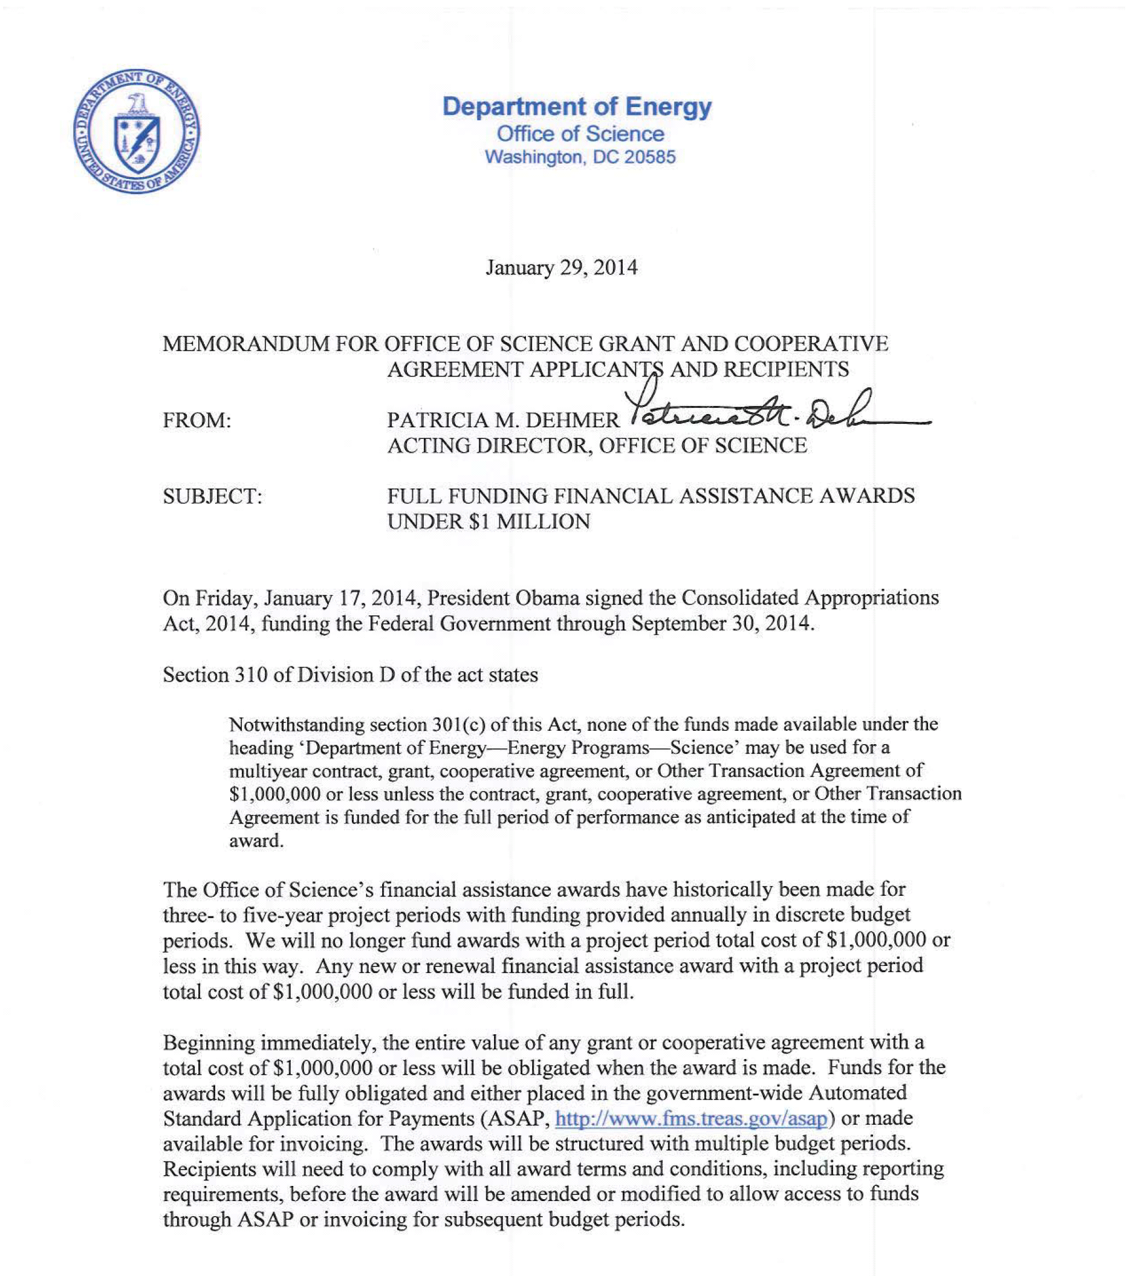
http://science.energy.gov/~/media/grants/pdf/FullFundingMemo.pdf

Slide 33
Administration consolidation of STEM activities across federal agencies

Slide 34
DOE Programs Terminated in the FY 2014 President’s Budget Request
Computational Sciences Graduate Fellowship (SC/ASCR)
Summer School in Nuclear Chemistry and Radiochemistry (SC/BES-NP)
Global Change Education Program (SC-BER) (phasing out)
QuarkNet (SC-HEP)
National Undergraduate Fellowship Program in Plasma Physics and Fusion Energy Sciences (SC-FES) (phasing out)
Plasma/Fusion Science Educator Programs (SC-FES) (phasing out)
Graduate Automotive Technology Education (EERE)
Wind for Schools (EERE)
Nuclear Scholarships/Integrated University Partnerships (NE)

