Slide 1
Office of Science Update
25 July 2013
Patricia M. Dehmer Acting Director
Office of Science, U.S. Department of Energy
http://science.energy.gov/sc-2/presentations-and-testimony/
Notes:
WDTS dates from FY 2004.
Prior to that time, the core activities (SULI, NSB, and Einstein Fellows) were budgeted in SCPD. Prior to inclusion in SCPD, the workforce activities were in ER except for a small period when DOE apparently attempted to create a new office. But Congress objected in FY 1996. “In fiscal year 1996, these activities are to be managed by the Office of Energy Research as they were from 1977 to 1993.”

Slide 2
Update on Office of Science
DOE Organization &
Who’s in Place/Who’s Not
Priority Goal
BESAC & BES

Slide 3
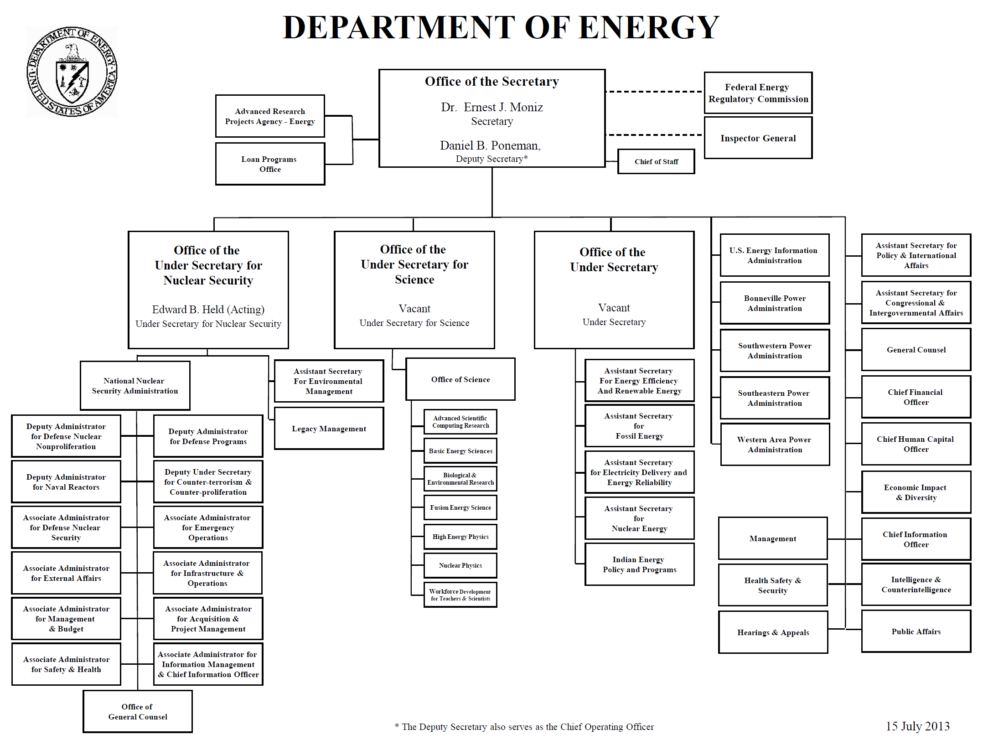

Slide 4
Restructuring the Under Secretary Positions
The current position of Under Secretary for Science is expanded to encompass both science and energy. The resulting Office of the Under Secretary for Science and Energy will manage:
Office of Science (SC)
Office of Fossil Energy (FE)
Office of Energy Efficiency and Renewable Energy (EERE)
Office of Nuclear Energy (NE)
Office of Electricity Delivery and Energy Reliability (OE)
Office of Indian Energy (IE)
Office of Technology Transfer Coordinator
A new Office of the Under Secretary for Management and Performance will manage:
Office of Management and Administration (MA)
Office of Chief Human Capital Officer (HC)
Office of Chief Information Officer (CIO)
Office of Economic Impact and Diversity (ED)
Office of Hearings and Appeals (OHA)
Office of Environmental Management (EM)
Office of Legacy Management (LM)

Slide 5
More on DOE Restructuring
Reactivating and restructuring the Secretary of Energy Advisory Board (SEAB), with SEAB having four standing sub-committees to address each of the major Departmental mission areas.
A new organizational unit, the National Laboratory Operations Board will report to the Office of the Under Secretary for Management and Performance.
New Secretarial Councils:
An Energy Council
A National Laboratory Policy Council
A revised Credit Review Board
A Cyber Security Council

Slide 6
Office of the Under Secretary for Management and Performance

Slide 7
FY 2012-2013 SC Priority Goal
Prioritization of scientific facilities to ensure optimal benefit from Federal investments. By September 30, 2013, formulate a 10-year prioritization of scientific facilities across the Office of Science based on (1) the ability of the facility to contribute to world-leading science, (2) the readiness of the facility for construction, and (3) an estimated construction and operations cost of the facility.
The charge letter from Bill Brinkman to all FACAs is on all Advisory Committee websites, e.g., http://science.energy.gov/~/media/bes/besac/pdf/2012-1220-brinkman-to-advisorycommittees.pdf
7

Slide 8
Recall: “Facilities for the Future of Science”
Plan 2003; Update 2007
Download here
8

Slide 9
What is the role of BESAC and the other Federal Advisory Committees?

Slide 10
A Few of the Other FACA and Non-FACA Charges/Workshops
All FACAs are addressing the SC Priority Goal. In addition,
ASCR
ASCAC and non-ASCAC on data intensive science and HPC
BES
BESAC on next-gen photon sources
BER
BERAC on long-term vision and follow on studies
FES
FESAC on magnetic fusion energy priorities; opportunities for international collaborations
HEP
“Snowmass” and, after that, P5/HEPAP (P5=Particle Physics Project Prioritization Panel)
NP
NSAC on implementation of the 2007 Long Range Plan

Slide 11
BES Facilities Construction ~30 Years

