Slide 1
Committee of Visitors Review of EFRC/Hub
Update for BESAC
March 1, 2013
Harriet Kung

Slide 2
History of COVs in SC/BES
The very first COV in SC was the review of the chemical sciences portion of the CSGB division in 2002.
All previous COV reports and BES responses can be found at: http://www.science.doe.gov/bes/archives/COVs.html
COVs are now a standard part of BES practice. COV recommendations are taken very seriously by BES and have resulted in substantive changes.
The response to this recommendation, and similar recommendations for improved information management made by other COVs, has been the development of a new system for SC: Portfolio Analysis and Management System (PAMS).
This will be the first review of the EFRCs and the Hub (JCAP) in BES.

Slide 3
COV Charge
The Basic Energy Sciences Advisory Committee has given the panel the following charge:
(1) For the EFRCs and JCAP, assess the efficacy and quality of the processes used to:
(a) solicit, review, recommend, and document proposal actions and
(b) monitor active projects.
(2) Within the boundaries defined by DOE missions and available funding, comment on how the award process has affected:
(a) the breadth and depth of portfolio elements, and
(b) the national and international standing of the portfolio elements.
The review will be structured into the following groups:
(1) EFRC Procurement
(2) EFRC Management
(3) JCAP Procurement and Management

Slide 4
COV Details
Persis Drell, SLAC National Accelerator Laboratory, Chair.
EFRC Panel Co-Chairs:
Marc Kastner, Massachusetts Institute of Technology
Cynthia Friend, Harvard University
JCAP Panel Chair:
Michelle Buchanan, Oak Ridge National Laboratory
May 29 - 31, 2013 at DOE Germantown.
Aiming for up to 10 members for the EFRC Panel and 5 members for the JCAP Panel.

Slide 5
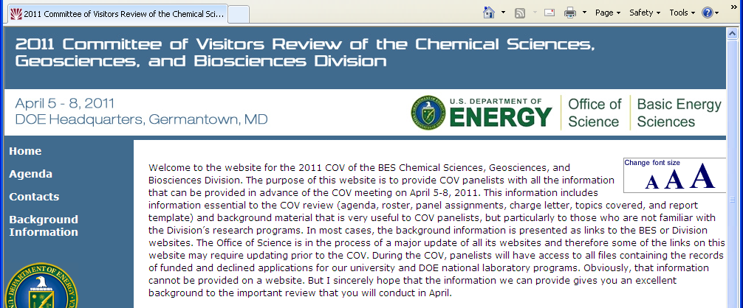
COV Preparations
Chair will visit BES on during the week of March 11, 2013
Will meet with Linda Horton (interim EFRC Lead), John Miller (acting CSGB Director), and the EFRC/JCAP Program Managers.
Will inform chair of the EFRC and JCAP programs and agenda for COV.
Conference calls – chair, panel leads/members, BES management team.
After initial COV recruitment to explain roles and responsibilities of panel leads and members.
Prior to COV (May 29) to go over agenda, discuss process, and address concerns.
COV Website:
(Under Construction)
To provide read ahead materials for COV panelists
2013 Committee of Visitors Review of the EFRC and JCAP
May 29-31, 2013
COV Website Under Construction

Slide 6
COV Agenda
Wednesday, May 29, 2013
Time |  | Activity | Participants/Lead | Location
7:50am |  | Pick-up via bus | COV Members/Kerry Gorey | Front of Hotel
8:00am | 8:50am | Check-in Germantown Facility | COV Members/BES Staff | North Lobby
8:55 am | 9:15am | Welcome and Charge to the Committee | John Hemminger, BESAC Chair | A-410
9:15 am | 9:45am | Welcome and SC-BES Overview, including EFRCs and Hubs | Harriet Kung, BES Associate Director | A-410
9:45am | 10:15am | Instructions, procedures, and schedule | Persis Drell, COV Chair | A-410
10:15am | 10:30am | Refreshment Break |  | A-410
10:30am | 11:00am | Overview of EFRCs: Procurement | Eric Rohlfing, Division Director- Chemical Sciences, Geosciences and Biosciences | A-410
11:00am | 11:30am | Overview of EFRCs: Management | Linda Horton, Materials Sciences Division Director and Interim Lead, EFRC Management Team | A-410
11:30am | 12:00pm | Overview of Fuels from Sunlight Hub: Procurement and Management | Eric Rohlfing, Division Director- Chemical Sciences, Geosciences and Biosciences | A-410
12:00pm | 1:15PM | Working Lunch: Discussion of initial questions from overviews and process Move to panel rooms | BES/COV members | A-410
Panel Breakouts 1:15pm - 5:00pm |  | EFRC Panel: Review EFRC folders | EFRC Panel Lead BES Rep: Linda Horton BES Staff: Dawn Adin, Robin Hayes, Craig Henderson, Jeff Krause, Gail McLean, Thiyaga Thiyagarajan, and John Vetrano Admin Support: Kerry Gorey | A-410
 |  | Hub Panel: Review Hub folders | Hub Panel Lead BES Rep: Eric Rohlfing BES Staff: Rich Greene Admin Support: Diane Marceau | E-301
5:00pm | 5:30pm | COV Executive Session - preliminary assessment | COV | A-410
5:30pm | 6:00pm | COV and BES Discussion - respond to questions and provide additional information | COV with BES Management | A-410
6:00pm | 6:15pm | Check-out Germantown Facility | COV Members/Kerry Gorey | North Lobby
6:30pm | 8:00pm | Dinner (optional) | BES/COV members | Carrabba's

Slide 7
COV Agenda, cont’d.
Thursday, May 30, 2013
Time |  |  |  |  | Activity |  | Participants/Lead | Location
7:50am |  |  |  |  | Pick-up via bus |  | COV Members/Kerry Gorey | Front of Hotel
8:00am | - | 8:30am |  |  | Check-in Germantown Facility |  | COV Members/BES Staff | North Lobby
Panel Breakouts, cont'd 8:30am - 12:00pm |  |  |  |  | EFRC Panel: Continued review of folders |  | As above | A-410
 |  |  |  |  | Hub Panel: Continued review of folders |  | As above | E-301
12:00pm | - | 1:00pm |  |  | Lunch in DOE Cafeteria
Second Read Panels 1:00pm - 4:00pm |  |  |  |  | EFRC Panel: Second read by Hub Panel (Some members of EFRC panel continue reading EFRC folders) |  | As above | A-410
 |  |  |  |  | Hub Panel: Second read by selected members of EFRC panel |  | As above | E-301
4:00pm | - |  | 4:30pm |  | Break and opportunity for discussion with BES representatives in both panel rooms |  | As above
4:30pm | - |  | 5:30pm |  | COV Executive Session - preliminary assessment for panel assignments |  | COV | A-410
5:30pm | - |  | 6:00pm |  | COV and BES Discussion - respond to questions |  | COV with BES Management | A-410
6:00pm | - |  | 6:15pm |  | Check-out Germantown Facility |  | COV Members/Kerry Gorey | North Lobby
 |  |  |  |  | Dinner on your own
Friday, May 31, 2013
Time |  |  |  |  |  | Activity | Participants/Lead | Location
7:50am |  |  |  |  |  | Pick-up via bus | COV Members/Kerry Gorey | Front of Hotel
8:00am |  | - |  | 8:30am |  | Check-in Germantown Facility | COV/BES Staff | North Lobby
8:30am |  | - |  | 10:30am |  | Breakout Panels - Writing of Report | COV | A-410
10:30am |  | - |  | 11:15am |  | COV Executive Session | COV / BES Management | A-410
11:15am |  | - |  | 12:00pm |  | Closeout Session | COV / BES Staff | A-410
12:00pm |  |  |  |  |  | Adjourn - Thank You!

