Slide 1
“Science Serving the Nation”
Basic Energy Sciences Advisory Committee Meeting
July 27, 2012
Linda L. Horton
Director; Materials Sciences and Engineering Division
Office of Basic Energy Sciences

Slide 2
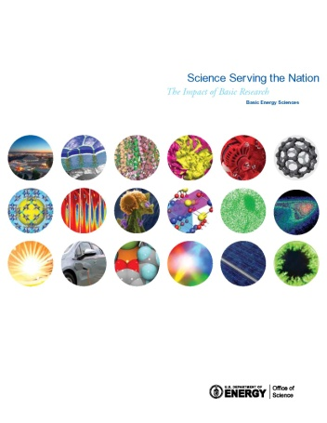
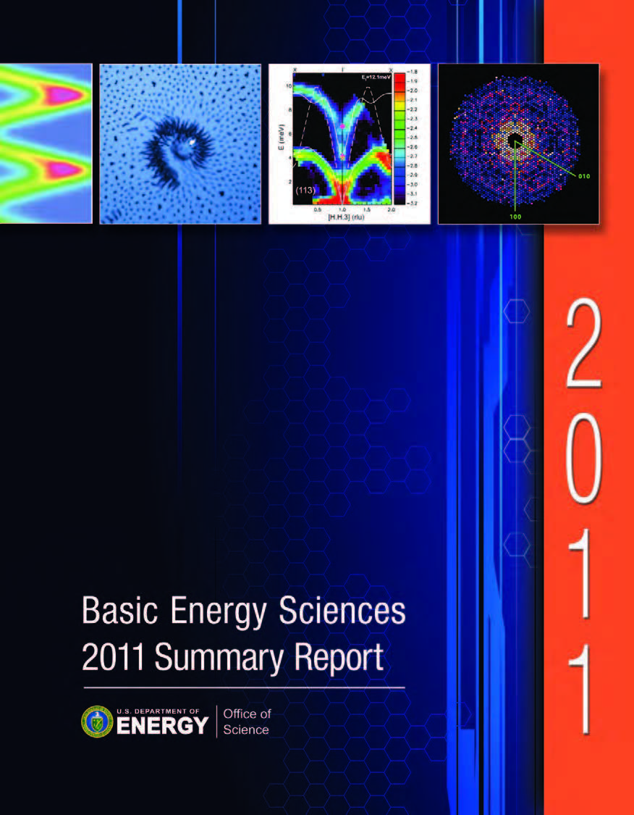
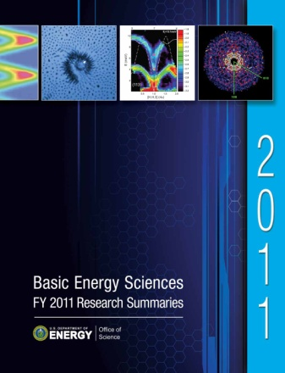
BES Publications for Improved Communication
Science Serving the Nation (brochure)
  http://science.energy.gov/~/media/bes/pdf/brochures/files/BES_SSN.pdf
  Brief vignettes describing the impact of BES funded research on scientific innovation and its impact on end-use technology
BES 2011 Summary Report
  http://science.energy.gov/~/media/bes/pdf/reports/files/BES2011SR_rpt.pdf
  Overview of BES
  How BES does business
  Descriptions and representative research highlights for 3 BES divisions, EFRCs, and Energy Innovation Hubs
BES FY 2011 Research Summaries
  http://science.energy.gov/~/media/bes/pdf/reports/files/bes_fy2011_research_summaries.pdf
  Summaries of more than 1300 research projects across 3 BES divisions, including senior investigators, postdocs, graduate and undergraduate students, and a brief project description

Slide 3
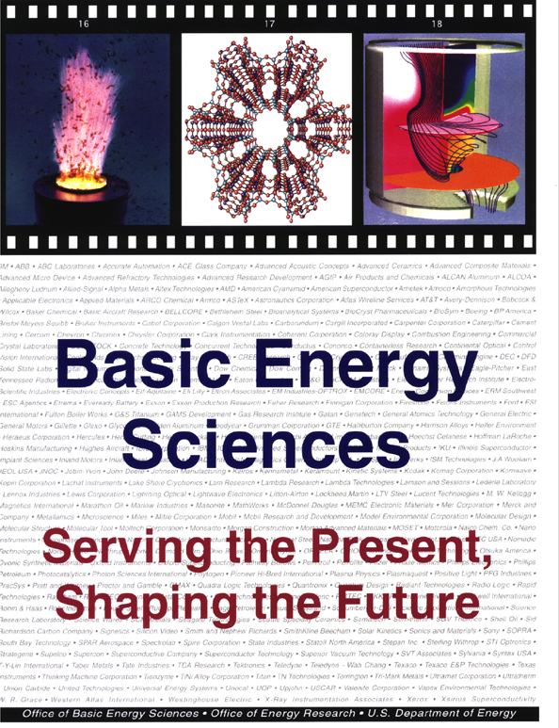
The Original Document…..
1996 report highlighted the formal and informal interactions between BES researchers and industry and featured specific success stories that demonstrated the impact of BES research investments on energy technologies.
Congressional staffers have pointed to this document as a good example of what BES should be doing to better communicate research impact.

Slide 4
Science Serving the Nation – 2012
An update to the 1996 document to include impacts over the last 15 years, with emphasis on how BES basic research has translated into technological advances.
Foundation for updating:
  Recent “success stories” from labs and grants, which will include those recently featured on SC website.
  BESAC Workshop - Science for Energy Technology:
  Strengthening the Link between Basic Research and Industry
  BRNs
Collection of additional input:
  Broad email engagement of PIs requesting input
  Formation of a “Working Group” to select highlights, consolidate input, and draft individual sections
Complement hard copy brochure with more in-depth web-based highlights – Goal: web highlights become a “living document” on the impacts of BES research

Slide 5
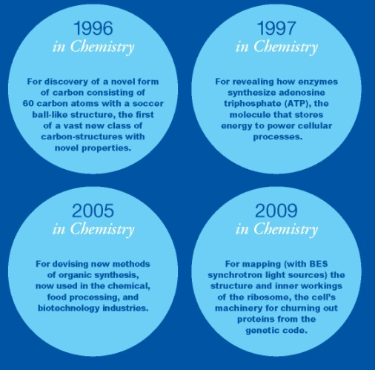
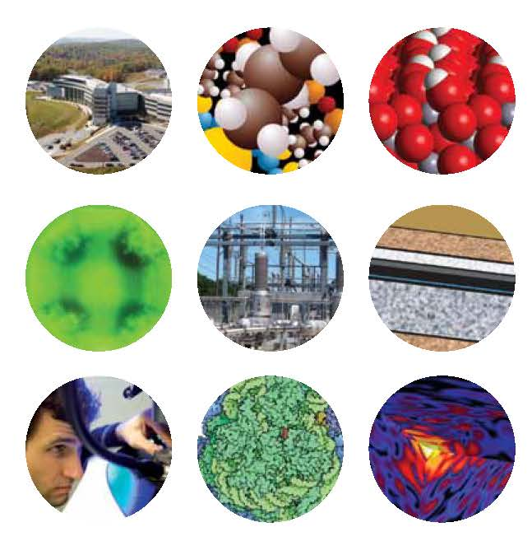
Science Serving the Nation – the Update!
Presents the Impact of BES broadly:
  Scientific impact:
    9 Nobel Prizes since 1986
    Over 175 members of the National Academies (now 183!)
  User Facilities
Primary Focus: Fundamental Science to Energy Technology
  “Better Ways to Tap the Sun’s Energy”
  “Efficient Approaches to Power the Future”
  “Innovative Seeds for Clean Energy Technologies”
  “Converting New Insights into New
  Technologies”

Slide 6
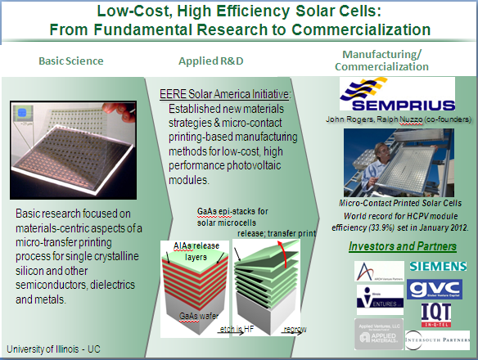
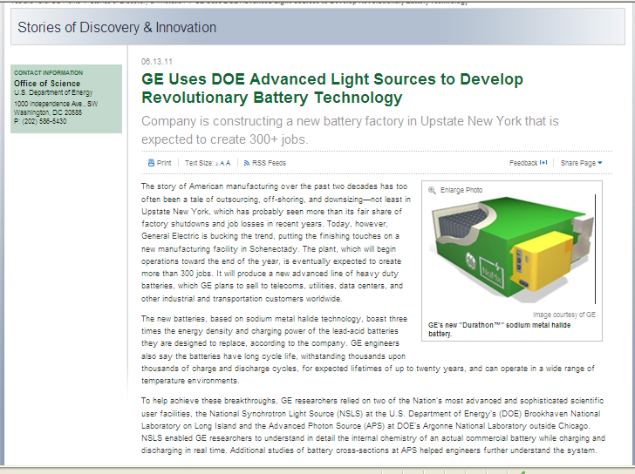
Evolution of the Brochure
Highlight information from BES programs was collected
  Many formats…
  Both national laboratory and university research
Many of these were made into “3-panel charts” highlighting the science supported by BES, the applied research funded by others, and the commercial applications
Some have longer “Stories of Discovery and Innovation” on the SC webpage
Science and impacts formed the basis for each of the vignettes in the brochure

Slide 7
From Science Serving the Nation:
Microspheres for Low-Cost Thin-Film Solar Cells
One way to reduce the cost of solar cells is to use less material, but the penalty is less light absorbed. Fundamental research on light trapping and absorption is paying off with new strategies for production of cost effective and highly efficient solar cells made from thin films.
For example, to capture more of the incident light, optical coatings on these cells now include microspheres to scatter and reflect sunlight through the cell many times, so that virtually all the light is used. Adding these tiny particles to an array of silicon nanowires increases absorption to 90% of the sunlight, while significantly reducing the amount of silicon far below that used for conventional photovoltaic cells. Other cost reductions are coming from basic research including how to make thin-film devices reproducibly and with high quality. Successfully combining these approaches has now yielded a new generation of flexible, organic-based solar cells.

Slide 8
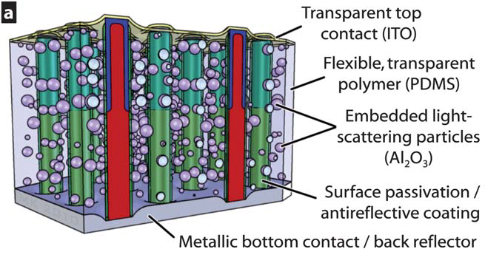
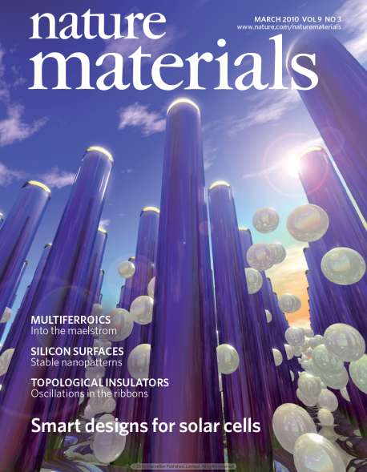
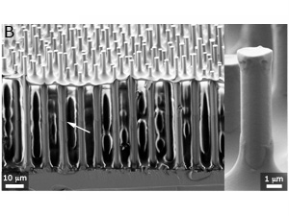
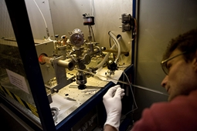




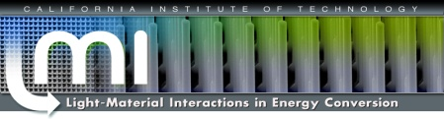
Inexpensive Solar Cell Absorbs Nearly All Available Light
From Fundamental Research to Rooftop Applications
Basic Science
Energy Frontier Research Center
Breakthrough Award from Popular Mechanics in 2010.
Manufacturing/
Commercialization
Caelux, a start-up company funded by the DOE PV Solar Incubator Program, develops solar cell designs and flexible manufacturing process that minimize the use of semiconducting material.
This invention has the potential to significantly improve device efficiency while dramatically reducing production costs.
  Light absorbing nanowires surrounded by polymer that contains Al₂O₃ scattering particles
Sunlight can be efficiently collected and redirected: Materials that occupy as little as 2% of the solar cell volume absorb up to 85% of the available sunlight
Breakthrough Award from Popular Mechanics 2010
Notes:
Basic Science: Professor Harry Atwater at the California Institute of Technology and his coworkers at the DOE Energy Frontier Research Center (EFRC) Light-Material Interactions for Energy Conversion (LMI) have grow crystalline silicon nanowires using vapor-liquid-solid (VLS) processes (lower left). These silicon nanowires are vertically aligned and embedded within a transparent polymer, with light-scattering (Al2O3) particles, and a transparent top contact (upper left). The new silicon wire arrays are able to convert 90 -100% of the photons they absorb into electrons, with near-perfect internal quantum efficiency. Since each silicon wire measures between 30 and 100 microns in length and only 1 micron in diameter, in terms of area or volume, just 2% of it is silicon, and remaining 98% is polymer, making the solar cells much cheaper to produce, possibly manufactured in a roll-to-roll process. Findings were reported in the journal Nature Materials (see Cover, center). The work was supported by BES and by BP.
The Light-Material Interactions in Energy Conversion EFRC led by Caltech was featured as an SC Story of Discovery & Innovation on 7/7/2011.
Manufacturing/Commercialization: Under the PV Incubator program, DOE helps to develop and commercialize promising emerging solar technologies by shortening the timeline from pre-commercial and prototype stage PV technologies to pilot and full-scale manufacturing operations. In the fourth installment of the PV Incubator Program (where companies benefit from close partnerships with DOE national laboratories), Professor Atwater’s start-up company, Caelux (Pasadena, California) develops a flexible solar cell designs and manufacturing processes that minimize the amount of semiconducting material used. His company’s work has the potential to significantly improve device efficiency while dramatically reducing production costs. Caelux receives Tier I support for the development of commercially viable solar cell technology prototypes. The project received $1 million over one year.
References: 1) M. D. Kelzenberg et al. "High-performance Si microwire photovoltaics," Energy & Environmental Science 4 866 (2011) 2) M. D. Kelzenberg, "Enhanced absorption and carrier collection in Si wire arrays for photovoltaic applications," Nature Materials 9 239 (2010) 3) P. N. Saeta et al. "How much can guided modes enhance absorption in thin solar cells?" Optics Express 17 20975 (2009)

Slide 9

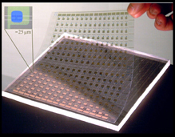
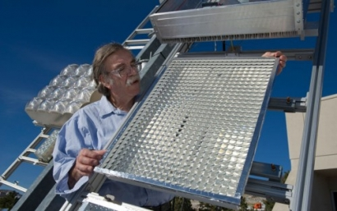
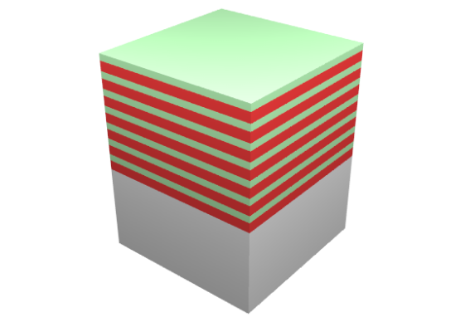
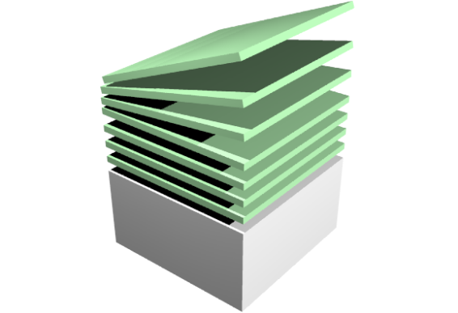







Low-Cost, High Efficiency Solar Cells
From Fundamental Research to Commercialization
Basic Science
Applied R&D
Manufacturing/
Commercialization
EERE Solar America Initiative: Established new materials strategies & micro-contact printing-based manufacturing methods for low-cost, high performance photovoltaic modules.
John Rogers, Ralph Nuzzo (co-founders)
Micro-Contact Printed Solar Cells
World record for HCPV module efficiency (33.9%) set in January 2012.
Basic research focused on materials-centric aspects of a micro-transfer printing process for single crystalline silicon and other semiconductors, dielectrics and metals.
GaAs epi-stacks for
solar microcells
release; transfer print
AlAs release
layers
Investors and Partners
GaAs wafer
etch in HF
regrow
University of Illinois - UC
Notes:
John Rogers and Ralph Nuzzo University of Illinois
BES-supported materials research at UIUC has resulted in an extensive intellectual property (IP) portfolio related to printable, flexible electronics.
The basic research knowledge base includes key materials-centric aspects of a micro-transfer printing process for single crystalline silicon and other semiconductors, dielectrics and metals.
Key Technology Outcomes/Benefits:
Efficiencies of ~12% at thicknesses of 15 microns (> 10x thinner than conventional monocrystalline silicon photovoltaic devices)
Integration with flexible substrates (e.g., plastic)
Integration with optical over-layers for directing/focusing light
Controllable transparency
The goal of the EERE program was to establish new materials strategies & manufacturing methods for low-cost, high performance photovoltaic modules
Semprius has 25 full-time employees; 2 researchers received PhD’s at UIUC under DOE BES support
Large joint development programs: Siemens (solar), Cambridge Display Technology, Sumitomo, X-FAB
First purchase order for 1 kW concentrator PV system from Tucson Electric Power
Attracted over $10 M in venture capital funding from: Applied Materials, Arch, GVC, In-Q-Tel and Intersouth Partners,
In January 2012, set the world record for high concentration photovoltaic (HCPV) module efficiency of 33.9% .
http://www.semprius.com/news/news-releases/semprius-sets-world-record-for-solar-module-efficiency.html

Slide 10
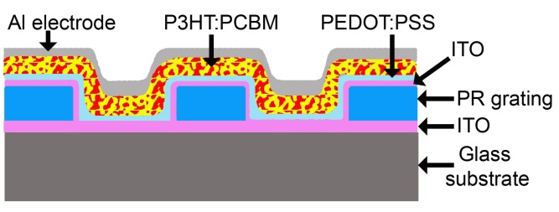
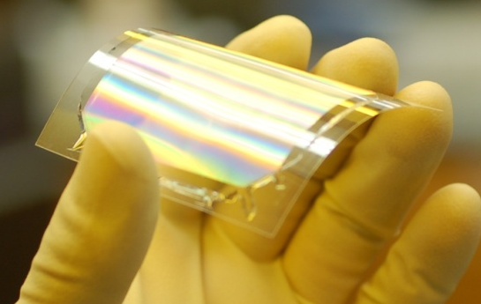
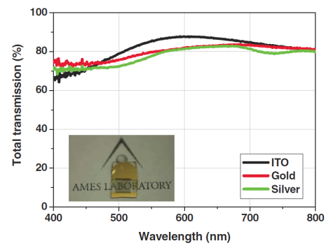
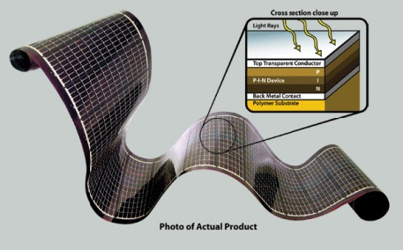

Textured Organic Solar Cells and Transparent Electrodes
Basic Science
Applied R&D
Manufacturing/
Commercialization
Option agreements pending under DOE/EERE “America’s Next Top Energy Innovator Program”.
Realizing textured cells and transparent electrodes on large area, flexible substrates
Thin film Si solar cell under development with PowerFilm Inc.
Textured substrate
Textured organic photovoltaic cells realized with enhanced red absorption and 20% improvement in power conversion effciency
Investigation of textured substrates amenable to conformal coating of organic photovoltaic layers
ITO free transparent electrode
Tall and thin metallic structures gives high optical transmission
without sacrificing conductivity
Modeling and theory for high optical transparency and electrical conductivity
Ames Laboratory
Notes:
Ames Laboratory: BES-supported research on light-trapping textured organic photovoltaic structures, and metal-based transparent electrodes created the intellectual property (IP) portfolio related to the technology.
The background of this research and developments at Ames laboratory:
Textured Organic Solar Cells
Organic photovoltaic cells consist of thin active layer sandwiched between electrodes. Out of all losses within a device, optical losses account for nearly 40% of the total loss.
Textures substrates can increase the light absorption in the active layer of organic photovoltaic cells, but realizing conformal coatings from solution process is challenging. Ames lab discovered optimal dimensions of textured substrate for which solution flow is amenable to conformal coating of photovoltaic polymer layers.
Transparent Electrodes
At least one electrode in solar cells should be transparent. Metal oxides (ITO, ZnO) have used as transparent electrodes. Alternative transparent electrodes are triggered by high demand and short supply of indium metal.
Ames lab has developed highly transparent and conducting electrodes based on metal and free from indium. Conductivity is high due to high aspect ratio of metallic grating structures, and transparency is high due to nanoscale footprint of metal on a substrate.
Our architecture relieves the classic trade-off between optical transparency and electrical conductivity.

Slide 11
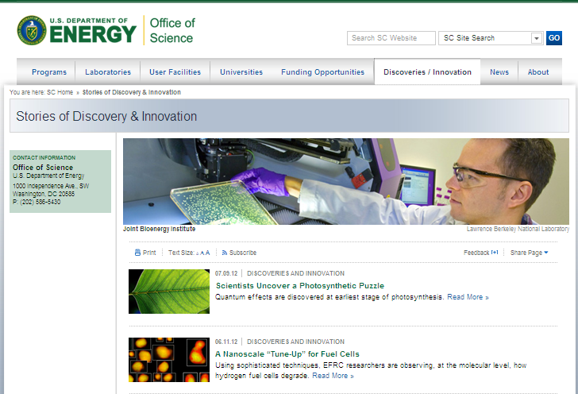
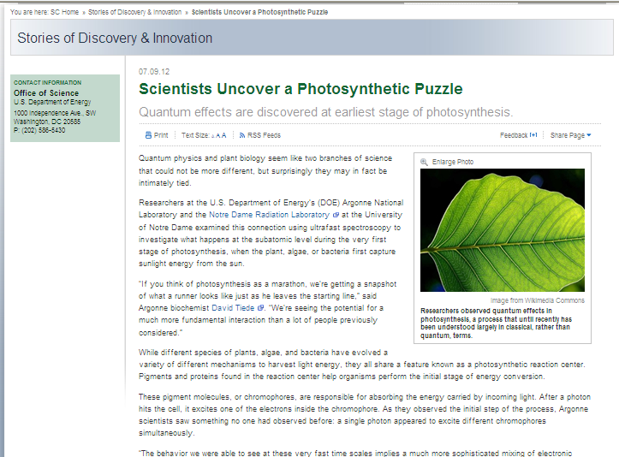
Next Step – Add In-depth Highlights to the Web!
Incorporated into the Office of Science (SC) communication strategy
Standard format has been developed for SC programmatic Web Highlights
Similar to the SC “Discovery and Innovation Stories”
Web highlight drafts prepared by DOE staff, reviewed by original authors, plus others as needed

Slide 12
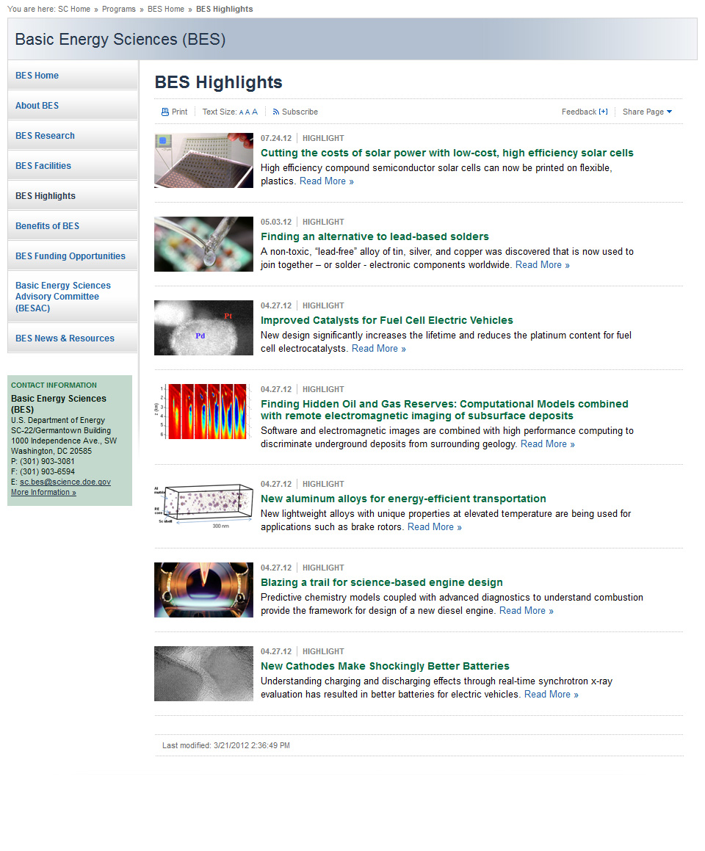
Future: BES Home Page Will Have a Highlights Link

Slide 13
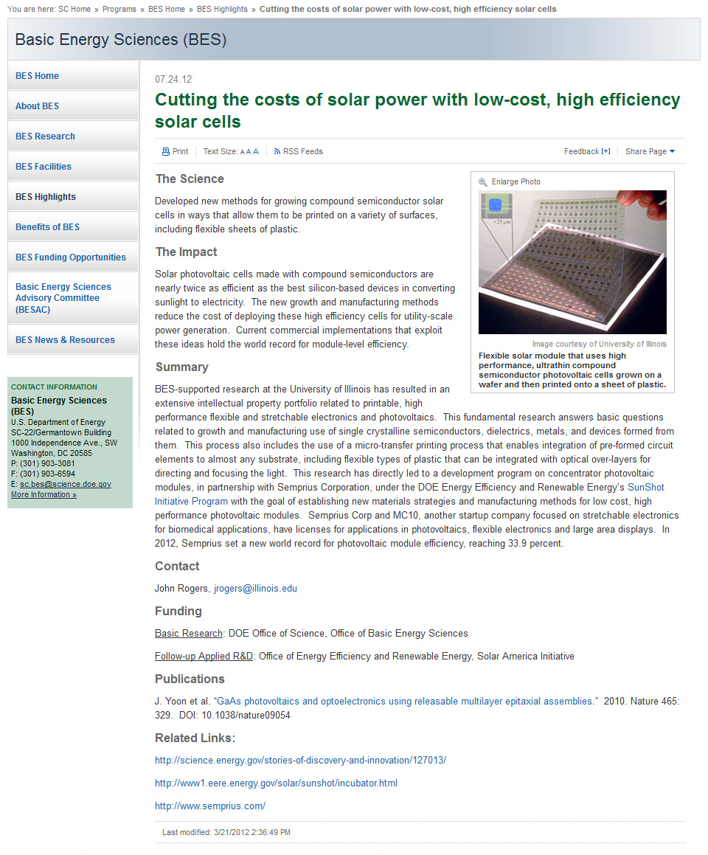
Next Step – Add In-depth Highlights to the Web!

Slide 14
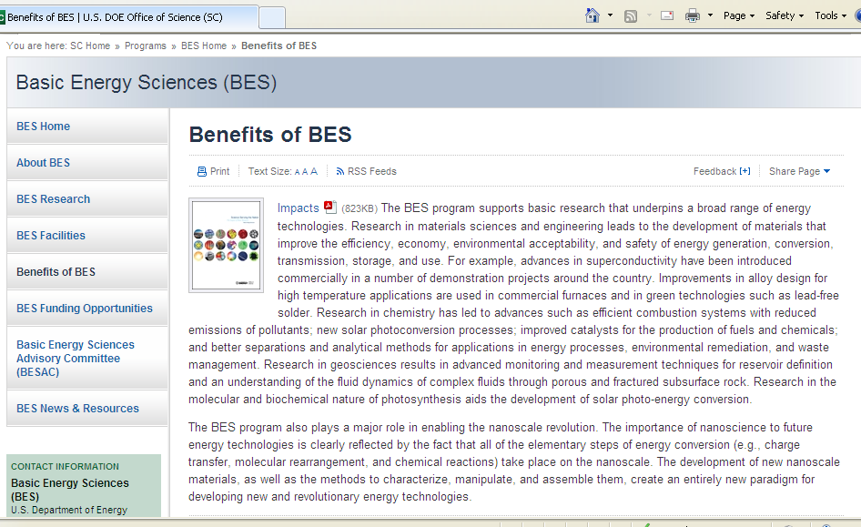
Final Step – Linking the Highlights to the Brochure
Revise the “Benefits of BES” section of the current webpage, adding headings that link to additional information
Excellence in Science: Short summary text plus links to Nobel prizes, other information that is currently elsewhere on website
User Facilities: Short summary text plus links to other information on the website
Impact on Energy Technologies: Short summary text then
  Better Ways to Tap the Sun’s Energy: opens to list of highlights
  Efficient Approaches to Power the Future: ditto
  Science Driving Transportation Innovations (replaces brochure subheading on “Innovative Seeds for Clean Energy Technologies)
  Converting New Insights into New Technologies

Slide 15
Final Step – Linking the Highlights to the Brochure
Revise the “Benefits of BES” section of the current webpage, adding headings that link to additional information
Excellence in Science: Short summary text plus links to Nobel prizes, other information that is currently elsewhere on website
User Facilities: Short summary text plus links to other information on the website
Impact on Energy Technologies: Short summary text
  Better Ways to Tap the Sun’s Energy: opens to list of highlights
  Efficient Approaches to Power the Future
  Science Driving Transportation Innovations (replaces brochure subheading on “Innovative Seeds for Clean Energy Technologies”)
  Converting New Insights into New Technologies

Slide 16
Examples – the Highlight Links…
Better Ways to Tap the Sun’s Energy
Efficient Approaches to Power the Future

Slide 17
Examples – the Highlight Links…
Science Driving Transportation Innovations
Converting New Insights into New Technologies

Slide 18
Science Serving the Nation Communicates the Impact of BES Research
The brochure is published!
The highlights for the web supporting the brochure will follow a standard format and are nearing completion.
  Reviews by many before they are posted…
The strategy is to maintain the web resource as a living document that is refreshed frequently to highlight the impact of BES research to many audiences.
  The Science
  The Impact
  Summary of the details for a general audience…
Brochure and web highlights are integrated into the broader SC communication strategy.

Slide 19
Questions?

