Slide 1

Workforce Development
for Teachers and Scientists
Update: One year after the BESAC COV report
2 August 2011
Dr. Patricia M. Dehmer
Deputy Director for Science Programs &
Acting Associate Director for WDTS
Office of Science, U.S. Department of Energy
http://science.energy.gov/sc-2/presentations-and-testimony/

Slide 2
A Refresher: Key Findings of the COV
WDTS contains programs that the COV ranked from excellent to poor with several programs playing a unique and important role in U.S. science workforce development.
Several of the programs that the COV found to be of the highest quality do not have sufficient resources to allow them to reach their full potential.
Periodic short- and long-term assessment of the quality and impact of all programs in WDTS is completely inadequate.
Procedures and policies for establishing new programs are absent.
In nearly all programs in WDTS, there is no connection with scientists, staff, and research activities in DOE Germantown.
Note: Passages in blue are quotes from the COV report or from Geri Richmond’s presentation.

Slide 3
Recent Events in WDTS
In April 2011, Bill Valdez, the WDTS Associate Director, became DOE’s Deputy Assistant Secretary for Economic Impact and Diversity (ED-2).
Pat became Acting AD of WDTS.
Informed by the BESAC COV Review of WDTS and with knowledge of the program management practices for the SC science programs, Pat and team (staff of SC-2* and WDTS) initiated an assessment of the WDTS programs and business systems.
*Includes 7 PhDs, more than half with significant program management experience; 4 full time
and 3 part time in GTN.
This is a report 90 days after starting that process.

Slide 4

Secretary
Steven Chu
Deputy Secretary
Daniel B. Poneman
Advanced Research Projects Agency – Energy
Arun Majumdar
Under Secretary for Nuclear Security/Administrator for National Nuclear Security Administration
Thomas P. D’Agostino
Under Secretary
for Science
Steven E. Koonin
Under Secretary
Arun Majumdar (A)
Defense Nuclear Nonproliferation
Office of Science
William Brinkman
Patricia Dehmer
Energy Efficiency & Renewable Energy
Defense Programs
Fossil Energy
Basic Energy Sciences
Harriet Kung
High Energy Physics
Mike Procario(A)
Naval Reactors
Nuclear Energy
Counter-terrorism
Advanced Scientific Computing Research
Daniel Hitchcock (A)
Nuclear Physics
Tim Hallman
Electricity Delivery
& Energy Reliability
Defense Nuclear Security
Biological & Environmental Research
Sharlene Weatherwax
Fusion Energy Sciences
Ed Synakowski
Emergency Operations
Forrestal
SBIR/STTR
Manny Oliver
Workforce Develop. for Teachers & Scientists
Patricia Dehmer (A)
4
Notes:
4

Slide 5
What is WDTS?
Mission: To develop the next generation of scientists and engineers to support Department missions, administer its programs, and conduct the research that will realize the nation’s science and innovation agenda.*
Vision: To be the standard for workforce development programs in a mission agency in which “Science and technology lie at the heart of the mission.”*
Current WDTS programs:
  At the DOE laboratories: Student intern programs (one for 4-yr institutions and one for community colleges) and a visiting faculty program
  Office of Science Graduate Fellowship
  Albert Einstein Distinguished Educator Fellowship
  National Science Bowl
Other activities:
  On-line business systems modernization
  Program evaluation and assessment
* Pat’s unofficial versions, drawn largely
from the May 2011 DOE Strategic Plan.

Slide 6
From the DOE Strategic Plan, May 2011
SUSTAIN A WORLD-LEADING TECHNICAL WORKFORCE
Excellent scientists, technologists, and engineers are the creative engine of the Department. The Department and its national laboratories must cooperate to create conditions that allow today’s researchers to be as productive as possible, as well as to ensure an adequate supply of tomorrow’s researchers. Investments will help develop the next generation of scientists and engineers to support Department missions, administer its programs, and conduct the research that will realize the nation’s science and innovation agenda. These investments will enrich the diversity of the STEM pipeline so that it is more inclusive of women, minorities, and persons with disabilities while mentoring the next generation of scientists, technologists, and engineers. …

Slide 7
Summary: DOE’s Role in STEM Activities
  Workforce development, primarily executed by the Office of Science, to support Department missions, administer its programs, and conduct the research that will realize the nation’s science and innovation agenda.
  Education and training programs involving energy literacy and energy efficiency, primarily executed by other-than-SC offices.

Slide 8
DOE Labs Employ ~30,000 Scientists and Engineers
From DOE website: DOE's labs and technology centers, which employ more than 30,000 scientists and engineers, are home to advanced facilities for R&D.
Notes:
SC labs employ ~22,000. Maybe ½ are S&T or about 10,000.

Slide 9
Key Recommendations of the COV, Part I
Focus efforts and resources on its strong programs (SCGF, SULI, CCI, Einstein, Lindau, NSB) and work to improve and expand them to assure future success and impact.
Redirect funds from the weak programs (ACTS, FaST, Undergraduate Research Journal, College Guide, RWDC, PST) to funding the recommended changes and expansions in the strong programs (listed above).
Add Ph.D.-level scientists to the staff that have experience in scientific research, educational outreach, and grants program management.
Increase the level of interaction, cooperation, and coordination between staff in WDTS with programs and program officers in the Office of Science in Germantown.

Slide 10
How are the WDTS Funds Distributed Today?
FY12 President’s Request $35,600K; House Mark $17,849K*
Other
National Science Bowl
Einstein Fellows
SULI
CCI
SC Grad
Fellowships
FaST**
Activities at DOE Labs
* Pie Chart reflects House Mark $17,849K
** FaST is being restructuring

Slide 11
Activities at the DOE Laboratories – SULI, CCI, and FaST
SC-2 & WDTS began by examining the lab programs, focusing on:
  Program goal
  Program scope and definition
  Metrics of success
  Measurement and evaluation
We derived a logic model for each program.
In mid-July, we hosted a meeting of the DOE Laboratory Education Directors in D.C. to further refine the basics and the logic models.
By mid-August, we expect to finalize this process.
By early FY2012, we will commission new business system software that will incorporate participant applications, reviewer input, participant deliverables, and questionnaires.
We will collect and archive data so that it can be shared and analyzed.

Slide 12
Science Undergraduate Laboratory Internship (SULI)
Goal: Encourage undergraduate students to pursue science, technology, engineering, or mathematics (STEM) careers, especially relevant to the DOE mission, by providing research experiences at Department of Energy (DOE) National Laboratories under the direction of laboratory scientific and technical staff, who serve as research advisors and mentors.
The SULI program places undergraduate students in paid internships in science and engineering research activities at DOE National Laboratories. Students work with laboratory staff scientists or engineers on projects related to ongoing research programs. Appointments are for 10 weeks during the Summer Term (May through August) or for 16 weeks during the Fall Term (August through December) and Spring Term (January through May).
570 undergraduates supported in FY 2010

Slide 13
Community College Internship (CCI)*
Goal: Encourage community college students to pursue technical careers relevant to the DOE mission by providing technical training experiences at the DOE National Laboratories under the direction of laboratory staff that serve as advisors and mentors.
The Community College Internship (CCI) places students from community colleges in paid internships in technologies supporting laboratory work under the supervision of a laboratory technician or researcher. The CCI Program addresses technical workforce needs at the DOE Laboratories to maintain the DOE’s capacity.
  125 students supported in FY 2010
  *née Community College Institute for Science and Technology

Slide 14
  Visiting Faculty Program (née FaST)
Goal: Increase the research competitiveness of faculty members and their students at institutions historically underrepresented in the research community in order to expand the workforce that addresses DOE mission areas.
The program will be restructured to: improve recruitment; improve faculty-laboratory PI synergy; provide for optional student involvement that does not rely on SULI funding; increase the use of laboratory scientific user facilities; …
At the July 2011 meeting, Lab Education Directors described best practices and innovative programs, and these might serve as models for other labs and/or for the entire DOE program.

Slide 15
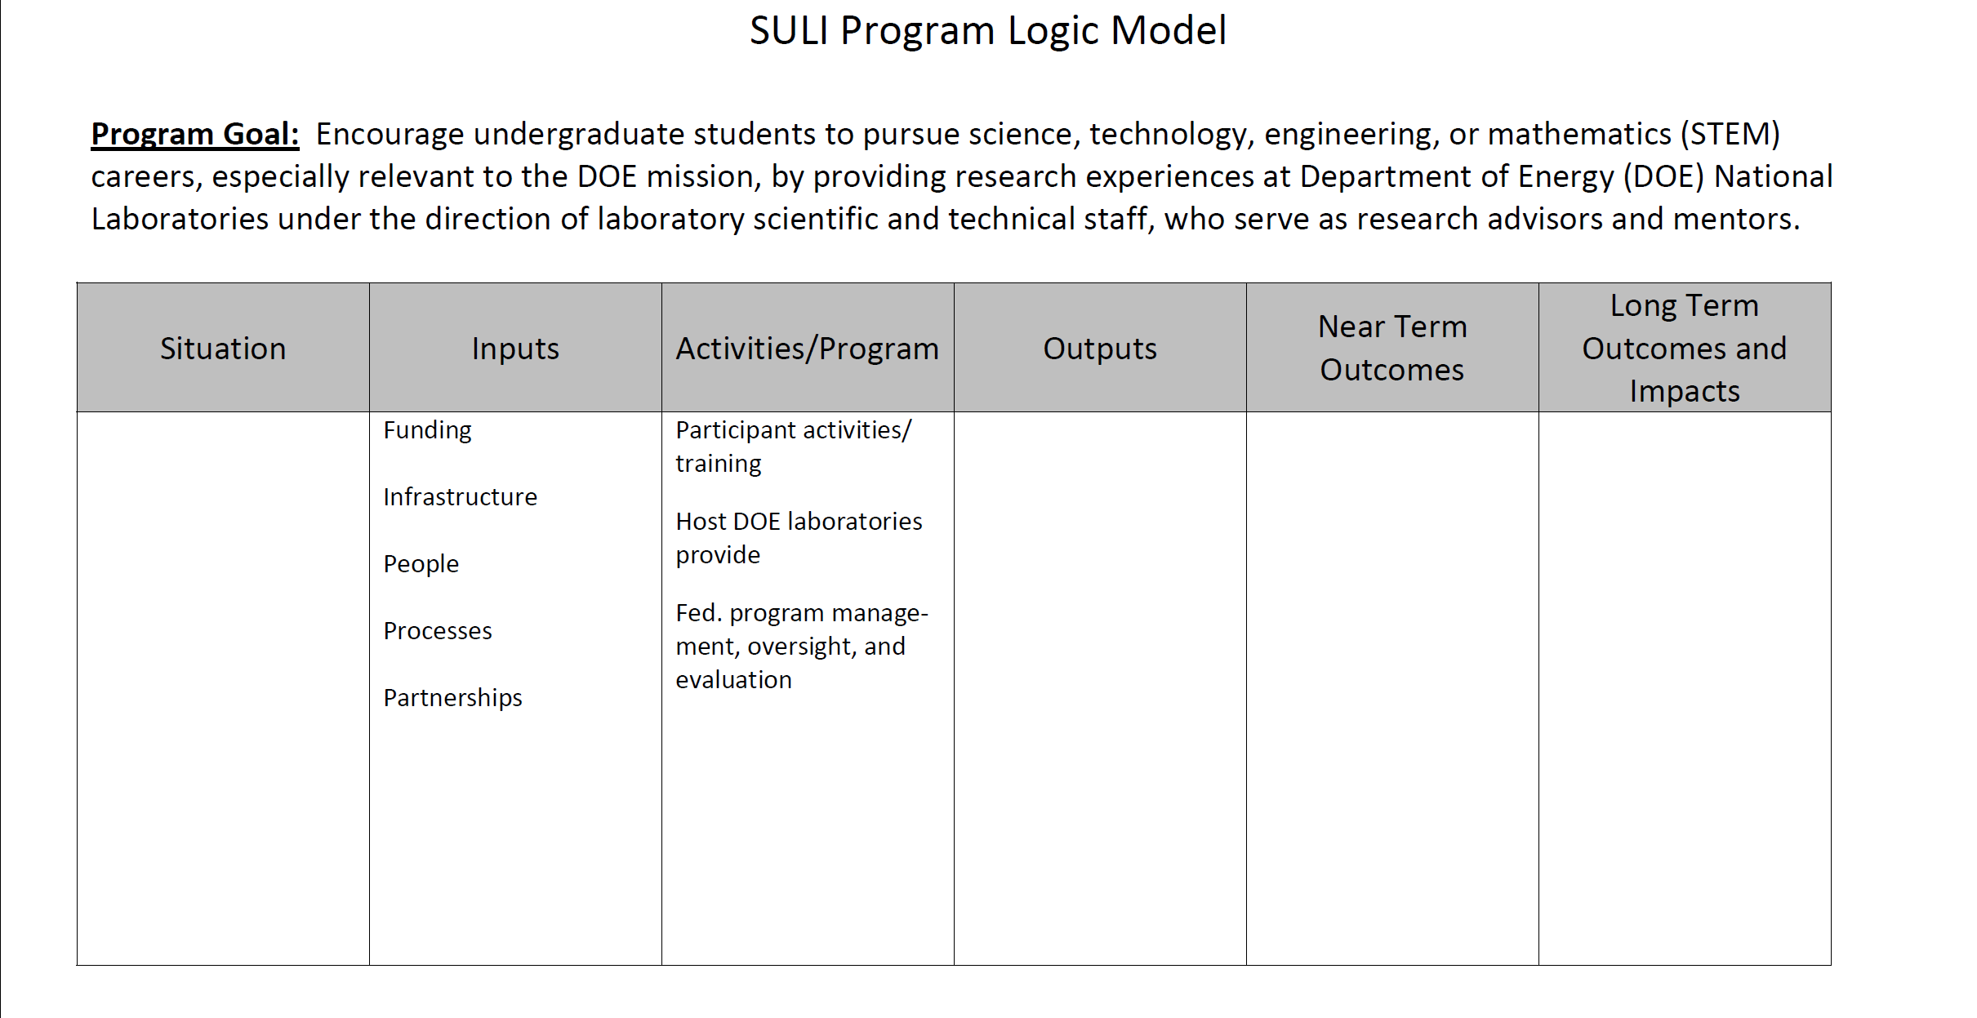
Logic Model Chart - Overview

Slide 16
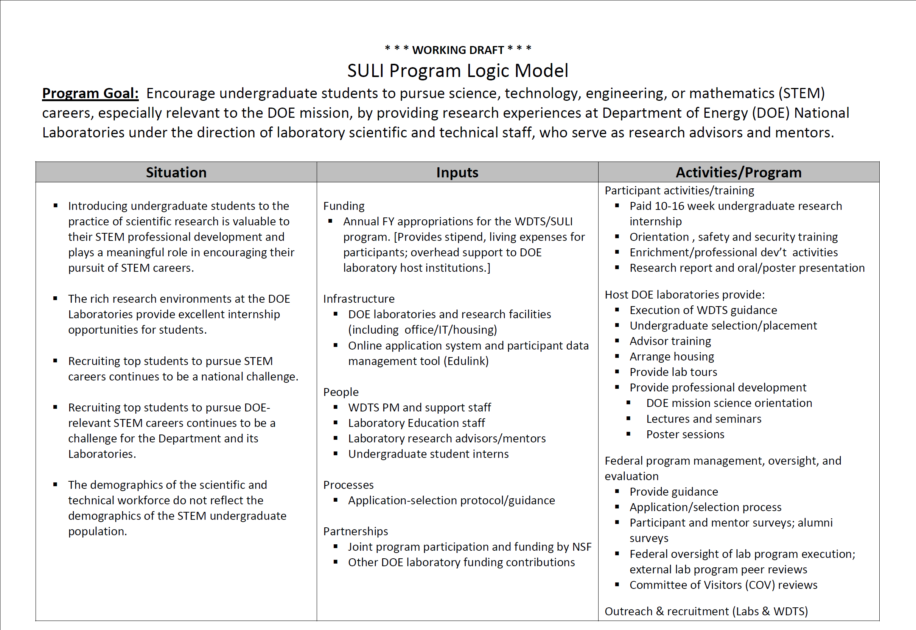
Sample of a Logic Model Chart – SULI
WORKING DRAFT

Slide 17
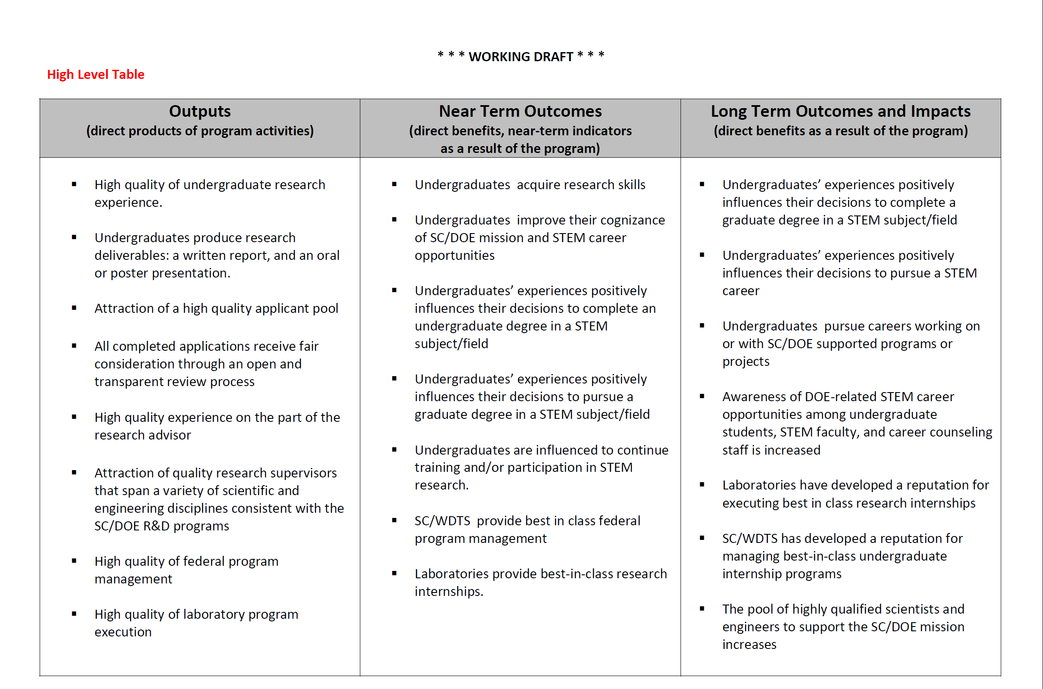
Sample of a Logic Model – SULI
WORKING DRAFT

Slide 18
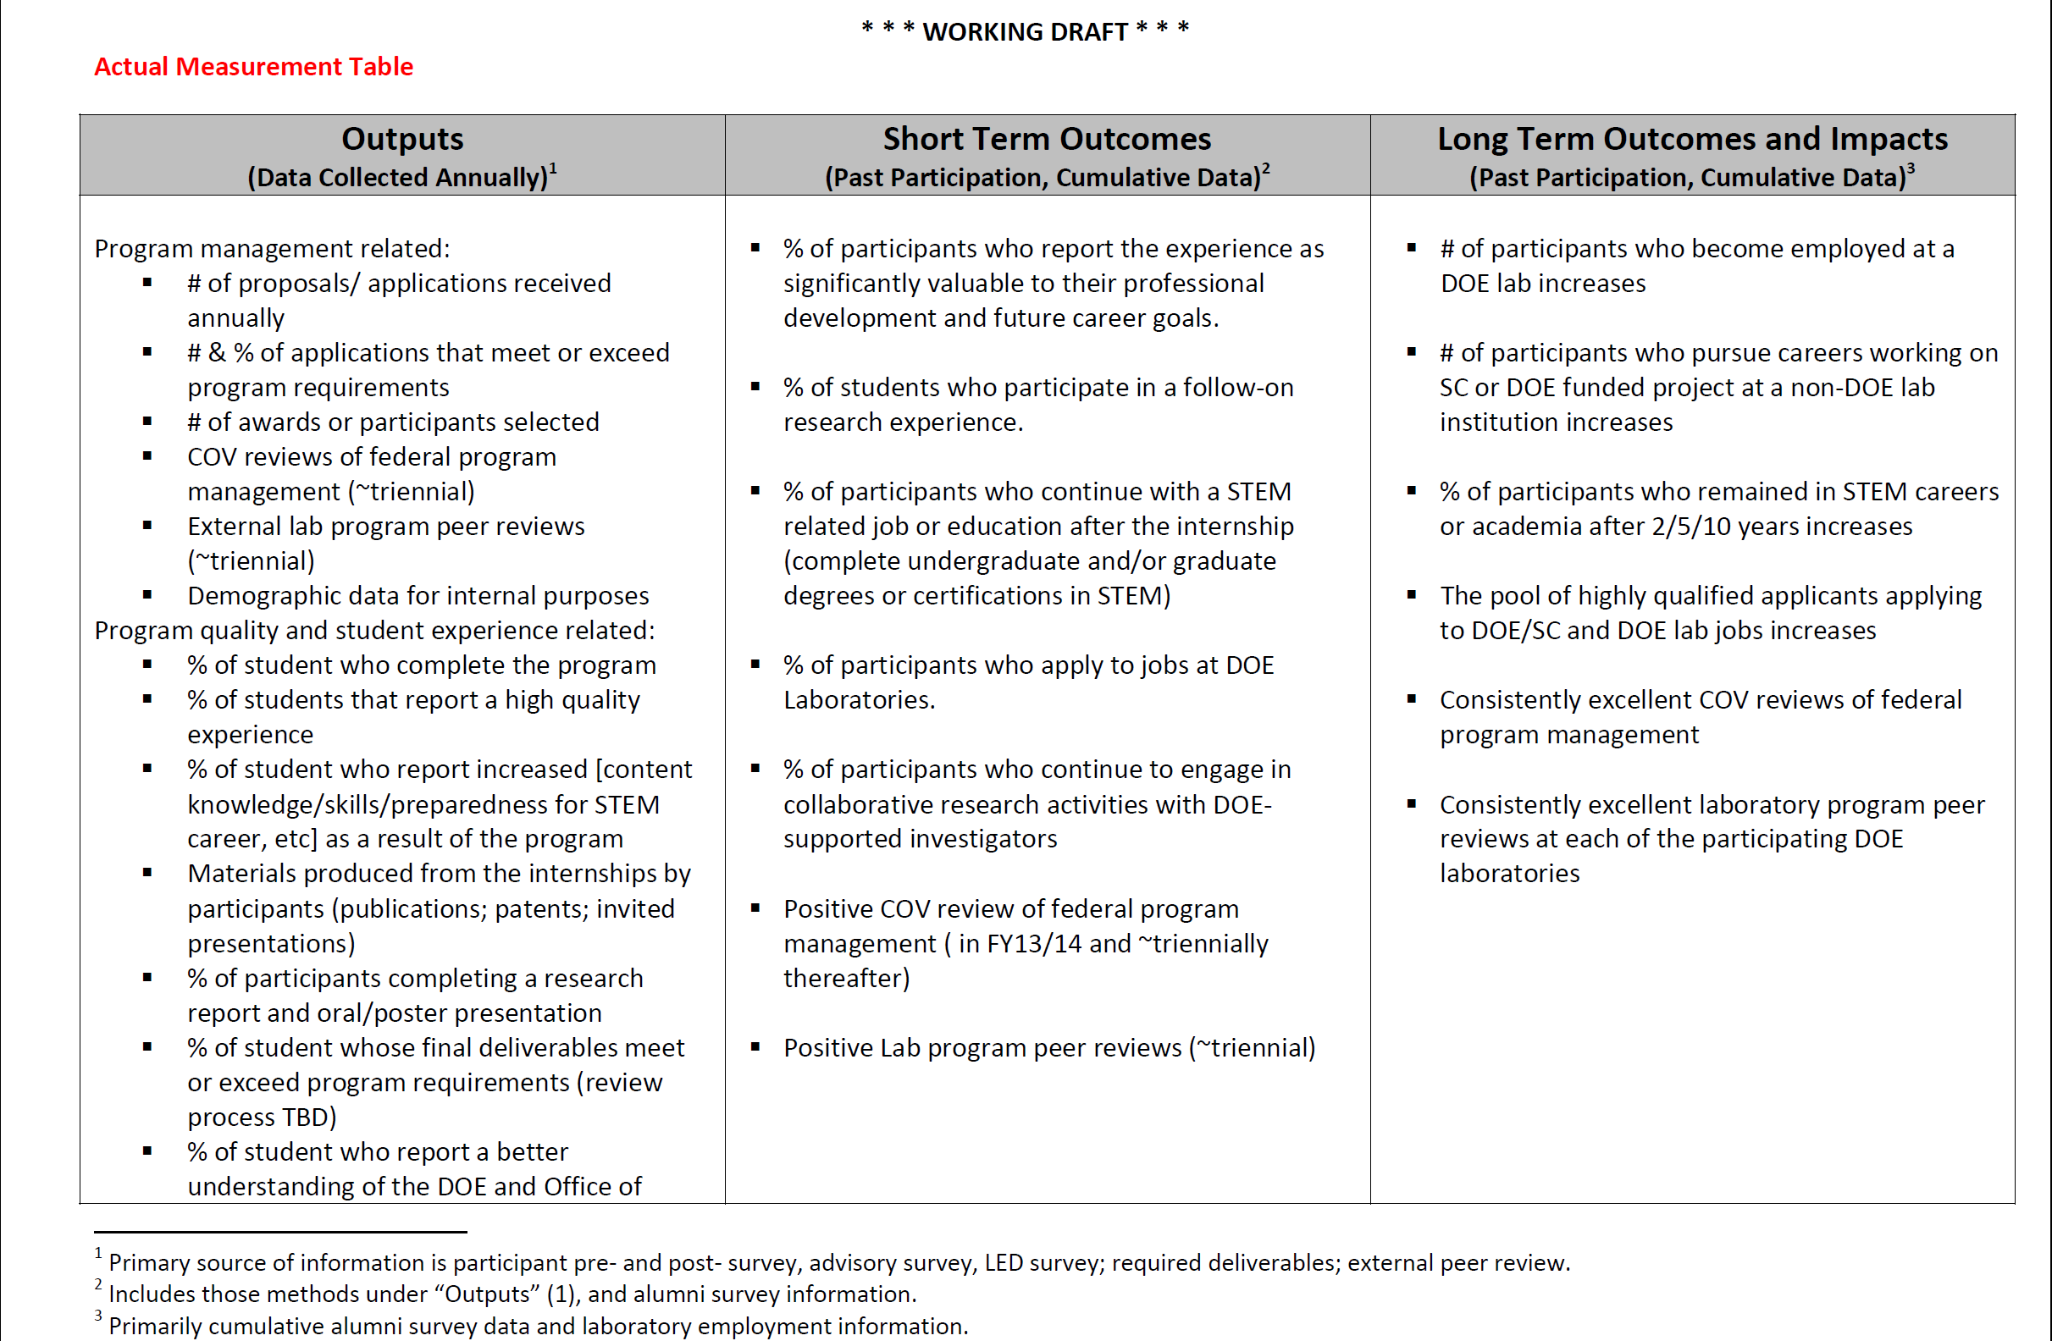
Sample of a Logic Model – SULI
WORKING DRAFT

Slide 19
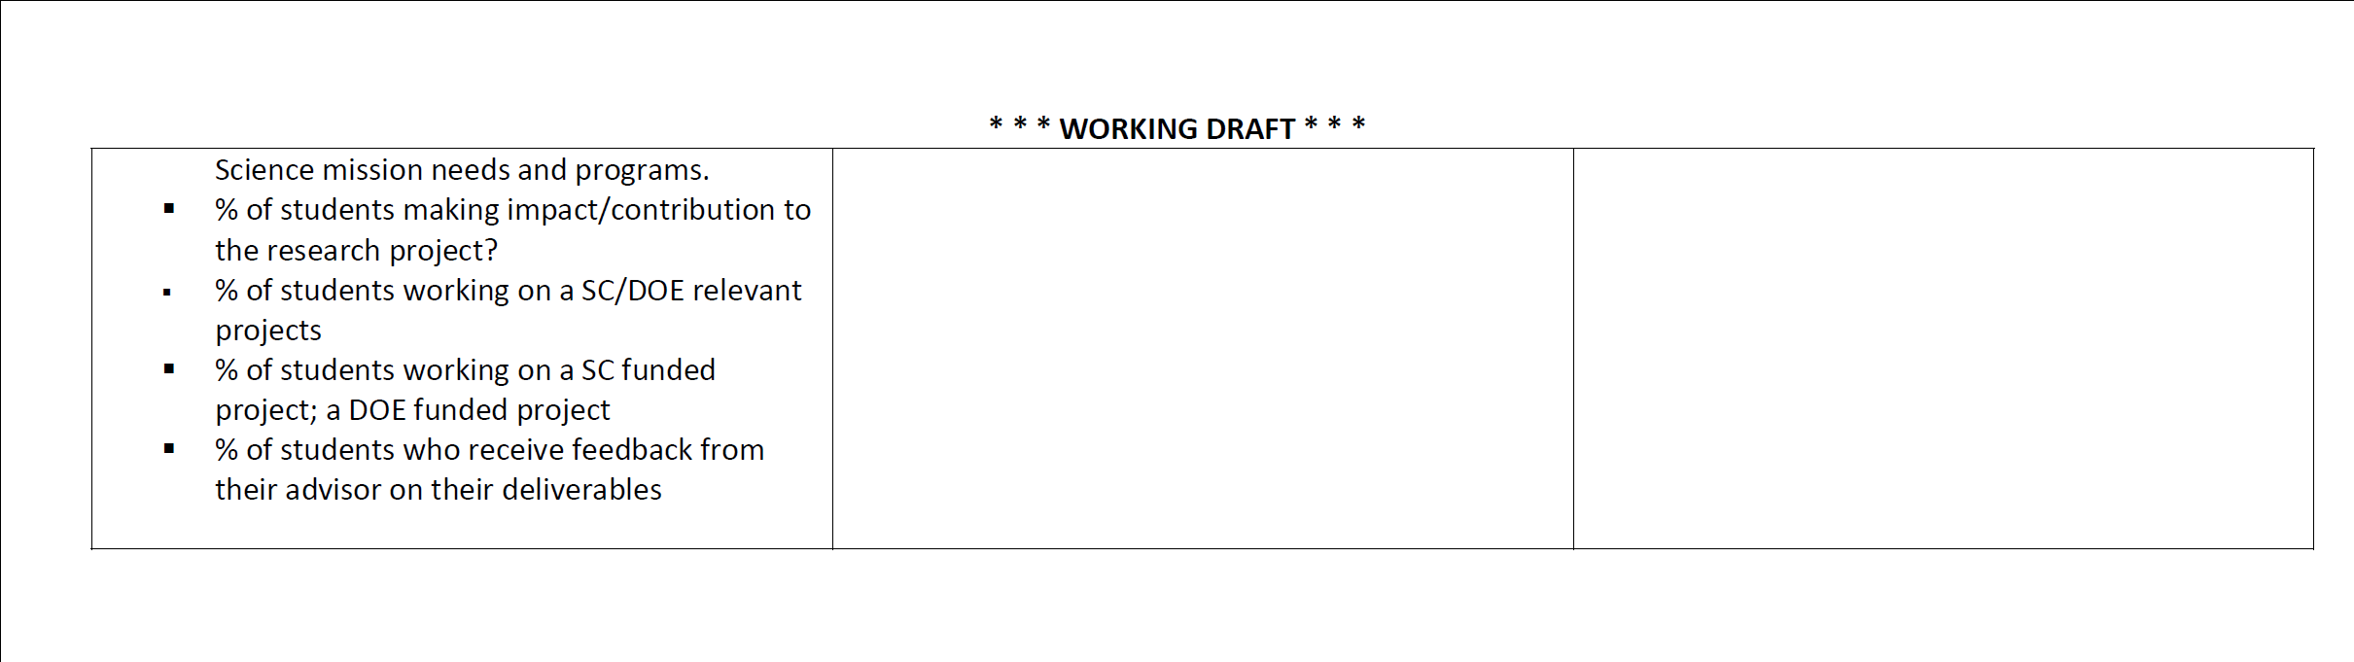
Sample of a Logic Model – SULI
WORKING DRAFT

Slide 20
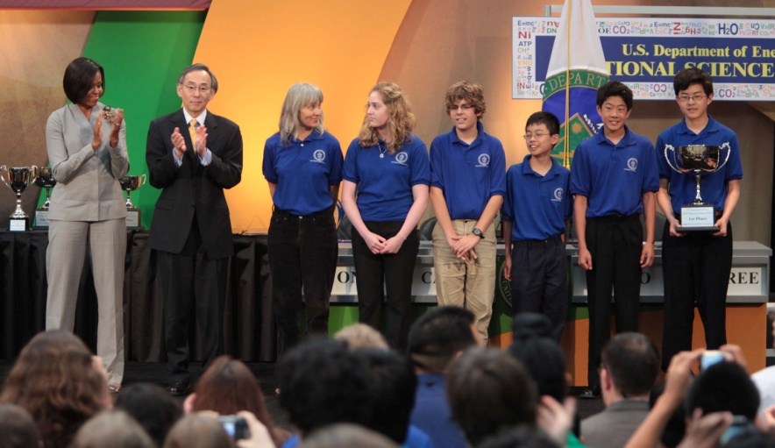
  National Science Bowl
Begun in 1991, DOE’s National Science Bowl® is a nationwide academic competition that tests students' knowledge in all areas of science. High school and middle school students are quizzed in a fast paced question-and-answer format similar to Jeopardy.
  Students at the national event are members of winning teams from more than 100 Regional Science Bowl competitions held earlier in the year. The program also hosts an engineering competition for middle school teams to design, build, and operate “energy efficient” model cars.
  22,000 students from 1,500 schools; 6,000 volunteers
First Lady Michelle Obama and Secretary of Energy Steven Chu congratulate Albuquerque Academy, Albuquerque, NM, First Place winner in the 2010 NSB Middle School competition .

Slide 21
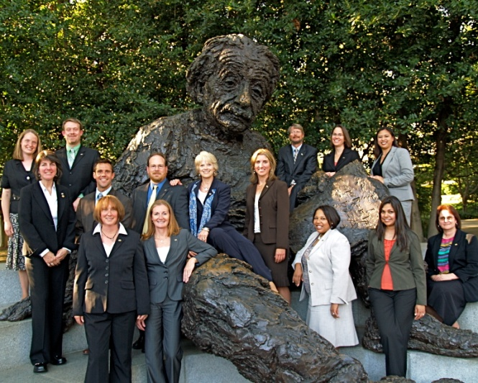
  Albert Einstein Distinguished Educator Fellowship
The Albert Einstein Distinguished Educator Fellowship Act was signed into law in November 1994 and gives DOE the responsibility for administering the program.
(Fellowship Act Public Law 103-382 IMPROVING AMERICA'S SCHOOLS ACT OF 1994)
The Einstein Fellowship Program provides a professional development opportunity for K-12 educators in STEM fields to serve in the national education arena.
Fellows spend 11 months working on
education issues or programs, in a
Congressional office or in a Federal
agency, such as DOE, NASA, NOAA,
or NSF.
  In FY 2010, WDTS sponsored 7 fellows
2008 -2009 Einstein Fellows

Slide 22
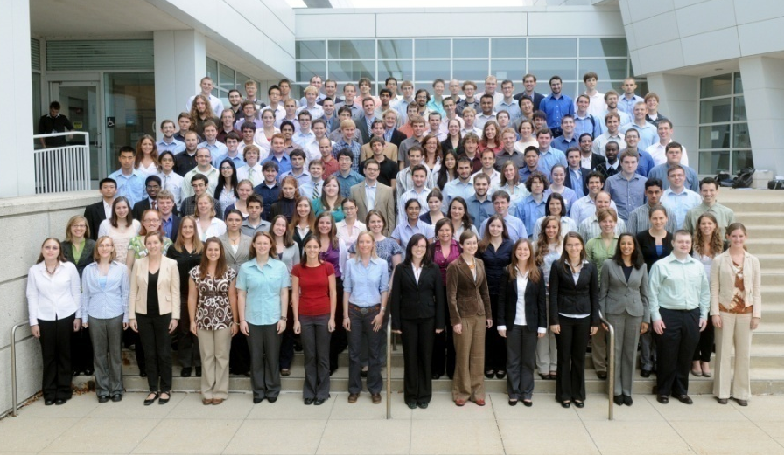
  SC Graduate Fellowship Program
  Begun in 2009 with ARRA funding and WDTS base funding, the SCGF program provides 3-year fellowship awards totaling $50,500 annually, to graduate students pursuing advanced degrees in fundamental basic research areas relevant to Office of Science research programs.
  The awards provide support towards tuition, a stipend for living expenses, and support for research expenses such as travel to conferences and to DOE user facilities.
  Fellows participate in an annual research meeting with SC-supported scientists and learn how to access SC scientific user facilities; SC research program managers are encouraged to include Fellows in programs’ meetings.
  150 Fellowships awarded in FY 2010.
DOE SCGF Cohort 2010 at the SCGF Annual Meeting
at Argonne National Laboratory.

Slide 23
  SC Graduate Fellowship Summaries of Cohorts
  Assumes FY 2012 President’s Request is Appropriated
 | FY 2010 |  | FY 2011 |  |  |  | FY 2012 |  |  | Total Number of Fellowships (including ARRA)
DOE SCGF | ARRA 2009 | WDTS Base Funding | Budget Request |  | Full Year CR |  | Budget Request |  |  | With Full Budget Requests | With FY11 CR + FY12 Request
Total Funding ($K) | 12,500 | 5,006 | 15,000 |  | 5,000 |  | 16,100 |  |  | --- | ---
FY 2010 | 80 (1st yr) | 70 (1st yr) |  |  |  |  |  |  |  | 150 | ---
FY 2011 | 80 (2nd yr) |  | 70 (2nd yr) | 150 (1st yr) | 70 (2nd yr) | 0 (1st yr) |  |  |  | 300 | 150
FY 2012 | 80 (3rd yr) |  |  |  |  |  | 70 (3nd yr) | 0 (2st yr) | 170 (1st yr) | 320 | 320

Slide 24
  House E&WD Mark
WORKFORCE DEVELOPMENT FOR TEACHERS AND SCIENTISTS
The Committee recommends $17,849,000 for workforce development for teachers and scientists, $4,751,000 below fiscal year 2011 and $17,751,000 below the request.
Within the funds provided, up to $5,000,000 is for the graduate fellowship program to fund the existing cohort established in fiscal year 2010. The Department is directed to report to the Committee, not later than 90 days after enactment of this Act, a 10-year plan outlining the long-term objectives for this program, the number of simultaneous fellowships the Department plans to ultimately support under a flat-budget scenario for the Office of Science, and the funding needs under that plan. The plan shall also justify to the Committee why fellowships should be funded within the Office of Science when other agencies, in particular the National Science Foundation, are the primary federal entities for such purposes.

Slide 25
  SC Graduate Fellowship Summaries of Cohorts
  Assumes FY 2012 House Mark is Appropriated
 | FY 2010 |  | FY 2011 |  |  |  | FY 2012 |  |  | Total Number of Fellowships (including ARRA)
DOE SCGF | ARRA 2009 | WDTS Base Funding | Budget Request |  | Full Year CR |  | Budget Request House Mark |  |  | With Full Budget Requests | With FY11 CR + FY12 House Mark
Total Funding ($K) | 12,500 | 5,006 | 15,000 |  | 5,000 |  | 16,100 5,000 |  |  | --- | ---
FY 2010 | 80 (1st yr) | 70 (1st yr) |  |  |  |  |  |  |  | 150 | ---
FY 2011 | 80 (2nd yr) |  | 70 (2nd yr) | 150 (1st yr) | 70 (2nd yr) | 0 (1st yr) |  |  |  | 300 | 150
FY 2012 | 80 (3rd yr) |  |  |  |  |  | 70 (3nd yr) | 0 (2st yr) | 170 0 (1st yr) | 320 | 320 150

Slide 26
  House E&WD Mark
WORKFORCE DEVELOPMENT FOR TEACHERS AND SCIENTISTS
The Committee recommends $17,849,000 for workforce development for teachers and scientists, $4,751,000 below fiscal year 2011 and $17,751,000 below the request.
Within the funds provided, up to $5,000,000 is for the graduate fellowship program to fund the existing cohort established in fiscal year 2010. The Department is directed to report to the Committee, not later than 90 days after enactment of this Act, a 10-year plan outlining the long-term objectives for this program, the number of simultaneous fellowships the Department plans to ultimately support under a flat-budget scenario for the Office of Science, and the funding needs under that plan. The plan shall also justify to the Committee why fellowships should be funded within the Office of Science when other agencies, in particular the National Science Foundation, are the primary federal entities for such purposes.

Slide 27
  SC Graduate Fellowship – Why 450 Fellows?
The original goal for the SCGF was to support 450 Graduate Fellows in steady state, i.e., each year’s cohort would be 150 fellows.
  In FY 2009, SC supported ~4,500 graduate students through its research awards across the programs.
    For this new program, SC set a goal of supporting 450 fellows or 10% of the current programmatic support of graduate students; the fellows selected for the SCGF would be in a prestigious group.
    SCGF attracted more than 3,200 completed applications in its first year, with no advertisement or outreach.
    450 finalists were selected based on a merit-based peer review process; 150 fellowships were awarded (4.6% success rate).
27

Slide 28
  SC Graduate Fellowship – Why a Responsibility of DOE?
Should mission agencies take responsibility for graduate fellow education?
We have collected data on support of graduate fellows. Here are preliminary findings:
  NSF, through its NSF Graduate Research Fellowship Program, supports about 5,000 graduate fellows annually.
    The total number of graduate fellows supported by other federal agencies is about the same (~5,000) with the following among the leaders:
      NIH (F31) about 1,800
      DOD (SMART and NDSEG) about 1,000
      NASA (3 separate fellowships) about 1,000
      EPA Star and USDA about 400-450 each

Slide 29
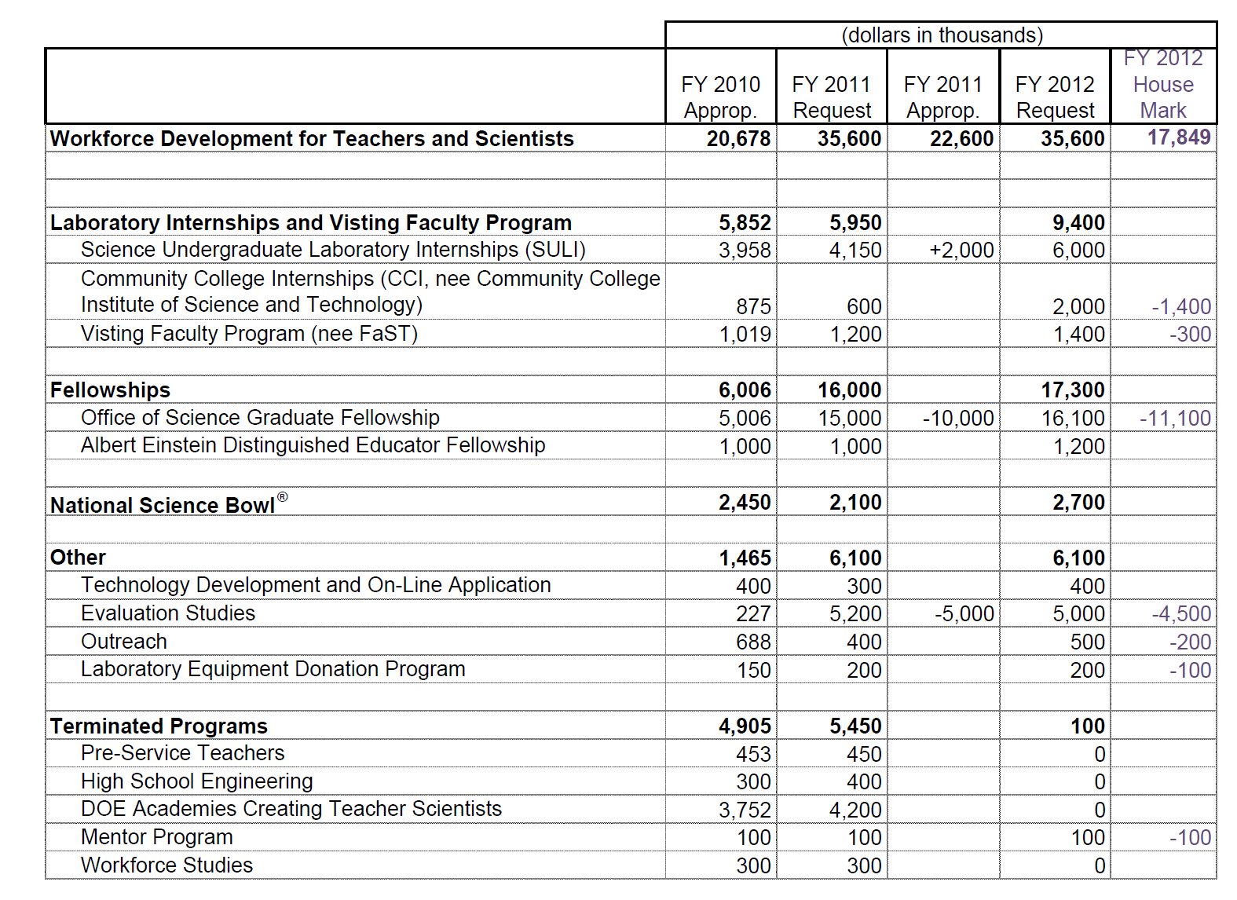
  WDTS Budget Overview Summary

Slide 30
Key Recommendations of the COV, Part II
Improve the procedures used in the solicitation and selection of the Graduate Fellows, building on the experience learned in the first year.
Work diligently and strategically in all programs to increase the participation of students and scholars from underrepresented groups.
Develop and implement assessment and evaluation procedures for its programs that meet the standards of similar programs in other agencies such as NSF.
Use these assessments on a regular basis to improve/modify existing programs.
Follow the procedure that is routinely used in the Office of Science in developing new programs: specifically, new program development should involve careful planning before implementation, including a national workshop and workshop report attended by stakeholders.

Slide 31
Summary
We again thank BESAC for the COV Review.
We agree with the findings, and we are implementing the majority of the recommendations. We are focusing on our core programs.
Implementation is a work in progress, but we have an aggressive timeline for early deliverables.
Near term goals:
  Make the WDTS programs the model for WD programs in mission agencies. Take advantage of the unique opportunity presented by the DOE labs.
  Grow the SC Graduate Fellowship program.

