Slide 1
Basic Energy Sciences Update
BES Advisory Committee Meeting
July 29, 2014
Harriet Kung Director, Basic Energy Sciences
Office of Science, U.S. Department of Energy

Slide 2
Outline
BES Staffing Update
FY 2014 Program Highlights
FY 2015 President’s Request and Congressional Marks
New BESAC Charge

Slide 3
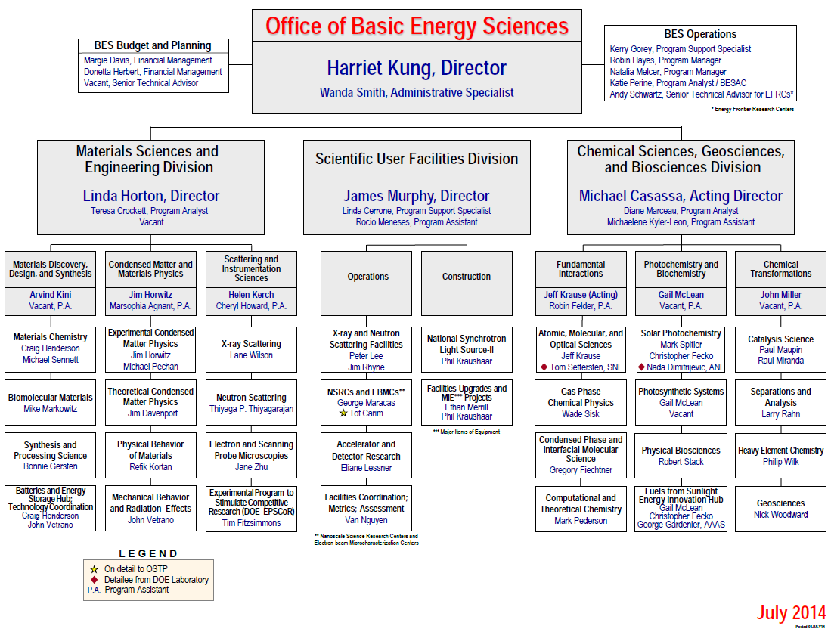
New
Vacancy

Slide 4
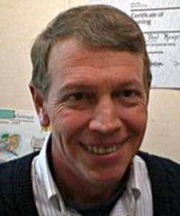
In Memoriam: Dr. Paul H. Maupin
Dr. Paul Maupin was a program manager in BES (1995 – 2014), most recently for the Catalysis Science Program.
Prior to joining the Office of Science in 1991, Paul was a staff member in the Chemistry Division at Oak Ridge National Laboratory (1976-1978), and then worked as a polymer chemist, and later a group leader, with a subsidiary of Rohm and Hass.
4

Slide 5
FY 2014 BES Budget Appropriation
Research programs
Energy Innovation Hubs & Energy Frontier Research Centers are funded at FY 2013 levels
Core Research nearly flat with FY 2013 (+$6M)
EPSCoR (~$10M)
Full funding of financial assistance awards of $1M or less.
Scientific user facilities
Facilities at ~97% of optimal operations
NSLS-II early ops ($56M)
FY 2014 Approp:
$ 1,712M
(+116M from FY 2013
-$150M from FY 2014 Request)
SBIR/STTR, LTSM & GPP
63
SUF Research
29
Const, OPC, MIE
EFRCs + Hubs
148
NSRCs 101
184
Neutron Sources
246
Facilities
Ops 779
CSGB
Research
240
Light Sources
432
MSE
Research
269
Construction and instrumentation
Construction and MIE projects are funded at optimal or near-optimal levels:
National Synchrotron Light Source-II ($53.7M) and NEXT instrumentation ($25M)
Advanced Photon Source upgrade ($20M)
Linac Coherent Light Source-II ($85.7M)

Slide 6
Status of Implementing Full Funding of Financial Assistance Awards
# of Proposals
# of Proposals
To comply with full funding of all awards under $1M, the two research divisions are making a concerted effort to use all available options, including shortened budget periods, “terminal renewals,” and no cost extensions (NCE) to maintain quality and portfolio balance.
While the NCE approach affords extra flexibility to adjust to the full funding requirement, it also delays the time for the divisions to return to the normal portfolio size and success rates.
For MSE, the renewal rate was reduced from ~80% (historic value) to ~70% in FY 2013 (anticipation of full funding) to ~50% in FY 2014. The new award rate decreased from ~22% to ~15%
For CSGB, the renewal rate was reduced from ~80% (historic value) to ~65% in FY 2013 to ~40% in FY 2014. The new award rate was reduced from ~40% to ~20%

Slide 7
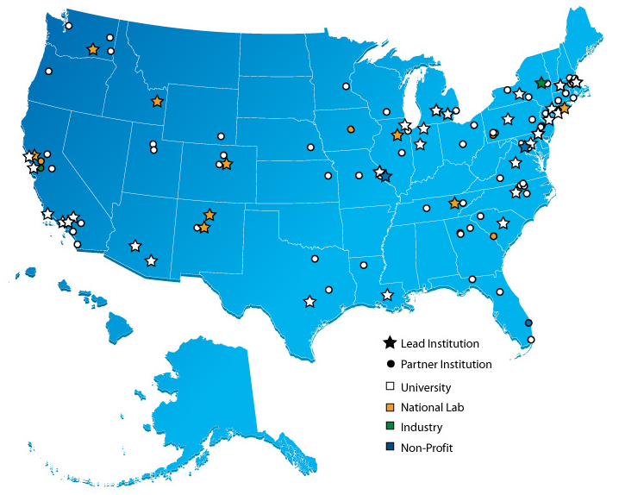
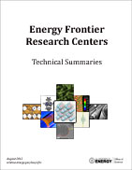
Energy Frontier Research Centers
46 EFRCs were launched in late FY 2009; $777M for 5 Years
Participants:
46 EFRCs in 35 States + Washington D.C.
~850 senior investigators and ~2,000 students, postdoctoral fellows, and technical staff at ~115 institutions
> 260 scientific advisory board members
from 13 countries and > 40 companies
Progress to-date (~4.5 years funding):
>5,400 peer-reviewed papers including >215 publications in Science and Nature
17 PECASE and 15 DOE Early Career Awards
37 EFRCs have created over 280 US and 180 foreign patent applications, nearly 100 patent/invention disclosures, and at least 70 licenses
~ 70 companies have benefited from EFRC research
EFRC students and staff now work in: > 300 university faculty and staff positions; > 475 industrial positions; > 200 national labs, government, and non-profit positions
http://science.energy.gov/bes/efrc/

Slide 8
Companies that Benefit from EFRC Research

Slide 9
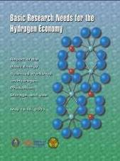
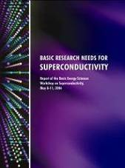
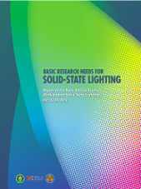
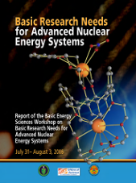
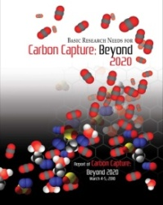
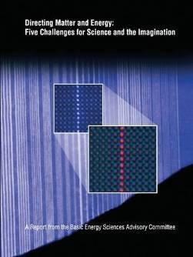
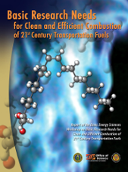
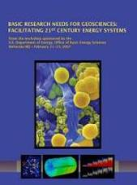
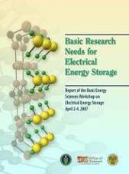
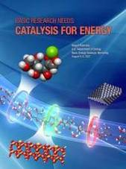
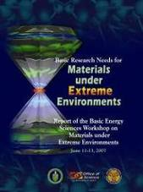
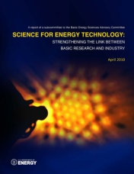
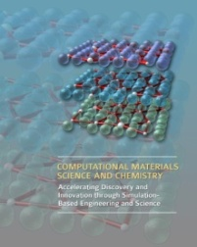
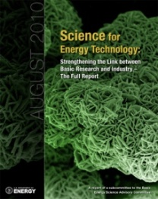
Energy Frontier Research Centers FY2014 Recompetition
The initial 46 EFRCs were funded for 5-years beginning in FY 2009: 30 EFRCs were funded annually at about $100M; 16 were fully funded by Recovery Act support
Solicitation requested both renewal and new EFRC applications including:
Areas of energy-relevant research identified by recent BES and BESAC workshops
Research to advance the rate of materials and chemical discovery
Mesoscale science
Selection of awards will be based on rigorous peer review of applications of the proposed research
Renewal awards will include assessment of the progress during the first 5-year award
Renewal and new awards will maintain a balanced EFRC portfolio for grand challenge and use-inspired energy research
9

Slide 10
EFRC FY2014 Recompetition
Oct 13
Dec 13
Feb 14
Apr 14
Jun 14
Aug 14
9/30/2013
FOA issued
11/13/2013
Nearly 300 letters of intent received
1/9/2014
More than 200 proposals received
Feb – April 2014
Merit Review
May 2014
Awards Selected
June 2014
Awards Announced
August/ September 2014
Awards Start
32 EFRCs are selected, including 22 renewals and 10 new awards at $2 – 4M/yr for up to 4 years.
As stated in the FOA, funding for the final two years of the 4-year awards is contingent upon satisfactory completion of an extensive mid-term progress review.
Starting in FY2016 DOE plans to open the EFRC program to new applications every two years.
10

Slide 11
Topical Distribution of EFRC Awards
Number of EFRCs (Total: 32)
Est. Annual Funding Distribution*
(Total: $100M)
32 EFRCs: 22 Renewal + 10 New
(23 Univ. + 8 Lab + 1 non-profit)
* Subject to budget negotiations

Slide 12
EFRC Partner Institutions
213 Partner Institutions
101 Unique Institutions
12

Slide 13
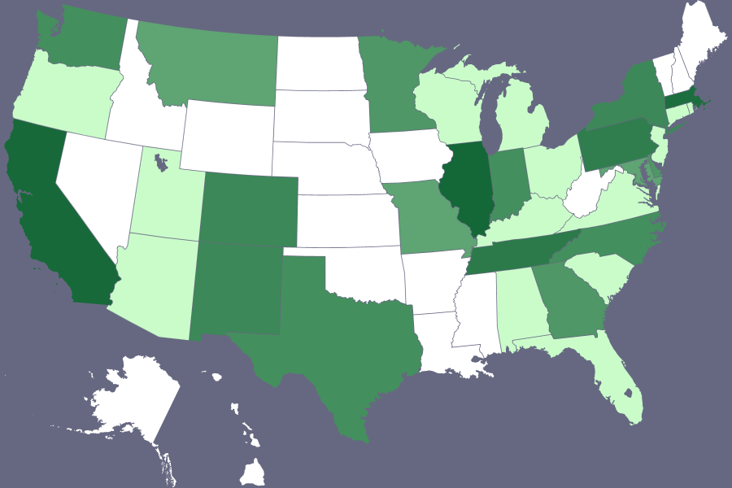
EFRC Annual Funding by State for All Partner Institutions
32 States & DC
$100M/Year
Funding ($M) | States
> 10 | CA, IL, MA
5-10 | PA, TN
1-5 | CO, DC, DE, GA, IN, MD, MN, MO, MT, NC, NM, NY, TX, WA
0-1 | AL, AZ, CT, FL, KY, MI, NJ, OH, OR, RI, SC, UT, VA, WI
13

Slide 14
EPSCoR Implementation Grant Awards FY 2014 Funding Opportunity Announcement
Experimental Program to Stimulate Competitive Research (DOE EPSCoR) Implementation Grant Awards
Enhance capabilities of designated jurisdictions to conduct sustainable and nationally competitive energy-related research
Jumpstart infrastructure development in the jurisdiction(s) through increased human and technical resources
Support a group of scientists working on a common theme, with mutually supporting goals and objectives
Feb 14
Mar 14
Apr 14
May 14
Jun 14
Jul 14
Aug 14
Sep 14
2/14/2014
FOA issued
3/25/2014
25 Letters of Intent
Received
4/15/2014
25 Full
Proposals
Received
April - May
Merit
Review
June 2014
3 Proposals Recommended for Funding; 3 Proposals held for Possible FY 2015 Funding.
August/
September 2014
Awards Start
14

Slide 15
Jurisdictions Eligible for EPSCoR Program Support – FY 2014
DOE EPSCoR follows the NSF EPSCoR eligibility criteria. Twenty five states, the Commonwealth of Puerto Rico, Guam, and the U.S. Virgin Islands are eligible to participate in the DOE EPSCoR program. [Note that Iowa, Tennessee, Utah lost eligibility in February 2013.]

Slide 16
EPSCoR Implementation Grant Award FY 2014 Funding: $4,823k EPSCoR funds, $514k partnering programs
Building Neutron Scattering Infrastructure in Louisiana for Advanced Materials
Lead PI: John DiTusa (Louisiana State University)
University Partners: Louisiana Tech, Tulane, University of New Orleans
DOE Funding Partners: BES Materials Sciences and Engineering
Atmosphere to Grid: Addressing Barriers to Energy Conversion and Delivery
Lead PI: Jonathan Naughton (University of Wyoming)
University Partners: Montana Tech
DOE Funding Partners: EERE Wind and Water Program; OE Grid Reliability Program
Radionuclide Waste Disposal: Development of Multi-scale Experimental and Modeling Capabilities
Lead PI: Brian Powell (Clemson University)
University Partners: South Carolina State University, University of South Carolina
DOE Funding Partners: BES Chemical Sciences, Geosciences and Biosciences; BER Subsurface Bio-Geo Chemical Research Program
16

Slide 17
Ultrafast Materials and Chemical Sciences FY 2014 Funding Opportunity Announcement
Funding Opportunity for Scientific Discovery through Ultrafast Materials and Chemical Sciences
Support for hypothesis-driven research by collaborative investigator teams that combine experimental and theoretical efforts
Addresses the grand challenge to characterize and control chemical and materials processes at the level of the electrons
Focus on application of the new ultrafast capabilities in areas critical to the BES mission, utilizing x-rays, VUV, and lower energy photons; not source development
Feb 14
Mar 14
Apr 14
May 14
Jun 14
Jul 14
Aug 14
Sep 14
2/21/2014
FOA issued
3/17/2014
71 Letters of Intent
Received
4/21/2014
58 Full
Proposals
Received
April - May
Merit
Review
June 2014
9 Proposals Recommended for Funding
August/ September 2014
Awards Start
17

Slide 18
Ultrafast Chemical Sciences Awards FY 2014 Funding: $3,025k
Understanding Roles of Ultrafast and Coherent Electronic and Atomic Motions in Photochemical Reactions
Lead PI: Lin Chen (ANL)
University Partners: Northwestern; Washington; NC State Univ.
Probing Ultrafast Electron (De)localization Dynamics in Mixed Valence Complexes Using Femtosecond X-ray Spectroscopy
Lead PI: Munira Khalil (Washington)
University Partners: UC, Irvine
Lab Partners: LBNL; PNNL
Exploiting Non-equilibrium Charge Dynamics in Polyatomic Molecules to Steer Chemical Reactions
Lead PI: Wen Li (Wayne State Univ.)
University Partners: Univ. Colorado, Boulder, UCLA
Time-Resolved High Harmonic Spectroscopy: A Coherently Enhanced Probe of Charge Migration
Lead PI: Kenneth Schafer (Louisiana State Univ.)
University Partners: Ohio State Univ.; Univ. Virginia
18

Slide 19
Ultrafast Materials Sciences Awards FY 2014 Funding: $3,085k
Ultrafast Control of Emerging Electronic Phenomena in 2D Quantum Materials
Lead PI: Xiaodong Xu (Washington)
University Partners: Carnegie Melon
Lab Partners: ANL
Induction and Dynamics of New States of Matter in 2D Materials
Lead PI: Thomas Devereaux (SLAC)
Understanding Valley Spin Coupling and 2D Exciton Gases in Layered Materials at Extreme Magnetic Fields
Lead PI: Denis Karaiskaj (Univ. of South Florida)
University Partners: Univ. Alabama, Penn State
Dynamic Visualization and Control of Emergent Phases in Complex Oxide Heterostructures
Lead PI: V. Gopalan (Penn State)
University Partners: UCSD, U. Arkansas, Columbia, Drexel
Lab Partners: ANL, LBNL
Ultrafast IR Nano-Spectroscopy and Nano-Imaging of Unconventional Superconductivity in Cuprate and Pnictide Hi-Tc Systems
Lead PI: Dimitri Basov (UCSD)
University Partners: Columbia
19

Slide 20
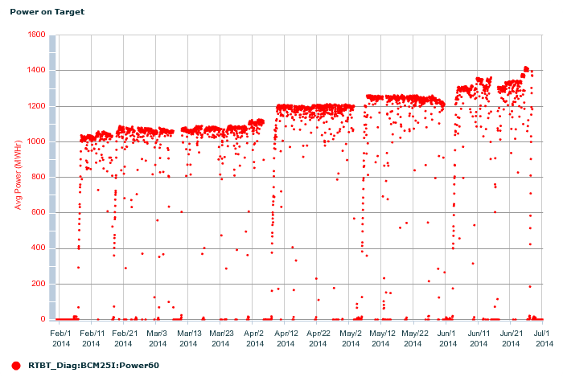
SNS operates at record power of 1.4 MW and on path to continue at this level
Breaking previous records, SNS operated reliably at its maximum design power of 1.4 MW at the end the Spring 2014 run period.
Power was gradually increased from 1 MW to the record 1.425 MW following the Winter 2014 shutdown.
1.3-1.4 MW operation to continue after Summer 2014 providing up to 40% higher flux than previous 1 MW operation.
Significant improvements in quality assurance in target manufacturing and a new “jet-flow” design have mitigated target failure issues and may lead to significant longer target lifetimes than previously indicated.
In addition to the maximum power of 1.425 MW, new energy and power records were set:
Energy on Target (T9): 4195 MW-Hr
Average Power to Target (T9): 1.033 MW
24 hour shift energy: 31.43 MW-Hr on 6/25-26/14
Longest running Proton Beam Window: 12.5 dpa (installed 07/12)
SNS Target 9 Power History
Power stepped from 1 MW to 1.4 MW
starting in February 2014

Slide 21
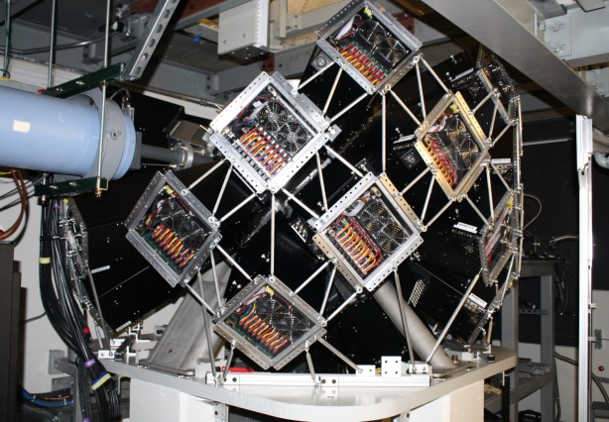
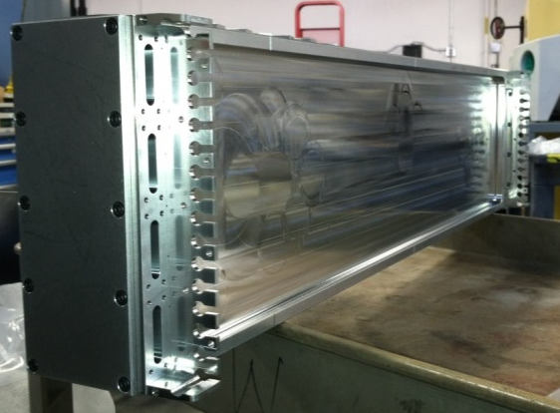
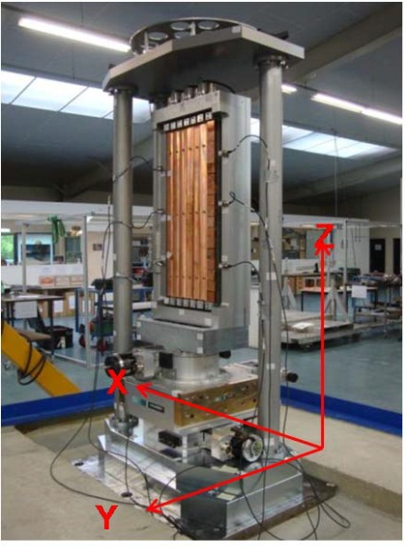
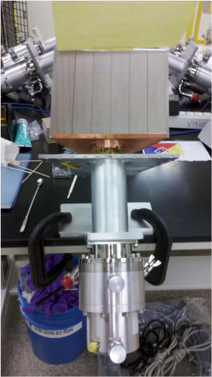
SING-II Project to Complete at the SNS in Sept 2014
The SNS Instruments Next Generation II (SING-II), project designed and built 4 new neutron scattering instruments at the SNS:
VISION – A Be filter analyzer inelastic instrument for chemical spectroscopy
MaNDi – A new design protein crystallography machine that connects BES interests with OBER and NIH. It completed 10 structures during its commissioning phase from Jan.-June 2014.
CORELLI – A unique instrument for isolating and analyzing diffuse scattering apart from inelastic components.
USANS – A double-crystal design low Q machine to probe 100 times longer length scales than conventional SANS
The SC OPA CD-4 review of the SING-II project will be Aug. 5-6, 2014 and includes the CORELLI and USANS instruments. VISION and MaNDi previously received CD-4 in Feb. 2012, and Aug. 2013 respectively. The project will complete on schedule (CD-4 Sept. 2014) and under the $60M TPC.
Anger cameras (photomultipliers) on MaNDi
Corelli detector module
VISION Be filter assembly
USANS focusing Cu pre-monochromator

Slide 22
SNS Instruments
SING-II:
CORELLI
MaNDi
USANS
VISION

Slide 23
National Synchrotron Light Source-II
97.3% Complete (as of 7/9/2014)
Highly optimized electron storage ring:
exceptional x-ray brightness and beam stability
suite of advanced instruments, optics, and detectors that capitalize on these capabilities
Capabilities:
~ 1 nm spatial resolution
~ 0.1 meV energy resolution
single atom sensitivity
Storage Ring commissioning with SC-RF completed
Stored ~50 mA beam achieved on 7/11/14
Aug 2005 CD-0, Approve Mission Need (Complete)
Jul 2007 CD-1, Approve Alternative Selection and Cost Range (Complete)
Jan 2008 CD-2, Approve Performance Baseline (Complete)
Jan 2009 CD-3, Approve Start of Construction (Complete)
Feb 2009 Contract Award for Ring Building (Complete)
Aug 2009 Contract Award for Storage Ring Magnets (Complete)
May 2010 Contract Award for Booster System (Complete)
Feb 2011 1st Pentant Bldg Beneficial Occupancy; Start Accelerator Installation (Complete)
Feb 2012 Beneficial Occupancy of Experimental Floor (Complete)
Mar 2012 Start LINAC Commissioning (Complete)
Nov 2013 Start Booster Commissioning (Complete)
Mar 2014 Start Storage Ring Commissioning
Sep 2014 Projected Early Completion; Ring Available to Beamlines
Jun 2015 CD-4, Approve Start of Operations
23

Slide 24
Linac Coherent Light Source-II (LCLS-II)
North side source: 0.2-1.2 keV (up to 1 MHz)
South side source:
1-25 keV (120 Hz, Cu Linac) 1-5 keV (up to 1 MHz, SC Linac)
The LCLS-II project will:
Provide scientists with a new, world-leading, high repetition rate x-ray laser source to complement the existing LCLS x-ray free electron laser. In response to the July 25, 2013 BES Advisory Committee report, the LCLS-II project has been modified to include a superconducting linear accelerator and two new variable gap undulators to generate an ultra-bright, high repetition rate x-ray free electron laser (XFEL). Together, the two XFELs will solidify the LCLS complex as the world leader in ultrafast x-ray science for a decade or more.
Key components:
A superconducting, high repetition rate, 4 GeV electron linear accelerator
Two, variable gap undulators (for x-ray production)
A cryogenics facility to support the superconducting linac
Modifications/upgrades to existing scientific instruments and technical systems
The Mission Need Statement was updated on September 27, 2013. The project is currently revising CD-1 in response to the BESAC Report.
$148.0M is requested in FY 2015 to continue R&D and prototyping, design, long lead procurement, and fabrication of technical systems.

Slide 25
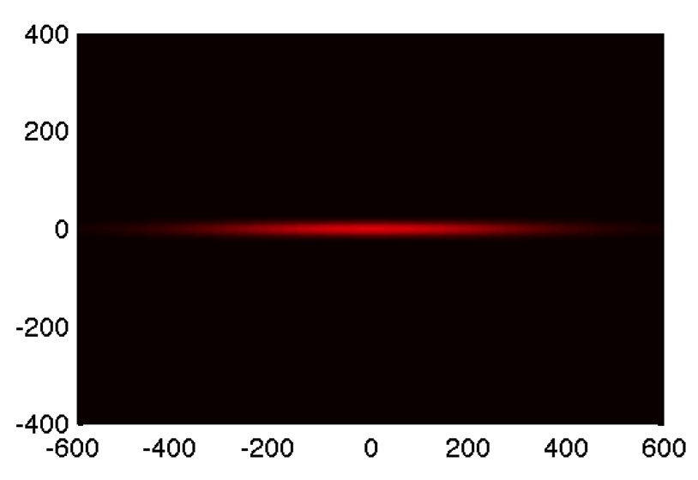
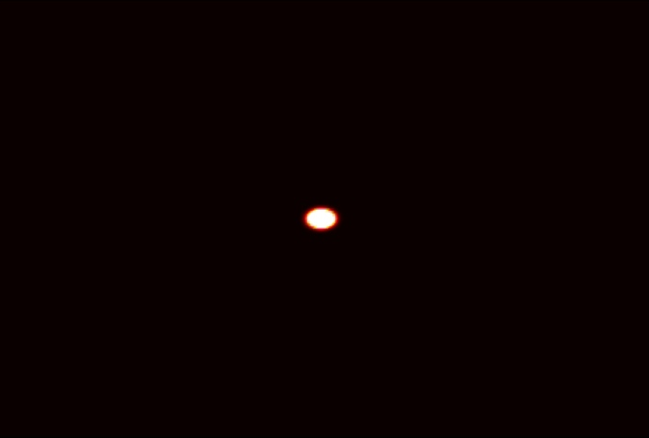
Advanced Photon Source Upgrade (APS-U)
APS today
APS w/MBA Lattice
The APS-U project will:
Provide scientists with a high energy x-ray source possessing world-leading transverse coherence and extreme brightness. The magnet lattice of the APS storage ring will be upgraded to a multi-bend achromat (MBA) configuration to provide brightness enhancements. This upgrade will ensure APS remains a world leader in hard x-ray science providing a unique scientific capability directly relevant to problems in energy, the environment, new and improved materials, and biological studies.
The project team in currently re-planning the project based on the revised project scope in response to the July 2013 BESAC report recommendations. Critical Decision-0 (CD-0) and CD-1 documentation will be revised accordingly.
Key components:
A new, multi-bend achromat accelerator lattice for the APS storage ring.
New and/or upgraded beamlines to take advantage of the new high brightness source.
Enhanced technical capabilities including controls and diagnostics upgrades as required.
$20.0M is requested in FY 2015 to continue research and development, project planning and conceptual design, and limited prototype fabrication.

Slide 26
FY 2015 BES Request Highlights
New computational materials research will develop codes for design of functional materials.
Energy Frontier Research Centers (EFRCs) continue at the FY 2014 level.
Two Energy Innovation Hubs continue:
Joint Center for Artificial Photosynthesis (JCAP) will be in its fifth project year.
Joint Center for Energy Storage Research (JCESR) will be in its third year.
National Synchrotron Light Source-II (NSLS-II) transitions to operations; NSLS ceases operations.
Linac Coherent Light Source-II (LCLS-II) construction continues.
BES user facilities operate at optimum levels.
Two major items of equipment: NSLS-II Experimental Tools (NEXT) and Advanced Photon Source Upgrade (APS-U).
Lujan Neutron Scattering Center ceases operations.
26

Slide 27
FY 2015 BES Budget Request
Research programs
Energy Innovation Hubs & Energy Frontier Research Centers are funded at FY 2014 levels
Core Research approximately flat with FY 2014
Computational Materials Sciences ($24.2M)
Scientific user facilities
All full operating facilities at optimal operations
NSLS-II transition to full operations ($115M)
NSLS & Lujan cease operations; funding requested to transition facilities to safe storage
FY 2015 Request:
$ 1,806.5M
(+94.6M from FY 2014)
SBIR/STTR, LTSM & GPP
65.7
SUF Research
19.8
Const, OPC, MIE
NSRCs 118.8
EFRCs, Hubs, CMS
172.5
190.5
Neutron Sources
248.5
Facilities
Ops 851.5
CSGB
Research
239.1
Light Sources
484.2
MSE
Research
267.4
Construction and instrumentation
NSLS-II instrumentation (NEXT) ($22.5M)
Advanced Photon Source upgrade ($20M)
Linac Coherent Light Source-II ($138.7M + $9.3M OPC)

Slide 28
Balance Between BES Portfolio Elements

Slide 29
Computational Materials Sciences Accelerating Materials Discovery and Development
Deliverable: Open-source community codes and software packages that incorporate multiple length and time scales for discovery and prediction of materials functionality
Deliver research codes and data for design of functional materials to the materials sciences communities in academia, labs, and industry
Use integrated teams combining expertise in materials theory, modeling, computation, synthesis, characterization, and processing/fabrication
Use facilities and tools for materials synthesis, characterization, simulation, and computation, relying especially on the SC scientific user facilities
Support will begin in FY 2015 for up to 4 teams for multi-year awards
Tailored Surfaces for Advanced Electronics
Novel Thermal Transport
Next Generation Magnets
Enhanced Light Absorption

Slide 30
Software is Key to US Leadership in Materials Sciences
Today – US trails Europe in computational codes for materials discovery and engineering
For materials users at NERSC, the most used code is VASP
Atomic scale materials modeling
Commercial code (users have to have their own purchased license) from Austria
Espresso, a popular materials modeling code, was developed by Italy.
Top codes for other fields used at NERSC were developed in the U.S. and are all free, community codes.
Another materials software package in wide use in over 70 countries to calculate thermodynamic data, largely in metals, is Thermo-Calc
From Sweden, commercially available for 25 years
Future – US-developed materials sciences software can inform future development of high performance computing, including the path to exascale
Climate
Atomic Scale Materials Modeling
QCD Physics
Plasma Physics
QCD
Physics
Molecular Dynamics
Bio Physics
Atomic Scale Materials
Modeling
2012 Top Application Codes at NERSC

Slide 31
Computational Materials Sciences What is Different?
Will move theory and computation from research-use by experts to more general use by the community --- then industry
Will fund teams of theorists and experimentalists with the express purpose of accelerating the development of multiscale, validated computational software
Fill in theoretical and scientific knowledge gaps
Current codes fail for strategic functional materials – magnets, thermal materials, superconductors, advanced semiconductors
Open source software, maintained for broad-use
Enhance speed and complexity by taking full advantage of super computers at the petascale and beyond
Builds on the current portfolio of theory research and experimental characterization facilities, including user facilities
Seamlessly integrate codes with databases of validated information from both theory and experiments
Will provide U.S. computational software for materials discovery – restoring the U.S. as a leader in the field
31

Slide 32
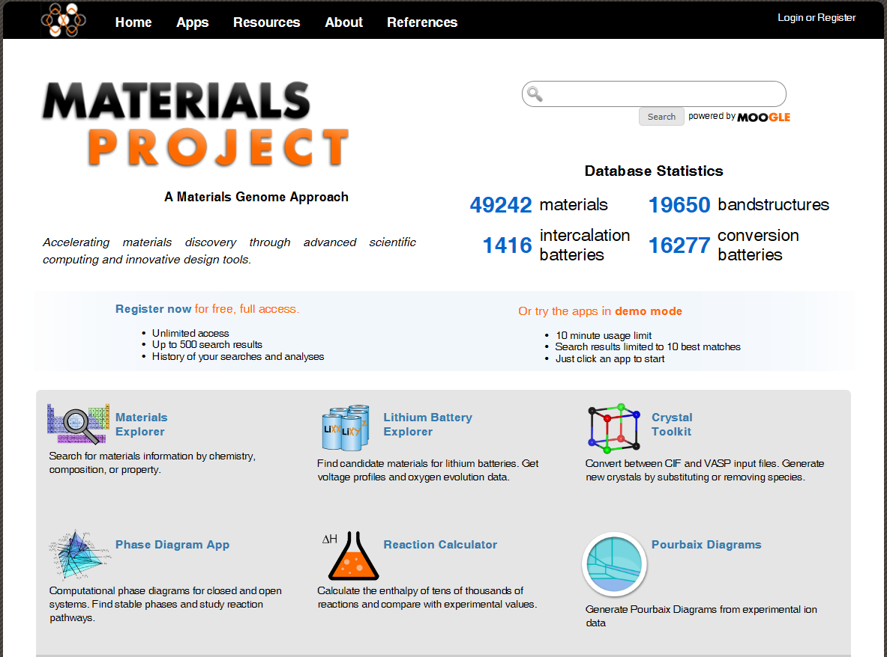
Computational Materials Sciences: Example of Early Success – The Materials Project
The Materials Project, a current BES supported research activity, is leading the discovery of new oxides and materials for batteries
Free resource for the community
Performs calculations for new compounds
Mines existing data through comprehensive collections of calculated and experimental data
Utilizes NERSC and the VASP code
Opportunity for Computational
Materials Sciences to replace the
VASP code with better community code
Capabilities are expanding with the
JCESR Hub
Developing an “electrolyte genome”
Data from characterization and
theory-modeling-computation
Joint Center for Energy Storage Research
An Energy Innovation Hub led by Argonne National Laboratory

Slide 33
FY 2015 BES HEWD Mark
The Committee recommends $1,702,000,000 for Basic Energy Sciences, $10,757,000 below fiscal year 2014 and $104,500,000 below the budget request.
The program’s budget consists of funding for research, the operation of existing user facilities, and the design, procurement, and construction of new facilities and equipment. The long-term success of the program hinges on striking a careful balance among these three areas. The Committee strongly cautions the Department against assuming an ever-increasing budget when planning the balance among facility runtime, construction, and research funding.
The recommendation provides $100,000,000 for Energy Frontier Research Centers, $8,000,000 for Computational Materials Sciences, $24,175,000 for the third year of the Batteries and Energy Storage Innovation Hub, and $10,000,000 for the Experimental Program to Stimulate Competitive Research.
The recommendation includes no funding for the Fuels from Sunlight Innovation Hub, which received its final year of funding for its initial five-year award term in fiscal year 2014. The Committee notes the Department has made no decision for continued funding for the hub beyond the initial term, which ends in September 2015.
MIE: $42,500,000 for two major items of equipment, the same as the request: $20,000,000 for the Advanced Photon Source Upgrade and $22,500,000 for NSLS-II Experimental Tools.
Facilities: $799,529,000 for facilities operations of the nation’s synchrotron radiation light sources, high flux neutron sources, and nanoscale science research centers, $51,925,000 below the request, of which $248,490,000 is for the High-Flux Neutron Sources to operate at optimal levels and $105,000,000 is for the National Synchrotron Light Source-II to transition from early operations to full operations during fiscal year 2015, $10,000,000 below the request.
Construction: $128,000,000 for Basic Energy Sciences construction, $26,000,000 above fiscal year 2014 and $10,700,000 below the budget request. The recommendation supports the second year of construction funding for the revised LINAC Coherent Light Source II project to include the addition of a superconducting linear accelerator and additional undulators to generate an unprecedented high-repetition-rate free-electron laser.
33

Slide 34
FY 2015 BES SEWD Subcommittee Mark
The Committee recommends $1,806,500,000 for Basic Energy Sciences, same as the request. Of these funds, $703,161,000 is for research, $964,639,000 is for the operations and maintenance of scientific user facilities including $248,490,000 for high-flux neutron sources, and $138,700,000 is for construction.
The Committee recommends up to $100,000,000 for Energy Frontier Research Centers. The Committee is encouraged by recent findings of scientific and management reviews that these research centers are demonstrating scientific productivity and world leadership, and are making progress in ways that would not have been likely through individual efforts at the national laboratories and universities.
The Committee recommends $24,175,000 for the Batteries and Energy Storage Hub. The Committee recommends $24,175,000 for the Fuels from Sunlight Hub only if the Office of Science completes an internal and peer review of the Hub and notifies the House and Senate Appropriations Committees of the results of the review with a determination on whether to extend the Hub for another 5 years, the benefit of extending the Hub, and specific milestones and objectives over those 5 years.
The Committee also recommends $18,000,000 for a new computational material science effort, $6,175,000 below the request, and $15,000,000 for the Experimental Program to Stimulate Competitive Research program.
The Committee supports the Office of Science’s decision to shut down the Lujan Neutron Scattering Center at Los Alamos National Laboratory.
MIE: $42,500,000 for two major items of equipment, the same as the request: $20,000,000 for the Advanced Photon Source Upgrade and $22,500,000 for NSLS-II Experimental Tools.
Construction: $138,700,000 is for construction, same as the request.
34

Slide 35
FY 2015 BES Appropriations: HEWD vs. SEWD
HEWD Mark
SEWD Subcommittee Mark
 | FY 2014 Approp. | FY 2015 Request | FY 2015 House | FY 15 House vs. FY 14 Approp. |  | FY 15 House vs. FY 15 Request
BES Total | 1,711,929 | 1,806,500 | 1,702,000 | -9,929 | -0.6% | -104,500 | -5.8%
MSE & CSGB | 678,765 | 702,856 | 662,662 | -16,103 | -2.4% | -40,194 | -5.7%
SUFD | 931,164 | 964,944 | 911,338 | -19,826 | -2.1% | -53,606 | -5.6%
Construction | 102,000 | 138,700 | 128,000 | +26,000 | +25.5% | -10,700 | -7.7%
 | FY 2014 Approp. | FY 2015 Request | FY 2015 Senate | FY 15 Senate vs. FY 14 Approp. |  | FY 15 Senate vs. FY 15 Request
BES Total | 1,711,929 | 1,806,500 | 1,806,500 | +94,571 | +5.5% | —— | ——
MSE & CSGB | 678,765 | 702,856 | 703,161 | +24,396 | +3.6% | +305 | +0.04%
SUFD | 931,164 | 964,944 | 964,639 | +33,475 | +3.6% | -305 | -0.03%
Construction | 102,000 | 138,700 | 138,700 | +36,700 | +36.0% | —— | ——
BES research is held approximately flat with FY 2014, including EFRCs and the Batteries Hub.
No funding for the Fuels from Sunlight Hub.
$8M for computational materials sciences.
The LCLS-II construction project is funded at $128M, $10.7M below the FY 2015 request.
Major items of equipment and the neutron scattering facilities are funded at the FY 2015 request level.
NSLS-II operations funded at $105M, $10 below the request.
Due to the language included the House mark, reductions must be taken from the light sources and nanoscale science research centers, resulting in ~10% reduction for these facilities compared to the FY 2015 request.
$10M for the DOE EPSCoR program, $1.5 M above the request.
The Senate mark provides funding for all of the activities requested in FY 2015.
$18M for computational materials sciences, $6.2M below the request.
The Senate mark fully funds ramp up of NSLS-II operations.
All construction and MIE projects are funded at the requested levels.
$15M for the DOE EPSCoR program, $6.5 M above the request.
35

Slide 36
FY 2015 SC Appropriations: HEWD vs. SEWD
HEWD Mark
 | FY 14 Approp. | FY 15 Request | FY 15 HEWD | FY 15 HEWD vs. FY 14 |  | FY 15 HEWD vs. FY 15 Req.
SC Total | 5,066,372 | 5,111,155 | 5,065,743 | -629 | -0.01% | -45,412 | -0.9%
ASCR | 478,093 | 541,000 | 541,000 | +62,907 | +13.2% | —— | ——
BES | 1,711,929 | 1,806,500 | 1,702,000 | -9,929 | -0.6% | -104,500 | -5.8%
BER | 609,696 | 628,000 | 540,000 | -69,696 | -11.4% | -88,000 | -14.0%
FES | 504,677 | 416,000 | 540,000 | +35,323 | +7.0% | +124,000 | +29.8%
HEP | 796,521 | 744,000 | 775,000 | -21,521 | -2.7% | +31,000 | +4.2%
NP | 569,138 | 593,573 | 600,000 | +30,862 | +5.4% | +6,427 | +1.1%
SEWD Mark
 | FY 14 Approp. | FY 15 Request | FY 15 SEWD | FY 15 SEWD vs. FY 14 |  | FY 15 SEWD vs. FY 15 Req.
SC Total | 5,066,372 | 5,111,155 | 5,086,000 | +19,628 | +0.4% | -25,155 | -0.5%
ASCR | 478,093 | 541,000 | 557,000 | +78,907 | +16.5% | +16,000 | +3.0%
BES | 1,711,929 | 1,806,500 | 1,806,500 | +94,571 | +5.5% | —— | ——
BER | 609,696 | 628,000 | 627,533 | +17,837 | +2.9% | -467 | -0.1%
FES | 504,677 | 416,000 | 341,000 | -163,677 | -32.4% | -75,000 | -18.0%
HEP | 796,521 | 744,000 | 774,482 | -22,039 | -2.8% | +30,482 | +4.1%
NP | 569,138 | 593,573 | 601,573 | +32,435 | +5.7% | +8,000 | +1.3%
36

Slide 37
BESAC Charge on Grand Challenges (January 25, 2005)
From: Dr. Ray Orbach, Director of Office of Science
I am asking BESAC to sponsor a workshop entitled "How atomic assemblies govern the world we live in: Key scientific questions for the Basic Energy Sciences", perhaps in conjunction with a future BESAC meeting, with the following goals:
Identify and articulate for the broader scientific community the most important scientific questions and science-driven technical challenges facing the disciplines supported by BES. The challenges should be limited in number to perhaps one dozen and should be described in a manner that is independent of current disciplinary labels and of terms such as "multidisciplinary" or "interdisciplinary." These challenges should arise from major gaps in our understanding, future discovery potential, and excitement of the quest.
Describe the importance of these challenges to advances in disciplinary science, to technology development, and to energy and other societal needs.
Describe what might be needed to address these challenges, including the development of theories, instruments, facilities, and computational capabilities and education and workforce development.
Connect the challenges with disciplines outside of those supported by BES, as appropriate.
Use as resource material previous discussions at BESAC and relevant studies by BESAC, other SC Advisory Committees, the NRC, and other bodies.
Suggest follow-on activities, as appropriate.
37

Slide 38
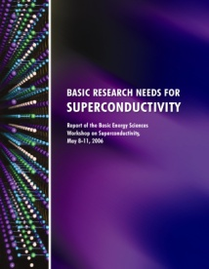
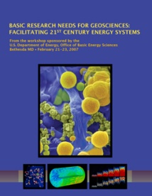
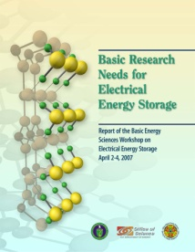
Directing Matter and Energy: Five Challenges for Science and the Imagination
Control the quantum behavior of electrons in materials
Synthesize, atom by atom, new forms of matter with tailored properties
Control emergent properties that arise from the complex correlations of atomic and electronic constituents
Synthesize man-made nanoscale objects with capabilities rivaling those of living things
Control matter very far away from equilibrium
December 2007

Slide 39
Chapter 7: Enabling Grand Challenge Science: the People and the Tools Required
Training and Supporting the Energy Scientists of the Future
A DOE Energy Institute, supporting creativity and accomplishment by the most promising and productive researchers.
An Energy Sciences Study Group, to approach problems requiring science and technology to meet energy security challenges.
A DOE Fellows program for training and inspiring young scientists.
Theory for the Grand Challenges
The Grand Challenges require theorists to discover the new behaviors that govern systems from the nanoscale to the human scale.
Physical Resources: Seeing More Deeply into Nature
New instrument development in individual laboratories or small groups.
Major national facilities.
Specific new enabling methodologies.

Slide 40
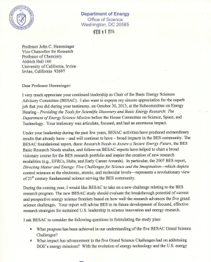
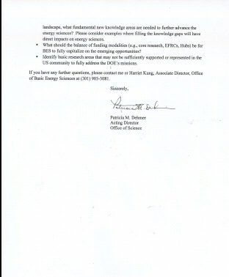
BESAC New Charge on Strategic Planning for BES Research
From: Dr. Pat Dehmer (Acting Director of Office of Science)
The new BESAC study should evaluate the breakthrough potential of current and prospective energy science frontiers based on how well the research advances the five grand science challenges. Your report will advise BES in its future development of focused, effective research strategies for sustained U.S. leadership in science innovation and energy research.
I ask BESAC to consider the following questions in formulating the study plan:
What progress has been achieved in our understanding of the five BESAC Grand Science Challenges?
What impact has advancement in the five Grand Science Challenges had on addressing DOE’s energy missions? With evolving energy technology and U.S. energy landscape, what fundamental new knowledge areas are needed to further advance the energy sciences? Please consider examples where filling the knowledge gaps will have direct impacts on energy sciences.
What should the balance of funding modalities (e.g., core research, EFRCs, Hubs) be for BES to fully capitalize on the emerging opportunities?
Identify research areas that may not be sufficiently supported or represented in the US community to fully address the DOE’s missions.

