Slide 1
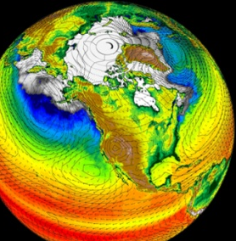
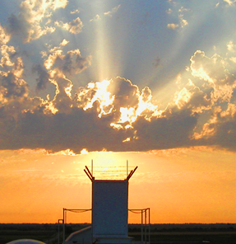
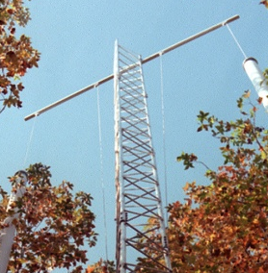
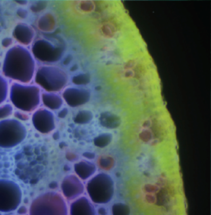
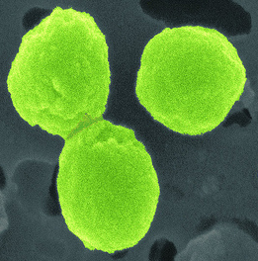


BERAC Meeting
Biological Systems Science Division Update
Sharlene C. Weatherwax, Ph.D.
Director
Biological Systems Science Division
February 23, 2010
Office
of Science
Office
of Science
Office
of Science
Office of Biological
and Environmental Research
Office of Biological
and Environmental Research
Office of Biological
and Environmental Research

Slide 2
Updates on Division Solicitations
CURRENT SOLICITATIONS
  09-25 Biological Systems Research on the Role of Microbial Communities in Carbon Cycling
  FOA-0000143 Computational Biology and Bioinformatic Methods to Enable a Systems Biology Knowledgebase
  FOA-0000223 Joint USDA-DOE Plant Feedstock Genomics for Bioenergy
  FOA-0000265 Radiochemistry and Radionuclide Imaging Instrumentation Research
UPCOMING SOLICITATIONS
  Genomic Science Research (formerly GenomicsGTL)
2 BERAC Feb2010
Department of Energy • Office of Science • Biological and Environmental Research
2 BER BSSD
Department of Energy • Office of Science • Biological and Environmental Research
2 BER BSSD
Department of Energy • Office of Science • Biological and Environmental Research

Slide 3
DOE BER/ASCR Workshop: Opportunities in
Biology at the Extreme Scale of Computing
August 17-19, 2009 in Chicago, IL
Chairs: Rick Stevens (ANL/UC) and Mark Ellisman (UCSD)
BER coordinators: Susan Gregurick and Dan Drell
Goal: Examine the role of extreme-scale computing in biological research and the overlap to further DOE missions in bioenergy, bioremediation and the global carbon cycle.
Five Focus Areas:
  Tissues, Organs, and Physiology Modeling
  Pathways, Organelles, and Cells
  Macromolecular Proteins and Protein Complexes
  Populations, Communities, Ecosystems, and Evolutionary Dynamics: Genomics and Metagenomics
  Data Analysis, Imaging, and Visualization
3 BERAC Feb2010
Department of Energy • Office of Science • Biological and Environmental Research
3 BER BSSD
Department of Energy • Office of Science • Biological and Environmental Research
3 BER BSSD
Department of Energy • Office of Science • Biological and Environmental Research

Slide 4
DOE BER/ASCR Workshop: Opportunities in
Biology at the Extreme Scale of Computing
Overview Findings: Computing at this scale will drive new hardware architectures to enable multi-scale biological computations which require:
  Significant advances to change the development of algorithmic, analytical, mathematical and statistical methods in order to meet these computational and data-rich challenges.
  Advances in Data, Image and Visual analyses are as essential as new methodologies in the extreme-scale to enable biological-science driven discovery processes.
4 BERAC Feb2010
Department of Energy • Office of Science • Biological and Environmental Research
4 BER BSSD
Department of Energy • Office of Science • Biological and Environmental Research
4 BER BSSD
Department of Energy • Office of Science • Biological and Environmental Research

Slide 5
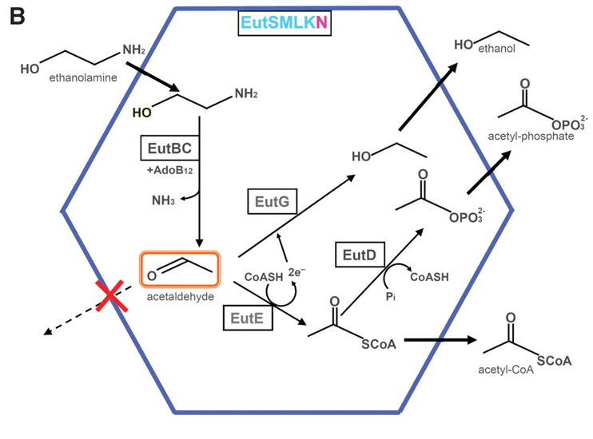

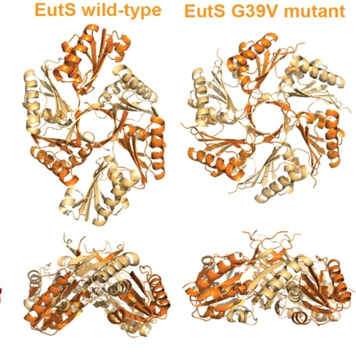
Solving the structure of a microbial metabolic microcompartment
Objective
Understand how microbes sequester metabolic processes in specialized microcompartments
Approach
Select the E. coli ethanolamine utilization microcompartment (Eut) as a test
Determine shell protein x-ray crystal structures and reconstruct a model of the microcompartment
Result/Impact
Determined structures of the four shell proteins, and showed how changes in one protein impact overall microcompartment shell shape
Potential to design novel structures for applications in biofuel production
Tanaka et al., Science (2010) 327, 81–84. UCLA-DOE Institute for Genomics and Proteomics
5 BERAC Feb2010
Department of Energy • Office of Science • Biological and Environmental Research
5 BER BSSD
Department of Energy • Office of Science • Biological and Environmental Research
5 BER BSSD
Department of Energy • Office of Science • Biological and Environmental Research

Slide 6
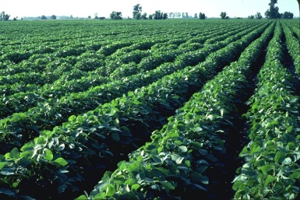
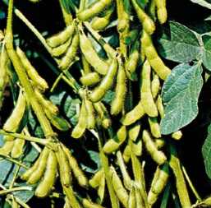
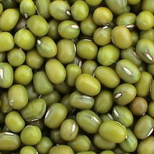
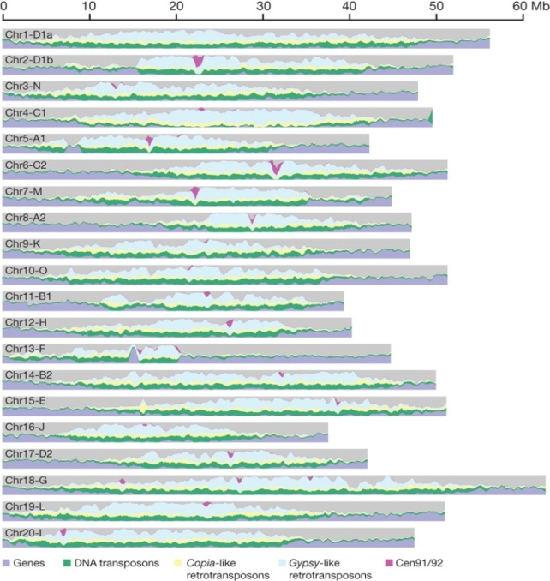
1.1 Gb Soybean Genome Sequenced at the JGI
Whole-genome shotgun sequencing, assembly and integration with physical and high-density genetic maps
Over 46,000 putative genes identified
High-quality draft soybean genome as a reference for other legumes
New tools to develop improved soybean traits for biodiesel, nitrogen-fixation, and nutrition
Genomic landscape of the 20 assembled soybean chromosomes
Schmutz, et. al, Nature, January 14, 2010
6 BERAC Feb2010
Department of Energy • Office of Science • Biological and Environmental Research
6 BER BSSD
Department of Energy • Office of Science • Biological and Environmental Research
6 BER BSSD
Department of Energy • Office of Science • Biological and Environmental Research

Slide 7
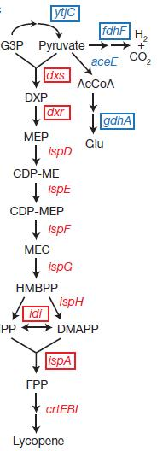
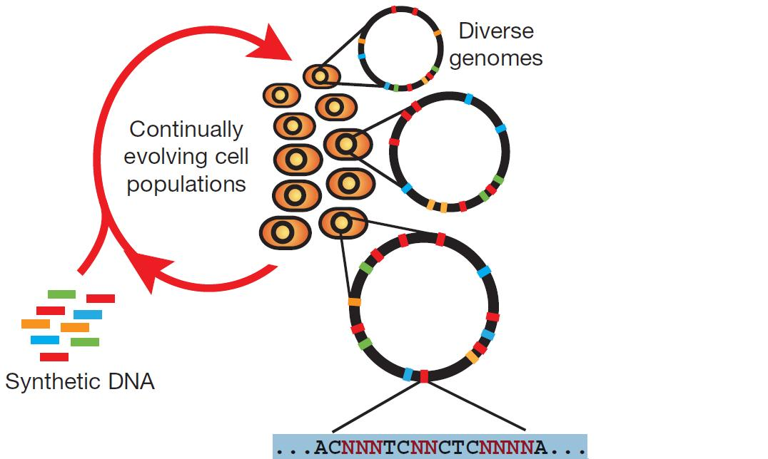


Multiplex Automated Genome Engineering
Objective:
Concurrent engineering of multiple target genes in a microbial biosynthetic pathway for enhanced production
Approach:
Use multiple cycles of oligomer-directed mismatch against target genes.
Results/Impact:
Generated 4.3 billion genomic variants per day
Isolated variants with more than five-fold increase in lycopene production
The methodology for rapid, multigene engineering is broadly applicable to a variety of other pathways, including biofuel production.
Harris H. Wang et al, Nature 460, 894-898
7 BER BSSD
7 BERAC Feb2010
Department of Energy • Office of Science • Biological and Environmental Research
7 BER BSSD
Department of Energy • Office of Science • Biological and Environmental Research
7 BER Overview
7 BER BSSD
Department of Energy • Office of Science • Biological and Environmental Research

Slide 8
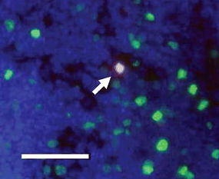



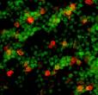
An Adoptive Transfer Method to Detect Low-Dose Radiation-Induced Bystander Effects In Vivo
Objectives
Develop a method for studying low-dose and low-dose-rate radiation-induced bystander effects in vivo in an intact non-irradiated organ of a physiologically normal animal
Test whether bystander effects are the same as seen in low-dose in vitro studies
Spleen section of recipient mouse. Donor cell (red, arrowed) lodged in local field. Proliferating cells stained (green). Tissue section is counterstained with DAPI (blue).
Scale bar = 50 µm.
Results/Impact
Novel robust method is developed.
These results suggest that if bystander effects are occurring in vivo, they may not pose as large a concern to radiation risk estimation as in vitro studies might predict.
Blyth, et al., Radiation Research, 2010
Blyth, et al., Radiation Research, 2010
Donor Mouse
Spleen harvested
Donor Cells
X-rays
Injected intravenously
Image donor and bystander Cells
Recipient Mouse
Spleen harvested
8 BERAC Feb2010
Department of Energy • Office of Science • Biological and Environmental Research
8 BER BSSD
Department of Energy • Office of Science • Biological and Environmental Research
8 BER BSSD
Department of Energy • Office of Science • Biological and Environmental Research

Slide 9
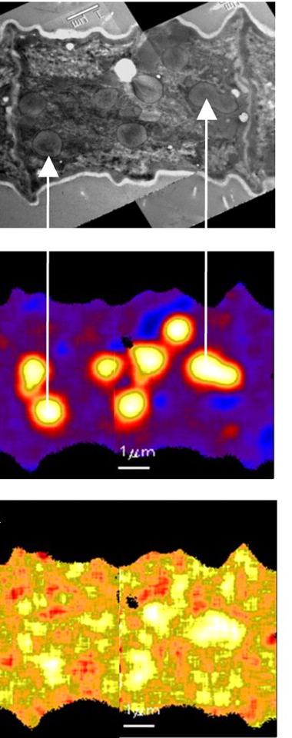
Using NanoSIMS to Analyze Carbon and Nitrogen
Metabolism in Cyanobacteria
Objective
Analyze unique co-occurence of photosynthesis and nitrogen fixation in the cyanobacterium Trichodesmium at the single cell level
Approach
Incubate cells with labeled ¹³C and ¹⁵N
Use high resolution secondary ion mass spectrometry (NanoSIMS) to quantify uptake and image localization of radiolabeled substrates
Results/Impacts
New understanding of temporal regulation of incompatible metabolic processes
Development of new analytical approaches for simultaneous quantification and spatial imaging of metabolic processes at the single cell level
Finzi-Hart et al. 2009 PNAS 106:6345-6350
9 BERAC Feb2010
Department of Energy • Office of Science • Biological and Environmental Research
9 BER BSSD
Department of Energy • Office of Science • Biological and Environmental Research
9 BER BSSD
Department of Energy • Office of Science • Biological and Environmental Research

Slide 10
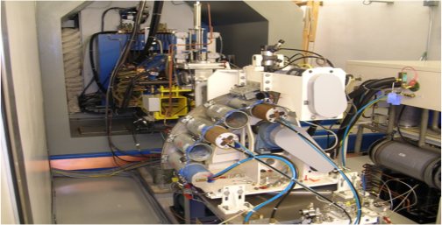
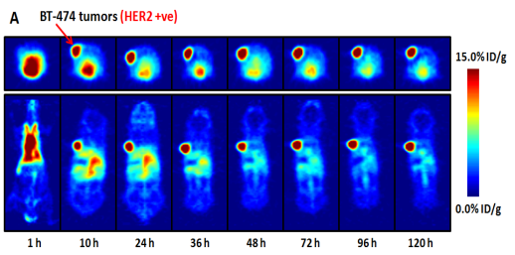
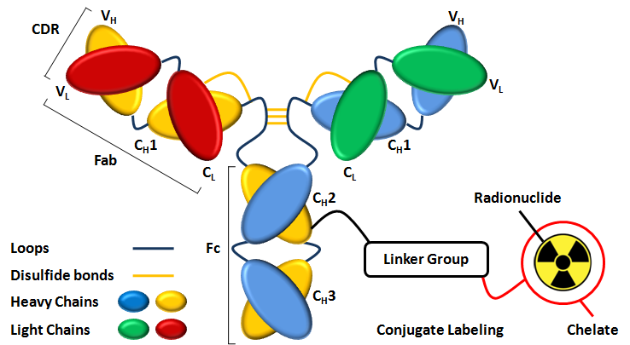
Advancing Research and Training in Radiochemistry
Objective:
Train the next generation of scientists in novel and innovative state-of-the-art radiochemistry research
Encourage Climate of Collaboration
Radiochemistry
(BER)
Applications Res
(NIH)
Approach:
⁸⁹Zr Complexation with Desferrioxamine (DFO)-Conjugated-Protein
Results/Impact:
Contribute to training goals
Fundamental radiochemistry methodology translated to medical application by synthesis of radiolabeled tracer for non-invasive tumor imaging.
Holland et al., PLoS One, January 25th, 2010
10 BERAC Feb2010
Department of Energy • Office of Science • Biological and Environmental Research
10 BER BSSD
Department of Energy • Office of Science • Biological and Environmental Research
10 BER BSSD
Department of Energy • Office of Science • Biological and Environmental Research

Slide 11
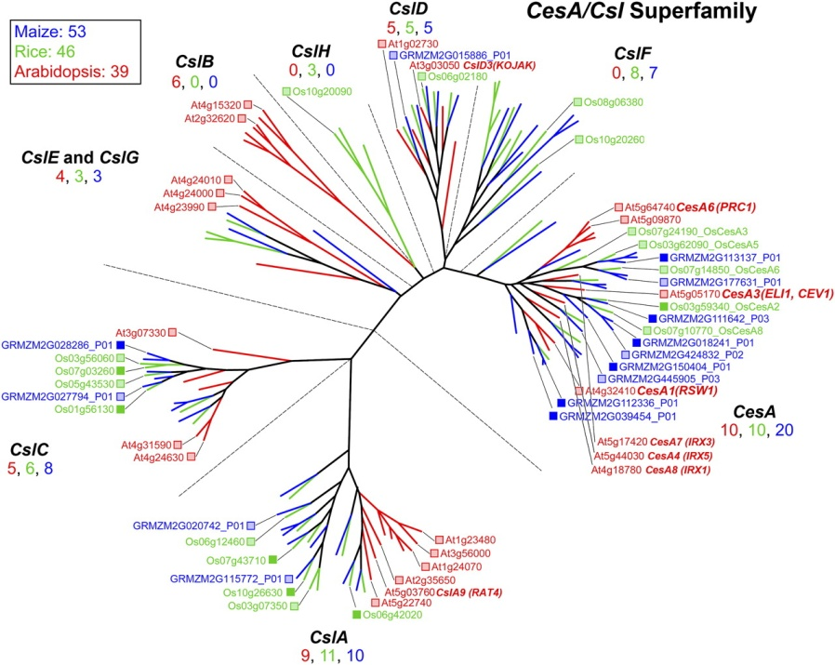
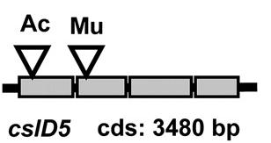

A Resource for Grass Cell Wall Genes
Objectives:
Inventory of maize cell wall genes
High-throughput screen to identify cell wall mutants
Approach:
Comparative genomics; analyze gene expression patterns
Identify mutants with forward and reverse genetics
Find and confirm “invisible” mutants spectroscopically
Results/Impact:
Differences highlight need for grass-specific genetic model
Characterize grass cell wall gene functions
Translate to improved biomass yield and quality in grass bioenergy species
Penning BW, et al. 2009, Plant Physiology 151: 1703-1728.
11 BERAC Feb2010
Department of Energy • Office of Science • Biological and Environmental Research
11 BER Overview
Department of Energy • Office of Science • Biological and Environmental Research
11 BER BSSD
Department of Energy • Office of Science • Biological and Environmental Research
Notes:
11

Slide 12

DOE Bioenergy Research Centers
Second year on-site progress reviews
  GLBRC—September 9-10, 2009
  JBEI—September 30 – October 1, 2009
  BESC—October 14-15, 2009
External review team evaluated:
  science and management
  progress against stated milestones
Review findings
  Reviewers were enthusiastic about each BRC’s successful transition from start up to full operational mode
  All centers have demonstrated significant research accomplishments
  Reviewers all expressed confidence in leadership and management by each BRC director
Specific recommendations communicated to BRC directors
12 BERAC Feb2010
Department of Energy • Office of Science • Biological and Environmental Research
12 BER Overview
Department of Energy • Office of Science • Biological and Environmental Research
12 BER BSSD
Department of Energy • Office of Science • Biological and Environmental Research

Slide 13

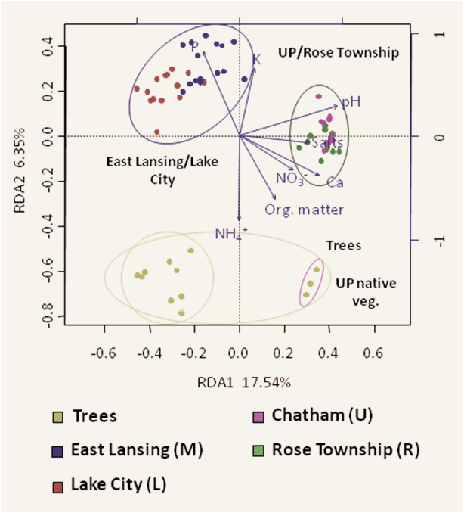
Characterization of Bacterial Communities in Marginal Lands to Improve Sustainability
Objectives
Understand soil microbial community structure for biomass crop growth on marginal lands
Approach:
Determine microbial community composition as function of plant species, soil attributes, and location
Sequence 16S rRNA genes in environmental samples
Results/Impact:
Soil type and location were more important determinants of microbial communities than were crop species
Controlling for other measures, microbial soil communities were more diverse under cultivated crops than forests, despite the greater above-ground diversity in forests.
Jesus et al.,BioEnergy Research 3:1939-1234
13 BERAC Feb2010
Department of Energy • Office of Science • Biological and Environmental Research
13 BER Overview
Department of Energy • Office of Science • Biological and Environmental Research
13 BER BSSD
Department of Energy • Office of Science • Biological and Environmental Research

Slide 14

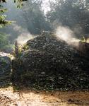
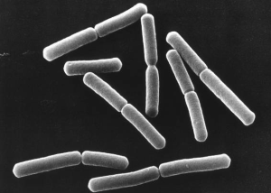
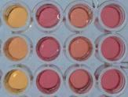
Mining Compost for Enzymes to Degrade Switchgrass
Green-waste compost
Objective
Develop novel enzymes for switchgrass degradation
Approach
Bioreactor
Screen, identify, characterize enzymes
10% compost : 90% switchgrass
adapted microbial community
synthesize two hemicellulose-degrading genes
Introduce into E. coli and
demonstrate activity
Results/Impact
One of the two enzymes actively degraded cellulosic material and is a promising candidate for further study
These methods advance the ability to discover, synthesize, and produce new enzymes with the high efficiency observed in nature, and provide a path to further improvements
14 BERAC Feb2010
Department of Energy • Office of Science • Biological and Environmental Research
14 BER Overview
Department of Energy • Office of Science • Biological and Environmental Research
14 BER BSSD
Department of Energy • Office of Science • Biological and Environmental Research

Slide 15

Use of a Thermophilic Bacterium to Reduce the Need for Biomass Pretreatment
Objectives
Reduce the cost of pretreatment requirements through the use of thermophilic microbes and/or enzymes for the conversion of biomass
C. bescii
Attached to Switchgrass
Approach
Caldicellulosiruptor bescii strain DSM 6725 is an extremely thermophilic celluloytic organism (T_{opt} 75ºC)
C. bescii was tested with crystalline cellulose and xylan, several hardwoods and grasses, and “spent biomass” -- residual, insoluble substrate
Results/Impact
More than 60% of the switchgrass material was solubilized without pretreatment
Provides optimism for the possibility of direct conversion of biomass without pretreatment
15 BERAC Feb2010
Department of Energy • Office of Science • Biological and Environmental Research
15 BER Overview
Department of Energy • Office of Science • Biological and Environmental Research
15 BER BSSD
Department of Energy • Office of Science • Biological and Environmental Research

Slide 16
Joint Genome Institute
March 10-11 Operations Review
  Project tracking
  Communication with JGI users
  Resource optimization for operational efficiency
  Adoption of new technologies
  Contingency planning
Community Sequencing Program 2011—anticipate March 2010 release
  Large-scale resequencing of organisms
  Large scale metagenome sequencing
  Single cell genomes
  Large scale microbial isolate sequencing
Strategic Planning update
  Applications of High Performance Computing (HPC) in Genomics --January 2010
16 BERAC Feb2010
Department of Energy • Office of Science • Biological and Environmental Research
16 BER BSSD
Department of Energy • Office of Science • Biological and Environmental Research
16 BER BSSD
Department of Energy • Office of Science • Biological and Environmental Research

Slide 17
A look ahead for BSSD
Principal investigator meetings
  JGI User Meeting
  Low Dose Radiation Research
  Artificial Retina
Future workshops
  Systems Biology Knowledgebase Conceptual Design
  Critical Assessment of Functional Annotation Experiment (CAFAE)
  Central DOE Institutional Review Board
  ESNet requirements gathering (joint ASCR/BER)
17 BERAC Feb2010
Department of Energy • Office of Science • Biological and Environmental Research
17 BER BSSD
Department of Energy • Office of Science • Biological and Environmental Research
17 BER BSSD
Department of Energy • Office of Science • Biological and Environmental Research

