Slide 1
Advanced Research Projects Agency – Energy
(ARPA-E)
Dr. Arun Majumdar
Director, ARPA-E
U.S. Department of Energy
http://arpa-e.energy.gov/

Slide 2
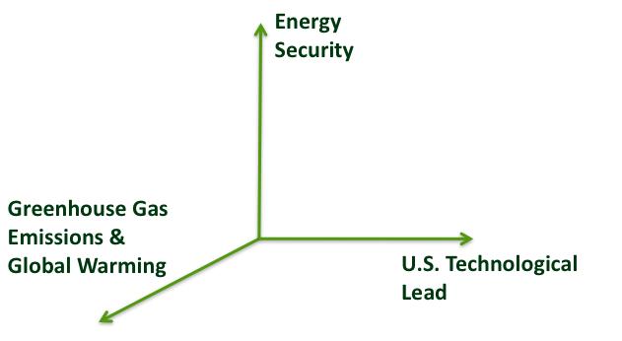
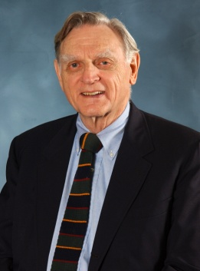


SPUTNIK MOMENT OF
OUR GENERATION
EXAMPLE
Lithium-ion battery manufacturing volumes in 2009
(millions of cells/year)
2009
John Goodenough, U. Texas at Austin
2

Slide 3

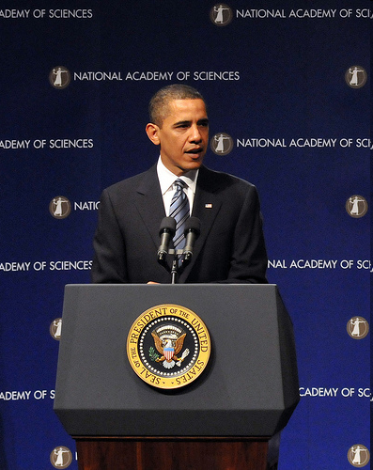
CREATION OF ARPA-E
American Recovery and Reinvestment Act of 2009
(Recovery Act)
2007
America COMPETES Act
  $400M appropriated for ARPA-E
  President Obama launches ARPA-E in a speech at NAS on April 27, 2009
2006
Rising Above the Gathering Storm
(National Academies)
Notes:
Where did we come from?

Slide 4
FIRST ROUND OF FUNDING
Concept Paper Phase
Full Application Phase
Final Selection
Review
312
Encouraged
Full
Applications
3700
Received
Panel Reviews
37 Projects
(avg. $4M)
(2-3 years)
April - June 2009
June - July 2009
September –
Early October 2009
Announced on
October 26
Award Negotiations Completed in 3 months including 3 Uses of Other Transaction Authorities
“In my 30 years of doing Government contracting…..I have never seen any government project move from selection to contracts and to actual work with such speed anywhere near what we are seeing out of ARPA-E…..” CEO, Diversified Energy Corporation, Gilbert, AZ - 01/27/10

Slide 5

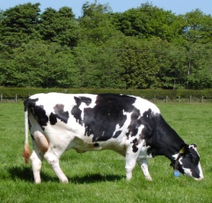
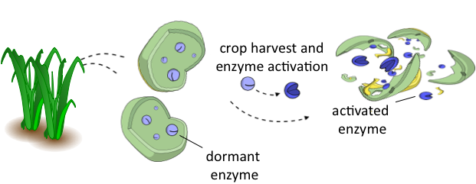
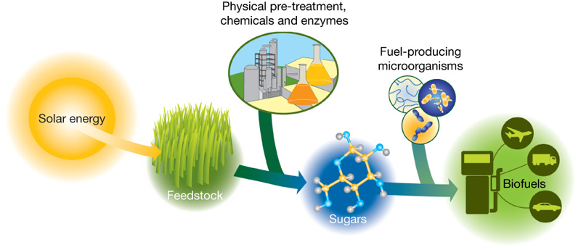
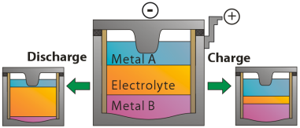
Examples from First Round
of Funding
Cellulosic Biofuels
GreenGenesTM Technology
Artificial Cellulose Breakdown is Expensive ($$)
Putting the cow inside the plant!
Plant produces all the enzymes & chews itself from the inside!!
Breakthrough High Efficiency Mixer/Ejector Wind Turbine (MEWT) – FloDesign Wind Turbine Corp.
Grid-Level Electricity Storage - MIT
Megawatts of storage
For several hours
Mimic jet engines,
not propellers, for wind turbine
40% lower cost expected vs. horizontal axis wind turbines (HAWT)
Potential Cost:
$50/kW-hr
Lithium Ion Laptop Battery: $2000/kW-hr
Lithium Ion Car Battery: $1000/kW-hr

Slide 6
What is an ARPA-E Project?
High Impact on ARPA-E
Mission Areas
Disruptive, Innovative
Technical Approaches & New Learning Curves
Best-in-class People & Teams; Attract the US Intellectual Horsepower to Energy
Strong Impact of ARPA-E
Funding Relative to Private
Sector
Notes:
High Impact Missing
What ARPA-E is looking for ….4 big boxes…move slowly
Here is what we’re looking for and here is how we do it (Project Management Philosophy)
6

Slide 7
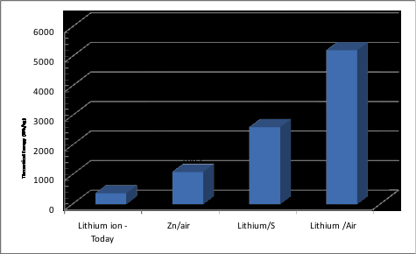
Batteries for Electrical Energy Storage for
Transportation (BEEST)
ARPA-E Investment
Current US
Investments
Novel Architectures/
Manufacturing Processes
Energy Density (Wh/kg)
Practical
Value for Engines
Japanese govt investing $60M/yr

Slide 8
Batteries for Electrical Energy Storage for Transportation
(BEEST)
Recapping
Stanford
(Capacitive)
Program Director: David Danielson (PhD Materials Sci, MIT; General Catalyst)
  Cell-level energy density: 400 W-hr/kg (2.5X higher)
  Cost: $250/kW-hr (4X lower)
  New architectures & manufacturing processes
Upside
Ultra-High Energy
PolyPlus
(Li-Air)
Missouri Inst of Sci/Tech
Sion Power
(Li-S)
MIT
(Flow Batt)
ReVolt (Zn-Air Flow)
Mfg Innovations
Pellion (Mg-Ion)
Planar Energy Devices
(Solid State Li-Ion)
Infrastructure Compatible
High Energy Materials
AMAT/A123/
LBNL
(Li Ion Mfg)
Time to Market

Slide 9
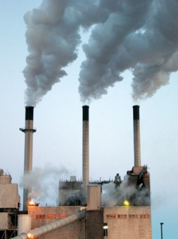
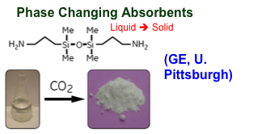
Low-Cost Carbon Capture
Program Director: Mark Hartney (PhD Chem Engr, UC Berkeley, DARPA, Lincoln Labs, Bell Labs, Flex Tech)
Today:
CO₂ +
Today’s CO₂
Binding Chemicals
Bind, Isolate & Release
Cost: $70-100/tCO₂
Cost Above Price = Loss!
High-Temperature Heat
Market Price of CO₂: ≈ $30/tCO₂
Carbon Capture in Solid Form
Potential Cost = $25-30/tCO₂
9

Slide 10
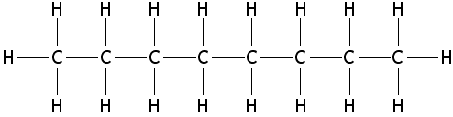
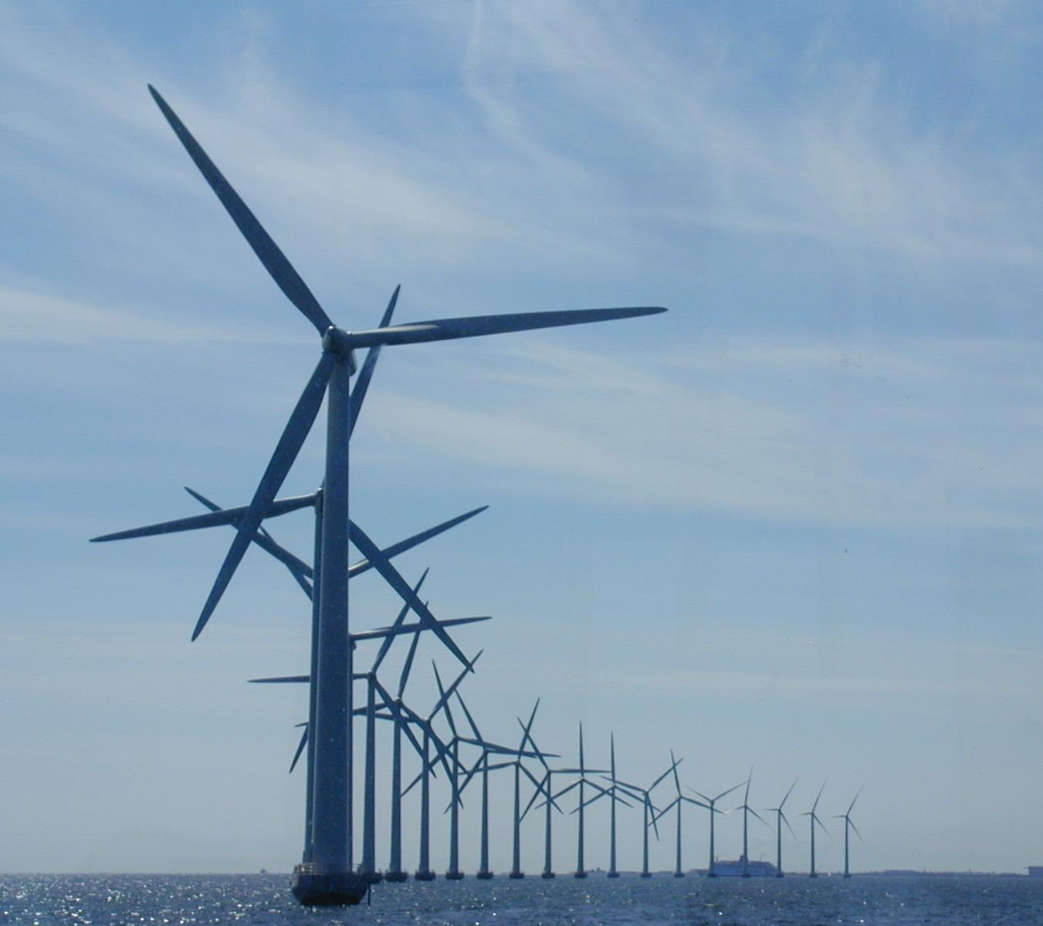
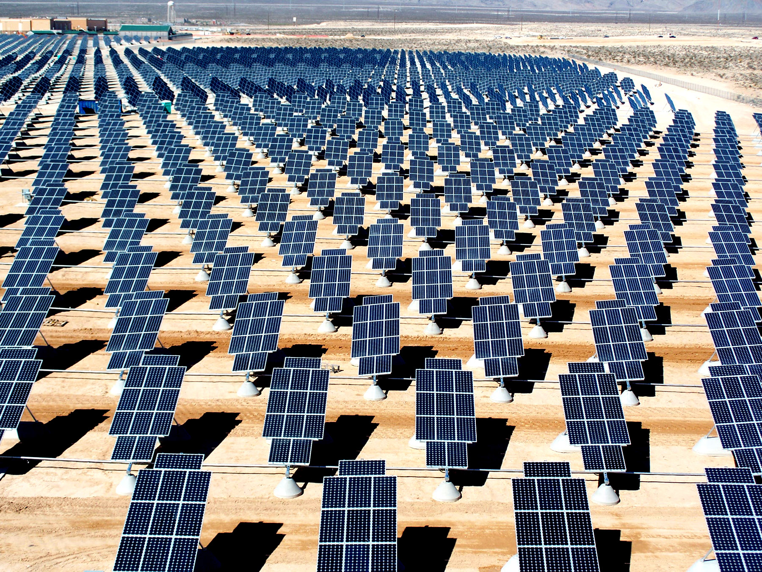
Electrofuels
Program Director: Eric Toone (Robert Bass Prof of Chemistry, Duke; PhD-Toronto; Post-Doc - Harvard)
CO₂
Octane
3. Greenhouse gas emissions
Gasoline
Non-Photosynthetic/Modular/Mix-and-Match
4. 60% imported
H₂
2. Difficult to store
Electricity
1. Difficult to store
PIs: David Baker (U. Washington), Jay Keasling (Berkeley), Pam Silver (Harvard), ….

Slide 11
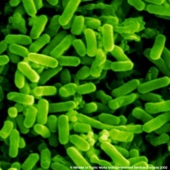
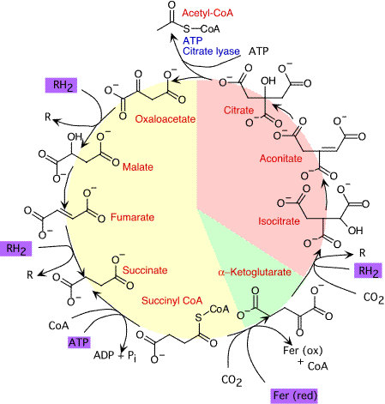
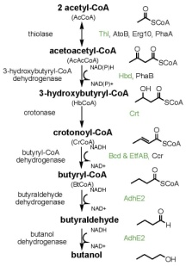
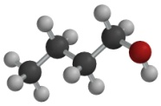
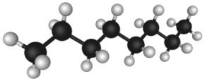
Electrofuels approach is non-photosynthetic, modular, and solutions can be mixed- and- matched
Reducing equivalents: other than reduced carbon or products from Photosystems I & II
Assimilate Reducing Equivalents
H₂S
Direct Current
Fe²⁺
H₂
NH₃
Pathway for carbon fixation: reverse TCA, Calvin- Benson, Wood-Ljungdahl, hydroxpropionate/hydroxybutyrate, or newly designed biochemical pathways
Fix CO₂ for Biosynthesis
Fuel synthesis metabolic engineering to direct carbon flux to fuel products
Generate Energy Dense Liquid Fuel
+ numerous possibilities
butanol
alkanes

Slide 12
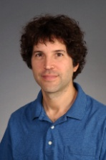
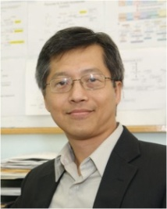
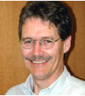
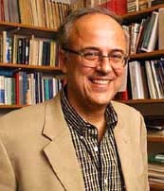
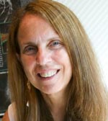
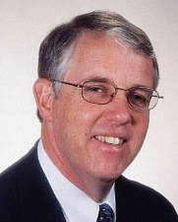

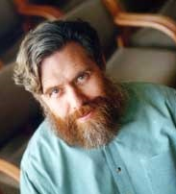
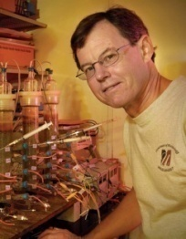
The Electrofuels PIs are leading scientists from multiple disciplines
Biochemists
Synthetic Biologists
Microbiologists
Dr. David Baker (Washington)
Dr. James Liao (UCLA)
Dr. Mike Adams (Georgia)
Dr. Greg Stephanopoulos (MIT)
Dr. Pamela Silver (Harvard)
Dr. Robert Kelly (NCSU)
Dr. Anthony Sinskey (MIT)
Dr. George Church (Harvard)
Dr. Derek Lovley (UMass Amherst)
Notes:
12

Slide 13
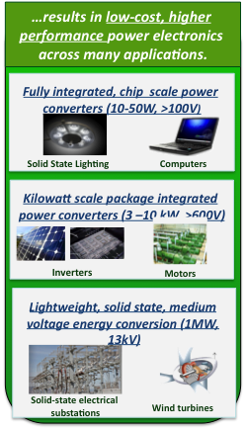
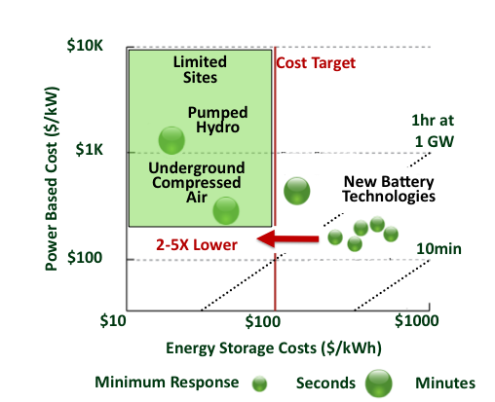
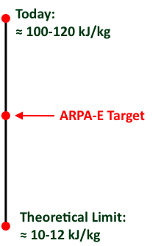
Round 3 Programs
Grid-Scale Rampable Intermittent
Dispatchable Storage (GRIDS)
Building Energy Efficiency Through Innovative Thermo-devices (BEETIT)
Power Electronics
Program Director: Mark Johnson (Prof. of Mat Sci, NCSU)
Program Director: Ravi Prasher (Formerly Intel, PhD-ASU)
Program Director: Rajiv Ram (Professor, EECS Dept, MIT)
Announced: March 2, 2010
Awardees Selected: July, 2010
All Awards Made: September, 2010

Slide 14
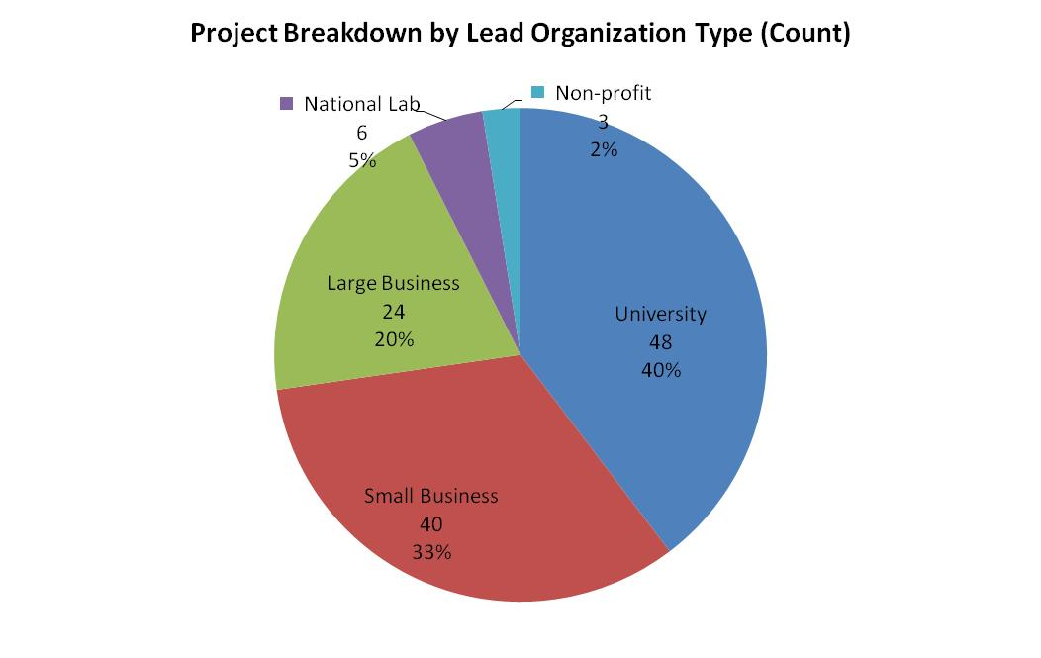
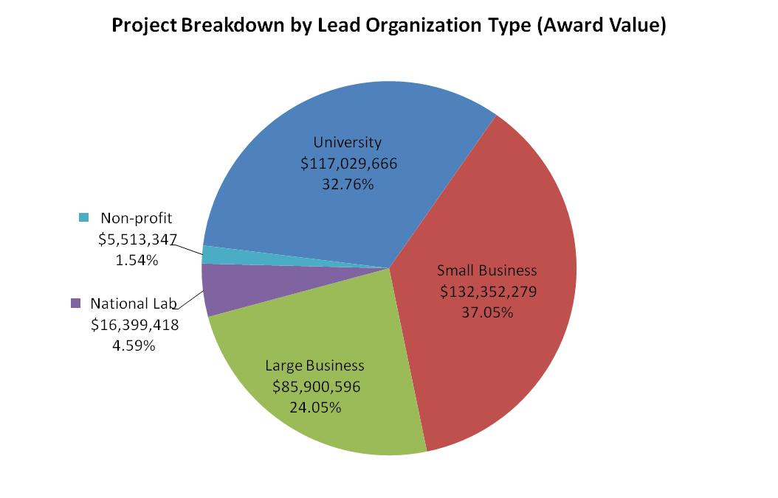
Statistics

Slide 15
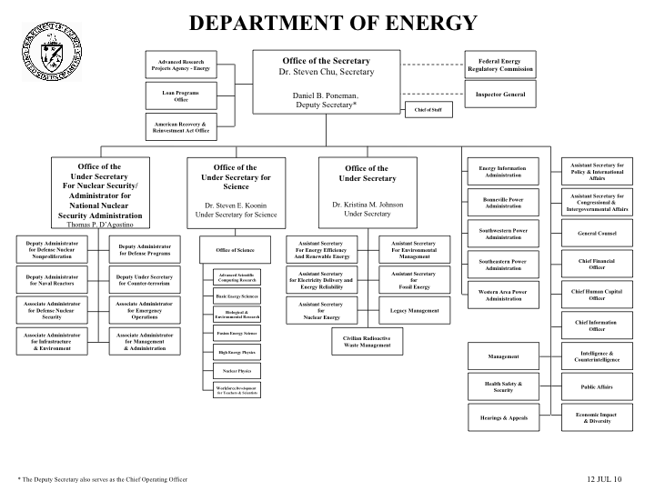
Doe organizational chart

Slide 16
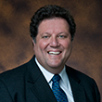

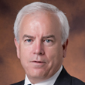
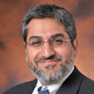
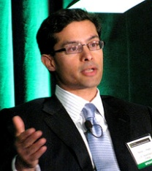
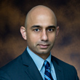




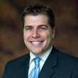


Arpa-e Team
Program Team
Commercialization Team
Leshika Samarasinghe
Eric Toone
Dave Danielson
Mark Hartney
Rajeev Ram
Srini Mirmira
Sanjay Wagle
Mark Johnson
Ravi Prasher
Karma Sawyer
Strategic Outreach
Operations Team
Shannon Barrett
Shane Kosinski
Tony DiGiovanni
Matt Dunne

Slide 17
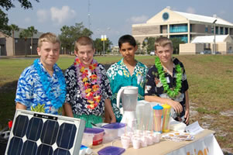
ARPA-E Fellows Program
  …bring best and brightest scientist, engineers, and technical entrepreneurs in to ARPA-E and create a think tank to identify gaps, challenges, opportunities and new ways of creating energy technologies (80% of time)
…engage with the next generation and get them excited and educated in energy and environment (20% of time)

Slide 18
MANAGING EXPECTATIONS
NOW
3 - 5 YRS
10+ YRS
Attracting the best minds to energy R&D
Follow on investment post ARPA-E award ($)
Increase in enterprise value of company ($)
Companies created (#)
Initiating new technology-business ecosystems
Accelerated market entry - Products to market (#) / Product sales ($)
Patents filed and licensed (#)
Papers published in top journals (#)
World Record-setting “best-in-class” performance (#)
Home Runs
Domestic and global sales, US market share ($)
Avoided greenhouse gas emissions
(tCO₂ equivalent)
Reduced oil imports (barrels of oil equiv.)
Creation of new technology/business or new industry ecosystem (#)
Jobs created (#)
Beating current projections and trajectories (Moving McKinsey GHG abatement cost curves, EIA & IPCC projections, etc.)
Oversubscription
Pace of Operation
Recruiting all-star program directors who span science, technology, and business (#)
New outcome-based innovative programs
Investment in “white spaces” with high potential mission impact ($)
Innovative organizational structure/processes
ARPA-E Energy Innovation Summit

Slide 19

ARPA-E ENERGY INNOVATION SUMMIT
2 months preparation
1700 attendees
Integrating relevant communities
Favorite aspects
  Technology showcase
  Summit acting as a “catalyst”
  Interacting with ARPA-E Program Directors
“Probably the best conference I have ever attended with extremely high caliber speakers and panelists. Great job!” – Executive from large corporation
“It was great to see a fast paced, entrepreneurial mentality applied to energy.” – Technology company executive
“Great event. Came away with renewed enthusiasm for DOE’s ability to be part of the solution.” – Academic researcher
“The ARPA-E showcase was the best venue to meet potential funding sources, collaborators, customers, partners, and vendors with an excellent opportunity to talk to the best and brightest experts in the field. This will become a must do event.” - Technology company executive, Showcase exhibitor
“As an investor, I found the technology showcase to be of tremendous value. Not only in terms of finding prospective investments, but also to get my finger on the pulse of up and coming technologies in the field. This was by far the best part of the conference for me.” – Investor

