Slide 1
Dr. R. Todd Anderson
Biological Systems Science Division (BSSD) Update
Biological and Environmental Research Advisory Committee Meeting
October 6, 2011
Rockville, MD

Slide 2
Update Outline
Personnel
Completed Programmatic Activities
Upcoming Programmatic Activities
Division Science Highlights
  Bioenergy research centers
  Genomic Sciences
  Radiochemistry
  Low Dose Radiation Science
  Structural Biology
  JGI News

Slide 3
Personnel Update
BSSD Division Director Position
  Position closed on September 9, 2011
  Timeframe for selection - TBD
National Laboratory Detailee (Genomic Sciences)
  Dr. Michael Thelen (LLNL)
  October 2011

Slide 4
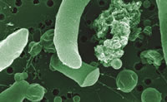
Programmatic Activities
(Completed)
University Notice:
Genomic Sciences Review (Dec. 8-10, 2010)
  Award processing began in late April.
138 full proposals received
28 awards (16 bioenergy and 12 environmental)
General Topics of Research
Bioenergy-related
Plant polymer biosynthesis and degradation
  cellulose, hemicellulose and lignin
Plant systems biology
Growth rate regulation in grasses
Systems biology of photosynthetic microbes
Metabolomics of biofuel production
Enabling tools for plant cell wall research
Environmental processes-related
Electron flow in metal-reducing biofilms
Symbiosis and cell-cell signaling in
microbial communities
Omics methods for nutrient cycling processes
Metagenomics approaches to natural
attenuation of contaminants
Functional proteomics of microbial iron and
sulfate reduction

Slide 5
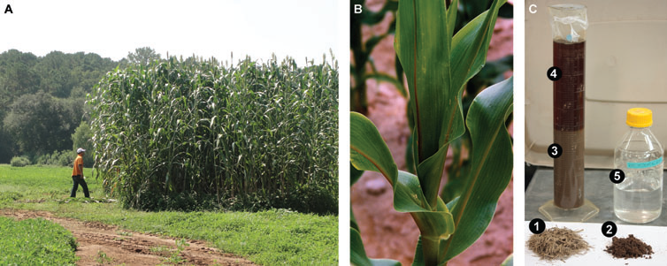
Programmatic Activities
(Completed)
USDA-DOE Plant Feedstock Genomics for Bioenergy: 2011 Awards
Fundamental research to enhance translation of genomics information into cultivar improvement (“phenomics”) for bioenergy crops.
Phenotyping plant germplasm collections and advanced breeding lines in public breeding programs of bioenergy crops.
Ten Projects Selected for Awards Totaling $12.2M
($10.2M DOE, $2M USDA)
  Switchgrass (U Oklahoma; Colorado St U)
  Populus (Virginia Tech; UC Davis)
  Sorghum (U Missouri; U S Carolina; Kansas St U)
  Brachypodium (Danforth Center)
  Miscanthus (U Illinois)
  Energy cane (U Florida)

Slide 6
Programmatic Activities
(Completed)
National Laboratory Reviews:
PNNL’s Low Dose SFA (on site) (July13-15)
LBNL’s Low Dose SFA (on site) (September 7-9)
PNNL’s Foundational Genomic Science SFA (on site) (September 7-9)
Workshops
Applications of New DOE National User Facilities in Biology Workshop
(May 9-11, 2011)
Biosystems Design Workshop (July 18-20, 2011)
Committee of Visitors (COV) Review
June 13-15, 2011 (DOE HQ – Germantown. MD)
Human Subjects Protection Program Reviews:
LLNL, LANL, and ANL (since Sept 2010)

Slide 7
Programmatic Activities
(Upcoming)
Reviews
Annual BRC reviews
Review of the Joint Genome Institute (Dec. 2011)
Human Subjects Protection Program reviews at LBNL, PNNL in FY12
Program Meetings
Genomic Science Principal Investigator’s Meeting (Feb. 26-29, 2012) Bethesda
North Marriott, MD
USDA-DOE Plant Feedstocks Genomics for Bioenergy annual Principal
Investigators Meeting (Jan.13, 2012)
Notices
Joint DOE-USDA Plant Feedstock Genomics Notice
(post date mid Nov. 2011 FOA SC0000598)
Symposia/Conferences
PittCon 2012 “Mass spectrometry advances conversion of biomass to biofuels”
(R. Hirsch and A. Katz organizers; Mar. 14, 2012)
IMAG - Interagency Modeling and Analysis Group Grantee Meeting (Oct. 5-6,
2011 at NIH)

Slide 8

New Award!!
DOE Systems Biology Knowledgebase
One Project, four National Laboratories
PI: Adam Arkin (LBL)
Co-PIs: Rick Stevens (ANL), Robert Cottingham (ORNL), Sergei Maslov (BNL)
Objective:
Develop a cyber infrastructure needed to support the creation, maintenance and use of predictive models and methods in the study of microbes, microbial communities and plants and demonstrate the utility of these tools in advancing DOE goals in bioenergy, carbon cycle research and environmental microbiology.
Long Term Goals:
Rapidly reconstruct metabolic and regulatory pathways for 100-1000 microbes with comparative reconstructions at 90% accuracy for growth and phenotypic characteristics.
Integrate experimental data with key plant genomes, including real-time field data. Associate experimental data with plant phenotype and predict relationship between phenotype to genotype to environment.
Integrate experimental ‘omics data with reference metagenomics sample sequences. Develop capabilities for metabolic reconstructions and modeling in natural microbial communities.

Slide 9

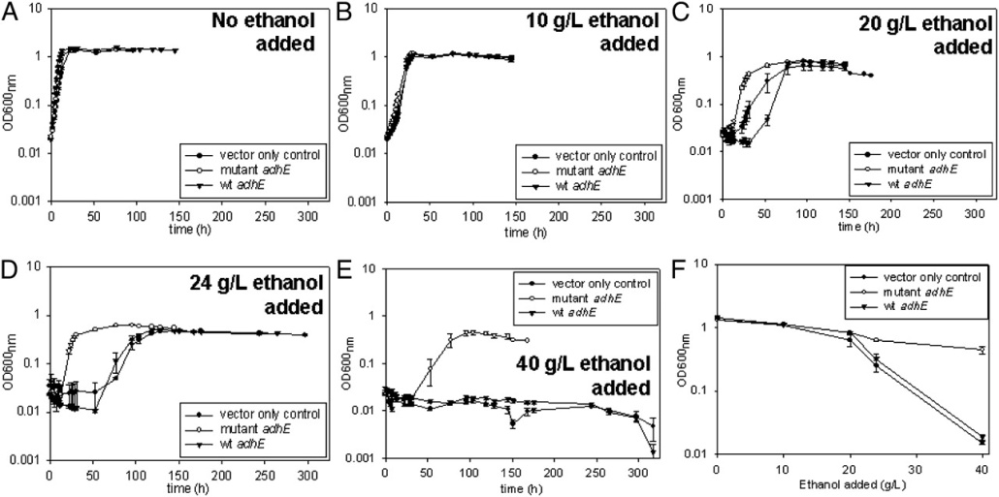
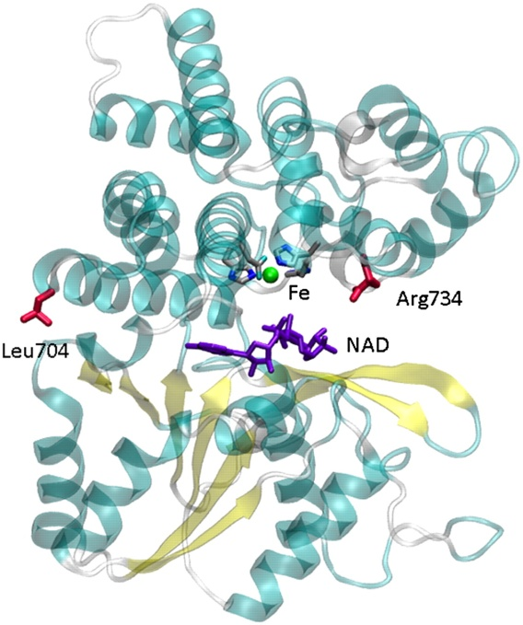
BRC Science Highlight
Key Ethanol Tolerance Gene Identified
Objective
Improve the bioprocessing efficiency of converting plant biomass conversion to ethanol.
Approach:
Comparative analysis of genomes of wild type (WT) and ethanol-tolerant Clostridium thermocellum strains revealed a mutation in acetaldehyde-CoA/alcohol dehydrogenase (adhE), a gene involved in ethanol production.
Additional assays confirmed addition of mutated adhE to WT cells (mutated adhE⁺) imparted marked increased ethanol tolerance.
Results/Impacts:
Modification of one gene resulted in a marked increase in ethanol tolerance.
Ethanol tolerance may be linked more to central metabolism than previous thought.
The relative simplicity of producing the expressed phenotype is informative to developing bioengineered microbial strains for cellulosic ethanol production.
Brown S D et al. PNAS 2011;108:13752-13757

Slide 10

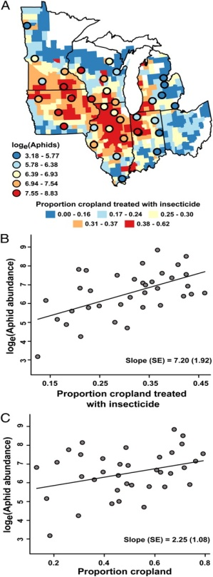
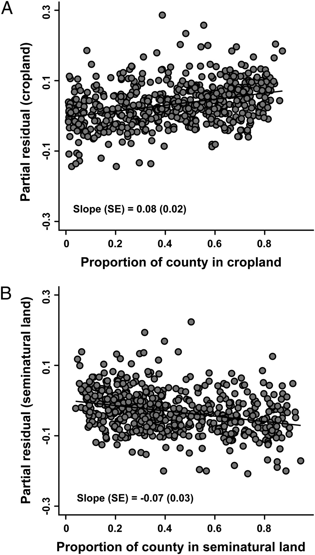
BRC Science Highlight
Impact of Bioenergy Feedstocks on Agricultural landscapes
Objective:
Evaluate insecticide use and insect pest pressure in expansive monoculture cultivated landscapes to inform sustainable bioenergy practices.
Approach:
Analyze remotely sensed land cover data, a census of farm management practices and information from regional pest monitoring network across the entire Mid-Western US.
Test the hypothesis that landscape simplification results in increased insect pest pressure and therefore increased insecticide use.
Results/Impacts:
This study provides correlative evidence of a relationship between landscape simplification, insecticide use and pest abundance using data from the entire Mid-Western US farming region.
Implications for forecasting bioenergy crop production and management practices.
Meehan T D et al. PNAS 2011;108:11500-11505
Notes:
.

Slide 11

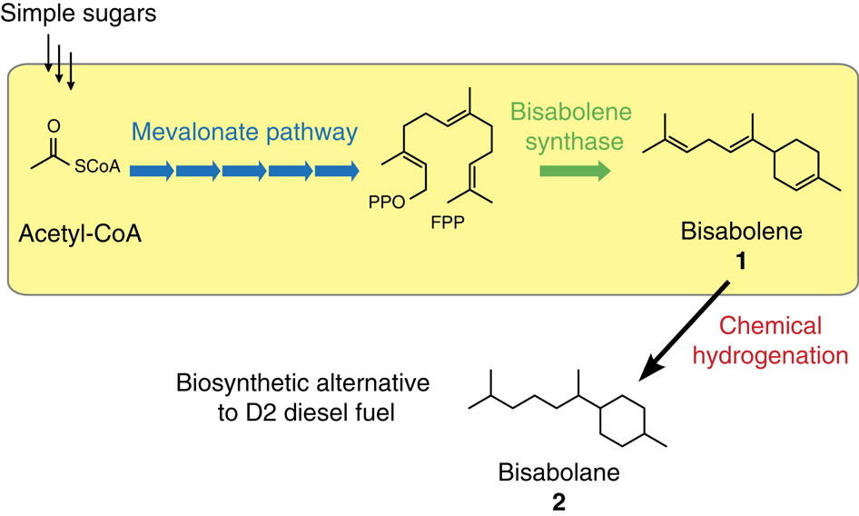
BRC Science Highlight
Joint Bioenergy Institute (JBEI):
Microbial Production of Bisabolane
Chemical
Hydrogenation
Objective:
Develop biological synthesis of a high energy content biofuel molecule compatible with existing engines and fuel infrastructure
Approach:
Identified a terpene (bisabolane) with fuel properties similar to diesel and metabolically engineered E. coli and S. cerevisiae to synthesize a precursor (bisabolene) that can be subsequently converted to the desired end product.
Results/Impact:
First demonstration of microbial synthesis of this high energy content, low toxicity biofuel from simple sugars.
Peralta-Yahya et al. 2011. Nature Communications 2:483.

Slide 12

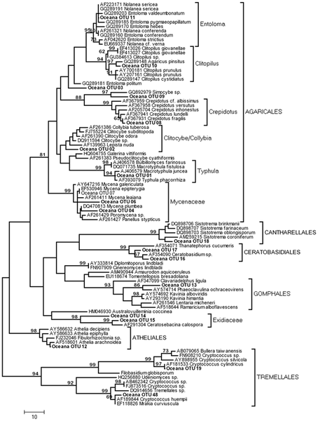
GSP Science Highlights
Systems Biology Approach to Terrestrial Carbon and Nitrogen Cycling
Objective:
In some northern forest ecosystems, increased nitrogen input results in a net increase in storage of organic carbon in forest soils. How is the structure and function of microbial communities related to this phenomenon?
Approach:
At a N manipulated field site, targeted metatranscriptomic analysis and enzyme assays were used to examine shifts in fungal community composition and expression of enzymes involved in degradation of cellulose and lignin.
Results/Impact:
Under elevated N conditions, there were significant shifts in fungal community composition and a correlated 2-4 fold reduction in expression of genes involved in lignin degradation, suggesting decreased decomposition of recalcitrant soil carbon.
Edwards et al. PLoS ONE 2011; 6(6): e20421. doi:10.1371/journal.pone.0020421

Slide 13
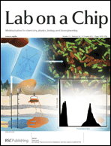
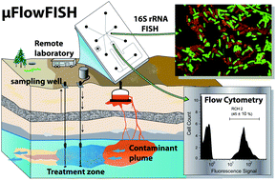
GSP Science Highlights
New Microfluidic Device for Identification and Quantification of Environmental Microbes
Objective:
High throughput identification and quantification of functional classes of microbes in environmental samples containing low amounts of biomass
Approach:
Developed a microfluidic chip with chambers for diagnostic fluorescent labeling of cells (“FISH”) and flow cytometric counting of labeled cells.
Results/Impact:
Initial analysis using groundwater samples from uranium contaminated Hanford 100H site in Washington detected different classes of uranium immobilizing microbes.
When coupled to “omic” techniques, provides a powerful tool to estimate population levels of microbes performing important functional processes in the environment.
Liu et al. Lab On A Chip 2011; 11: 2673-2679

Slide 14

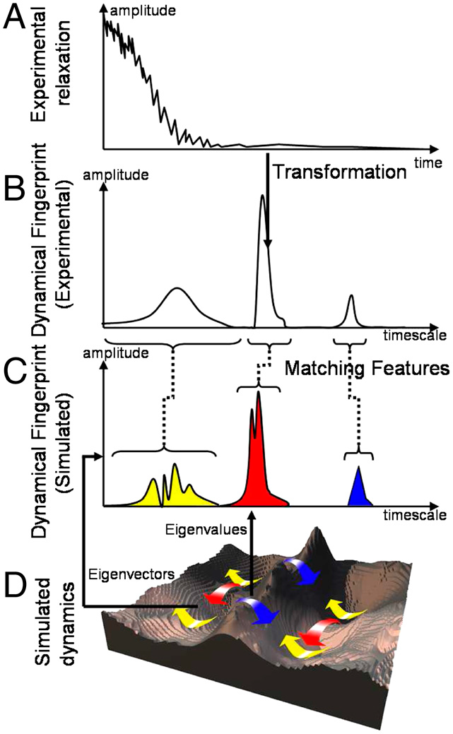
GSP Science Highlights
Correlating Experimental Measurements with Computational Simulations
Objective:
Correlate biomolecular structural changes from kinetic experiments with computer simulations of the process.
Approach:
Theory based on structural dynamics as a time-dependent probability transport in state space
New method called Dynamical Fingerprints allows researchers to compare the kinetic features of an experiment directly with computational simulations
Results/Impact:
New method to interpret single molecule fluorescence correlation spectroscopy experiments with molecular dynamics simulations.
Enables design of new experiments with site specific labels to optimally probe processes in the proteins under investigation. Now being applied to interpret neutron scattering data.
Frank Noě, et.al, PNAS 2011;108 (12):4822-4827

Slide 15
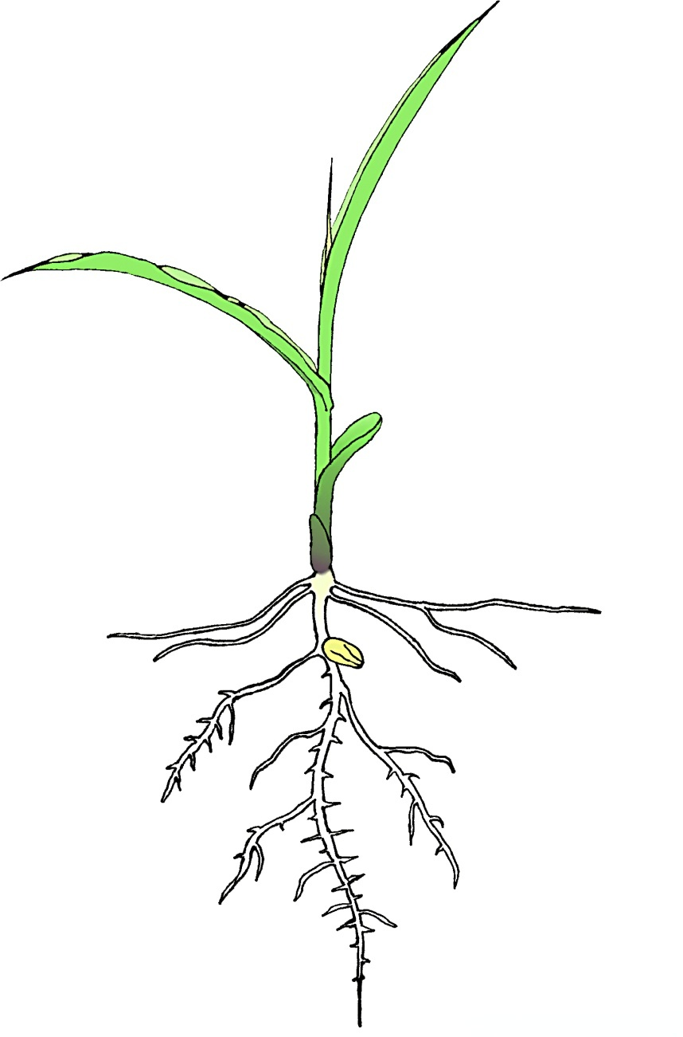
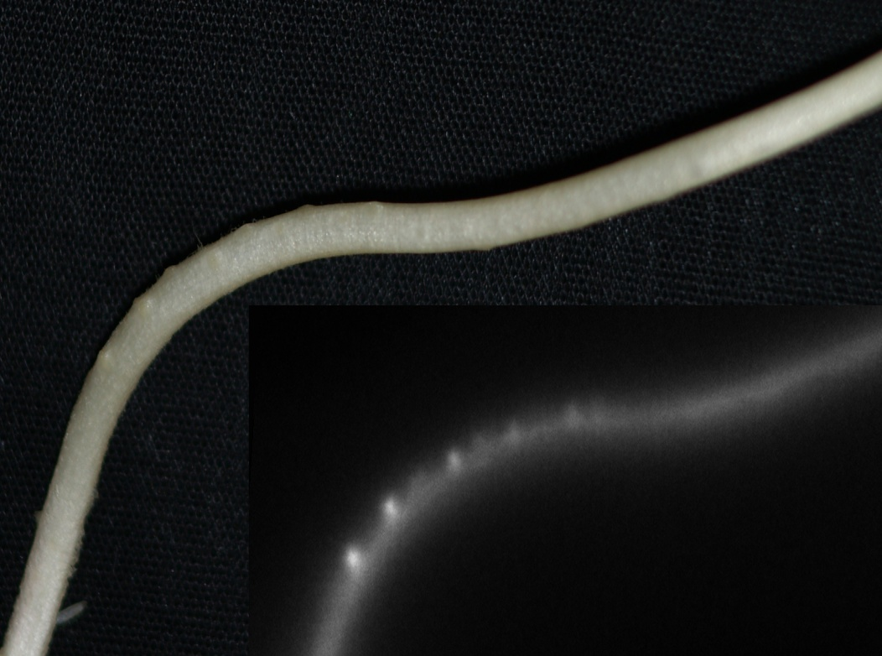
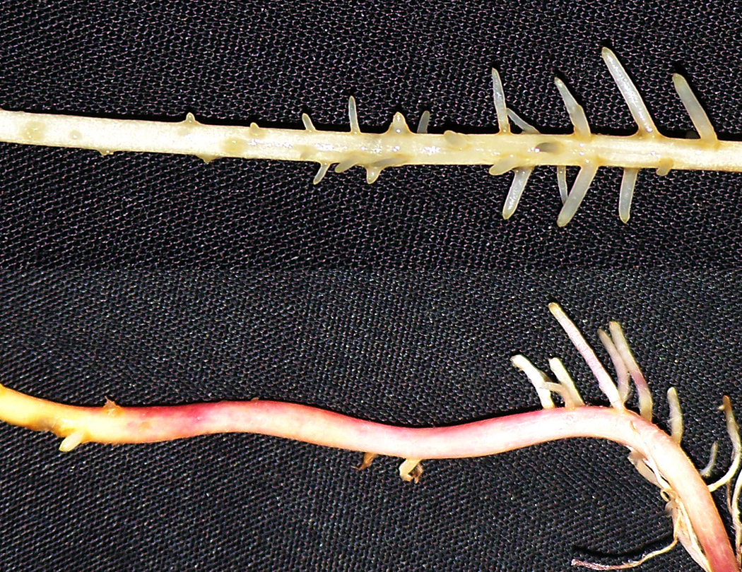




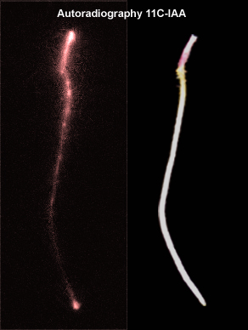

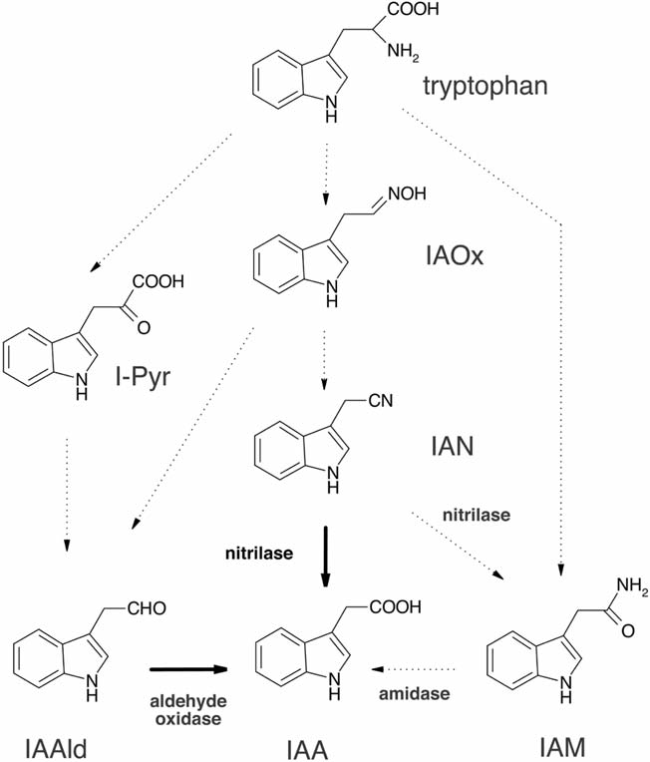
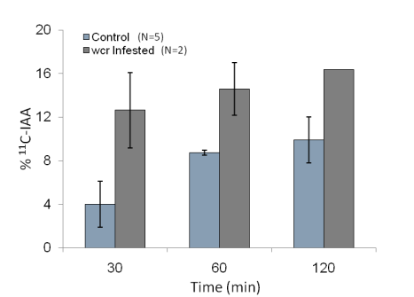
Radiochemistry Science Highlights
Synthesis of ¹¹C-Radiotracers for Signaling
Studies in Plants
Objective:
Develop carbon-11 (t_{1/2}: 20.4 min) radiotracers to measure changes in auxin signaling and metabolism in rootworm challenged plants.
Healthy Root
Healthy Root
¹¹CO₂
Damaged Root
Damaged Root
wound
High metabolic activity coincides with developing
lateral root primordia.
Approach:
¹¹CO₂ was administered to leaves as a metabolic tracer and measured by autoradiography.
[¹¹C] auxin was administered to roots as a tracer of auxin patterning, and [¹¹C] IAN was administered to damaged and healthy roots and used to measure biosynthetic conversion of ¹¹C-IAN to ¹¹C-auxin .
¹¹C-IAA
Photo
Sites of auxin accumulation coincide with lateral root primordia & the root apical meristem.
[¹¹C]IAA
*
¹¹C
Results/Impact:
Development of a rapid synthesis of [¹¹C]IAA and IAN enables a study of the links between hormone signaling, metabolism and root development in response to environmental and other challenges including root herbivory.
¹¹C
*
Damaged roots have higher IAA biosynthetic rates.
Reid AE et al. Journal of Labeled Compounds and Radiopharmaceuticals 2011; 54:433-437.

Slide 16
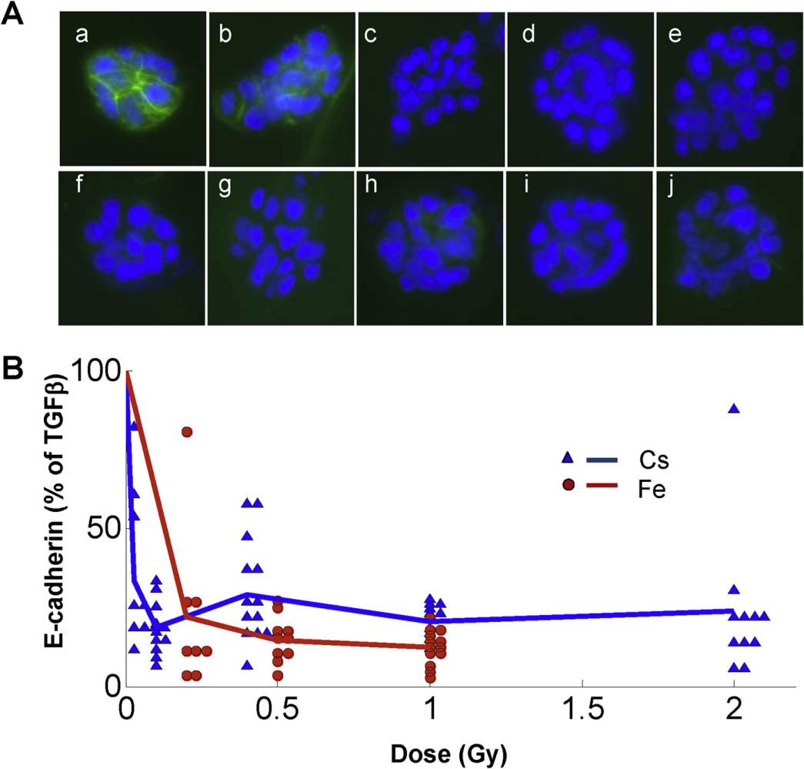
Low Dose Program Science Highlights
Epithelial-to-Mesenchymal Transition is Induced as a Non-Linear Function of Radiation Dose
Objective:
Study the dose-dependent kinetics of a radiation-induced biological effect important in cancer risk
Approach:
Determine whether radiation dose affects the TGF-ß–mediated epithelial-to-mesenchymal transition (EMT)
  The TGF-ß–mediated EMT program in normal cells inhibits growth of transformed cells; it is subverted by cancer cells to support motility and invasion
Human mammary epithelial cultures were exposed to radiation in the presence of TGF-ß
Image analysis measured membrane-associated EMT markers such as E-cadherin protein
Results/Impact:
Radiation acts as a switch to prime human mammary epithelial cells to undergo TGF-ß-mediated EMT (- a relatively abrupt transition or threshold, followed by saturation or a plateau)
These results do not support the LNT model for predicting cancer risks at low doses
Anarawewa K et al. Int. J Radiation Oncology Biol. Phys. 2011; epub, in press

Slide 17
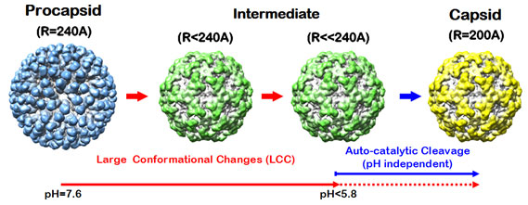

Structural Biology Science Highlights:SSRL-APS
New understanding of how viruses work
Objective:
Gain new understanding of how viruses work using high-resolution information about their structures as they interact with cellular components
Approach:
Applied small-angle x-ray scattering to delineate how procapsid is converted to the infectious capsid form (above)
Used x-ray crystallography to determine how the viral IRES domains interact with the Thermus thermophilus ribosome to take over cellular functions (below)
Results/Impact:
Identified a three-step process of shape changes that help protect the virus from cellular defense mechanisms (above)
The virus binds to the small ribosome subunit by structurally mimicking tRNA and mRNA strands (below)
Hiro Tsuruta
1961–2011
SSRL 1991–2011
Tsuruta Matsui et al. Biophysical Journal 2010; 98:1337-1343
Zhu J et al. PNAS 2011; 108:1839-1844

Slide 18

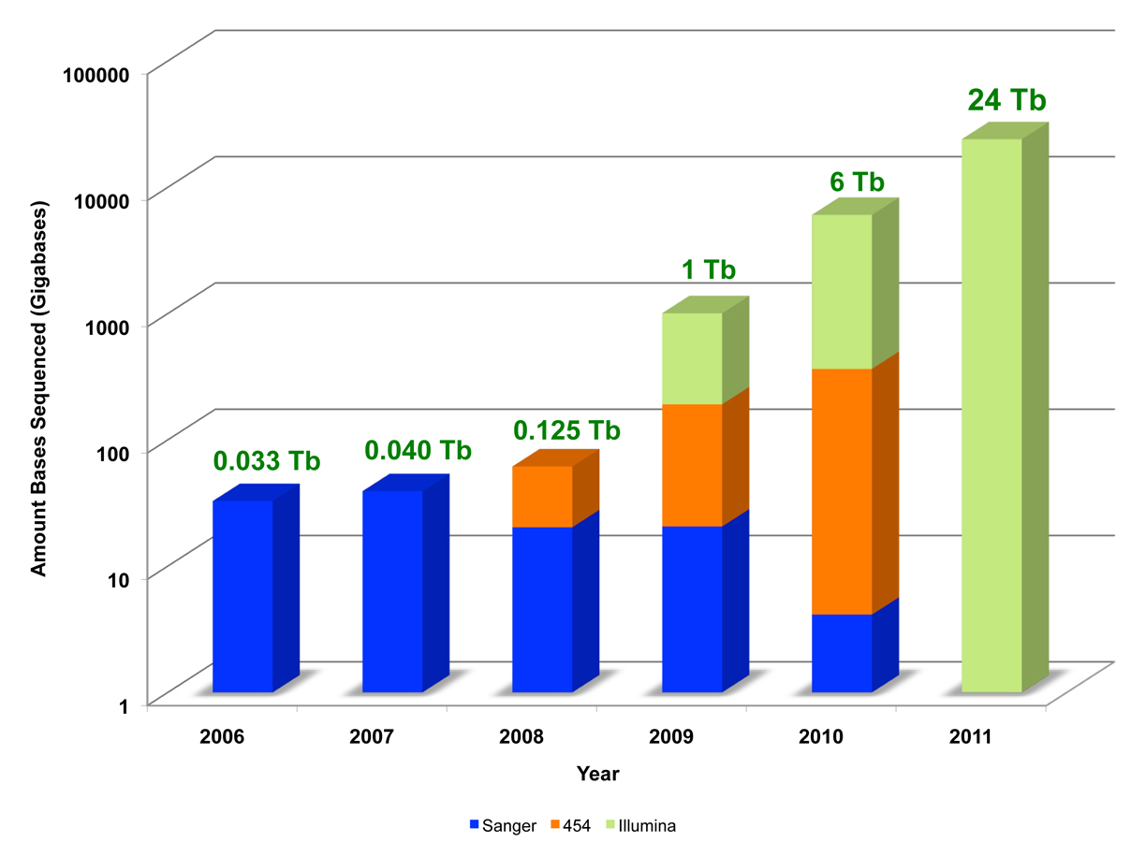
JGI Latest News
2011 Community Sequencing Program: Status
 | Full Proposals Received | Number of Accepted Proposals | Total Sequencing (Tb)
Eukaryotic | 52 | 14 | 8.333
 |  | Plants – 5, fungi – 9
Prokaryotic | 75 | 27 | 11
 |  | Microbial – 6. metagenomes - 21
Popular Science
“Brilliant 10”
Susannah Tringe
Early Career Award
Selection Notifications TBA
Upcoming Activities
JGI Scientific and Operational review (Dec. 2011)
  Reviewers recruited, venue set
  JGI Strategic Plan in development
Sequencing capacity tops 24Tb!
Sequencing Capacity
JGI sequencing capacity continues to increase
and will top 24Tb in 2011 and projected to increase
further in 2012.

Slide 19
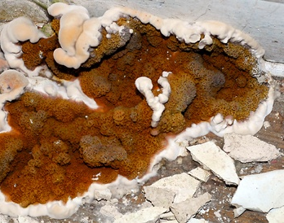
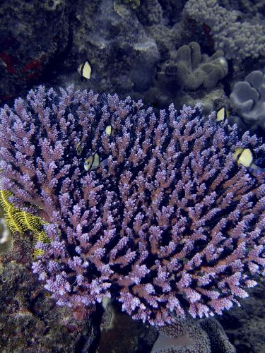
JGI Science Highlights
Selected High Impact Publications
Banks, JA, et. al. (2011) “The Selaginella Genome Identifies Genetic Changes Associated with the Evolution of Vascular Plants”Science, 332:960-963
Eastwood, DC, et. al. (2011) “The Plant Cell Wall–Decomposing Machinery Underlies the Functional Diversity of Forest Fungi” Science, 333:762-765.
Swan BK, et. al., (2011) “Potential for chemolithoautotrophy among ubiquitous bacteria lineages in the dark ocean,” Science, 333:1296-1300
Duplessis, D. et. al. (2011) “Obligate biotrophy features unraveled by the genomic analysis of rust fungi,“PNAS 2011 108 (22) 9166-9171
Voolstra CR, et al. (2011) “Rapid Evolution of Coral Proteins Responsible for Interaction with the Environment.”PLoS ONE 6(5): e20392. doi:10.1371/journal.pone.0020392
Hellsten, U, Aspen, JL, Rio, DC, Rokhsar DL. (2011) “A segmental genomic duplication generates a functional intron,” Nature Communications Vol. 2, Article number: 454 DOI: doi:10.1038.
Kyrpides, N. (JGI contact) “The complete genome sequence of Thermoproteus tenax: A physiologically versatile member of the Crenarchaeota ,“ accepted in PLoS One.
Berka, R.M., et. al. “Comparative Genomic Analysis of the ThermophilicBiomass-Degrading Fungi Myceliophthora thermophila and Thielavia terrestris,” accepted in Nature Biotechnology. (October 2011).
Druzhinina, I.S. et. al. 2011 “Trichoderma: The Genomics of Opportunistic Success,” accepted in Nature Microbiology Review 9, 749-759 (October 2011) | doi:10.1038/nrmicro2637
McCluskey, K. et.al, 2011 “Rediscovery by Whole Genome Sequencing: Classical Mutations and Genome Polymorphisms in Neurospora crassa,” G3 (Genetics, Genomes and Genes), September 2011 1:303-316; doi:10.1534/g3.111.000307
102 Total articles published with JGI acknowledgement since March 2011
A variant of Serpula lacrymans causes dry rot. (Dave Brown via Flickr/Creative Commons Attribution 2.0)
Acropora table coral on the Great Barrier Reef (Image (c) Pete Faulkner,

Slide 20
Thank You!

