Slide 1
View from Germantown
March 5, 2013
Barbara Helland
Acting Associate Director for Advanced Scientific Computing Research
U.S. Department of Energy
www.science.energy.gov

Slide 2
ASCR Budget Overview
 | (dollars in thousands)
 | FY 2012 Enacted | FY 2013 CR Annualized | FY2013 with Sequestration
Advanced Scientific Computing Research | 440,868 ª | 443,566 | 418,163
ª FY 2012 Appropriation: SBIR $11,073,000 and STTR $1,491,000 (transferred out of ASCR in FY 2012 Current column)
The FY 2012 appropriation is reduced by $1,132,000 for the Advanced Scientific Computing Research share of the DOE-wide $73,300,000 rescission for contractor pay freeze savings.
Impacts of
Continuing Resolution:
  No new starts
Sequestration
  No funding for second RFP for Fast forward (Design Forward)
  Delays in research funding to university grants, impacting as many as 60 graduate students
  No planning for power upgrades
The Office of Science amount for the sequestration is $245M. This is a 5% reduction to the annualized CR level of $4,904M.
Notes:
Exascale Total is $68.5M in FY13, details:
$5M in Applied Mathematics for Uncertainty Quantification
$20M in Computer Science for Software Environments
$5M in Computational Partnerships for Software Environments
$22.5M in Research and Evaluation Prototypes for Industry Partnerships
$16 M in Computational Partnerships for Co-design

Slide 3
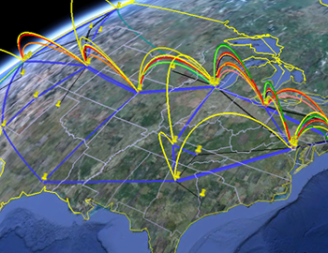

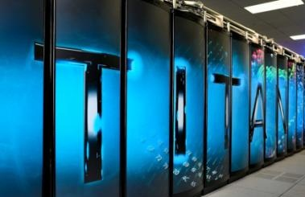
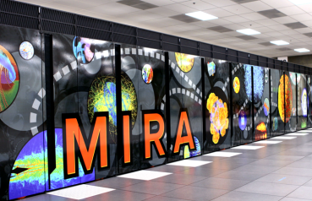
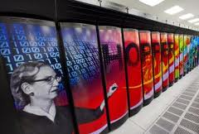
World Class Facilities
High Performance Production Computing for the Office of Science
  Characterized by a large number of projects (over 400) and users ( over 4800)
Leadership Computing for Open Science
  Characterized by a small number of projects ( about 50) and users (about 800) with computationally intensive projects
Linking it together – ESnet
Investing in the future – R&E Prototypes
ESnet
November 2012
Titan at ORNL (#1)
Mira at ANL
(#4)
Hopper at LBNL (#19)
Notes:
3

Slide 4
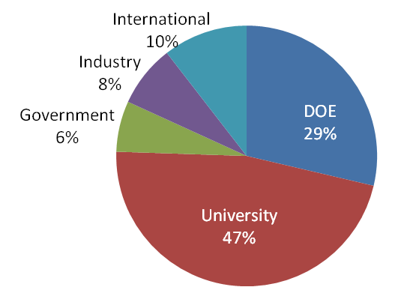

Innovative and Novel Computational Impact on Theory and Experiment
INCITE awards time on the Argonne and Oak Ridge Leadership Computing Facility (ALCF and OLCF) systems for researchers to pursue transformational advances in science and technology.
2013 Call for Proposals
Request for Information helped attract new projects
Call closed June 27th, 2012
Total requests ~14 billion core-hours, nearly 3x more than the 5 billion core-hours requested last year
143 proposals submitted, an increase of nearly 20% over the 119 proposals submitted last year.
Awards of ~5 billion core-hours to be announced in November for CY 2013
Number of 2013 INCITE Submittals
by PI Affiliation
Reaching out to Researchers
Contact information
Julia C. White, INCITE Manager
whitejc@DOEleadershipcomputing.org
Nearly 50% of the non-renewal proposals are by new PIs.
Julia White Talk
Notes:
The INCITE program is jointly managed by the Oak Ridge and Argonne Leadership Computing Facilities. The combined INCITE awards for 2012 were 1.7 billion core-hours for 60 projects. 5 billion core-hours will be allocated for 2013. In March, 2012, INCITE issued a request for information (RFI), inviting potential proposal authors to let us know if they were considering applying for INCITE time. We received 105 responses to the RFI.
The number of new PIs requesting time in 2013 is 63 (e.g., have never before submitted a proposal to the INCITE program as PI).
The number of projects requesting 100+ million core-hours has more than tripled from last year, from 11 to more than 33.
The largest single-system request is 600 million core-hours; the largest multi-system request is nearly 900 million core-hours (for CY2013).
The average per-project INCITE award in 2013 will exceed 50 million core-hours. Average awards for other allocation programs: NERSC (2 million), XSEDE (8 million), PRACE (20 million).

Slide 5
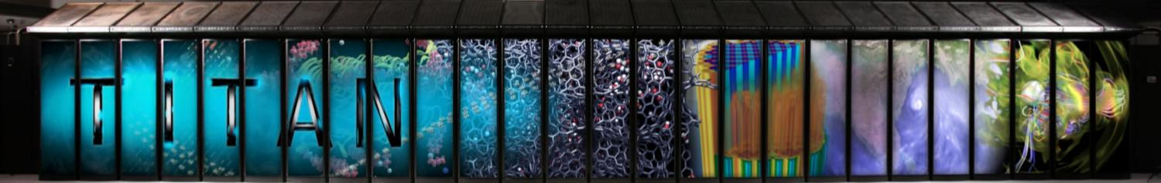
ORNL’s “Titan” Hybrid System:
Installation complete and undergoing acceptance testing
Current Status:
Passed functionality and performance tests
Fixing a stability problem that is requiring board repair at Cray
Users are on the system running on the CPUs
GPUs will be available to users in mid-March
Expect to complete acceptance testing in April/May, after all boards are repaired
SYSTEM SPECIFICATIONS:
Peak performance of 27.1 PF
  24.5 GPU + 2.6 CPU
18,688 Compute Nodes each with:
  16-Core AMD Opteron CPU
  NVIDIA Tesla “K20x” GPU
  32 + 6 GB memory
512 Service and I/O nodes
200 Cabinets
710 TB total system memory
Cray Gemini 3D Torus Interconnect
8.9 MW peak power

Slide 6
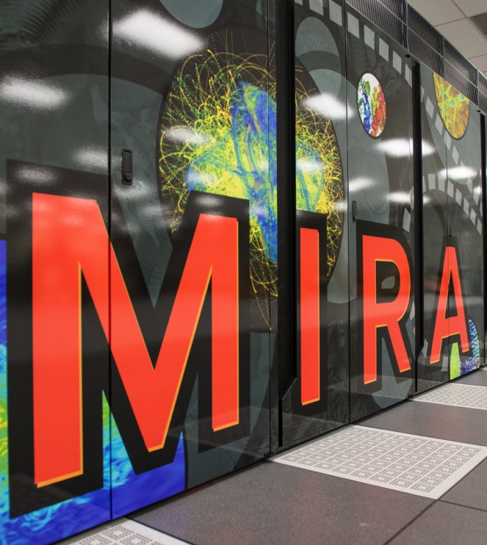
Argonne Leadership Computing Facility
Mira – IBM Blue Gene/Q system
  49,152 nodes / 786,432 cores
  786 TB of memory
  Peak flop rate: 10 PF
  Linpack flop rate: 8.1 PF
Storage
  Scratch: 28.8 PB raw capacity, 240 GB/s bw (GPFS)
  Home: 1.8 PB raw capacity, 45 GB/s bw (GPFS)
Passed acceptance and in Early Science/Shakedown period

Slide 7
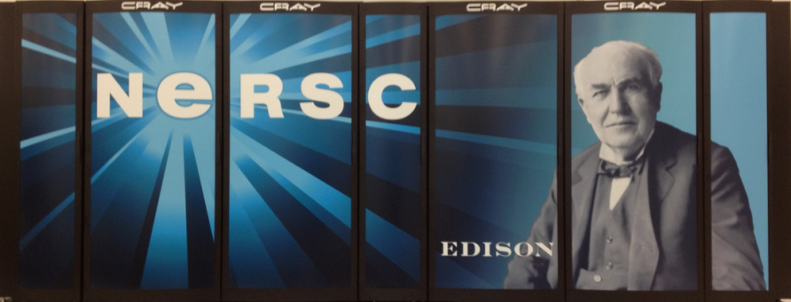
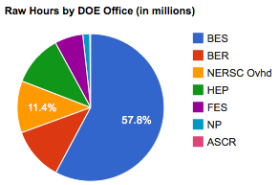
Users are quickly up and running on Edison
  NERSC: Hopper 1+ Petaflop Cray XE6; First phase of NERSC-7 delivered
The Cray Cascade System is the result of DOE’s investment in DARPA’s High Productivity Computing Systems Program (HPCS)
Will more than double high performance production supercomputing capability for the Office of Science
  First Cray system with Intel processors
  New Aries interconnect and dragonfly topology will enhance data transfer, which is a performance bottleneck for many codes
  High memory per core will enable emerging data-centric applications
Users are off and running on the 4 rack Phase 1 system -- the HPCS demo system
Phase 2 will be complete later this year and will bring Edison up to ~ 2 PF with 104K computer cores, 333 TB of aggregate memory and 6.4 PB of disk
Notes:
Our largest system is a Cray XE6 supercomputer known as Hopper. As I mentioned before Hopper is No. 5 on the world’s list of most powerful supercomputers. Some interesting features of Hopper are listed here. Its 150,000 CPU cores and super-fast Gemini interconnect network permit parallelism at the largest scale. It has a huge dedicated disk pool of 2 PB for storing scientific data. Use Hopper for cutting edge simulations and also to develop code to take advantage of machines of this size.

Slide 8
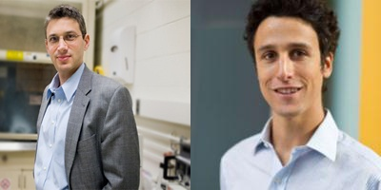
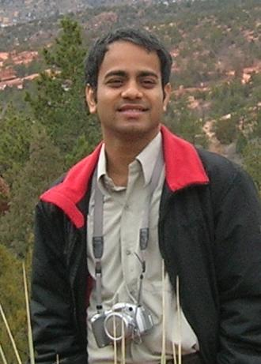
NERSC Award for High Impact Scientific Achievement 2013
A New Approach to Water Desalination
Jeff Grossman and David Cohen-Tanugi, MIT
New material’s water permeability is several orders of magnitude greater than conventional membranes.
Using supercomputers at NERSC, Grossman and Cohen-Tanugi came up with a new approach for desalinating seawater using sheets of graphene, a one-atom-thick form of the element carbon. This method holds the promise of being far more efficient and less expensive than existing desalination systems.
Grossman’s project “Quantum Simulations of Nanoscale Energy Conversion” has used 5.6 Million hours at NERSC since 2010.
Jeff Grossman (left) and David Cohen-Tanugi are the recipients of the inaugural NERSC award.
One of Smithsonian Magazine’s Top Ten “Surprising Scientific Milestones of 2012”
Early Career Award
Tanmoy Das, Las Alamos National Laboratory
Das completed groundbreaking computational work to understand fundamental properties of novel superconductors and spin-orbit ordering effects in two-dimensional electron gases. A postdoctoral researcher at LANL, Das was the first author on three, and the sole author on one, 2012 articles published in the highly regarded journal Physical Review Letters. The topics spanned superconductors, actinides, and Fermi gases.

Slide 9
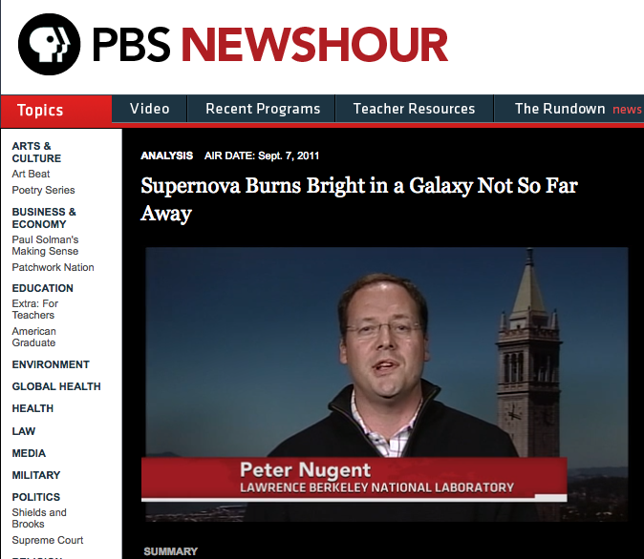
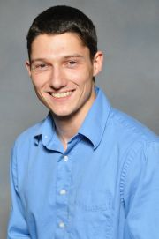
NERSC Award for Innovative Use of High Performance Computing
Data Pipeline Transfers, Analyzes, Stores, & Disseminates Astronomical Observations
Peter Nugent and the PTF Team, Berkeley Lab & UC Berkeley, California Institute of Technology
Innovative workflow enables earliest supernova discovery, first direct observations of progenitor systems.
Every night observations from the Palomar Observatory in Southern California are sent to NERSC where computers running machine learning algorithms scour the data for transients. Once an interesting event is discovered, an automated system sends its coordinates to ground-based telescopes around the world for follow-up observations. NERSC also archives this data and allows collaborators to access it over the Internet through a web-based science gateway.
Peter Nugent, the PTF’s Realtime Transient Detection Lead, is interviewed on the PBS News Hour following the discovery of supernova PTF 11kly within hours of its appearance.
Early Career Award
Edgar Solomonik, UC Berkeley
Solomonik, a graduate student at UC Berkeley, has developed novel algorithms for massively parallel tensor contractions and applied them to quantum chemistry problems. Solomonik’s algorithmic developments are instantiated in the Cyclops Tensor Framework (CTF), which has been used on some of the largest supercomputers in the world, including the NERSC Hopper system, and the IBM Blue Gene/Q systems at the Lawrence Livermore National Laboratory and Argonne Leadership Computing Facility.

Slide 10

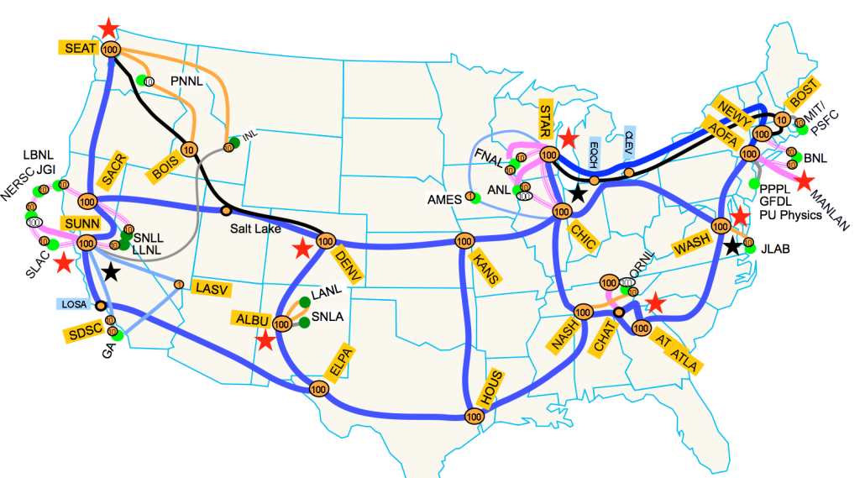
ESnet5: World’s First Continental 100G Network Moved to Full Production Status
Two years of planning, design, and development will culminate in deployment of production 100G network to support DOE science missions, November 2012.
20-step build process now underway.
  deploying optical components, 100G routers, and other infrastructure on a national footprint
For the latest information about this transition, please visit:
https://my.es.net/esnet5/timeline

Slide 11


Two Awards for Deployment of ESnet5
FierceGovernment chose the ESnet5 Deployment Team as a recipient of the annual Fierce 15 award, in recognition of “federal employees and teams who have done particularly innovative things.”
“The expert execution of this science-enabling project is also worth noting.”
Information Week named ESnet as one of the “top 15 innovators for 2012”, among government entities at every layer: federal, state and local. This is the second time in four years ESnet has receive this award.

Slide 12
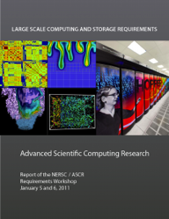
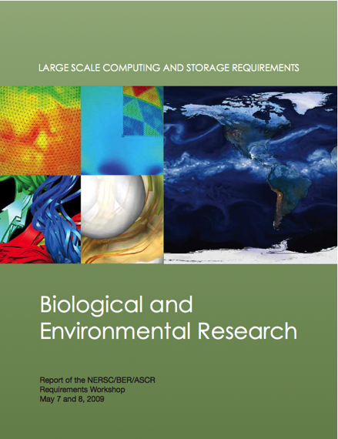
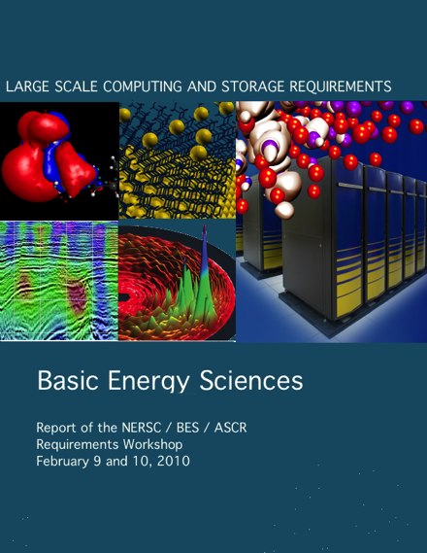
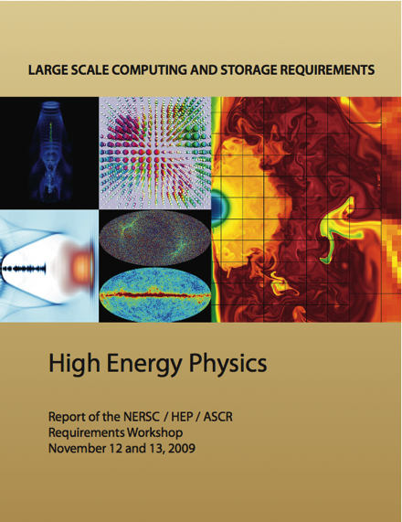
Requirements Gathering Ensure ESnet and NERSC Meet DOE Needs
NERSC and ESnet gather requirements directly from Scientists
Program Requirements Reviews
Science Case Studies drive discussions
Program offices evaluated every three years
Participants include program managers, PI/Scientists, ESnet/NERSC staff and management
User-driven discussion of science opportunities and needs
What: Instruments and facilities, data scale, computational requirements
How: science process, data analysis, collaboration scope, data distribution
When: 0-2 years, 2-5 years, 5+ years
Covers of Last round of NERSC Requirements Reports
Value of Approach
Review meetings establish consensus on requirements, capabilities, services
Scientists, programs offices, and facilities have the same conversation
Historical trends, technology advances, etc. are also incorporated
Provides a solid, fact-based foundation for service and capability investments
Addresses DOE mission goals by ensuring DOE science is effectively supported
Notes:
12

Slide 13
Facilities Strategic Planning
Objective: To inform the development of an ASCR Facilities 10 year plan
  Understand and shape the focus of each facility
  Unify the overarching strategy across facilities
  Develop plans of action given possible future dependencies, opportunities, and threats
Constraint: 30 MW of power
Facilities presented their plans to each other, HQ and ASCAC Facilities Subcommittee on January 30, 2013
Findings: Need for coordination with other SC office
  To prepare applications for future architectures
  To develop a common strategy for addressing SC data analysis and archival needs from simulations and experiments
Next step: Generate draft ASCR 10-year facilities plan

Slide 14
Overall Acquisition Strategy for Next Systems:
Hundreds of Petaflops and beyond
Joint RFPs between NNSA and SC laboratories
  Trinity/NERSC-8 (LANL/SNL/LBNL) - Targeting 2015/2016 deployments
  CORAL (ORNL/ANL/LLNL) - Targeting later deployments
Open Solicitations
  Joint selection teams, RFIs, RFPs, but ultimately separate vendor/lab for actual systems
  RFPs contain core requirements plus lab specific features
Non-Recurring Engineering Investment coupled with Acquisitions
  Opportunity for software or technology investments to provide additional features
  Opportunity for variations through separate contracts
Facilities Subcommittee Report

Slide 15
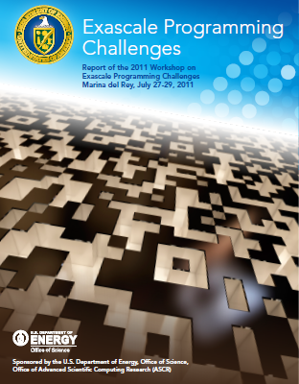
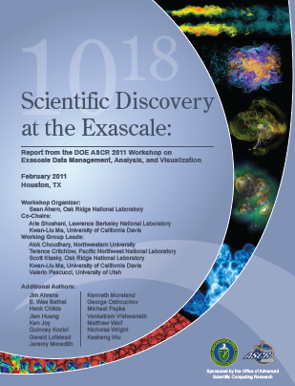
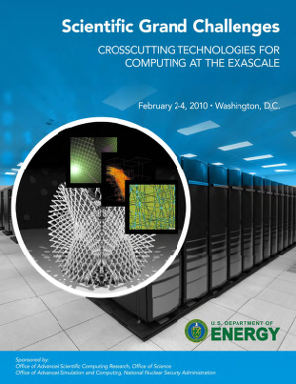
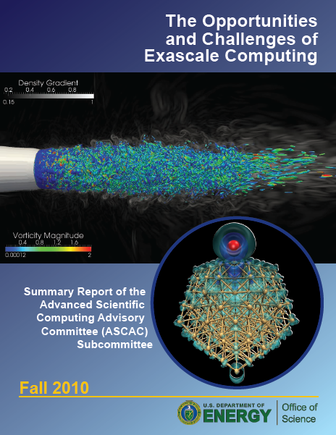
Research to Enable the Future
Applied Mathematics: Expanding to cover complex systems, uncertainty quantification, large data, exascale algorithms;
Computer Science: Exascale Computing and Data, Advanced Architectures, Many-core, power aware,…;
Partnerships: CoDesign to pioneer the future of scientific applications;
Next Generation Networks for Science: Tools for the future of distributed science

Slide 16

DOE Progress Toward Exascale
FY2010:
  Applied Math: Uncertainty Quantification
  Computer Science:
    Advanced Architectures / X-Stack / Scientific Data Management and Analysis
FY2011:
  Computational Partnerships: 3 Exascale Co-Design Centers Funded
  Request for Information: critical and platform technologies
FY2012:
  Computer Science: Programming Environments
  Applied Math: Extreme scale algorithms
  R&E Prototypes: FastFoward: Critical / Cross Cutting technologies (joint with NNSA)
FY2013
  Computer Science: Operating System / Runtime
        R&E Prototypes: DesignFoward: Critical / Cross Cutting technologies (joint with NNSA)
        Applied Math: Uncertainty Quantification
16

Slide 17
Timeline for Context
Multi-Petaflops Systems Acquisitions
Exascale Systems Acquisitions
Applications Co-Design
Exascale Applications Development Activities
Design Forward
Systems Engineering and Integration
Exascale Programming Environment, Operating Systems and Runtime
Fast Forward
Path Forward Phase
Exascale Initiative Funding
2012
2013
2014
2015
2016
2017
2018
2019
2020
2021
2022
2023
2024

Slide 18
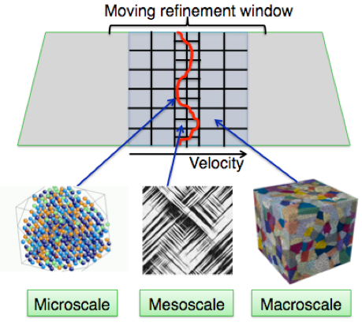
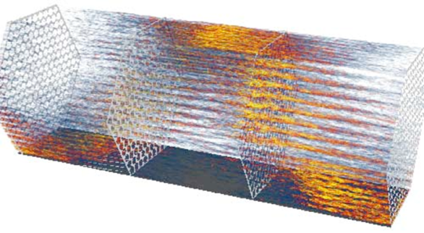
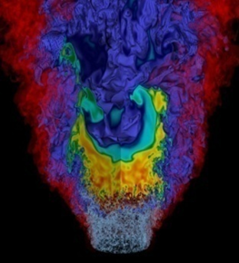
Co-Design Deep Dives
In October, 2012, each Exascale Co-Design Center presented a 3-hr long deep dive on the Center’s physics problems, models (i.e., equations), the equations being solved, and the overall workflow, including the development of “proxy apps”
These high-profile sessions were well attended; anecdotal evidence suggested that many researchers were interested in learning more about the co-design projects afterwards
  Increased requests for presentations & co-design centers websites visits
Most important: Because it was held during the Exascale PIs meeting, the Fast Forward memory, processors, and storage vendors were present – the beginning of their technical engagements with the Co-Design Centers
Jackie Chen Talk

Slide 19
Proxy Apps help answer co-design questions
Some co-design questions from hardware architects, computer scientists, and algorithms researchers will need to be answered by co-design centers. For example,
  What is the balance between serial and parallel parts of algorithms?
  How important is cache coherence if it costs significant additional power?
  If the programming model is “MPI+X”, what is “X”?
  Are apps more amenable to many small cores or heterogeneous nodes?
  How much data must be moved (what are the required “speeds and feeds”), both intra- and inter-node (e.g. requirements on interconnect bandwidth)?
  What is the relative importance of very low-latency small messages vs. higher bandwidth, higher latency operations?
  Are there algorithms that emphasize fine grain parallelism (strong scaling)?
We tried to convey the collaborative nature of these proxy apps, that is, they must be custom-made for each question and they are not “off-the-shelf”.

Slide 20
Early Collaborations: Fast Forward Projects
Fast Forward
  Jointly funded by DOE SC and NNSA, LLNL managed the RFP and contracting processes
  Two-year contracts, started July 1, 2012
Project Goals & Objectives
  Initiate partnerships with multiple companies to accelerate transition of innovative research of critical technologies, such as processor and memory architecture, into products needed for extreme-scale computing
  Fund technologies targeted for productization in the 5–10 year timeframe
Vendor | SCOPE | Value
AMD | Processor / Memory | $12,600,000
IBM | Memory | $10,476,714
Intel | Processor / Memory | $18,963,437
NVIDIA | Processor | $12,398,893
WhamCloud (Intel) | Storage & I/O | $7,996,053
Total |  | $62,435,097
Notes:
Fixed the amount on the AMD row.

Slide 21
Fast Forward Part 2: Design Forward
Design Forward RFP will be issued by LBNL on behalf of ANL, LANL, LBNL, LLNL, ORNL, PNNL and SNL
Design Forward Technology Focus Areas:
  Interconnect Networks: Led by SNL and LBNL
  System design and integration: Led by ORNL and LLNL
At this time, the Design Forward RFP has not been released

Slide 22
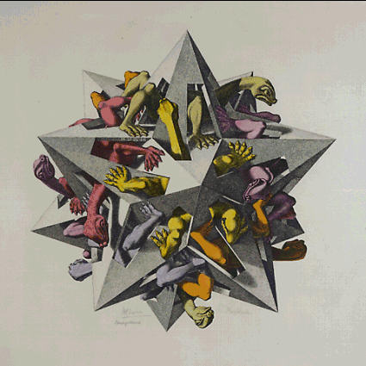
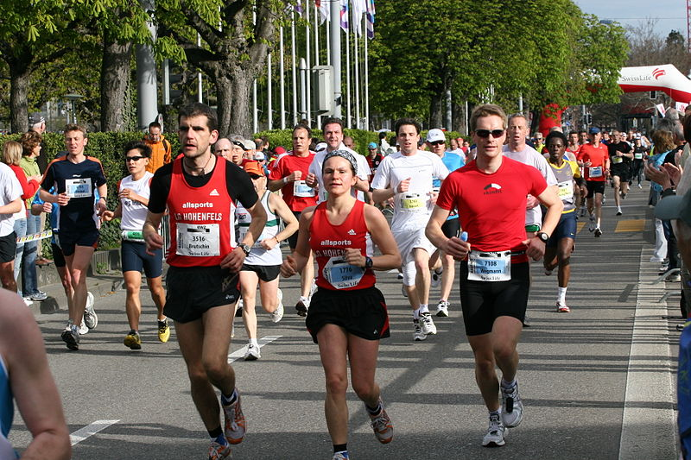

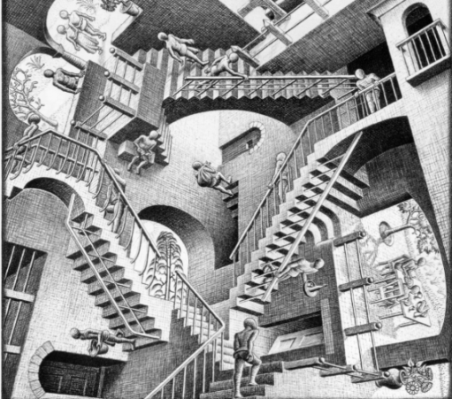
Path Towards Exascale:
The X-Stack Programming Environment Program
Goals and Objectives
  Address fundamental Exascale software challenges
  Create complete solutions that are portable across multiple future machine generations
  Define a transition path for existing scientific applications
  Initiate Exascale community prior to establishment of long-term Exascale program
Key Program Elements
Manage parallelism and data movement
Dynamic, Adaptive Runtime Systems
Manage locality and minimize energy consumption
Interoperability across different HPC languages and interfaces
All M.C. Escher works © 2010 The M.C. Escher Company - the Netherlands. All rights reserved. Used by permission. www.mcescher.com
Notes:
The X-Stack Program makes research investments that
address fundamental Exascale software challenges,
are portable across multiple future machine generations,
offering a transition path for existing scientific applications to fully explore the challenges and rewards of Exascale platforms.
Images from Wikipedia Common – Plasma Lamp
Programming Models: new approaches to managing parallelism and data movement through innovations in interfaces
Runtime Systems: dynamically adapt to changing application goals and system conditions
Locality-aware and energy efficient mechanisms: manage locality and optimize for energy
Interoperability: interoperability with different HPC languages and interfaces as well as cross-cutting execution models
More details:
Runtime Systems: alternative mechanisms for dynamically adapting to changing application goals and changing systems energy, performance, and resilience conditions. Mechanisms for supporting communication, synchronization, resource management, load balancing, code migration.
Programming Models: alternative approaches to achieve parallel control (data parallel? Dynamic threads? SPMD?), for sharing, synchronization, and communication, for domain decomposition, for data placement, for management of heterogeneity and data movement.
Locality-aware and energy efficient mechanisms: alternative constructs and approaches to manage locality and optimize for energy.
Interoperability: different projects have interoperability with different HPC languages. For example, DEGAS, has interoperability with MPI, UPC, CAF, Habanero, Python. D-TEC interoperates with MPI, C++, Fortran, X-10, OpenCL, and DSLs. Intel’s project has interoperaperability with MPI,C++, Chapel, Habanero-C, CnC. Express interoperates with MPI and OpenMP.
Top complementary Elements of the Program:
Execution Models: the ETI and the Intel project explore the codelet-based execution model: dataflow, dynamic, event-driven scheduling, non-blocking, dynamic decision to move computation to data, and observation-based adaptation. The Xpress project explore the Parallex execution model, also a dataflow using parcel message-driven computation and futures synchronization.
Resilience: The DEGAS project explores containment domains and state capture mechanisms and lightweight, asynchronous recovery mechanisms for PGAS models.
DSL and optimizations, mappings, refinements: the D-TEC project will define and build several DSLs, define and demonstrate the analysis and optimizations required to build DSLs, define mappings between DSLs to compiler analysis, generate refinements using equivalence checking, multi-target code-generation using domain semantics and architecture characteristics, communication optimization using high-level semantic information.
Hardware+Software simulation infrastructure: near-native application execution on host processor, rapid application development, hardware units modeled, exact memory and network hierarchies including messages, power estimator, memory analyzer, features of programming models and execution models, data movement patterns to memory and interconnect, resource management techniques,

Slide 23

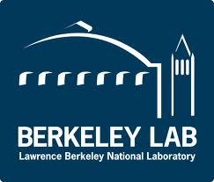







X-Stack Portfolio
DEGAS (Kathy Yelick)
  Hierarchical and resilient programming models, compilers and runtime support.
Traleika (Shekhar Borkar)
  Exascale programming system, execution model and runtime, applications, and architecture explorations, with open and shared simulation infrastructure.
D-TEC (Dan Quinlan)
  Complete software stack solution, from DSLs to optimized runtime systems code.
XPRESS (Ron Brightwell)
  Software architecture and interfaces that exploit the ParalleX execution model, prototyping several of its key components.
DynAX (Rishi Khan)
  Novel programming models, dynamic adaptive execution models and runtime systems.
X-Tune (Mary Hall)
  Unified autotuning framework that integrates programmer-directed and compiler-directed autotuning.
GVR (Andrew Chien)
  Global view data model for architecture support for resilience.
CORVETTE (Koushik Sen)
  Automated bug finding methods to eliminate non- determinism in program execution .
SLEEC (Milind Kulkarni)
  Semantics-aware, extensible optimizing compiler that treats compilation as an optimization problem.
Notes:
Mention that each project is a large collaboration among Labs, Universities, and/or Industries.
I would mention, for example MIT for the D-TEC project.

Slide 24
Exascale Research Conference October 2012
Participants gain a greater understanding of the technical progress and directions of ASCR Computer Science projects funded as a result of 2010 Funding Opportunity Announcements (FOAs), and newly awarded exascale research projects are introduced to the DOE exascale community.
In-depth discussions on technical issues associated with proxy applications help participants gain better understanding of issues surrounding exascale co-design.
Opportunities for collaboration, leveraging of work, and new research directions are identified.

Slide 25
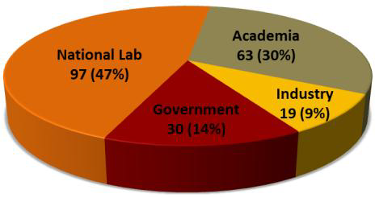
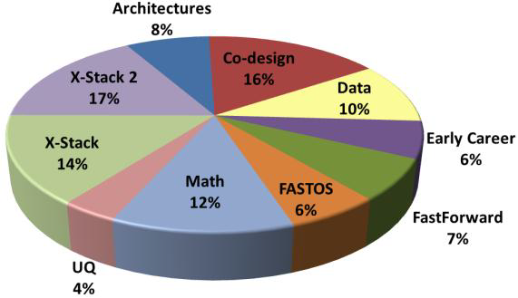
Exascale Research Conference
Total attendees: 209
Technical Content
Posters presented: 60
Technical presentations:
  43 technical talks
  42 working session position talks
  15 co-design deep dive talks
  13 plenary talks
Working sessions:
  12 technical talk sessions
  14 working sessions
  3 co-design deep dives
Website contains all technical materials:
  http://exascaleresearch.labworks.org/oct2012/
Attendees by organizational type
Attendees by program affiliation
Notes:
Companies participating (10): Advanced Micro Devices, ET International, Hewlett Packard, IBM Corporation, Intel Corporation, Kitware, Inc., NVIDIA Corporation, Reservoir Labs, Inc., SAIC, Science and Technology Associates, Inc. (STA) , representing DARPA
Agencies represented (5): DOE/SC, DOE/NNSA, DoD (including a contractor who represented DARPA), NASA, NSF
Universities represented (38): Colorado State U., Columbia U., Georgia Tech, Indiana U., Information Sciences Institute, MIT, Nortwestern U, Ohio State U, Penn. State U., Polytechnic Institute of NYU, Purdue U. Renssalaer Polytechnic Institute, Rice U., Rugters U., Stanford U., SUNY Stonybrook, U. of British Columbia, UC Berkeley, UC Davis, UC San Diego, UC Santa Cruz, U. Chicago, U. Delaware, U. Houston, UIUC, U. MD, U. New Mexico, U. Oregon, UT Austin, UT El Paso, UT San Antonio, U. Utah, U. Wisconsin Madison, Washington State U., William & Mary, Worchester Polytechnic Institute
The Co-Design Deep Dives were the hit of the show, drawing heavier attendance than expected. Everyone (including ASCR PMs) complained about having to choose between them and the other programmatic technical sessions.

Slide 26
Workshops and Meetings
Past PI Meetings
  SciDAC PI Meeting, Rockville MD, September 10-12, 2012
  Exascale PI Meeting,, Arlington, VA, October 1-3, 2012
Past Workshops
  Exascale Operating Systems and Runtime Software Workshop, Washington D.C., October 4-5, 2012
  Data Summit, Rockville Hilton, Rockville, MD, January 8-9, 2013
  Exascale Ecosystem Coordination Meeting, LLNL, February 11-15, 2013
  Extreme Scale Application Software Productivity Summit, DOE Headquarters, Germantown, MD, February 28,2013
Planned PI Meetings
  Next Generation of Networking Systems PI meeting, Berkeley, California, to be held March 18-20 .
  X-Stack PI and Coordination meeting, LBNL, Berkeley California, to be held March 20-22
  SciDAC PI Meeting, Rockville Hilton, Rockville MD, July 22-26, 2013
  Math PI Meeting, Albuquerque, NM, August 6-8, 2013
Planned Workshops and Reviews
  Execution Models Program Review , Rockville Hilton, Rockville, MD, to be held April 3
  Modeling and Simulation of Exascale Systems and Applications, University of Washington, Seattle, to be held August 15-16.
  Applied Math Research for Exascale Computing workshop, AGU, Washington D.C. to be held August 21-22, 2013

Slide 27
Applied Math: RX-Solvers Synopsis
“Advanced Scientific Computing Research (ASCR), Office of Science (SC), US Department of Energy (DOE), invites applications for basic research in Resilient Extreme-Scale Solvers (“RX-Solvers”) that demonstrably advances the state of science and practice for scalable, resilient, extreme-scale numerical algorithms, to enable scientific discovery on the supercomputers expected to come online in the next 5-10 years and lay the foundation for research in numerical algorithms for extreme-scale scientific computing.”
Issued: 8 June 2012; closed: 13 August 2012
Three required elements:
  Advances in solvers
  Fault tolerance and resilience at the algorithmic level
  Performance of proposed algorithms (i.e., with metrics)
Announcement: http://science.doe.gov/grants/pdf/SC_FOA_0000742.pdf
Total funds available:$4.5M per year for up to three years
18 proposed projects received (~48 proposals total); all have been reviewed by mail
Notes:
At this point 5 projects have been recommended for funding; the negotiations have been completed. Awaiting resolution on FY13 funds to finish the paperwork – cannot make any announcement yet.

Slide 28
Math COV Status Update
First meeting with ASCR PMs on Feb 19, 2013 to discuss charge and logistics
Math programs undergoing review:
  Uncertainty Quantification, FY10
  Mathematical Multifaceted Integrated Capability Centers (MMICCs), FY12
  Lab programs, FY11-FY12
Committee recruitment underway
Expected COV meeting June 2013
Final report due late August 2013

Slide 29
DOE Office of Science
Early Career Research Program
FY13 is 4th year of this University & DOE Laboratory funding opportunity:
Posted on July 20, 2012
Pre-applications due Sept 6
Encourage applications by Oct 4
Full applications due Nov 26
The Early Career program supports:
Development of individual research programs of outstanding scientists early in their careers
Stimulates research careers in the disciplines supported by the DOE
http://science.energy.gov/early-career
ASCR received 75 of ~770 Early Career applications submitted to the Office of Science
Panel reviews held at Rockville Hilton on February 5-6, 2013
54 applications reviewed by Applied Mathematics & 21 applications reviewed by Computer Science
ASCR anticipates making FY13 awards to 3 University PIs and 2 DOE Laboratory PIs
Panel name | Date of review | Program | # of Proposals
Math for Complex Systems | 2/5/2013 | Applied Math | 30
Math for Large-Scale Data | 2/6/2013 | Applied Math | 13
Scalable Solvers | MAIL | Applied Math | 11
Computer Science I | 2/5/2013 | Computer Science | 13
Data and Visualization | 2/6/2013 | Computer Science | 8

Slide 30
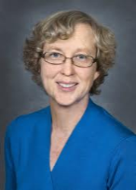
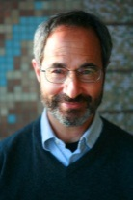
ASCR Researchers Named 2012 ACM Fellows
ACM recognizes members for contributions to computing that fundamentally advance technology. The 2012 ACM Fellows personify the highest achievements in computing research and development.
Kathy Yelick
University of California at Berkeley/Lawrence Berkeley National Laboratory
For contributions to parallel languages that improve programmer productivity
Robert S. Schreiber
Hewlett-Packard
For contributions to matrix computations and to languages, compilers, and architectures for parallel scientific computing

Slide 31

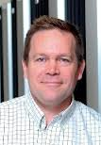
ASCR Researchers Named ACM Distinguished Scientist
ACM grants Distinguished Scientist status to members with 15 years of experience who have achieved significant accomplishments or made a significant impact on the computing field.
Wes Bethel
Lawrence Berkeley National Laboratory
Jeffrey Vetter
Oak Ridge National Laboratory/Georgia Institute of Technology

Slide 32
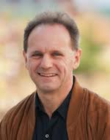
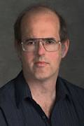
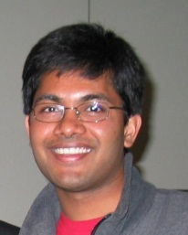
Professional recognition for ASCR researchers
Paul Fischer, Argonne National Laboratory, elected an American Association for the Advancement of Science (AAAS) Fellow for his contributions to the field of computational fluid dynamics .
John Bell, Lawrence Berkeley National Laboratory, selected as a member of the National Academy of Sciences for his contributions in development and application of numerical methods to problems in fields including combustion, shock physics, seismology, flow in porous media, and astrophysics.
Pavan Balaji, Argonne National Laboratory, was recognized as one of Crain’s Chicago Business 40 under 40 for his work on scalable computing

Slide 33
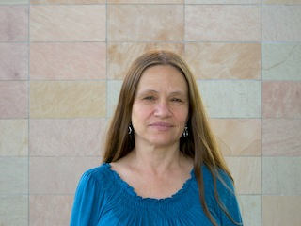
Applied Mathematics Researcher Awarded SIAM / ACM Prize in Computational Science and Engineering
Prof. Linda Petzold of University of California Santa Barbara was awarded the 2013 SIAM/ACM Prize in Computational Science and Engineering. This prize is awarded biennially for outstanding research contributions to the development and use of mathematical and computational tools and methods for the solution of science and engineering problems.
DOE Impact: Dr. Petzold’s research focuses on high-performance algorithms for discrete stochastic simulation. Stochastic reaction systems are of key interest to many DOE applications in biochemistry, materials, and electrochemistry; including devices such as batteries, photovoltaic cells, and fuel cells.

Slide 34
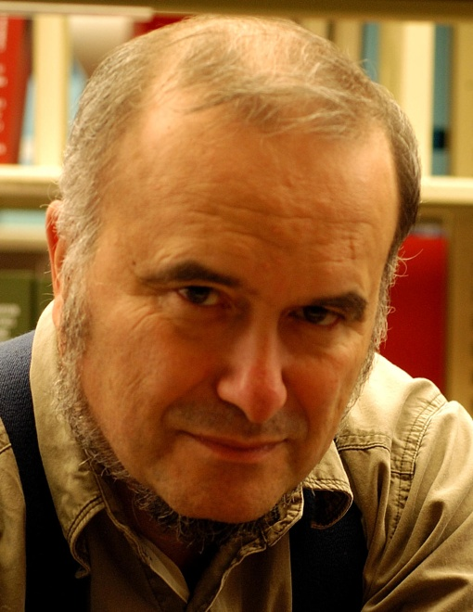
Computer Science Researcher Recognized for Excellence in Scalable Computing
Marc Snir, Argonne National Laboratory, will be presented the prestigious 2013 IEEE Technical Committee on Scalable Computing TCSC Award for Excellence in Scalable Computing in May, 2013 at the 13th IEEE/ACM International Symposium on Cluster, Cloud and Grid Computing in Delft, The Netherlands
The award is given for significant and sustained contributions to the scalable computing community coupled with an outstanding record of high quality and high impact research
Marc is also an Argonne Distinguished Fellow, AAAS Fellow, ACM Fellow, and IEEE Fellow

Slide 35
ASCR Personnel News
Interviews for AD position taking place now
  There is currently a moratorium on the hire of new SES until a new Secretary of Energy is confirmed by the Senate. We will go through all of the steps up to submission of our package to Office of Personal Management (OPM). After a new Secretary is on board, all of the SES hiring packages will be reviewed and submitted to OPM
Open Math and Computer Science position
Facilities
  Carolyn Lauzon, AAAS Fellow, working on interface between ASCR and BES Facilities (and many other things)
  Dave Goodwin - NERSC Program Manager
  Ravi Kapoor - OLCF Program Manager

Slide 36
ASCR at a Glance
Office of Advanced Scientific Computing Research
Acting Associate Director – Barbara Helland
Phone: 301-903-7486
E-mail: Barbara.Helland@science.doe.gov
Research
Division Director – William Harrod
Phone: 301-903-5800
E-mail: William.Harrod@science.doe.gov
Facilities
Division Director – Barbara Helland
Phone: 301-903-9958
E-mail: Barbara.Helland@science.doe.gov
Relevant Websites
ASCR: science.energy.gov/ascr/
ASCR Workshops and Conferences:
science.energy.gov/ascr/news-and-resources/workshops-and-conferences/
SciDAC: www.scidac.gov
INCITE: science.energy.gov/ascr/facilities/incite/
Exascale Software: www.exascale.org
DOE Grants and Contracts info: science.doe.gov/grants/

Slide 37
BACKUP

Slide 38
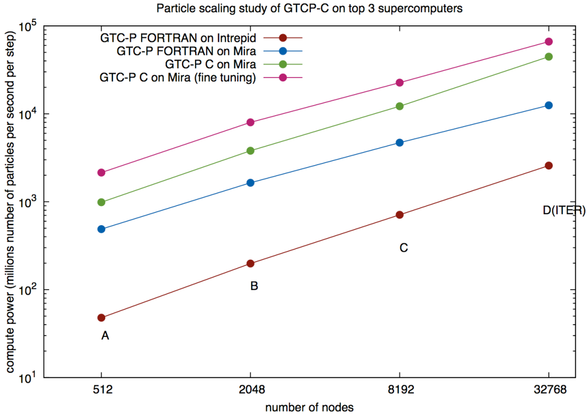
Full-Scale Simulations of ITER Plasmas
ESP
Global Simulation of Plasma Microturbulence at the Petascale & Beyond
William Tang (PPPL, Princeton U.)
Bei Wang (Princeton U.)
Stephane Ethier (PPPL)
Kinetic particle-in-cell simulation of turbulence in fusion-grade ITER plasmas
Aims to understand the gyro-Bohm confinement scaling theory
Design of ITER assumes confinement does not degrade with increased plasma size above a certain transition point
Mira simulations:
  Sizes range from current international tokamaks (A,B,C) to targeted ITER size
  Over 30 billion particles provide unprecedented resolution
  The largest runs demanded 2/3 of the entire computer (524,288 processor cores)
  Code has 10x faster time to solution
  Physics fidelity (resolution, duration, etc.) were impossible on previous-generation computers
Millions of particles/sec/timestep
Notes:
The figure shows performance of the GTC particle-in-cell code on different physical system (tokamak) sizes. The largest size, “D” is the designed size of ITER. The Fortran implementation of GTC has been supplanted by a new, faster, C implementation.
This sequence of successively-larger runs is what’s needed to verify that favorable gyro-Bohm scaling of plasma confinement holds.

Slide 39
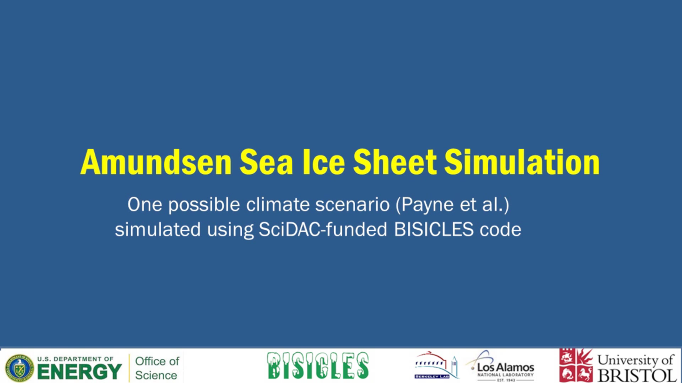



PISCEES: SciDAC Partnership with BER
AMR Ice Sheet Modeling Using FASTMath’s Chombo
Simulation of Amundsen Sea Sector in Antarctica for one climate scenario
Very fine (sub km) spatial resolution is needed to get the dynamics correct
Red line denotes location of grounding line (GL), the boundary between floating and grounded ice.
Warm water incursion around 2100, causing melting of floating ice shelves, especially near GL.
4 km uniform mesh (standard for many models): shelf melts, no GL motion, minimal effect upstream.
250 m AMR mesh: shelf melt couples to GL retreat, ice velocity increase, and ice-sheet mass loss.
Notes:
shows a simulation of the Amundsen Sea sector in Antarctica that we did for a paper this summer (which will hopefully be cited in the upcoming IPCC AR5 report). Citation is Payne , et al, submitted to Earth and Planetary Science Letters (2012).
What you see:
Grey is ice, dark blue is open sea. The red line marks the point ("the grounding line") where the ice begins to float as it makes its way to the sea. So the ice "seaward" of the red line is floating (known as the ice "ice shelf"), while the ice landward of the red line is thick and heavy enough that it's sitting on the ground ("land ice" or "ice sheet"
Brown color is the speed of the ice (so as it darkens, the ice is speeding up)
What's being simulated: The projection is that warm water comes into the Amundsen Sea at around the year 2100, which causes enough melting under the shelf (and at the grounding line) to more or less destroy the ice shelf. This is a simulation from 1986->2200 (the time slider at the lower left is calendar year).
There are 3 different run-throughs:
1. a uniform mesh (no AMR) simulation with 4 km horizontal resolution (which is about average for what people generally do). Note that while the ice shelves are hit hard, the grounding lines don't move.
2. with AMR turned on, we refine around the grounding line down to 250 m resolution. Note that the grounding lines retreat, the ice speeds up, and if you watch the ice surface upstream of the grounding line, you'll see a certain amount of deflation as a result of increased ice loss (which translates into sea level rise). The moral here is that you need very fine spatial resolution to get the right answer, and we can do that because we have an AMR code...
3. The third run-through shows the same as (2), but showing where the AMR meshes go...
39

Slide 40
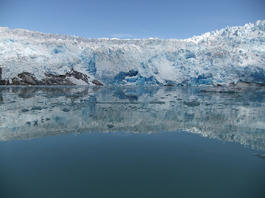
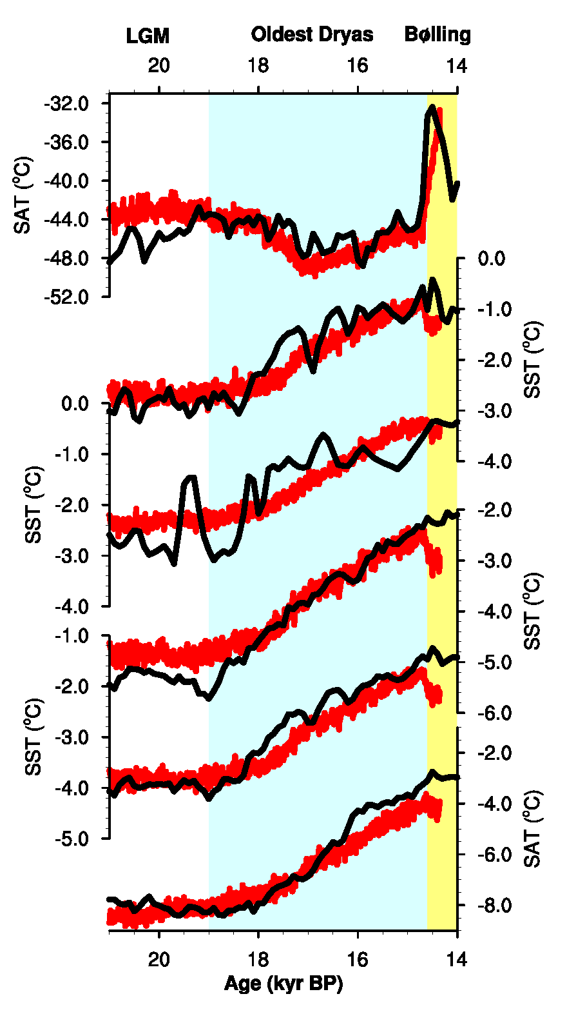
Climate Science: Ocean circulation drove warming
and deglaciation of the Southern Hemisphere
Nature, 7 February 2013
Feng He, University of Wisconsin-Madison
Objectives
Meltwater pond
in southwest Greenland.
The team’s simulations show that a large amount of meltwater led to
a gradual slowing of the AMOC, thus triggering warming in the Southern Hemisphere.
Discover what triggered beginning of last period
of Southern Hemisphere warning and deglaciation
Solve this mystery by explaining the global temperature record during the last deglaciation
Produce a more comprehensive global
temperature dataset
Simulate earth system energy transport mechanisms
Accomplishments
Comparison of data and model simulation. From top to bottom:
Greenland surface air temperature
Regional sea surface temperature in South Atlantic, Indian Ocean, South Pacific, Southern Hemisphere
Antarctic region surface air temp.
Chart at left:
= data; = simulation.
LGM, Last Glacial Maximum.
Innovative reconstruction of insolation, ocean currents
  Demonstrated how Atlantic Meridional Ocean Circulation (AMOC) contributed to “bipolar seesaw”
Transient global Earth System Model simulation
  22,000 year simulation reproduces reconstructed global temperature response to CO₂
  Points to CO₂, insolation, and ocean currents’ role in driving global climate change over glacial cycles
“Our project could have only been done using OLCF resources,
given the computational and storage requirements.” – Tom Bettge
Notes:
INCITE: Warren Washington, PI
F. He, J.D. Shakun, P. U. Clark, A.E. Carlson, Z. Liu, B.L. Otto-Bliesner, and J.E. Kutzbach 2013. “Northern Hemisphere forcing of Southern Hemisphere climate during the last deglaciation.” Nature 494, 81-85. DOI:10.1038/nature11822.
Related Publications
J. Shakun, P. Clark, F. He, S. Marcott, A. Mix, Z. Liu, B. Otto-Bliesner, A. Schmittner, E. Bard 2012. “Global Warming Preceded by Increasing Carbon Dioxide Concentrations during the Last Deglaciation.” Nature 484, No. 7392, 49–54. DOI 10.1038/nature10915.
Z. Liu, B. Otto-Bliesner, F. He, E. C. Brady, R. Tomas, P. U. Clark, A. E. Carlson, J. Lynch-Stieglitz, W. Curry, E. Brook, D. Erickson, R. Jacob, J. Kutzbach, J. Cheng. “Transient Simulation of Last Deglaciation with a New Mechanism for Bølling-Allerød Warming.” Science Vol. 325, 310-314 , 49–54. DOI: 10.1126/science.1171041 .
Summary from Nature Editor:
Carbon dioxide is a force behind deglaciation
Changes in ocean circulation are the most plausible explanation for the early Southern Hemisphere deglacial warming and its lead over Northern Hemisphere temperature.
Summary of ORNL’s Highlight
A large team led by researchers at Harvard, Oregon State University, and the University of Wisconsin used a global dataset of paleoclimate records and ORNL’s Jaguar supercomputer to show that solar radiation impinging on the Northern Hemisphere led to a reduced ocean current, the combination of which gradually warmed the Southern Hemisphere
Their work explained a scientific mystery: what caused a disproportionate warming of the Southern Hemisphere at the beginning of the last deglaciation.
Orbital variation led to Greenland’s warming, and the meltwater slowed the Atlantic Meridional Ocean Circulation, a key component of the ocean conveyor belt.
This trapped heat in the Southern Hemisphere that melted back sea ice and freed a southern ocean carbon sink that contributed to a warming of the whole planet.
“The simulation reproduces the Southern Hemisphere proxy temperature records beautifully. A good model is the result of many people’s efforts,” – Feng He, Assistant Scientist, Center for Climatic Research, Nelson Institute for Environmental Studies, University of Wisconsin-Madison
This IPCC-class modeling simulation required 14 million processor hours from the INCITE Program run continuously for more than 4 years and a large repository for the simulation data, currently just under 300TB.
Quotes from most recent quarterly reports.
“To simulate transient climate evolution of the last 22,000 years, we need to have CCSM3 running all day and all night for the past five years and the simulation produced enormous model output. Our project could have only been done using NCCS/ORNL resources, given the computational and storage requirements. This project produced model output of almost 300 TB – therefore, the HPSS is critical for us doing the data analysis in the last five years. We anticipate the need to analyze this data through the summer/fall of 2013. The large disk storage and machine stability in OLCF are also critical for our project.”
40

Slide 41
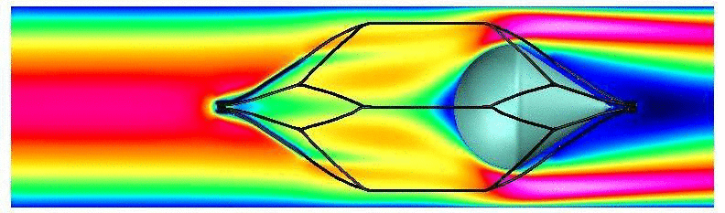
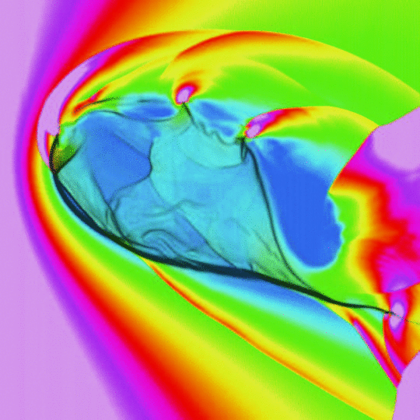
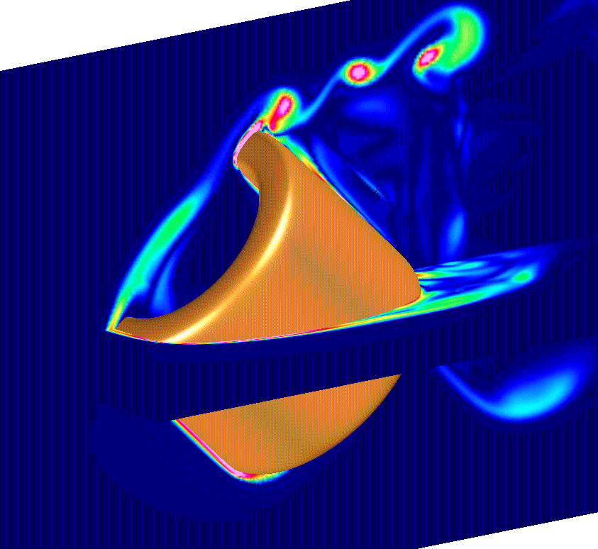
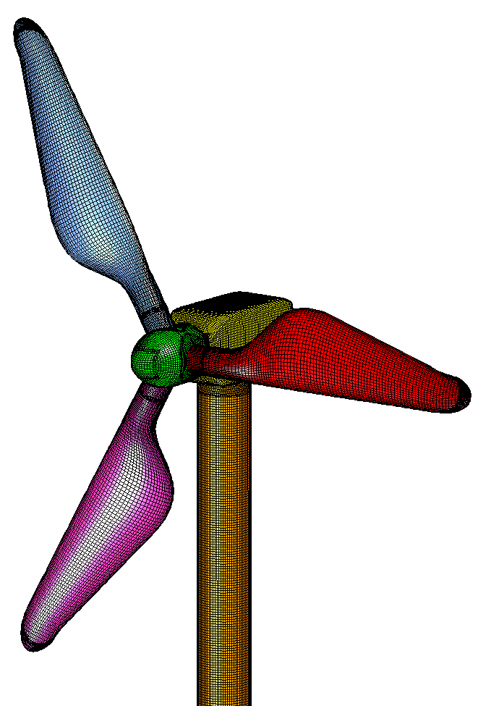
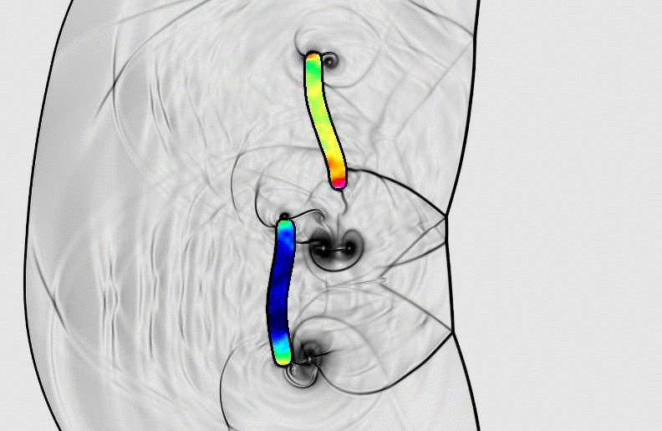
Domain-Adaptive High-Order Accurate Algorithms for PDEs
Bill Henshaw, LLNL
ASCR- Applied Mathematics Highlight
Impact
Objectives / Novel Ideas
Novel approach enables large deformation fluid-structure-interactions simulations.
Improved modeling and understanding of condensed phase explosives.
Fast parallel algorithms enable improved wind energy and building efficiency simulations.
Improved modeling of blood clot filters.
Open source software used by many graduate students, professors and researchers.
  Simulate multi-domain multi-physics problems in complex moving geometry.
    Accurate, efficient, and scalable algorithms using adaptive overlapping structured grids.
    Open source software with state-of-the-art numerical methods.
2011-2012 Accomplishments
New fluid-solid interface formulation overcomes the well know added-mass instability for fluid-structure problems.
Incompressible flow and multigrid algorithms enable large scale moving grid simulations for wind energy and building energy efficiency.
High-order accurate electromagnetic approximations for material interfaces used in laser damage mitigation.
New efficient upwind schemes for elastic wave propagation.
Large scale parallel grid generation enables high-fidelity simulations.
Papers: “Deforming Composite Grids for Solving Fluid Structure Problems”, Banks, Henshaw, Schwendeman, J. Comput. Phys. (2012). “Upwind Schemes for the Wave Equation in Second-Order Form”, Banks, Henshaw, J. Comput. Phys. (2012).
Blood clot filter
Flow past rotating torus
High speed bubble collapse
Wind turbine grid
Shock hitting elastic rods
Notes:
Figures:
Top left: blood flow simulation of wire filter and trapped clot improves understanding of a widely used widely used medical implant.
Top right: high resolution simulation of a shock induced cavity collapse simulation for explosives modeling uses new multifluid algortihms and parallel adaptive mesh refinement.
Middle: simulation of flow past a moving sphere demonstrates new parallel incompressible flow and moving grid capabilities.
Lower right: grid for a wind turbine demonstrates our advanced grid generation capabilities.
Lower right: shock impacting two deformable sticks illustrates new FSI capabilities.
41

Slide 42
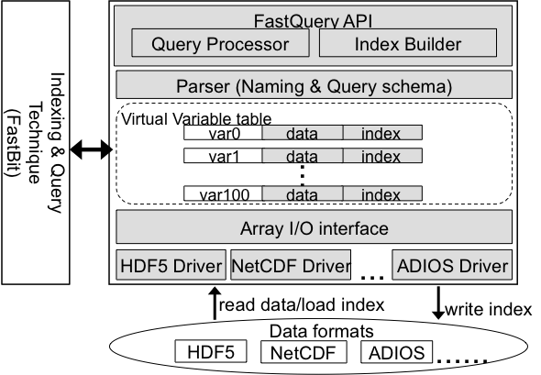
CS: FastQuery: Uniform Query Capability on Scientific Files
IMD
Investigators: K. Wu, S. Byna, A. Shoshani, in collaboration with LBNL Vis group
Key Ideas
  Provide uniform array interface for scientific data in commonly used file formats, e.g., HDF5, ADIOS, and NetCDF
  Provide efficient searching functionality on top of existing user analysis frameworks while expand data handling capability and improve user productivity
Results
Public release of FastQuery software
Indexed and queried a trillion particle dataset for studying magnetic reconnection (or “space weather”)
  Built index in 10 minutes
  Located highly energetic particles in seconds
“This is the first time anyone has ever queried and visualized 3D particle datasets of this size.” -- Homa Karimabadi, Physicist from UCSD
  Particle distribution of highly energetic particles around the region of magnetic reconnection. The off-centered and oblong distribution confirms the existence of a previously speculated property known as agyrotropy.
Notes:
HDF5, ADIOS and netCDF are three of the most frequently used file formats among NERSC users according NERSC usage statistics. FastQuery enables the users to query and index their data files without putting their data into a database management system or loading their data into another system. These systems typically produce a second copy of the data files. Since the scientific data sets are usually very large, avoiding making the second copy can significantly reduce the cost of analysis operations. FastQuery can be incrementally introduced into an existing data analysis workflow and seamlessly increases the analysis capability. In many cases, as demonstrated in this use case involving magnetic reconnection simulation data, FastQuery provides a new way to accessing large data files.
FastQuery developers are directly working with HDF5 developers to improve the accesses to HDF5 files (through the ExaHDF5 project). The particular example given on this slide is using HDF5. We have modified VPIC code to output HDF5 files to significantly simplify the files produced by the VPIC code. A number of commonly used simulation codes, including S3D and Chombo are producing HDF5 outputs.
Magnetic reconnection also known under a couple of other names such as X-point, magnetic portal, or electron diffusion region, is a key mechanism for creating the aurora in the polar regions. It could also cause severe disruptions of satellite communication systems. Studying magnetic reconnection is a critical part of understanding “Space Weather.” Agyrotropy is postulated as an important measurable feature of magnetic reconnection. A satellite mission designed to measure agyrotropy has been planned for 2014. However, due to lack of tools for handling the large amounts of particle data produced from simulations, this feature has not be observed in the simulation data. Without FastQuery, Homa's team was using summary statistics to do their analyses, NOT using the particle data. The set of tools we have developed (together with ExaHDF5 project) enabled Homa to directly work with the particle data. We are the first to provide direct evidence from simulations.
We are able to produce FastBit index for more than 1 trillion particles in about 10 minutes. This is an impressive speed because in 10 minutes some database systems may only index a few million data records. We are able to locate the high energy particles used for producing the agyrotropy plot in about 3 seconds. Without proper indexes on the data, the data management system would have to read data at more than ten terabytes per second in order to complete the same task in the same amount of time. The file system we used has a peak theoretic I/O rate of about 35 GB/s. Clearly, indexing is essential in reducing the data access time.

Slide 43
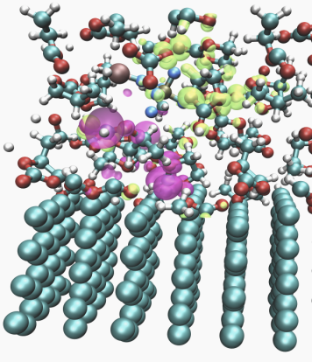
SciDAC: Discontinuous methods for accurate, massively parallel quantum molecular dynamics:
Lithium Ion interface dynamics from first principles
John Pask, Vince Lordi, Erik Draeger (LLNL); Lin Lin, Chao Yang (LBNL)
Impact:
Objectives:
Increase energy/power density, lifetime, and safety of Li-ion batteries.
Make possible larger, more realistic quantum mechanical simulations than possible heretofore, on gamut of physical systems.
Advance core numerical algorithms and implementations making QMD, and other applications relying on these, possible at such scale.
Apply new method to advance understanding of structure and dynamics of electrolyte/SEI/anode systems in Li-ion cells.
Develop new Discontinuous Galerkin (DG) electronic structure method and code to accomplish quantum molecular dynamics (QMD) on an unprecedented scale.
Progress and Accomplishments
Li-ion battery
Rewrote and restructured new massively parallel DG code
Strong scaling of new parallel pole expansion and selected inversion (P-PEXSI) code demonstrated (up to 2560 procs with 40 poles)
Developed new eigensolvers to minimize orthogonalization and Rayleigh-Ritz projection (spectrum slicing and penalty trace minimization)
Qbox planewave code sped up by a factor of 3 for metals
3 papers submitted to J. Phys. Condens. Matter, SIAM J. Sci. Comput., and Parallel Computing
SEI layer formation, product of electrolyte decomposition. Thin, stable SEI layer with high Li⁺ ion conductivity and low electrical conductivity is crucial to performance and safety
Notes:
43

Slide 44

Largest, Most Detailed Simulation of Universe
ESP
Cosmic Structure Probes of the Dark Universe
Salman Habib (Argonne National Laboratory), Katrin Heitmann (ANL), Hal Finkel (ESP postdoc, ALCF), Adrian Pope (Arthur Holly Compton postdoc fellow, ANL)
Simulate entire volume of next-generation sky surveys
  First at this scale to resolve galaxy-scale mass concentration
    Only possible on newest leadership-class machines like Mira
  Simulate (predict) observational signatures for different cosmology parameters
  Interpret sky-survey observations
Numerically build mock galaxy catalogue
  Determine effects of new physics on cosmological observables
  Simulations will be used to analyze results from ongoing and upcoming surveys
HACC framework (code) 2012 Gordon Bell finalist
  69% of peak speed on whole Mira machine (786,432 cores)
    90% parallel efficiency
Now possible: the “Outer Rim” simulation
  4.25 Gpc domain, 10,240³ grid
  1.07 trillion particles
Gordon Bell paper: http://arxiv.org/abs/1211.4864 (Habib et al.)
Notes:
Gpc – giga parsec; one Gpc = 3.26 billion light-years = ~30.9 billion trillion kilometers
The figure illustrates the large dynamic range covered by these simulations. The whole domain is around 4 Gpc, but structures on the order of a couple of Mpc (mega parsec) are resolved (this is about the size of the dark matter halo surrounding a galaxy).

Slide 45

Energy-Storage Materials and Catalysis
ESP
Materials Design and Discovery: Catalysis and Energy Storage
Larry Curtiss (Argonne National Laboratory), Nick Romero (ALCF), Anouar Benali (ESP postdoc, ALCF)
Designing and understanding advanced batteries with large-scale simulation
Chemistry in batteries for electric vehicles: electric, hybrid, and plug-in
Metal nanoparticles as catalysts for key chemical reactions
  Accurate quantum Monte Carlo (QMC) simulations demand computer capability beyond previous-generation Leadership-Class machines
  These are possible with the latest-generation machine, Mira
  Completed simulation study of Van der Waals dominated solids
  Currently in progress: QMC simulations of Platinum metal nanoparticles.
Notes:
Figure: Cuboctahedra platinum clusters, ranging from 13 to 1415 atoms.

Slide 46



Understanding Solar Storm/Magnetosphere Interaction
INCITE Project
William Daughton, LANL
Science Objectives and Impact
Develop a better understanding of magnetic reconnection physics in the Earth’s magnetosphere, where it plays a key role in space weather.
Conduct first large-scale 3D kinetic simulations, which treat the problem at the most basic level.
Spaceweather can diminish the performance of fusion reactors and poses a continual threat to the Earth’s technological systems, already caused over $4 billion in satellite losses.
Isosurface of electron vorticity, showing the development of vortex tubes along the top (magnetospheric) side of the layer. These vortices wrap up magnetic field lines, providing an alternative way of generating flux ropes..
Supercomputing Application
Science Results
Used H3D and VPIC to achieve micro-
and macro-level understanding of magnetosphere interaction
Used 264,000 of Jaguar/Titan’s cores,
the largest VPIC simulation to date
Required more than 80 TB of disk space
Visualization performed on Lens
Particle-in-cell simulations predict reconnection can spontaneously generate turbulence, which is dominated by coherent structures in the form of current sheets.
Predict the development 3D flux ropes during component reconnection.
These predictions will be tested with high-time resolution measurements from NASA’s upcoming Magnetospheric Multiscale mission (MMS).
MMS will use 4 identical spacecraft, variably spaced in Earth orbit, to make 3D measurements of magnetospheric boundary regions to understand the process of magnetic reconnection.
V. Roytershteyn, Phys. Rev. Lett., 2012
M. Wan, Phys. Rev. Lett., 2012
Notes:
Citation:
“Role of electron physics in the development of turbulent magnetic reconnection in collisionless plasmas,” W. Daughton, V. Roytershteyn, H. Karimabadi, L. Yin, B. J. Albright, B. Bergen, K. J. Bowers, Nature Physics 7, 539-542, 2011.
“Influence of the lower-hybrid drift instability on magnetic reconnection in asymmetric configurations,” V. Roytershteyn, W. Daughton, H. Karimabadi and F.S. Mozer, Phys. Rev. Lett., 108, 185001, 2012
“Multiscale Studies of the Three-Dimensional Dayside X-line,” T.E. Moore, J.L. Burch, W. S. Daughton, S.A. Fuselier, H. Hasegawa, S.M. Petrinec, Zuyin Pu, Journal of Atmospheric and Solar-Terrestrial Physics, Nov. 6, 2012
“Coherent Structures, Intermittent Turbulence and Dissipation in High-Temperature Plasmas,” H. Karimabadi, V. Roytershteyn, M.Wan ,W. H. Matthaeus,W. Daughton, P.Wu, M. Shay, B. Loring, J. Borovsky, E. Leonardis, S. Chapman, & T. K. M. Nakamura, Phys. Plasmas 20, 012303 (2013).
“Intermittent dissipation at kinetic scales in collisionless plasma turbulence,” M. Wan, W. H. Matthaeus, H. Karimabadi, V. Roytershteyn, M. Shay. P. Wu, W. Daughton, B. Loring and S. C. Chapman, Phys. Rev. Lett. 109, 195001 (2012).
Abstract (from Wan, PRL, 2012):
High resolution kinetic simulations of collisionless plasma driven by shear show the development of turbulence characterized by dynamic coherent sheetlike current density structures spanning a range of scales down to electron scales. We present evidence that these structures are sites for heating and dissipation, and that stronger current structures signify higher dissipation rates. Evidently, kinetic scale plasma, like magnetohydrodynamics, becomes intermittent due to current sheet formation, leading to the expectation that heating and dissipation in astrophysical and space plasmas may be highly nonuniform and patchy.
Codes:
H3D is a global code developed at UCSD that treats the ions as particles and the electrons as a fluid. VPIC defines both electrons and ions as particles.

